Slide 1
VideoSearcher AgenticAI
Orchestrator LLM benchmark & sampling optimization
Stefano Garzoni, Daniel Guarnizo, Leonardo Scappatura
Politecnico di Milano · 21/07/2026
1/13
Notes:
Final defense of VideoSearcher AgenticAI. Two contributions: (1) a 5-model orchestrator-LLM benchmark on a 66-run suite, and (2) Bayesian sampling-parameter tuning with d-MALIBOO, including an honest analysis of evaluation noise.

Slide 2
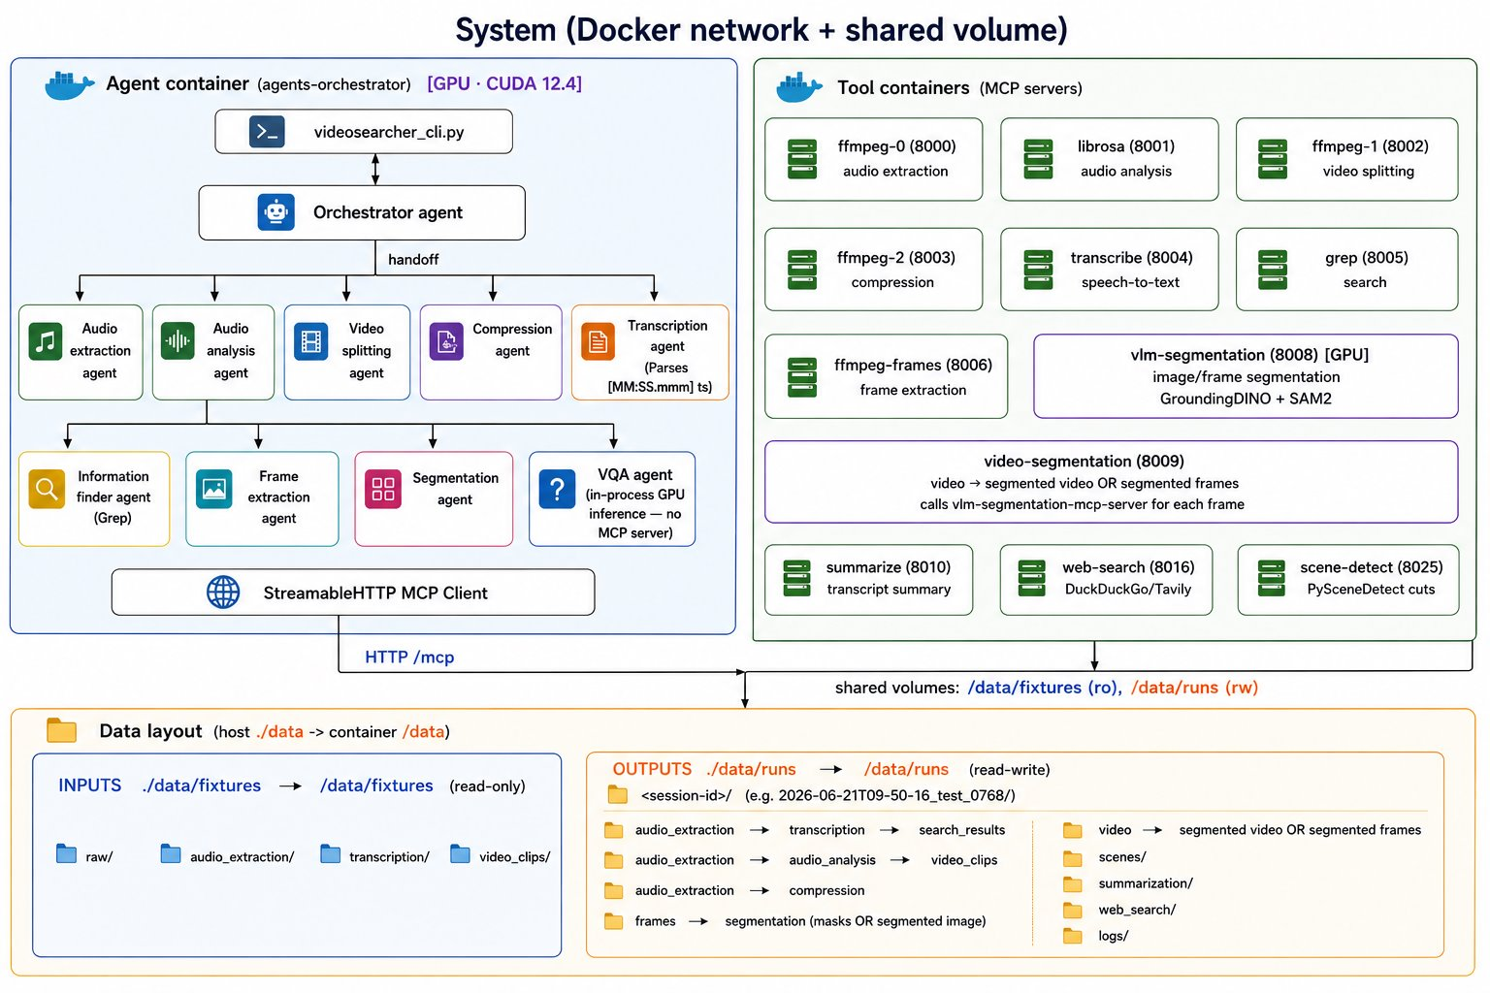
System overview
2/13
Notes:
The orchestrator LLM runs locally (GGUF via llama-server) and routes each natural-language request through 12 Dockerized MCP tool servers — ffmpeg, Whisper transcription, librosa, grep, summarize, scene-detect, web-search, segmentation — plus an in-process Phi-4-reasoning-vision VQA model. Every configuration is evaluated on the 66-run suite: 22 scenarios × 3 prompt levels (vague / clear / algorithmic), each run gated on handoff ∧ vision ∧ result.

Slide 3
Benchmark setup
Model | Size | Architecture
qwen3.6-35B-A3B | 35B | MoE
gemma-4-12b | 12B | dense
gemma-4-E2B | 5B | dense
qwen3.6-27B | 27B | dense
gpt-oss-120b | 120B | MoE
• 14 metrics recorded per run
• Defaults sampling; full 66-run suite per model
• Hardware: DGX GB10, 128 GB unified memory
3/13
Notes:
Five orchestrators: two MoE (qwen3.6-35B-A3B, gpt-oss-120b) and three dense (gemma-4-12b, gemma-4-E2B, qwen3.6-27B). All benchmarked with default sampling on the full 66-run suite, 14 metrics recorded per run. Hardware: DGX GB10, 128 GB unified memory.

Slide 4
Benchmark results — 66-run suite, defaults sampling
Model | Overall % | Handoff % | Vision % | Result % | Energy (Wh/suite) | passes/kWh
qwen3.6-35B-A3B (35B MoE) | 95.5 | 95.5 | 100 | 100 | 29.1 | 2163
gemma-4-12b (12B dense) | 93.9 | 97.0 | 100 | 92.6 | 92.8 | 668
gemma-4-E2B (5B dense) | 90.9 | 93.9 | 88.9 | 92.6 | 35.3 | 1701
qwen3.6-27B (27B dense) | 87.9 | 89.4 | 100 | 96.3 | 86.5 | 670
gpt-oss-120b (120B MoE) | 87.9 | 87.9 | 88.9 | 96.3 | 28.3 | 2050
• MoEs lead accuracy and energy efficiency
• Dense models pay ~3× energy per suite
4/13
Notes:
qwen3.6-A3B leads: 95.5% overall, 100% result, 29.1 Wh per suite → 2163 passes/kWh. gemma-4-12b is the accuracy runner-up (93.9%, best handoff 97.0%) but at 92.8 Wh. gpt-oss-120b ties qwen3.6-27B at 87.9% overall while using a third of the energy (28.3 vs 86.5 Wh). Vision is 100% for three models; result reaches 100% only for a3b.

Slide 5
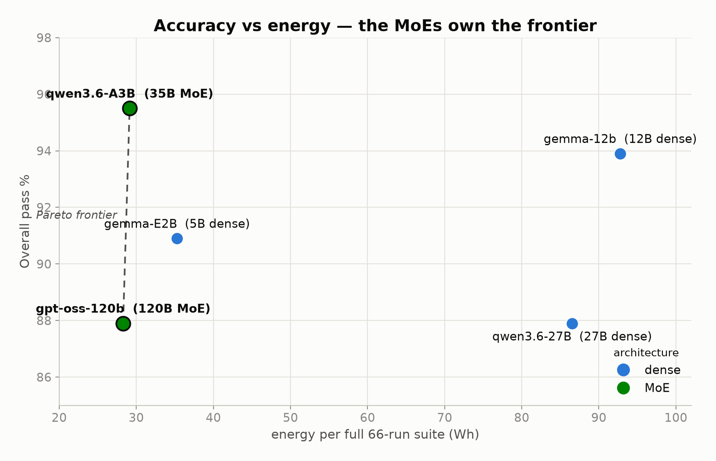
Accuracy vs energy — Pareto frontier
• MoEs own the accuracy–energy Pareto frontier
• a3b: 95.5% at 29.1 Wh → 2163 passes/kWh
• Dense models pay ~3× energy
5/13
Notes:
Accuracy vs energy per suite: the two MoEs (a3b 29.1 Wh, gpt-oss 28.3 Wh) sit on the Pareto frontier; dense models pay roughly 3× the energy for equal or lower accuracy. a3b combines the best overall score (95.5%) with 2163 passes/kWh.

Slide 6
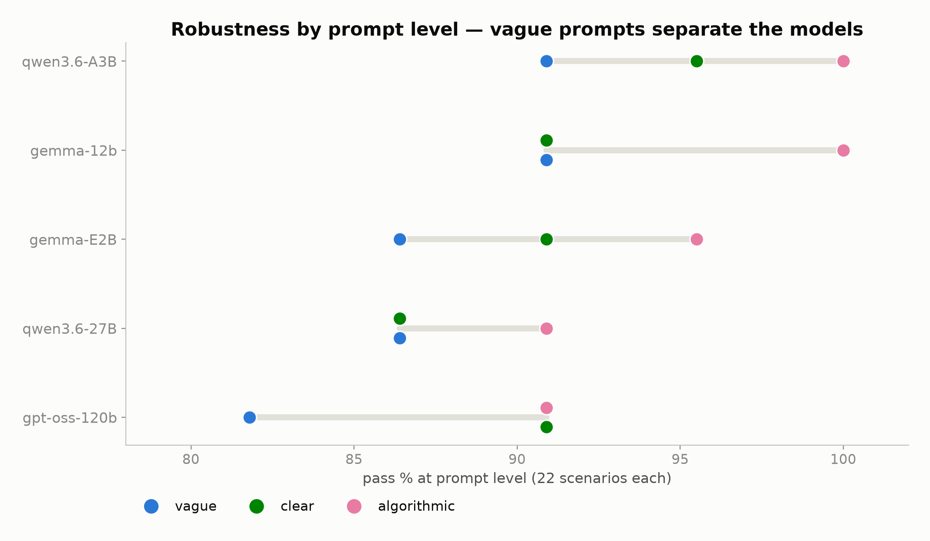
Robustness by prompt level
• Algorithmic prompts near-saturated
• Vague prompts separate the models
• gpt-oss: 81.8% on vague
6/13
Notes:
Per prompt level: the algorithmic level is near-saturated for all five models; vague prompts are where the models separate — gpt-oss drops to 81.8% on vague.

Slide 7
Sampling tuning — d-MALIBOO methodology
• Grid: temperature × top-p × top-k = 384 combos
• t {0.2..0.9} · p {0.65, 0.70, 0.77, 0.84, 0.91, 0.98} · k {10..80}
• Budget: 5 random init + 95 guided trials per model
• d-MALIBOO (PoliMI): Gaussian-Process surrogate, Matérn kernel
• Expected Improvement augmented by ML model (MLP classifier)
• Trials guided, not random; objective = suite Overall %
7/13
Notes:
Tuning with d-MALIBOO (PoliMI): 384-point grid — temperature {0.2..0.9}, top-p {0.65, 0.70, 0.77, 0.84, 0.91, 0.98}, top-k {10..80}. Budget: 5 random init + 95 guided trials per model. Gaussian-Process surrogate with Matérn kernel; Expected Improvement acquisition augmented by an MLP classifier — trials are guided, not random. Objective: suite Overall %.

Slide 8
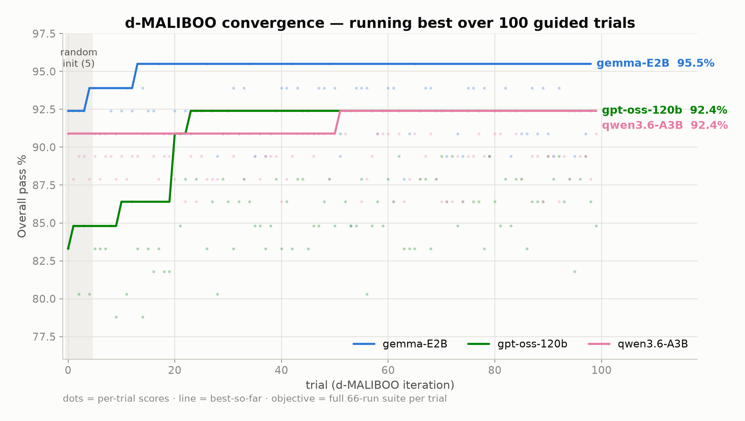
Convergence of the guided search
• 5 random init, then guided trials • Plateaus reached within ~20–50 trials
8/13
Notes:
Convergence: after the 5 random-init points, the guided search reaches each model's plateau within roughly 20–50 trials.

Slide 9
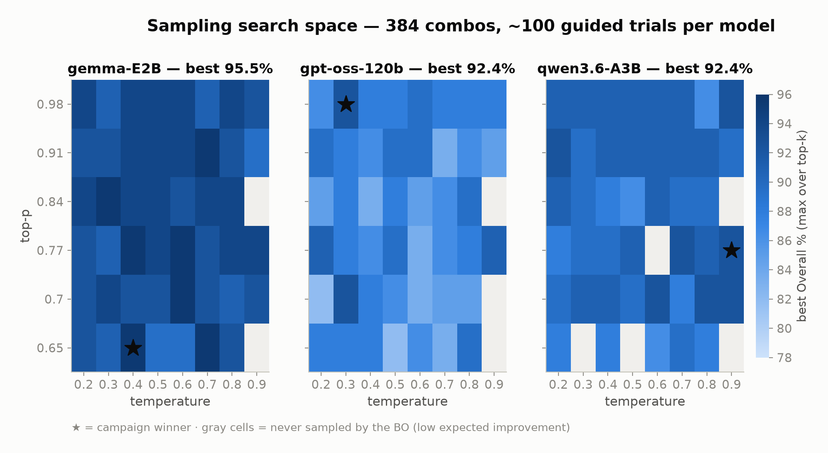
Search-space landscape
• gemma: broad low-temp / low-k plateau • a3b: flat • gray cells: never sampled
9/13
Notes:
Best score per temperature × top-p cell: gemma shows a broad low-temperature / low-top-k plateau, gpt-oss is patchier, a3b is flat. Gray cells were never sampled by the Bayesian optimizer.

Slide 10
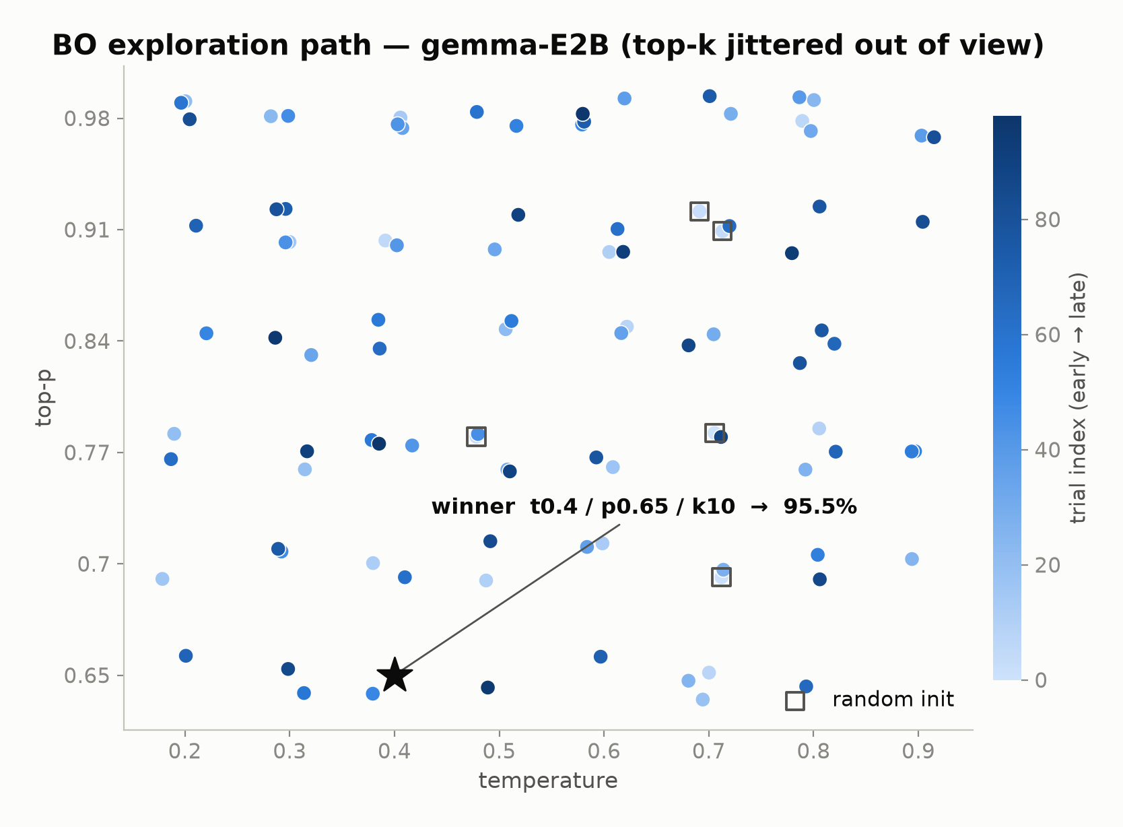
Exploration path — winner model
• Exploration → exploitation on the winner model
• Random-init squares; early→late color ramp
• Winner starred
10/13
Notes:
Exploration path of the BO on the winner model: random-init squares, early→late color ramp, winner starred — a clear shift from exploration to exploitation.

Slide 11
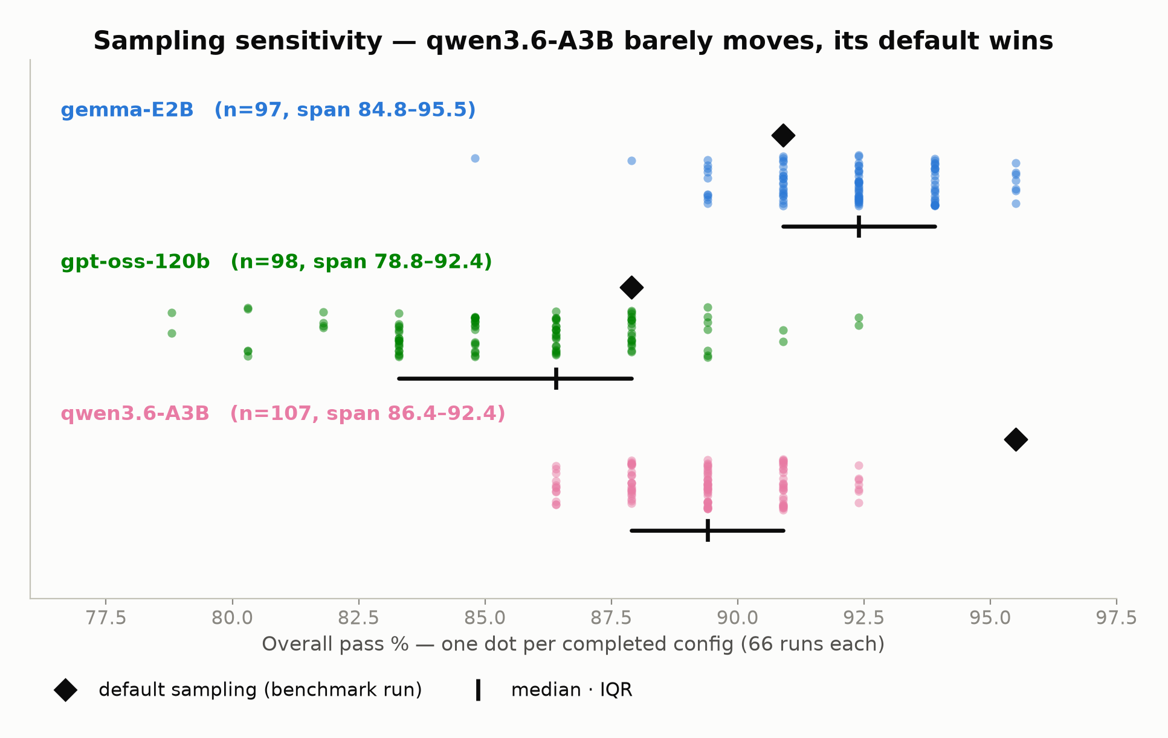
Sampling sensitivity
• gpt-oss spans 13.6 pts — sampling matters
• a3b spans 6 (107 configs, 86.4–92.4)
• a3b default 95.5 wins → tuning not useful
11/13
Notes:
Sensitivity across ~100 full-suite evaluations per model: gpt-oss spans 13.6 points, so sampling matters; a3b spans only 6 — 107 configs within 86.4–92.4 — and its default run (95.5) remains the best observed, so keep defaults for a3b. Winners over completed full-suite trials: gemma-E2B 95.5% @ t0.40/p0.65/k10 (7-way tie at 95.5, +4.6 vs default 90.9); gpt-oss-120b 92.4% @ t0.30/p0.98/k20 (+4.5 vs default 87.9). Both improvable models optimize in the low-temperature / small-top-k region.

Slide 12
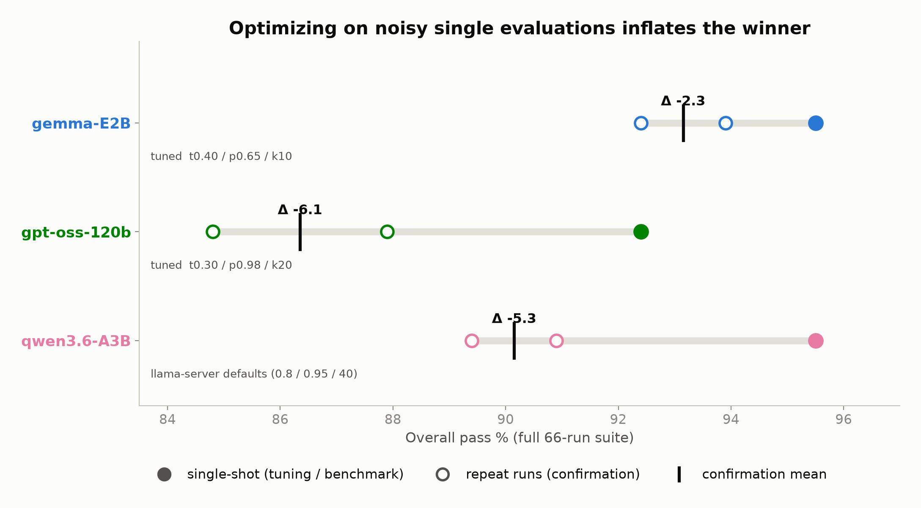
Noise & optimizer bias — confirmation runs
• Single-shot winners inflated 2.3–6.1 pts
• Run-to-run spread 1.5–3.1 pts
• Report confirmation means
Config | single-shot | repeats | mean | Δ
gemma-E2B t0.40/p0.65/k10 | 95.5 | 93.9 · 92.4 | 93.2 | −2.3
gpt-oss t0.30/p0.98/k20 | 92.4 | 84.8 · 87.9 | 86.3 | −6.1
qwen3.6-A3B defaults | 95.5 | 89.4 · 90.9 | 90.2 | −5.3
12/13
Notes:
The methodological caveat, presented honestly: re-running each winner twice (a3b on defaults) shows single-shot scores are optimistically biased — gemma-E2B 95.5 → mean 93.2 (−2.3), gpt-oss 92.4 → 86.3 (−6.1), a3b defaults 95.5 → 90.2 (−5.3). The objective is stochastic (orchestrator sampling gives a run-to-run spread of 1.5–3.1 points); BO maximizes over noisy single evaluations, so reported winners are optimistically biased — max-of-noisy-samples. The hierarchy holds (gemma strongest at ~93%), but absolute scores must be read as mean ± 3–6.

Slide 13
Conclusions & future work
• gemma-E2B: t0.40 / p0.65 / k10 — confirmed mean 93.2%
• gpt-oss-120b: t0.30 / p0.98 / k20 — confirmed mean 86.3%
• qwen3.6-A3B: keep defaults — best observed 95.5%
• MoE models for energy-bounded deployments
• Limitation: noisy objective → single-shot winners optimistically biased
• Future work: k≥3 averaging per trial, noise-aware GP, larger fixture set
13/13
Notes:
Recommendations: gemma-E2B at t0.40/p0.65/k10 and gpt-oss-120b at t0.30/p0.98/k20 — reporting confirmation means (93.2 and 86.3); keep defaults for qwen3.6-A3B (sampling-insensitive, best observed 95.5). MoEs are the choice for energy-bounded deployments. Limitation: the noisy objective inflates single-shot winners by 2.3–6.1 points. Future work: average k≥3 evaluations per trial or use a noise-aware GP, and a larger fixture set.

