Slide 1


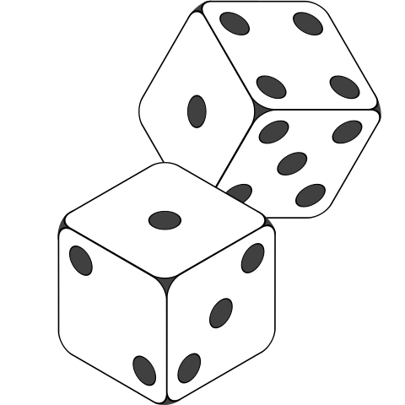






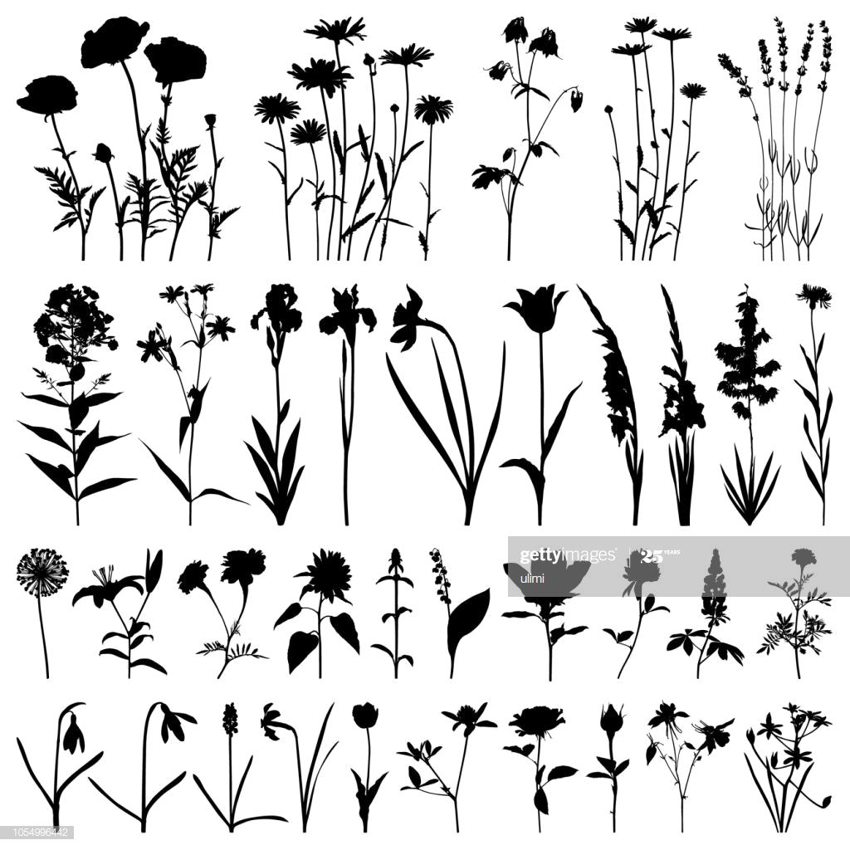



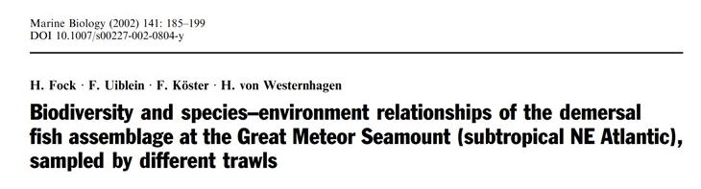



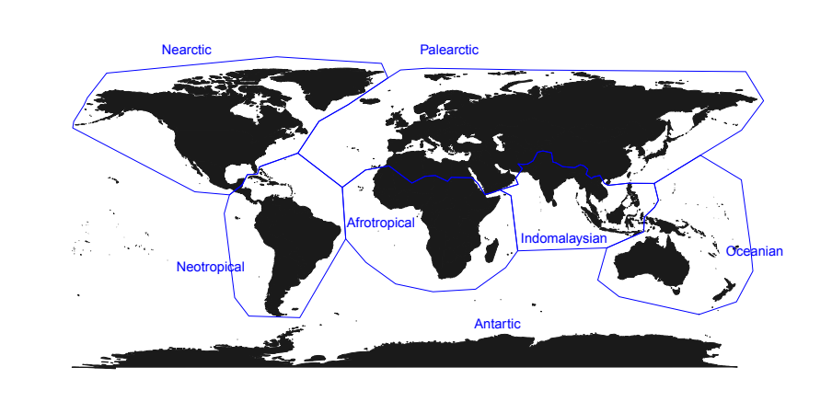











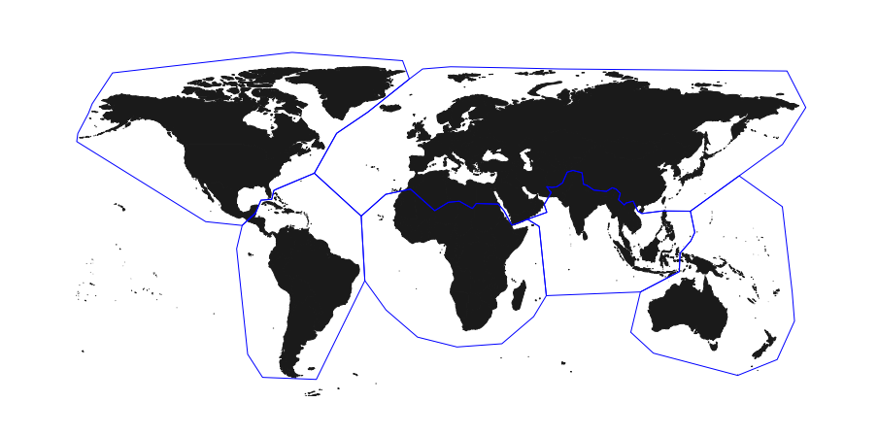
A
Literature extraction
Random selection (~10%)
TI = “Biodiversity” AND PY = (1965–2020) AND WC = ("Ecology" OR "Soil Science" OR "Environmental Studies" OR "Environmental Sciences" OR "Marine & Freshwater Biology" OR "Multidisciplinary Sciences" OR "Paleontology")
N = 10170 articles
N = 916 articles
Data extraction
B
Propotion of biodiversity
Biodiversity facets
Title “moderators”
Methods
Geography & System
29 cm
Mention of Habitat, Taxa,
or Locations in the title
Method(s) used to collect biodiversity
data
Biogeographic region(s) and system(s)
(Terrestrial, Freshwater, Saltwater)
Observed biodiversity
e.g., 4 out of 56 = 0.07
TD
Insectivorous
PD
FD
Expected biodiversity
(N = 56 macrogroups)
C
How much biodiversity is “sampled”, on average, by each study? What facets are considered?
How does this proportion varies across systems, regions and over time?
Is a low proportion of sampled biodiversity compensated by the use
of title moderators?
Is there a relationship between “sampled” diversity and impact?
Biodiversity
Biodiversity
Biodiversity
Publication year
Location
Taxa
Citations
No moderators
Habitat

