Slide 1



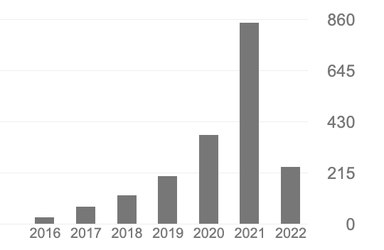
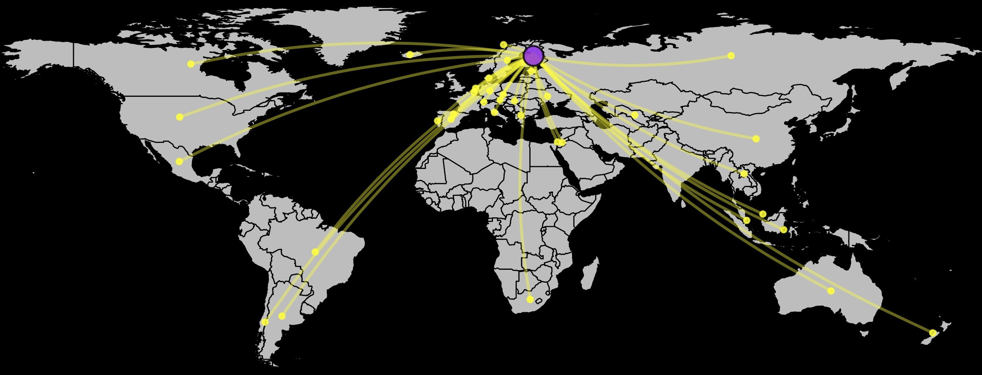


wos
Extract publication data
Additional functions
h-index
h-index calculation
i-map
Map collaboration network
Main functions
i-index
r-index
The i number of co-author countries
in more than i publications
Overlap between an author’s collabroative network and the expected network if co-authors were distributed independently of country GDP
For each publication by a given researcher/institution, derive the list of countries of the co-authors’ institutions;
Bla bla
Remove duplicated countries;
Bla bla
Sum the number of instances per country across all publications;
Order countries by their sum;
Bla bla
Calculate i as the number of countries whose sum is higher or equal than their rank when ordered.
i * r
weighted i-index
Promote recognition of scientific partnerships
Incentivize collaboration and transfer of
knowledge among countries
Promote the use of more inclusive metrics in Academic evaluations at personal and institutional levels

