Slide 1
Remote-sensing data
Stefano Mezzini
Animove 2023

Slide 2
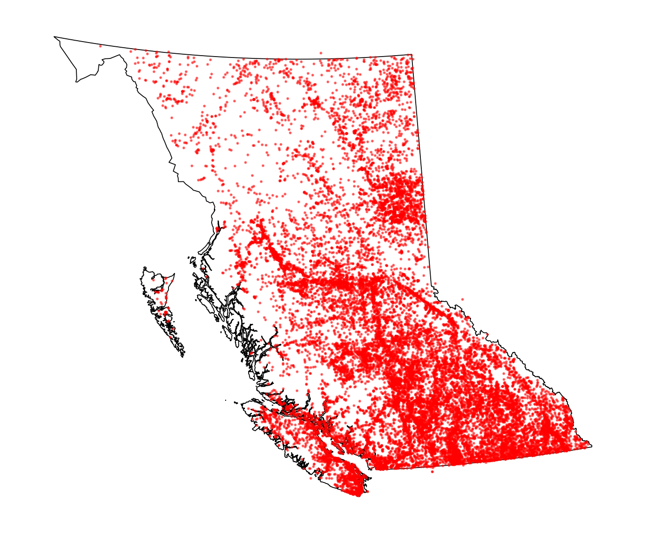
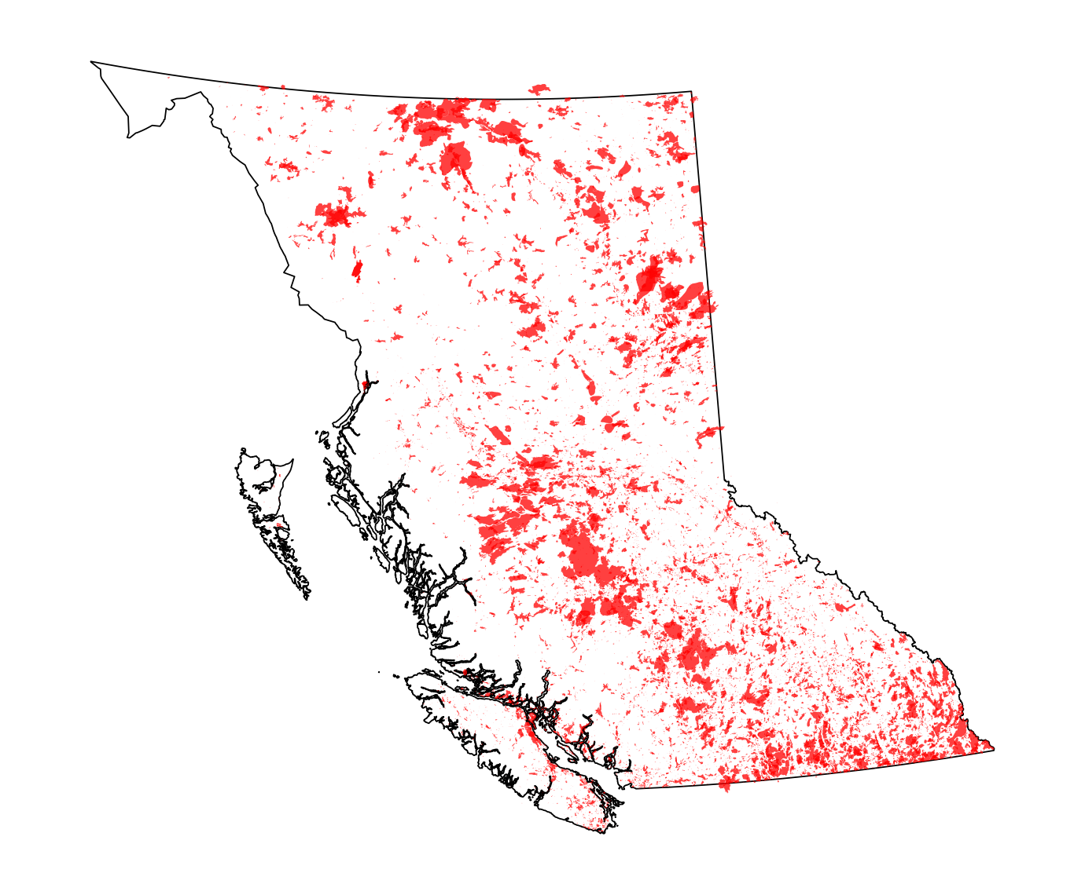
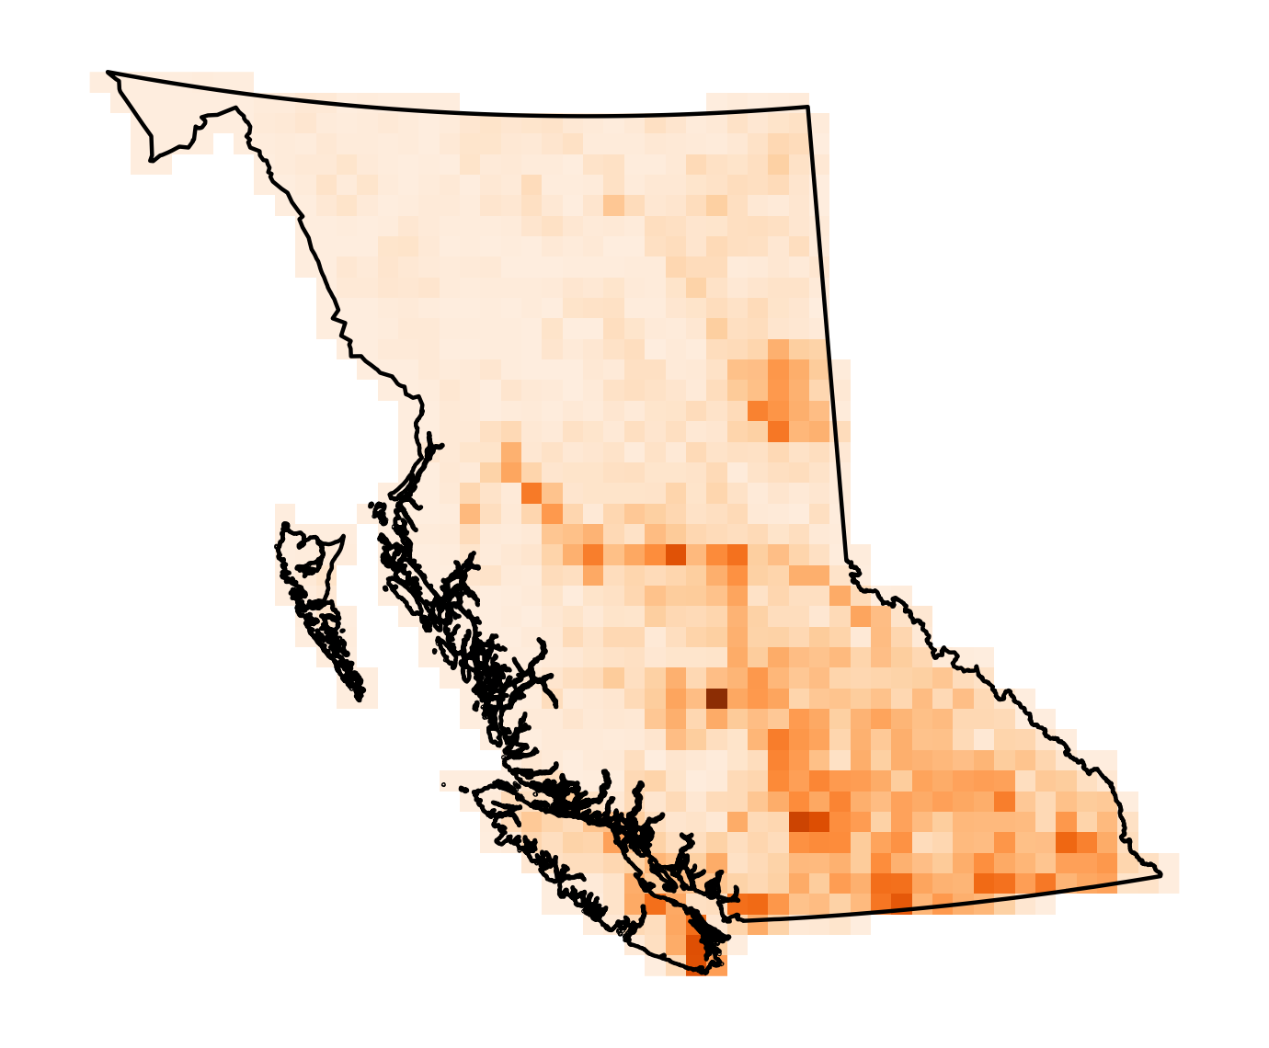
Types of spatial data
Spatial points (vectors)
Locations
Two-dimensional
Spatial polygons (vectors)
Areas, perimeters
Two-dimensional
Rasters (not vectors)
Surfaces (depends on resolution)
Three-dimensional (attributes)

Slide 3
Many sources of data
Data type | Source | R Package | Uses
>= 16-day raster data | Various satellites | MODIStsp, … | High spatial, low temporal resolution
Daily raster data | AVHRR | luna (see this issue) | High temporal, low spatial resolution
Various raster data | GEE | rgee (uses Python) | Various, including cloud computation
Historical climate projections | ERA5 | ecmwfr | High temporal (hourly!), but modeled
Future climate projections | ClimateNA | climatenaR | Monthly projections with IPCC SSPs
Annotated tracking data | Movebank | move (?) | Telemetries with weather data
And many more…

Slide 4
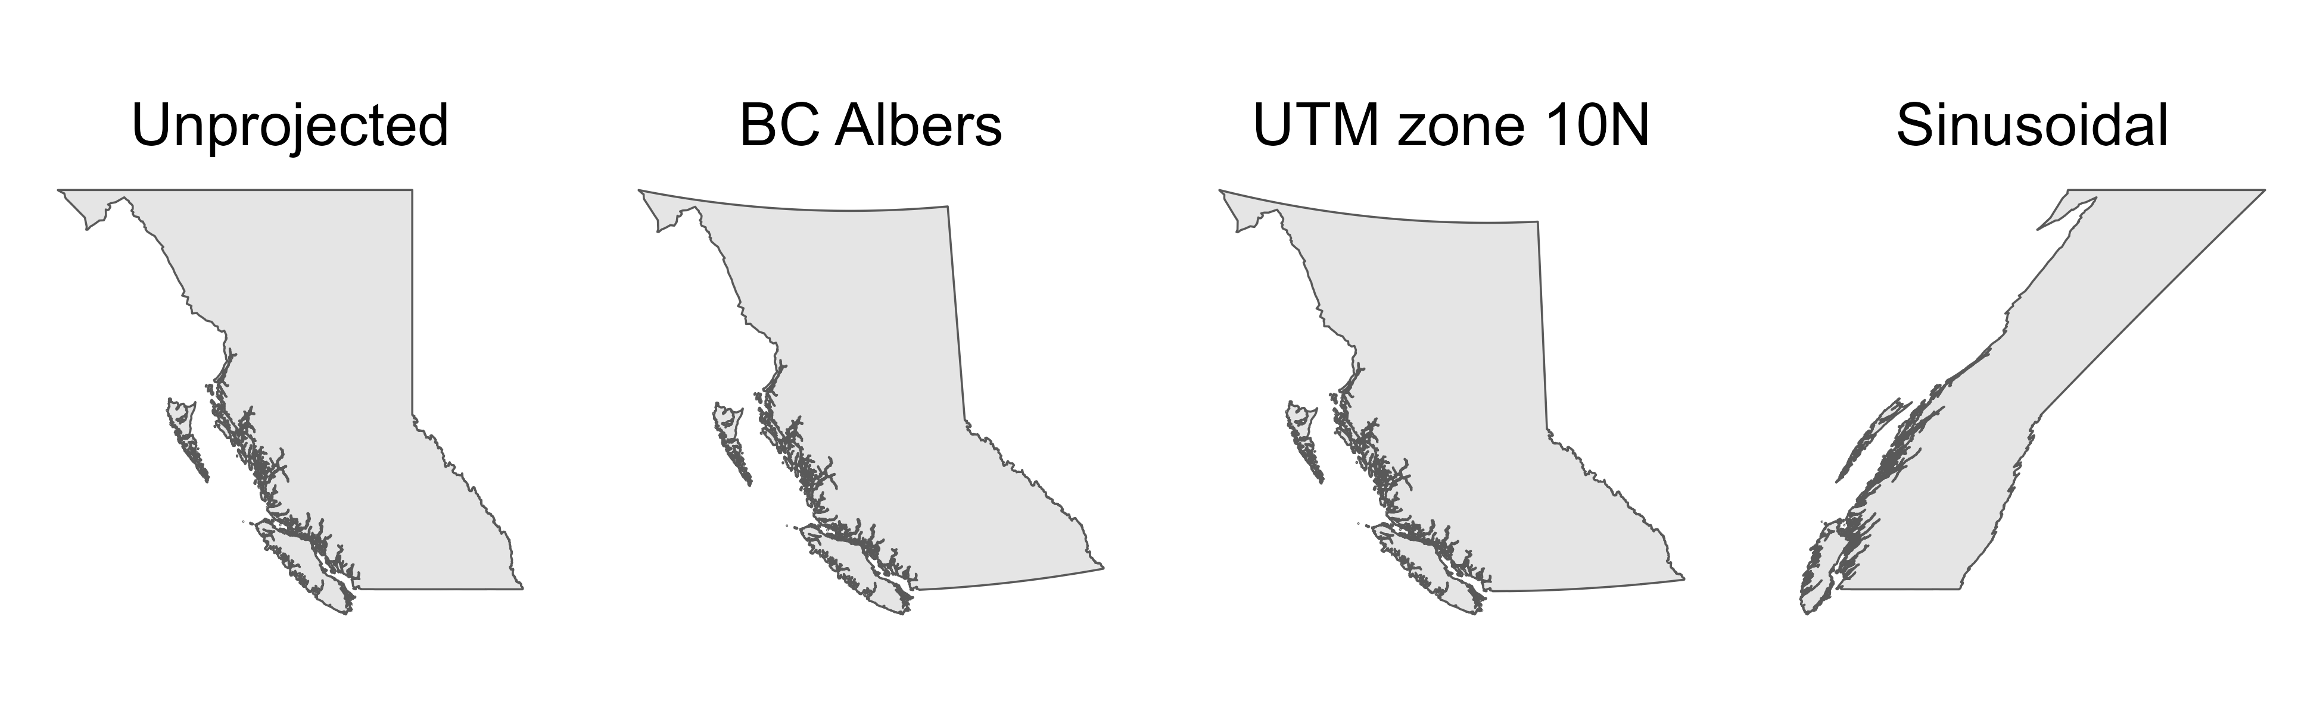
Project carefully: BC with different projections

Slide 5
Project carefully: UBCO-UBCV distance
Projection | Est. distance (m) | Est. error (m)
Unprojected (lat/long) | 286 860 | 500
BC Albers | 287 480 | 120
UTM zone 10N | 287 320 | 40
Sinusoidal | 404 670 | 117 310
Equidistant Azimuthal | 287 360 | NA

Slide 6
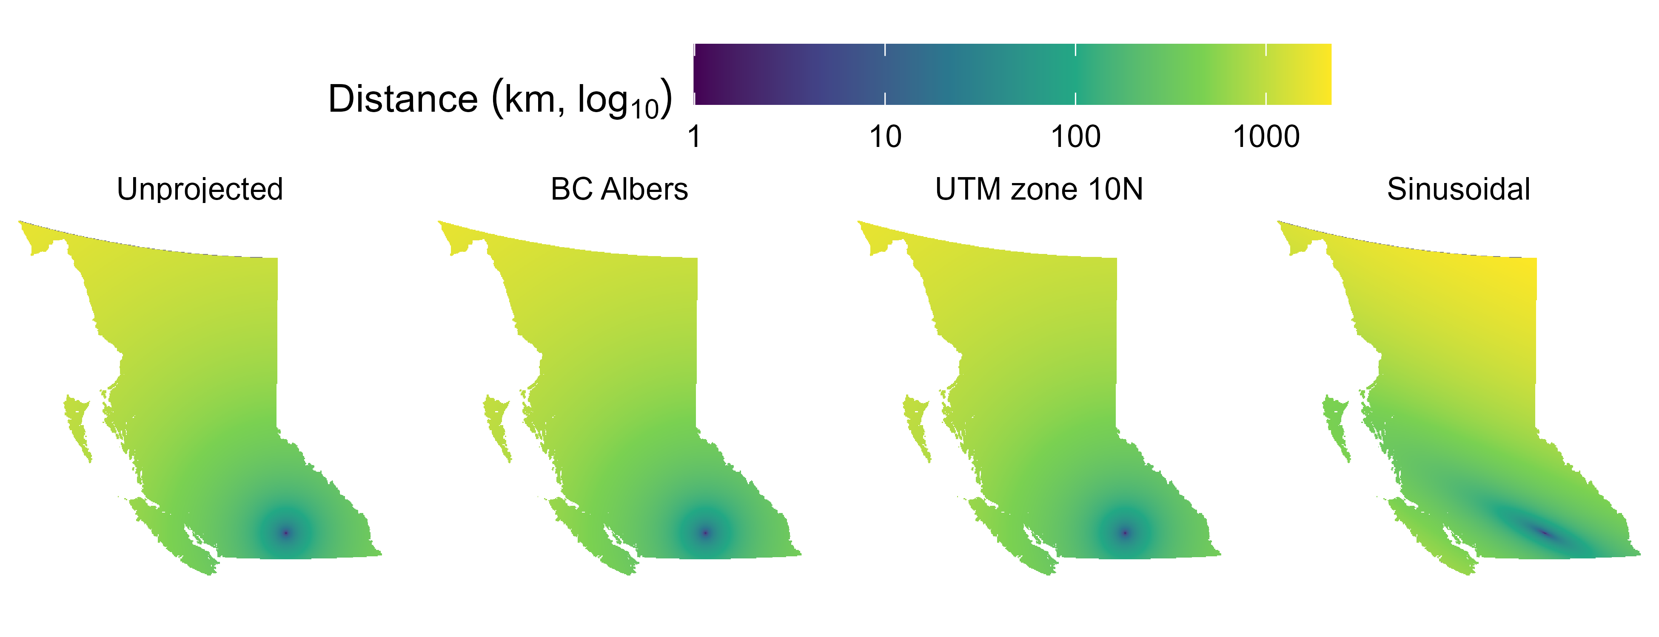
Project carefully: distances from UBCO

Slide 7
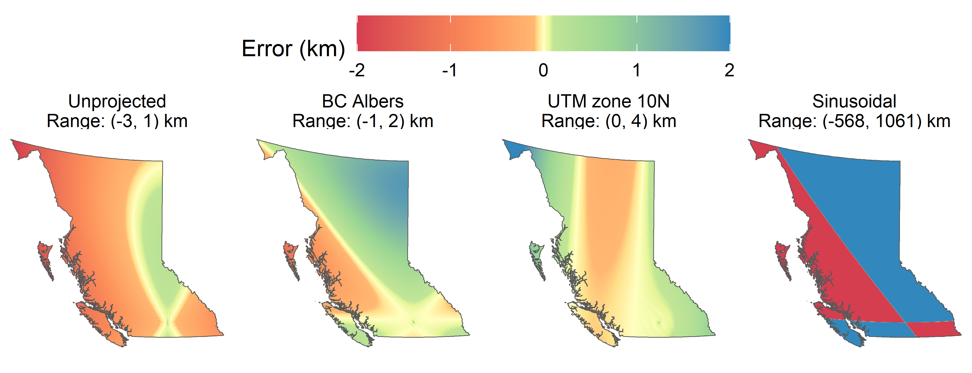
Project carefully: distance errors

Slide 8
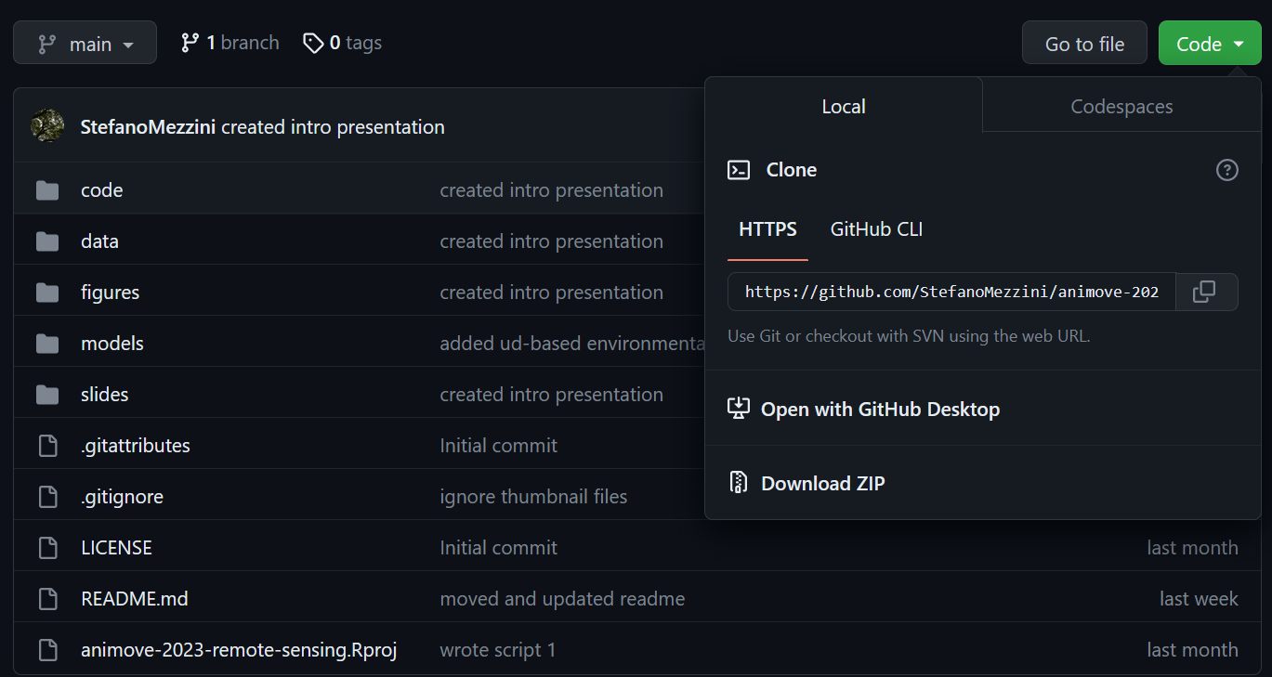
Today’s material
tinyurl.com/2023-animove-rs
1
2

