Slide 1
How do resource abundance and predictability affect animal movement?
Stefano Mezzini – M.Sc. Biol. – stefano.mezzini@ubc.ca

Slide 2
Hypotheses
Resource abundance lowers spatial needs
Stochasticity (randomness) increases spatial needs
Stochasticity lowers resource abundance (interaction effect)
Low space lowers fitness, increases conflicts

Slide 3
Fuzzy gralbers and space use

Slide 4
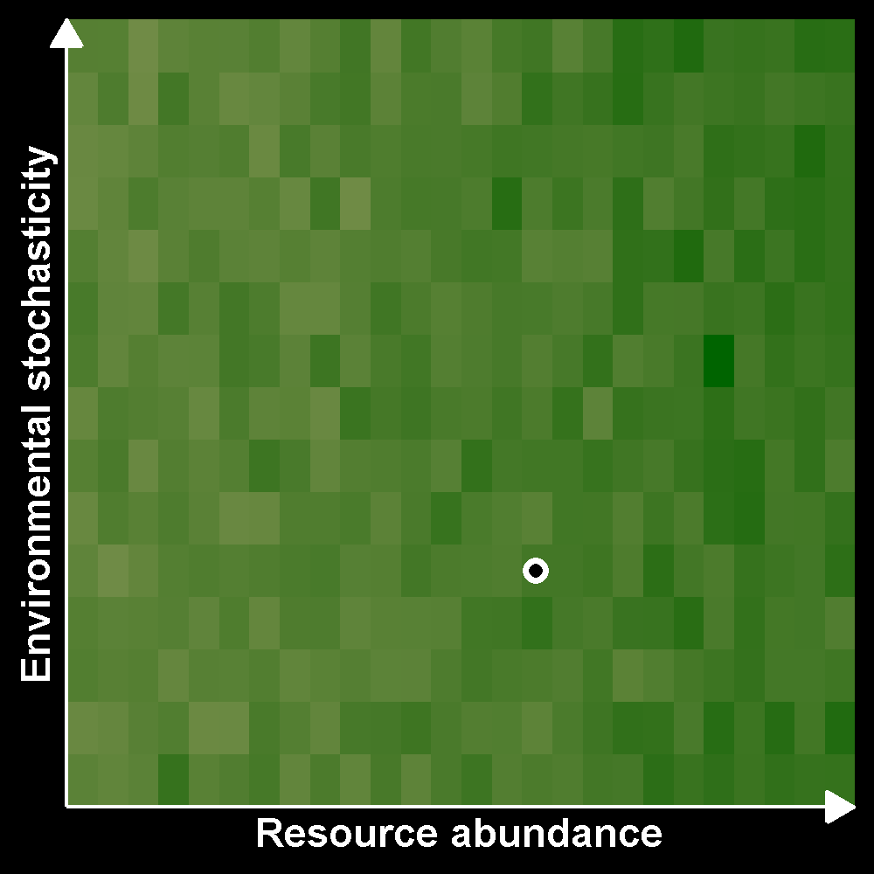
Fuzzy gralbers (Gralbus wagneri)
Very elusive, but born with GPS
Live in abstract space
Eat green pixels
Cannot sleep

Slide 5
Fuzzy gralbers (Gralbus wagneri)
Very elusive, but born with GPS
Live in abstract space
Eat green pixels
Cannot sleep

Slide 6
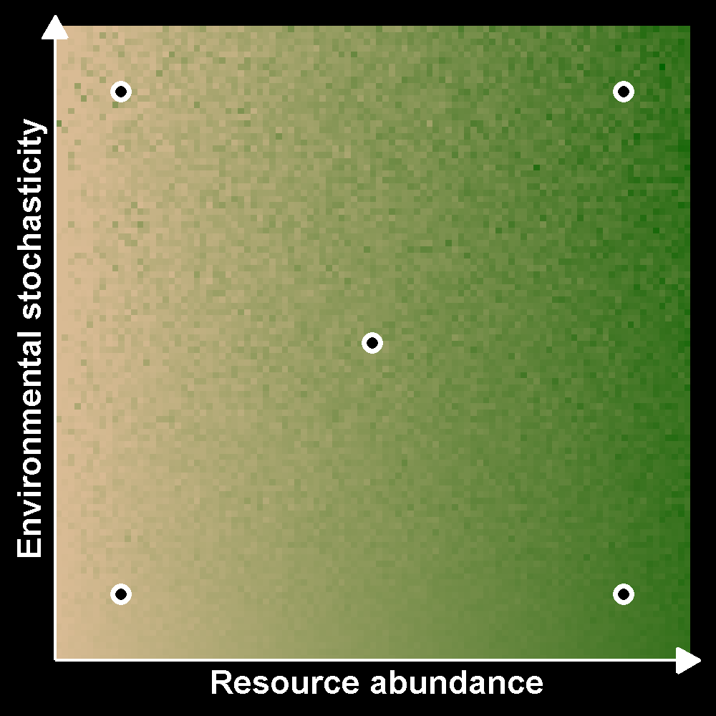
How do resource abundance and predictability affect animal movement?
Abundance decreases HR size
Stochasticity increases HR size
Interaction effects?
Effects of space restriction

Slide 7
How do resource abundance and predictability affect animal movement?
Abundance decreases HR size
Stochasticity increases HR size
Interaction effects?
Effects of space restriction

Slide 8
Modeling movement data

Slide 9
Common issues with movement data
Irregular sampling in time
Spatiotemporal autocorrelation
Most common methods don’t address these issues

Slide 10
Minimum Convex Polygons (MCPs)
Very common method
Convex polygon with X% of data
Inflexible (convex)
Ignores autocorrelation

Slide 11
Kernel Density Estimation (KDE)
Common method
Kernel covering X% of the data
Flexible
Ignores autocorrelation

Slide 12
Autocorrelated Kernel Density Estimation (AKDE)
Recent method
Kernel covering X% of the data
Flexible
Accounts for autocorrelation

Slide 13
Autocorrelated Kernel Density Estimation (AKDE)
Recent method
Kernel covering X% of the data
Flexible
Accounts for autocorrelation

Slide 14
Integrating stochasticity

Slide 15
Environmental stochasticity
Normalized Difference Vegetation Index
Range in yearly temperature, precipitation
Summarize to first 2 PCA axes?

Slide 16
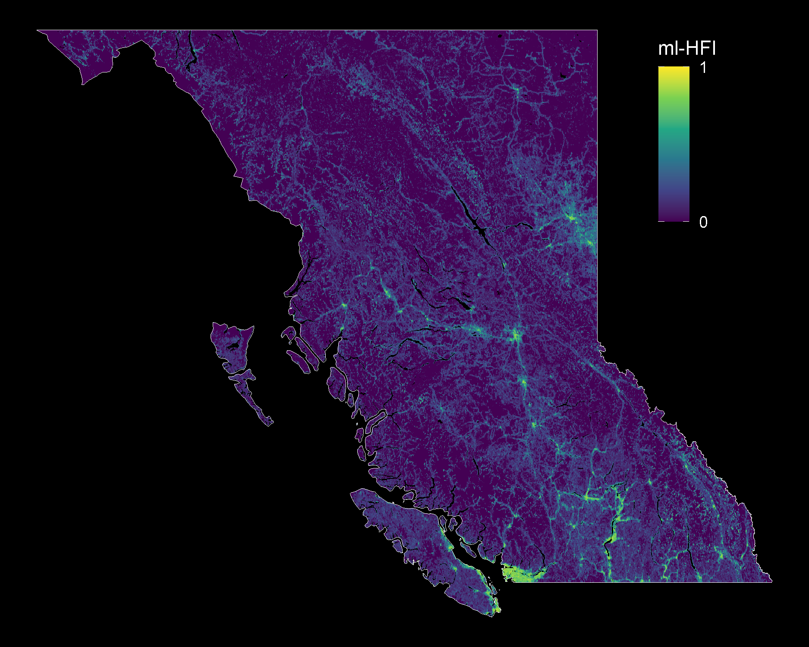
Machine-learning Human Footprint Index
Unitless index
0 = no modification
1 = maximum modification
Static in time (data: 2000-2019)
ml-HFI raster: Keys, Barnes, & Carter 2021. doi.org/10.1088/1748-9326/ABE00A
BC multipolygon: Statistics Canada

Slide 17
Modeling it all

Slide 18
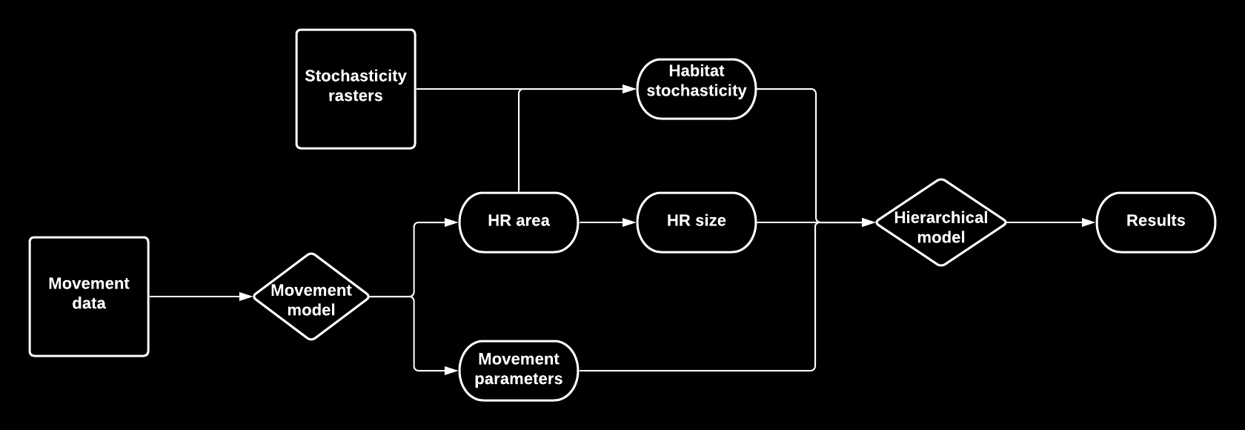
Lots of modeling for lots of data
Notes:
>1500 animals, 77 globally-distributed species

Slide 19
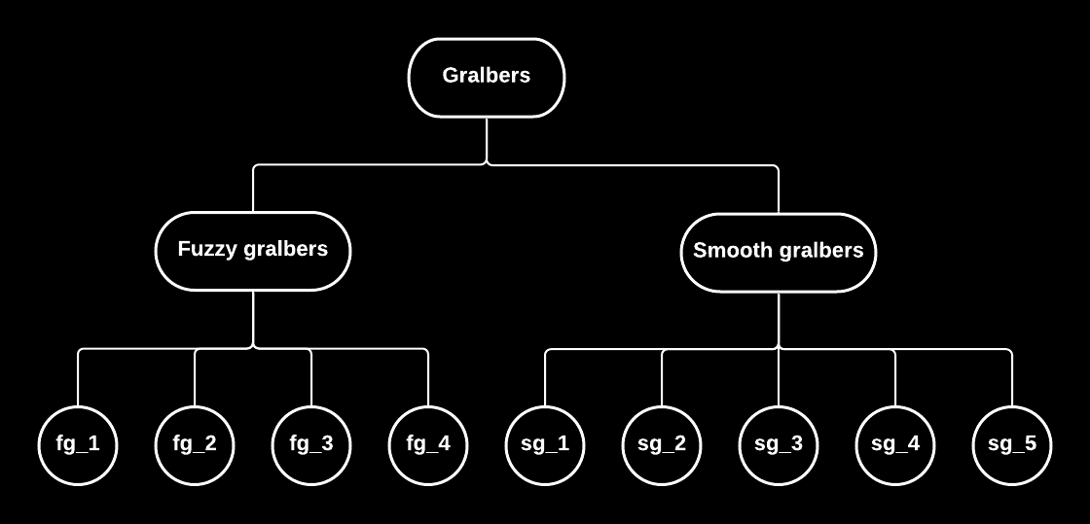
Estimating common trends
Effects of abundance and stochasticity on:
Home range size
Average speed
Autocorrelation parameters:
range crossing time
directional persistence

Slide 20
How do resource abundance and predictability affect animal movement?

Slide 21
Stefano Mezzini – M.Sc. Biol. – stefano.mezzini@ubc.ca

Slide 22
Additional slides

Slide 23
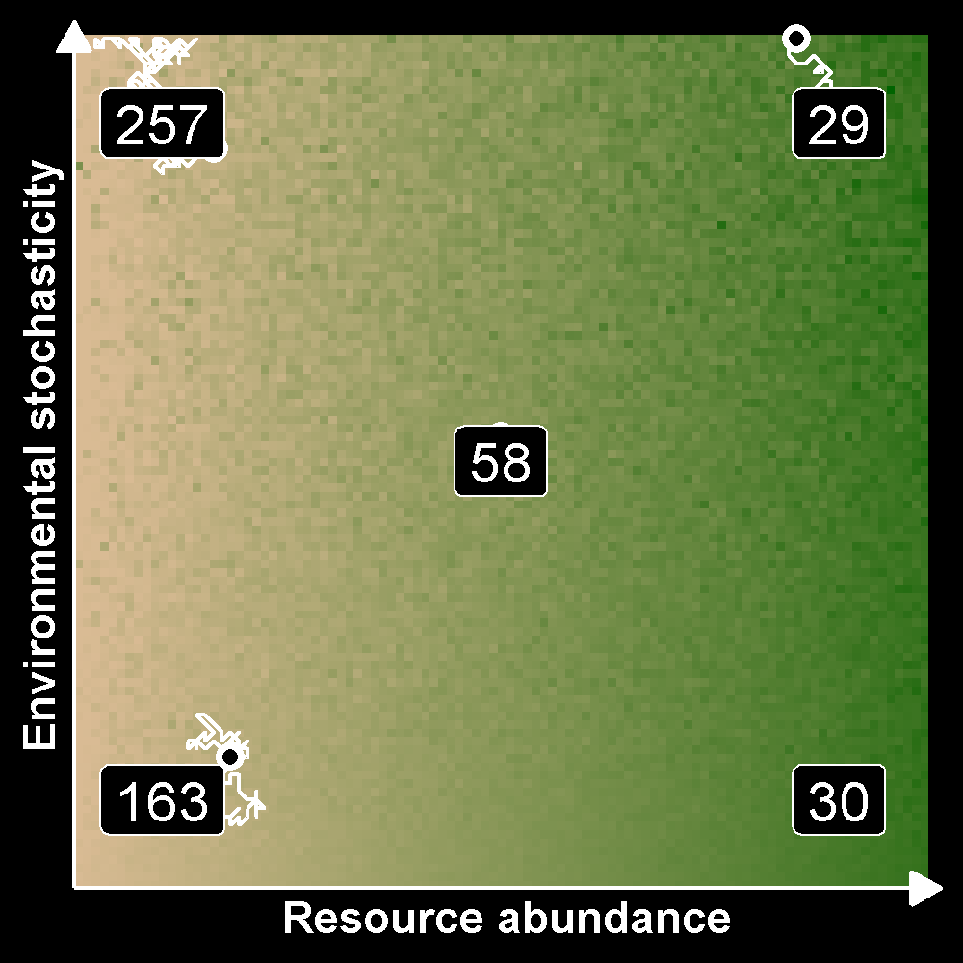
How do resource abundance and predictability affect animal movement?
Abundance decreases HR size
Stochasticity increases HR size
Interaction effects?
Effects of space restriction

