Slide 1
R basics
Ahmed Rebaï

Slide 2
What Is R?
a programming “environment”
object-oriented
similar to S-Plus
freeware
provides calculations on matrices
excellent graphics capabilities
supported by a large user network

Slide 3
What is R Not?
a statistics software package
menu-driven
quick to learn
a program with a complex graphical interface

Slide 4
Installing R
www.r-project.org/
download from CRAN
select a download site
download the base package at a minimum
download contributed packages as needed

Slide 5
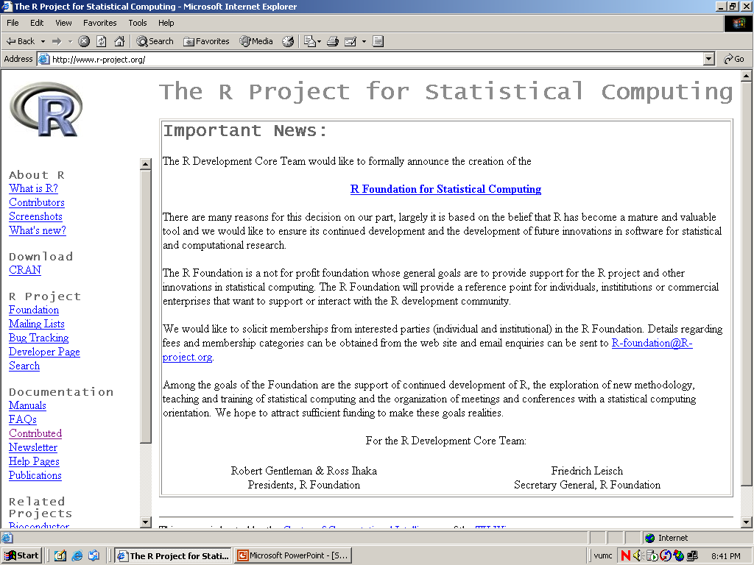

Slide 6
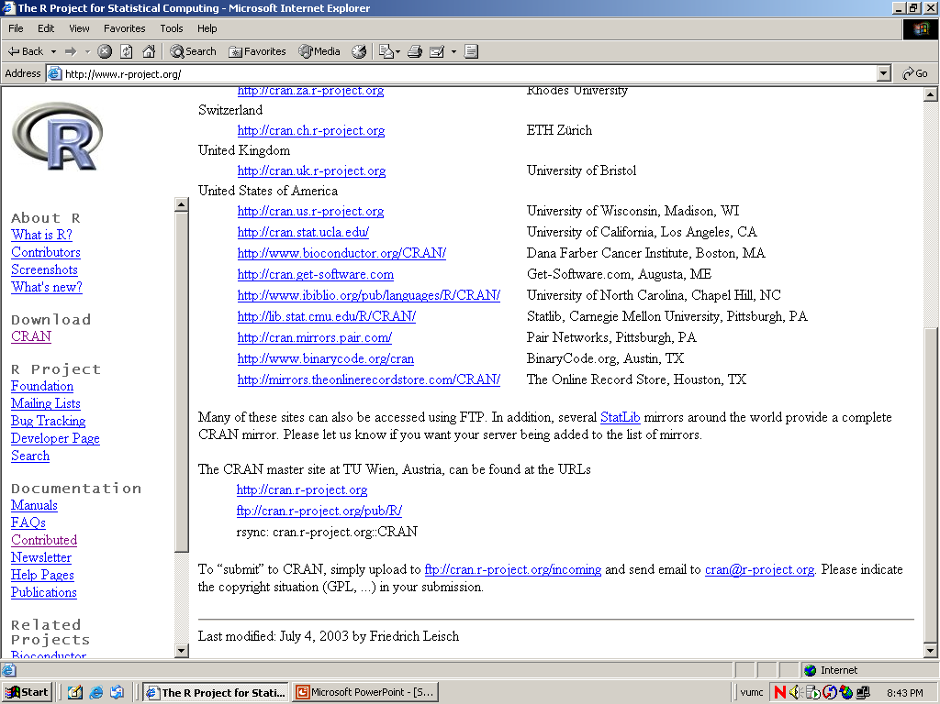

Slide 7
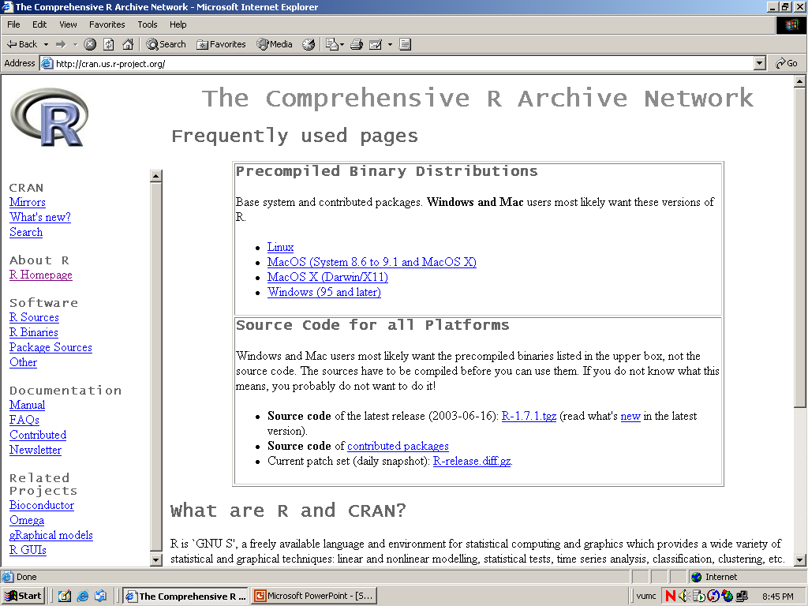

Slide 8
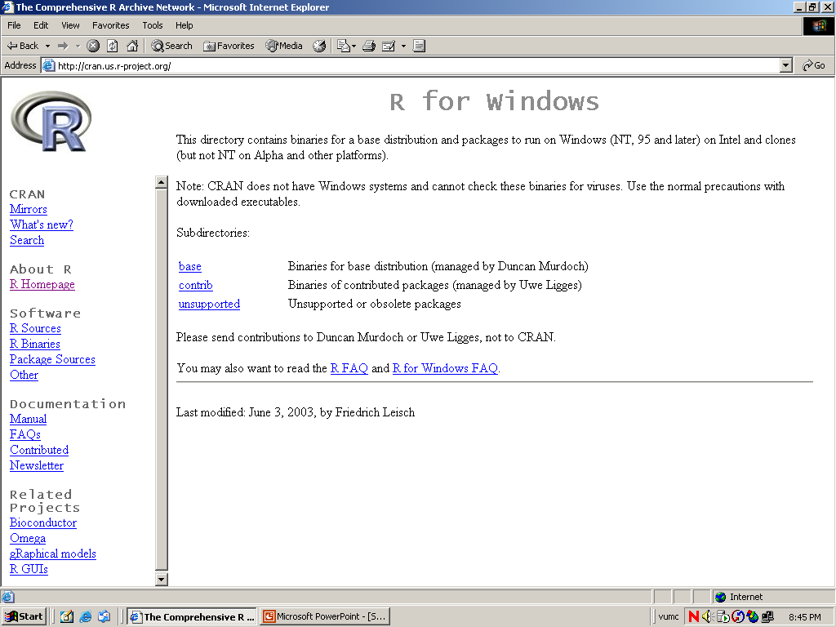

Slide 9
Tutorials
From R website under “Documentation”
  “Manual” is the listing of official R documentation
    An Introduction to R
    R Language Definition
    Writing R Extensions
    R Data Import/Export
    R Installation and Administration
    The R Reference Index

Slide 10
Tutorials cont.
  “Contributed” documentation are tutorials and manuals created by R users
    Simple R
    R for Beginners
    Practical Regression and ANOVA Using R
  R FAQ
  Mailing Lists (listserv)
    r-help

Slide 11
Tutorials cont.
Textbooks
  Venables & Ripley (2002) Modern Applied Statistics with S. New York: Springer-Verlag.
  Chambers (1998). Programming With Data: A guide to the S language. New York: Springer-Verlag.

Slide 12
R Basics
objects
naming convention
assignment
functions
workspace
history

Slide 13
Objects
names
types of objects: vector, factor, array, matrix, data.frame, ts, list
attributes
  mode: numeric, character, complex, logical
  length: number of elements in object
creation
  assign a value
  create a blank object

Slide 14
Naming Convention
must start with a letter (A-Z or a-z)
can contain letters, digits (0-9), and/or periods “.”
case-sensitive
  mydata different from MyData
do not use underscore “_”

Slide 15
Assignment
“<-” used to indicate assignment
  x<-c(1,2,3,4,5,6,7)
  x<-c(1:7)
  x<-1:4
note: as of version 1.4 “=“ is also a valid assignment operator

Slide 16
Functions
actions can be performed on objects using functions (note: a function is itself an object)
have arguments and options, often there are defaults
provide a result
parentheses () are used to specify that a function is being called

Slide 17
Let’s look at R

Slide 18
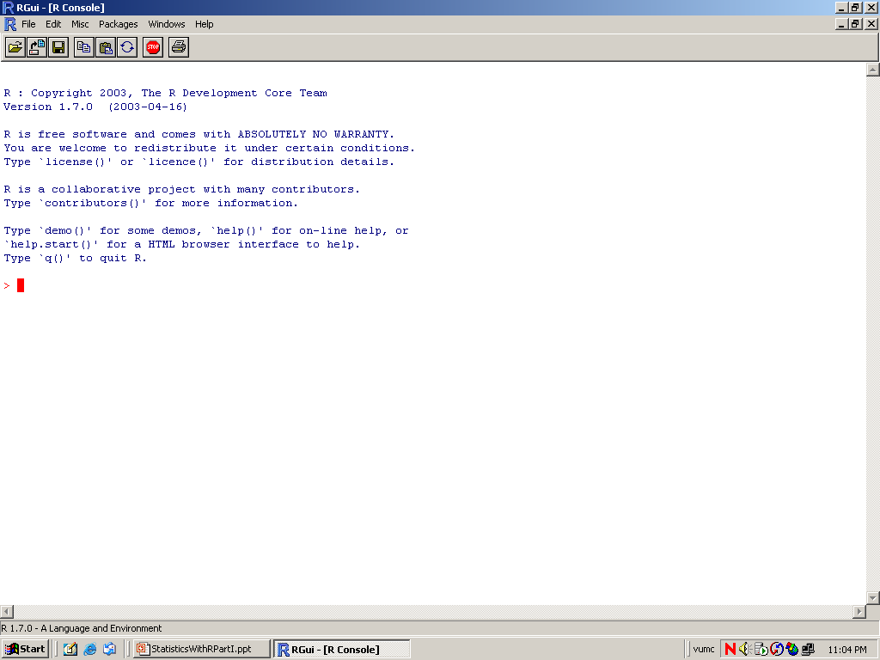

Slide 19
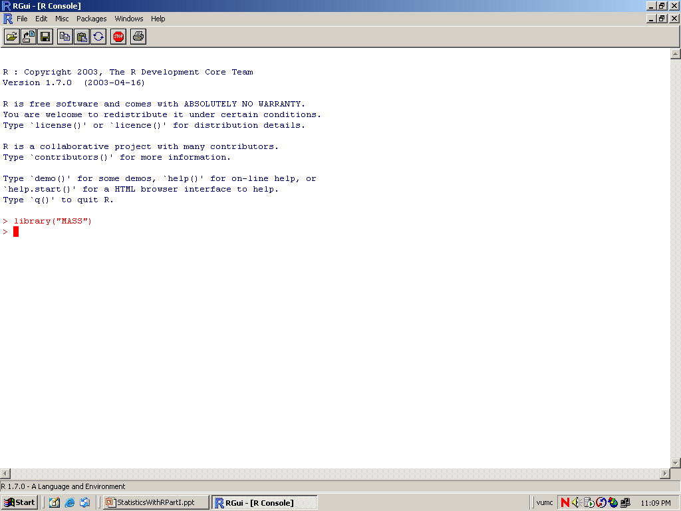

Slide 20
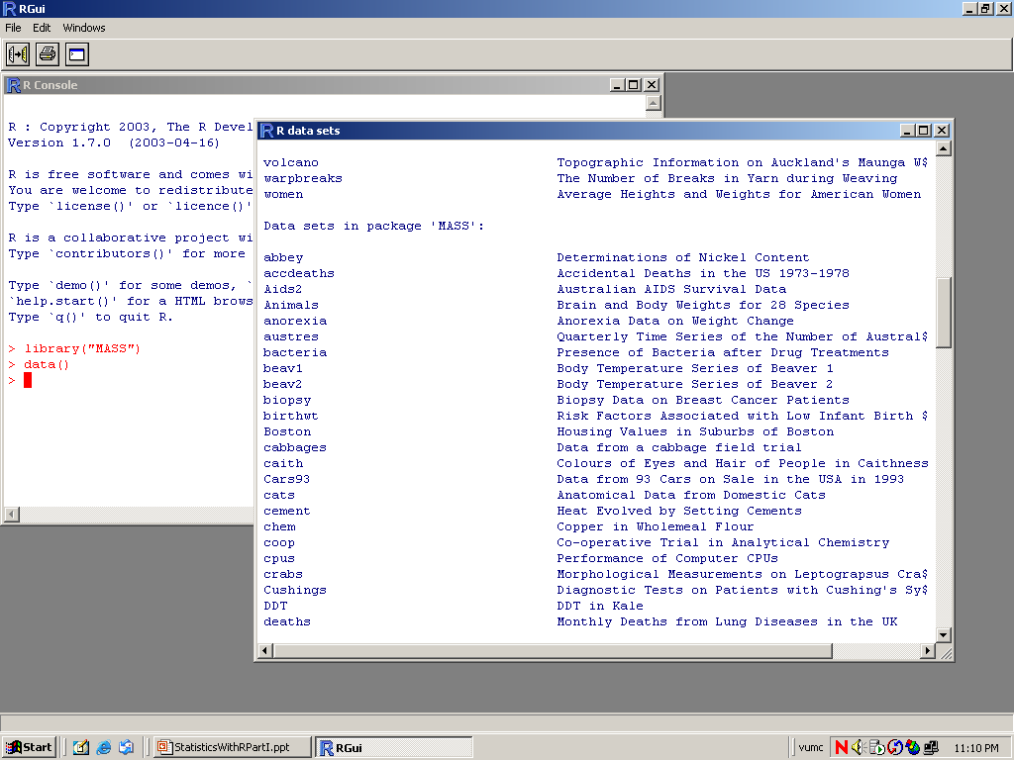

Slide 21
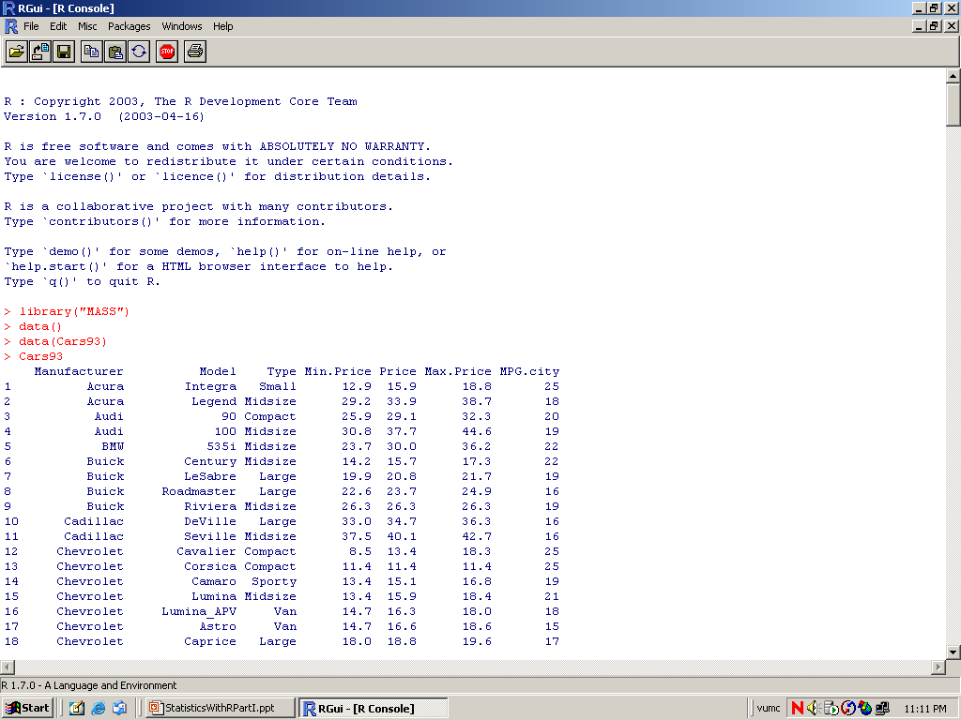

Slide 22
R Workspace & History

Slide 23
Workspace
during an R session, all objects are stored in a temporary, working memory
list objects
  ls()
remove objects
  rm()
objects that you want to access later must be saved in a “workspace”
  from the menu bar: File->save workspace
  from the command line: save(x,file=“MyData.Rdata”)

Slide 24
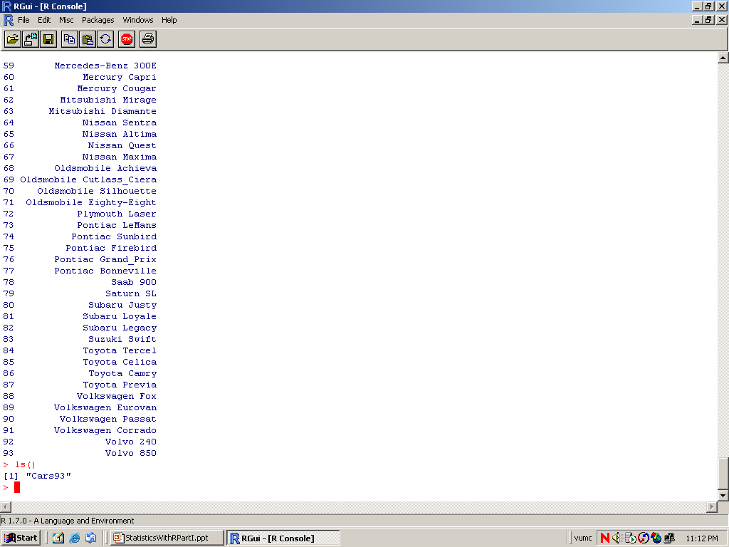

Slide 25
History
command line history
can be saved, loaded, or displayed
  savehistory(file=“MyData.Rhistory)
  loadhistory(file=“MyData.Rhistory)
  history(max.show=Inf)
during a session you can use the arrow keys to review the command history

Slide 26
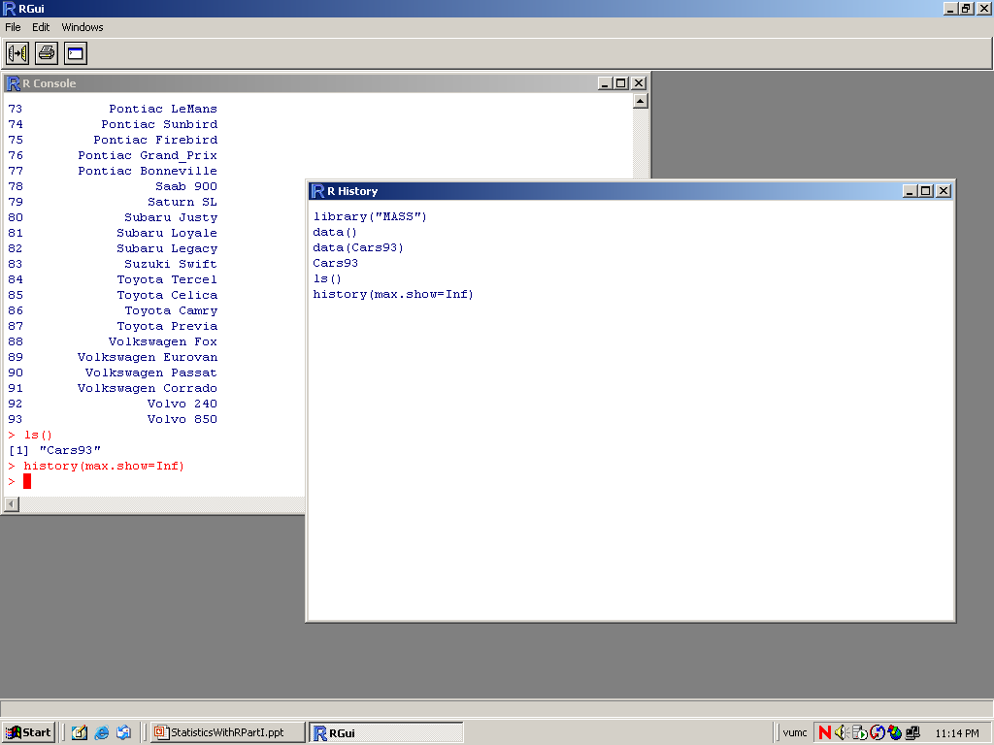

Slide 27
Two most common object types for statistics:
matrix
data frame

Slide 28
Matrix
a matrix is a vector with an additional attribute (dim) that defines the number of columns and rows
only one mode (numeric, character, complex, or logical) allowed
can be created using matrix()
    x<-matrix(data=0,nr=2,nc=2)
    or
    x<-matrix(0,2,2)

Slide 29
Data Frame
several modes allowed within a single data frame
can be created using data.frame()
    L<-LETTERS[1:4] #A B C D
    x<-1:4 #1 2 3 4
    data.frame(x,L) #create data frame
attach() and detach()
  the database is attached to the R search path so that the database is searched by R when it is evaluating a variable.
  objects in the database can be accessed by simply giving their names

Slide 30
Data Elements
select only one element
  x[2]
select range of elements
  x[1:3]
select all but one element
  x[-3]
slicing: including only part of the object
  x[c(1,2,5)]
select elements based on logical operator
  x(x>3)

Slide 31
Data Import & Entry

Slide 32
Importing Data
read.table()
  reads in data from an external file
data.entry()
  create object first, then enter data
c()
  concatenate
scan()
  prompted data entry
R has ODBC for connecting to other programs

Slide 33
Data entry & editing
start editor and save changes
  data.entry(x)
start editor, changes not saved
  de(x)
start text editor
  edit(x)

