Slide 1
> An Introduction to R
[1] Tyler K. Perrachione
[4] Gabrieli Lab, MIT
[7] 28 June 2010
[10] tkp@mit.edu

Slide 2
What is R?
A suite of operators for calculations on arrays, in particular matrices,
A large, coherent, integrated collection of intermediate tools for data analysis,
Graphical facilities for data analysis and display either on-screen or on hardcopy, and
A well-developed, simple and effective programming language which includes conditionals, loops, user-defined recursive functions and input and output facilities.
Free (as in beer and speech), open-source software

Slide 3
Installing, Running, and Interacting with R
How to get R:
  http://www.r-project.org/
  Google: “R”
  Windows, Linux, Mac OS X, source
  On mindhive:
    user@ba1:~$> R [terminal only]
    user@ba1:~$> R –g Tk & [application window]
Files for this tutorial:
  http://web.mit.edu/tkp/www/R/R_Tutorial_Data.txt
  http://web.mit.edu/tkp/www/R/R_Tutorial_Inputs.txt

Slide 4
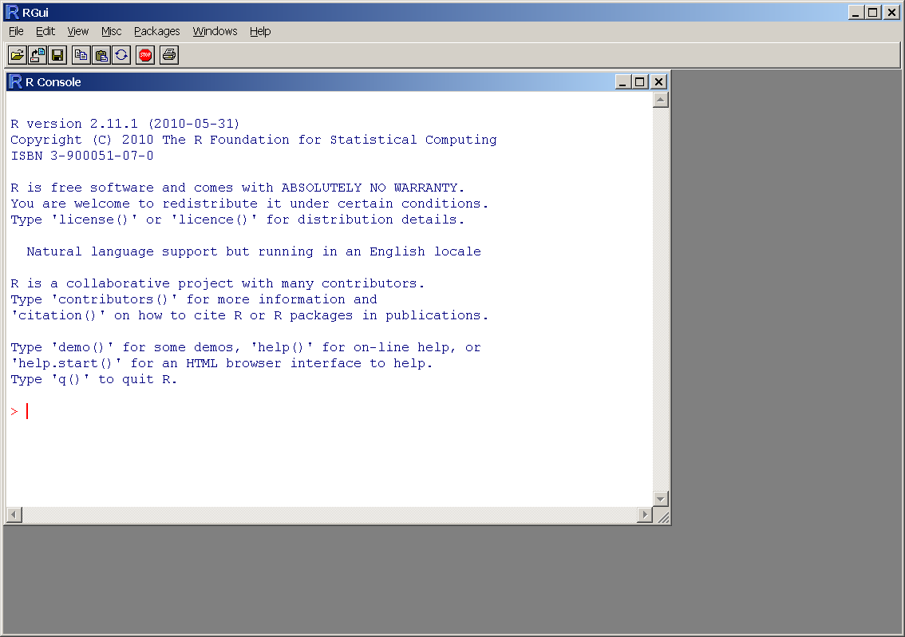
Installing, Running, and Interacting with R

Slide 5
Installing, Running, and Interacting with R
All examples are in file “R_Tutorial_Inputs.txt”
Entering data
  Math
  Variables
  Arrays
  Math on arrays
  Functions
Getting help
Reading data from files
Selecting subsets of data

Slide 6
Installing, Running, and Interacting with R
Math:
Variables:
> 1 + 1
[1] 2
> 1 + 1 * 7
[1] 8
> (1 + 1) * 7
[1] 14
> x <- 1
> x
[1] 1
> y = 2
> y
[1] 2
> 3 -> z
> z
[1] 3
> (x + y) * z
[1] 9

Slide 7
Installing, Running, and Interacting with R
Arrays:
> x <- c(0,1,2,3,4)
> x
[1] 0 1 2 3 4
> y <- 1:5
> y
[1] 1 2 3 4 5
> z <- 1:50
> z
[1] 1 2 3 4 5 6 7 8 9 10 11 12 13 14 15
[16] 16 17 18 19 20 21 22 23 24 25 26 27 28 29 30
[31] 31 32 33 34 35 36 37 38 39 40 41 42 43 44 45
[46] 46 47 48 49 50

Slide 8
Installing, Running, and Interacting with R
Math on arrays:
> x <- c(0,1,2,3,4)
> y <- 1:5
> z <- 1:50
> x + y
[1] 1 3 5 7 9
> x * y
[1] 0 2 6 12 20
> x * z
[1] 0 2 6 12 20 0 7 16 27 40 0
[12] 12 26 42 60 0 17 36 57 80 0 22
[23] 46 72 100 0 27 56 87 120 0 32 66
[34] 102 140 0 37 76 117 160 0 42 86 132
[45] 180 0 47 96 147 200

Slide 9
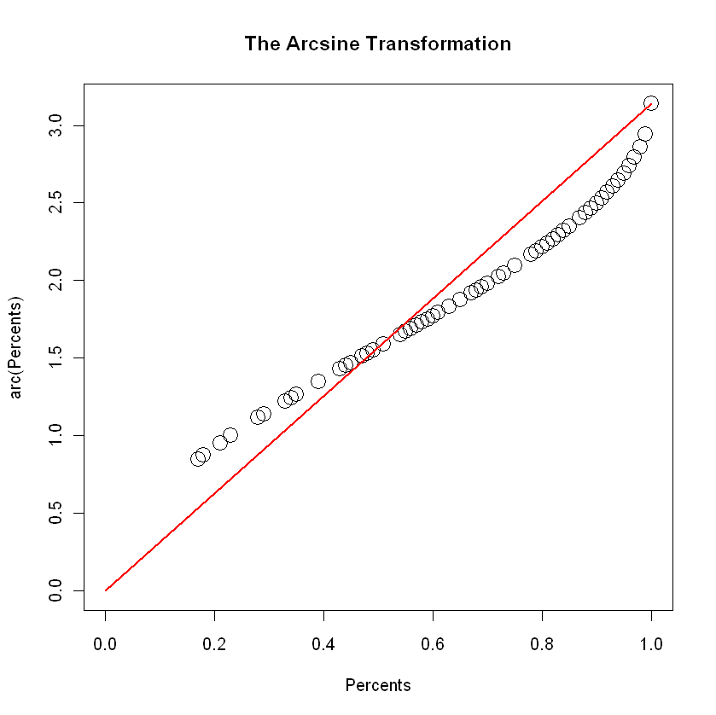
Installing, Running, and Interacting with R
Functions:
> arc <- function(x) 2*asin(sqrt(x))
> arc(0.5)
[1] 1.570796
> x <- c(0,1,2,3,4)
> x <- x / 10
> arc(x)
[1] 0.0000000 0.6435011 0.9272952
[4] 1.1592795 1.3694384
> plot(arc(Percents)~Percents,
+ pch=21,cex=2,xlim=c(0,1),ylim=c(0,pi),
+ main="The Arcsine Transformation")
> lines(c(0,1),c(0,pi),col="red",lwd=2)

Slide 10
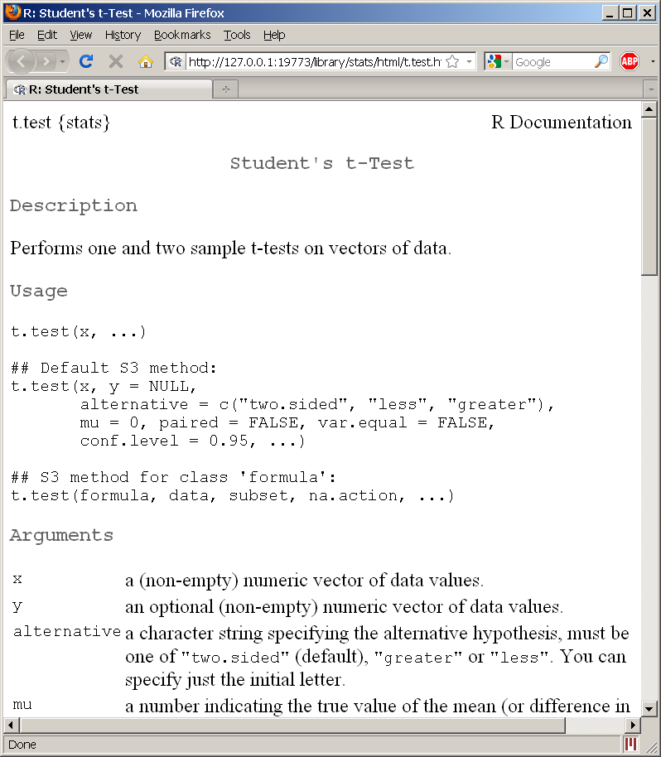
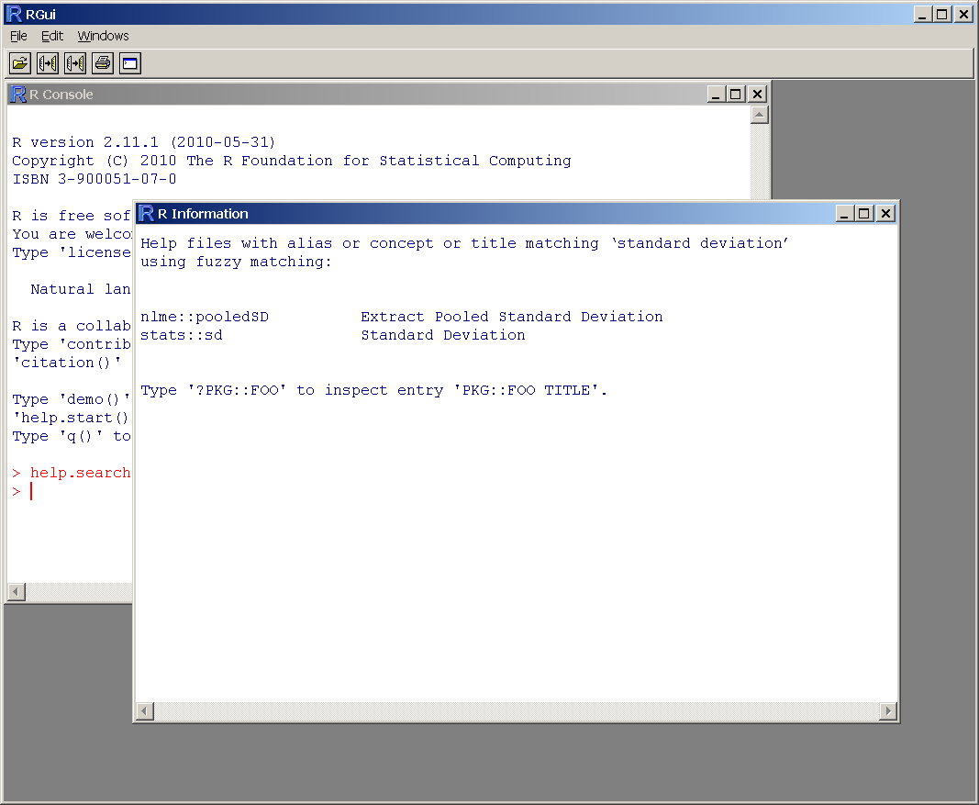
Installing, Running, and Interacting with R
Getting help:
> help(t.test)
> help.search("standard deviation")

Slide 11

Installing, Running, and Interacting with R
Example experiment:
  Subjects learning to perform a new task:
  Two groups of subjects
    (“A” and “B”; high and low aptitude learners)
  Two types of training paradigm
    (“High variability” and “Low variability”)
  Four pre-training assessment tests
Example data in “R_Tutorial_Data.txt”

Slide 12
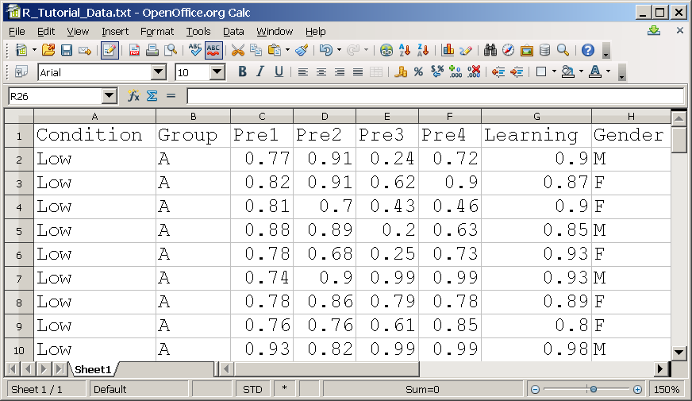
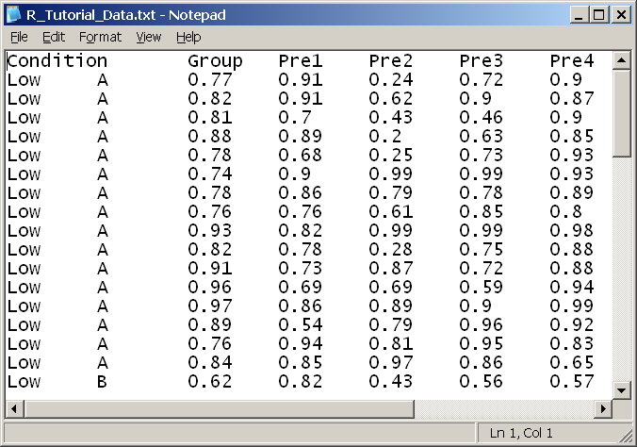
Installing, Running, and Interacting with R
Reading data from files:
> myData <- read.table("R_Tutorial_Data.txt",
+ header=TRUE, sep="\t")
> myData
Condition Group Pre1 Pre2 Pre3 Pre4 Learning
1 Low A 0.77 0.91 0.24 0.72 0.90
2 Low A 0.82 0.91 0.62 0.90 0.87
3 Low A 0.81 0.70 0.43 0.46 0.90
. . .
61 High B 0.44 0.41 0.84 0.82 0.29
62 High B 0.48 0.56 0.83 0.85 0.48
63 High B 0.61 0.82 0.88 0.95 0.28

Slide 13
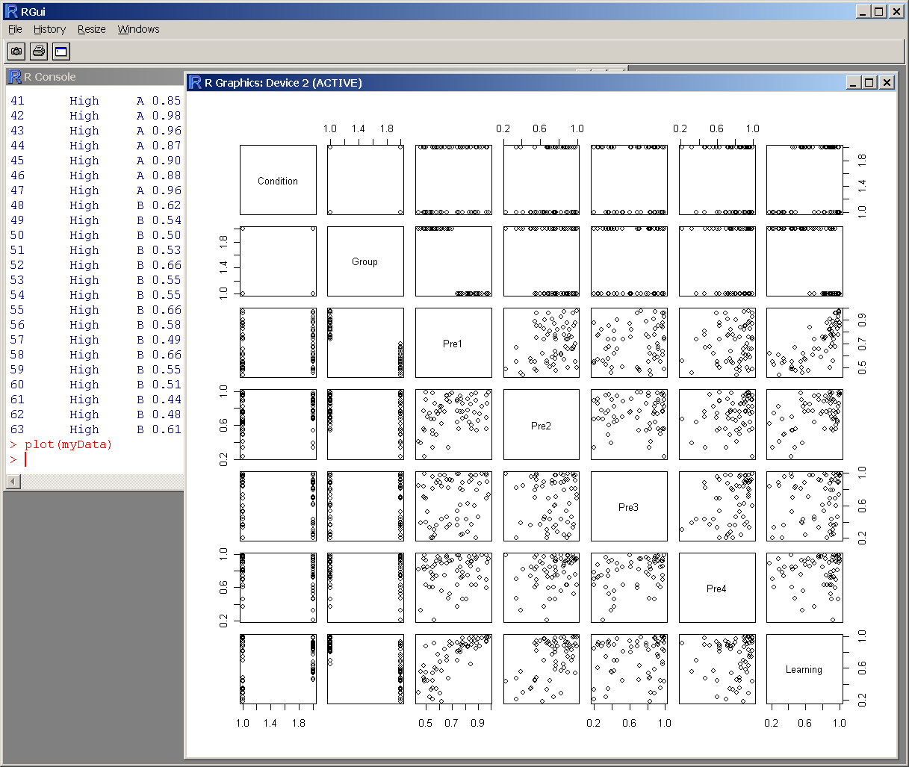
Installing, Running, and Interacting with R
Examining datasets:
> plot(myData)

Slide 14
Installing, Running, and Interacting with R
Selecting subsets of data:
> myData$Learning
[1] 0.90 0.87 0.90 0.85 0.93 0.93 0.89 0.80 0.98
[10] 0.88 0.88 0.94 0.99 0.92 0.83 0.65 0.57 0.55
[19] 0.94 0.68 0.89 0.60 0.63 0.84 0.92 0.56 0.78
[28] 0.54 0.47 0.45 0.59 0.91 0.98 0.82 0.93 0.81
[37] 0.97 0.95 0.70 1.00 0.90 0.99 0.95 0.95 0.97
[46] 1.00 0.99 0.18 0.33 0.88 0.23 0.75 0.21 0.35
[55] 0.70 0.34 0.43 0.75 0.44 0.44 0.29 0.48 0.28
> myData$Learning[myData$Group=="A"]
[1] 0.90 0.87 0.90 0.85 0.93 0.93 0.89 0.80 0.98
[10] 0.88 0.88 0.94 0.99 0.92 0.83 0.65 0.98 0.82
[19] 0.93 0.81 0.97 0.95 0.70 1.00 0.90 0.99 0.95
[28] 0.95 0.97 1.00 0.99

Slide 15
Installing, Running, and Interacting with R
Selecting subsets of data:
> myData$Learning
[1] 0.90 0.87 0.90 0.85 0.93 0.93 0.89 0.80 0.98
[10] 0.88 0.88 0.94 0.99 0.92 0.83 0.65 0.57 0.55
[19] 0.94 0.68 0.89 0.60 0.63 0.84 0.92 0.56 0.78
[28] 0.54 0.47 0.45 0.59 0.91 0.98 0.82 0.93 0.81
[37] 0.97 0.95 0.70 1.00 0.90 0.99 0.95 0.95 0.97
[46] 1.00 0.99 0.18 0.33 0.88 0.23 0.75 0.21 0.35
[55] 0.70 0.34 0.43 0.75 0.44 0.44 0.29 0.48 0.28
> attach(myData)
> Learning
[1] 0.90 0.87 0.90 0.85 0.93 0.93 0.89 0.80 0.98
[10] 0.88 0.88 0.94 0.99 0.92 0.83 0.65 0.57 0.55
[19] 0.94 0.68 0.89 0.60 0.63 0.84 0.92 0.56 0.78
[28] 0.54 0.47 0.45 0.59 0.91 0.98 0.82 0.93 0.81
[37] 0.97 0.95 0.70 1.00 0.90 0.99 0.95 0.95 0.97
[46] 1.00 0.99 0.18 0.33 0.88 0.23 0.75 0.21 0.35
[55] 0.70 0.34 0.43 0.75 0.44 0.44 0.29 0.48 0.28

Slide 16
Installing, Running, and Interacting with R
Selecting subsets of data:
> Learning[Group=="A"]
[1] 0.90 0.87 0.90 0.85 0.93 0.93 0.89 0.80 0.98
[10] 0.88 0.88 0.94 0.99 0.92 0.83 0.65 0.98 0.82
[19] 0.93 0.81 0.97 0.95 0.70 1.00 0.90 0.99 0.95
[28] 0.95 0.97 1.00 0.99
> Learning[Group!="A"]
[1] 0.57 0.55 0.94 0.68 0.89 0.60 0.63 0.84 0.92
[10] 0.56 0.78 0.54 0.47 0.45 0.59 0.91 0.18 0.33
[19] 0.88 0.23 0.75 0.21 0.35 0.70 0.34 0.43 0.75
[28] 0.44 0.44 0.29 0.48 0.28
> Condition[Group=="B"&Learning<0.5]
[1] Low Low High High High High High High High
[10] High High High High High
Levels: High Low

Slide 17
Statistics and Data Analysis
Parametric Tests
  Independent sample t-tests
  Paired sample t-tests
  One sample t-tests
  Correlation
Nonparametric tests
  Shapiro-Wilks test for normality
  Wilcoxon signed-rank test (Mann-Whitney U)
  Chi square test
Linear Models and ANOVA

Slide 18
Basic parametric inferential statistics
Independent sample t-tests:
> t.test(Pre2[Group=="A"],
+ Pre2[Group=="B"],
+ paired=FALSE)
Welch Two Sample t-test
data: Learning[Group == "A"] and Learning[Group == "B"]
t = 1.6117, df = 53.275, p-value = 0.1129
alternative hypothesis: true difference in means is not equal to 0
95 percent confidence interval:
-0.0179193 0.1645725
sample estimates:
mean of x mean of y
0.7764516 0.7031250

Slide 19
Basic parametric inferential statistics
Independent sample t-tests:
> t.test(Pre2[Group=="A"],
+ Pre2[Group=="B"],
+ paired=FALSE,
+ var.equal=TRUE)
Welch Two Sample t-test
data: Learning[Group == "A"] and Learning[Group == "B"]
t = 1.601, df = 61, p-value = 0.1145
alternative hypothesis: true difference in means is not equal to 0
95 percent confidence interval:
-0.0179193 0.1645725
sample estimates:
mean of x mean of y
0.7764516 0.7031250

Slide 20
Basic parametric inferential statistics
Independent sample t-tests:
> t.test(Pre2[Group=="A"],
+ Pre2[Group=="B"],
+ paired=FALSE,
+ var.equal=TRUE,
+ alternative="greater")
Welch Two Sample t-test
data: Learning[Group == "A"] and Learning[Group == "B"]
t = 1.601, df = 61, p-value = 0.5727
alternative hypothesis: true difference in means is greater than 0
95 percent confidence interval:
-0.003169388 Inf
sample estimates:
mean of x mean of y
0.7764516 0.7031250

Slide 21
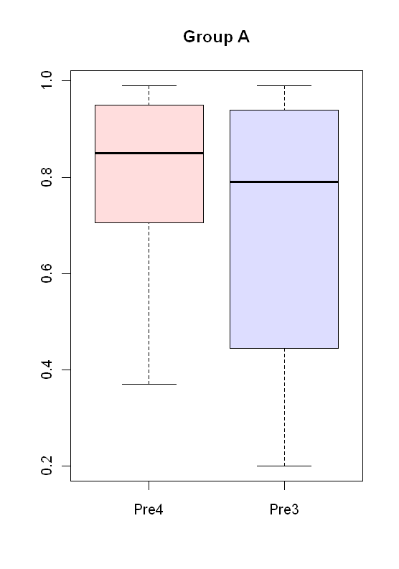
Basic parametric inferential statistics
Paired sample t-test:
> t.test(Pre4[Group=="A"],
+ Pre3[Group=="A"],
+ paired=TRUE)
Paired t-test
data: Pre4[Group == "A"] and Pre3[Group == "A"]
t = 2.4054, df = 30, p-value = 0.02253
alternative hypothesis: true difference in means is not equal to 0
95 percent confidence interval:
0.01641059 0.20100876
sample estimates:
mean of the differences
0.1087097
> boxplot(Pre4[Group=="A"],
+ Pre3[Group=="A"],
+ col=c("#ffdddd","#ddddff"),
+ names=c("Pre4","Pre3"),main="Group A")

Slide 22
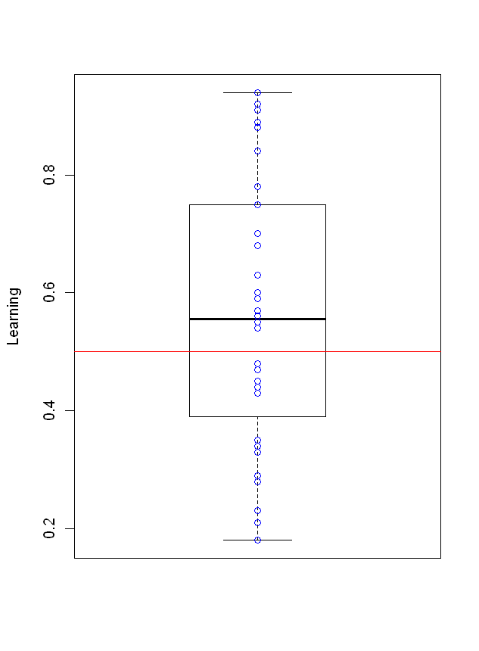
Basic parametric inferential statistics
One sample t-test:
> t.test(Learning[Group=="B"], mu=0.5, alternative="greater")
One Sample t-test
data: Learning[Group == "B"]
t = 1.5595, df = 31, p-value = 0.06452
alternative hypothesis: true mean is greater than 0.5
95 percent confidence interval:
0.4945469 Inf
sample estimates:
mean of x
0.5625
> boxplot(Learning[Group=="B"],
+ names="Group B", ylab="Learning")
> lines(c(0,2), c(0.5, 0.5), col="red")
> points(c(rep(1,length(Learning[Group=="B"]))),
+ Learning[Group=="B"], pch=21, col="blue")

Slide 23
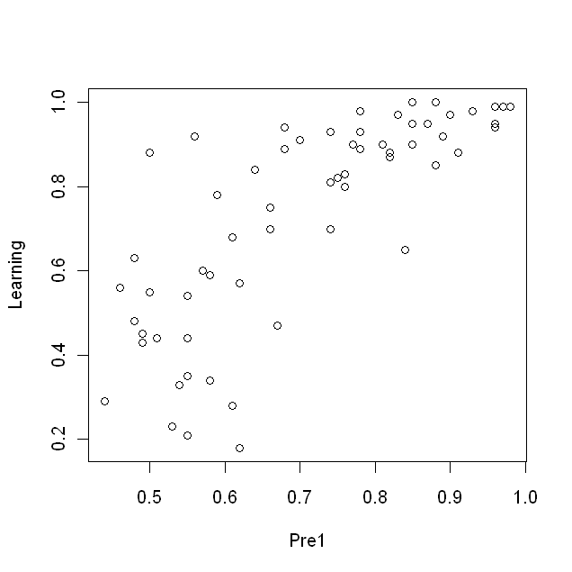
Basic parametric inferential statistics
Correlation:
> cor.test(Pre1,Learning,method="pearson")
Pearson's product-moment correlation
data: Pre1 and Learning
t = 9.2461, df = 61, p-value = 3.275e-13
alternative hypothesis: true correlation is not equal to 0
95 percent confidence interval:
0.6366698 0.8506815
sample estimates:
cor
0.7639292
> plot(Pre1,Learning)

Slide 24
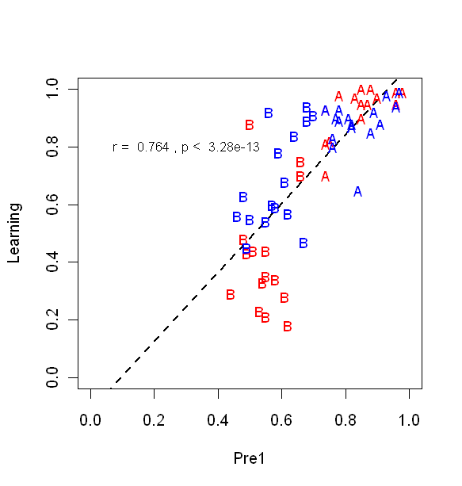
Basic parametric inferential statistics
Correlation (fancier plot example):
> cor.test(Pre1,Learning,method="pearson")
Pearson's product-moment correlation
data: Pre1 and Learning
t = 9.2461, df = 61, p-value = 3.275e-13
alternative hypothesis: true correlation is not equal to 0
95 percent confidence interval:
0.6366698 0.8506815
sample estimates:
cor
0.7639292
> plot(Learning~Pre1, ylim=c(0,1), xlim=c(0,1), ylab="Learning", xlab="Pre1", type="n")
> abline(lm(Learning~Pre1),col="black",lty=2, lwd=2)
> points(Learning[Group=="A"&Condition=="High"]~Pre1[Group=="A"&Condition=="High"],
+ pch=65, col="red", cex=0.9)
> points(Learning[Group=="A"&Condition=="Low"]~Pre1[Group=="A"&Condition=="Low"],
+ pch=65, col="blue", cex=0.9)
> points(Learning[Group=="B"&Condition=="High"]~Pre1[Group=="B"&Condition=="High"],
+ pch=66, col="red", cex=0.9)
> points(Learning[Group=="B"&Condition=="Low"]~Pre1[Group=="B"&Condition=="Low"],
+ pch=66, col="blue", cex=0.9)
> legend(2.5,1.0, c("LV Training", "HV Training"), pch=c(19), col=c("blue","red"), bty="y")
> yCor <- cor.test(Pre1, Learning, method="pearson")
> text(0.3,0.8, paste("r = ", format(myCor$estimate,digits=3),", p < ", format(myCor$p.value,digits=3)), cex=0.8)

Slide 25
Statistics and Data Analysis
Are my data normally distributed?
> t.test(Learning[Condition=="High"&Group=="A"],
+ Learning[Condition=="Low"&Group=="A"])
Welch Two Sample t-test
data: Learning[Condition == "High" & Group == "A"] and Learning[Condition == "Low" & Group == "A"]
t = 1.457, df = 28.422, p-value = 0.1561
alternative hypothesis: true difference in means is not equal to 0
95 percent confidence interval:
-0.01764821 0.10481488
sample estimates:
mean of x mean of y
0.9273333 0.8837500

Slide 26
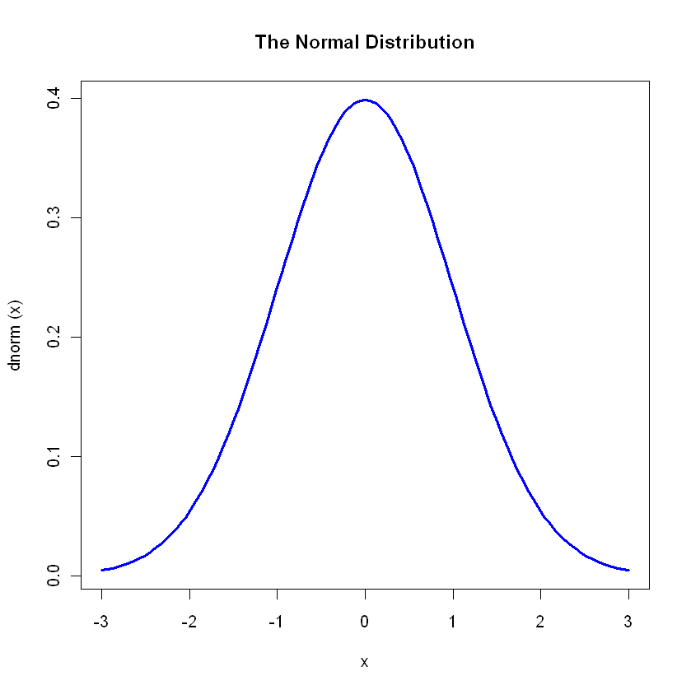
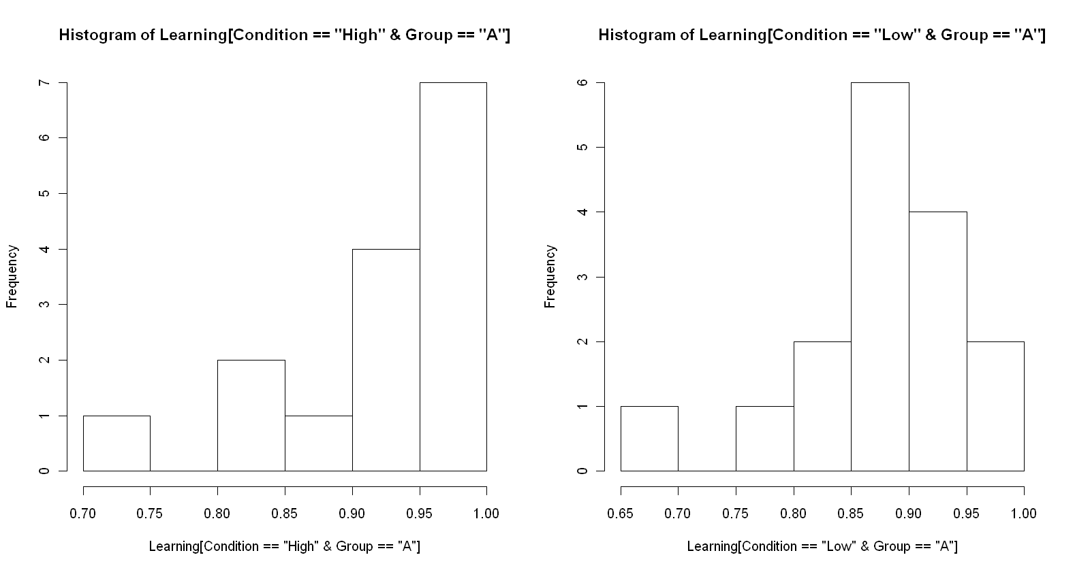
Statistics and Data Analysis
Are my data normally distributed?
> plot(dnorm,-3,3,col="blue",lwd=3,main="The Normal Distribution")
> par(mfrow=c(1,2))
> hist(Learning[Condition=="High"&Group=="A"])
> hist(Learning[Condition=="Low"&Group=="A"])

Slide 27
Statistics and Data Analysis
Are my data normally distributed?
> shapiro.test(Learning[Condition=="High"&Group=="A"])
Shapiro-Wilk normality test
data: Learning[Condition == "High" & Group == "A"]
W = 0.7858, p-value = 0.002431
> shapiro.test(Learning[Condition=="Low"&Group=="A"])
Shapiro-Wilk normality test
data: Learning[Condition == "Low" & Group == "A"]
W = 0.8689, p-value = 0.02614

Slide 28
Basic nonparametric inferential statistics
Wilcoxon signed-rank / Mann-Whitney U tests:
> wilcox.test(Learning[Condition=="High"&Group=="A"],
+ Learning[Condition=="Low"&Group=="A"],
+ exact=FALSE,
+ paired=FALSE)
Wilcoxon rank sum test with continuity correction
data: Learning[Condition == "High" & Group == "A"] and Learning[Condition == "Low" & Group == "A"]
W = 173.5, p-value = 0.03580
alternative hypothesis: true location shift is not equal to 0

Slide 29
Basic nonparametric inferential statistics
Chi square test:
> x <- matrix(c(
+ length(Learning[Group=="A"&Condition=="High"&Gender=="F"]),
+ length(Learning[Group=="A"&Condition=="Low"&Gender=="F"]),
+ length(Learning[Group=="B"&Condition=="High"&Gender=="F"]),
+ length(Learning[Group=="B"&Condition=="Low"&Gender=="F"])),
+ ncol=2)
> x
[,1] [,2]
[1,] 4 12
[2,] 10 7
> chisq.test(x)
Pearson's Chi-squared test with Yates' continuity correction
data: x
X-squared = 2.5999, df = 1, p-value = 0.1069

Slide 30
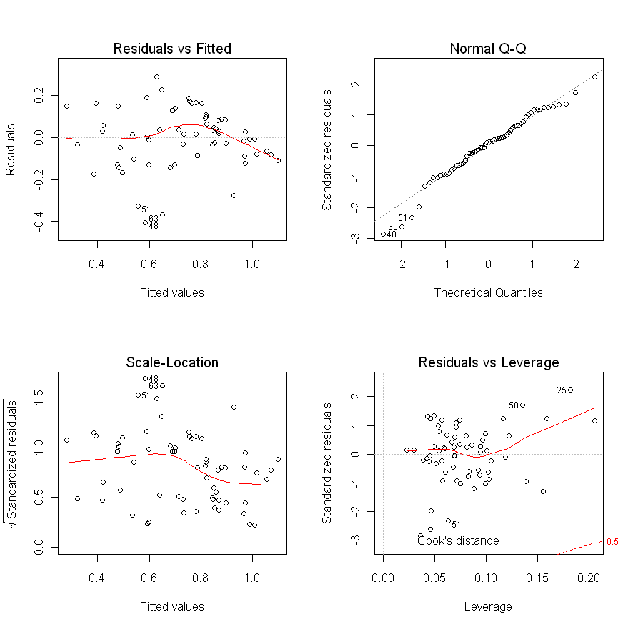
Linear models and ANOVA
Linear models:
> myModel <- lm(Learning ~ Pre1 + Pre2 + Pre3 + Pre4)
> par(mfrow=c(2,2))
> plot(myModel)

Slide 31
Linear models and ANOVA
Linear models:
> summary(myModel)
Call:
lm(formula = Learning ~ Pre1 + Pre2 + Pre3 + Pre4)
Residuals:
Min 1Q Median 3Q Max
-0.40518 -0.08460 0.01707 0.09170 0.29074
Coefficients:
Estimate Std. Error t value Pr(>|t|)
(Intercept) -0.22037 0.11536 -1.910 0.061055 .
Pre1 1.05299 0.12636 8.333 1.70e-11 ***
Pre2 0.41298 0.10926 3.780 0.000373 ***
Pre3 0.07339 0.07653 0.959 0.341541
Pre4 -0.18457 0.11318 -1.631 0.108369
---
Signif. codes: 0 ‘***’ 0.001 ‘**’ 0.01 ‘*’ 0.05 ‘.’ 0.1 ‘ ’ 1
Residual standard error: 0.1447 on 58 degrees of freedom
Multiple R-squared: 0.6677, Adjusted R-squared: 0.6448
F-statistic: 29.14 on 4 and 58 DF, p-value: 2.710e-13

Slide 32
Linear models and ANOVA
Linear models:
> step(myModel, direction="backward")
Start: AIC=-238.8
Learning ~ Pre1 + Pre2 + Pre3 + Pre4
Df Sum of Sq RSS AIC
- Pre3 1 0.01925 1.2332 -239.81
<none> 1.2140 -238.80
- Pre4 1 0.05566 1.2696 -237.98
- Pre2 1 0.29902 1.5130 -226.93
- Pre1 1 1.45347 2.6675 -191.21
Step: AIC=-239.81
Learning ~ Pre1 + Pre2 + Pre4
Df Sum of Sq RSS AIC
- Pre4 1 0.03810 1.2713 -239.89
<none> 1.2332 -239.81
- Pre2 1 0.28225 1.5155 -228.83
- Pre1 1 1.54780 2.7810 -190.58
...
...
Step: AIC=-239.89
Learning ~ Pre1 + Pre2
Df Sum of Sq RSS AIC
<none> 1.2713 -239.89
- Pre2 1 0.24997 1.5213 -230.59
- Pre1 1 1.52516 2.7965 -192.23
Call:
lm(formula = Learning ~ Pre1 + Pre2)
Coefficients:
(Intercept) Pre1 Pre2
-0.2864 1.0629 0.3627

Slide 33
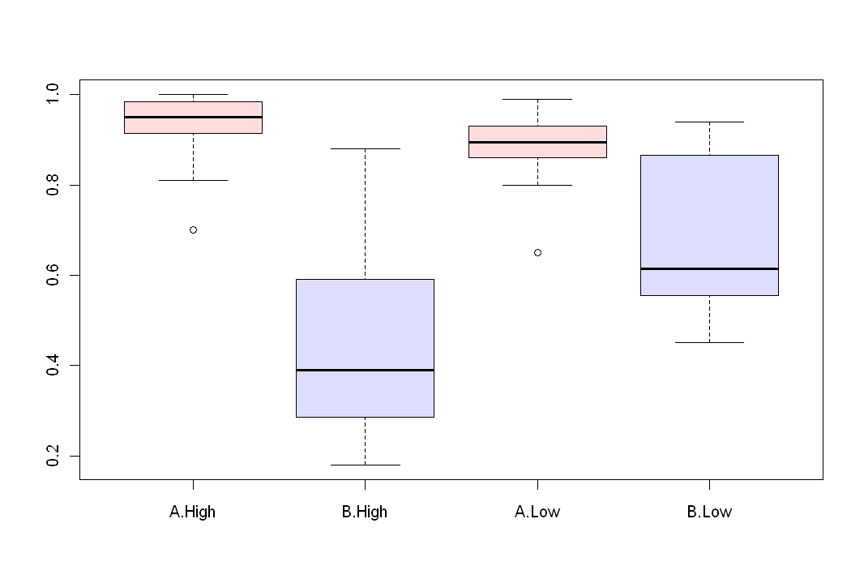
Linear models and ANOVA
ANOVA:
> myANOVA <- aov(Learning~Group*Condition)
> summary(myANOVA)
Df Sum Sq Mean Sq F value Pr(>F)
Group 1 1.8454 1.84537 81.7106 9.822e-13 ***
Condition 1 0.1591 0.15910 7.0448 0.0102017 *
Group:Condition 1 0.3164 0.31640 14.0100 0.0004144 ***
Residuals 59 1.3325 0.02258
---
Signif. codes: 0 ‘***’ 0.001 ‘**’ 0.01 ‘*’ 0.05 ‘.’ 0.1 ‘ ’ 1
> boxplot(Learning~Group*Condition,col=c("#ffdddd","#ddddff"))

Slide 34
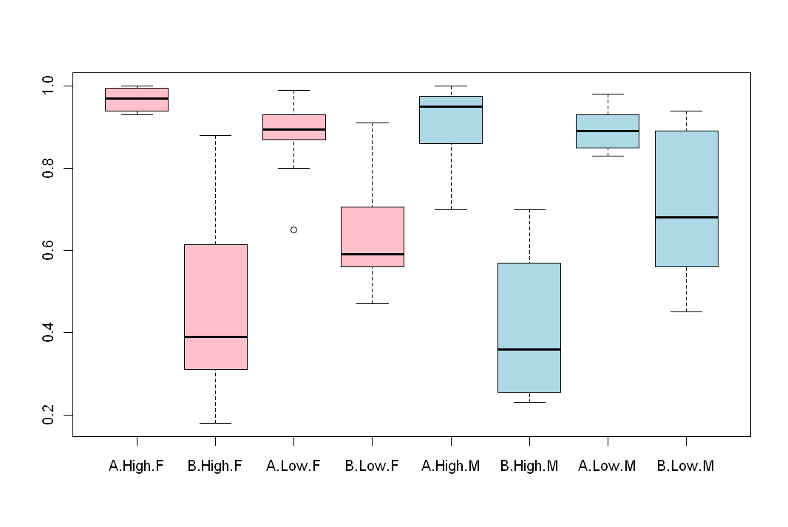
Linear models and ANOVA
ANOVA:
> myANOVA2 <- aov(Learning~Group*Condition+Gender)
> summary(myANOVA2)
Df Sum Sq Mean Sq F value Pr(>F)
Group 1 1.84537 1.84537 80.3440 1.523e-12 ***
Condition 1 0.15910 0.15910 6.9270 0.010861 *
Gender 1 0.04292 0.04292 1.8688 0.176886
Group:Condition 1 0.27378 0.27378 11.9201 0.001043 **
Residuals 58 1.33216 0.02297
---
Signif. codes: 0 ‘***’ 0.001 ‘**’ 0.01 ‘*’ 0.05 ‘.’ 0.1 ‘ ’ 1
> boxplot(Learning~Group*Condition+Gender,
+ col=c(rep("pink",4),rep("light blue",4)))

Slide 35



How to find R help and resources on the internet
R wiki:
http://rwiki.sciviews.org/doku.php
R graph gallery:
http://addictedtor.free.fr/graphiques/thumbs.php
Kickstarting R:
http://cran.r-project.org/doc/contrib/Lemon-kickstart/
ISBN: 9780596801700

