Slide 1
Introduction To R

Slide 2
What is R?
The R statistical programming language is a free open source package based on the S language developed by Bell Labs.
The language is very powerful for writing programs.
Many statistical functions are already built in.
Contributed packages expand the functionality to cutting edge research.
Since it is a programming language, generating computer code to complete tasks is required.

Slide 3
Getting Started
Where to get R?
Go to www.r-project.org
Downloads: CRAN
Set your Mirror: Anyone in the USA is fine.
Select Windows 95 or later.
Select base.
Select R-2.4.1-win32.exe
  The others are if you are a developer and wish to change the source code.
UNT course website for R:
  http://www.unt.edu/rss/SPLUSclasslinks.html

Slide 4
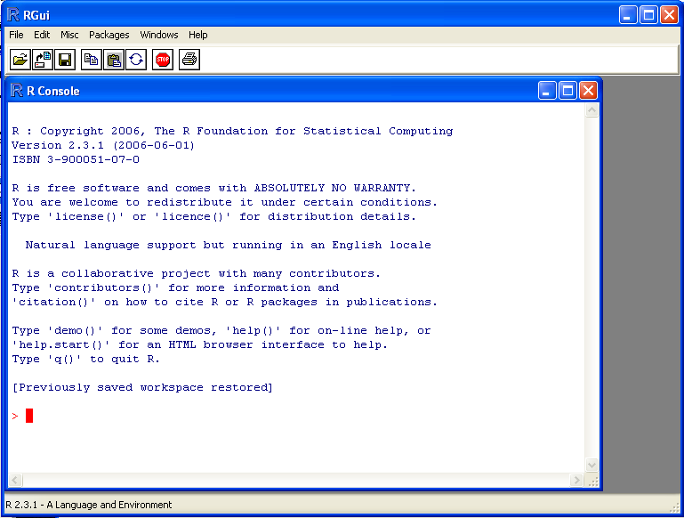
Getting Started
The R GUI?

Slide 5
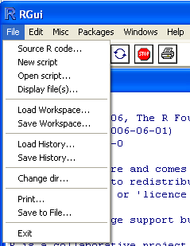
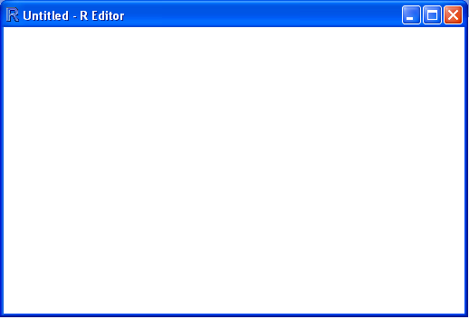
Getting Started
Opening a script.
This gives you a script window.

Slide 6
Getting Started
Basic assignment and operations.
Arithmetic Operations:
  +, -, *, /, ^ are the standard arithmetic operators.
Matrix Arithmetic.
  * is element wise multiplication
  %*% is matrix multiplication
Assignment
  To assign a value to a variable use “<-”

Slide 7
Getting Started
How to use help in R?
  R has a very good help system built in.
  If you know which function you want help with simply use ?_______ with the function in the blank.
  Ex: ?hist.
  If you don’t know which function to use, then use help.search(“_______”).
  Ex: help.search(“histogram”).

Slide 8
Importing Data
How do we get data into R?
Remember we have no point and click…
First make sure your data is in an easy to read format such as CSV (Comma Separated Values).
Use code:
  D <- read.table(“path”,sep=“,”,header=TRUE)

Slide 9
Working with data.
Accessing columns.
D has our data in it…. But you can’t see it directly.
To select a column use D$column.

Slide 10
Working with data.
Subsetting data.
Use a logical operator to do this.
  ==, >, <, <=, >=, <> are all logical operators.
  Note that the “equals” logical operator is two = signs.
Example:
  D[D$Gender == “M”,]
  This will return the rows of D where Gender is “M”.
  Remember R is case sensitive!
  This code does nothing to the original dataset.
  D.M <- D[D$Gender == “M”,] gives a dataset with the appropriate rows.

Slide 11
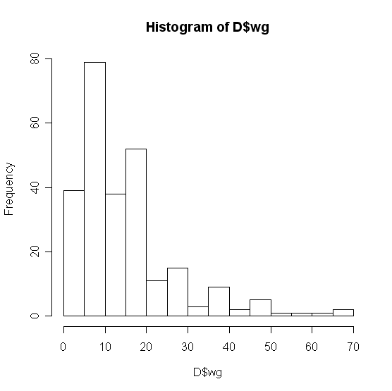
Basic Graphics
Histogram
  hist(D$wg)

Slide 12
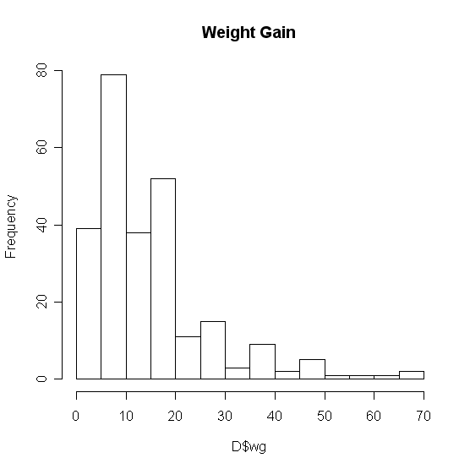
Basic Graphics
Add a title…
  The “main” statement will give the plot an overall heading.
  hist(D$wg , main=‘Weight Gain’)

Slide 13
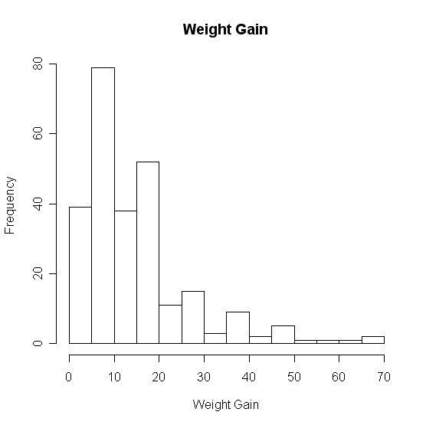
Basic Graphics
Adding axis labels…
Use “xlab” and “ylab” to label the X and Y axes, respectively.
hist(D$wg , main=‘Weight Gain’,xlab=‘Weight Gain’, ylab =‘Frequency’)

Slide 14
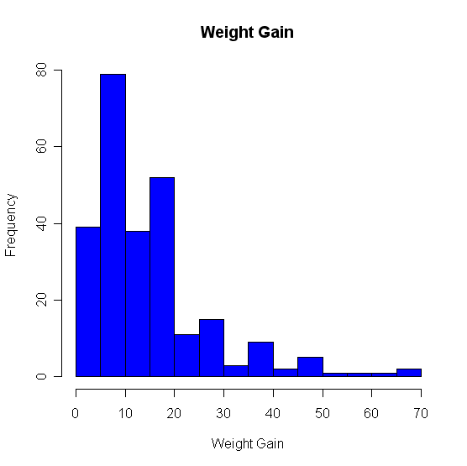
Basic Graphics
Changing colors…
Use the col statement.
  ?colors will give you help on the colors.
  Common colors may simply put in using the name.
  hist(D$wg, main=“Weight Gain”,xlab=“Weight Gain”, ylab =“Frequency”, col=“blue”)

Slide 15
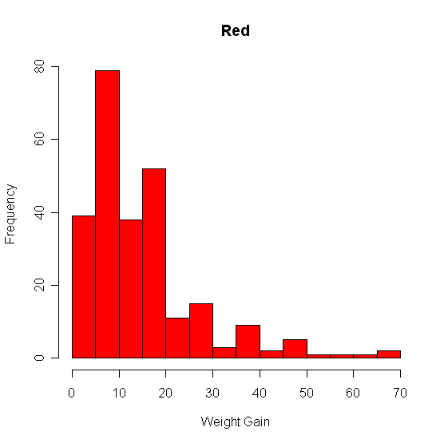
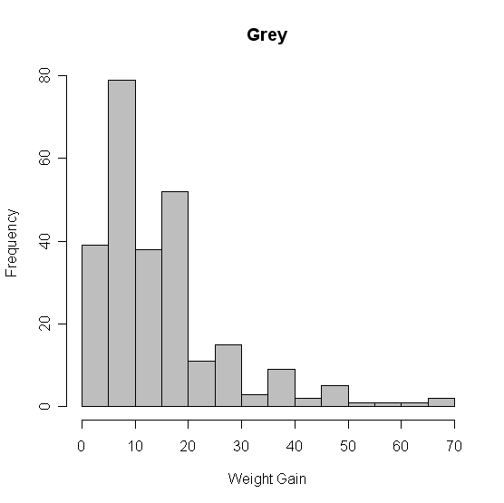
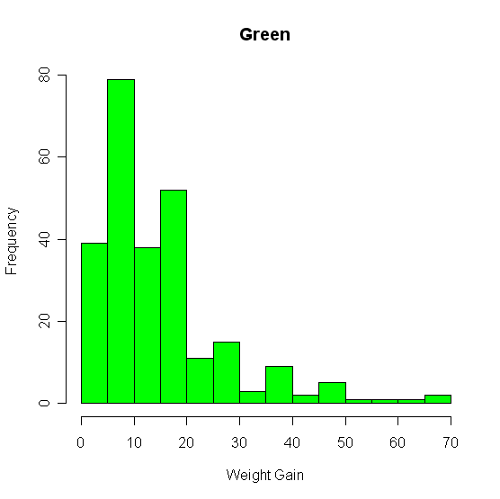
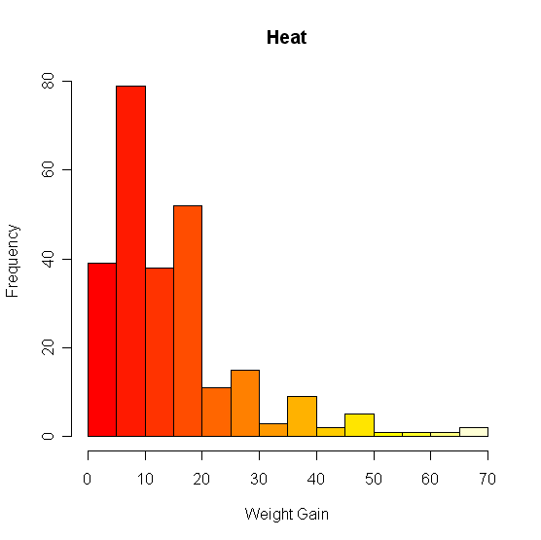
Basic Graphics – Colors

Slide 16
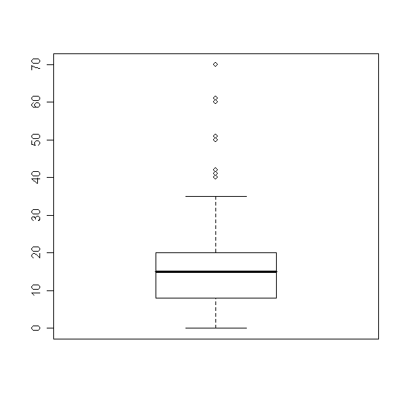
Basic Plots
Box Plots
boxplot(D$wg)

Slide 17
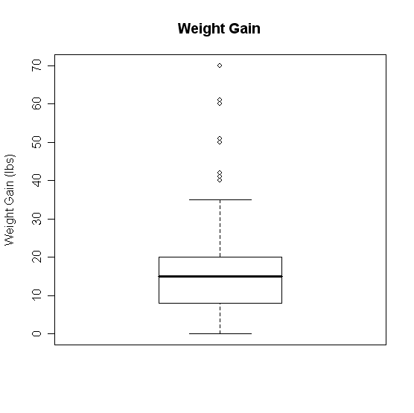
Boxplots
Change it!
boxplot(D$wg,main='Weight Gain',ylab='Weight Gain (lbs)')

Slide 18
Box-Plots - Groupings
What if we want several box plots side by side to be able to compare them.
First Subset the Data into separate variables.
  wg.m <- D[D$Gender=="M",]
  wg.f <- D[D$Gender=="F",]
Then Create the box plot.
  boxplot(wg.m$wg,wg.f$wg)

Slide 19
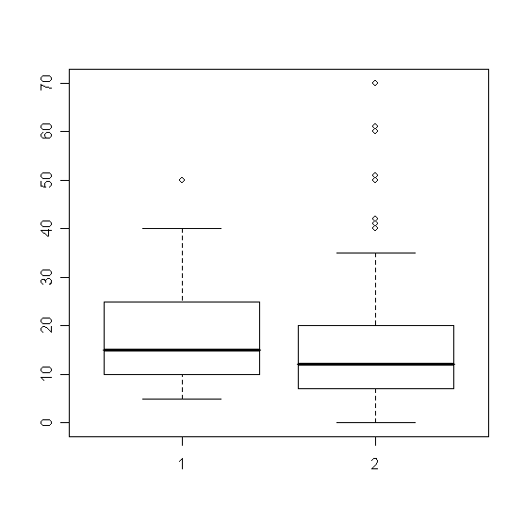
Boxplots – Groupings

Slide 20
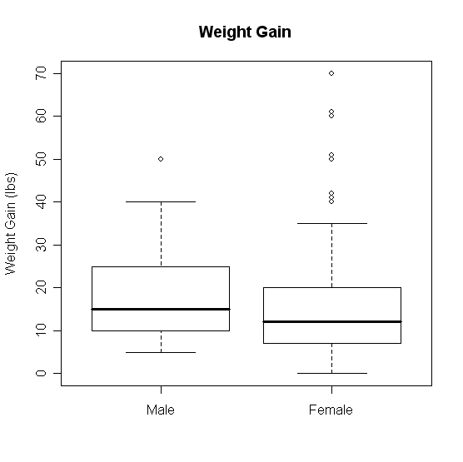
Boxplots - Groupings
boxplot(wg.m$wg, wg.f$wg, main='Weight Gain (lbs)', ylab='Weight Gain', names = c('Male','Female'))

Slide 21
Boxplot Groupings
Do it by shift
  wg.7a <- D[D$Shift=="7am",]
  wg.8a <- D[D$Shift=="8am",]
  wg.9a <- D[D$Shift=="9am",]
  wg.10a <- D[D$Shift=="10am",]
  wg.11a <- D[D$Shift=="11am",]
  wg.12p <- D[D$Shift=="12pm",]
  boxplot(wg.7a$wg, wg.8a$wg, wg.9a$wg, wg.10a$wg, wg.11a$wg, wg.12p$wg, main='Weight Gain', ylab='Weight Gain (lbs)', xlab='Shift', names = c('7am','8am','9am','10am','11am','12pm'))

Slide 22
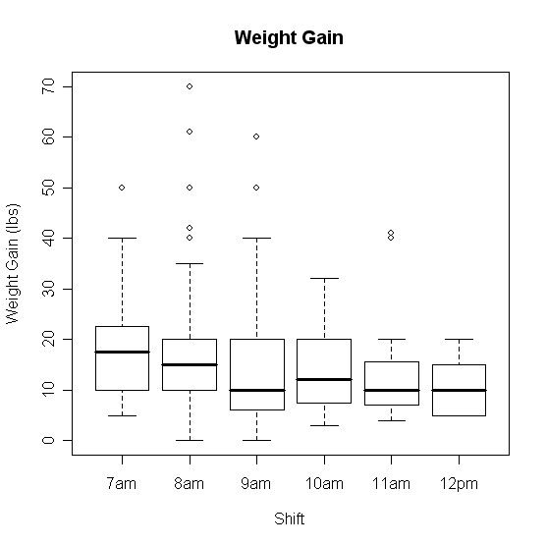
Boxplots Groupings

Slide 23
Scatter Plots
Suppose we have two variables and we wish to see the relationship between them.
A scatter plot works very well.
R code:
  plot(x,y)
Example
  plot(D$metmin,D$wg)

Slide 24
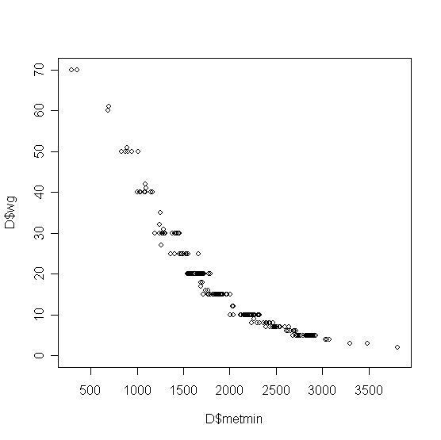
Scatterplots

Slide 25
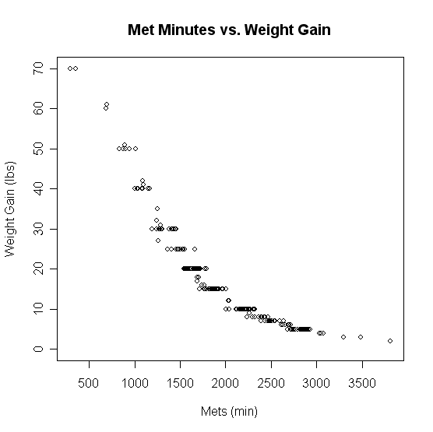
Scatterplots
plot(D$metmin,D$wg,main='Met Minutes vs. Weight Gain',
xlab='Mets (min)',ylab='Weight Gain (lbs)')

Slide 26
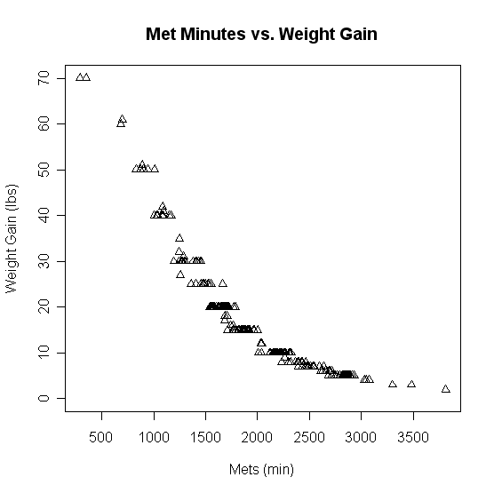
Scatterplots
plot(D$metmin,D$wg,main='Met Minutes vs. Weight Gain',
xlab='Mets (min)',ylab='Weight Gain (lbs)',pch=2)

Slide 27
Line Plots
Often data comes through time.
Consider Dell stock
  D2 <- read.csv("H:\\Dell.csv",header=TRUE)
  t1 <- 1:nrow(D2)
  plot(t1,D2$DELL)

Slide 28
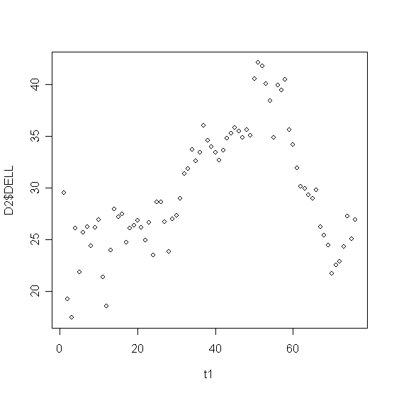
Line Plots

Slide 29
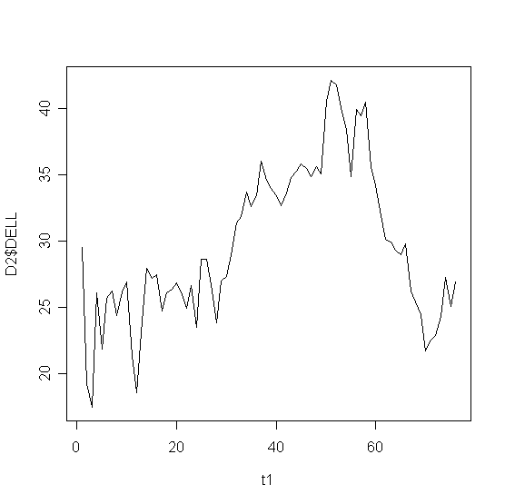
Line Plots
plot(t1,D2$DELL,type="l")

Slide 30
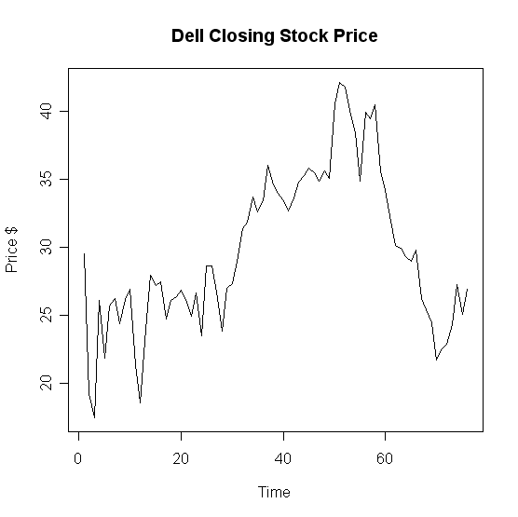
Line Plots
plot(t1,D2$DELL,type="l",main='Dell Closing Stock Price',
xlab='Time',ylab='Price $'))

Slide 31
Overlaying Plots
Often we have more than one variable measured against the same predictor (X).
  plot(t1,D2$DELL,type="l",main='Dell Closing Stock Price',xlab='Time',ylab='Price $'))
  lines(t1,D2$Intel)

Slide 32
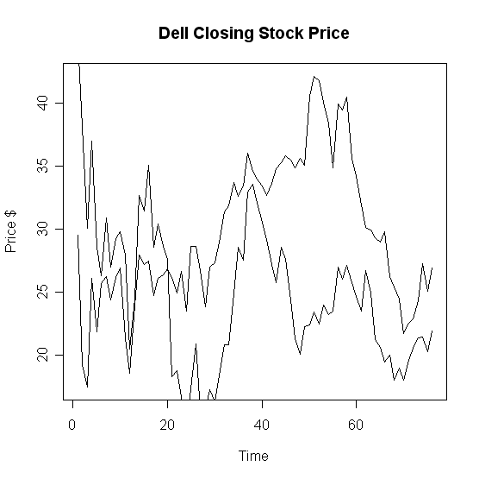
Overlaying Graphs

Slide 33
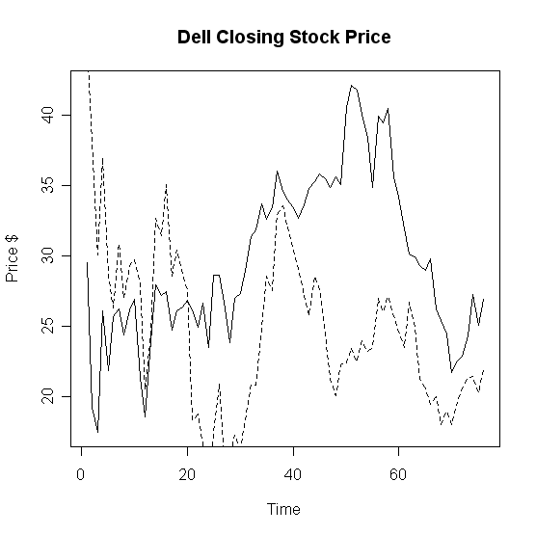
Overlaying Graphs
lines(t1,D2$Intel,lty=2)

Slide 34
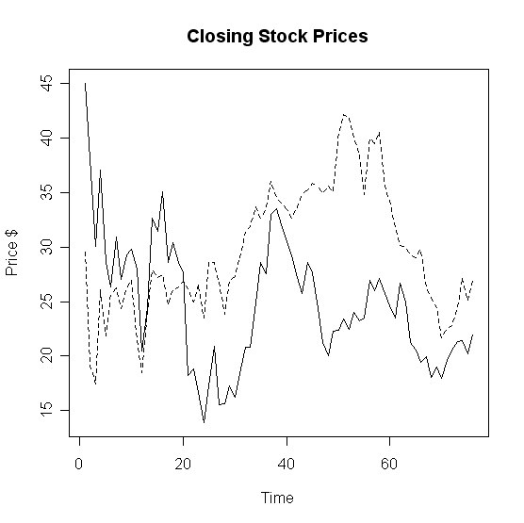
Overlaying Graphs

Slide 35
Adding a Legend
Adding a legend is a bit tricky in R.
Syntax
legend( x, y, names, line types)
X
coordinate
Y
coordinate
Names of series in column format
Corresponding line types

Slide 36
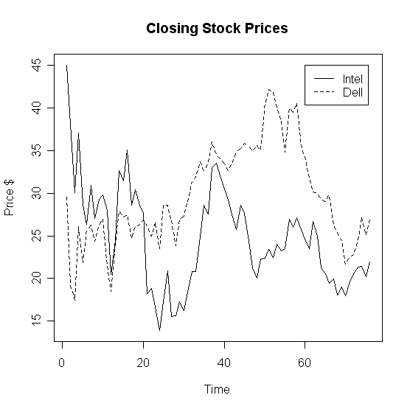
Adding a Legend
legend(60,45,c('Intel','Dell'),lty=c(1,2))

Slide 37
Paneling Graphics
Suppose we want more than one graphic on a panel.
We can partition the graphics panel to give us a framework in which to panel our plots.
par(mfrow = c( nrow, ncol))
Number of rows
Number of columns

Slide 38
Paneling Graphics
Consider the following
par(mfrow=c(2,2))
hist(D$wg, main='Histogram',xlab='Weight Gain', ylab ='Frequency', col=heat.colors(14))
boxplot(wg.7a$wg, wg.8a$wg, wg.9a$wg, wg.10a$wg, wg.11a$wg, wg.12p$wg, main='Weight Gain', ylab='Weight Gain (lbs)',
xlab='Shift', names = c('7am','8am','9am','10am','11am','12pm'))
plot(D$metmin,D$wg,main='Met Minutes vs. Weight Gain', xlab='Mets (min)',ylab='Weight Gain (lbs)',pch=2)
plot(t1,D2$Intel,type="l",main='Closing Stock Prices',xlab='Time',ylab='Price $')
lines(t1,D2$DELL,lty=2)

Slide 39
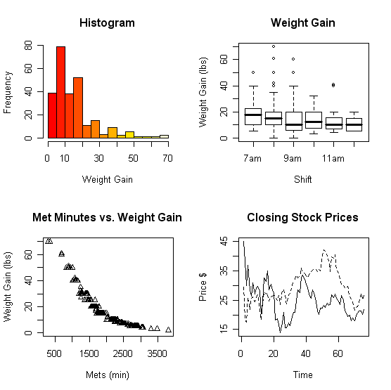
Paneling Graphics

Slide 40
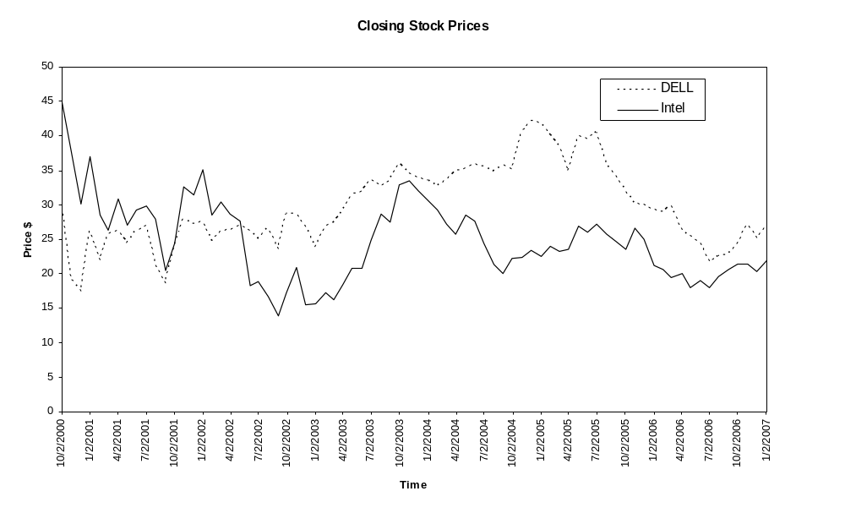
Quality - Excel

Slide 41
Quality - R

Slide 42
Summary
All of the R code and files can be found at:
http://www.cran.r-project.org/

