Slide 1
Functional Programming Fundamentals
Elements of Functional Programming
λ
Kaz Software Ltd.

Slide 2
”Life is too short for imperative programming”
John Hughes
Kaz Software Ltd.

Slide 3
Productivity
“
It’s really clear that the imperative style of programming has run its course. ... We’re sort of done with that. … However, in the declarative realm we can speculate a 10x improvement in productivity in certain domains.
”
Anders Hejlsberg C# Architect
(from his MIX07 keynote)
Kaz Software Ltd.

Slide 4
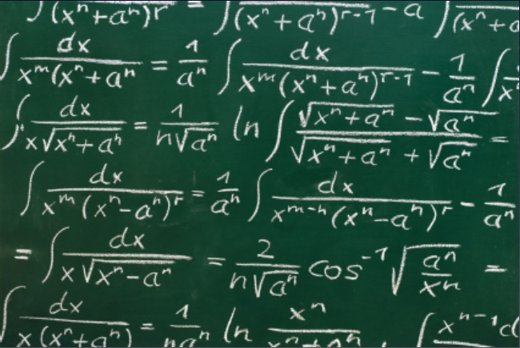
Origins
Kaz Software Ltd.

Slide 5
Origins
functional programming emerged slightly by accident from several sources
symbolic logic, specifically the λ-calculus (A.Church 1930s) and combinatory logic (H.Curry 1930s)
λop.λx.(op x x)
(λop.λx.(op x x)) (+) 21 = (λx.((+) x x)) 21 = (+) 21 21 = 42
the symbolic manipulation strand of Artificial Intelligence, or rather: LISP (J.McCarthy 1960)
pseudo-code for CS publications, ISWIM (P.Landin 1966)
support languages for logic and mathematics, e.g. LCF’s metalanguage ML (Milner et. al. 1970s)
OCaml – 1996
F# (and parts of C#) – 2002
Kaz Software Ltd.

Slide 6
λ-calculus Building Block
Anonymous functions Support
JavaScript
PHP 4.0.1 – PHP 5.2.x (kinda)
PHP 5.3 (more kinda)
C# 2.0
Java – Hardly any support. Anonymous Classes to use Closures. Java also supports another form of classes, which are called inner (or nested) classes. These are defined in the body of an enclosing class and have full access to each and every instance variable of the enclosing class, thus resembling standard function closures.
Kaz Software Ltd.

Slide 7
Fundamentals of FP Languages
The objective of the design of a FPL is to mimic mathematical functions to the greatest extent possible
The basic process of computation is fundamentally different in a FPL than in an imperative language
In an imperative language, operations are done and the results are stored in variables for later use
Management of variables is a constant concern and source of complexity for imperative programming
In an FPL, variables are not necessary, as is the case in mathematics
Kaz Software Ltd.

Slide 8
What is object-oriented programming?
Object-oriented programming is a style of
programming that enables you:
- Reuse code (via classes)
- Eliminate bugs (via encapsulating, data hiding)
Kaz Software Ltd.

Slide 9
What is functional programming?
Functional programming is a style of programming
that enables you:
- Re-use code (via function composition)
- Eliminate bugs (via immutability)
Kaz Software Ltd.

Slide 10
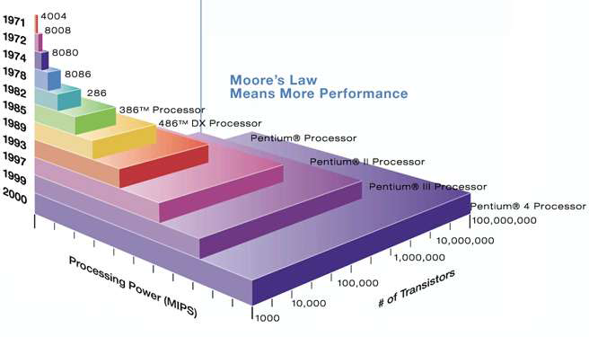
Moore’s Law Ran Out!
Kaz Software Ltd.

Slide 11
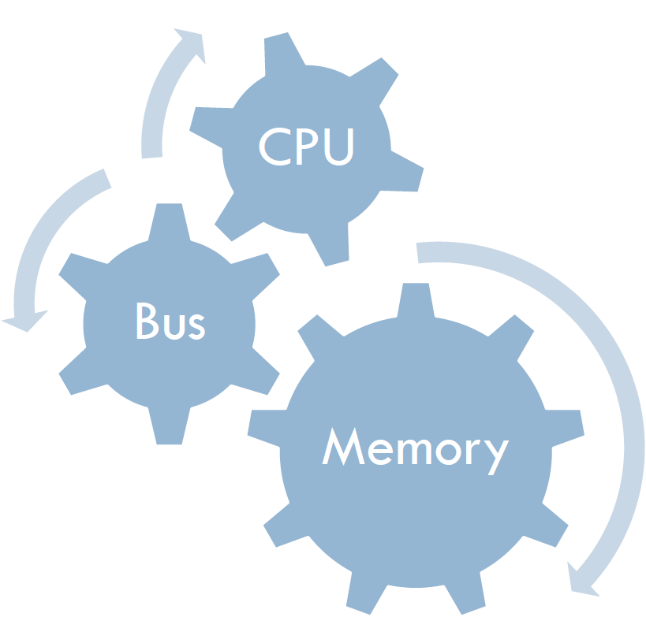
“Software gets slower faster than hardware gets faster”
--Wirth’s Law
Kaz Software Ltd.

Slide 12
Von Neumann syndrome
For most applications in massively parallel computing systems with thousands or tens of thousands of processors the performance can be less than hoped. Sometimes called a "supercomputing crisis" it is believed to be due to two factors. Firstly a hardware barrier in the efficiency in moving data, called the memory wall or von Neumann bottleneck (An inefficiency inherent in the design of any von Neumann machine [The von Neumann architecture is a design model for a stored-program digital computer that uses a central processing unit (CPU) and a single separate storage structure ("memory") to hold both instructions and data. It has a sequential architecture.] that arises from the fact that most computer time is spent in moving information between storage and the central processing unit rather than operating on it.
). Secondly a fall in programmer productivity when faced with systems that are massively parallel, the difficulties in developing for parallelism (or thread-level parallelism in multi-core CPUs) when previously this was not an issue.
Kaz Software Ltd.

Slide 13
Wikipedia!
In computer science, functional programming is a programming paradigm that treats computation as the evaluation of mathematical functions and avoids state and mutable data. It emphasizes the application of functions, in contrast to the imperative programming style, which emphasizes changes in state. Functional programming has its roots in the lambda calculus, a formal system developed in the 1930s to investigate function definition, function application, and recursion. Many functional programming languages can be viewed as elaborations on the lambda calculus.
In practice, the difference between a mathematical function and the notion of a "function" used in imperative programming is that imperative functions can have side effects, changing the value of already calculated computations. Because of this they lack referential transparency, i.e. the same language expression can result in different values at different times depending on the state of the executing program. Conversely, in functional code, the output value of a function depends only on the arguments that are input to the function, so calling a function f twice with the same value for an argument x will produce the same result f(x) both times. Eliminating side-effects can make it much easier to understand and predict the behavior of a program, which is one of the key motivations for the development of functional programming.

Slide 14
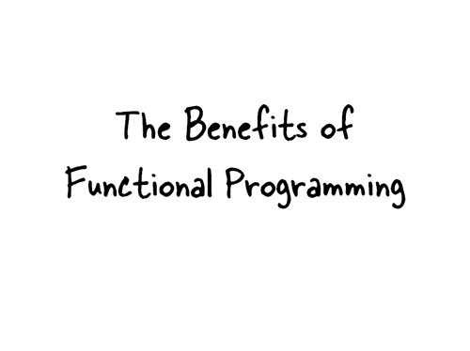
Kaz Software Ltd.

Slide 15
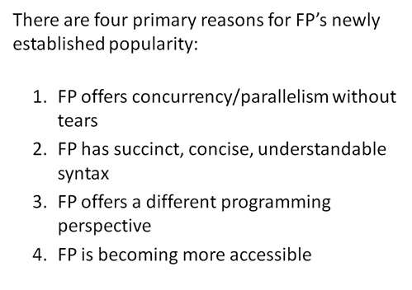
Kaz Software Ltd.

Slide 16
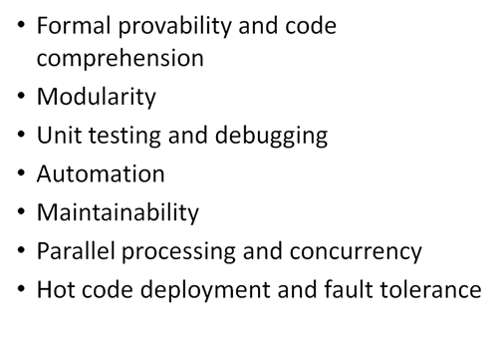
Kaz Software Ltd.

Slide 17
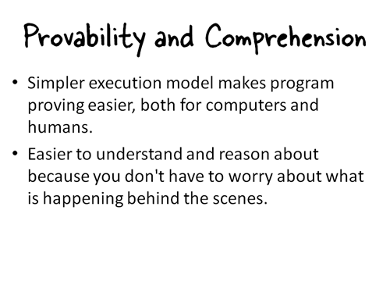
Kaz Software Ltd.

Slide 18
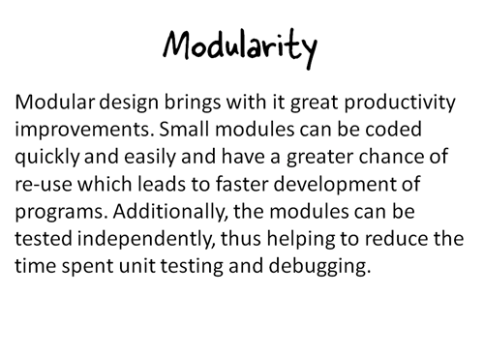
Kaz Software Ltd.

Slide 19
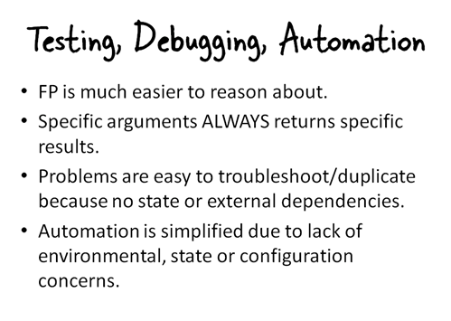
Kaz Software Ltd.

Slide 20
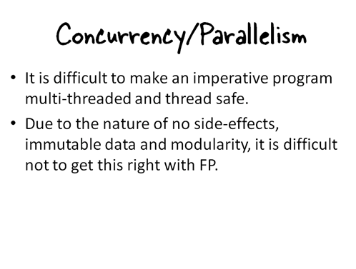
Kaz Software Ltd.

Slide 21
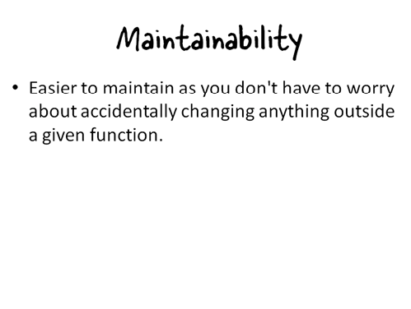
Kaz Software Ltd.

Slide 22
Functional Languages
Haskell
Clean
F#
ML / OCaml
Lisp / Scheme
Scala
Clojure
XSLT
Erlang
SQL
Mathematica
Kaz Software Ltd.

Slide 23
Pure Functional Languages
Haskell
Clean
F#
ML / OCaml
Lisp / Scheme
Scala
Clojure
XSLT
Erlang
SQL
Mathematica
Purely functional is a term in computing used to describe algorithms, data structures or
programming languages that exclude destructive modifications (updates). According to this
restriction, variables are used in a mathematical sense, with identifiers referring to immutable, persistent values.
Kaz Software Ltd.

Slide 24

Is it too hard?
Kaz Software Ltd.

Slide 25

The foundation
Kaz Software Ltd.

Slide 26
What is a function?
y = f(x)
Kaz Software Ltd.

Slide 27



FP Preachings!
Avoid Side-Effects!
Do not modify variables passed to them
Do not modify any global variable
Kaz Software Ltd.

Slide 28

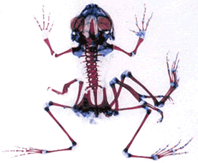
FP Preachings!
Avoid Mutation!
“Mutation Considered Harmful” ☺
Kaz Software Ltd.

Slide 29

FP Preachings!
Variables only assigned once
Same input -> Same output
Functions return values
Given a set of values in the parameter list, the function can only have one possible result.
No Shared State
Kaz Software Ltd.

Slide 30

FP Preachings!
Does order matter?
Order is a side effect as well..
Kaz Software Ltd.

Slide 31
Functional Programming
Focus on results not process
Emphasis is on what is to be computed not how it Happens
Data is immutable
Functions are data too
Decompose problem into ‘functions’
Kaz Software Ltd.

Slide 32
Data is immutable x = x + 1;
Why should a function in C never return a pointer?
Why should you make a copy of an internal array before returning it from your class?
Why is multi-threading so damn hard?
Kaz Software Ltd.

Slide 33
Why bother?
Pure functions can be executed in parallel without interfering with one another
Pure functions can be “perfectly” cached
Pure functions can be “partially” applied
Functions can receive and return functions, for which all of the above hold true
Allows for greater “modularity” and “composability”
Kaz Software Ltd.

Slide 34
Code!
//F#
open System
let a = 2
Console.WriteLine a
//C#
using System;
namespace ConsoleApplication1
{
class Program
{
static int a()
{
return 2;
}
static void Main(string[] args)
{
Console.WriteLine(a);
}
}
}
Kaz Software Ltd.

Slide 35
More Code!
//F#
open System
let a = 2
Console.WriteLine a
//C#
using System;
namespace ConsoleApplication1
{
class Program
{
static nt a()
{
return 2;
}
static void Main(string[] args)
{
Console.WriteLine(a);
}
}
}
More Noise
Than Signal!
Kaz Software Ltd.

Slide 36
Refactoring “hole in the middle”
Header() { ■ ■ ■ }
Footer() { ■ ■ ■ }
Red() { ■ ■ ■ }
Blue() { ■ ■ ■ }
Foo()
{
Header();
Red();
Footer();
}
Bar()
{
Header();
Blue();
Footer();
}
Factor out the differences and the similarities?!
Kaz Software Ltd.

Slide 37
Refactoring “hole in the middle”
Red() { ■ ■ ■ }
Blue() { ■ ■ ■ }
FooBar(func)
{
■ ■ ■
func();
■ ■ ■
}
The “FP Way” is to simply pass in an implementation of the “hole” to be filled:
FooBar( {■ ■ ■});
Kaz Software Ltd.

Slide 38
Example: Sorting by multiple keys
class GasResult { public GasResult(…) { … } public readonly string Name; public readonly double Price; public readonly double Distance; }
Problem: You want to sort lists of GasResults by various keys.
Kaz Software Ltd.

Slide 39
OO Approach: Many IComparers
class GasResult {
… public class GasPriceComparer : IComparer<GasResult> { public int Compare(GasResult a, GasResult b) { return a.Price.CompareTo(b.Price); } } public static GasPriceComparer GasPriceComparison = new GasPriceComparer(); }
Array.Sort<GasResult>(results, GasResult.GasPriceComparison);
Kaz Software Ltd.
Notes:
IComparer is a heavy-weight function pointer to Compare()

Slide 40
OO Approach: Many IComparers
class GasResult {
… public class GasNameComparer : IComparer<GasResult> { public int Compare(GasResult a, GasResult b) { return a.Name.CompareTo(b.Name); } } public static GasNameComparer GasNameComparison = new GasNameComparer(); }
Array.Sort<GasResult>(results,
GasResult.GasNameComparison);
Kaz Software Ltd.

Slide 41
OO Approach: Many IComparers
class GasResult {
… public class GasDistanceComparer : IComparer<GasResult> { public int Compare(GasResult a, GasResult b) { return a.Distance.CompareTo(b.Distance); } } public static GasDistanceComparer GasDistanceComparison = new GasDistanceComparer(); }
Array.Sort<GasResult>(results, GasResult.GasDistanceComparison);
Kaz Software Ltd.

Slide 42
FP Approach: Passed in lambdas
class GasResult {
… }
results.OrderBy<GasResult, double>(r => r.Price); results.OrderBy<GasResult, string>(r => r.Name); results.OrderBy<GasResult, double>(r => r.Distance);
(extension) IOrderedSequence<TSource> IEnumerable<TSource>.OrderBy<TSource, TKey>
(Func<TSource, Tkey> keySelector)
Kaz Software Ltd.
Notes:
Could instead have an Order() method taking a Func<T, U, int>; essentially passing in Compare()
Instead, here we’re passing in a selector and expecting the individual keys to be IComparable

Slide 43
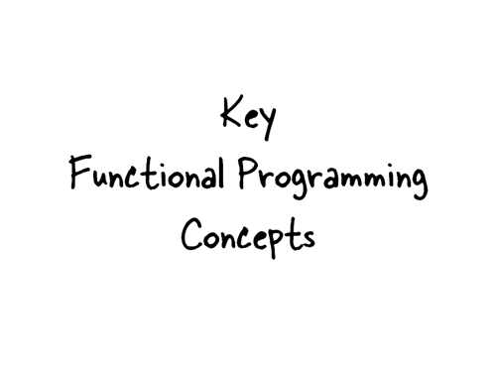
Kaz Software Ltd.

Slide 44
First-class function
In computer science, a programming language is said to support first-class functions if it treats functions as first-class objects. Specifically, this means that the language supports constructing new functions during the execution of a program, storing them in data structures, passing them as arguments to other functions, and returning them as the values of other functions.
Kaz Software Ltd.

Slide 45
Closure (computer science)
In computer science, a closure is a first-class function with free variables that are bound in the lexical environment. Such a function is said to be "closed over" its free variables. A closure is defined within the scope of its free variables, and the extent of those variables is at least as long as the lifetime of the closure itself..
Kaz Software Ltd.

Slide 46
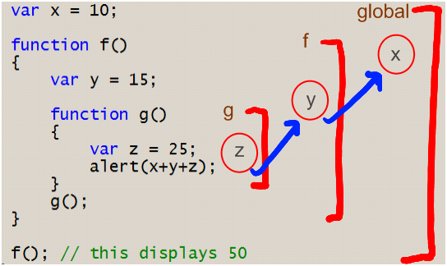
Closures
Kaz Software Ltd.

Slide 47
Closure example
Here is an example rewritten in ECMAScript (JavaScript) :
// Return a list of all books with at least 'threshold' copies sold. function bestSellingBooks(threshold) {
return bookList.filter( function (book) {
return book.sales >= threshold;
} );
}
A function may create a closure and return it, as in the following example:
// Return a function that approximates the derivative of f // using an interval of dx, which should be appropriately small. function derivative(f, dx) {
return function (x) {
return (f(x + dx) - f(x)) / dx;
};
}
Because the closure in this case outlives the scope of the function that creates it, the variables f and dx live on after the function derivative returns. In languages without closures, the lifetime of a local variable coincides with the execution of the scope where that variable is declared. In languages with closures, variables must continue to exist as long as any existing closures have references to them. This is most commonly implemented using some form of garbage collection.
Kaz Software Ltd.

Slide 48
Generators
/* Method that takes an iterable input (possibly an array) and returns all even numbers. */ public static IEnumerable<int> GetEven(IEnumerable<int> numbers) { foreach (int i in numbers) { if ((i % 2) == 0) { yield return i; } } }
You may even use multiple yield return statements and the compiler will return them in order on each iteration:
public class CityCollection : IEnumerable<string> {
public IEnumerator<string> GetEnumerator() {
yield return "New York";
yield return "Paris";
yield return "London";
}
}
Kaz Software Ltd.

Slide 49
Higher order functions
Higher-order functions are closely related to first-class functions, in that higher-order functions and first-class functions both allow functions as arguments and results of other functions. The distinction between the two is subtle: "higher-order" describes a mathematical concept of functions that operate on other functions, while "first-class" is a computer science term that describes programming language entities that have no restriction on their use (thus first-class functions can appear anywhere in the program that other first-class entities like numbers can, including as arguments to other functions and as their return values).
Kaz Software Ltd.

Slide 50
Higher order function example
//f is a function function derivative(f) { return function(x) { //approximation of derivative return (f(x + 0.00001) f(x)) / 0.00001; } }
Kaz Software Ltd.

Slide 51
Higher order function example
//evaluate derivative of x2: var deriv_x_squared = derivative( function(x) { return x*x; } ); alert(deriv_x_squared(3)); //alerts 6ish
Kaz Software Ltd.

Slide 52
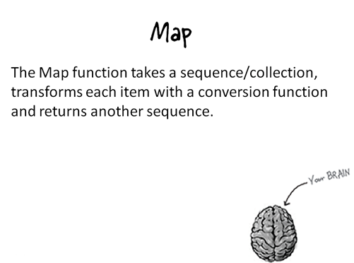
Kaz Software Ltd.

Slide 53
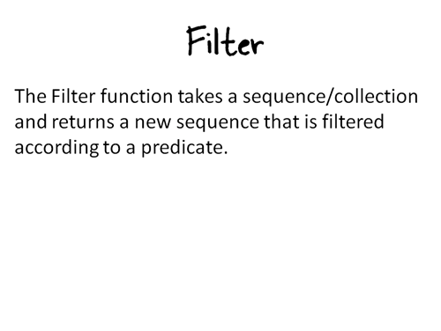
Kaz Software Ltd.

Slide 54
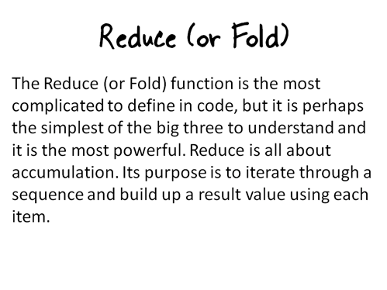
Kaz Software Ltd.

Slide 55
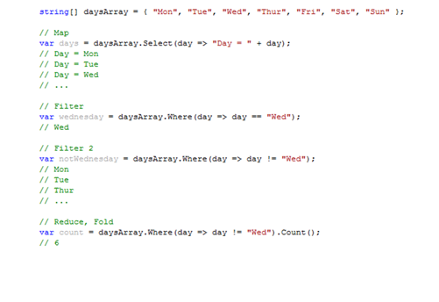
Kaz Software Ltd.

Slide 56
Map/Reduce/Filter
double CheapGasNearby(IEnumerable<GasResult> results) { double min = double.MaxValue; foreach (GasResult r in results) { if (r.Distance < 5.0) { double price = r.Price; if (r.Name == "Safeway") price *= 0.9; if (price < min) min = price; }
} return min; }
Kaz Software Ltd.
Notes:
Ahhhh! Mutation and mixing of intent all over the place!

Slide 57
Map/Reduce/Filter
double CheapGasNearby(IEnumerable<GasResult> results) { double min = double.MaxValue; foreach (GasResult r in results) { if (r.Distance < 5.0) { double price = r.Price; if (r.Name == "Safeway") price *= 0.9; if (price < min) min = price; }
} return min; }
Kaz Software Ltd.

Slide 58
Map/Reduce/Filter
double CheapGasNearby(IEnumerable<GasResult> results) { double min = double.MaxValue; foreach (GasResult r in results) { if (r.Distance < 5.0) { double price = r.Price; if (r.Name == "Safeway") price *= 0.9; if (price < min) min = price; }
} return min; }
Kaz Software Ltd.

Slide 59
Map/Reduce/Filter
double CheapGasNearby(IEnumerable<GasResult> results) { double min = double.MaxValue; foreach (GasResult r in results) { if (r.Distance < 5.0) { double price = r.Price; if (r.Name == "Safeway") price *= 0.9; if (price < min) min = price; }
} return min; }
Kaz Software Ltd.

Slide 60
Map/Reduce/Filter
double CheapGasNearby(IEnumerable<GasResult> results) { results .Where(r => r.Distance < 5.0) .Select(r => r.Price * (r.Name == "Safeway" ? 0.9 : 1.0)) .Aggregate(double.MaxValue, (m, p) => p < m ? p : m)); }
.Where<GasResult>(Func<GasResult, bool> predicate) .Select<GasResult, double>(Func<GasResult, double> mapping) .Aggregate<double, double>(double seed, Func<double, double, double> func)
Kaz Software Ltd.
Notes:
Separation of concerns.
No assignment.
Solution assembled from already well-tested compositional units.

Slide 61
Map/Reduce/Filter
double CheapGasNearby(IEnumerable<GasResult> results) { results .Where(r => r.Distance < 5.0) .Select(r => r.Price * (r.Name == "Safeway" ? 0.9 : 1.0)) .Min(); }
.Where<GasResult>(Func<GasResult, bool> predicate) .Select<GasResult, double>(Func<GasResult, double> mapping) .Aggregate<double, double>(double seed, Func<double, double, double> func)
Kaz Software Ltd.
Notes:
Min() is really a specialization of filter

Slide 62
Map/Reduce/Filter
double CheapGasNearby(IEnumerable<GasResult> results) { (from r in results where r.Distance < 5.0 select r.Price * (r.Name == "Safeway" ? 0.9 : 1.0) ).Min() }
.Where<GasResult>(Func<GasResult, bool> predicate) .Select<GasResult, double>(Func<GasResult, double> mapping) .Aggregate<double, double>(double seed, Func<double, double, double> func)
Kaz Software Ltd.
Notes:
Using LINQ syntax is nice, but not necessary.
Note: LINQ is for querying collections (or anything IEnumerable / IQueryable) not necessarily anything to do with SQL.

Slide 63
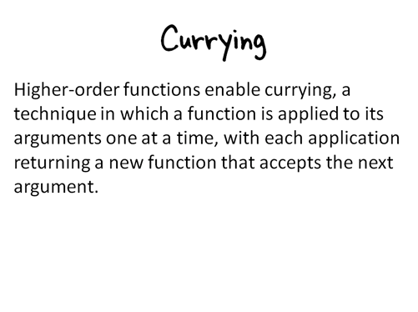
Kaz Software Ltd.

Slide 64
Summary
Pure functions
Working without assignment
Recursion rather than for/while/etc.
Higher-order functions
Power! Brevity! Beautiful!
Hole in the middle
Compositional
Becoming mainstream
Driven by concurrency
More productivity regardless
Kaz Software Ltd.

Slide 65
Quiz
Is ”2+2” equal to ”4”?
Kaz Software Ltd.

Slide 66
Reference
F# http://research.microsoft.com/fsharp
Can Your Programming Language Do This? http://www.joelonsoftware.com/items/2006/08/01.html
Why Functional Programming Matters http://www.math.chalmers.se/~rjmh/Papers/whyfp.pdf
John Backus’ 1977 Turing Award Lecture: “Can Programming be Liberated from the von Neumann Style?”
System.Concurrency Library http://msdn.microsoft.com/msdnmag/issues/07/10/Futures/default.aspx
Google MapReduce http://labs.google.com/papers/mapreduce.html
Kaz Software Ltd.

Slide 67
End of the Talk
Thank You!
Questions?
Kaz Software Ltd.

