Slide 1

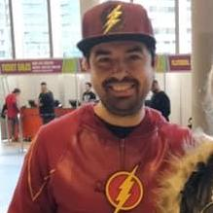
STEFANO'S PORTFOLIO

Slide 2
Structure of the website
There are five pages:
  Homepage
  About
  Projects
  Blog
  Contact

Slide 3
WHAT IS IN AND HOW I'VE BUILT IT
Images
A Resume
The option to write me an email
GitHub and Linkedin links
Built with HTML, CSS and JavaScript

Slide 4
CHALLENGES AND FAVOURITE
Challenges:
  CSS in general (I really don't like it :) )
  Some cases of flexbox directions
  I could not add any executable files to launch my projects directly from the website, thus they need to be downloaded locally
  Responsive layout for small screen and mobile
Favourite parts:
  Menu
  Address view and email form in contact
  The pop down feature by interacting with the picture in about me

Slide 5
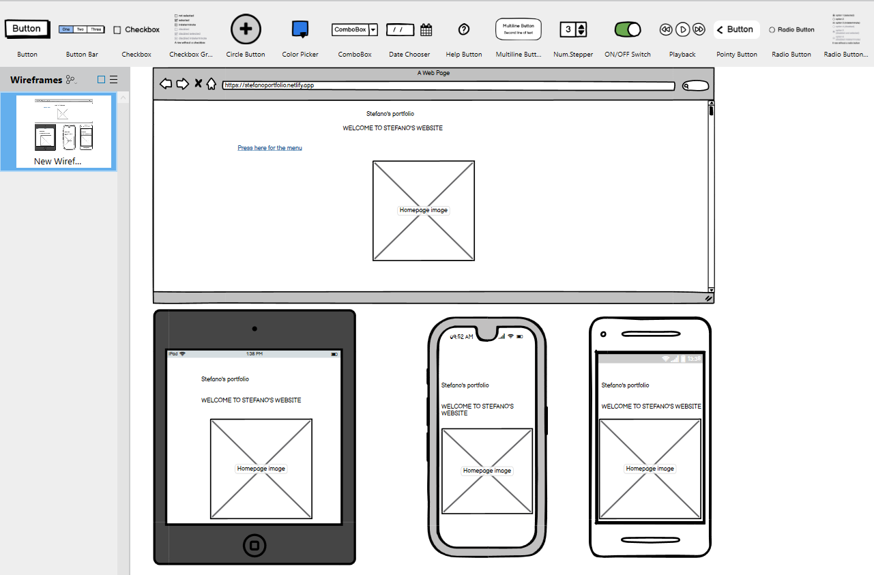
Wireframe

Slide 6
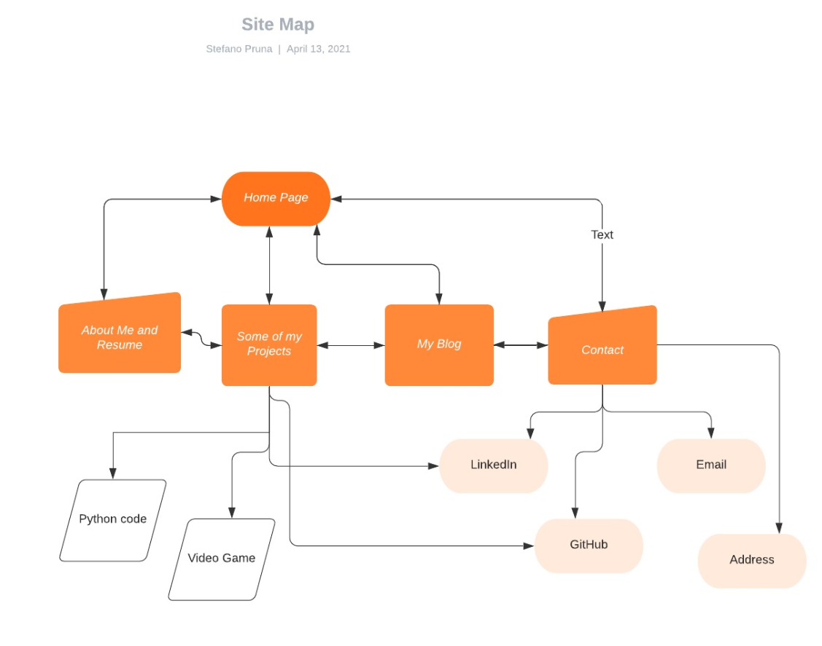
SITEMAP

