Slide 1
OS161 SHELL Project
Implement system calls (for file and process management) and exception handling
Bongo Federica 292395
Rizzello Stefano 288013

Slide 2
Project Goals
The purpose of this project is to support running multiple processes at once from actual compiled programs stored on disk.
The system calls implemented for process and file management are:
File System Calls
Process System Calls
Open()
Read()
Write()
Close()
Exit()
Fork()
Execv()
Getpid()
Waitpid()

Slide 3
Preliminary Operations

Slide 4
Preliminary Operations
To implement system calls, changes were made within the file systems.
In proc.h, the File Table and Process Table were managed and the structure of the processes was defined by adding their IDs. As far as the synchronisation of threads is concerned, a lock and a flag for their exit were added. In addition, the variable myCV was added for communication between the Parent process and the Child process.
In synch.c the Lock has been modified to synchronise threads concerning system calls, and cv for the waitpid system call.

Slide 5
Writing a new system call

Slide 6
Writing a new system call
In kern/arch/mips/syscall/syscall.c there is switch case in which you can menage the system calls
To menage a system call it's necessary an integer code. See:
kern/include/kern/syscall.h
Create your system call in kern/syscall/my_syscalls.c
Modify kern/include/syscall.h adding a prototype of the syscall function
Modify kern/conf/conf.kern inserting the new file (#System call layer):
file syscall/my_syscalls.c
Finally do the make of the kernel
In kern/conf
./config DUMBVM
In kern/compile/DUMBVM
bmake depend
bmake
bmake install

Slide 7
File System Calls
Open()
Read()
Write()
Close()

Slide 8
Open
int sys_open
(const char *filename, int flag, int *retfd)
Description:
open opens the file, device, or other kernel object named by the pathname filename. The flags argument specifies how to open the file.
Return Values:
On success, open returns 0 while the variable “retval” is the file descriptor of the opened object. On error, returns the error of the function that had the error at that moment.

Slide 9
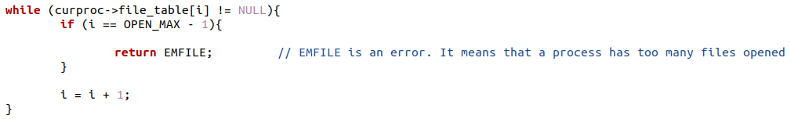
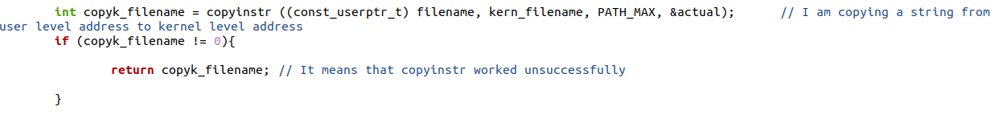
Open
1. Cycle through the File Table until it finds an empty entry.
2. Convert the filename string from user level to kernel level.
3. A space in memory is allocated in the System File Table. This location is pointed by the File Table.

Slide 10
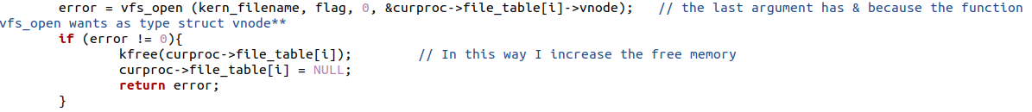
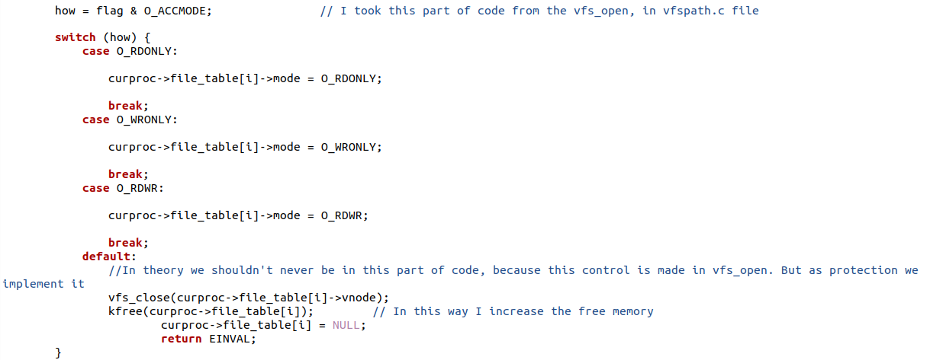
Open
4. The file is opened using the function vfs_open().
5. In the corresponding row of the System File Table it is saved the mode in which the file is opened (such as Write Only, Read Only, Read and Write).

Slide 11
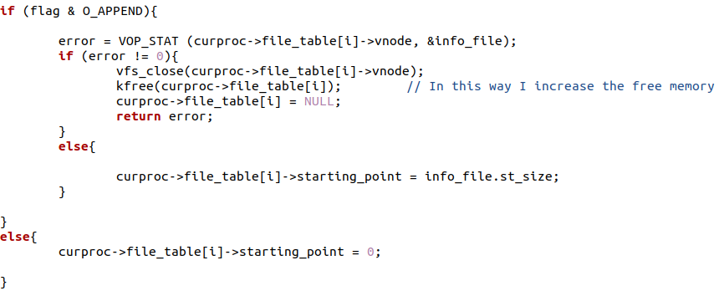
Open
6. If the flag passed as argument is about an operation of append, in the corresponding row of the System File Table it is saved the position of the first free space at the end of the file, otherwise it will be saved a position equal to 0.

Slide 12
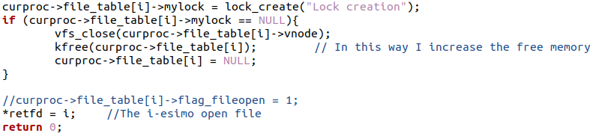
Open
7. A lock is created, and the returned value is set to the index of the File Table position that was found at the beginning, which is the file descriptor.

Slide 13
Read
int sys_read
(int fd, userptr_t buf, size_t size, int *retval)
Description:
read reads up to size bytes from the file specified by fd and stores them in the space pointed by buf. The file must be open for reading.
Return Values:
On success, open returns 0 while the variable “retval” is the number of bytes read. On error, returns the error of the function that had the error at that moment.

Slide 14
Read
1. Three preliminary checks are performed: File Descriptor must not be a negative value; the flag associated with the file must not be equal to O_WRONLY; the corresponding row of the File Table must point to an existing region of memory.
2. A lock is acquired and this makes sure that the reading operation is performed by only one thread.

Slide 15
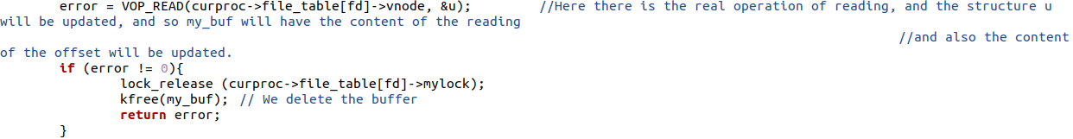
Read
3. The actual reading is performed by the function VOP_READ(), and the message read is therefore stored.
4. The amount of message read is computed and this is the return value. It is saved in the corresponding row of the System File Table the first free space at the end of the file.

Slide 16
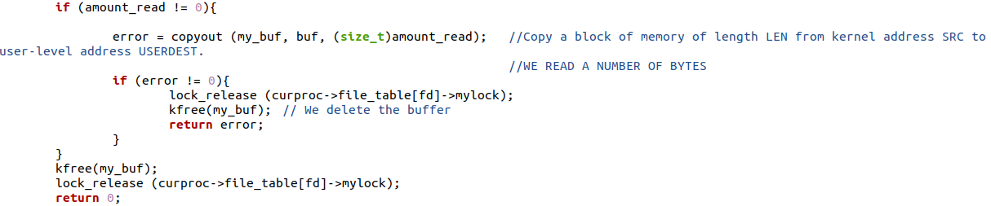
Read
5. The message read is copied from kernel address to user-level address and the lock is released.

Slide 17
Write
int sys_write
(int fd, const userptr_t buf, size_t size, int *retval)
Description:
write writes up to size bytes to the file specified by fd taking the data from the space pointed by buf.
Return Values:
On success, open returns 0 while the variable “retval” is the number of bytes written. On error, returns the error of the function that had the error at that moment.

Slide 18
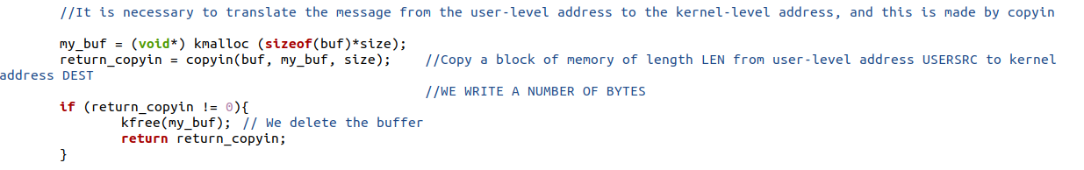
Write
1. Three preliminary checks are performed: File Descriptor must not be a negative value; the flag associated with the file must not be equal to O_RDONLY; the corresponding row of the File Table must point to an existing region of memory.
2. The message passed as argument is copied from user-level address to kernel address.

Slide 19
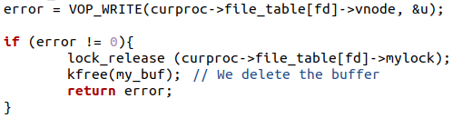
Write
3. A lock is acquired and this makes sure that the writing operation is performed by only one thread.
4. The actual writing is performed by the function VOP_WRITE().

Slide 20

Write
5. The amount of message written is computed and this is the return value. It is saved in the corresponding row of the System File Table the first free space at the end of the file.
6. The lock is released.

Slide 21
Close
int sys_close (int fd)
Description:
close closes the file handle passed with fd.
Return Values:
On success, close returns 0.

Slide 22


Close
1. Two preliminary checks are performed: File Descriptor must not be a negative value; the corresponding row of the File Table must point to an existing region of memory.
2. A lock is acquired, then the function VFS_CLOSE() is performed, then the lock is released and destroyed.

Slide 23

Close
3. The corresponding row to the file descriptor of the File Table is reset, and the corresponding space into the System File Table is erased.

Slide 24
Process System Calls
Exit()
Fork()
Execv()
Getpid()
Waitpid()

Slide 25
Exit
int sys_exit(int exitcode)
Description:
Cause the current process to exit.
Return Values:
exit does not return.

Slide 26
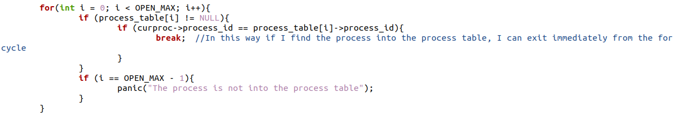
Exit
1. A first check is made to verify that the current process, to which the exit is called, is already present into the process table. Otherwise, an error is generated.
2. A flag called “flag_exited” into the process is set equal to 1 to show to other processes that is terminated.

Slide 27
Exit
3. The number, that is put into the exit by the user, is converted in an exit code on 16 bits. This exit code is saved into the process.
4. Before the process actually ends, its parent process must be waked up from its waiting state.
5. The process ends with the use of the function thread_exit().

Slide 28
Fork
int sys_fork
(struct trapframe *tf_parent, pid_t *child_pid)
Description:
fork duplicates the currently running process. The two copies are identical, except that one (the "new" one, or "child"), has a new, unique process id, and in the other (the "parent") the process id is unchanged.
Return Values:
On success, fork returns twice, once in the parent process and once in the child process. In the child process, 0 is returned. In the parent process, the process id of the new child process is returned. On error, returns the error of the function that had the error at that moment.

Slide 29

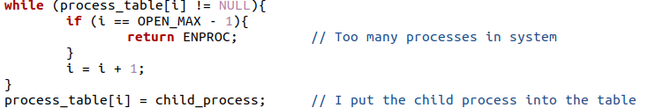
Fork
1. Create a new process that is the child process.
2. Connect the child process to the first free position of the Process Table.

Slide 30

Fork
3. Give the child process a new ID, that will be the return value of the system call for the parent process. Moreover it is updated its parent ID to that of the current process.
4. Copy into each row of the File Table of the child process the content of the corresponding row of the parent process.

Slide 31

Fork
5. Copy into the address space of the child process the content of the address space of the parent process.
6. Copy into the registers of the trapframe of the child process the content of the corresponding registers of the trapframe of the parent process.

Slide 32
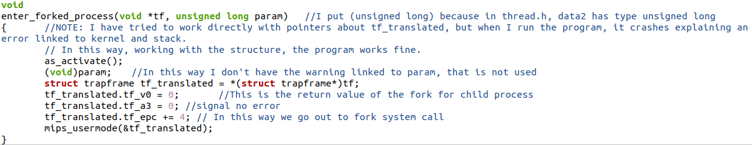
Fork
7. Set appropriately the main registers of the child process trapframe and assign it a new thread, consisting of a copy of the parent thread.
enter_forked_process():

Slide 33
Execv
int sys_execv
(const char* program, char**args)
Description:
execv replaces the currently executing program with a newly loaded program image.
Return Values:
On success, execv does not return; instead, the new program begins executing. On failure, execv returns the error of the function that had the error at that moment.

Slide 34

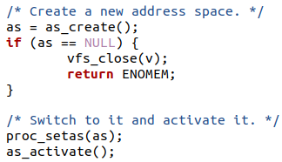
Execv
1. Open the executable file.
2. Create a new address space, and therefore switching to it and activating it.

Slide 35
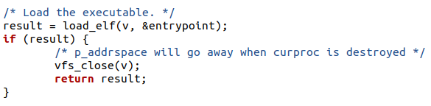

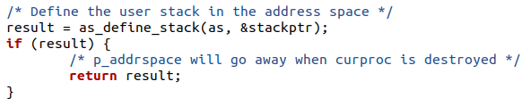
Execv
3. Load the executable file.
4. Close the executable file.
5. Define the user stack in the address space.

Slide 36
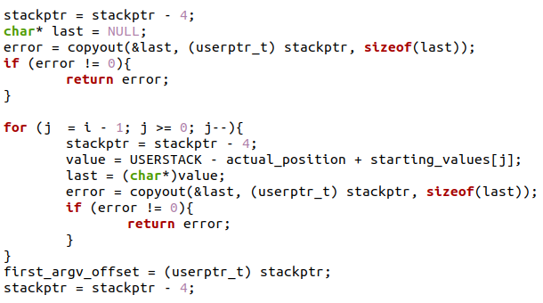
Execv
6. Copy the arguments into the user stack.
7. Perform the necessary initialization of the trapframe, paying attention to initialize correctly the stack pointer.

Slide 37
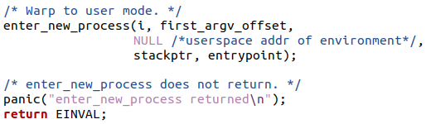
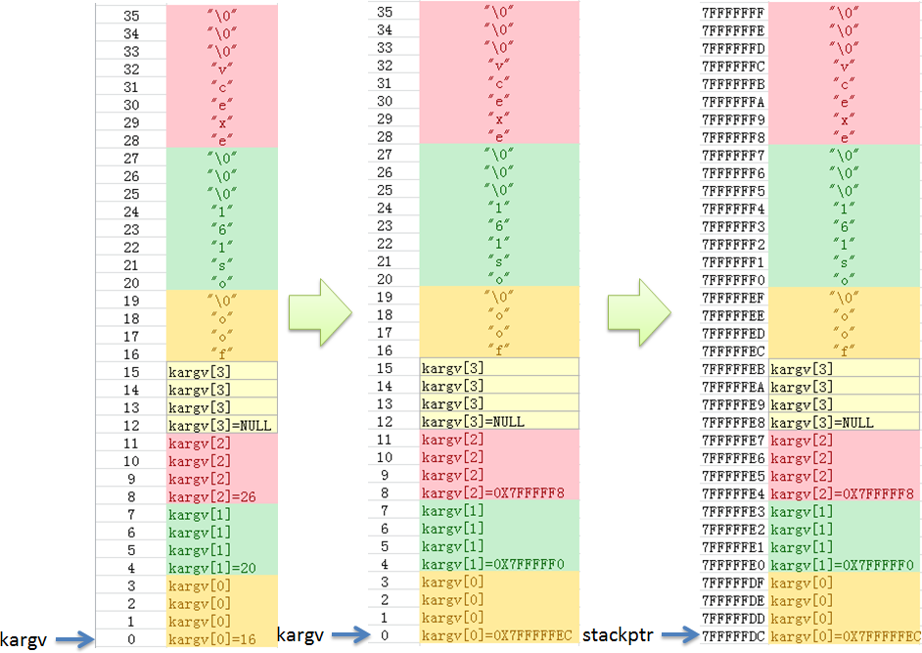
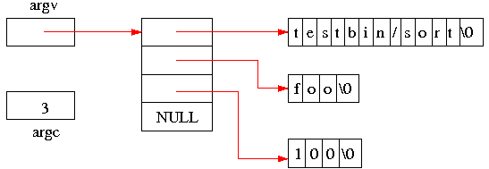
Execv
8. Enter user mode
Example: arguments that are
copied from kernel buffer to
stack user
If the tail program is invoked from the kernel
command line like this:
OS/161 kernel [? for menu]: p testbin/sort foo 100
Then the argv and argc variables should be
set up as illustrated in the following illustration:

Slide 38
Getpid
int sys_getpid (pid_t *retval)
Description:
getpid returns the process id of the current process.
Errors:
getpid does not fail.

Slide 39
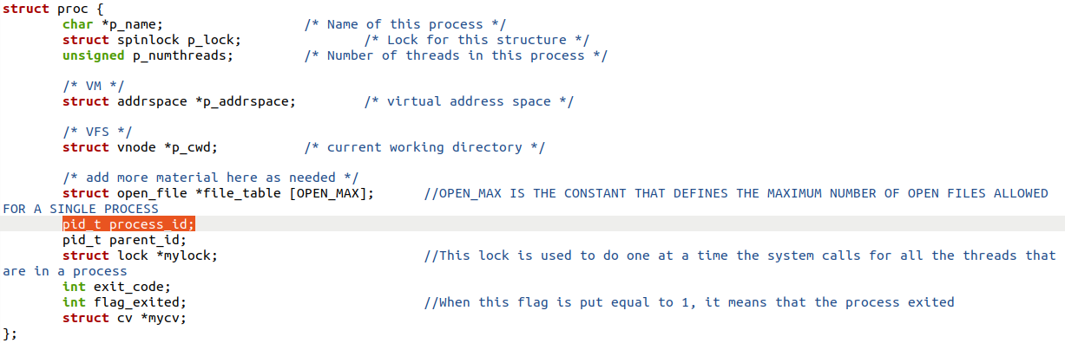
Getpid
Returns the process id of the current process
process_id is a variable added in the proc struct:

Slide 40
Waitpid
int sys_waitpid
(pid_t waiting_for_pid, int *status, int options, pid_t *retval)
Description:
wait for a process, specified by its id, to end.
Return Values:
waitpid returns the pid value of the child process.

Slide 41
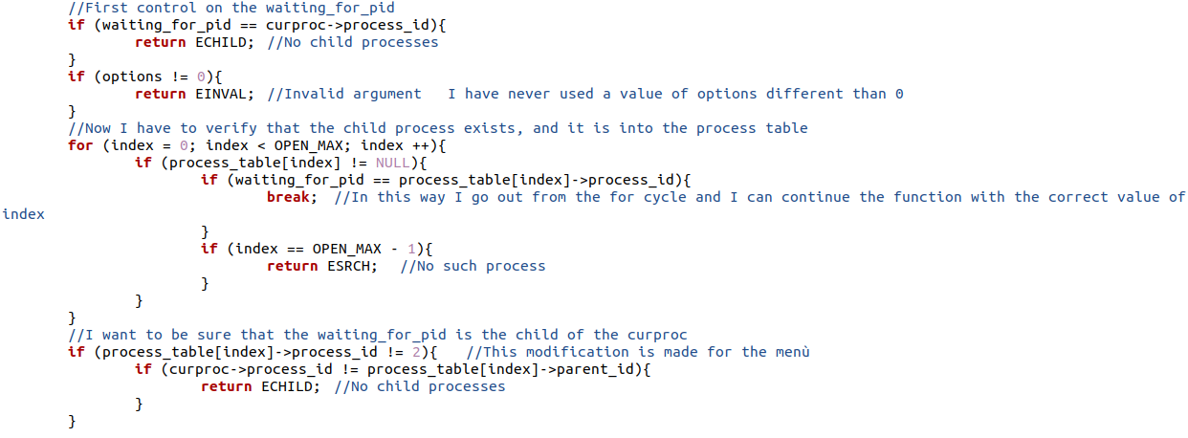
Waitpid
1. It is necessary to understand if the PID passed as argument refers to a really existing process. Therefore that PID has been searched in all the processes belonging to the process table. If successful, the position of the process within the process table is obtained, otherwise an error is generated.

Slide 42
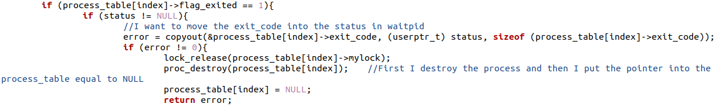
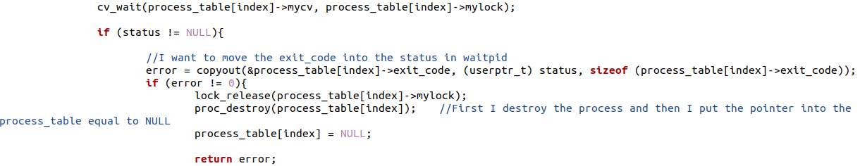
Waitpid
2. If flag_exited of this process has already a value equal to 1, its exit code is moved into the status; Otherwise, the parent process enters in a sleep state, and it will be awakened by the child process before it ends. At this point its exit code is moved into the status.

Slide 43
Waitpid
3. The return value of this system call will be equal to the ID of the child process, and finally the child process will be destroyed and the pointer into the process table will be equal to NULL. In this way the process table can host a new process.

Slide 44
Results
In the following slides will be shown the test of each system call and the corresponding results.

Slide 45
The Open and Close system calls are tested in the Write test and Read test.
The Exit, Fork and Getpid system calls are tested in the Waitpid test.

Slide 46
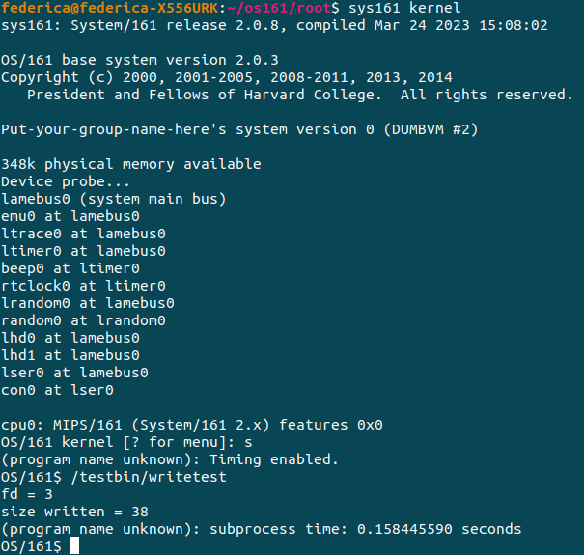
Write Test
#include <unistd.h>
#include <string.h>
#include <stdlib.h>
#include <stdio.h>
#include <err.h>
int main(){
//WRITING INTO A FILE
int fd;
int sz;
char message [60];
int len;
fd = open ("/bin/myfilew.txt", O_WRONLY | O_CREAT);
printf("fd = %d\n", fd);
strcpy(message, "This is a test write by the write test");
len = strlen(message);
sz = write(fd, message, len);
close(fd);
printf("size written = %d\n", sz);
return 0;
}

Slide 47
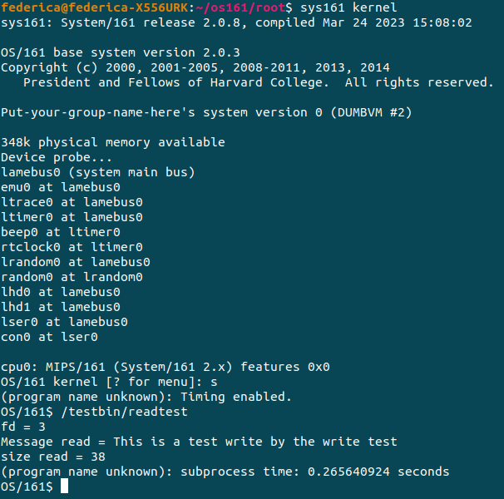
Read Test
#include <unistd.h>
#include <string.h>
#include <stdlib.h>
#include <stdio.h>
#include <err.h>
int main(){
//READING FROM A FILE
int fd;
int sz;
char message [60];
fd = open ("/bin/myfilew.txt", O_RDONLY | O_CREAT);
printf("fd = %d\n", fd);
sz = read(fd, message, 60);
printf("Message read = %s\n", message);
close(fd);
printf("size read = %d\n", sz);
return 0;
}

Slide 48
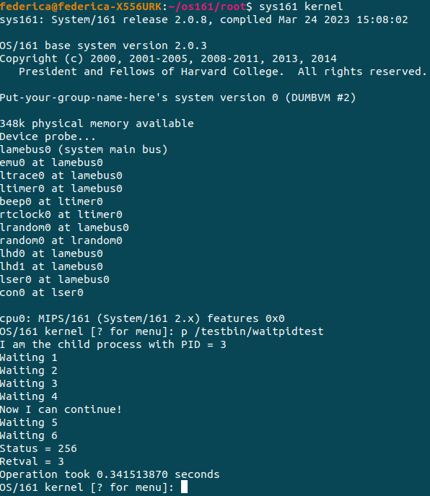
Waitpid Test
#include <unistd.h>
#include <string.h>
#include <stdlib.h>
#include <stdio.h>
#include <err.h>
int main(){
pid_t pid;
int retval;
int status;
pid = fork();
if (pid == 0){
//Child process
printf ("I am the child process with PID = %d\n", getpid());
printf("Waiting 1\n");
printf("Waiting 2\n");
printf("Waiting 3\n");
printf("Waiting 4\n");
exit(1);
}
else{
//Parent process
retval = waitpid(pid, &status, 0);
printf("Now I can continue!\n");
printf("Waiting 5\n");
printf("Waiting 6\n");
printf("Status = %d\n", status);
printf("Retval = %d\n", retval);
}
return 0;
}

Slide 49
Other Tests
Using the shell, it is also possible to test individual system calls, with:
myforktest
exittest
getpidtest

