Slide 1

Analysis and Testing
of a New Epidemiological Model
Applied to COVID-19
Team Members: Stefano Veroni & José Guzmán Funck 25th June 2020
Supervisor: Kilian D Stenning

Slide 2
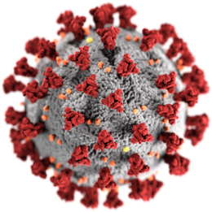
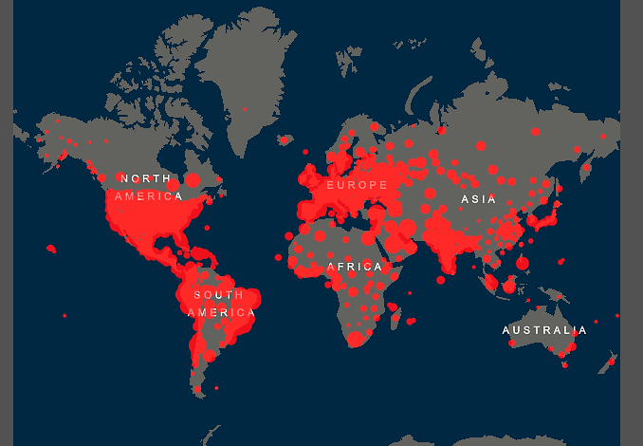
An Epidemiological Introduction to COVID-19
In 2019, in China, a new coronavirus called SARS-CoV-2 was first detected.
The disease the virus causes, known as COVID-19 (Corona-Virus-Disease 2019), fast spread all over the world.
In 2020, COVID-19 has bent great part of the world:
More than 9.3 million cases (the detected ones);
More than 470 thousand deaths (the internationally certified ones);
Image adapted from Johns Hopkins University Coronavirus Dashboard. Consulted June 21st 2020. Available at https://coronavirus.jhu.edu/map.html
Team Members: Stefano Veroni & José Guzmán Funck 25th June 2020
Supervisor: Kilian D Stenning

Slide 3
The SEIRD model
Non-Infected Susceptible (S)
Still-in-Incubation Infected (E)
Dead (D)
Infected
(and infectious) (I)
Recovered (R)
Team Members: Stefano Veroni & José Guzmán Funck 25th June 2020
Supervisor: Kilian D Stenning

Slide 4
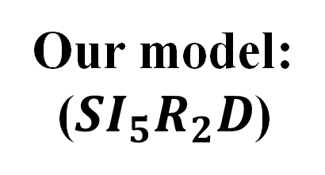
Non-Infected Susceptible (S)
Our model:
($SI_{5}R_{2}D$)
Still-in-Incubation Infected (IU)
Infected Symptomatic (IS)
Infected Asymptomatic (IA)
Detected Infected Symptomatic (ISD)
Detected Infected Asymptomatic (IAD)
Unregistered Recovered
(not infectious anymore) (RU)
Dead (D)
Registered Recovered (RR)
Team Members: Stefano Veroni & José Guzmán Funck 25th June 2020
Supervisor: Kilian D Stenning

Slide 5
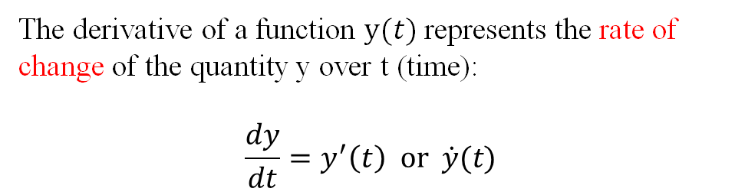


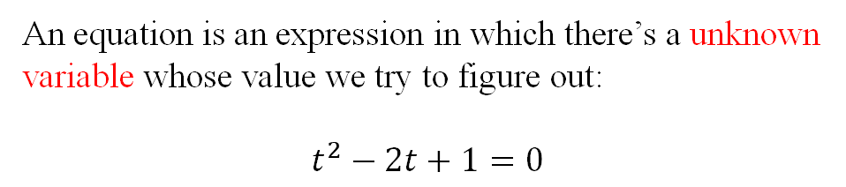
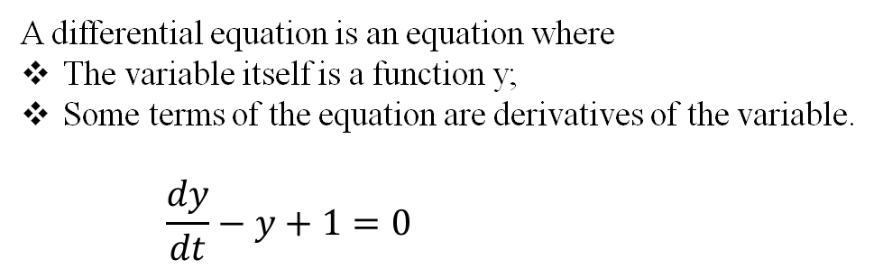
… a small differential deviation…
The derivative of a function $y(t)$represents the rate of change of the quantity y over t (time):
$$\frac{dy}{dt}=y^{′}\left(t\right) or \dot{y}(t)$$
An equation is an expression in which there’s a unknown variable whose value we try to figure out:
$$t^{2}−2t+1=0$$
A differential equation is an equation where
The variable itself is a function y;
Some terms of the equation are derivatives of the variable.
$$\frac{dy}{dt}−y+1=0$$
$$⟹ y\left(t\right)=Ae^{t}+1$$
$$y\left(0\right)=10 ⟹ y\left(t\right)=9e^{t}+1$$
Team Members: Stefano Veroni & José Guzmán Funck 25th June 2020
Supervisor: Kilian D Stenning

Slide 6
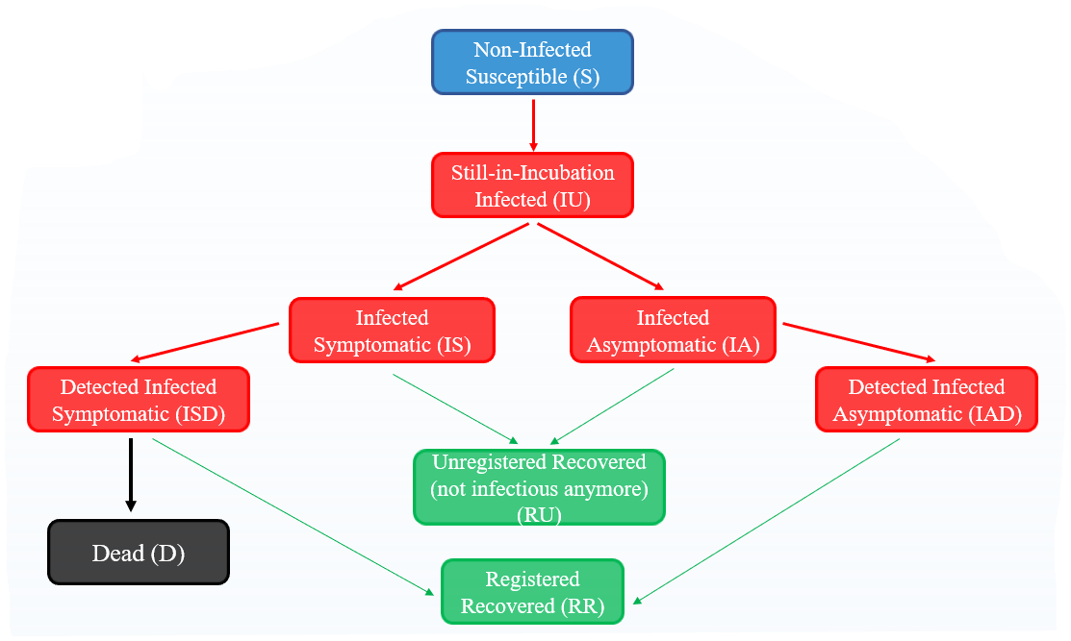























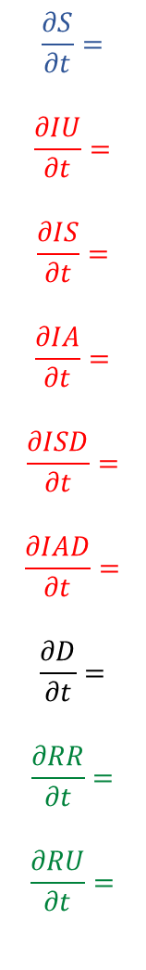






$$\frac{∂S}{∂t}=$$
$$\frac{∂IU}{∂t}=$$
$$\frac{∂IS}{∂t}=$$
$$\frac{∂IA}{∂t}=$$
$$\frac{∂ISD}{∂t}=$$
$$\frac{∂IAD}{∂t}=$$
$$\frac{∂D}{∂t}=$$
$$\frac{∂RR}{∂t}=$$
$$\frac{∂RU}{∂t}=$$
$$−\frac{β\left( IS+λ_{A}IA+λ_{U}IU\right)}{U−D}∙S$$
$$+\frac{β\left( IS+λ_{A}IA+λ_{U}IU\right)}{U−D}∙S$$
$$−\frac{1}{τ}IU$$
$$\frac{β\left( IS+λ_{A}IA+λ_{U}IU\right)}{U−D}∙S$$
$$+\frac{ρ}{τ}IU$$
$$−\frac{1}{T_{DS}}IS$$
$$−\frac{1}{T_{RS}}IS$$
$$+\frac{1−ρ}{τ}IU$$
$$−\frac{1}{T_{DA}}IA$$
$$−\frac{1}{T_{RA}}IA$$
$$\frac{ρ}{τ}IU$$
$$\frac{1−ρ}{τ}IU$$
$$\frac{1}{T_{DS}}IS$$
$$+\frac{1}{T_{DS}}IS$$
$$−\frac{α}{T_{D}}I_{Tot}$$
$$−\frac{γ}{T_{RD}} ISD$$
$$\frac{1}{T_{DA}}IA$$
$$+\frac{1}{T_{DA}}IA$$
$$−\frac{1}{T_{RD}}IAD$$
$$\frac{1}{T_{RS}}IS$$
$$\frac{1}{T_{RA}}IA$$
$$+\frac{α}{T_{D}}I_{Tot}$$
$$\frac{α}{T_{D}}I_{Tot}$$
$$\frac{γ}{T_{RD}} ISD$$
$$\frac{1}{T_{RD}}IAD$$
$$+\frac{γ}{T_{RD}} ISD$$
$$+\frac{1}{T_{RD}}IAD$$
$$+\frac{1}{T_{RS}}IS$$
$$+\frac{1}{T_{RA}}IA$$
Team Members: Stefano Veroni & José Guzmán Funck 25th June 2020
Supervisor: Kilian D Stenning

Slide 7
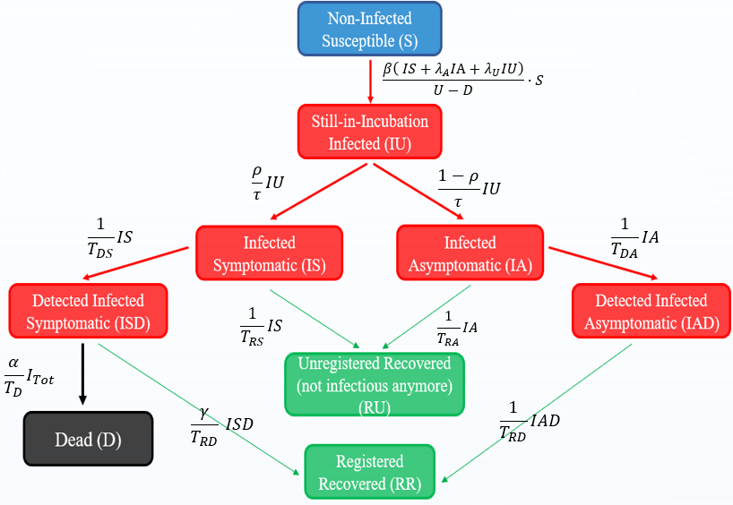
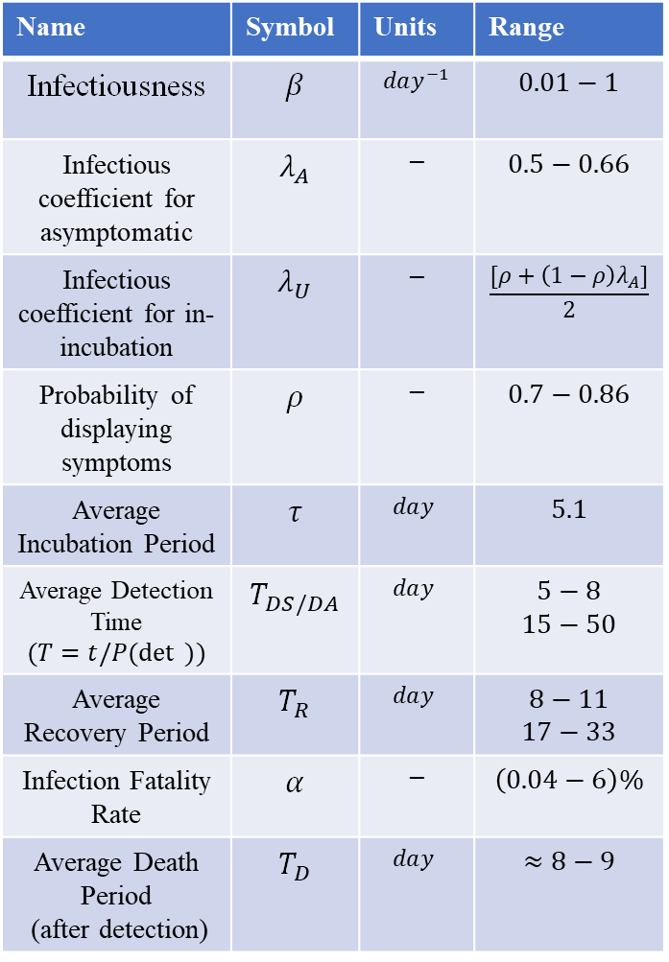
Name | Symbol | Units | Range
Infectiousness | $$β$$ | $$day^{−1}$$ | $$0.01−1$$
Infectious coefficient for asymptomatic | $$λ_{A}$$ | $$−$$ | $$0.5−0.66$$
Infectious coefficient for in-incubation | $$λ_{U}$$ | $$−$$ | $$\frac{[ρ+\left(1−ρ\right)λ_{A}]}{2}$$
Probability of displaying symptoms | $$ρ$$ | $$−$$ | $$0.7−0.86$$
Average Incubation Period | $$τ$$ | $$day^{ }$$ | $$5.1$$
Average Detection Time $$(T=t/P(\det{ }))$$ | $$T_{DS/DA}$$ | $$day^{ }$$ | $$5−8$$ $$15−50$$
Average Recovery Period | $$T_{R}$$ | $$day^{ }$$ | $$8−11$$ $$17−33$$
Infection Fatality Rate | $$α$$ | $$−$$ | $$\left(0.04−6\right)\%$$
Average Death Period (after detection) | $$T_{D}$$ | $$day^{ }$$ | $$≈8−9$$
Team Members: Stefano Veroni & José Guzmán Funck 25th June 2020
Supervisor: Kilian D Stenning

Slide 8
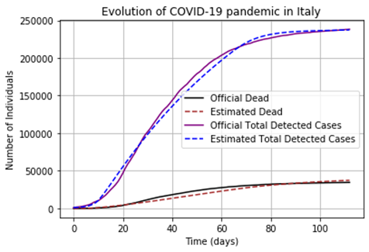
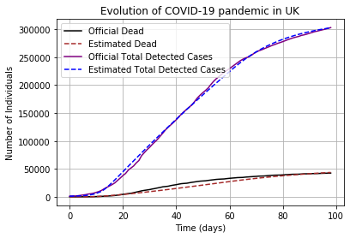
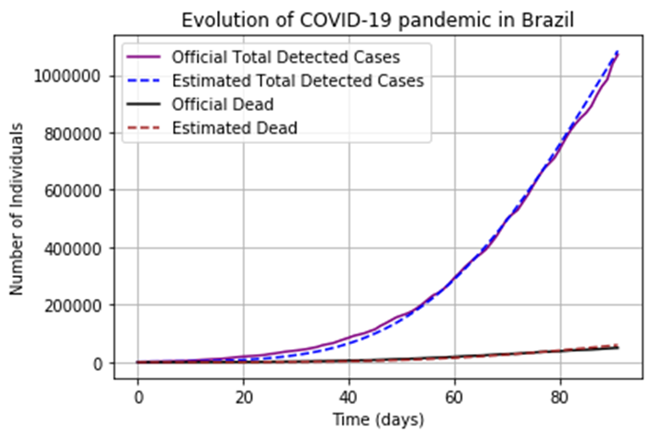
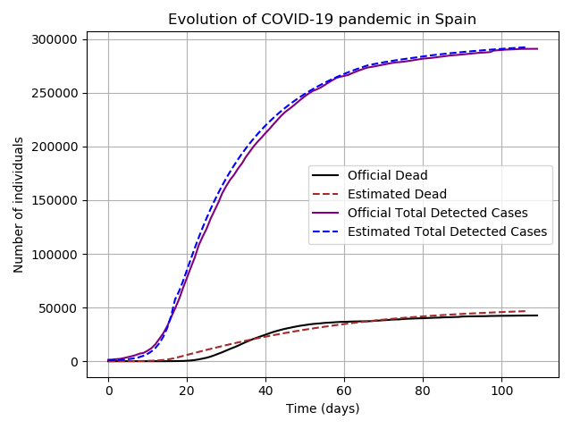
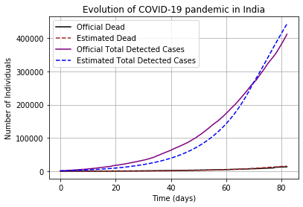
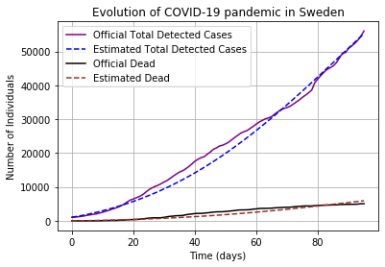
Model – Real World Comparison
For all countries, the day 0 is the first day they officially overcame 1000 detected active cases. The last is the 20th of June 2020, apart for Sweden, for which it’s the 18th .
Team Members: Stefano Veroni & José Guzmán Funck 25th June 2020
Supervisor: Kilian D Stenning

Slide 9
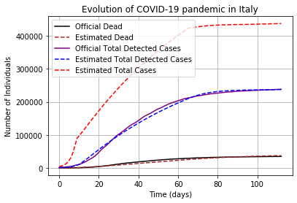
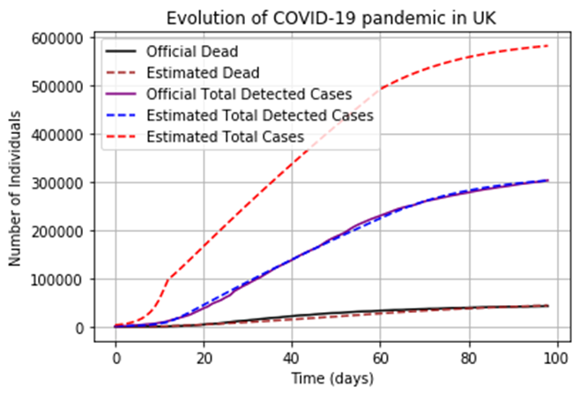
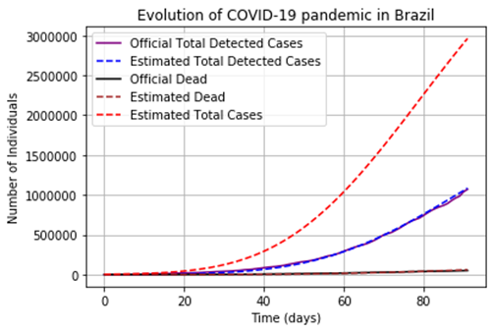
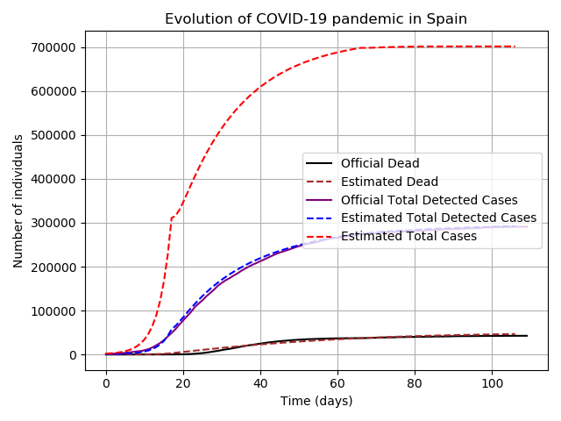
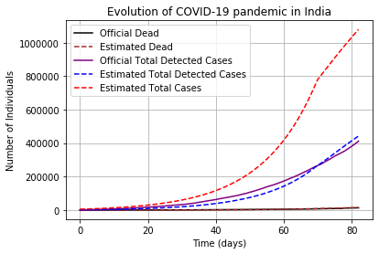
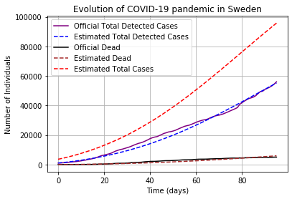
Model – Real World Comparison 2
For all countries, the day 0 is the first day they officially overcame 1000 detected active cases. The last is the 20th of June 2020, apart for Sweden, for which it’s the 18th .
Team Members: Stefano Veroni & José Guzmán Funck 25th June 2020
Supervisor: Kilian D Stenning

Slide 10
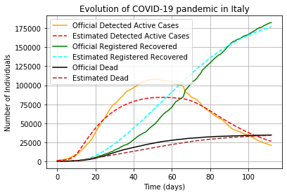
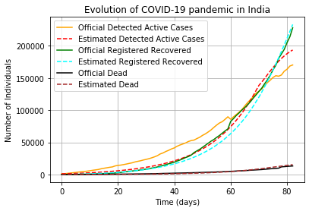
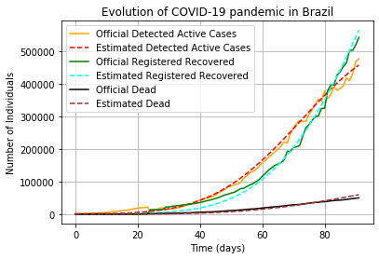
Model – Real World Comparison 3
ITALY
INDIA
BRAZIL
For all countries, the day 0 is the first day they officially overcame 1000 detected active cases. The last is the 20th of June 2020, apart for Sweden, for which it’s the 18th .
Team Members: Stefano Veroni & José Guzmán Funck 25th June 2020
Supervisor: Kilian D Stenning

Slide 11
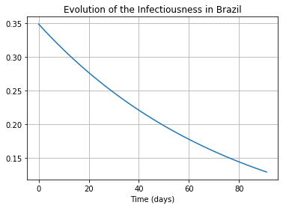
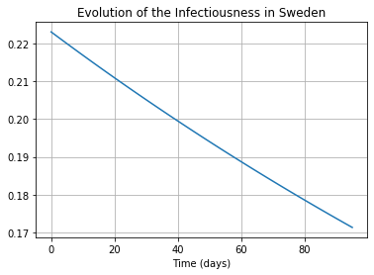
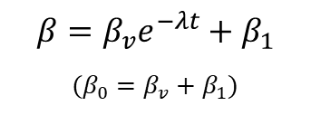
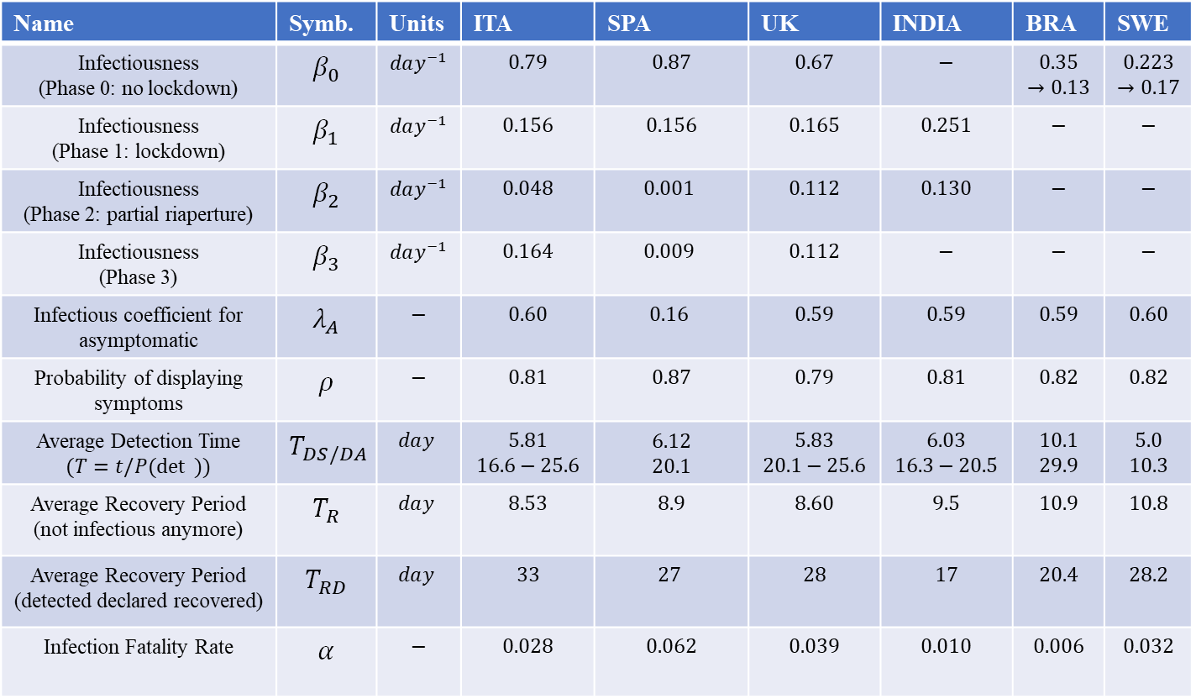
Model – Real World Comparison: the Parameters
The curve of common sense
(or fear)
Name | Symb. | Units | ITA | SPA | UK | INDIA | BRA | SWE
Infectiousness (Phase 0: no lockdown) | $$β_{0}$$ | $$day^{−1}$$ | $$0.79$$ | $$0.87$$ | $$0.67$$ | $$−$$ | $$0.35$$ $$→0.13$$ | $$0.223$$ $$→0.17$$
Infectiousness (Phase 1: lockdown) | $$β_{1}$$ | $$day^{−1}$$ | $$0.156$$ | $$0.156$$ | $$0.165$$ | $$0.251$$ | $$−$$ | $$−$$
Infectiousness (Phase 2: partial riaperture) | $$β_{2}$$ | $$day^{−1}$$ | $$0.048$$ | $$0.001$$ | $$0.112$$ | $$0.130$$ | $$−$$ | $$−$$
Infectiousness (Phase 3) | $$β_{3}$$ | $$day^{−1}$$ | $$0.164$$ | $$0.009$$ | $$0.112$$ | $$−$$ | $$−$$ | $$−$$
Infectious coefficient for asymptomatic | $$λ_{A}$$ | $$−$$ | $$0.60$$ | $$0.16$$ | $$0.59$$ | $$0.59$$ | $$0.59$$ | $$0.60$$
Probability of displaying symptoms | $$ρ$$ | $$−$$ | $$0.81$$ | $$0.87$$ | $$0.79$$ | $$0.81$$ | $$0.82$$ | $$0.82$$
Average Detection Time $$(T=t/P(\det{ }))$$ | $$T_{DS/DA}$$ | $$day^{ }$$ | $$5.81$$ $$16.6−25.6$$ | $$6.12$$ $$20.1$$ | $$5.83$$ $$20.1−25.6$$ | $$6.03$$ $$16.3−20.5$$ | $$10.1$$ $$29.9$$ | $$5.0$$ $$10.3$$
Average Recovery Period (not infectious anymore) | $$T_{R}$$ | $$day^{ }$$ | $$8.53$$ | $$8.9$$ | $$8.60$$ | $$9.5$$ | $$10.9$$ | $$10.8$$
Average Recovery Period (detected declared recovered) | $$T_{RD}$$ | $$day^{ }$$ | $$33$$ | $$27$$ | $$28$$ | $$17$$ | $$20.4$$ | $$28.2$$
Infection Fatality Rate | $$α$$ | $$−$$ | $$0.028$$ | $$0.062$$ | $$0.039$$ | $$0.010$$ | $$0.006$$ | $$0.032$$
$$β=β_{v}e^{−λt}+β_{1}$$
$$(β_{0}=β_{v}+β_{1})$$
Team Members: Stefano Veroni & José Guzmán Funck 25th June 2020
Supervisor: Kilian D Stenning

Slide 12
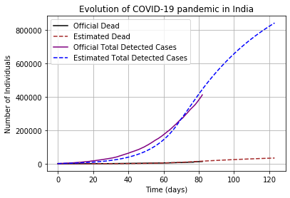
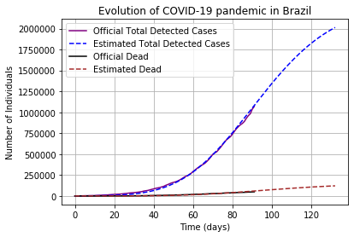
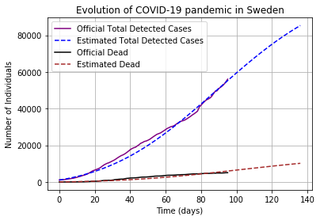
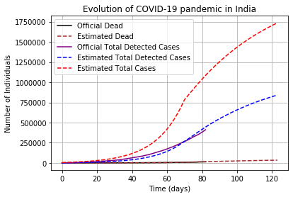
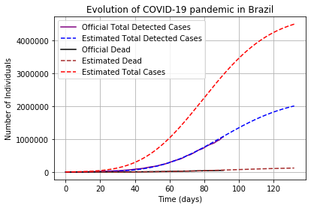
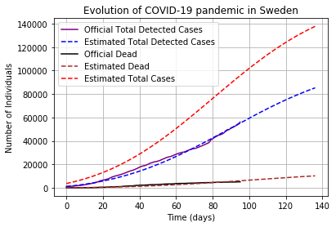
Short-term (attempts of) predictions (up to 1st August)
INDIA
BRAZIL
SWEDEN
Team Members: Stefano Veroni & José Guzmán Funck 25th June 2020
Supervisor: Kilian D Stenning

Slide 13
To summarise, we have been able to…
Develop a new epidemiological model to study the spread and statistics of diseases
Apply this model to the novel coronavirus in 6 countries:
Fitting our model to current official data
Estimating unknown quantities such as the total number of cases
Making short term predictions in Sweden, Brazil and India
Team Members: Stefano Veroni & José Guzmán Funck 25th June 2020
Supervisor: Kilian D Stenning

