Slide 1
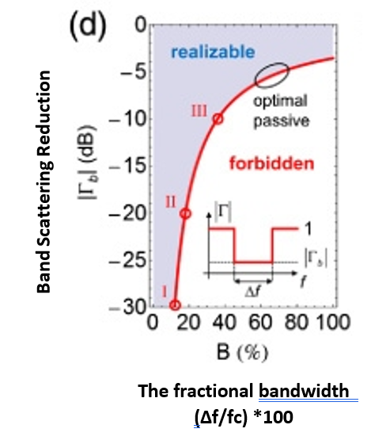
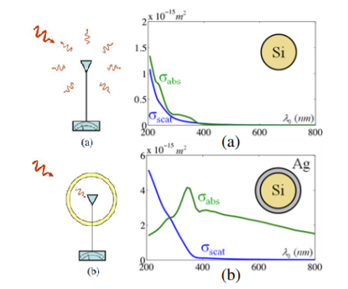
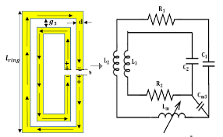
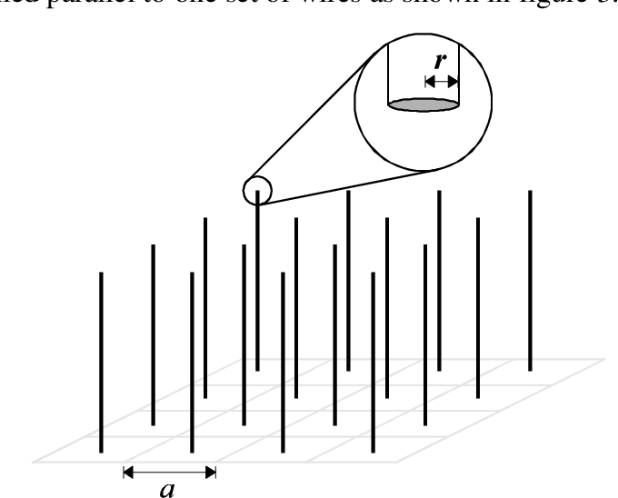
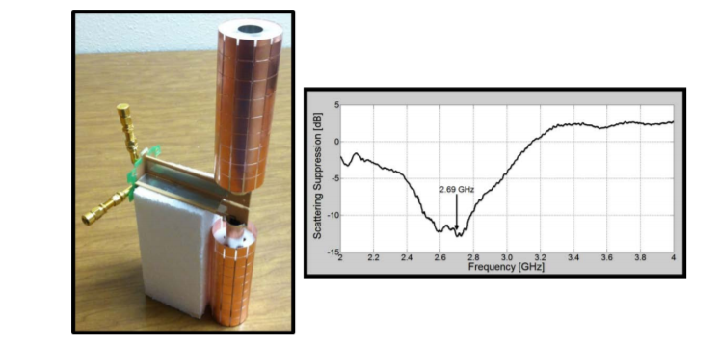
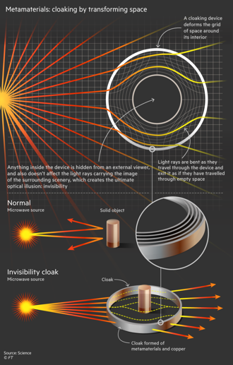
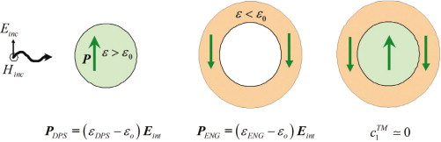

Blackett Laboratory,
Imperial College London,
South Kensington Campus, London,
SW7 2AZ
IS CLOAKING JUST FICTION?
NEMO
Oliver Brown Mark Salim
Stefano Veroni Sophie Mosselmans
Introduction:
Cloaking has pervaded throughout many works of fiction across a vast variety of cultures, stimulating the minds of their contemporary academics and laymen alike. It is only recently, after the advent of metamaterials, with properties superseding that of natural materials, it might become realised. This would have a wide impact on our society, from biomedical to communication technologies, from electronics to seismic applications. Despite the scientific community’s ambitions, the field has only taken its first few steps in order to establish itself hence it has been met with scepticism.
TIMELINE
1940s - W. E. Kock and others research artificial dielectrics. This showed any value for permittivity and permeability could be achieved.
1967 - V. G. Veselago hypothesizes 'left hand’ materials for which electromagnetic properties are reversed.
1999 - J. Pendry theoretically identified a practical way to make ‘left hand’ materials.
2001 – in University CA Sandiego first metamaterial is made.
2006 - D.Smith produced first cloaking device using a J. Pendry model and gradient-index metamaterials (in microwave range).
2008 - University of CA Berkeley developed metamaterials to cloak in 3D.
2010 - University of St.Andrews produced a flexible cloaking material that functions in the visible light region.
2016 - fundamental bounds of passive metamaterial cloaking were derived
Limitations:
Can only cloak small objects (estimated maximum dimensions 30cm)
Short wavelength cloaking is very difficult to achieve, as the structure must be approximately the same size as the wavelength of the light.
Dissipation of energy is caused by resistance of the cell components.
Can only cloak for small band widths of light. Wide bandwidths cause dispersion, which causes the phase velocity to not equal the group velocity.
Group velocity can’t exceed the speed of light due to the causality limitation.
Fig.3 shows the intrinsic bounds of passive cloaking.
Fig. 3
Metamaterials:
Left-handed materials are synthesised materials, which have a negative permittivity and permeability simultaneously.
These properties result in anti-parallel phase and group velocities.
Leading to unique properties such as a negative refractive index.
John Pendry proposed two structures: one of which has negative permittivity (‘thin wire’) while the other has negative permeability (‘split ring resonator’).
UCSD team led by David R Smith created the first LH electromagnetic metamaterial prototype by creating a composite structure consisting of TM and SRR structures, designed to have overlapping frequency ranges of negative permittivity and permeability respectively.
There are two categories of metamaterials: passive and active, based on whether they use external sources of energy.
Applications:
Cloaking devices would have many applications, besides the more obvious military applications, among which there are:
Cloaked sensors for low invasive measurements, which minimise the perturbation of the measured field, making the measurement more precise, fig.4.
Nonreciprocal photonic devices, which may pave the way to magnetic-free, fully integrated, and CMOS–compatible nonreciprocal components with wide applications in photonic networks and thermal management.
Cloaked antennas, which can transmit and receive signals while producing significantly less scattering than a bare antenna, improving wireless communication, fig.5.
Figure 4, adapted from [4]. The capabilities of normal sensors(a) and optimised cloaked sensors(b) are compared.
Cloaking devices applications can go beyond the field of electromagnetism, expanding their utility to the field of acoustic, seismic, thermal waves:
Invisible acoustic sensors, capable of absorbing the entire incoming signal, creating no shadow or reflection;
Seismic cloaking of buildings, through the use of composite foundations able of filtering a considerable amount of energy of the seismic waves, via an internal dissipation process.
Thermal invisibility may open new vistas in hiding hot spots in infrared thermography, military furtivity, and electronics heating reduction.
Cloaking Techniques:
Invisibility is an illusion, as metamaterials are used to create directed blind spots, by guiding specific parts of the electromagnetic spectrum, around the hidden object, to arrive on the other side in the same phase as if it were in free space.
Metamaterials distort the surrounding electromagnetic field, which can be represented
by coordinate transformations, which in turn can be used to discover new permittivities ($ε$)
and permeabilities ($μ$) (negative). [1]
ray’s path must not be too harsh, as $ε$ and $μ$ required would be infeasible for
metamaterials.
Another method, not using metamaterials, but using cylinders of refractive index between
2.7 and 3.8, stems from dipole cancellation within the cylinder.
this is known as optoelectrics, and relies on relationship between refractive index and
scattering efficiency of the material, which can be visualized. by Mie Scattering [2]
Fig. 2 illustrates the principle of Scattering Cancellation.
dipole moments with opposite signs are induced in the sphere
and shell, and therefore cancel.
Spectral Cloaking works by using a series of devices first
redistributing the incoming wave’s energy towards non-interacting
frequencies, then recomposing it into its original composition.
Figure 5, adapted from [5]. On the left a cloaked dipole antenna, on the right the measured scattering gain, as the ratio between a bare antenna and a cloaked one.
Fig. 1
Conclusion:
We have reviewed the study of metamaterial cloaking, its progress and where the field is heading. Through NEMO’s expansive research, it has been revealed that metamaterial cloaking is theoretically feasible and has been demonstrated. However, the extent of the field’s practical applications falls short of what is depicted in fiction due to technological limitations.
To address the question, cloaking is not just fiction but it is far from fact.
Fig. 2
References I:
[1]: https://my.ece.utah.edu/~dschurig/Site/Recognition_files/1780.pdf
[2]: Study opens a new route to achieving invisibility without using metamaterials - 2018
https://phys.org/news/2019-04-route-invisibility-metamaterials.html
[3]: Invisibility exposed: physical bounds on passive cloaking
Francesco Monticone and Andrea Alù, Optica Vol. 3, Issue 7, pp. 718-724 (2016)
References II:
[4]:Cloaking and Invisibility: A Review, Romain Fleury and Andrea Alù (Invited Review), Progress In Electromagnetics Research, Vol. 147, 171–202, 2014
[5]:Frontiers of Engineering: Reports on Leading-Edge Engineering from the 2015 Symposium (2016)
Chapter: Metamaterial-based Device Engineering--Andrea Alù

