Slide 1
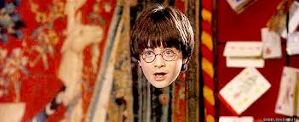
Is Cloaking just Fiction?
Oliver Brown Mark Salim
Stefano Veroni Sophie Mosselmans

Slide 2
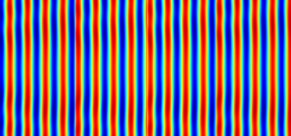
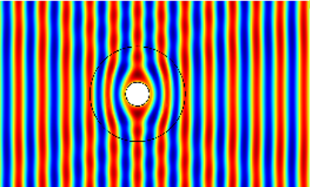
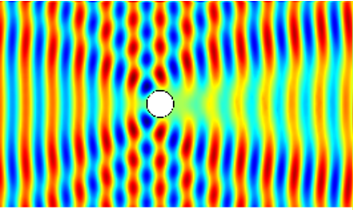

What is cloaking?

Slide 3
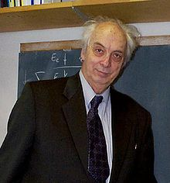
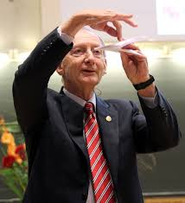
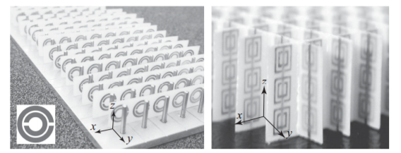
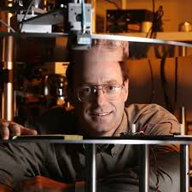
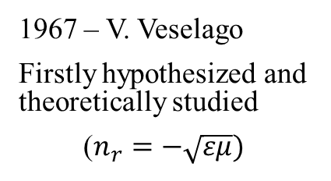
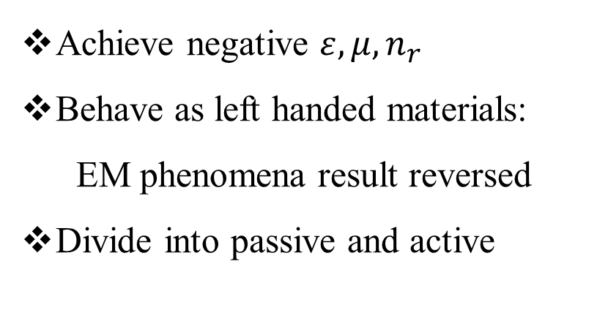
Metamaterials
1967 – V. Veselago
Firstly hypothesized and theoretically studied
($n_{r}=−\sqrt{εμ})$
Achieve negative $ε,μ,n_{r}$
Behave as left handed materials:
EM phenomena result reversed
Divide into passive and active
1999 - J.Pendry
Firstly explained how to make them real
2001 – D. Smith
The first metamaterial ever realized
The first experimental LHM structure, as a combination of the thin wire and the split ring resonator. [1]

Slide 4
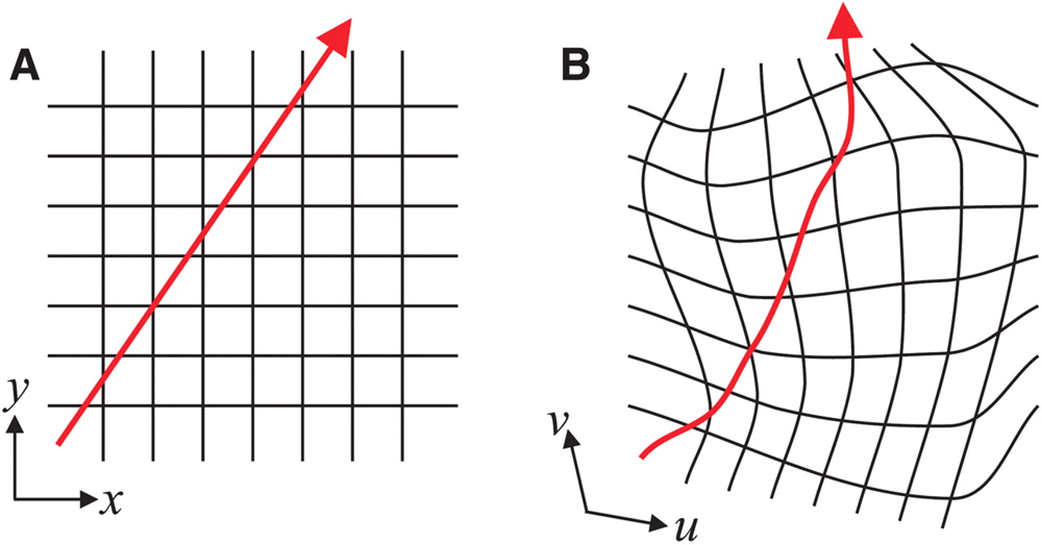
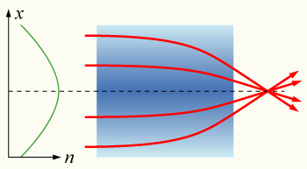
Transformation Optics
Works by applying Coordinate Transformations
Allows varying ε and µ
GRIN Optics
[2]
[3]
GRIN Optics: A gradient-index lens with a parabolic variation of
refractive index (n) with radial distance (x).
Coordinate Transformation

Slide 5
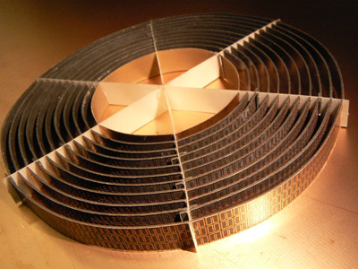
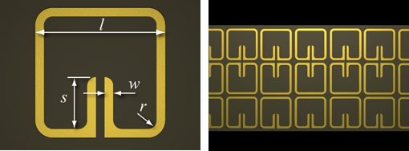

The $1^{st}$ Metamaterial Cloaking
David R Smith et al. 2006
Only worked for a small Copper Cylinder
Only worked in Microwaves
Only worked in 2D
[4]
[4]
Single Split Ring Resonator
The 1st Cloaking device

Slide 6
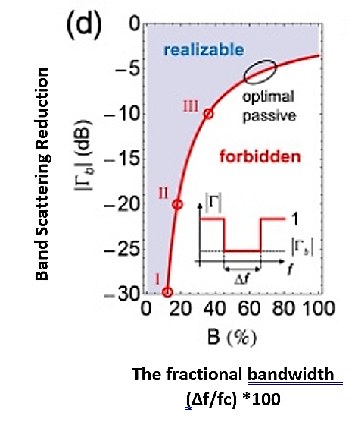
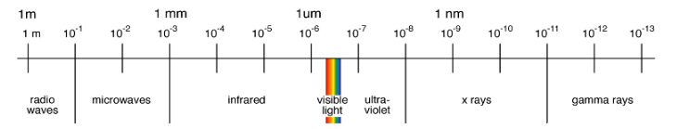
Limitations
[5]
Can only cloak small objects
Dispersion when dealing with wider bandwidths
Shorter wavelength cloaking difficult to achieve
Dissipation of energy

Slide 7
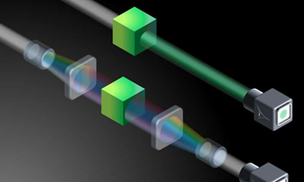
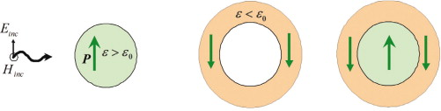
Alternative Techniques
Scattering Cancellation
At certain frequencies, the scattering from the object and from the shell cancel each other, making the object and the device invisible.
The active form improves its capabilities for wider bandwidths.
Spectral Cloaking
Redistributes the incoming wave’s energy towards non interacting frequencies.
Recomposes the wave into its original form.
[7]
[6]

Slide 8
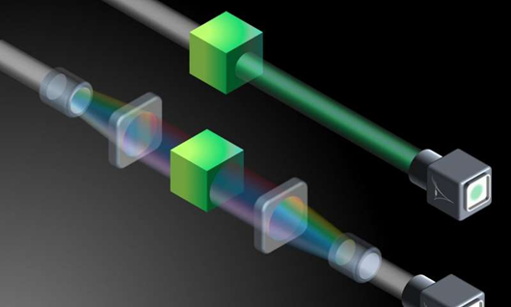








Limitations of the alternative techniques
 | Scattering Cancellation | Spectral Cloaking
Object of any size ?
Wide bandwidth ?
Omni-directional ?
Relatively easy (and cheap) to realize ?
Can be integrated into small complex systems ?

Slide 9
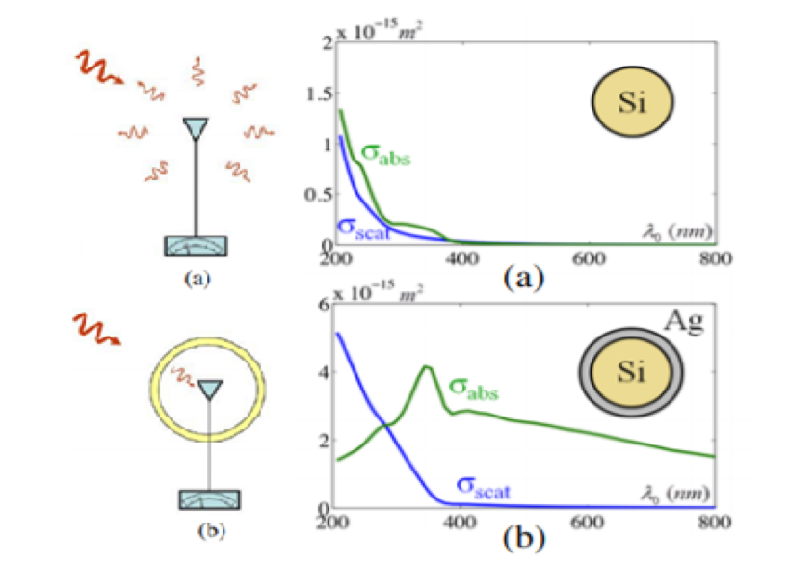
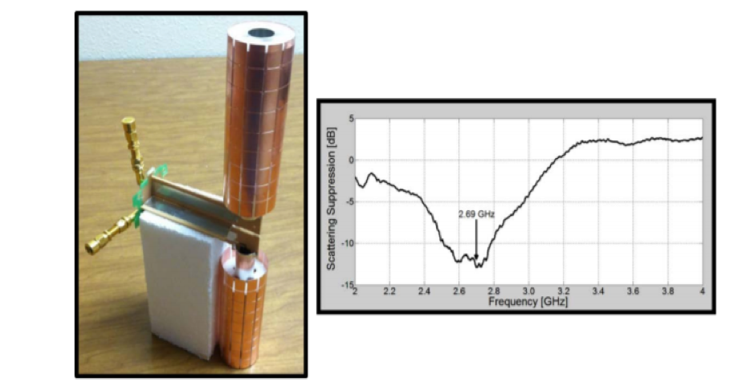
Applications
[2]
Cloaked Sensors
For low-invasive, more accurate, measurements
[8]
Cloaked Antennas
For improved wireless communications

Slide 10
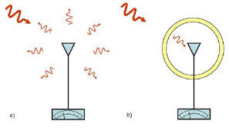
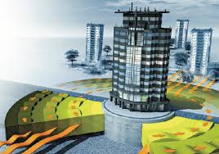
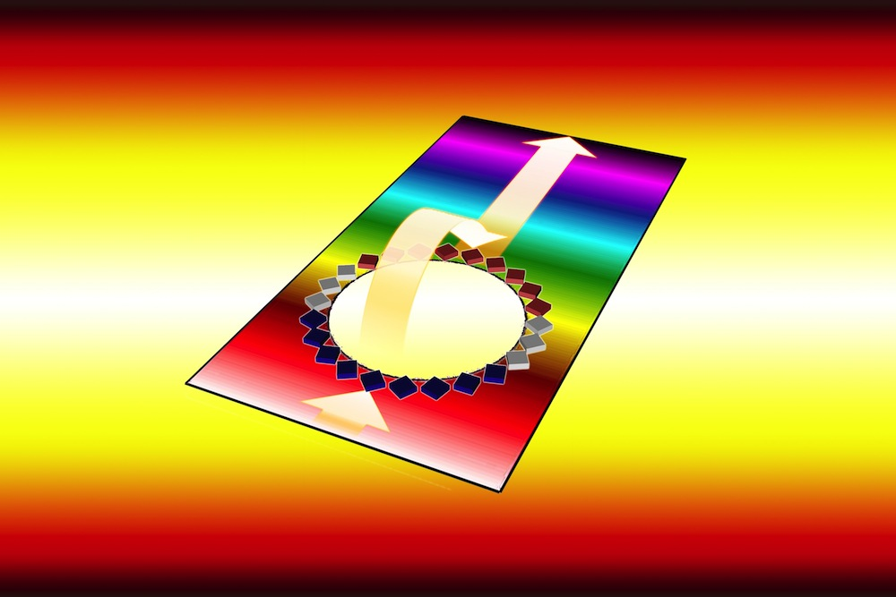
…beyond electromagnetism
[2]
Cloaked Acoustic Sensors
[9]
Seismic Cloaking
[10]
Thermal invisibility

Slide 11
Conclusion
In the last 20 years many innovations have been made towards achieving a perfect cloak:
→different techniques have been developed, all with their own strengths and weaknesses.
Cloaking technologies would have many applications in many different fields.
So, is cloaking just fiction?
No, cloaking is not just fiction…
… but is still far from fact!

Slide 12
References
[1]«Electromagnetic Metamaterials: Transmission Line Theory and Microwave Applications» by Caloz, Cristophe; Itoh, Tatsuo
[2]“Cloaking and Invisibility: A Review”, Romain Fleury and Andrea Alù (Invited Review), Progress In Electromagnetics Research, Vol. 147, 171–202, 2014
[3] https://upload.wikimedia.org/wikipedia/commons/2/2c/Grin-lens.png, by Piachoo v2
[4] “Metamaterial Electromagnetic Cloak at Microwave Frequencies”, by D.Schurig, J.J.Mock, J.Justice, S.A.Cumer, J.B.Pendry, A.F.Starr, D.R.Smith
[5]“Invisibility exposed: physical bounds on passive cloaking”, by Francesco Monticone and Andrea Alù, Optica Vol. 3, Issue 7, pp. 718-724, 2016
[6]“Electromagnetic cloaking with metamaterials”, by P.Alitao and S.Tretyakov, Materials today, volume 12, issue 3, march 2009, pages 22-29
[7]“Spectral cloaking could make objects invisible under realistic conditions”by Optical Society of America, JUNE 28, 2018, Phys.org
[8]”Frontiers of Engineering: Reports on Leading-Edge Engineering from the 2015 Symposium” (2016),Chapter: “Metamaterial-based Device Engineering”, by Andrea Alù
[9] “Earthquake-Proof Skyscrapers Hide From Seismic Waves” By Carina StorrsOctober 14, 2009
[10] “Thermal "invisibility cloak" could keep people cool”, BY CHARLES Q. CHOI, SEPTEMBER 23, 2015 / 11:39 AM / LIVESCIENCE.COM

