Slide 1
Fitting

Slide 2
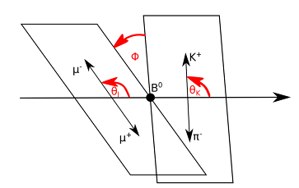


Parameterization of $B^{0}$ Decay
The decay rate of the $B0 → K^{∗}0 μ^{+}μ^{−}$ channel,
as you know, depends on these angles
But HOW?
De Cian M. Track Reconstruction Efficiency and Analysis of $B^{0}→K^{∗0}μ^{+}μ^{−}$ at the LHCb Experiment. 2013, Sep

Slide 3
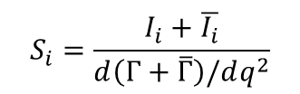
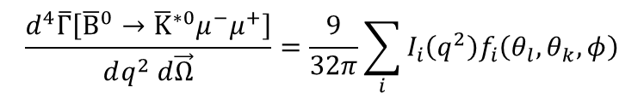
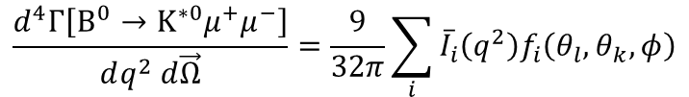

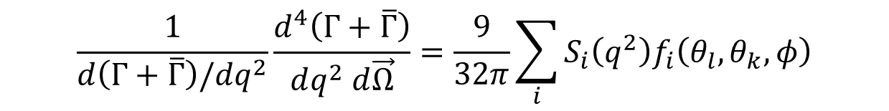
Parameterization of $B^{0}$ Decay
$$\frac{d^{4}Γ\left[B^{0}→K^{∗0}μ^{+}μ^{−}\right]}{dq^{2} d\vec{Ω}}=\frac{9}{32π}\sum_{i}{{\overline{I}}_{i}\left(q^{2}\right)f_{i}\left(θ_{l},θ_{k},φ\right)}$$
$$\frac{d^{4}\overline{Γ}\left[{\overline{B}}^{0}→{\overline{K}}^{∗0}μ^{−}μ^{+}\right]}{dq^{2} d\vec{Ω}}=\frac{9}{32π}\sum_{i}{I_{i}\left(q^{2}\right)f_{i}\left(θ_{l},θ_{k},φ\right)}$$
$$S_{i}=\frac{I_{i}+\overline{I_{i}}}{d\left(Γ+\overline{Γ}\right)/dq^{2}}$$
$$\frac{1}{d\left(Γ+\overline{Γ}\right)/dq^{2}}\frac{d^{4}\left(Γ+\overline{Γ}\right)}{dq^{2} d\vec{Ω}}=\frac{9}{32π}\sum_{i}{S_{i}\left(q^{2}\right)f_{i}\left(θ_{l},θ_{k},φ\right)}$$
$$12$$

Slide 4



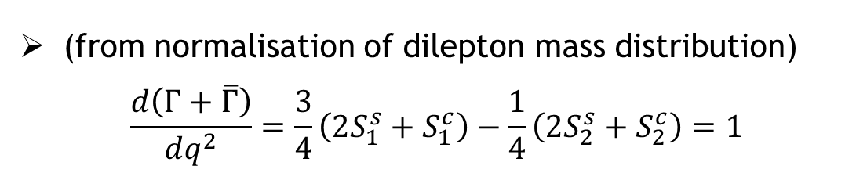



Can we simplify this?
$$8$$
$$12$$
A: YES, assuming massless muons
$S_{6}^{c}$ vanishes
$S_{1}^{s}=3S_{2}^{s}$
$S_{1}^{c}=−S_{2}^{c}$
(from normalisation of dilepton mass distribution)
$$\frac{d\left(Γ+\overline{Γ}\right)}{dq^{2}}=\frac{3}{4}\left(2S_{1}^{s}+S_{1}^{c}\right)−\frac{1}{4}\left(2S_{2}^{s}+S_{2}^{c}\right)=1$$

Slide 5
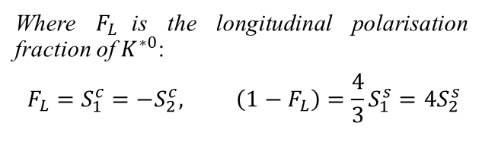
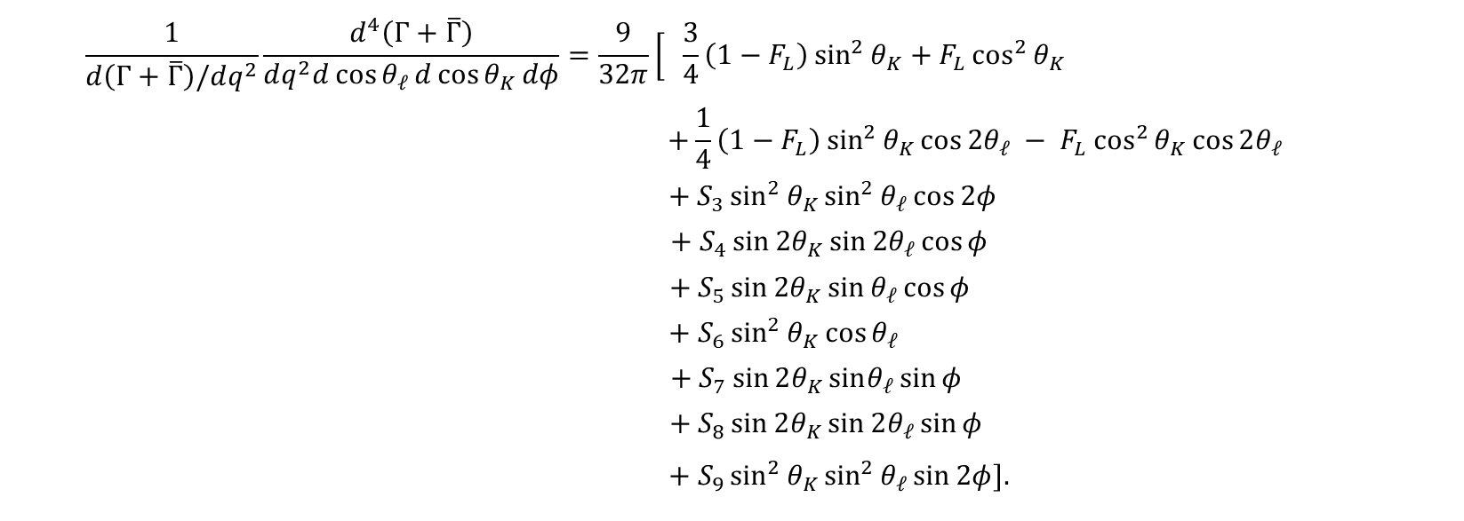
CP – Averaged Distribution
$$\frac{1}{d\left(Γ+\overline{Γ}\right)/dq^{2}}\frac{d^{4}\left(Γ+\overline{Γ}\right)}{dq^{2}d\cos{θ_{𝓁}}d\cos{θ_{K}}dφ}=\frac{9}{32π}\left[\begin{aligned} \\ \end{aligned}\right. \frac{3}{4}\left(1−F_{L}\right)\sin^{2}{θ_{K}}+F_{L}\cos^{2}{θ_{K}}$$
$$+\frac{1}{4}\left(1−F_{L}\right)\sin^{2}{θ_{K}}\cos{2θ_{𝓁}} − F_{L}\cos^{2}{θ_{K}}\cos{2θ_{𝓁}}$$
$$+ S_{3}\sin^{2}{θ_{K}}\sin^{2}{θ_{𝓁}}\cos{2φ}$$
$$+ S_{4}\sin{2θ_{K}\sin{2θ_{𝓁}}}\cos{φ}$$
$$+ S_{5}\sin{2θ_{K}}\sin{θ_{𝓁}}\cos{φ}$$
$$+ S_{6}\sin^{2}{θ_{K}}\cos{θ_{𝓁}}$$
$$+ S_{7}\sin{2θ_{K}}sinθ_{𝓁}\sin{φ}$$
$$+ S_{8}\sin{2θ_{K}}\sin{2θ_{𝓁}}\sin{φ}$$
$$+ S_{9}\sin^{2}{θ_{K}}\sin^{2}{θ_{𝓁}}\sin{2φ}].$$
Where $F_{L}$is the longitudinal polarisation fraction of $K^{∗0}$:
$$F_{L}=S_{1}^{c}=−S_{2}^{c}, \left(1−F_{L}\right)=\frac{4}{3}S_{1}^{s}=4S_{2}^{s}$$

Slide 6
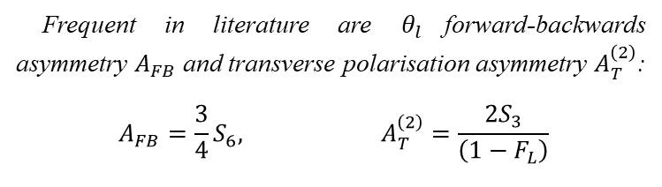
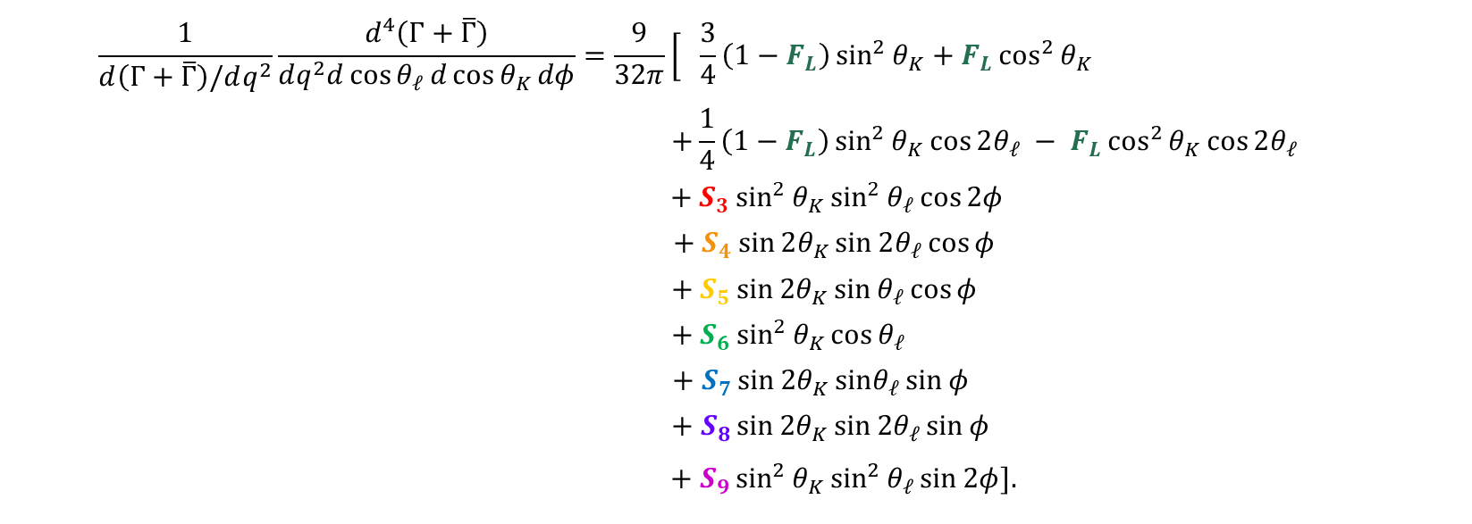
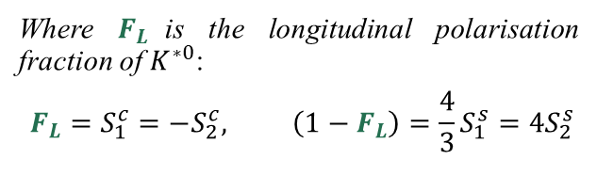
CP – Averaged Distribution
$$\frac{1}{d\left(Γ+\overline{Γ}\right)/dq^{2}}\frac{d^{4}\left(Γ+\overline{Γ}\right)}{dq^{2}d\cos{θ_{𝓁}}d\cos{θ_{K}}dφ}=\frac{9}{32π}\left[\begin{aligned} \\ \end{aligned}\right. \frac{3}{4}\left(1−F_{L}\right)\sin^{2}{θ_{K}}+F_{L}\cos^{2}{θ_{K}}$$
$$+\frac{1}{4}\left(1−F_{L}\right)\sin^{2}{θ_{K}}\cos{2θ_{𝓁}} − F_{L}\cos^{2}{θ_{K}}\cos{2θ_{𝓁}}$$
$$+ S_{3}\sin^{2}{θ_{K}}\sin^{2}{θ_{𝓁}}\cos{2φ}$$
$$+ S_{4}\sin{2θ_{K}\sin{2θ_{𝓁}}}\cos{φ}$$
$$+ S_{5}\sin{2θ_{K}}\sin{θ_{𝓁}}\cos{φ}$$
$$+ S_{6}\sin^{2}{θ_{K}}\cos{θ_{𝓁}}$$
$$+ S_{7}\sin{2θ_{K}}sinθ_{𝓁}\sin{φ}$$
$$+ S_{8}\sin{2θ_{K}}\sin{2θ_{𝓁}}\sin{φ}$$
$$+ S_{9}\sin^{2}{θ_{K}}\sin^{2}{θ_{𝓁}}\sin{2φ}].$$
Where $F_{L}$is the longitudinal polarisation fraction of $K^{∗0}$:
$$F_{L}=S_{1}^{c}=−S_{2}^{c}, \left(1−F_{L}\right)=\frac{4}{3}S_{1}^{s}=4S_{2}^{s}$$
( )
Frequent in literature are $θ_{l}$forward-backwards asymmetry $A_{FB}$ and transverse polarisation asymmetry $A_{T}^{\left(2\right)}$:
$$A_{FB}=\frac{3}{4}S_{6}, A_{T}^{\left(2\right)}=\frac{{2S}_{3}}{\left(1−F_{L}\right)}$$

Slide 7
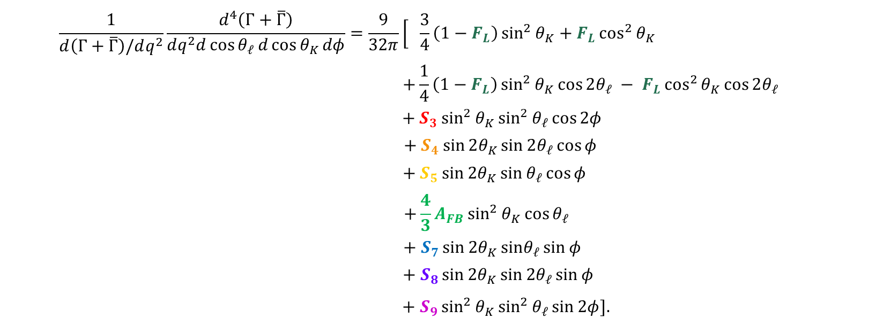
CP – Averaged Distribution
$$\frac{1}{d\left(Γ+\overline{Γ}\right)/dq^{2}}\frac{d^{4}\left(Γ+\overline{Γ}\right)}{dq^{2}d\cos{θ_{𝓁}}d\cos{θ_{K}}dφ}=\frac{9}{32π}\left[\begin{aligned} \\ \end{aligned}\right. \frac{3}{4}\left(1−F_{L}\right)\sin^{2}{θ_{K}}+F_{L}\cos^{2}{θ_{K}}$$
$$+\frac{1}{4}\left(1−F_{L}\right)\sin^{2}{θ_{K}}\cos{2θ_{𝓁}} − F_{L}\cos^{2}{θ_{K}}\cos{2θ_{𝓁}}$$
$$+ S_{3}\sin^{2}{θ_{K}}\sin^{2}{θ_{𝓁}}\cos{2φ}$$
$$+ S_{4}\sin{2θ_{K}\sin{2θ_{𝓁}}}\cos{φ}$$
$$+ S_{5}\sin{2θ_{K}}\sin{θ_{𝓁}}\cos{φ}$$
$$+\frac{4}{3}A_{FB}\sin^{2}{θ_{K}}\cos{θ_{𝓁}}$$
$$+ S_{7}\sin{2θ_{K}}sinθ_{𝓁}\sin{φ}$$
$$+ S_{8}\sin{2θ_{K}}\sin{2θ_{𝓁}}\sin{φ}$$
$$+ S_{9}\sin^{2}{θ_{K}}\sin^{2}{θ_{𝓁}}\sin{2φ}].$$
Where $F_{L}$is the longitudinal polarisation fraction of $K^{∗0}$:
$$F_{L}=S_{1}^{c}=−S_{2}^{c}, \left(1−F_{L}\right)=\frac{4}{3}S_{1}^{s}=4S_{2}^{s}$$
( )
Frequent in literature are $θ_{l}$forward-backwards asymmetry $A_{FB}$ and transverse polarisation asymmetry $A_{T}^{\left(2\right)}$:
$$A_{FB}=\frac{3}{4}S_{6}, A_{T}^{\left(2\right)}=\frac{{2S}_{3}}{\left(1−F_{L}\right)}$$

Slide 8


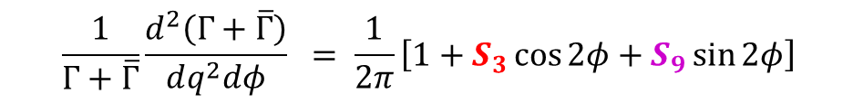


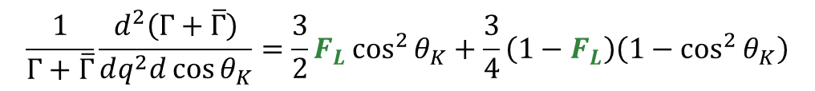



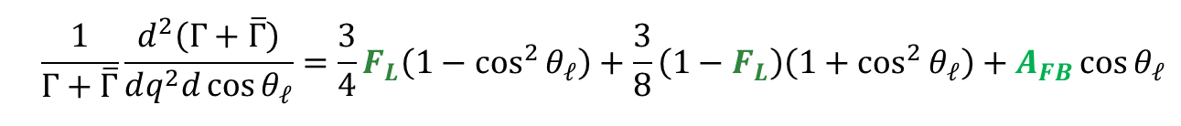






How do we find them?
$$Observables:$$
$$F_{L}$$
$$S_{3}$$
$$S_{4}$$
$$S_{5}$$
$$A_{FB}(S_{6})$$
$$S_{7}$$
$$S_{8}$$
$$S_{9}$$
First, project: integrate, integrate and integrate!
$$\underset{⇒}{over θ_{k} \& φ}$$
$$\frac{1}{Γ+\overline{Γ}}\frac{d^{2}\left(Γ+\overline{Γ}\right)}{dq^{2}d\cos{θ_{𝓁}}}=\frac{3}{4}F_{L}\left(1−\cos^{2}{θ_{𝓁}}\right)+\frac{3}{8}\left(1−F_{L}\right)\left(1+\cos^{2}{θ_{𝓁}}\right)+A_{FB}\cos{θ_{𝓁}}$$
$$\underset{⇒}{over θ_{ℓ} \& φ}$$
$$\frac{1}{Γ+\overline{Γ}}\frac{d^{2}\left(Γ+\overline{Γ}\right)}{dq^{2}d\cos{θ_{K}}}=\frac{3}{2}F_{L}\cos^{2}{θ_{K}}+\frac{3}{4}\left(1−F_{L}\right)\left(1−\cos^{2}{θ_{K}}\right)$$
$$\underset{⇒}{over θ_{ℓ} \& θ_{K}}$$
$$\frac{1}{Γ+\overline{Γ}}\frac{d^{2}\left(Γ+\overline{Γ}\right)}{dq^{2}dφ} = \frac{1}{2π}\left[1+S_{3}\cos{2φ}+S_{9}\sin{2φ}\right]$$

Slide 9
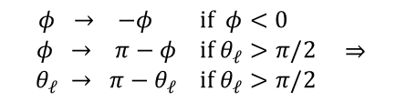



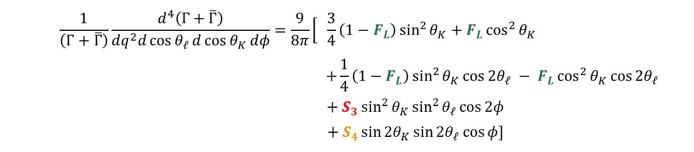
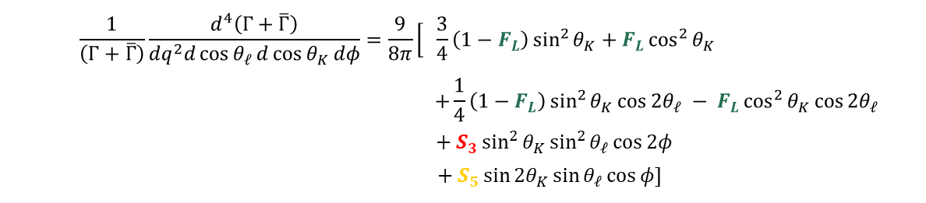


$$Observables:$$
$$F_{L}$$
$$S_{3}$$
$$S_{4}$$
$$S_{5}$$
$$A_{FB}(S_{6})$$
$$S_{7}$$
$$S_{8}$$
$$S_{9}$$
Then … fold!
$$\begin{matrix}φ → −φ \\ φ → π−φ \\ θ_{𝓁} → π−θ_{𝓁}\end{matrix} \begin{matrix}if φ<0 \\ if θ_{𝓁}>π/2 \\ if θ_{𝓁}>π/2\end{matrix} ⇒$$
$$\frac{1}{\left(Γ+\overline{Γ}\right)}\frac{d^{4}\left(Γ+\overline{Γ}\right)}{dq^{2}d\cos{θ_{𝓁}}d\cos{θ_{K}}dφ}=\frac{9}{8π}\left[\begin{aligned} \\ \end{aligned}\right. \frac{3}{4}\left(1−F_{L}\right)\sin^{2}{θ_{K}}+F_{L}\cos^{2}{θ_{K}}$$
$$+\frac{1}{4}\left(1−F_{L}\right)\sin^{2}{θ_{K}}\cos{2θ_{𝓁}} − F_{L}\cos^{2}{θ_{K}}\cos{2θ_{𝓁}}$$
$$+ S_{3}\sin^{2}{θ_{K}}\sin^{2}{θ_{𝓁}}\cos{2φ}$$
$$+ S_{4}\sin{2θ_{K}\sin{2θ_{𝓁}}}\cos{φ}]$$
$$\begin{matrix}φ → −φ \\ θ_{𝓁} → π−θ_{𝓁}\end{matrix} \begin{matrix}if φ<0 \\ if θ_{𝓁}>π/2\end{matrix} ⇒$$
$$\frac{1}{\left(Γ+\overline{Γ}\right)}\frac{d^{4}\left(Γ+\overline{Γ}\right)}{dq^{2}d\cos{θ_{𝓁}}d\cos{θ_{K}}dφ}=\frac{9}{8π}\left[\begin{aligned} \\ \end{aligned}\right. \frac{3}{4}\left(1−F_{L}\right)\sin^{2}{θ_{K}}+F_{L}\cos^{2}{θ_{K}}$$
$$+\frac{1}{4}\left(1−F_{L}\right)\sin^{2}{θ_{K}}\cos{2θ_{𝓁}} − F_{L}\cos^{2}{θ_{K}}\cos{2θ_{𝓁}}$$
$$+ S_{3}\sin^{2}{θ_{K}}\sin^{2}{θ_{𝓁}}\cos{2φ}$$
$$+ S_{5}\sin{2θ_{K}\sin{θ_{𝓁}}}\cos{φ}]$$

Slide 10

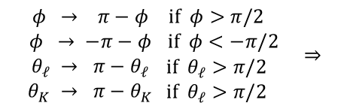

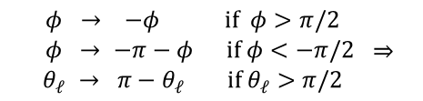
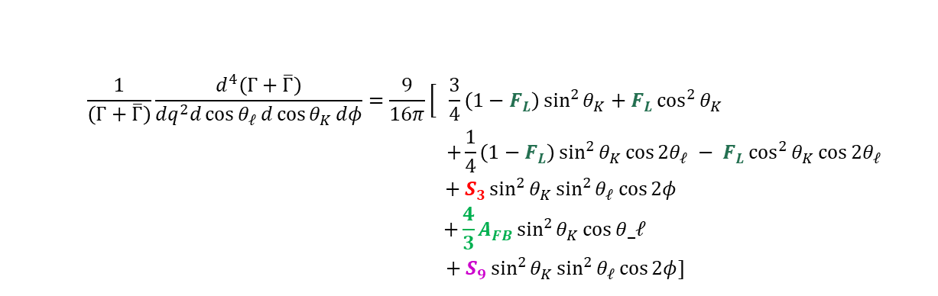

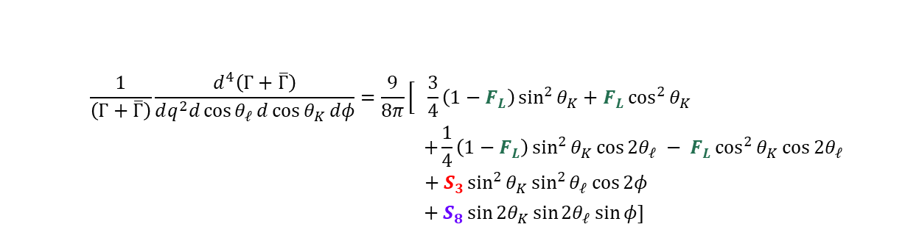

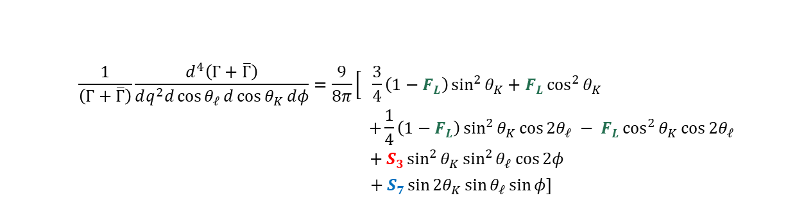
$$Observables:$$
$$F_{L}$$
$$S_{3}$$
$$S_{4}$$
$$S_{5}$$
$$A_{FB}(S_{6})$$
$$S_{7}$$
$$S_{8}$$
$$S_{9}$$
$$\begin{matrix}φ → −φ \\ φ → −π−φ \\ θ_{𝓁} → π−θ_{𝓁}\end{matrix} \begin{matrix}if φ>π/2 \\ if φ<−π/2 \\ if θ_{𝓁}>π/2\end{matrix} ⇒$$
$$\frac{1}{\left(Γ+\overline{Γ}\right)}\frac{d^{4}\left(Γ+\overline{Γ}\right)}{dq^{2}d\cos{θ_{𝓁}}d\cos{θ_{K}}dφ}=\frac{9}{8π}\left[\begin{aligned} \\ \end{aligned}\right. \frac{3}{4}\left(1−F_{L}\right)\sin^{2}{θ_{K}}+F_{L}\cos^{2}{θ_{K}}$$
$$+\frac{1}{4}\left(1−F_{L}\right)\sin^{2}{θ_{K}}\cos{2θ_{𝓁}} − F_{L}\cos^{2}{θ_{K}}\cos{2θ_{𝓁}}$$
$$+ S_{3}\sin^{2}{θ_{K}}\sin^{2}{θ_{𝓁}}\cos{2φ}$$
$$+ S_{7}\sin{2θ_{K}\sin{θ_{𝓁}}}\sin{φ}]$$
$$\begin{matrix}φ → π−φ \\ φ → −π−φ \\ θ_{𝓁} → π−θ_{𝓁} \\ θ_{K} → π−θ_{K}\end{matrix} \begin{matrix}if φ>π/2 \\ if φ<−π/2 \\ if θ_{𝓁}>π/2 \\ if θ_{𝓁}>π/2 \end{matrix} ⇒$$
$$\frac{1}{\left(Γ+\overline{Γ}\right)}\frac{d^{4}\left(Γ+\overline{Γ}\right)}{dq^{2}d\cos{θ_{𝓁}}d\cos{θ_{K}}dφ}=\frac{9}{8π}\left[\begin{aligned} \\ \end{aligned}\right. \frac{3}{4}\left(1−F_{L}\right)\sin^{2}{θ_{K}}+F_{L}\cos^{2}{θ_{K}}$$
$$+\frac{1}{4}\left(1−F_{L}\right)\sin^{2}{θ_{K}}\cos{2θ_{𝓁}} − F_{L}\cos^{2}{θ_{K}}\cos{2θ_{𝓁}}$$
$$+ S_{3}\sin^{2}{θ_{K}}\sin^{2}{θ_{𝓁}}\cos{2φ}$$
$$+ S_{8}\sin{2θ_{K}\sin{{2θ}_{𝓁}}}\sin{φ}]$$
$$φ → φ+π if φ<0 ⇒$$
$$\frac{1}{\left(Γ+\overline{Γ}\right)}\frac{d^{4}\left(Γ+\overline{Γ}\right)}{dq^{2}d\cos{θ_{𝓁}}d\cos{θ_{K}}dφ}=\frac{9}{16π}\left[\begin{aligned} \\ \end{aligned}\right. \frac{3}{4}\left(1−F_{L}\right)\sin^{2}{θ_{K}}+F_{L}\cos^{2}{θ_{K}}$$
$$+\frac{1}{4}\left(1−F_{L}\right)\sin^{2}{θ_{K}}\cos{2θ_{𝓁}} − F_{L}\cos^{2}{θ_{K}}\cos{2θ_{𝓁}}$$
$$+ S_{3}\sin^{2}{θ_{K}}\sin^{2}{θ_{𝓁}}\cos{2φ}$$
$$+\frac{4}{3}A_{FB}\sin^{2}{θ_{K}}\cos{θ_ℓ}$$
$$+ S_{9}\sin^{2}{θ_{K}\sin^{2}{θ_{𝓁}}}\cos{2φ}]$$

Slide 11





Negative Log Likelihood (NLL) Fit
First, the probability one specific measurement $u_{i}$ was obtained is
$P_{i}\left(u_{i};\vec{p}\right)$
For a whole set of measurements, the product
$$ℒ=\prod{P_{i}}\left(u_{i};\vec{p}\right)$$
Minuit
Take the logarithm, to turn the product into sum:
$$\ln\left(ℒ\right)=\sum{P_{i}}\left(u_{i};\vec{p}\right)$$
Finally, take its opposite, to turn it into a minimisation problem:
$$NLL\left(\vec{p}\right)=−\ln\left(ℒ\right)=−\sum{P_{i}}\left(u_{i};\vec{p}\right)$$
And recall, a $1σ$ uncertainty $Δ\vec{p}$ is such that:
$$NLL\left({\vec{p}}_{min}+Δ\vec{p}\right)=NLL_{min}+0.5$$

Slide 12
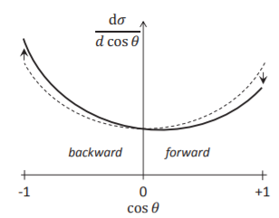
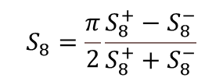


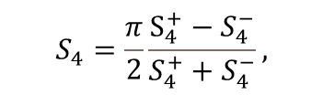
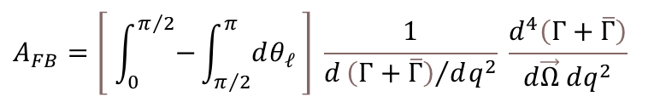


Counting Fit
$dΓ$
A completely different approach for some angular observables, known as counting method, predicts that
$$A_{FB}=\left[ \int_{0}^{π/2}{−}\int_{π/2}^{π}{dθ_{𝓁}} \right] \frac{1}{d{\left(Γ+\overline{Γ}\right)}/{dq^{2}}} \frac{d^{4}\left(Γ+\overline{Γ}\right)}{d\vec{Ω} dq^{2}}$$
Wascko M. 2022 Nuclear and Particle Physics.
Imperial College London. Course Notes.
$$S_{4}=\frac{π}{2}\left[ \int_{0}^{π/2}{−}\int_{π/2}^{π}{dθ_{𝓁}} \right]\left[ \int_{0}^{π/2}{−}\int_{π/2}^{π}{dθ_{K}} \right]\left[ −\int_{−π}^{−π/2}{+}\int_{−π/2}^{π/2}{−}\int_{π/2}^{π}{dφ}\right]\frac{1}{d{\left(Γ+\overline{Γ}\right)}/{dq^{2}}}\frac{d^{4}\left(Γ+\overline{Γ}\right)}{d\vec{Ω} dq^{2}}$$
$$S_{5}=\frac{4}{3} \left[ \int_{0}^{π}{dθ_{𝓁}} \right] \left[ \int_{0}^{π/2}{−}\int_{π/2}^{π}{dθ_{K}} \right]\left[ −\int_{−π}^{−π/2}{+}\int_{−π/2}^{π/2}{−}\int_{π/2}^{π}{dφ}\right]\frac{1}{d{\left(Γ+\overline{Γ}\right)}/{dq^{2}}}\frac{d^{4}\left(Γ+\overline{Γ}\right)}{d\vec{Ω} dq^{2}}$$
$$S_{7}=\frac{4}{3} \left[ \int_{0}^{π}{dθ_{𝓁}} \right] \left[ \int_{0}^{π/2}{−}\int_{π/2}^{π}{dθ_{K}} \right] \left[ −\int_{−π}^{0}{+}\int_{0}^{π}{dφ}\right] \frac{1}{d{\left(Γ+\overline{Γ}\right)}/{dq^{2}}}\frac{d^{4}\left(Γ+\overline{Γ}\right)}{d\vec{Ω} dq^{2}}$$
$$S_{8}=\frac{π}{2}\left[ \int_{0}^{π/2}{−}\int_{π/2}^{π}{dθ_{𝓁}} \right]\left[ \int_{0}^{π/2}{−}\int_{π/2}^{π}{dθ_{K}} \right] \left[ −\int_{−π}^{0}{+}\int_{0}^{π}{dφ}\right] \frac{1}{d{\left(Γ+\overline{Γ}\right)}/{dq^{2}}}\frac{d^{4}\left(Γ+\overline{Γ}\right)}{d\vec{Ω} dq^{2}}$$
$$A_{FB}=\frac{A_{FB}^{+}−A_{FB}^{−}}{A_{FB}^{+}+A_{FB}^{−}},$$
$$S_{4}=\frac{π}{2}\frac{S_{4}^{+}−S_{4}^{−}}{S_{4}^{+}+S_{4}^{−}},$$
$$S_{5}=\frac{4}{3}\frac{S_{5}^{+}−S_{5}^{−}}{S_{5}^{+}+S_{5}^{−}},$$
$$S_{7}=\frac{4}{3}\frac{S_{7}^{+}−S_{7}^{−}}{S_{7}^{+}+S_{7}^{−}},$$
$$S_{8}=\frac{π}{2}\frac{S_{8}^{+}−S_{8}^{−}}{S_{8}^{+}+S_{8}^{−}}$$

Slide 13
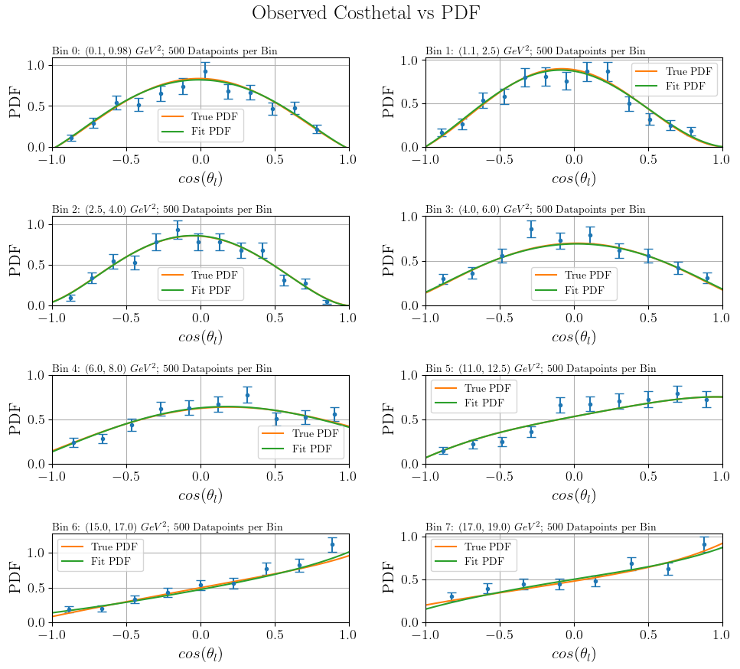
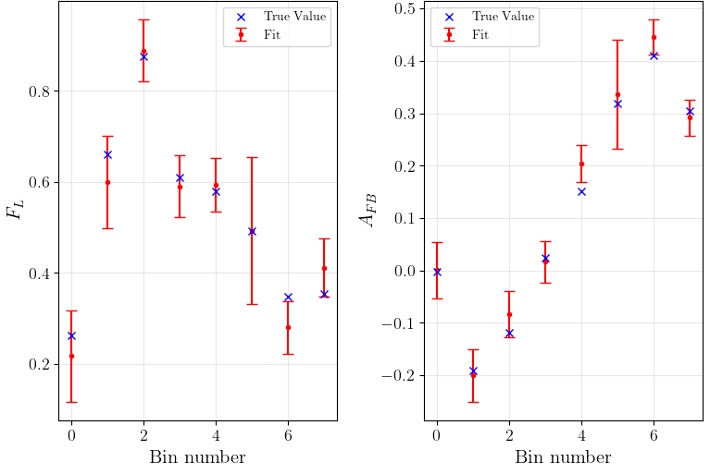
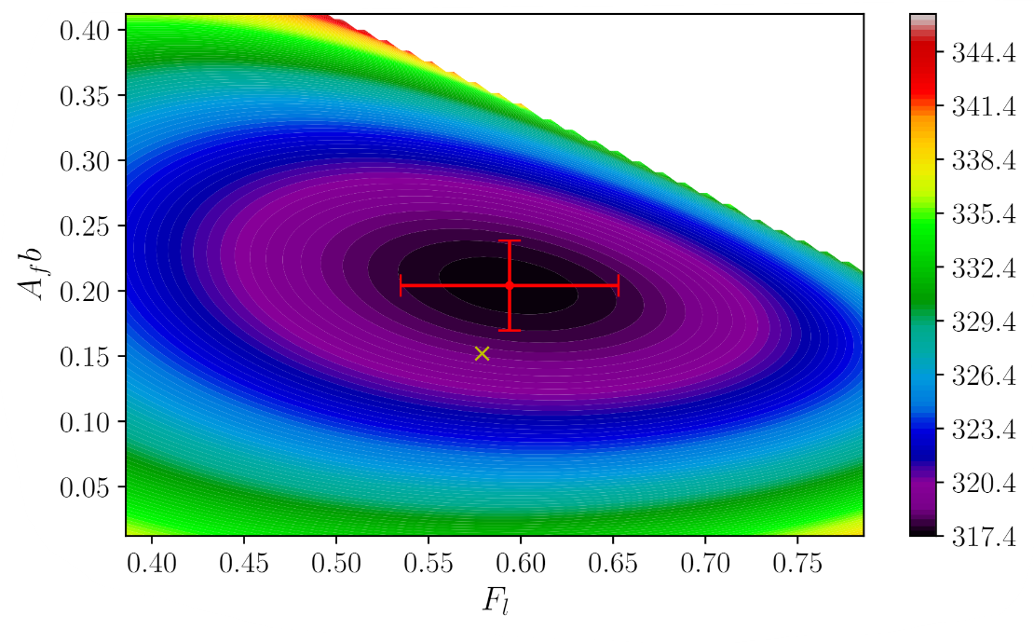
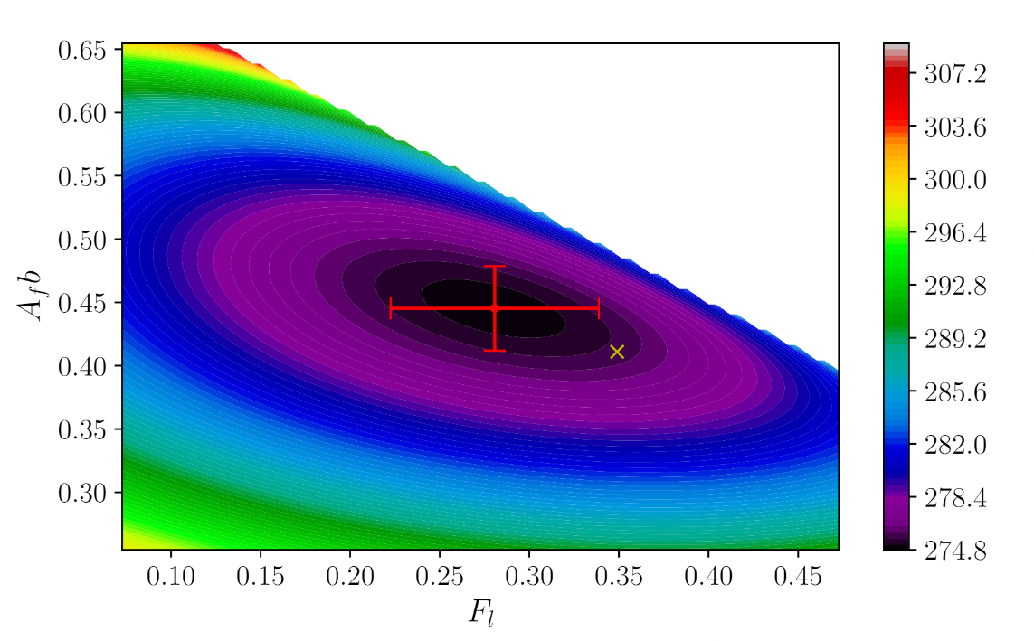

Testing Toy Data – ${NLL}_{θ_{ℓ}}$
Let’s look at the outcasts:
Bin 4
Bin 6

Slide 14
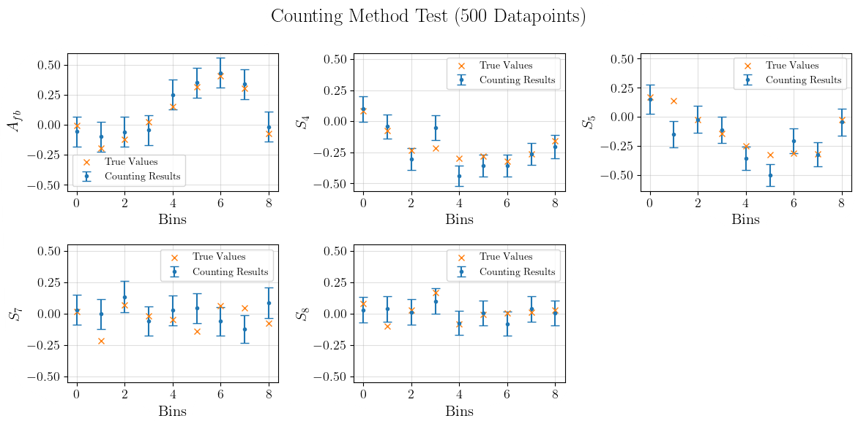

Testing Toy Data – Counting
Counting, $1σ \sim \sqrt{n}$ , then, when normalising:
$$1σ_{norm}\sim \frac{\sqrt{n}}{n}\sim \frac{1}{\sqrt{n}}$$

