Slide 1
Classification Analysis for Cancer Detection
In Machine Learning and Content Analytics
From the MSc in Business Analytics Full time students:
Chalioris Stefanos-Anthimos (F2821916) & Melekos Panagiotis-Chrysovalantis (F2822008)

Slide 2
Our Goal
The purpose of this assignment is to create a model that will be able to classify successfully batches of images in 5 classes. This will be used by doctors worldwide in order to assist them in cancer detection on two different organs.

Slide 3
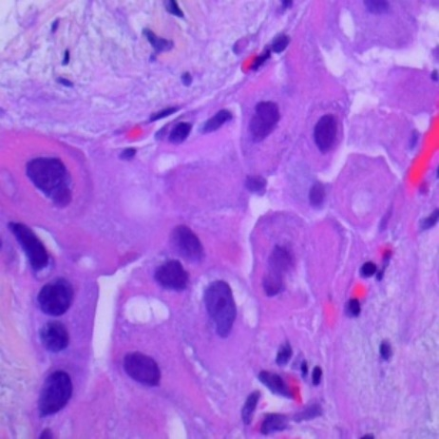
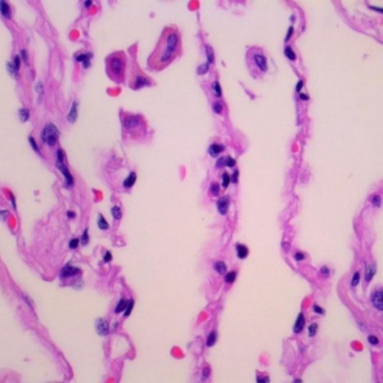
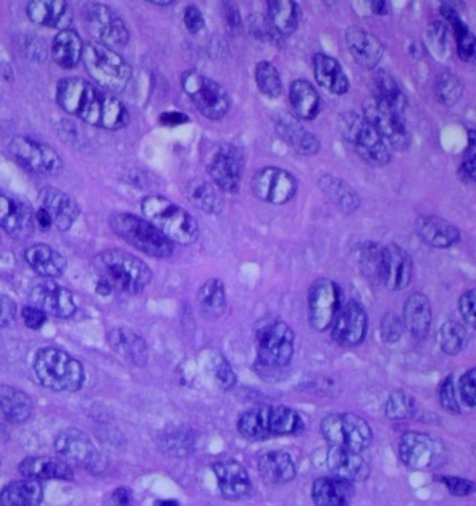
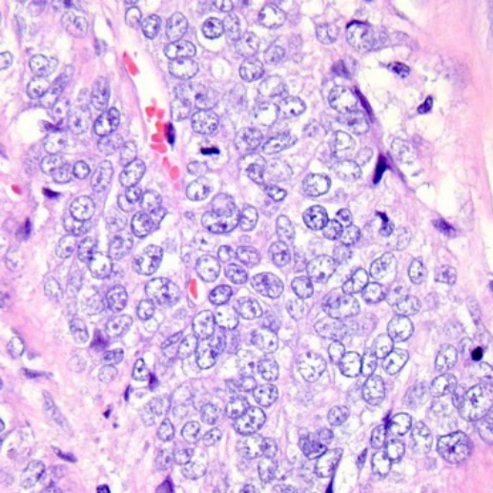
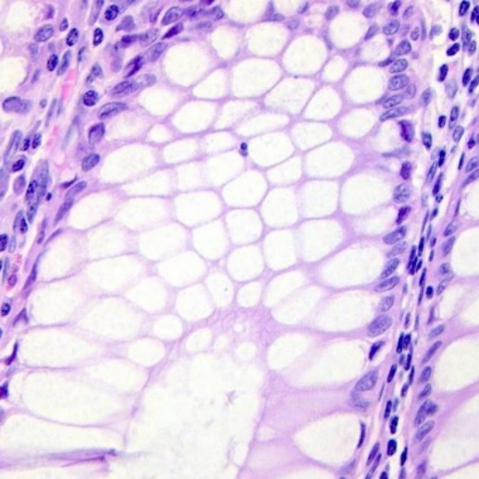
Dataset Overview
Lung adenocarcinoma
Lung benign tissue
Lung squamous cell carcinoma
Colon adenocarcinoma
Colon benign tissue

Slide 4
Dataset Overview
The dataset contains 25.000 images for 5 classes of cancer-benign tissue for 2 different organs. More specifically, 5000 images with lung benign tissue, 5000 images with lung adenocarcinoma, 5000 images with Lung squamous cell carcinoma, 5000 images with Colon adenocarcinoma and 5000 images with Colon benign tissue.

Slide 5
Pre-modeling activities
We split our data into 3 different folders: train, validation and test. Training folder contained 70% of the total images, validation folder contained 20% of total images and test folder contained 10% of the total images.

Slide 6
The Algorithms

Slide 7
Multi-Layer Perceptrons (MLPs)
A vast category of artificial neural networks are multi-layer perceptrons (MLPs). A multilayer perceptron (MLP) is a feedforward artificial neural network that generates a set of outputs from a set of inputs. An MLP is characterized by several layers of input nodes connected as a directed graph between the input and output layers.

Slide 8
Characteristics of Multi-Layer Perceptrons (MLPs)
The first layer consists of the input parameters of the images and a flatten function. The input parameters are: 224 x 224 x 3.
We added a second hidden layer with a dense function of 1024 neurons and an activation function called “relu”.
Adding a dropout layer, with a 25% of dropout.
The output layer has 5 neurons, followed by a softmax activation function.

Slide 9
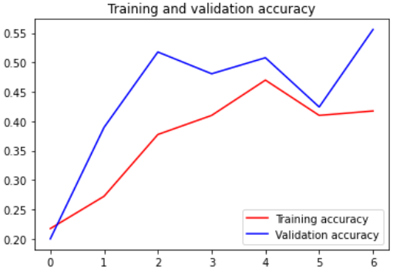
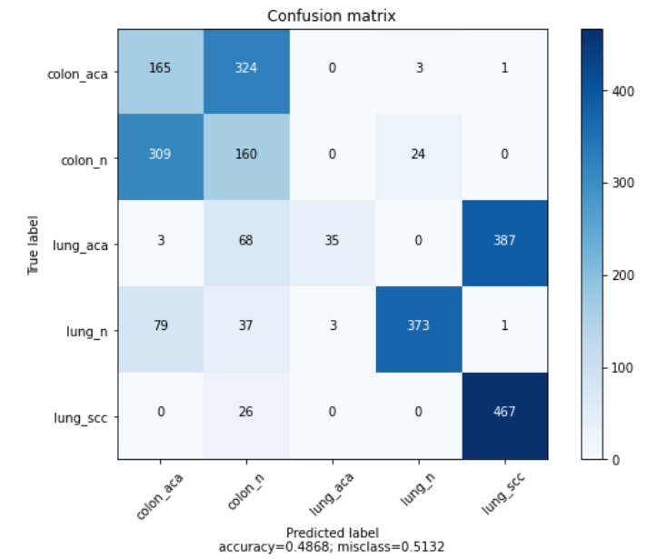
Results of Multi-Layer Perceptrons (MLPs) without augmentation

Slide 10
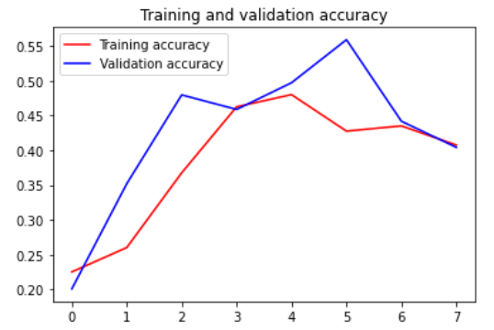
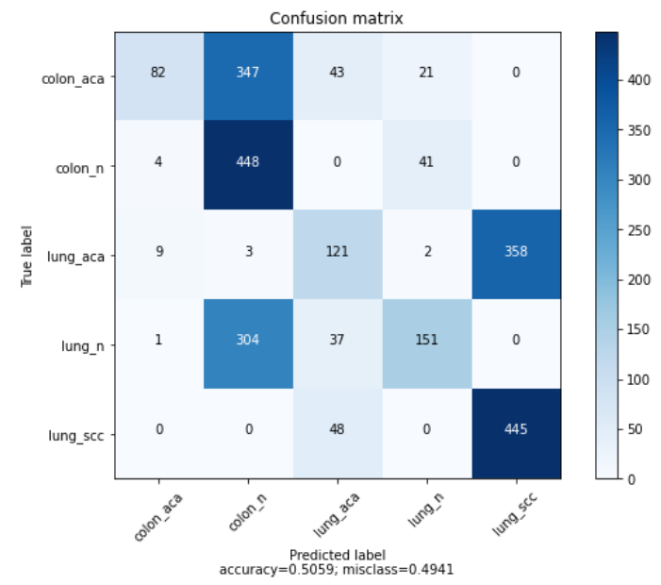
Results of Multi-Layer Perceptrons (MLPs) with augmentation

Slide 11
Convolutional Neural Networks (CNNs)
A Convolutional Neural Network (CNN) is a Deep Learning algorithm which can take in an input image, assign importance (learnable weights and biases) to various aspects/objects in the image and be able to differentiate one from the other.

Slide 12
Characteristics of Convolutional Neural Networks (CNNs)
The first layer is Convolution layer with 32 filters (output space), kernel size 3x3 (height x width), an activation function and the input shape of the previous models.
Adding a second pooling layer of max pooling with a kernel size of 2x2.
A third convolutional layer is added with 64 filters, kernel size of 3x3 and activation function relu.
Adding a dropout layer, with a 25% of dropout.

Slide 13
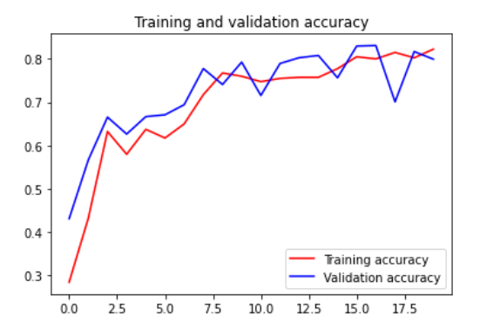
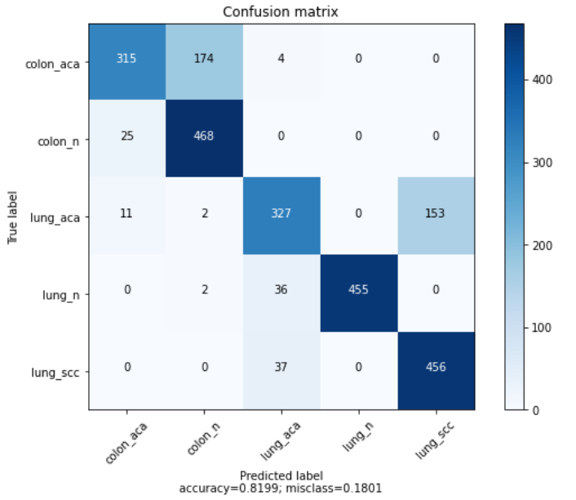
Results of Convolutional Neural Networks (CNNs) without augmentation

Slide 14
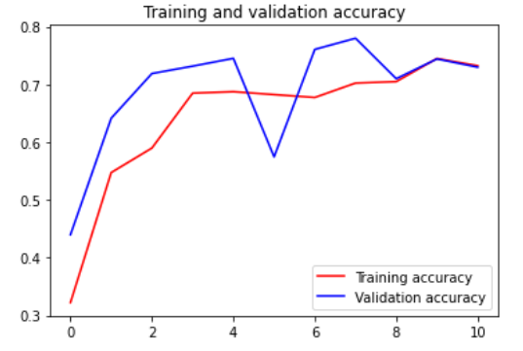
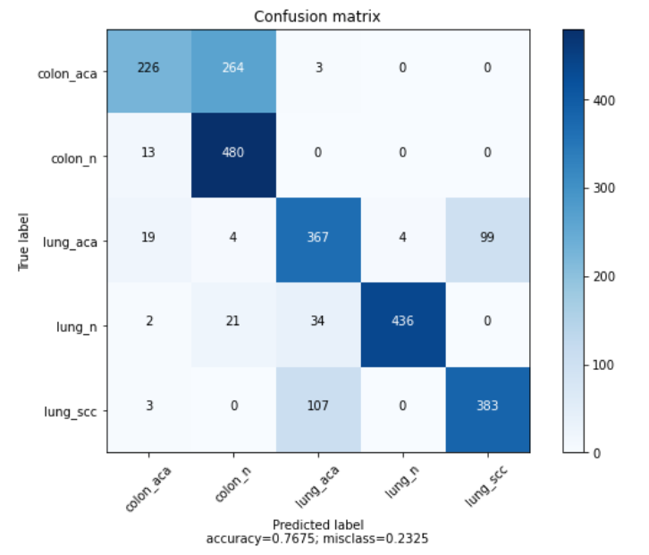
Results of Convolutional Neural Networks (CNNs) with augmentation

Slide 15
Inceptionv3
Inceptionv3 mainly focuses on burning less computational power by modifying the previous Inception architectures, both in terms of the number of parameters generated by the network and the economical cost incurred.

Slide 16
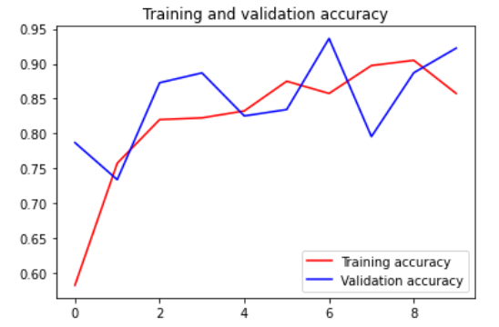
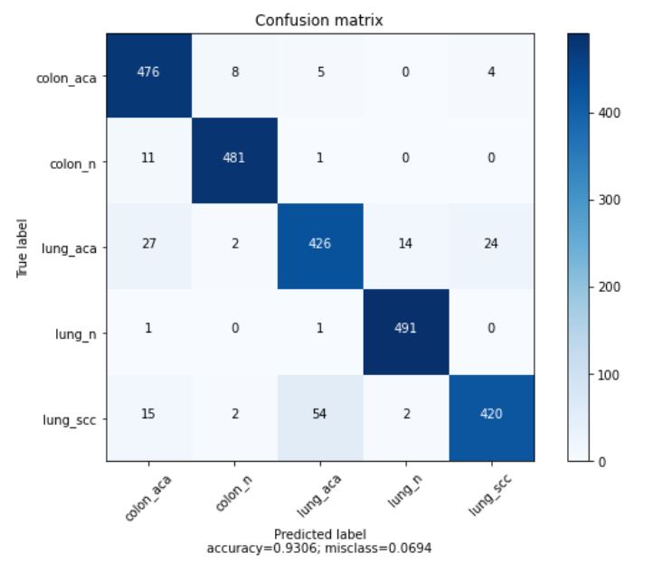
Results of Inceptionv3 without augmentation

Slide 17
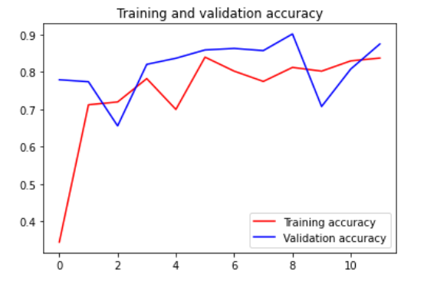
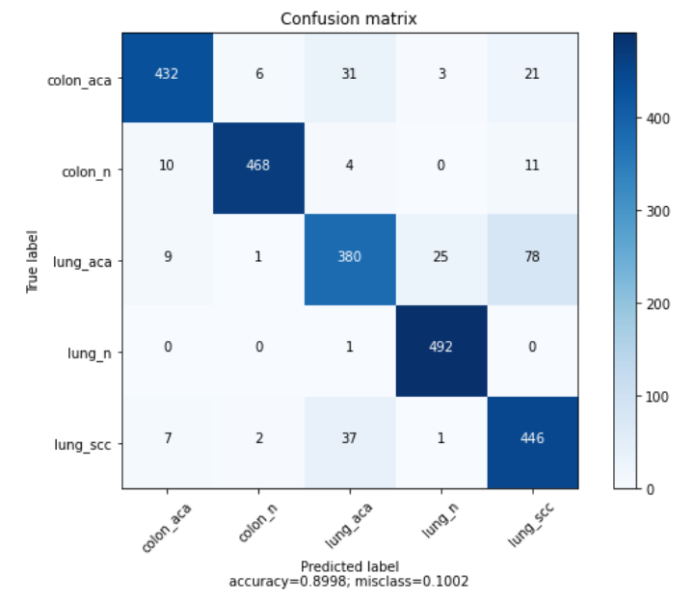
Results of Inceptionv3 with augmentation

Slide 18
Conclusions
CNN and Inceptionv3 performed worse with augmentation.
The best model is the Inceptionv3 without augmentation with an accuracy of 93%.

Slide 19
Thank you ☺

