Slide 1
Data Visualization
Redi Python Course

Slide 2
What is data visualization?

Slide 3
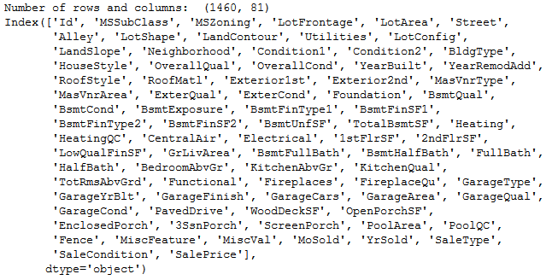
What is data visualization?

Slide 4

What is data visualization?

Slide 5
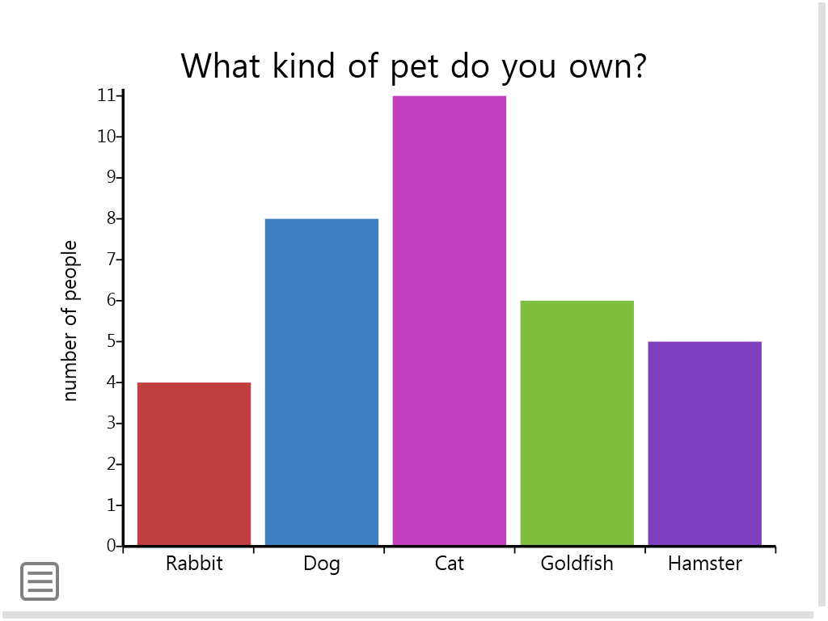
What is data visualization?

Slide 6
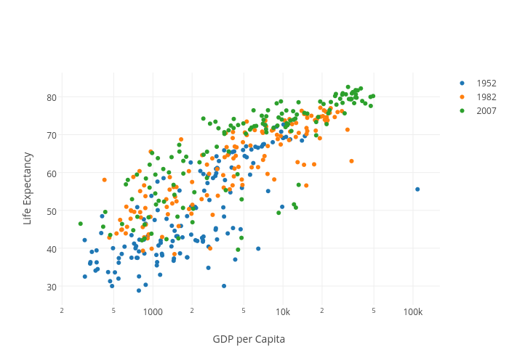
What is data visualization?

Slide 7
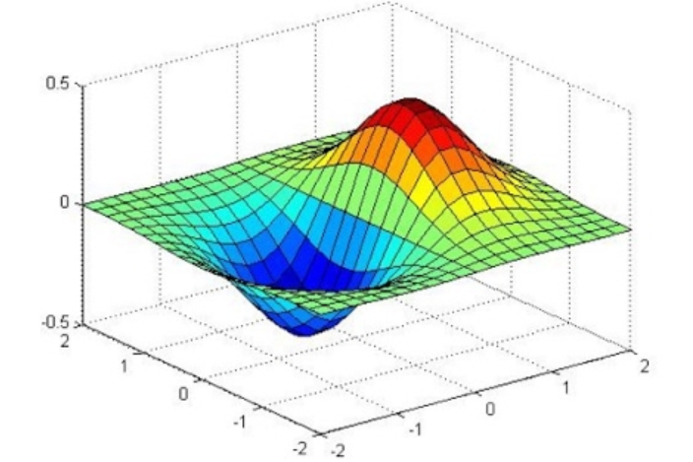
What is data visualization?

Slide 8
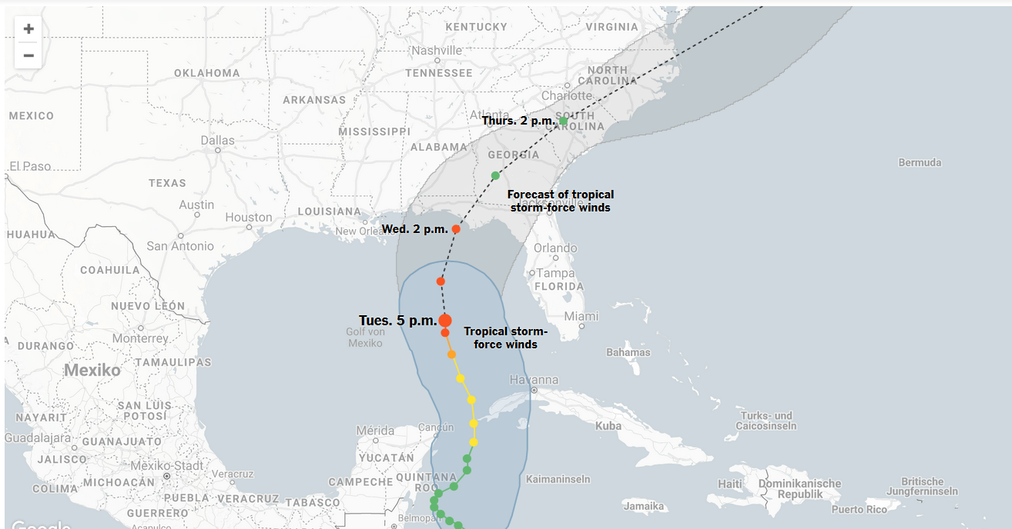
What is data visualization?
https://www.nytimes.com/interactive/2018/10/08/us/tracking-hurricane-michael-path.html

Slide 9
What is data visualization?
Data visualization is the presentation of data in a pictorial or graphical format
For exploration, discovery and insights
Source: https://www.sas.com/en_us/insights/big-data/data-visualization.html

Slide 10
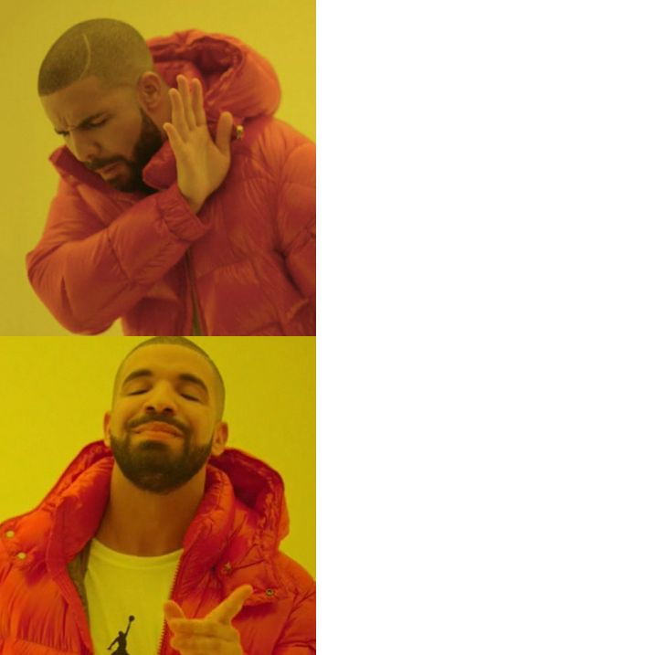
Why is data visualization important?
Because of the way the human brain processes information, using charts or graphs to visualize large amounts of complex data is easier than poring over spreadsheets or reports.
Source: https://www.sas.com/en_us/insights/big-data/data-visualization.html

