Slide 1

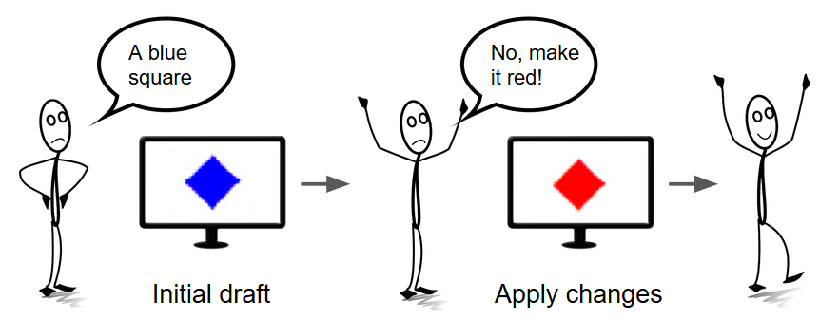
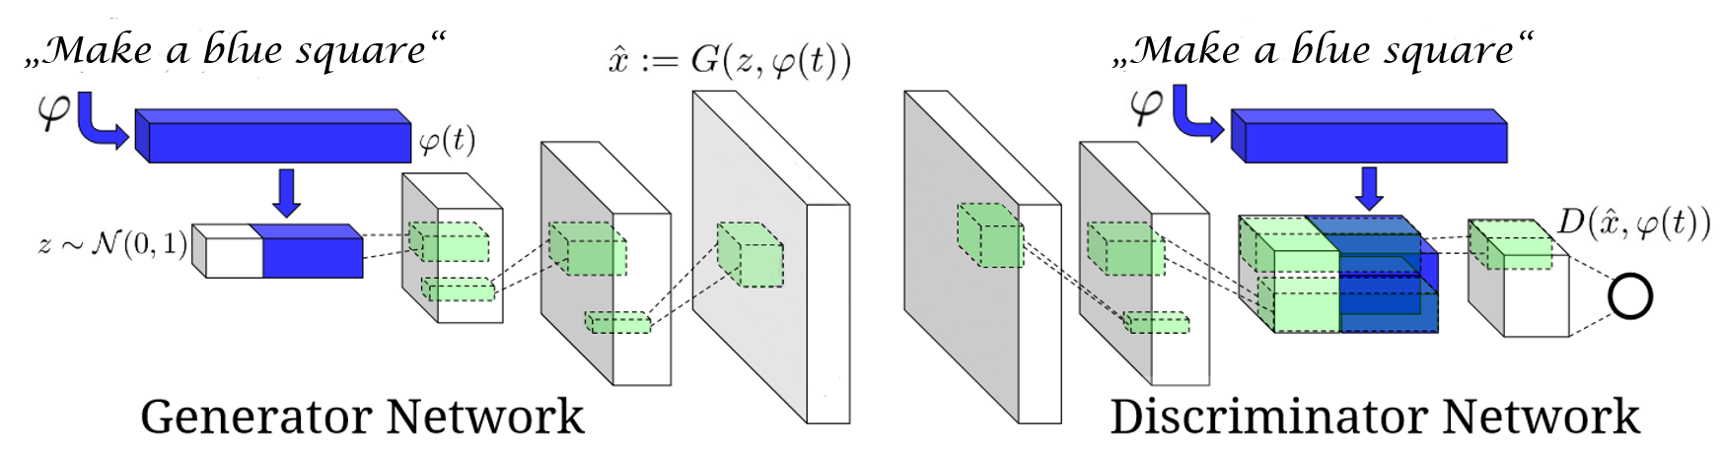

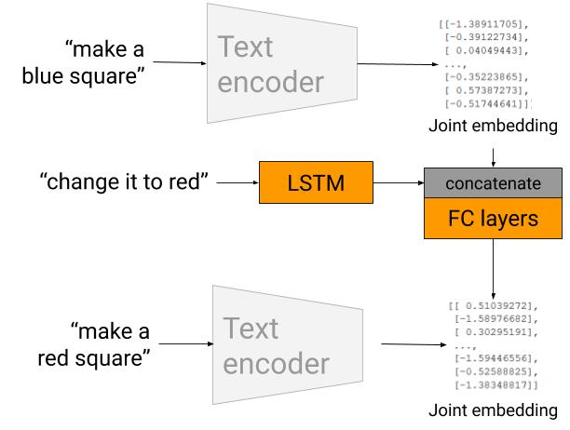
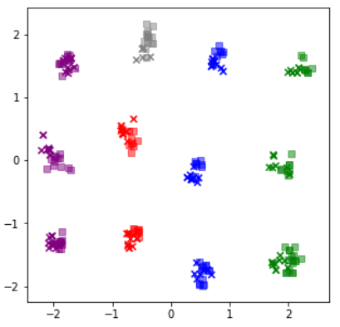
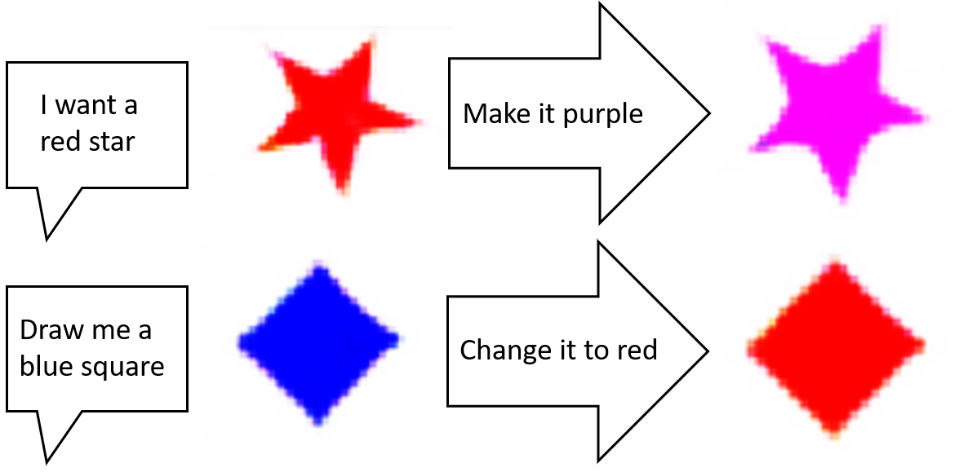
An intuitive natural language based image generation process
Steffen Berhorst Lukas Bonauer
Advanced Deep Learning for Computer Vision (IN2364)
The Idea
Generator GAN
The idea is to create images by describing them in your own words, instead of using a hard to learn design software.
For us, a complete design process consists not only of an initial draft, but also iterative changes that you can apply until you are happy with your result!
Schematic of the CGAN Generator Network. Figure adapted from Reed et al.(2016)
The Data
The generator is a conditional GAN (CGAN), consisting of a Generator G and a Discriminator D. The input joint embedding vector t is concatenated with a random vector z. The generated image is fed into the Discriminator D. After the image is processed, the intermediate result is concatenated with the input text embedding again before passing through the final fully connected layers.
The conditioning allows the discriminator to not only detect fake images, but also images not fitting the given description.
The mean Wasserstein color distance between generated and corresponding real images amounts to only 0.0026 +- 0.0006, indicating well fitting colors in generated images.
The dataset is self-generated. It consists of several shapes (square, star, triangle) in different colors (green, red, blue, purple).
How it works
There are two types of input: Descriptions
of images and already existing images.
The input is mapped to a joint embedding
space by Encoder Networks, implicitely
encoding the content information.
Vectors from this embedding space can be
transformed to images by a CGAN Generator
Network. The generator additionally includes
random vector z, which determines non specified factors such as rotation or size. To apply changes to an image, the Modifier Network shifts the joint embedding of an image. The shift is defined by a text description of the desired change. When generating this new image, it shares the previous random vector to ensure fitting position and size.
Modifier Network
The Modifier Network first passes the modification instruction through another LSTM. The result is joined with the initial embedding, before being passed through a fully connected network outputting the resulting embedding.
After modification, images still exhibit a mean Wasserstein color distance of 0.0026 +- 0.0007. The modifications are precise and do not negatively affect color quality of images.
Results
Encoder Networks
The Text Encoder is a Long short-term memory network, the Image Encoder a Convolutional Neural Network. Both Networks map to the same joint embedding space. In the training phase, triplet loss ensures two properties:
Similar images and text descriptions of these images are close to each other
Differing images are far from each other, and description embeddings are far from images not fitting the description.
The resulting embedding space is well formed and recovers the data properties of shape and color. The setup was inspired by Chen et al.(2018)
Image generation from descriptions
Successful modification by instructions
Clear shapes
Vivid colors
Joint embedding space samples projected to 2D with PCA. Crosses: Text Embeddings, Boxes: Image Embeddings
References
[1] Text2Shape: Generating shapes from natural language by learning joint embeddings. Chen et al., 2018.
[2] Generative adversarial text to image synthesis. Reed et al., 2016.

