Slide 1
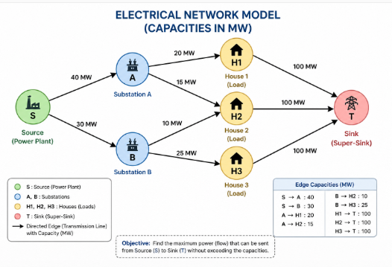
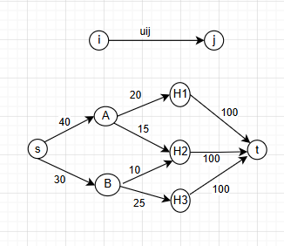
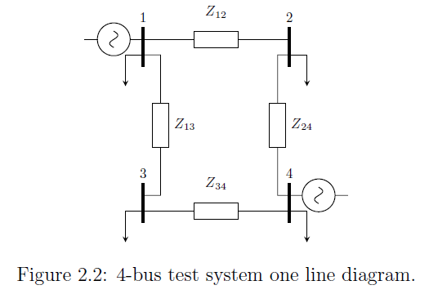
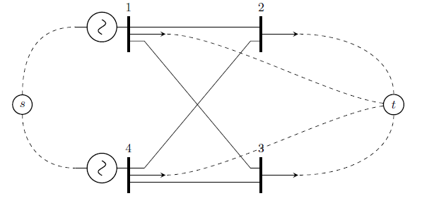
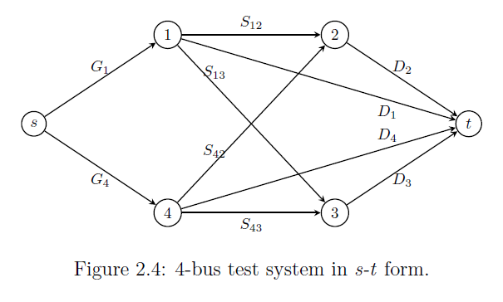
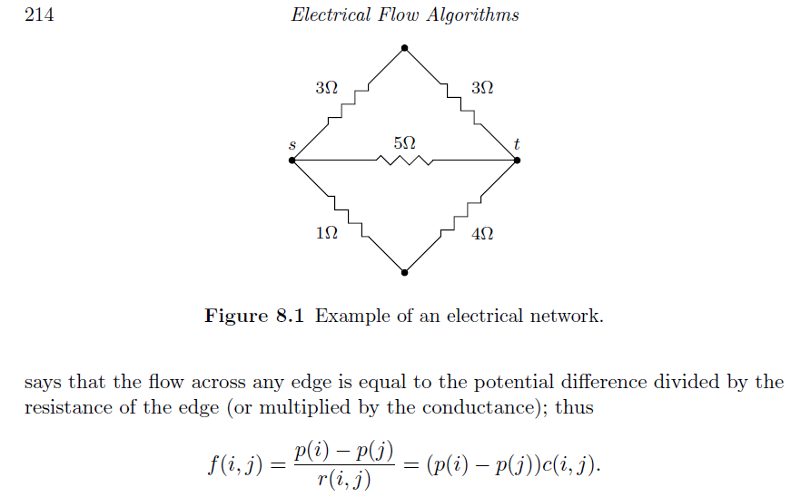
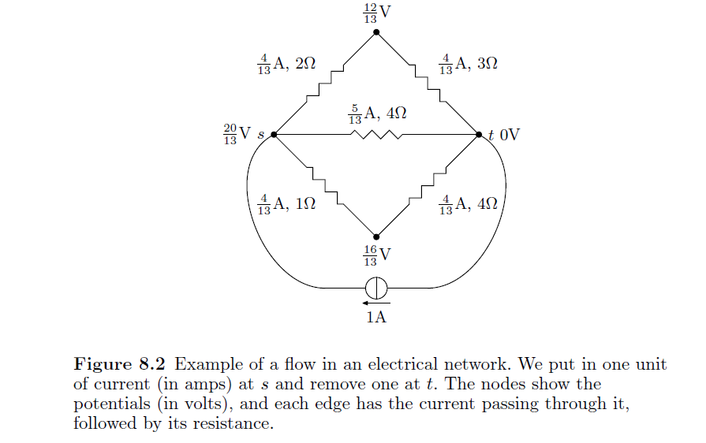
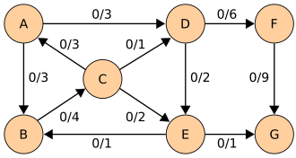
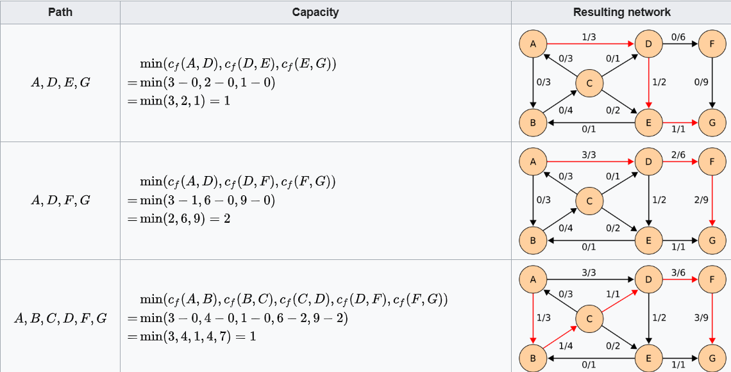
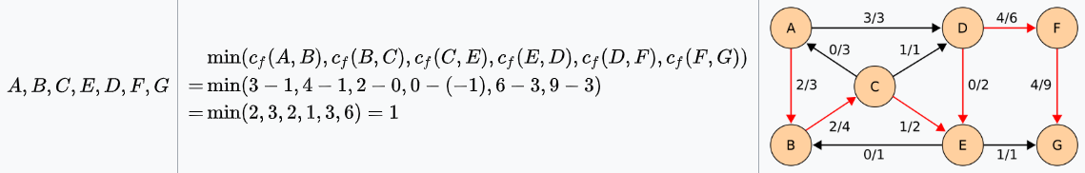



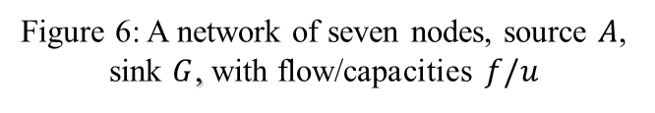
Maximum Flow analysis of Small Electrical Power distribution Network based on Electric flow algorithm
Khadija Amdored
Supervisor: Steffen Borgwardt
MATH 7825 _Spring2026
University of Colorado Denver
Department of Mathematical and Statistical Sciences
Abstract
Methodology
Data Analysis
System Design
Efficient electrical power distribution is a growing challenge as modern networks expand in scale and complexity. This project models and optimizes power flow in a small‑scale distribution system using network‑flow theory. The system includes one generation source, several substations, and multiple consumers connected by capacity‑limited transmission lines. Represented as a directed flow graph, nodes correspond to physical components and edges to transmission lines, with a super sink aggregating consumer demand. The Edmonds–Karp algorithm, a BFS‑based implementation of Ford–Fulkerson, computes the maximum feasible power transfer while revealing bottlenecks that constrain flow. Although simplified, the approach demonstrates how flow‑based optimization can inform efficient, reliable design of larger systems such as smart grids, renewable integration, and V2X infrastructures.
a. Electrical Networks:
Electrical networks can be modeled as an undirected graph $G\left(V,E\right)$, $as shown in figure 1$ where each edge $\left(i,j\right)∈E$has a resistance $r\left(i,j\right)>0$and a corresponding conductance $c(i,j)=1/r(i,j)$. A current flow $f$in this network is governed by two physical laws: Kirchhoff’s Current Law (KCL): At every node, the total current entering equals the total current leaving. If $b_{i}$denotes the net current injected at node $i$, then:
$\sum_{j:(i,j)∈E}{f(i,j)=}b_{i},\sum_{i∈V}{b_{i}}=0.$
And Ohm’s Law: Each node has a potential $p(i)$, and the current on an edge is proportional to the potential difference:
$$f(i,j)=\frac{p(i)−p(j)}{r(i,j)}=c(i,j) (p(i)−p(j)).$$
Substituting Ohm’s Law into KCL gives the standard electrical‑flow equation:$\begin{matrix} & b_{i}=\sum_{j:(i,j)∈E}{c(i,j) (p(i)−p(j)).} & & \end{matrix}$
In the example network (Figure 2), injecting one unit of current at source $s$and removing one unit at sink $t$yields a unique flow and node potentials that satisfy both laws. This flow is the optimal electrical flow, as it uniquely minimizes the total energy of the network.
b. Graph Laplacians: To express electrical‑flow equations in matrix form, we use the graph Laplacian. Let $e_{i}$be the standard basis vector with a 1 in position $i$. For an undirected graph $G(V,E)$, the Laplacian is
$$L_{G}=\sum_{\{i,j\}∈E}{(}e_{i}−e_{j})(e_{i}−e_{j})^{T}.$$
Each matrix ${\left(e_{i}−e_{j})(e_{i}−e_{j}\right)}^{T}$has $1$'s on the diagonal entries for $i$and $j$, $−1$at $\left(i , j\right)$and $\left(j , i\right)$, and zeros elsewhere. Thus, the Laplacian can also be written as $L_{G}=D−A,$where $D$is the diagonal degree matrix and $A$is the adjacency matrix. For weighted edges with weights $w(i,j)$, the weighted Laplacian is $L_{G}=\sum_{(i,j)∈E}{w(i,j)(}e_{i}−e_{j})(e_{i}−e_{j})^{T}=D−W,$
where $D_{ii}=\sum_{j}{w(i,j)}$and $W_{ij}=w(i,j)$. If the weights are conductance $c(i,j)$, then the electrical‑flow equation
$$\sum_{j:(i,j)∈E}{c(i,j)(p(i)−p(j))=b(i)}$$
can be written compactly as: $L_{G}p=b.$Then the flow vector is: $f=CB^{T}p,$
Where $C∈ℝ^{m×m}$be the diagonal matrix of conductance, and $B∈ℝ^{n×m}$be the incidence matrix whose column for edge $\left(i , j\right)$is $e_{i}−e_{j}$. and the weighted Laplacian satisfies $L_{G}=BCB^{T}.$
Finally, flow conservation becomes $b=L_{G}p=BCB^{T}p=Bf.$
d. Energy: For a resistor with resistance $r$and current $f$, the energy dissipated is $ε\left(f\right)=f^{2}r.$Thus, the total energy of a flow $f$in a graph $G$is:
$$ε(f)=\sum_{\left(i,j\right)∈E}{f^{2}(i,j}) r(i,j).$$
If the flow is defined by node potentials $p$, then using $c(i,j)=1/r(i,j)$:
$$ε\left(f\right)=\sum_{\left(i,j\right)∈E}{c(i,j) (p(i)−p(j)}=p^{T} \left(\sum_{(i,j)∈E}{c}(i,j)(e_{i}−e_{j})(e_{i}−e_{j})^{T}\right)p=p^{T}L_{G}p.$$
For an $s$-$t$ electrical flow: $L_{G}p=e_{s}−e_{t},$the energy becomes
$$ε(f)=p^{T}L_{G}p=p^{T}(e_{s}−e_{t})=p(s)−p(t)=r_{\text{eff}}(s,t).$$
Thus, the energy dissipated by sending one unit of current from $s$to $t$equals the effective resistance between them, treating the entire network as a single equivalent resistor.
2. Power System Transformation into s-t Flow:
To apply flow‑based methods to electric power systems, the network is converted into an $s\text{ _ }t$flow graph by linking all generator buses to a single super‑source and all load buses to a super‑sink. Consider an electrical network $N_{\text{electric}}=(B,D,G,L),$ with buses $B$, power lines $D$, generators $G$, and loads $L$. Each bus becomes a vertex in the corresponding graph $N_{st}=G(V,E)$, and each power line becomes an edge $\left(j , k\right)$. The source $s$supplies total demand plus losses, so the sum of flows on edges from $s$equals total generated power. The sink $t$collects all load demand, with each edge $\left(j , t\right)$representing the load at bus $j$. Edges incident to $s$and $t$have no electrical characteristics and do not affect internal power flows. Figures 3-5 show a 4‑bus system, its graph representation, and the resulting $s_t$transformation. [2]
a. Maximum Flow Mathematical Model.
For an electric network $N_{\text{electric}}^{st}=\left(G\left(V,E\right),s,t,G,L\right),$with vertices $V$, edges $E$, source $s$, sink $t$, generator set $G$, and load set $L$, a power‑flow solution is feasible if the flow function $f:A→ℂ$satisfies: Flow conservation at all internal buses: $\sum_{k:(i,k)∈E}{f(i,k)=0,}∀i∈V∖\{s,t\}.$ Source supplies total generation: $\sum_{j:(s,j)∈E}{f(s,j)=}\sum_{g∈G}{g.}$
Sink receives total load: $\sum_{j:(j,t)∈E}{f(j,t)=}\sum_{l∈L}{l.}$ The resulting flow must satisfy load demand and remain consistent with Kirchhoff’s laws. However, applying classical network‑flow methods to power systems introduces two challenges: ensuring voltage and current laws are preserved, and managing the large solution space that arises in traditional flow formulations.
3. Edmonds–Karp Algorithm:
The Edmonds–Karp algorithm is an efficient, BFS‑based implementation of the Ford–Fulkerson method for computing maximum flow. By using breadth‑first search to always select the shortest augmenting path in the residual graph, it guarantees polynomial‑time termination with complexity $O\left(nm^{2}\right)$. Unlike general Ford–Fulkerson, which may perform poorly if it chooses inefficient paths, Edmonds–Karp limits how often edges can become bottlenecks, ensuring a predictable and efficient runtime.
Example: Given a network of seven nodes, source $A$, sink $G$, and capacities as shown below in figure 6, In the pairs $f/u$written on the edges, $f$ is the current flow, and $u$is the capacity. The residual capacity from $i$ to $j i$s $u_{f}(i,j)=u(i,j)−f(i,j)$, the total capacity, minus the flow that is already used. [3]
4. Power System Design:
Efficient electrical power distribution is a key challenge, as power must move from generators to consumers through capacity‑limited transmission lines. This project models a small distribution system as a flow network and uses maximum‑flow principles to determine how much power can be delivered without violating these limits. The Edmonds–Karp algorithm is applied to compute the optimal flow, ensuring the maximum feasible transfer through the network.
4.1. Electrical Network Model
The electrical system consists of: One power plant (source), Two substations and Three houses (loads)as shown in figure 7. The transmission lines have the following capacities:
Power Plant → Substation A = 40 MW , Power Plant → Substation B = 30 MW
Substation A → House 1 = 20 MW , Substation A → House 2 = 15 MW
Substation B → House 2 = 10 MW , Substation B → House 3 = 25 MW
4.2. Graph Network Model
To apply flow algorithms, the electrical network is converted into a directed flow graph as shown in figure 8, Source node $s$: Power Plant, Intermediate nodes: Substations A and B and Sink node $t$: represents total demand. Each house is connected to the sink $t$with a large capacity (e.g., 100 MW), ensuring no restriction at the demand side.
4.3. Edmond–Karp Algorithm
The Edmonds–Karp algorithm is an implementation of the Ford–Fulkerson method that uses Breadth-First Search (BFS) to find the shortest augmenting paths.
Start with zero flow.
Find a path from source $s$to sink $t$.
Determine the minimum capacity (bottleneck).
Send flow along the path.
Update residual capacities.
Repeat until no path exists.
This guarantees finding the maximum flow in polynomial time. Find augmenting paths one by one.
1st path: S → A → H1 → T, Minimum capacity on this path: $\min\left(40,20,100\right)=20$
So, send 20 MW.
2nd path: S → A → H2 → T, $\min\left(20,15,100\right)=15,$Send 15 MW.
3rd path: S → B → H2 → T, $\min\left(30,10,100\right)=10,$Send 10 MW.
4th path: S → B → H3 → T, $\min\left(30,25,100\right)=25,$Send 25 MW.
Total maximum flow: $20+15+10+25=70 \text{MW}$, The maximum power that can be delivered from the power plant to all houses is: $70 \text{MW}$
This result satisfies all capacity constraints of the transmission lines.
Figure 8: Electrical network model with capacities (MW)
Figure 9 Graph Network Model with capacities (MW)
Figure 3: 4-bus test system one line diagram
Figure 4: 4-bus test system in graph form
Figure 5: 4-bus test system in s-t from
Introduction
Electrical Flow Algorithms are a class of optimization methods in graph theory that interpret network flow as electrical current. A graph is treated like an electrical circuit: edges act as resistors with capacities mapped to resistance, nodes function as junctions where current enters or exits, and flow behaves like electrical current governed by Ohm’s Law and Kirchhoff’s Current Law. These algorithms provide a global view of the network and can be solved in nearly linear time using Laplacian solvers, making them faster than many traditional max‑flow methods for large problems. They also produce diverse, robust routing solutions, useful in applications such as GPS navigation. The goal of optimization is to minimize total energy, yielding flows that are both short and well‑distributed. Electrical flow methods underpin several major applications: approximating maximum flows and minimum cuts through iterative electrical‑flow computations, identifying bottleneck edges in network analysis, and supporting Optimal Power Flow (OPF) in smart grids to manage decentralized energy sources like solar and wind. [1]
Figure 1: example of an electrical network
Figure 2: nodes display potential (volts), and edges are labeled with the current flow (amps) through resistance (ohms).
Conclusion
This project focused on applying maximum flow algorithms to a simplified electrical network consisting of a power source, substations, and multiple load nodes. The network was modeled as a directed graph with capacity constraints on each transmission line. A super-sink was introduced to unify the loads into a single destination, enabling the use of standard flow algorithms. The Edmonds–Karp algorithm was used to determine the maximum power that can be transmitted through the network. The process involved identifying augmenting paths using breadth-first search, calculating bottleneck capacities, and updating the residual graph iteratively. Manual calculations were performed to illustrate each step, and the results were verified using MATLAB. The final outcome showed that the maximum achievable power flow is 70 MW, constrained by the capacities of specific transmission paths. The project demonstrates how graph-based optimization techniques can be used to analyze and improve electrical systems, providing a foundation for more advanced applications in power engineering.
Objective
This project seeks a simplified approach to model and optimize power flow in a small‑scale distribution network using principles of network‑flow theory. The electrical system is represented as a directed flow graph, where nodes denote physical components and edges correspond to transmission lines with defined capacity limits. A super‑sink node aggregates consumer demand, enabling the application of classical maximum‑flow algorithms. The Edmonds–Karp algorithm—an implementation of the Ford–Fulkerson method that employs breadth‑first search (BFS) to identify augmenting paths—is used to determine the maximum feasible power transfer across the network.
Figure 6: A network of seven nodes, source $A$, sink $G$, with flow/capacities $f/u$
Figure 7: Edmond Karp Algorithm is applied on the network.
Bibliography
Methodology
References:
[1] Graph-Based Power Flow Solution Methods for Electric Power Systems, Ayman M. OTHMAN MOHAMED, Waterloo, Ontario, Canada, 2022.
[2] Network Flow Algorithm 2019, Davis P. Williamson, Cornell University
[3] http://en.wikipedia.org/wiki/Edmonds%E2%80%93Karp_algorithm.
1. Electrical flow:
This section explores electrical flows within resistor networks and their connections to graph theory, with applications to computing maximum flows in undirected graphs and graph scarification. It also introduces an algorithm for computing these flows, which shares similarities with the network simplex algorithm.

