Slide 1

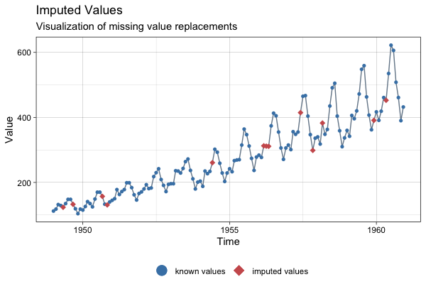
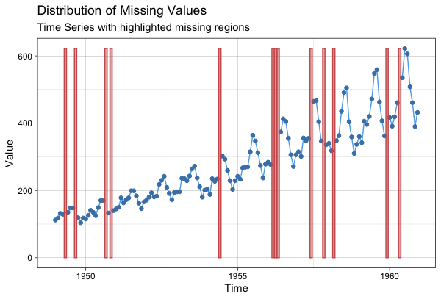
Time Series Imputation with imputeTS: : CHEAT SHEET
Mission
Imputation
Imputation Analysis Plots
Missing Data is nearly everywhere. Also in time series, especially in sensor recordings missing data is common.
The package offers multiple missing data replacement (imputation) functions, which are really easy to use.
Imputation results can be visualized with the ‘imputations’ plot. Here first na_kalman is performed and then the results are plotted.
imputeTS helps you with your missing data problems.
na_interpolation(x, option = “spline“)
Features
Imputation
Function
Your input
time series
Additional
Parameters
The package provides easy to use functions in these areas:
List of available Algorithms
Function | Description
na_interpolation | Imputation by Interpolation
na_kalman | Imputation by Kalman Smoothing
na_locf | Last Observation Carried Forward
na_ma | Imputation by Moving Average
na_mean | Imputation by Mean Value
na_random | Imputation by Random Sample
na_remove | Remove Missing Values
na_replace | Replace Missing Values by a Defined Value
na_seadec | Seasonally Decomposed Imputation
na_seasplit | Seasonally Splitted Imputation
Imputation Functions
Several algorithms for replacing NAs with reasonable values (imputation).
Missing Data Visualizations
imp <- na_kalman(tsAirgap)
ggplot_na_imputations(tsAirgap, imp)
imputation
Plots for analysis of the distribution of NAs, patterns and imputation performance.
visualization
Stats and Datasets
Functions for printing missing data stats and benchmarking datasets.
Workflows
The functions also work well in tidy style pipe workflows. Here an example of first using imputation and later forecasting and plotting.
Scope
library(“forecast”)
tsAirgap %>% na_interpolation() %>% ets() %>% forecast(h=36) %>% autoplot()
can be put in pipe workflows
imputeTS specializes on univariate time series that are:
a 36 step forecast is created and plotted
numeric
equally-spaced
Missing Data Overview Plots
Visualizations
The ‘distribution’, ‘intervals’ and ‘gapsize’ plots can be used on new datasets to gain insights about missing data patterns and distribution.
Datasets
There are multiple plots provided for analysing the missing data before and after imputation. All plotting functions start with ggplot_na_plotname.
The package includes three datasets for imputation experiments.
Function | Description
tsAirgap | Monthly totals of international airline passengers. 144 Observations / 13 NAs
tsNH4 | NH4 concentration in a wastewater system. 3552 observations / 883 NAs
tsHeating | A heating systems supply temperature. 606837 observations / 57391 NAs
Function | Description
ggplot_na_distribution | Getting a first overview of NAs
ggplot_na_distribution2 | Insights about NAs in specific periods
ggplot_na_gapsize | Insights about occurring NA gapsizes
ggplot_na_imputations | Evaluating imputation quality
CITATION
You can cite imputeTS the following:
Moritz, Steffen and Bartz-Beielstein, Thomas. "imputeTS: Time Series Missing Value Imputation in R." R Journal 9.1 (2017). doi: 10.32614/RJ-2017-009.
ggplot_na_distribution(tsAirgap)
example data
with NAs
CC BY-SA • Steffen Moritz • steffen.moritz@gmail.com • https://github.com/SteffenMoritz/imputeTS package version 3.1 • Updated: July 2020

