Slide 1




Towards kinetic theory for multi-scale muscle models
Steffen Plunder
March 8, 2024

Slide 2
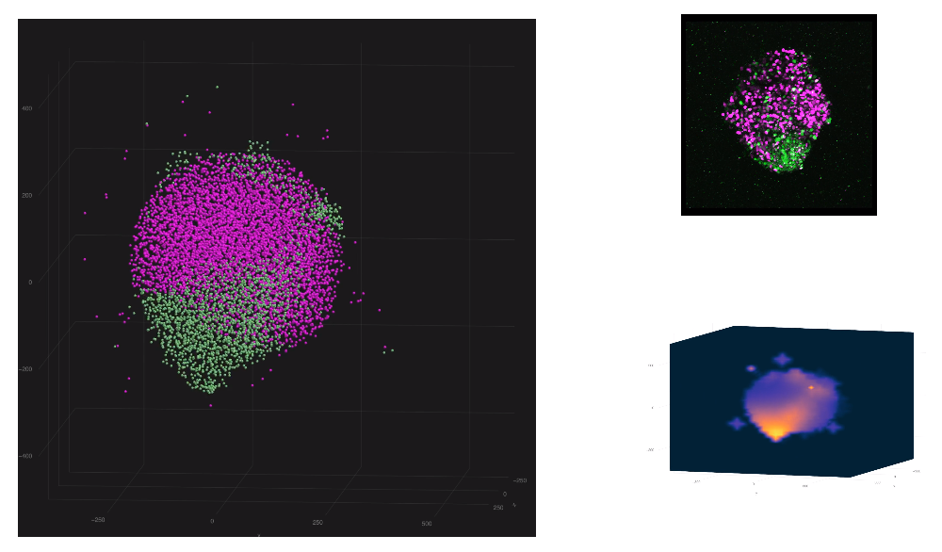
Short self-introduction
Current research in Kyoto Institute for the Advanced Study of Human Biology (ASHBi)
Limb bud
morphogenesis
Epithelial-to-mesenchymal
transitions
Developmental
biology
data
signaling
simulation
agent-based model for
growing epithelium

Slide 3
Today’s talk based on:
[1] S. Plunder, B. Simeon,
The mean-field limit for particle systems with uniform full-rank constraints.
Kinetic and Related Models. (2023)
[2] S. Plunder, B. Simeon,
Coupled Systems of Linear Differential-Algebraic and Kinetic Equations
with Application to the Mathematical Modelling of Muscle Tissue.
Conference preceding: Progress Differential-Algebraic Equations II. (2020).

Slide 4
Outline
1. Multi-scale (skeletal) muscle models
2. Abstract “macro-micro” model for tissue‒cross-bridge coupling
3. Convergence in mean-field limit to “macro-meso” model
4. Possible extensions
- impossible for me: adding a jump process for cross-bridge cycling
- easier (?): global “macro-macro” model and additive noise,
- abstract: non-full rank constraints
locally
macro‒micro
DAE
locally
macro‒micro
ODE
locally
macro‒meso
mf. char. ODE
locally
macro‒meso
mf. PDE
locally
macro‒macro
mf. PDE
global
macro‒macro
mf. PDE
future

Slide 5
Introduction

Slide 6
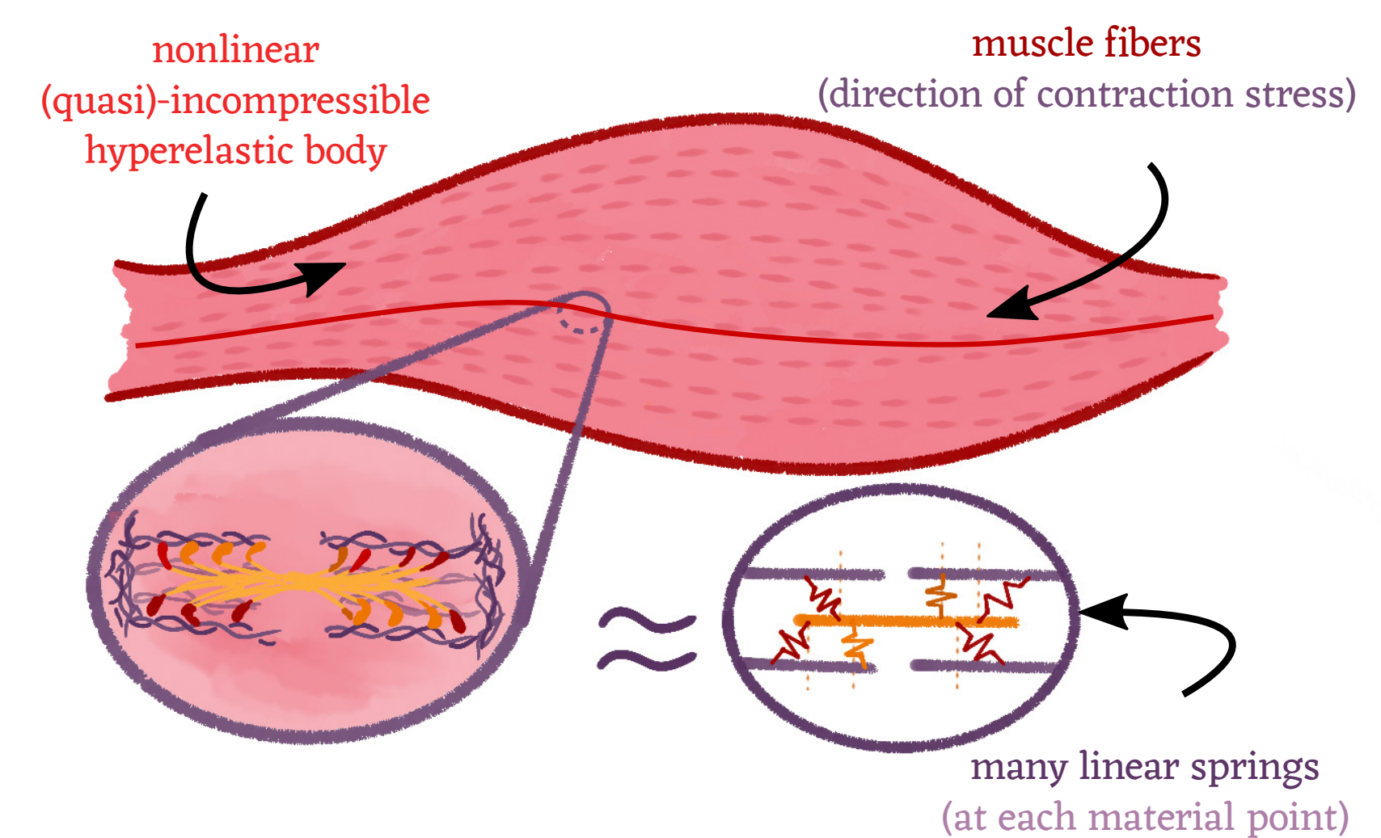
Motivation: Multi-scale muscle models
Question: How can we apply kinetic theory to such a system?

Slide 7
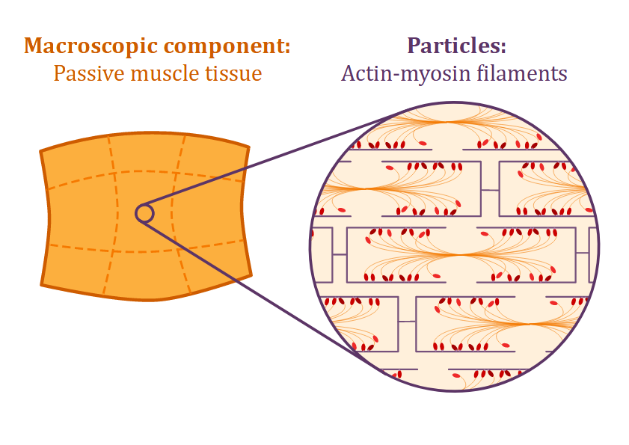
Challenges: From a kinetic theory perspective
Each attached cross-bridge is coupled to tissue deformation.
Hence, all particles interact with each other through the tissue!
(However, once formulated properly, kinetic theory works out rather well.)

Slide 8
Multi-scale muscle models
… and their lack of perfect physical structure

Slide 9
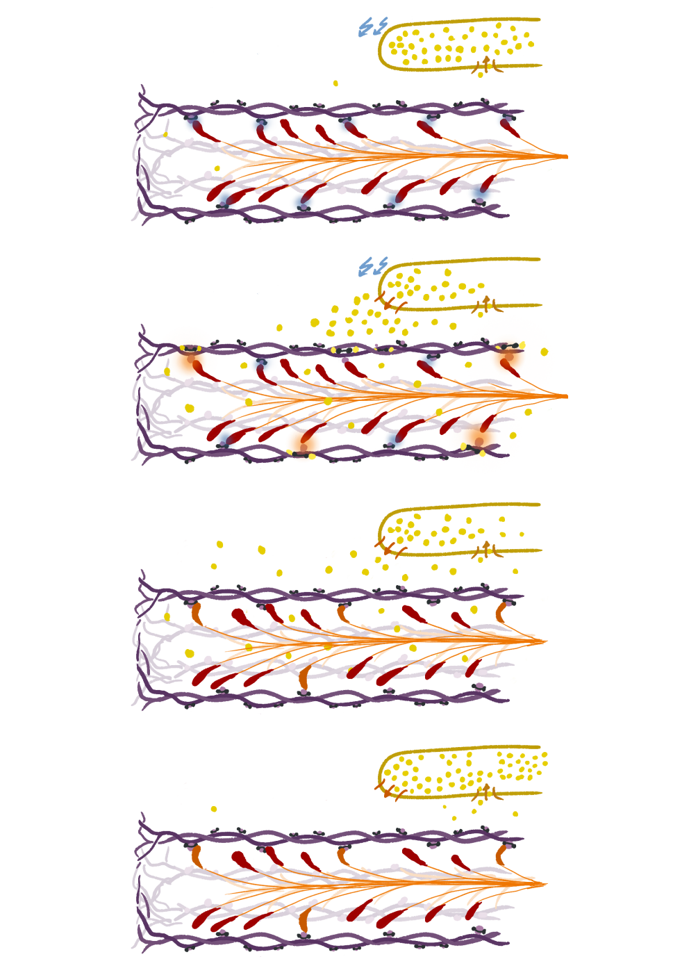
Ca²⁺
Foundations: Sliding filament theory
blocked
Huxley’s two-state mode:
attach
1. Cross-bridges have two states:
attached or detached.
2. Cross-bridge extension determines transition
probabilities between states.
3. Muscle deformation changes cross-bridge extensions
Generated force:
detach
Textbooks: [2009] J. Keener and J. Sneyd [2001] J. Howard

Slide 10
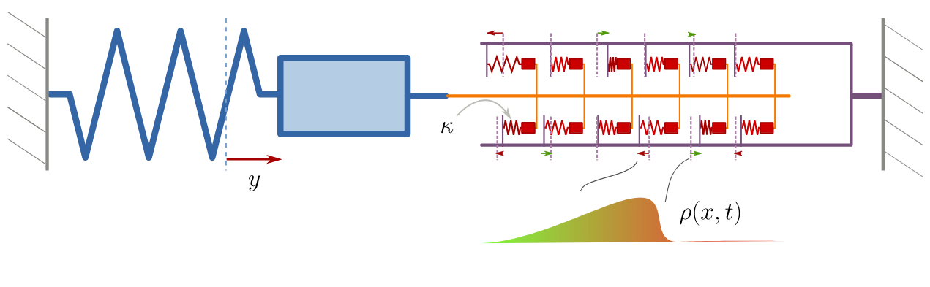
Unilateral tissue‒cross-bridge coupling
Simplest model:
Potential issues:
- This type of coupling ignores cross-bridge momentum.
- Ideally, the system should be conservative (no-cross bridge cycling, but it isn’t exactly)...
Not clearly a Lagrangian system/Euler-Lagrange equation?

Slide 11
Typical multi-scale models*
Quasi-incompressible hyperelasiticity (for muscle tissue)
Cross-bridge model enters via active stress term:
some equation to approximate (e.g. distributed moment method).
The system doesn’t seem to be a direct Euler-Lagrange equation.
*Very non-comprehensive list: [2008] M. Böl, S. Reese [2016] T. Heidlauf, O. Röhrle
[2017] Herzog, W. [2022] M. H. Gfrerer; B. Simeon

Slide 12
The microscopic dynamics are governed by the macroscopic scale
“Unilateral” coupling:
Actin-myosin contractions
accumulate
to macroscopic stress.
Tissue deformation
determines cross-bridge dynamics.

Slide 13
Focus today on bilateral coupling for multi-scale model
Both levels impact each other equally:
Actin-myosin contraction
accumulates
to macroscopic force.
Tissue deformation
pulls or pushes cross-bridges.

Slide 14
Disclaimer: In terms of physical units, the concrete
changes we discuss today are often insignificantly small!
This talk is about the math of these models, with the
hope get insights into the structure of the systems.

Slide 15
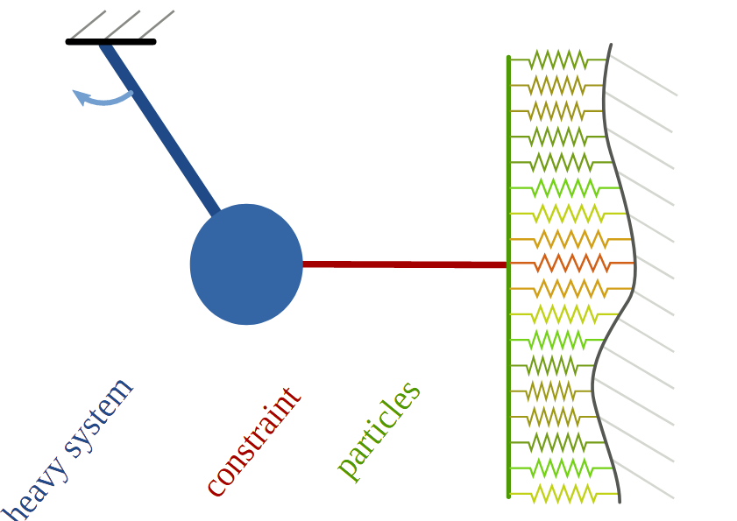
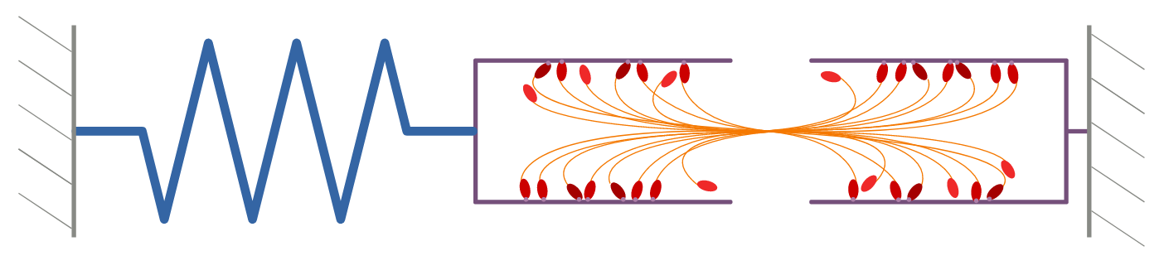
Abstract “macro-micro” model for
tissue‒cross-bridge coupling
locally
macro‒micro
DAE
locally
macro‒micro
ODE
locally
macro‒meso
mf. char. ODE
locally
macro‒meso
mf. PDE
locally
macro‒macro
mf. PDE
global
macro‒macro
mf. PDE
future

Slide 16
Very short recall of differential-algebraic equations (DAEs)
such that
can be implemented with Lagrangian multipliers via
locally
macro‒micro
DAE
locally
macro‒micro
ODE
locally
macro‒meso
mf. char. ODE
locally
macro‒meso
mf. PDE
locally
macro‒macro
mf. PDE
global
macro‒macro
mf. PDE
future

Slide 17
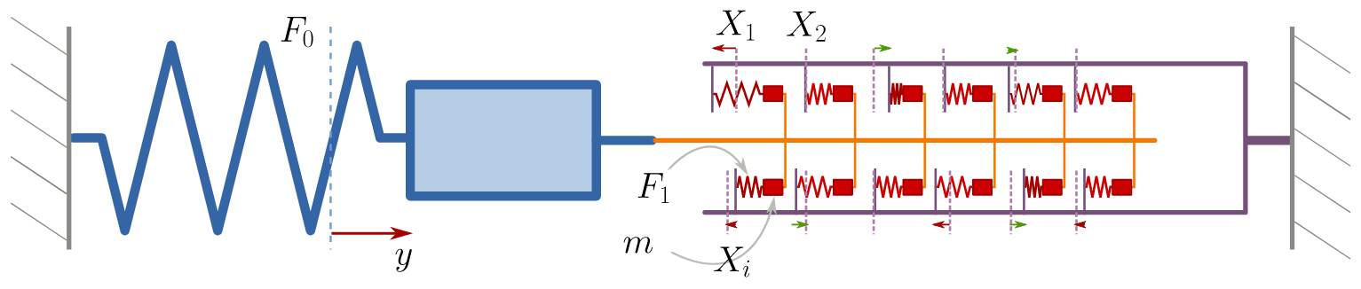
Abstract “macro-micro” system
Constraints
Lagrangian multipliers
Forces
Interaction forces
locally
macro‒micro
DAE
locally
macro‒micro
ODE
locally
macro‒meso
mf. char. ODE
locally
macro‒meso
mf. PDE
locally
macro‒macro
mf. PDE
global
macro‒macro
mf. PDE
future

Slide 18
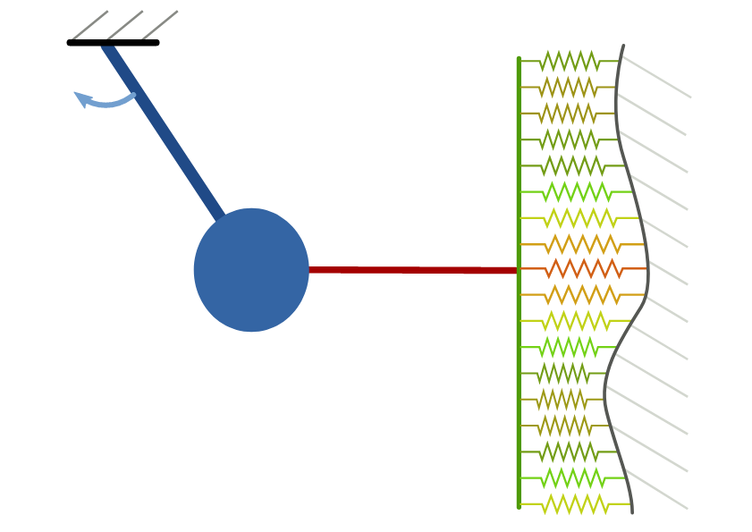
locally
macro‒micro
DAE
locally
macro‒micro
ODE
locally
macro‒meso
mf. char. ODE
locally
macro‒meso
mf. PDE
locally
macro‒macro
mf. PDE
global
macro‒macro
mf. PDE
future

Slide 19
This is a classical Lagrangian system
→ conservation of energy
→ scaling factors picked such that total energy remains of order one in the limit N → ∞.
locally
macro‒micro
DAE
locally
macro‒micro
ODE
locally
macro‒meso
mf. char. ODE
locally
macro‒meso
mf. PDE
locally
macro‒macro
mf. PDE
global
macro‒macro
mf. PDE
future

Slide 20
Examples (linear constraints)
Consider
Time derivative of constraint:
locally
macro‒micro
DAE
locally
macro‒micro
ODE
locally
macro‒meso
mf. char. ODE
locally
macro‒meso
mf. PDE
locally
macro‒macro
mf. PDE
global
macro‒macro
mf. PDE
future

Slide 21
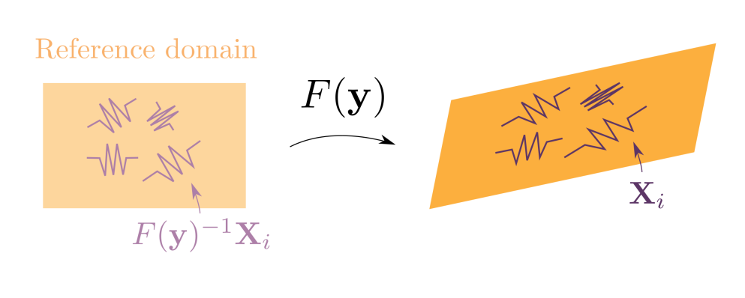
Examples (nonlinear constraint)
Consider linear deformations of a finite element (e.g. rotation, stretching, shearing, ...)
Cp. [1996] G. I. Zahalak. Non-axial Muscle Stress and Stiffness. Journal of Theoretical Biology
In our framework, we can directly derive resulting active stress component from given constraints.
locally
macro‒micro
DAE
locally
macro‒micro
ODE
locally
macro‒meso
mf. char. ODE
locally
macro‒meso
mf. PDE
locally
macro‒macro
mf. PDE
global
macro‒macro
mf. PDE
future

Slide 22
Strategy towards a mean-field description
DAE model
Mean-field PDAE system
Index reduction
+ multiplier elimination
ODE model
Mean-field PDE system
Mean-field
limit
locally
macro‒micro
DAE
locally
macro‒micro
ODE
locally
macro‒meso
mf. char. ODE
locally
macro‒meso
mf. PDE
locally
macro‒macro
mf. PDE
global
macro‒macro
mf. PDE
future

Slide 23
On this slide:
etc.
Index reduction
Index-3 DAE
Index-2 DAE
Index-1 DAE
Assume:
is always invertible
Elimination of multipliers (uses special structure of system!)

Slide 24
The equivalent ODE model
Each solution of the DAE model solves the ODE mode, and vice versa.
.
locally
macro‒micro
DAE
locally
macro‒micro
ODE
locally
macro‒meso
mf. char. ODE
locally
macro‒meso
mf. PDE
locally
macro‒macro
mf. PDE
global
macro‒macro
mf. PDE
future

Slide 25
Dealing with the non-constant mean-field mass
ODE model
“Remember”:
We need that mass is bounded from
below...
Lemma:
Assume is twice continuously differentiable and
are all bounded and Lipschitz and the Jacobian is uniformly elliptic, i.e.
then are well-defined, bounded and Lipschitz continuous.
locally
macro‒micro
DAE
locally
macro‒micro
ODE
locally
macro‒meso
mf. char. ODE
locally
macro‒meso
mf. PDE
locally
macro‒macro
mf. PDE
global
macro‒macro
mf. PDE
future

Slide 26
Full list of mathematical assumptions
Lemma:
The ODE model is well-posed and for any constant the map
is bounded and Lipschitz on .
locally
macro‒micro
DAE
locally
macro‒micro
ODE
locally
macro‒meso
mf. char. ODE
locally
macro‒meso
mf. PDE
locally
macro‒macro
mf. PDE
global
macro‒macro
mf. PDE
future

Slide 27
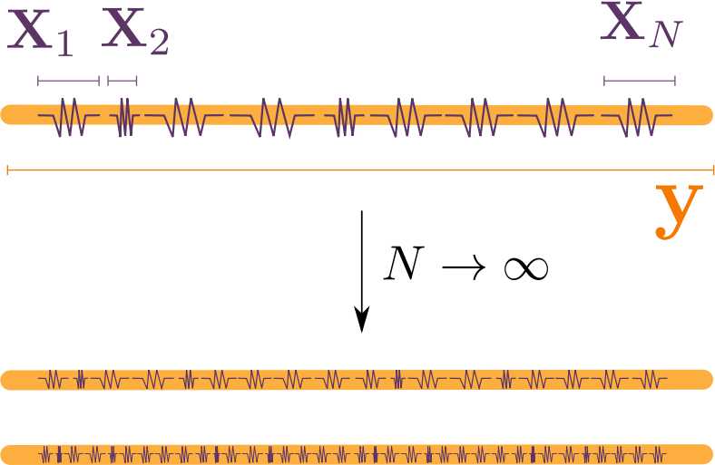
The mean-field limit

Slide 28
Formal transition from macro-micro to macro-meso...
ODE model
Define empirical measure as:
Mean-field characteristic flow:
locally
macro‒micro
DAE
locally
macro‒micro
ODE
locally
macro‒meso
mf. char. ODE
locally
macro‒meso
mf. PDE
locally
macro‒macro
mf. PDE
global
macro‒macro
mf. PDE
future

Slide 29
Mean-field PDE
For particle densities
where
and
.
The mean-field PDE is
with
Macro‒micro velocity map
“Mean-field” mass
“Mean-field” force
locally
macro‒micro
DAE
locally
macro‒micro
ODE
locally
macro‒meso
mf. char. ODE
locally
macro‒meso
mf. PDE
locally
macro‒macro
mf. PDE
global
macro‒macro
mf. PDE
future

Slide 30
Recall: nonlinear constraint example
Consider linear deformations of a finite element (e.g. rotation, stretching, shearing, ...)
Resulting mean-field PDE
locally
macro‒micro
DAE
locally
macro‒micro
ODE
locally
macro‒meso
mf. char. ODE
locally
macro‒meso
mf. PDE
locally
macro‒macro
mf. PDE
global
macro‒macro
mf. PDE
future

Slide 31
Mathematical setup for kinetic theory
space of probability measures with finite first moment.
Wasserstein distance (with exponent 1).
empirical measure

Slide 32
Stability estimate [SP, Simeon]
Given two solutions
with initial conditions
then
where the constants C and L only depend on the total energy and
Convergence in mean-field limit
For any sequence of microscopic initial conditions
such that
then
locally
macro‒micro
DAE
locally
macro‒micro
ODE
locally
macro‒meso
mf. char. ODE
locally
macro‒meso
mf. PDE
locally
macro‒macro
mf. PDE
global
macro‒macro
mf. PDE
future

Slide 33
Outline of the proof (mostly whiteboard)
Ingredients
Mean-field characteristic flow
Fundamental lemma:
If
Then

Slide 34
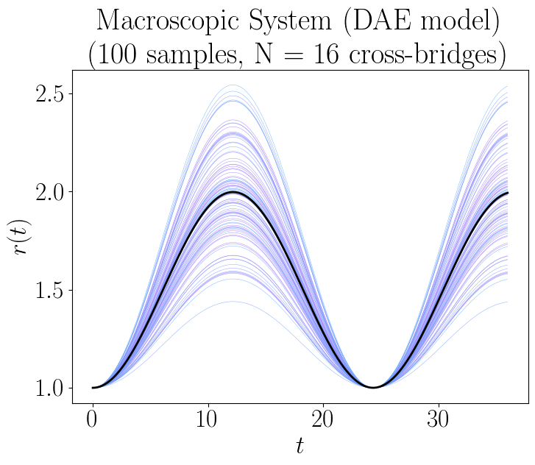
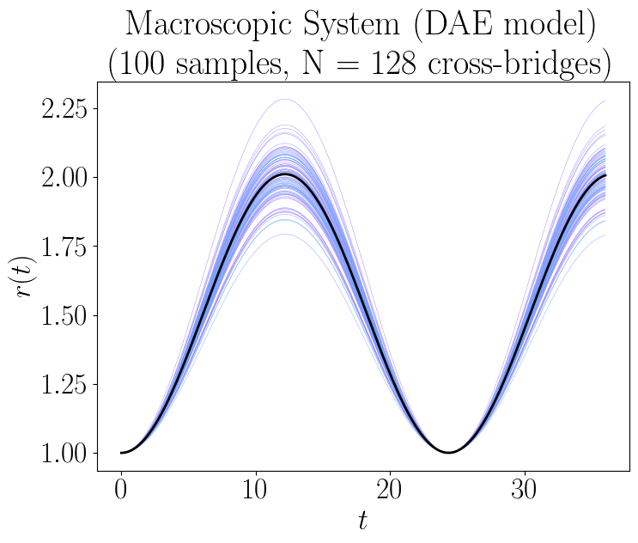
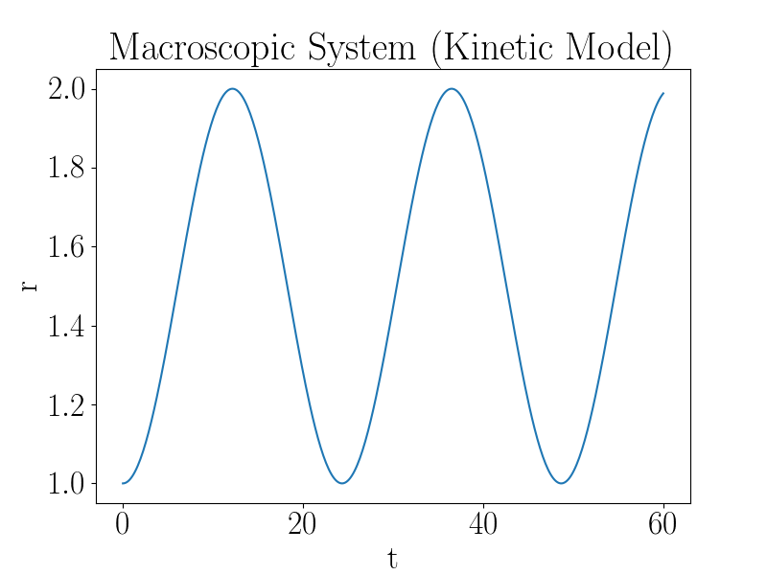
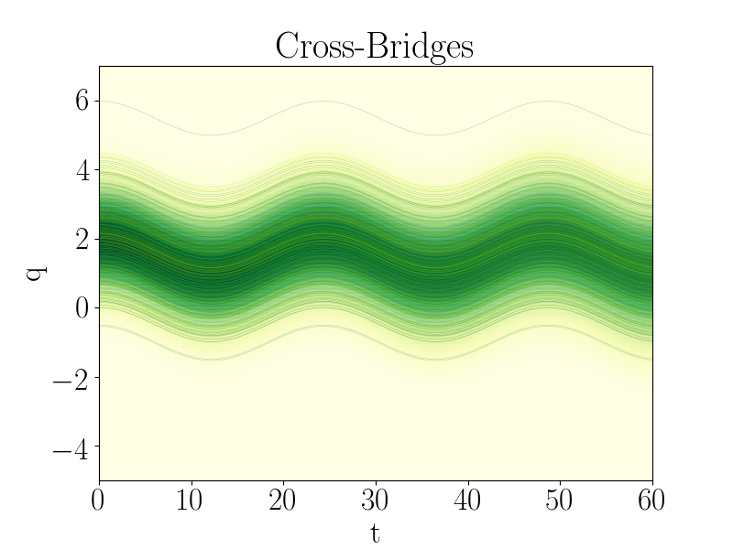
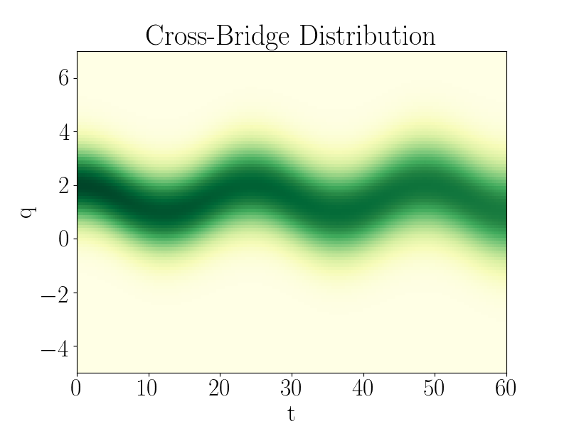
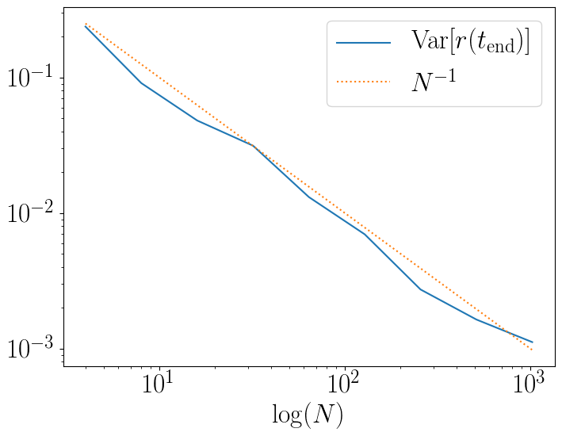
Small numerical validation (linear case)
locally
macro‒micro
DAE
locally
macro‒micro
ODE
locally
macro‒meso
mf. char. ODE
locally
macro‒meso
mf. PDE
locally
macro‒macro
mf. PDE
global
macro‒macro
mf. PDE
future

Slide 35
Outlooks

Slide 36
Is there general “Macro-macro” system?
Assuming
Mean-field PDE
To close the system, one might need
to use the concrete constraints...
locally
macro‒micro
DAE
locally
macro‒micro
ODE
locally
macro‒meso
mf. char. ODE
locally
macro‒meso
mf. PDE
locally
macro‒macro
mf. PDE
global
macro‒macro
mf. PDE
future

Slide 37
Or approximate “Macro-macro” systems?
Distributed moment
method?
Mean-field PDE
Find ODE for moments using
transport equation...
[1981] G. I. Zahalak, A distribution-moment approximation for kinetic theories of muscular contraction.
locally
macro‒micro
DAE
locally
macro‒micro
ODE
locally
macro‒meso
mf. char. ODE
locally
macro‒meso
mf. PDE
locally
macro‒macro
mf. PDE
global
macro‒macro
mf. PDE
future

Slide 38
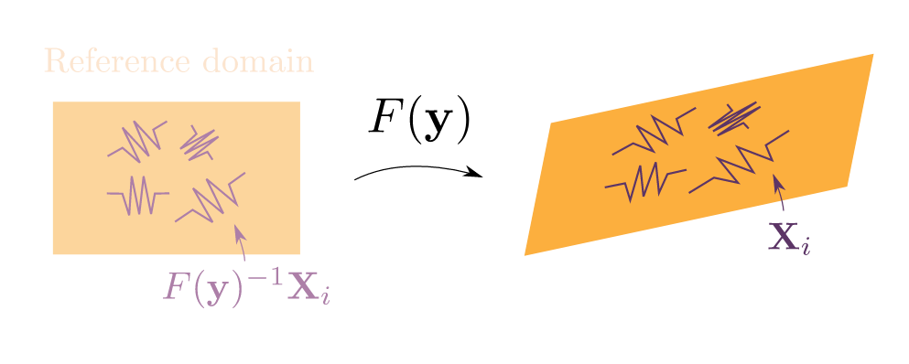
Adding spacial macroscopic model
Theory might well generalize for cases where the macroscopic system is a PDE:
Formally, the current framework always supports this:
However, it is probably overly complicated...
locally
macro‒micro
DAE
locally
macro‒micro
ODE
locally
macro‒meso
mf. char. ODE
locally
macro‒meso
mf. PDE
locally
macro‒macro
mf. PDE
global
macro‒macro
mf. PDE
future

Slide 39
Further directions
1. Most obvious current flaw: Cross-bridge cycling is missing!
Requires either two population with creation/annihilation:
Or one could modulate the constraints (but the analysis breaks):
(I am sure the audience knows better how to integrate cross-bridge cycling.)
2. Relaxing the full rank condition:

Slide 40
Thanks

