Slide 1


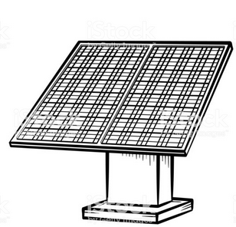

Understanding the impacts of biophysical constraints on IAM results
linking a bottom-up demand-side model and
the MESSAGE model: the case of copper
Final Presentation
Stefanie Klose
Industrial Ecology, University of Freiburg
Supervisors at IIASA: Volker Krey and Jihoon Min

Slide 2
Understanding the impacts of biophysical constraints on IAM results
linking a bottom-up demand-side model and
the MESSAGE model: the case of copper
On the road
Final Presentation
Stefanie Klose
Industrial Ecology, University of Freiburg
Supervisors at IIASA: Volker Krey and Jihoon Min

Slide 3
ODYM – MESSAGE Linkage
MESSAGEix
open-source integrated assessment model (IAM) of energy-engineering-economy-environment systems
Open-source Dynamic Material cycle model
ODYM-RECC

Slide 4
ODYM – MESSAGE Linkage
MESSAGEix
EGT installed capacity
ODYM-RECC

Slide 5
ODYM – MESSAGE Linkage
MESSAGEix
11 world regions, 2015 – 2100,
copper in electricity generation
technologies (EGT)
EGT installed capacity
ODYM-RECC

Slide 6
ODYM – MESSAGE Linkage
MESSAGEix
11 world regions, 2015 – 2100,
copper in electricity generation
technologies (EGT)
EGT installed capacity
1
Use
ODYM-RECC

Slide 7
ODYM – MESSAGE Linkage
MESSAGEix
11 world regions, 2015 – 2100,
copper in electricity generation
technologies (EGT)
EGT installed capacity
1
Use
Waste management
ODYM-RECC

Slide 8
ODYM – MESSAGE Linkage
MESSAGEix
11 world regions, 2015 – 2100,
copper in electricity generation
technologies (EGT)
EGT installed capacity
1
4
Use
Manufacturing
Waste management
3
2
Remelting and refining
Technical sorting
ODYM-RECC

Slide 9
ODYM – MESSAGE Linkage
MESSAGEix
11 world regions, 2015 – 2100,
copper in electricity generation
technologies (EGT)
EGT installed capacity
1
4
Use
Manufacturing
Waste management
3
2
Remelting and refining
Technical sorting
ODYM-RECC

Slide 10
ODYM – MESSAGE Linkage
MESSAGEix
11 world regions, 2015 – 2100,
copper in electricity generation
technologies (EGT)
EGT installed capacity
Primary copper production
0
1
4
Use
Manufacturing
Waste management
3
2
Remelting and refining
Technical sorting
ODYM-RECC

Slide 11
ODYM – MESSAGE Linkage
MESSAGEix
11 world regions, 2015 – 2100,
copper in electricity generation
technologies (EGT)
EGT installed capacity
Primary copper production
0
1
4
Use
Manufacturing
Waste management
3
2
Remelting and refining
Technical sorting
ODYM-RECC

Slide 12

ODYM – MESSAGE Linkage
MESSAGEix
11 world regions, 2015 – 2100,
copper in electricity generation
technologies (EGT)
EGT installed capacity
Primary copper production
0
1
4
Use
Manufacturing
Waste management
3
2
Remelting and refining
Technical sorting
ODYM-RECC

Slide 13
ODYM – MESSAGE Linkage
MESSAGEix
11 world regions, 2015 – 2100,
copper in electricity generation
technologies (EGT)
EGT installed capacity
Primary copper production
0
1
4
Use
Manufacturing
Waste management
3
2
Remelting and refining
Technical sorting
ODYM-RECC

Slide 14

ODYM – MESSAGE Linkage
MESSAGEix
11 world regions, 2015 – 2100,
copper in electricity generation
technologies (EGT)
EGT installed capacity
Primary copper production
0
1
4
Use
Manufacturing
Waste management
3
2
Remelting and refining
Technical sorting
ODYM-RECC

Slide 15
ODYM – MESSAGE Linkage
2.
MESSAGEix
11 world regions, 2015 – 2100,
copper in electricity generation
technologies (EGT)
EGT installed capacity
Primary copper production
1.
0
1
4
Use
Manufacturing
Waste management
3
2
Remelting and refining
Technical sorting
ODYM-RECC

Slide 16
What is copper used for today
Copper in-use stock
Consumer products
Transport
Buildings
Industry
Infrastructure
(Glöser et al.,2013)
16

Slide 17
What is copper used for today
Copper in-use stock
Annual copper demand
2018: 24000kt of copper
Consumer products
Buildings
Transport
Buildings
Consumer products
Industry
Transport
Infrastructure
Industry
Infrastructure
(Glöser et al.,2013)
(Coppercouncil, retrieved from http://www.coppercouncil.org/genstat1.aspx)
17

Slide 18
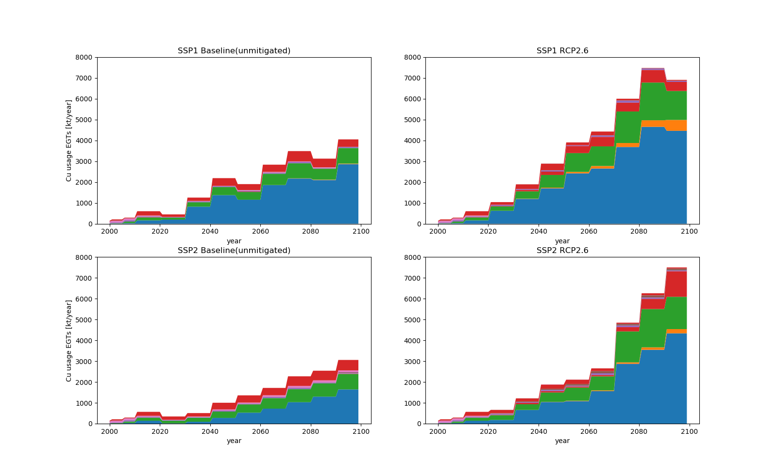
Copper in EGTs in SSP1
18

Slide 19
Copper in EGTs in SSP2
19

Slide 20
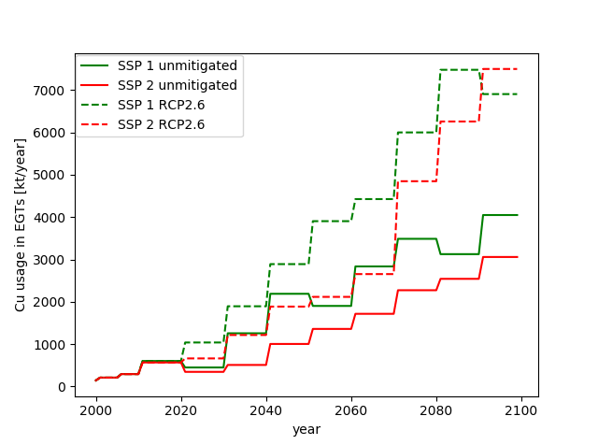
Copper in EGTs in SSP2
20

Slide 21
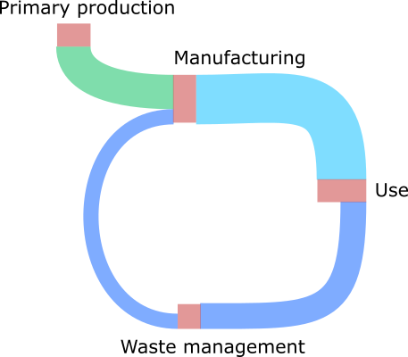
Copper flow in EGTs in 2100 (SSP2 RCP2.6)
21

Slide 22
Copper flow in EGTs in 2100 (SSP2 RCP2.6)
0,27 EJ
6,5 EJ
0,04 EJ
22

Slide 23
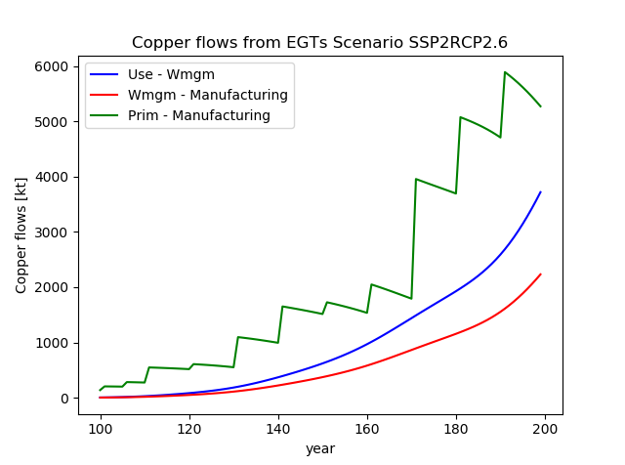
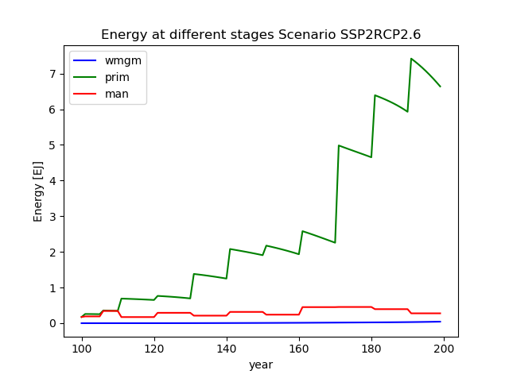
Copper and Energy in SSP2 RCP2.6
23

Slide 24
Linkage back into MESSAGE
24

Slide 25
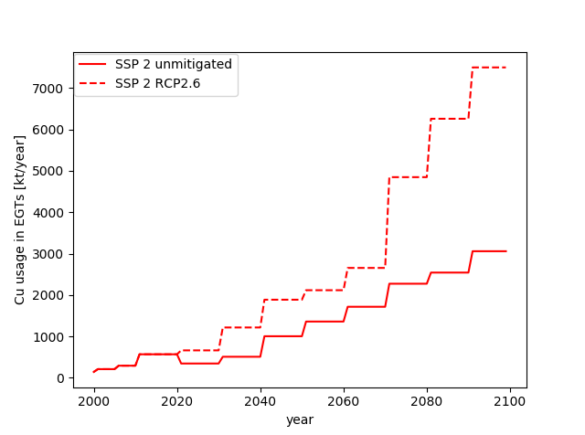
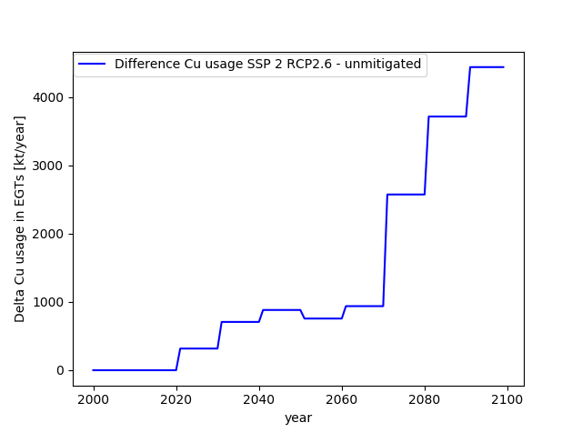
“Linkage” back into MESSAGE
25

Slide 26
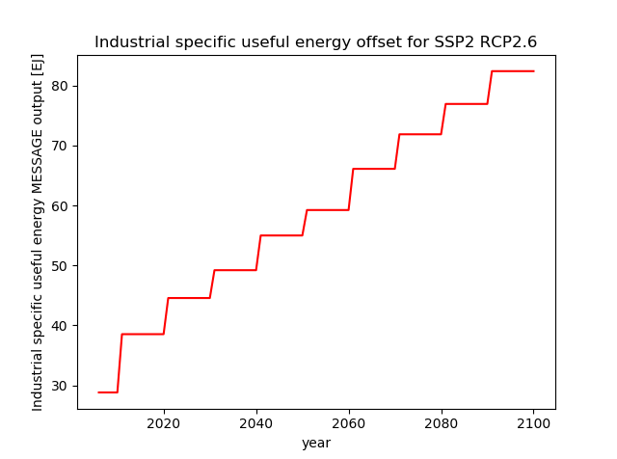
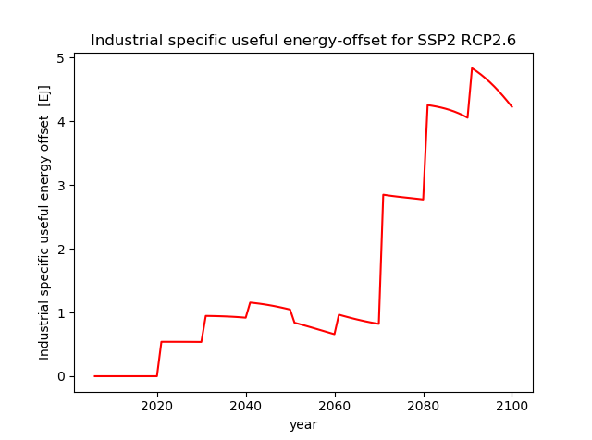
“Linkage” back into MESSAGE
26

Slide 27
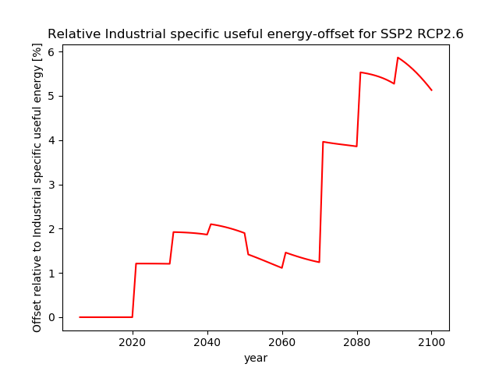
“Linkage” back into MESSAGE
27

Slide 28
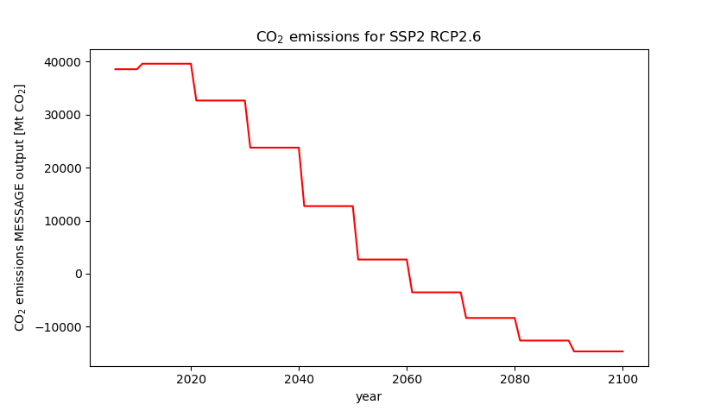
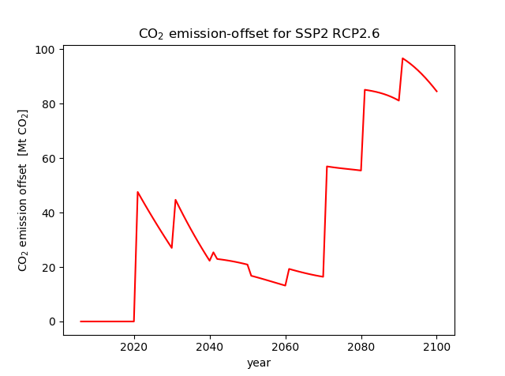
“Linkage” back into MESSAGE
28

Slide 29
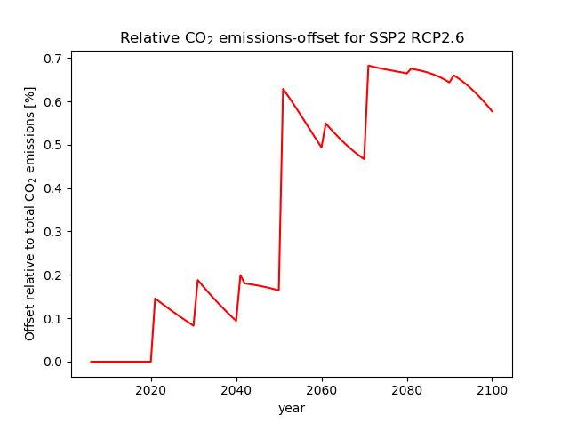
“Linkage” back into MESSAGE
29

Slide 30
Outlook: Implications on copper mining – will there be enough copper?
For medium growth
(Stephen Northey, 2019)

Slide 31
Research questions
How do best climate change mitigation pathways look like when copper in-use stocks and flows, vintage tracking and waste treatment of energy conversion technologies and transport technologies are considered?
Which conclusion can be drawn from this assessment towards the uncertainty of IAM results which do not consider any material cycles?
Which advice can be given to policy makers aiming for climate change mitigation and sustainable development strategies?

Slide 32
Further interest?
Presentation on Thursday
2. GitHub repository of the ODYM-Message Linkage module (OMli): https://github.com/SteffiKlose/OMli

Slide 33
Thank you for this great time!

Slide 34
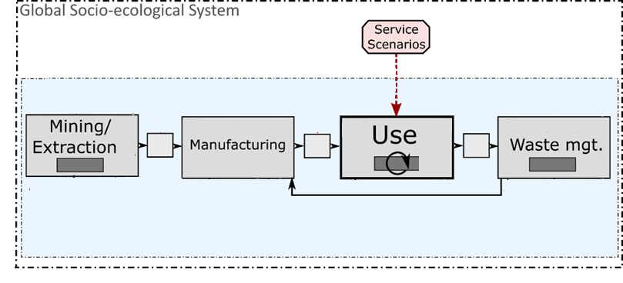
ODYM – MESSAGE Linkage
Infrastructure
Industry
Consumer products
Buildings
Transport
Electricity generation technologies
1.
MESSAGEix
Part:
Assess material demand
from MESSAGEix technologies
Energy
ODYM-RECC
Adapted from Pauliuk 2018

Slide 35

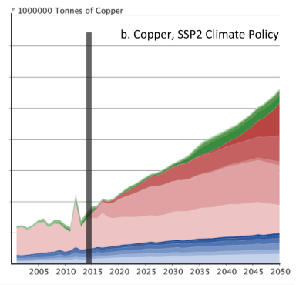
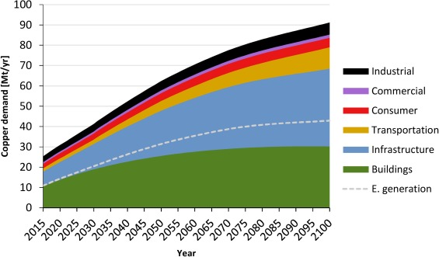
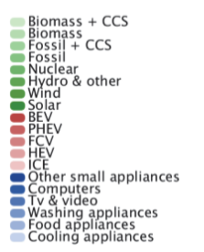
Deetman et al. (2018)
Schipper et al. (2018)

Slide 36
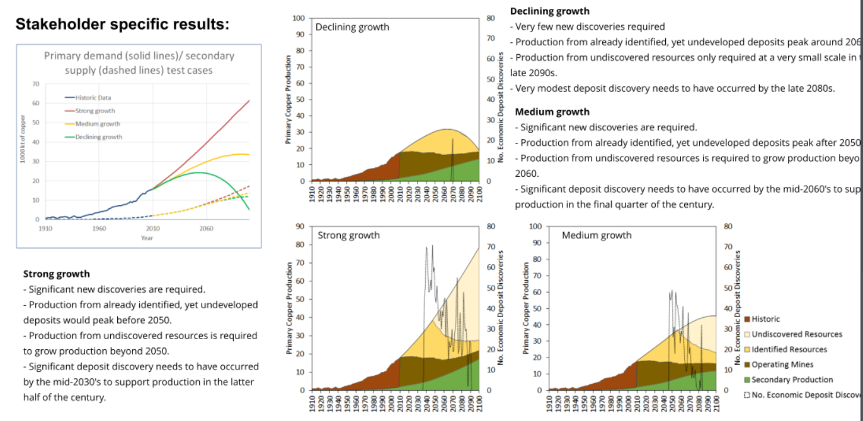

Slide 37
ODYM – MESSAGE Linkage
MESSAGEix
11 world regions, 2015 – 2100,
copper in electricity generation
technologies (EGT)
EGT installed capacity
Primary copper production
1
4
Use
Manufacturing
Waste management
3
2
Remelting and refining
Technical sorting
Legend:
Processes with process parameters Markets
Losses to the environment with stocks
In-use stock with vintage tracking
Material flows already included in model description
Energy flows Emissions feedback

