Slide 1


LOYOLA – ICAM COLLEGE OF ENGINEERING AND TECHNOLOGY (LICET) Loyola Campus, Nungambakkam , Chennai – 34
SPEECH CAFÉ
(Voice-controlled Application)
Done by:
Steffi Stanley
Vinisha Jemima Rani.N
Supervisor Name:
Ms.Limsa Joshi

Slide 2
OBJECTIVE OF THE PROJECT
To develop an Café ordering and billing system ,that is controlled by voice .
The items are to be ordered by speech and stored in database,
When the ordering is completed, the bill should be generated on commanding ‘bill’.
The ordered items should be viewed in database.
The table is truncated for next order to be placed.

Slide 3
JAVA API
The Java Speech API is an application programming interface for cross-platform support of
1.command and control recognizers
2.dictation systems
3.speech synthesizers
Two Core Speech technologies are supported through the Java Speech API:
1.Speech synthesis
2.Speech recognition
Among which Speech Café uses the Speech Recognition Technology.

Slide 4
SPEECH RECOGNITION
Speech Recognition makes using a keyboard and mouse optional.
You can control your PC with your voice and dictate text instead.
The major steps of a typical speech recognizer are as follows:
1. Grammar design
2. Signal processing
3. Word recognition
4. Result generation
A Grammar is an object in the Java Speech API that indicates what words a user is expected to say and in what patterns those words may occur.
These constraints make recognition faster and more accurate because the recognizer does not have to check complex words and sentences.

Slide 5
PLANNING OF THE PROJECT
Application selected : Café System
Main Concept : Voice Controlling
Language Used : JAVA
GUI : JFrames
Voice Technology : Speech Recognition
Database : jdbc
Jar files added : sphinx
Additional files : Grammar file
Developing Software : NetBeans 8.0.2
Hardwares used : Microphones

Slide 6
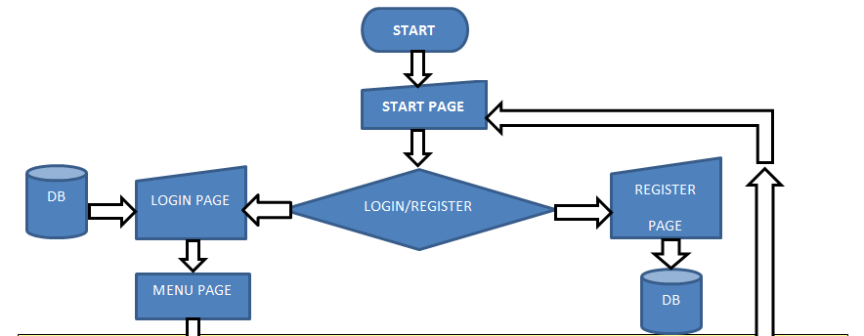
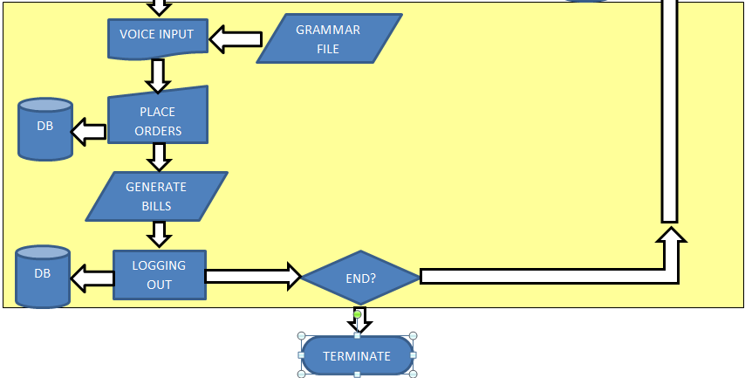
SYSTEM FLOW

Slide 7
MODULES EXPLANATION
Module 1:Start Page
The language used is JAVA. The GUI is created with JFrame .
This page gives the user options to Login or to Register.
Module 2: Login page
In case of logging in, the username and the password are checked with the database and logged in.
Else the message ‘Invalid ID or Password’ is displayed.
Module 3: Register page
In case of Registering, a register form is displayed. The user have to fill the form and submit.
Once the submit button is pressed, the data is stored in the database, which is confirmed by the message ‘Registered Successfully’.

Slide 8
Module 4: Menu Page
This is the most significant part of the system.
This page consist of the Speech Recognition module.
The menu displayed in the list can be ordered by voice, by pressing the ‘Press and Wait’ button.
This is confirmed by the message ‘Order Successful’. Else the message ‘Server Error’ is displayed.
By saying ‘Stop’, the final bill is displayed.
The items ordered is viewed in the Database.
When the user logs out, the database table is truncated and kept ready for the next order to be placed.
On logging out the Start page is displayed again.
LET US NOW SEE THE WORKING OF THE SPEECH RECOGNITION MODULE IN DETAIL WITH AN ALGORITHM.

Slide 9
ALGORITHM: Speech Recognition
startSpeechRecognition()
{
//Start Recognition
recognizer->startRecognition(true)
Display message ->“Speak Now”;
}
makeDecision()
{
int cost,bill;
Display message->“You ordered ‘+speech+’”
try
{
Insert ordered item into DB
if inserted ,display->”Ordered Successfully”
else,display->”Server Error”
}

Slide 10
catch(Exception e){}
if(speech==candy) then cost=5;bill=bill+cost;
if(speech==cookie) then cost=10;bill=bill+cost;
if(speech==water) then cost=15;bill=bill+cost;
if(speech==bread) then cost=20;bill=bill+cost;
if(speech==bill) then getbill()
getbill()
{
Display message->YOUR BILL AMOUNT IS "+bill+“
}
}
When logged off,
Truncate table in DB.

Slide 11
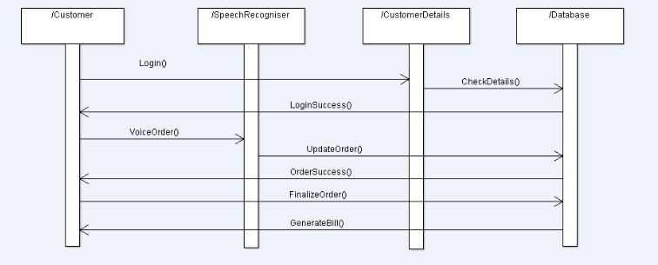
SEQUENCE DIAGRAM
LOOP

Slide 12
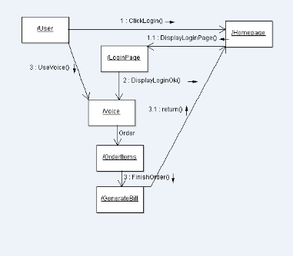
COLLABORATION DIAGRAM

Slide 13
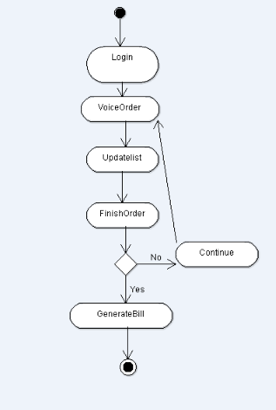
ACTIVITY DIAGRAM

Slide 14
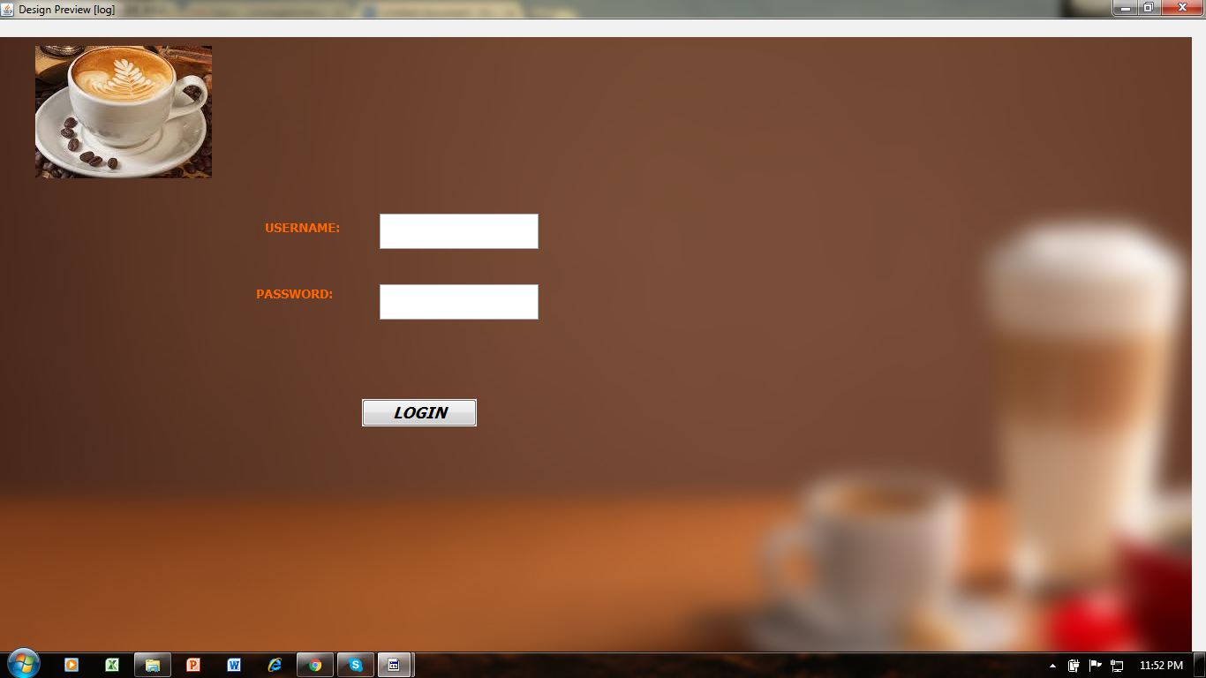
SCREENSHOTS
LOGIN FORM:

Slide 15
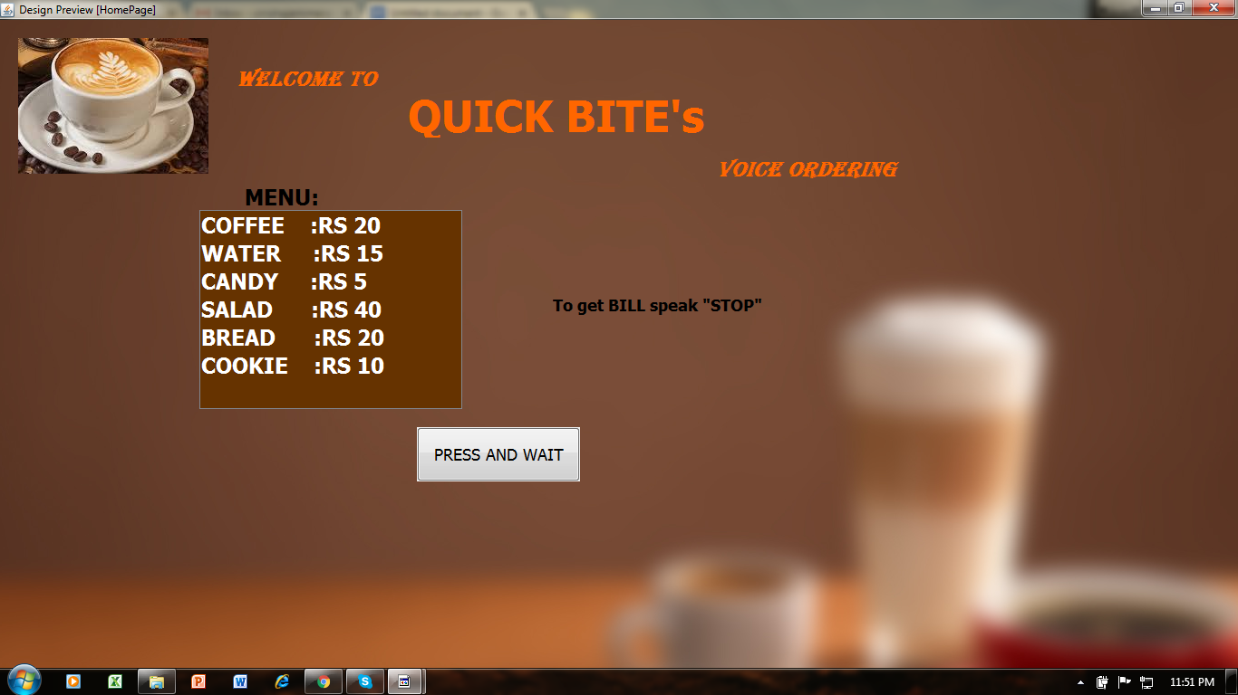
MENU PAGE:

Slide 16
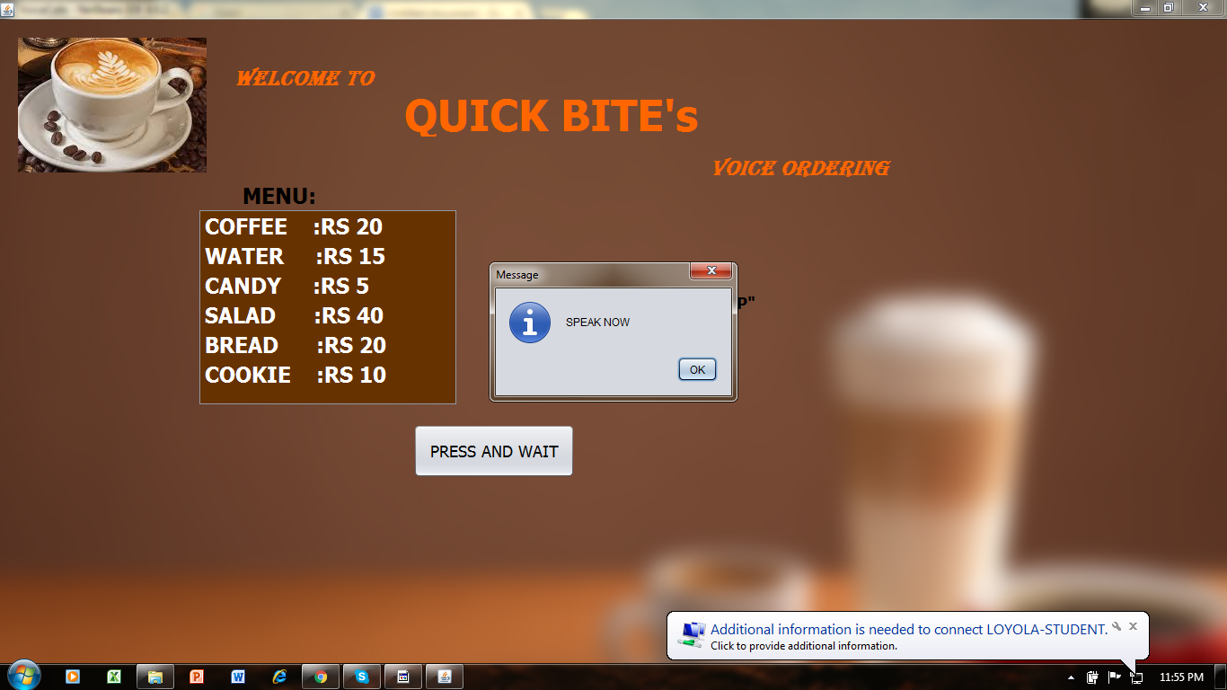
MENU PAGE:

Slide 17
PERFORMANCE CHART

Slide 18
FUTURE APPLICATIONS
Advances in technology have made it possible for voice activated protocols to be placed in almost every program allowing computer systems to run off voice recognition.
Non-Business Benefits:-
It gives those individuals who are blind or who cannot manipulate a keyboard due to a physical disability ,the opportunity to make use of a computer and in many cases gain a level of independence.
Voice activated programs can allow people with disabilities to be able to work and in some cases obtain a level of self sufficiency.

Slide 19
Business Benefits:-
Inside the office the benefits of voice recognition and voice activated applications are numerous.
Creating documents, memos, and reports can easily be spoken leaving hands free to complete other tasks.
Editing can be accomplished through the use of voice activated programming.
This makes the use of these types of software applications a way to increase productivity as well as giving individuals with disabilities new ways to interact and work.

Slide 20
CONCLUSION
Everyone from doctors, writers and the disabled are making use of voice recognition software and voice activated applications
The idea that a person is able to speak into a microphone attached to a computing device and have those words typed out used to be “The Stuff of Science Fiction”.
However, it is now Reality.

