Slide 1
Starting Situation:
Situation:
We are a math tutors company in Coímbra, Portugal
We have just begun our operations. We don’t know how to get clients and we have a limited marketing budget. How can we make our advertising activities more targeted? How can we identify the students that will be most receptive to our advertisement?
Luckily, our teammate Anis has just completed a Masters in Data Science for Education Experts. He says he can help us answering this question.
Quest:
More predictive than descriptive
→ We focus on prediction power
What measure are we looking for? Why?

Slide 2
Dataset
For this, we will use the following data set:
Skjvnksvnljfv
It has the following characteristics and interesting variables:
Slkfngsjkfb
Sdkjfns
Source:
Student Alcohol Consumption | Kaggle

Slide 3
Methdology:
Step 0: Cleaning the variables
Transforming binary variables with “no” and “yes” characters into factors with levels 0 and 1.
Eliminating variables G2 and G1, which are overly correlated to G3
Step 1: Which variables should we include in our models?
Approach 1: Identifying the most important variables
Using a classification tree to find out the most important variables
Using bagging to find out the most important variables
Using a Random Forest to find out the most important variables
Approach 2: Verifying the information tree through linear models
Comparing the different test MSE of the different lm models using the variables found to be of relevance through classification tree, bagging and random forest
Step 2: Which model gives us the best predictive power?
Logit and Probit
LDA and QDA
KNN and NB
Classification Tree and Random Forest
SVM

Slide 4
Results I: Trees, Bagging, Random Forest, lms

Slide 5
Results II: Logit and Probit

Slide 6
Results II: LDA and QDA

Slide 7
Results III: KNN and NB

Slide 8
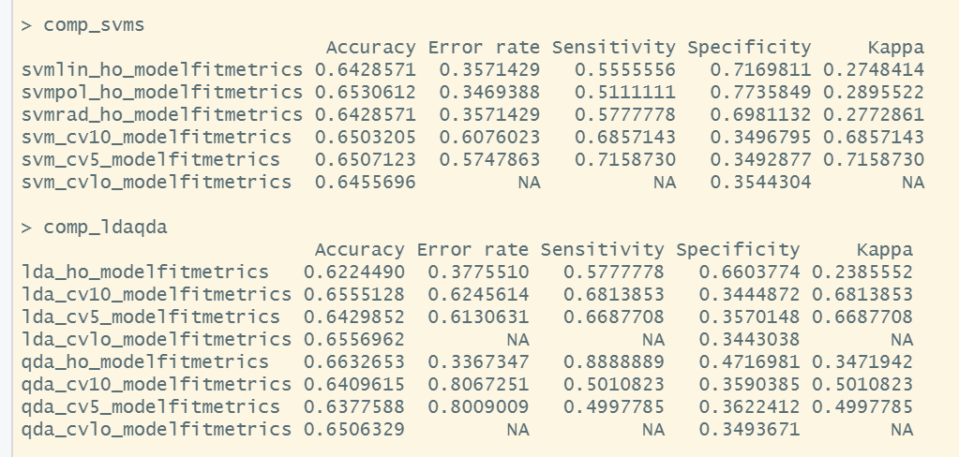
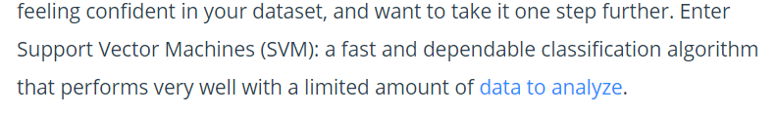
Results IV: SVM
An Introduction to Support Vector Machines (SVM) (monkeylearn.com)

