Slide 1
Credit Card Fraud Detection
Machine Learning Project
1

Slide 2
Introduction
Big Blue Bank needs a predictive model which detects the fraud transactions. Νowadays this is an important service for the clients.
In this presentation we are going to analyze the procedure of making the model.
Info
Credit card fraud is the unauthorized use of a credit or debit card, or similar payment tool (ACH, EFT, recurring charge, etc.), to fraudulently obtain money or property. Credit and debit card numbers can be stolen from unsecured websites or can be obtained in an identity theft scheme.
2

Slide 3

3

Slide 4
Terminal Check
Correct pin?
Sufficient Balance?
Blocked Card?
3

Slide 5
Terminal Check
Correct pin?
Sufficient Balance?
Blocked Card?
3

Slide 6
Rejected
Terminal Check
Correct pin?
Sufficient Balance?
Blocked Card?
3

Slide 7
Rejected
Terminal Check
Correct pin?
Sufficient Balance?
Blocked Card?
Predictive Model
3

Slide 8
Rejected
Terminal Check
Correct pin?
Sufficient Balance?
Blocked Card?
Predictive Model
Fraud
3

Slide 9

Rejected
Terminal Check
Correct pin?
Sufficient Balance?
Blocked Card?
Predictive Model
Fraud
3

Slide 10
Rejected
Terminal Check
Correct pin?
Sufficient Balance?
Blocked Card?
Predictive Model
Check Card
Notice the Client
Fraud
3

Slide 11
Rejected
Terminal Check
Correct pin?
Sufficient Balance?
Blocked Card?
Feedback/Response
Predictive Model
Check Card
Notice the Client
Fraud
3

Slide 12
Dataset
The Dataset which was given by the Bank so as to make the predictive model, has a column about the time of each transaction and 28 columns of PCA features in order to protect the users personal details. Also,it has a column considering the transactions’ range and an additional column if there is a fraud or not.
The total number of rows is 285.299. The 492 of them were fraud and the rest not.
https://www.kaggle.com/mlg-ulb/creditcardfraud
4

Slide 13
Preprocessing
We found out that the dataset had duplicate rows and we excluded them.
We split the dataset into Train and Test. Train was the 70% of this and Test the rest 30%.
Train had 344 frauds out of 198.756.
Test had 129 frauds out of 85.118 instead.
As the dataset was highly imbalanced we had an oversampling(using Smote) on Train data and we had 198.264 of frauds and normal transactions as well.
5

Slide 14
Models
We used 6 different kind of models in order to find the best one.
Logistic Regression
Decision Tree Classifier
Random Forest Classifier
Adaboost Classifier
XGBClassifier
LGBMClassifier
6

Slide 15
Pipeline
In our pipelines, except for the classifiers, we used a scaling method (StandardScaler) and the SelectKbest so as to find the most significant features.
With the GridSearchCV we tried to find the best hyper parameters for our Pipelines.
Here is an example of the pipeline of Logistic Regression :
Pipeline(steps=[('scaler', StandardScaler()),
('best_feat', SelectKBest(k=10)),
('log', LogisticRegression(class_weight='balanced',max_iter=10000,solver='lbfgs'))
])
7

Slide 16
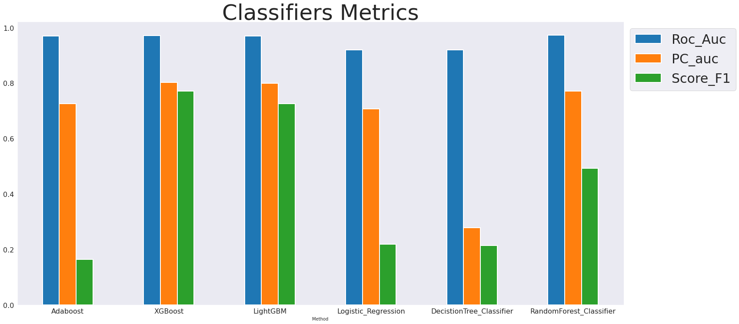
8

Slide 17
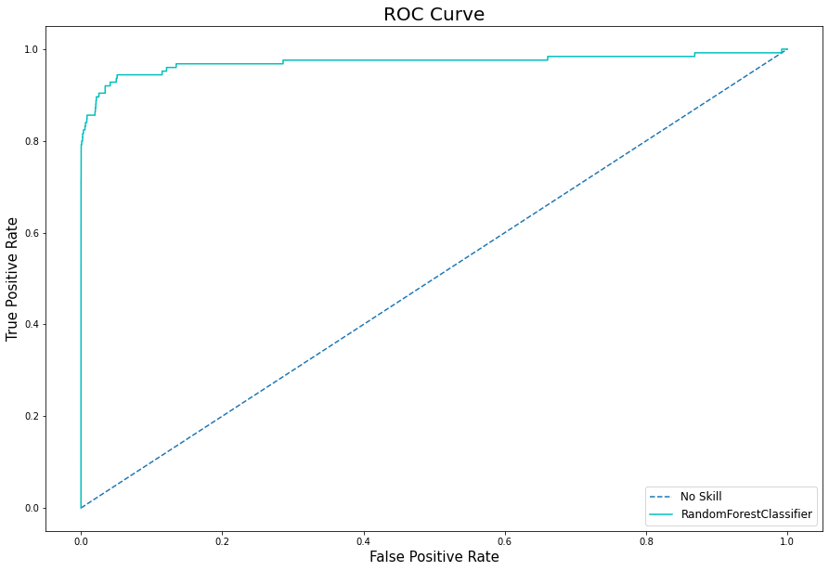
 | Negative | Positive
Negative | True Negative | False Positive
Positive | False Negative | True Positive
TPR = True Positives / (True Positives + False Negatives)
FPR =False Positives / (False Positives + True Negatives)
9

Slide 18
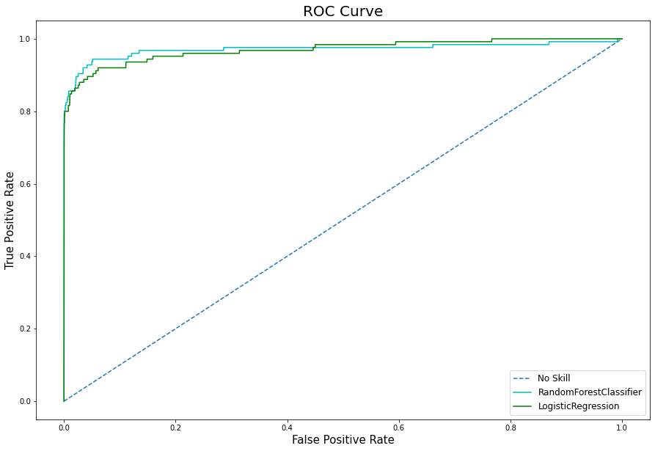
 | Negative | Positive
Negative | True Negative | False Positive
Positive | False Negative | True Positive
TPR = True Positives / (True Positives + False Negatives)
FPR =False Positives / (False Positives + True Negatives)
9

Slide 19
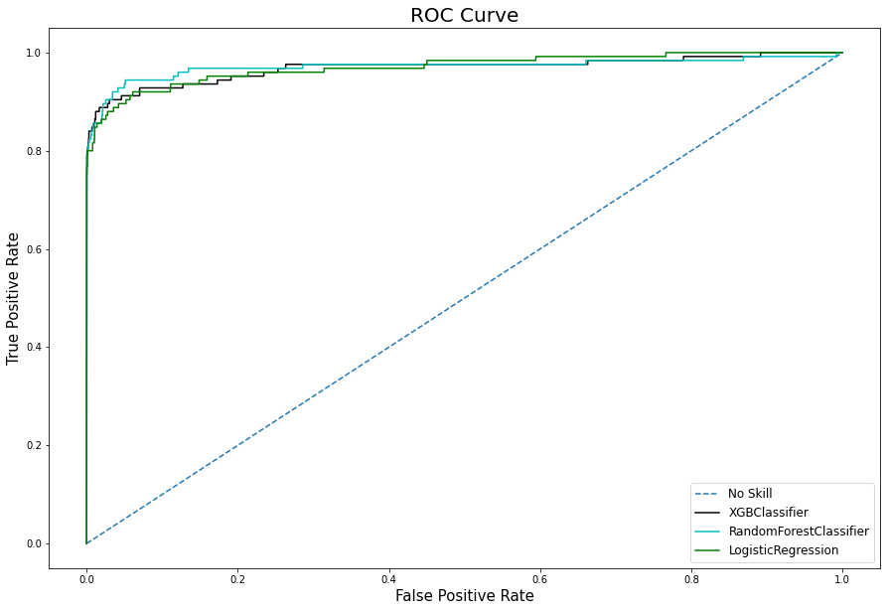
 | Negative | Positive
Negative | True Negative | False Positive
Positive | False Negative | True Positive
TPR = True Positives / (True Positives + False Negatives)
FPR =False Positives / (False Positives + True Negatives)
9

Slide 20
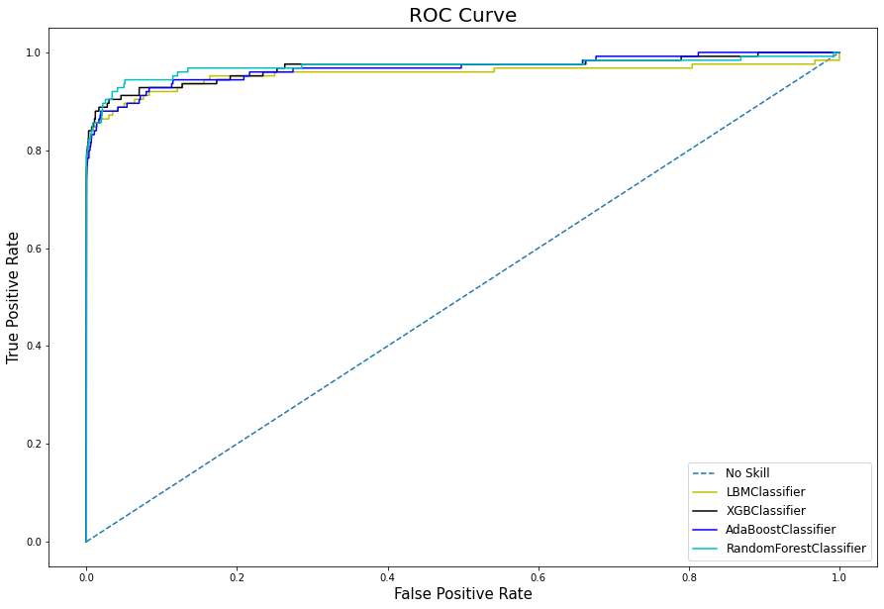
 | Negative | Positive
Negative | True Negative | False Positive
Positive | False Negative | True Positive
TPR = True Positives / (True Positives + False Negatives)
FPR =False Positives / (False Positives + True Negatives)
9

Slide 21
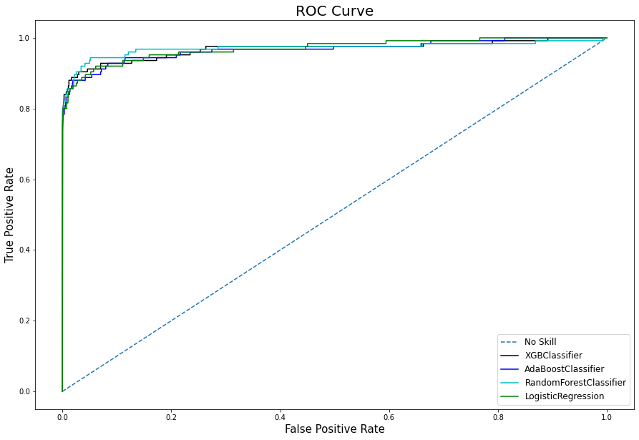
 | Negative | Positive
Negative | True Negative | False Positive
Positive | False Negative | True Positive
TPR = True Positives / (True Positives + False Negatives)
FPR =False Positives / (False Positives + True Negatives)
9

Slide 22
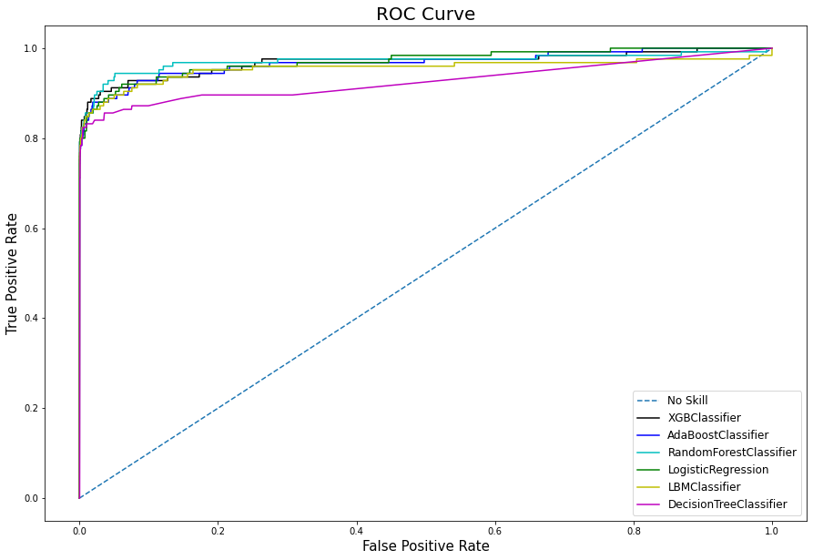
 | Negative | Positive
Negative | True Negative | False Positive
Positive | False Negative | True Positive
TPR = True Positives / (True Positives + False Negatives)
FPR =False Positives / (False Positives + True Negatives)
9

Slide 23
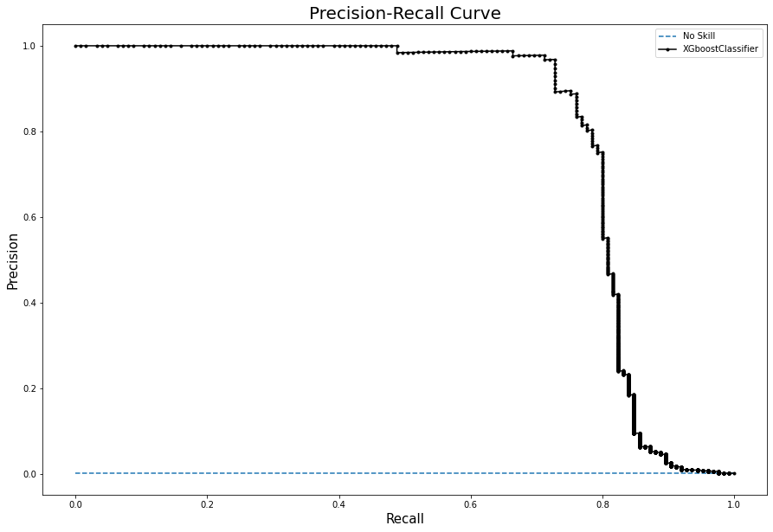
Precision = True Positives / (True Positives + False Positives)
Recall = True Positives / (True Positives + False Negatives)
10

Slide 24
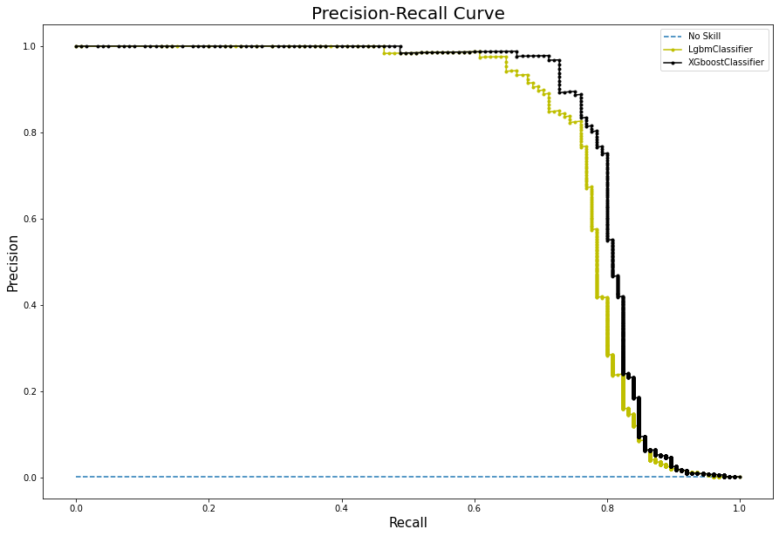
Precision = True Positives / (True Positives + False Positives)
Recall = True Positives / (True Positives + False Negatives)
10

Slide 25
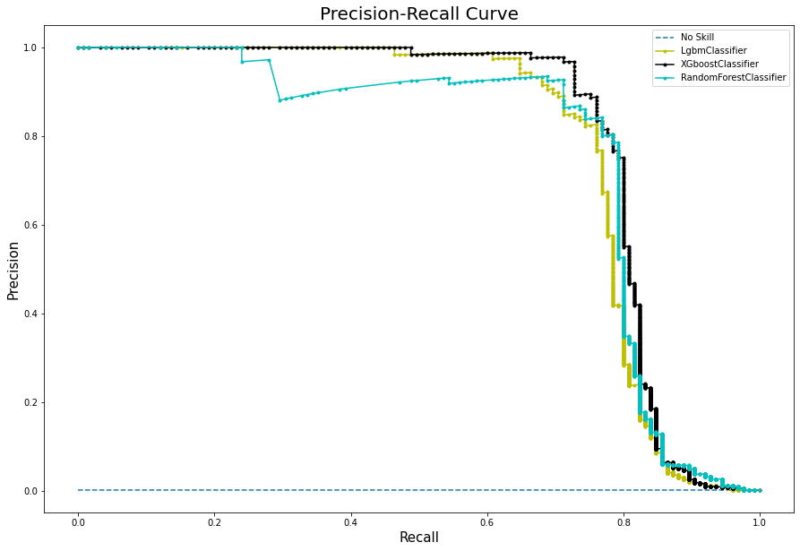
Precision = True Positives / (True Positives + False Positives)
Recall = True Positives / (True Positives + False Negatives)
10

Slide 26
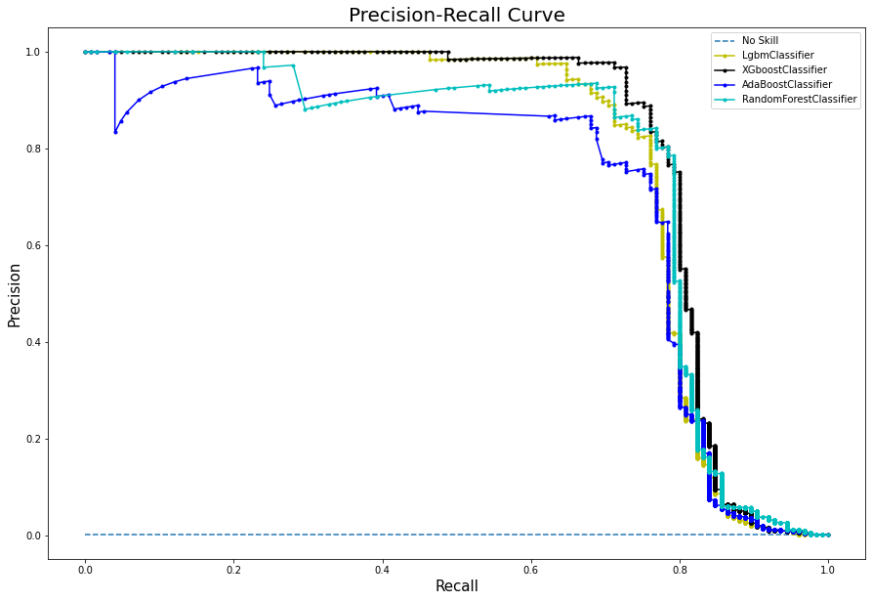
Precision = True Positives / (True Positives + False Positives)
Recall = True Positives / (True Positives + False Negatives)
10

Slide 27
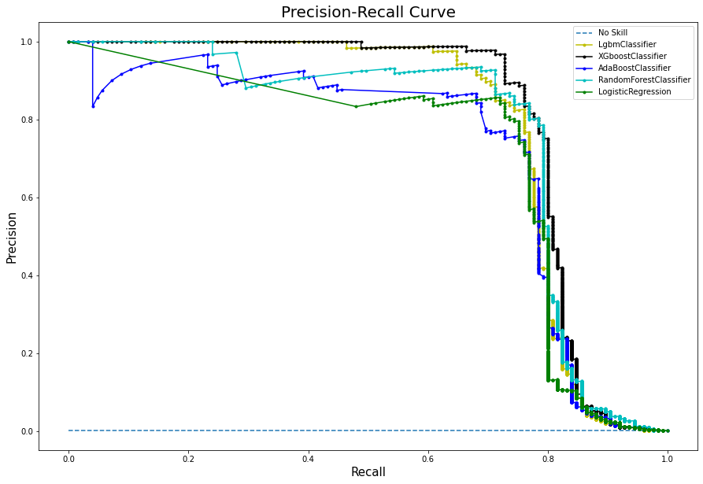
Precision = True Positives / (True Positives + False Positives)
Recall = True Positives / (True Positives + False Negatives)
10

Slide 28
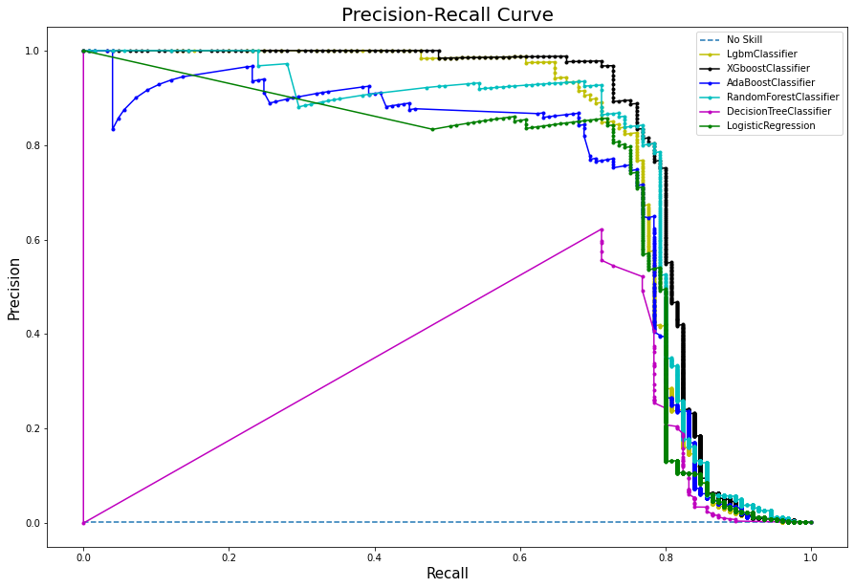
Precision = True Positives / (True Positives + False Positives)
Recall = True Positives / (True Positives + False Negatives)
10

Slide 29
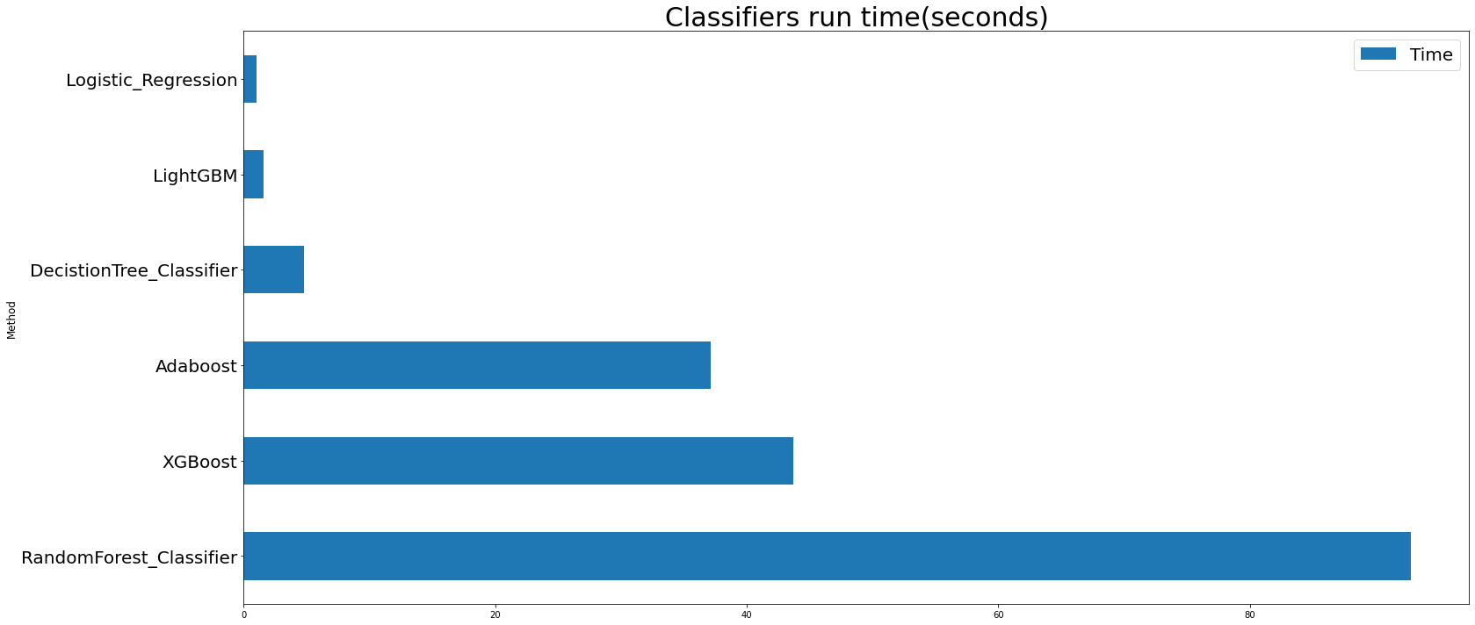
11

Slide 30
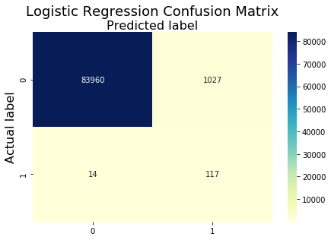
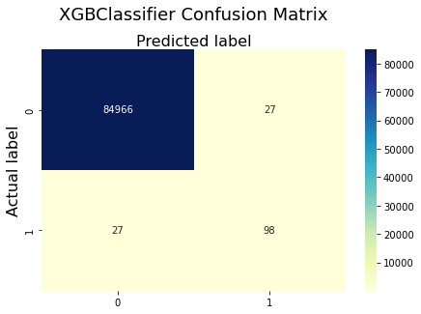
12

Slide 31
Conclusion
Based on the metrics and graphs the two best machine learning algorithms for this credit card fraud detection dataset are:
Logistic Regression
XGBClassifier
Logistic Regression makes the best predictions when the transaction is fraud while XGB provides best results overall and makes the fewer false predictions
13

Slide 32
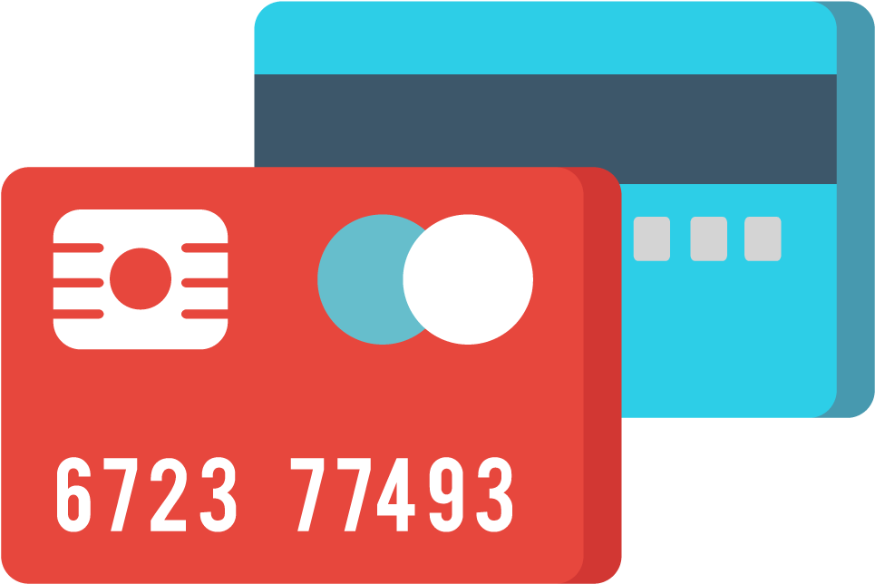

Credit Card Fraud Detection
Machine Learning Project
George Sylas
Stefanos Sekis
Big Blue Data Academy
14

