Slide 1
BASKETBALL PROJECT
Cluster analysis of nba players
1

Slide 2
Introduction
How to we determine if a basketball player is good or bad?
Can we categorize players based on their stats?
What it takes to be an all star?
Let’s find out!
2

Slide 3

Presentation Content
Today we are going to show you how we retrieved data from a web site,the way we cleaned them in order to make an analysis and finally how we tried to cluster them
The dataset includes stats from NBA players of the modern era(after 1980).Except from the stats the dataset also includes players detailed info
3

Slide 4







Web-scraping
Basketballreference.com
4

Slide 5
Analysis - Cleaning
Dataset had 17.131 rows with players info and every year stats
Dropped columns like age,team and position.
Grouped by players and the stats to get their average
Players selected based on at least 20 games each year
5

Slide 6
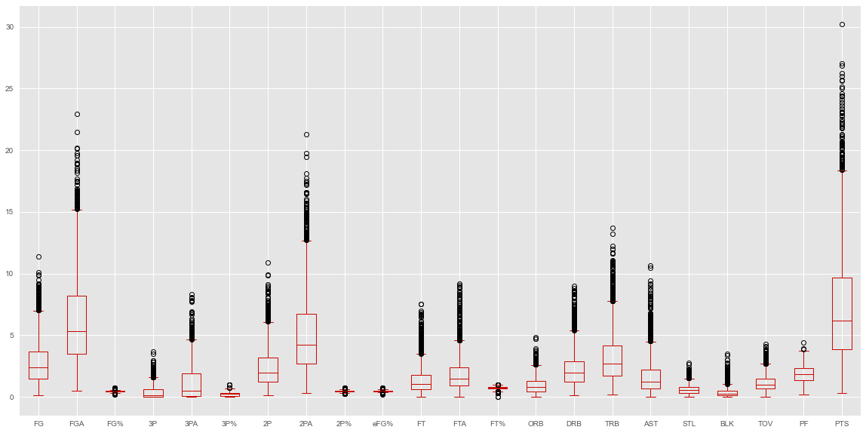
Data analysis
6

Slide 7
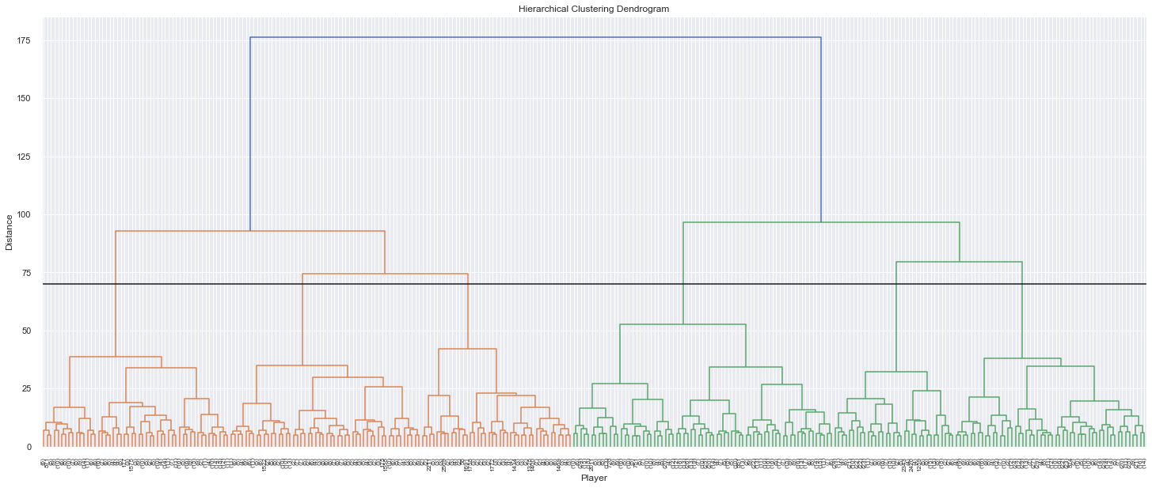
Data analysis
7

Slide 8

Cluster Size
282
0
322
759
1
2
3
630
417
4
5
111
8

Slide 9
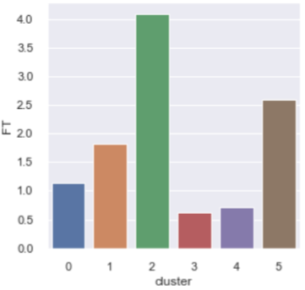
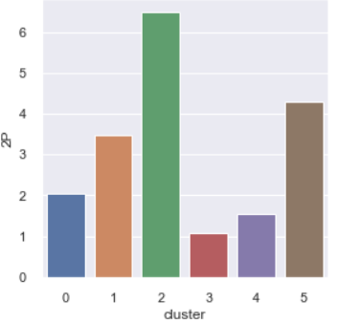
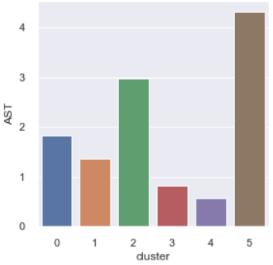
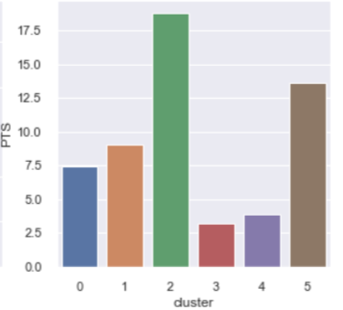
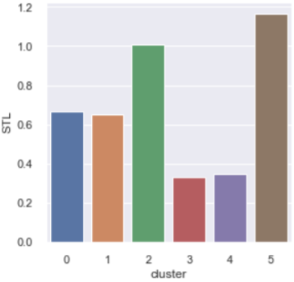
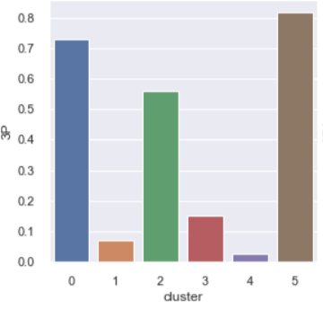
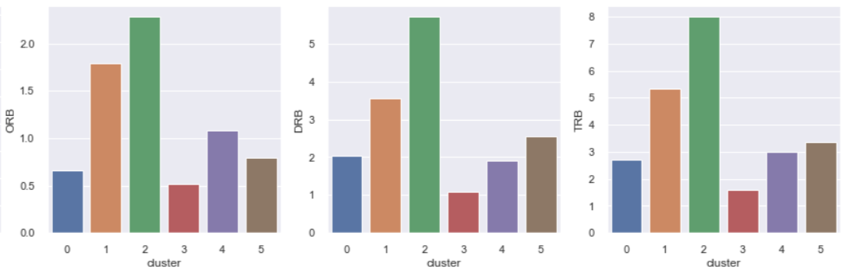
Cluster Stats Graphs
9

Slide 10
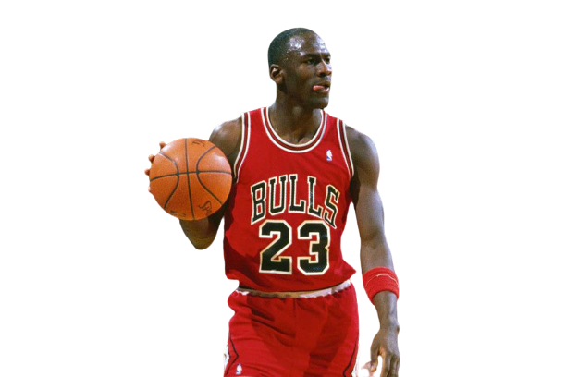



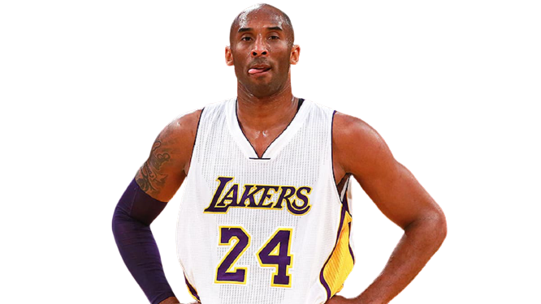
Cluster 2 : All Stars
Here we have the elite of the nba.Absolute superstars with outstanding all round stats
Jordan
James
Giannis
Bryant
10

Slide 11




Cluster 5 : Very good PG-SG-SF
Players with high three point,steals and assist percentage
Parker
Pippen
Thompson
Thomas
11

Slide 12




Cluster 1 : Powerful PF-C
Strong and tall players with high two point percentage and great offensive/defensive rebounds and blocks
Pekovic
Nowitzki
Ewing
Malone
12

Slide 13
Cluster 0 : Medium Performance Pg-Sg
High three point percentage but average all round stats
Cluster 3,4 : Low Performance Players
Low stats overall.The difference between the two clusters is the height and the position
13

Slide 14
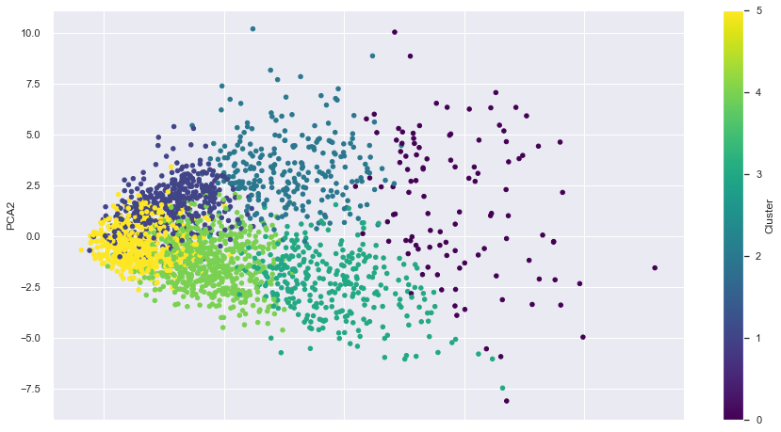
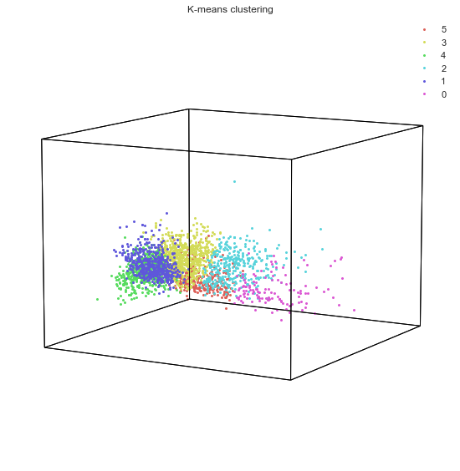
Cluster Hypergraphs
14

Slide 15
THANKS
A project by:
George Sylas
Stefanos Sekis
15

