Slide 1
Steganalysis of Images using QRC
Team Members
1.Meganisha.B
2. Bhavadharini.K
Facultyguide : Industrial guide :
Suseendran.S Yukthika.V
Assistant professor
Department of CSE
Department of CSE, KGiSL Institute of Technology, Coimbatore

Slide 2
Abstract
Steganalysis is an efficient technique used to encrypt any form of data and hide the key behind an image or any other digital media to make them more secure.
It can be used to carry out hidden exchanges and hence can enhance individual privacy.
The security of Steganalysis can be improved by using Quick Response Code to make it more user-friendly.
Department of CSE, KGiSL Institute of Technology, Coimbatore

Slide 3
Area Introduction-Existing system
The existing system of steganography can be used only to encrypt one type of file and it cannot accept all other types.
The text alone can be hidden inside the image which may provide less security and privacy.
The steganalysis can be a useful and advanced technique which might prevent intrusion or hacking.
Department of CSE, KGiSL Institute of Technology, Coimbatore

Slide 4
Proposed System
The steganalysis technique can be implemented to encrypt any form of file and hide its key behind an image.
This image can be converted to QRCode which can be decrypted by any user-friendly device like desktop, Mobile, scanners etc..,
It can support on any operating system like Windows, MacOS, blackberry, android etc.,
Future enhancements:
This analysis using QRC can be applied in transmission of bigdata to overcome the shortfalls of digital media and its associated security techniques.
Department of CSE, KGiSL Institute of Technology, Coimbatore

Slide 5
Literature Review
Drawbacks of existing methods
More vulnerable to threats & attacks.
Difficulty in detecting the intruders.
Lack of media quality & robustness.
References
https://www.mathworks.com/
https://in.mathworks.com/matlabcentral/fileexchange/
Various IEEE Journals.
Department of CSE, KGiSL Institute of Technology, Coimbatore

Slide 6
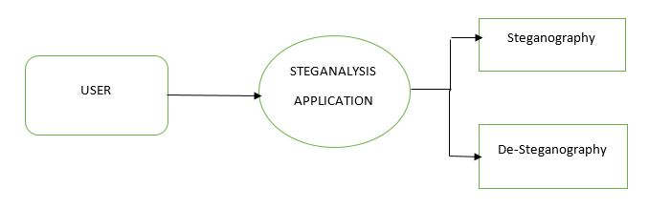
DATA FLOW DIAGRAM
LEVEL 0

Slide 7
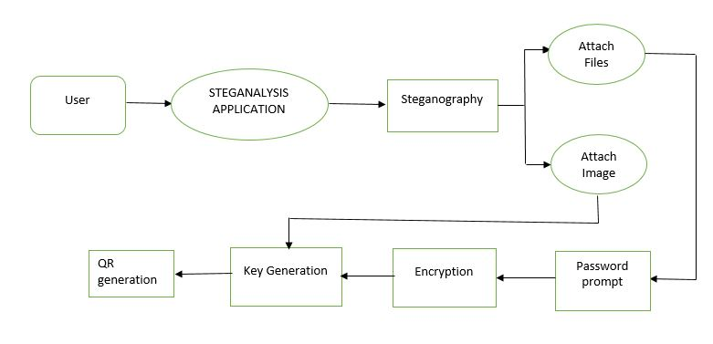
DATA FLOW DIAGRAM
LEVEL 1:encryption

Slide 8
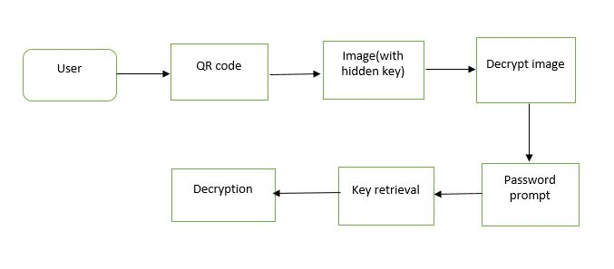
DATA FLOW DIAGRAM
Level 1: Decryption

Slide 9
Module Split-up
Module 1:
GUI Creation
Encryption & key generation
Module 2:
Hiding key behind image
Encrypted Image → QR
Module 3:
QR → encrypted Image
Extract key from image
Module 4:
Decryption
Department of CSE, KGiSL Institute of Technology, Coimbatore

Slide 10
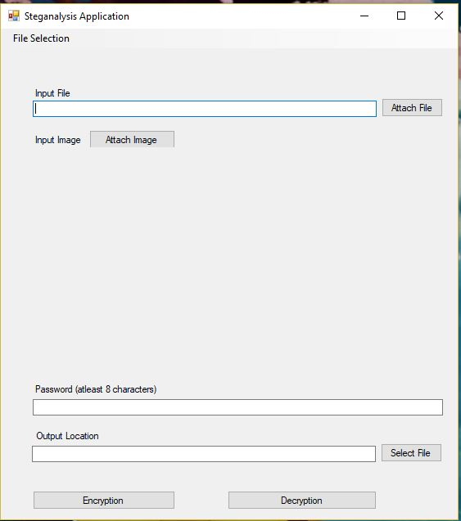
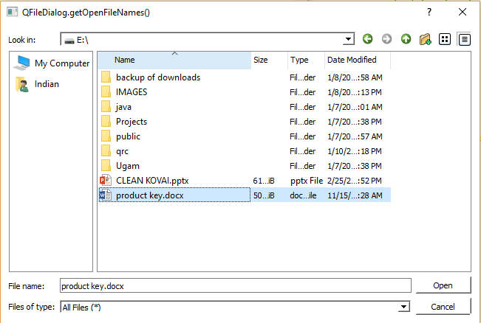
Screen shots of modules under progress….
User Interface
Importing Files

Slide 11
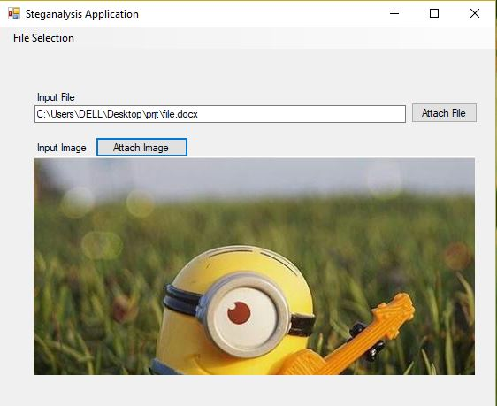
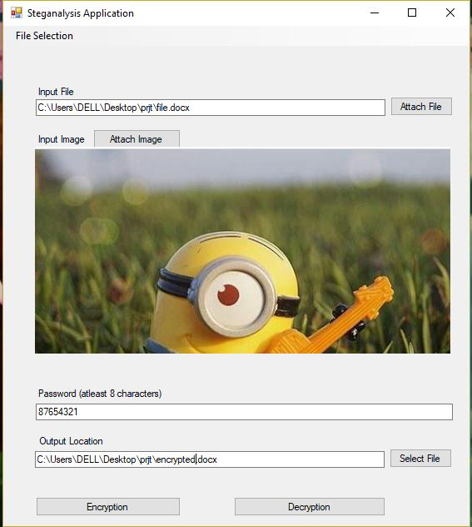
Contd…
Attaching the images
Password & encryption

Slide 12
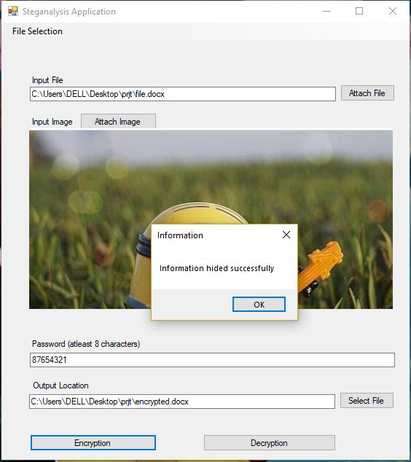
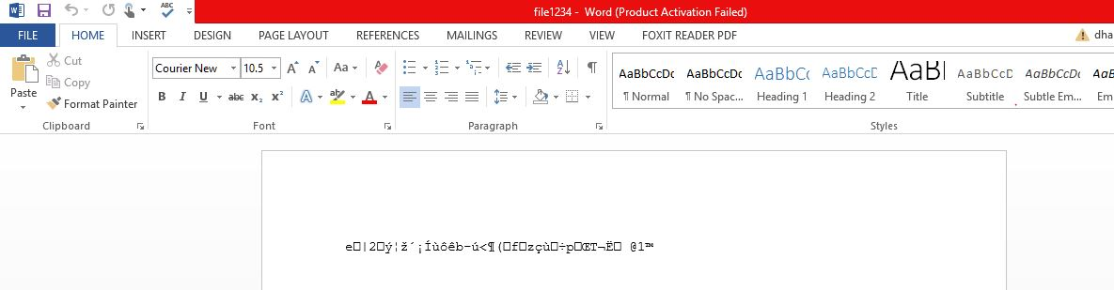
Contd…
encryption
Encrypted file

Slide 13
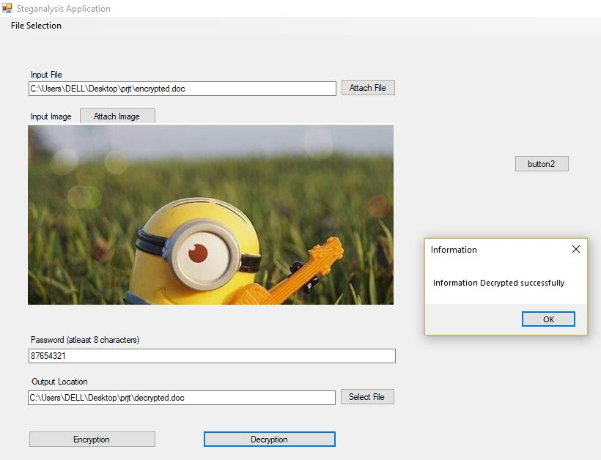
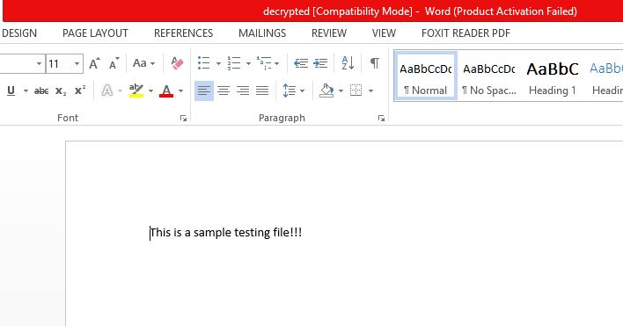
Contd..
decryption
Decrypted file

Slide 14
Thank You

