Slide 1
Morphological Decomposition
A Machine Learning Approach
Stegărescu Ana-Maria, 407
Mușat Bianca-Ștefania, 407
Linguistics for Computer Science

Slide 2
Definitions
Morphology
Morphemes
Studies the structure of words
Smallest units that carry meaning
Morphemes
It is a word that has meaning
It cannot be divided into smaller significant segments without changing its meaning
It has the same stable meaning in different verbal environments

Slide 3
Inflectional Morpheme
Varies the word by adding grammatical contrast
Preserves the meaning
Keeps the word class the same
Derivational Morpheme
Creates a new word from an existing word
Alters the meaning
Changes the word class

Slide 4

Problem statement
Given a Romanian noun, we want to decompose it in morphemes, so that we identify the prefix (derivational morphem), the root, the suffix (derivational morpheme) and the inflectional morphemes.
Nesupuneri:
Prefix: ne
Root: supune
Suffix: re
Infl morph: i

Slide 5
Decomposing a word in morphemes - datasets
RoMorphoDict (Barbu, 2008)
Contains information on inflected form, its stem, its morpho-syntactic description and the marking of the stressed vowel in pronunciation
nesupravegheátã nesupravegheát adj.f.sg.n-a.neart.
Around 65.000 lemmas and 700.000 entries
We extracted only the nouns from the dataset, leaving us with 376.178 entries and 50.809 stems
Prefixes (Mario Duma, 2007)
We extracted the prefixes described in “Ghid explicativ: prefixele şi sufixele limbii române” by Mario Duma
163 entries
Suffixes (Mario Duma, 2007)
We extracted the suffixes described in “Ghid explicativ: prefixele şi sufixele limbii române” by Mario Duma
298 entries

Slide 6
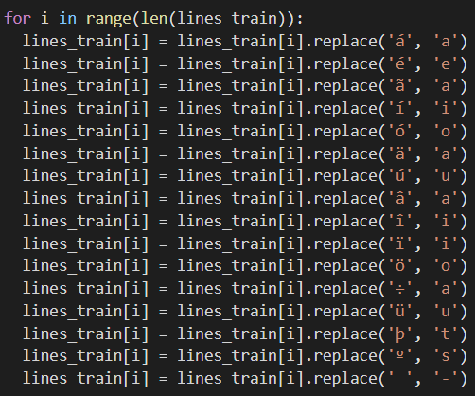
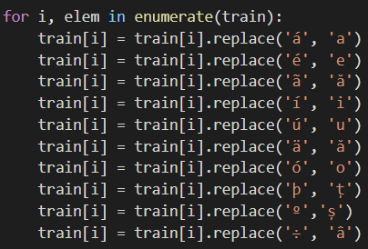
Data preprocessing
Inflectional Morphemes
Derivational Morphemes

Slide 7
01
Inflectional Morphemes

Slide 8
Our approach:
For the inflectional morphemes, we decided to extract them manually.
We noticed a pattern in inflectional morphemes in nouns, depending on their count, gender, article etc.
The nouns were separated into groups, and then the groups of morphemes could be manually searched and extracted. Here is an example:

Slide 9
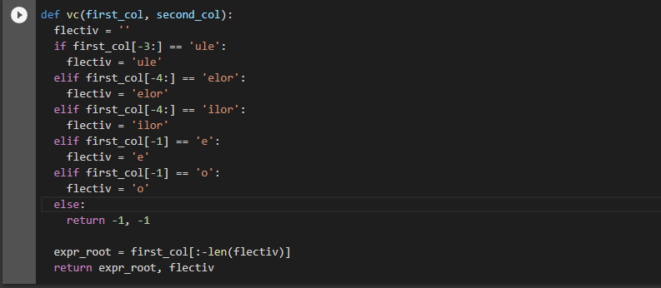

Slide 10
The next step is separating each group of inflectional morphemes, which was also done manually:

Slide 11
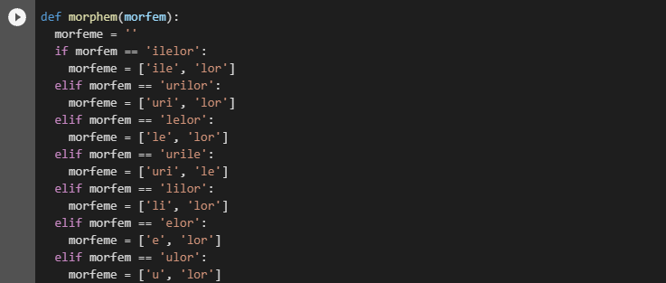

Slide 12
The last step is the function that receives a word and returns the stem and list of inflectional morphemes:

Slide 13
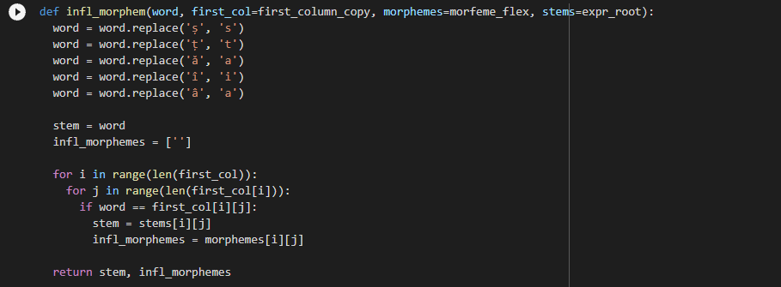

Slide 14
02
Derivational Morphemes

Slide 15
DERIVATIONAL MORPHEMES - SOLUTION
Read and preprocess data
1
2
Algorithmically extract the root, prefix and suffix
Manually correct some of the roots and update the prefixes and suffixes
3
4
Construct the features
Use the models to predict the prefixes and suffixes of arbitrary nouns
Build the models for prefixes and suffixes
5
6

Slide 16
DERIVATIONAL MORPHEMES - SOLUTION
Read data from RoMorphoDict, Prefixes and Suffixes datasets and preprocess the RoMorphoDict data.
Extract all stems from the RoMorphoDict that are associated with nouns.
For all these stems, algorithmically extract the root, prefix and suffix:
Extract the most probable prefix, by going through the list of prefixes, removing each matching prefix from the word and searching for a stem that matches the remaining word. If we manage to find a perfect match, it means we found our prefix.
Extract the prefix from the word.
For the remaining stem, go through the list of suffixes, remove the matching suffixes and if we find a similar enough stem in our stem list (more than 80% similarity) we add our suffix to the possible suffixes list and than choose the most probable one.
The root of the word will be the most probable stem found for the most probable suffix.

Slide 17
DERIVATIONAL MORPHEMES - SOLUTION
Manually check the correctness of the resulting roots and correct 400 randomly choosen roots.
Algorithmically update the prefixes and suffixes to match the new roots.
Construct the features:
For all the stems, we appended ‘#’ at the begging of the word and ‘$’ at the end of it.
“merge” -> “#merge$”
We constructed a vocabulary of all n-grams, n=1…3
“#merge$” -> #, m, e, r, g, e, $, #m, me, er, rg, ge, e$, #me, mer, erg, rge, ge$
We used the Bag of Words approach to mark 1 for each n-gram we have in our stem.
For the prefixes model, we also constructed a vocabulary of all prefixes and used the Bag of Words approach to represent the features.
Similar for the suffix model.

Slide 18
DERIVATIONAL MORPHEMES - SOLUTION
Build a SVM model to classsify the prefixes
Features: the BoW representation of the words (n-grams) concatenated with the BoW representation of the prefixes
Fit the SVM model on all nouns and use it to predict the prefix for arbitary nouns
Accuracy: 86%
Build a SVM model to classsify the suffixes
Features: the BoW representation of the words (n-grams) concatenated with the BoW representation of the suffixes
Fit the SVM model on all nouns and use it to predict the suffix for arbitary nouns
Accuracy: 80%
Use the predicted suffix and prefix to algorithmically extract the root.
Use these models to predict the suffix, prefix and root of new nouns.

Slide 19
Demo Time

Slide 20
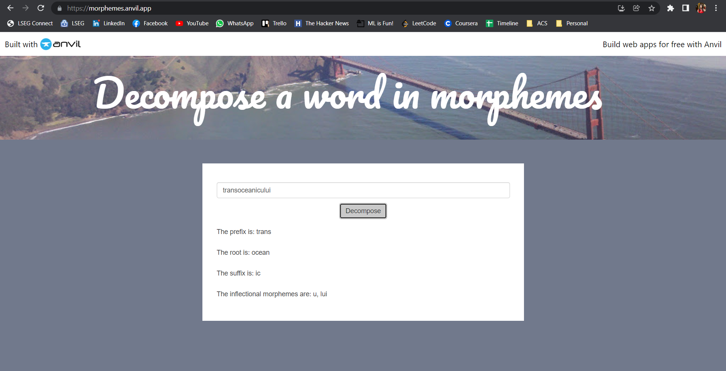

Slide 21
Future work
Improve the accuracy of the ML models for derivational morphemes by manually adjusting the correctness of the root of each noun, or by manually identifying the correct derivational morphemes in a noun for a long enough list of Romanian nouns
Experiment with different machine learning algorithms in order to improve the correctness of the predictions for derivational morphemes
Use a ML approach for the inflectional morphemes in order to predict more rapidly the correct inflectional morphemes of a new noun

Slide 22

THANK YOU
Do you have any questions?
Stegărescu Ana-Maria, 407
Mușat Bianca-Ștefania, 407
Linguistics for Computer Science

Slide 23
RESOURCES
http://ghidprefixesufixe.ro/MarioDuma_Ghid_Prefixe_Sufixe.pdf
https://www.rit.edu/ntid/sea/processes/wordknowledge/grammatical/whatare#:~:text=A%20%22morpheme%22%20is%20a%20short,or%20leaving%20a%20meaningless%20remainder.Dashboard element collection
Linguistics for CS, Course 3 – Morphology, author: Anca Dinu

