Slide 1
Asymmetric Encryption (RSA)
Teaching for CITS2006 Portfolio Task A24

Slide 2
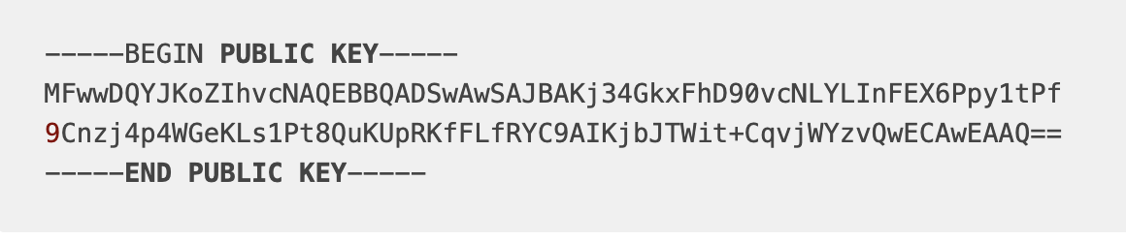
Public and Private Keys
Public Key
- Anyone can see it, often listed publicly
Private Key
- Only the owner has access

Slide 3
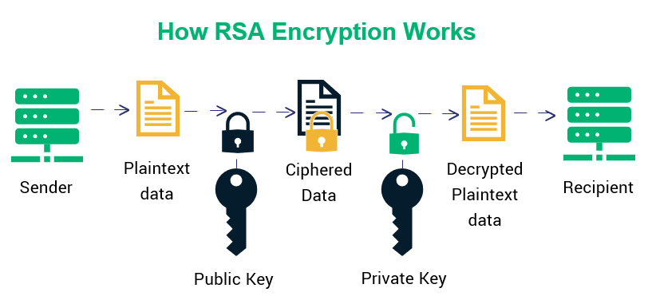
Flow

Slide 4
What do the keys contain?
Public Key
The public key is created by multiplying two very large (100 digit) prime numbers (often p and q, which are not in the key)
This creates a huge number (n) with only two factors (p and q)
Without explicit knowledge of p and q, n is functionally impossible to guess or calculate
Private Key
The private key is then created, with p and q contained within
This is kept secret, and should be stored very securely

Slide 5
How to send a secure message?
To send your friend a message, you take their public key
Use it to encrypt your message using some fancy math
Due to the way the encryption function works, even if an attacker knows n, without p and q it is functionally impossible to decrypt

Slide 6
How to decrypt a secure message?
Someone sends you a message encrypted with your public key
Using p and q contained in your private key, it is simple math to decrypt the message you have been sent.

Slide 7
Why does it work?
n = 299604539773691895576847697095098784338054746292313
044353582078965
p = 1090660992520643446103273789680343
q = 1162435056374824133712043309728653
- Even for an advanced computer, guessing the factors of n is functionally impossible, unless the factors are too small, or the method used to generate them is predictable.

Slide 8
Summary
Essentially, it all relies on a one-way set of mathematical functions.
They’re very easy to compute in one direction, but almost impossible to compute backwards.
This makes it quick to encrypt and decrypt, but secure due to the sheer size of the numbers involved.
With LLMs and supercomputer technologies, the old standard of 1024bit primes has been theorised to be breakable in the near future, prompting upgrades to 2048bit primes.
Notes:
Comments: It is what it says on the tin.

