Slide 1
Unsupervised Learning in Seismology
René Steinmann
GFZ Discovery Fellow
Leipzig, 8 May 2025

Slide 2
Outline
What is unsupervised learning and why is it interesting?
How do we do unsupervised learning?
Applications
Challenges & Solutions

Slide 3
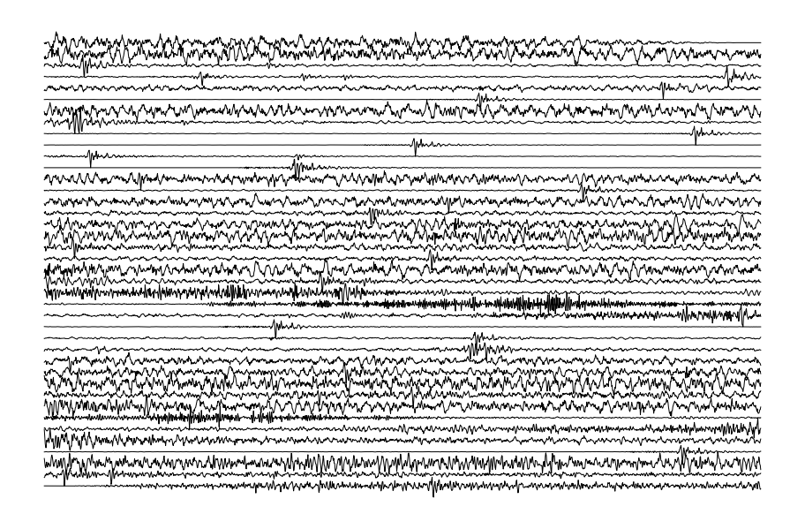
Why unsupervised learning?
20 min
What if we have 10 years of recordings?
?

Slide 4
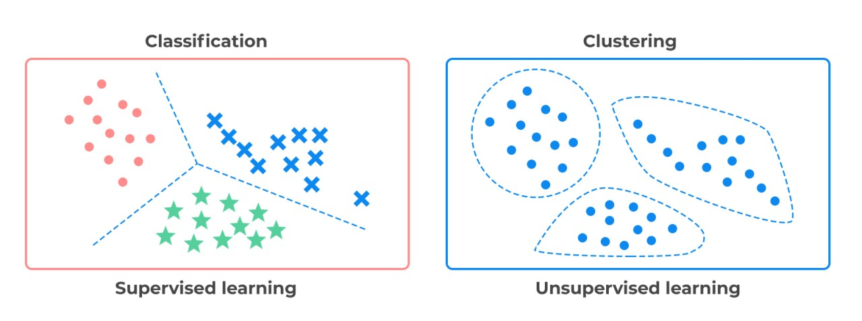
Unsupervised learning is about finding hidden patterns, structures, or groupings in data without using labels
https://vocal.media/01/supervised-and-unsupervised-learning
We have labels
Task: predict a category
Earthquake vs. Noise
No labels needed
Task: find signal families
Are there differnt type of noise sources?

Slide 5
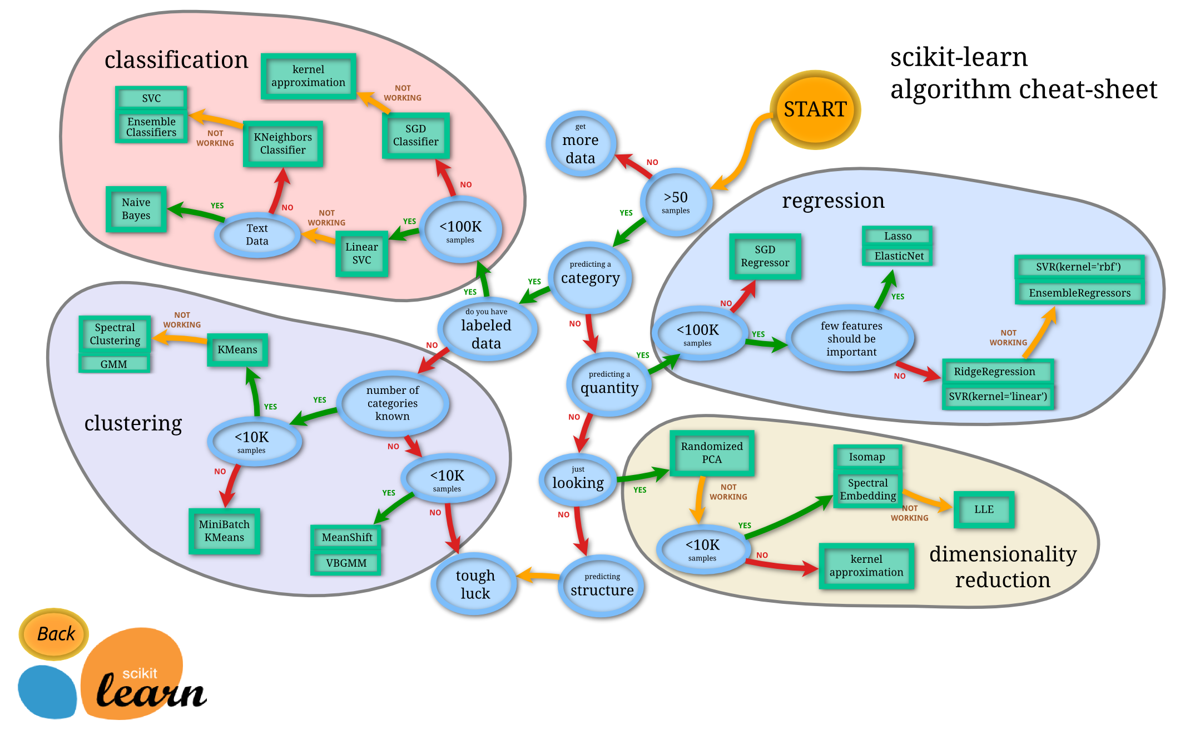
What methods of unsupervised learning exist?
Other methods:
Anomaly detection (e.g. Isolation Forest)

Slide 6
How could unsupervised learning be useful here?
Clustering: Finding groups of similar signals
Dimensionality reduction: Visualize large time series
Anomaly detection: any weird/rare signals in my data?

Slide 7
Outline
What is unsupervised learning and why is it interesting?
How do we do unsupervised learning?
Applications
Challenges & Solutions

Slide 8
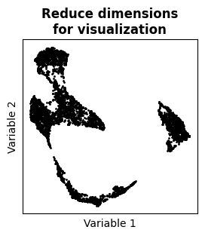
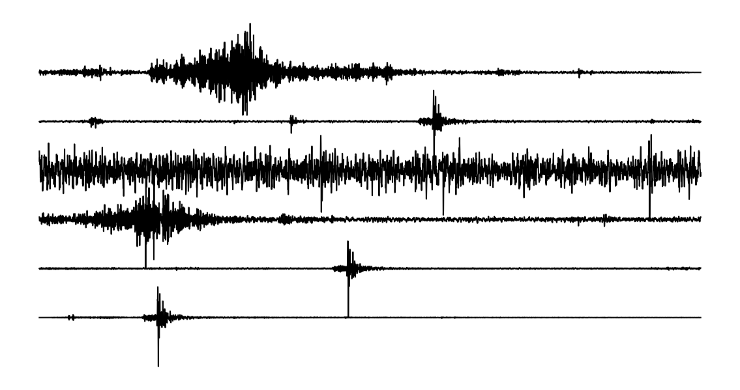
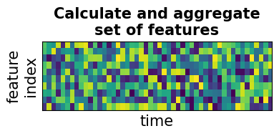
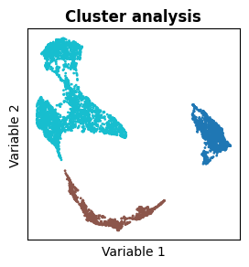
How do we apply unsupervised learning to continuous seismograms?

Slide 9
How do we apply unsupervised learning to continuous seismograms?

Slide 10

Why not working directly with the time series data?
High-dimensional (curse of dimensionality)
Time-invariant
Sensitive to small changes

Slide 11
What options of data representation do we have?
Hand-designed Features
fmax = 1 Hz
Peak Amplitude = 10⁻⁷ m
Energy = 10⁻⁴ m²
…
Frequency representation
(spectral or wavelet coefficients,
Mel Frequency ceptral coefficients)
Learned representation
(auto-encoders, contrastive learning)
Value
amplitude
frequency
Latent Variable
easy to interpret
low performance
hard to interpret
high performance

Slide 12
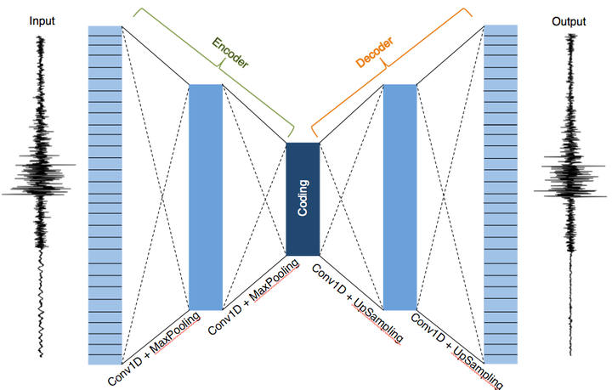
Quick introduction to auto-encoders
Coding = Latent Variables
Learning Objective = Reconstruction of input (no labels)
Classic use-case: denoising
Image: https://ngrayluna.github.io/project/denoiser/

Slide 13
3. The curse of dimensionality

Slide 14
Why do we need to reduce dimension?
The curse of dimensionality
Optimal number
Why?
distances become meaningless
data points become sparse
Model performance
How to reduce the dimensions?
Principal Component Analysis (PCA)
Manifold learning (T-SNE, UMAP)
…
Number of Features/Dimensions

Slide 15
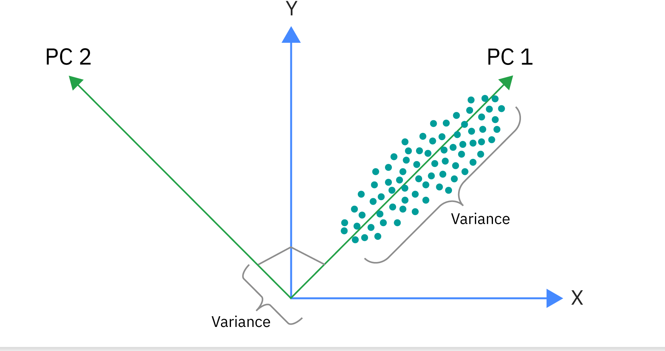
Principal Component Analysis (PCA)
Considered a linear method
PCA finds the dircetions in which the data varies the most
Provides the eigenvectors (direction) and the eigenvalues (variance)
Principal compontents are ranked according to variance
Principal compontents are orthogonal to each other
https://www.ibm.com/think/topics/principal-component-analysis

Slide 16
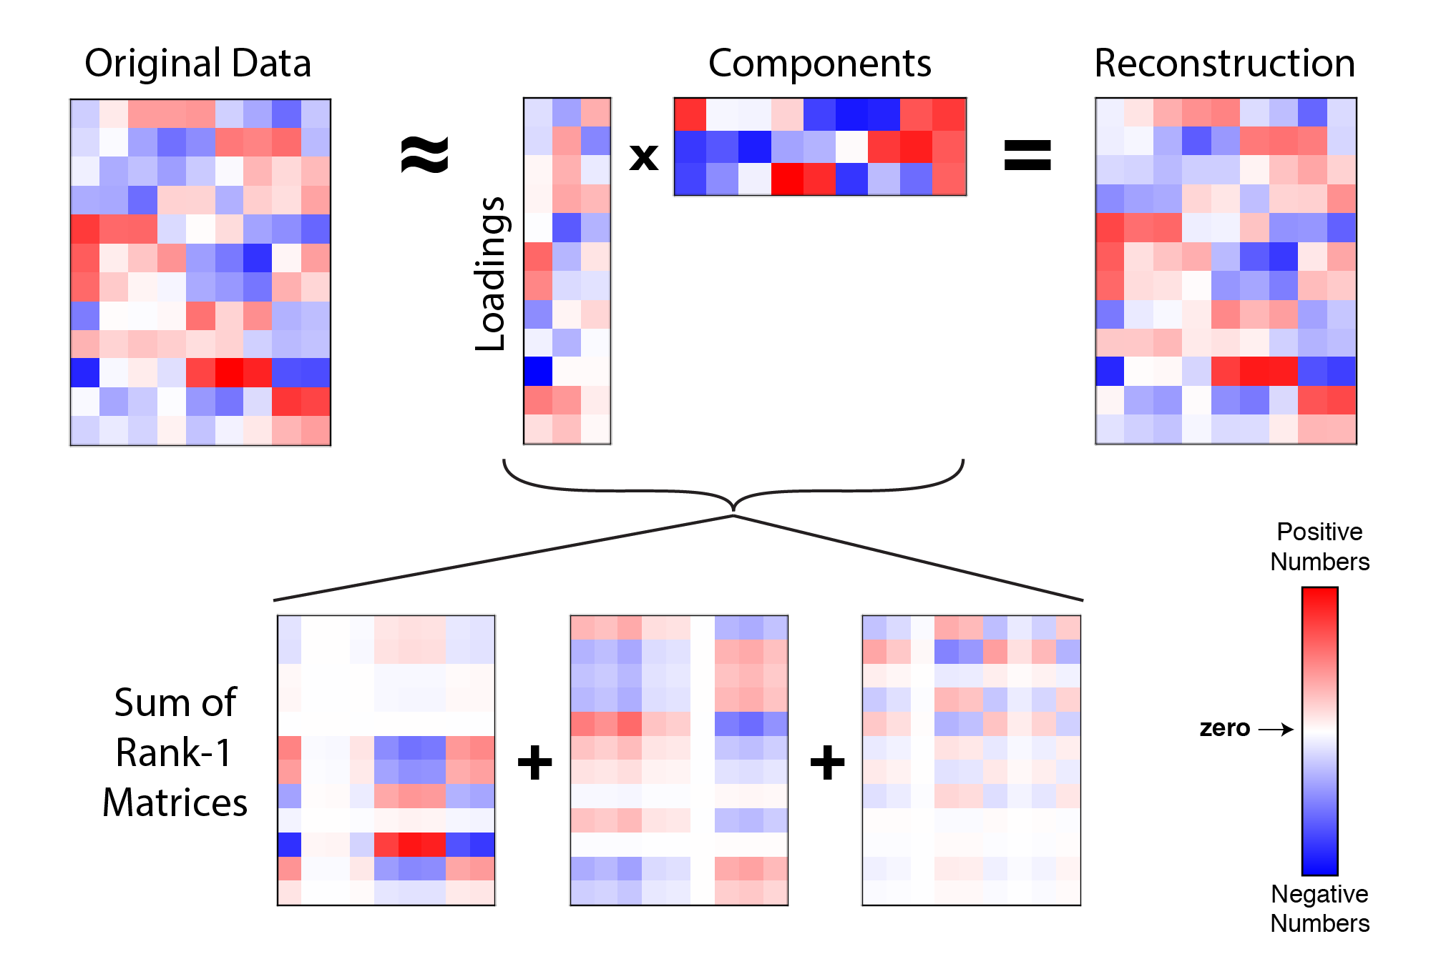
Principal Component Analysis (PCA)
Image: https://alexhwilliams.info/itsneuronalblog/2016/03/27/pca/

Slide 17
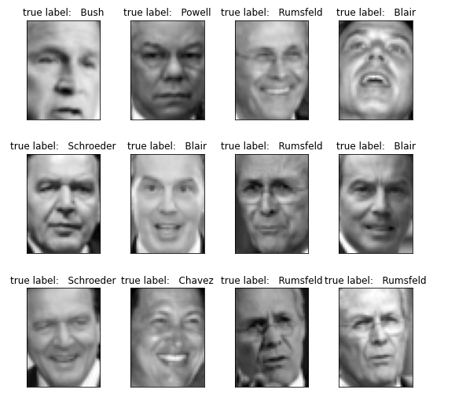
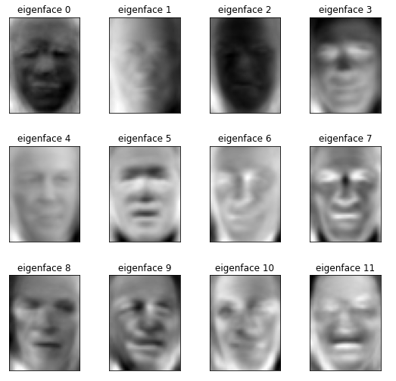
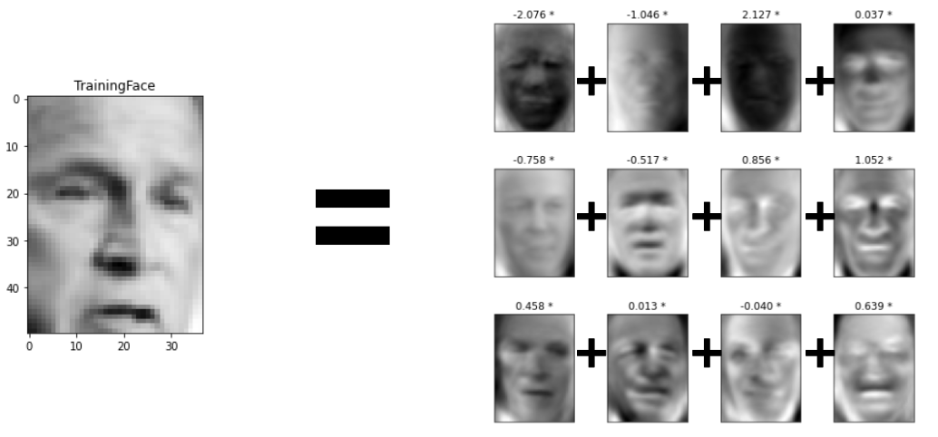
Principal Component Analysis (PCA)
https://www.geeksforgeeks.org/ml-face-recognition-using-eigenfaces-pca-algorithm/

Slide 18
Understanding UMAP and T-SNE

Slide 19
4. Identifying patterns with clustering

Slide 20
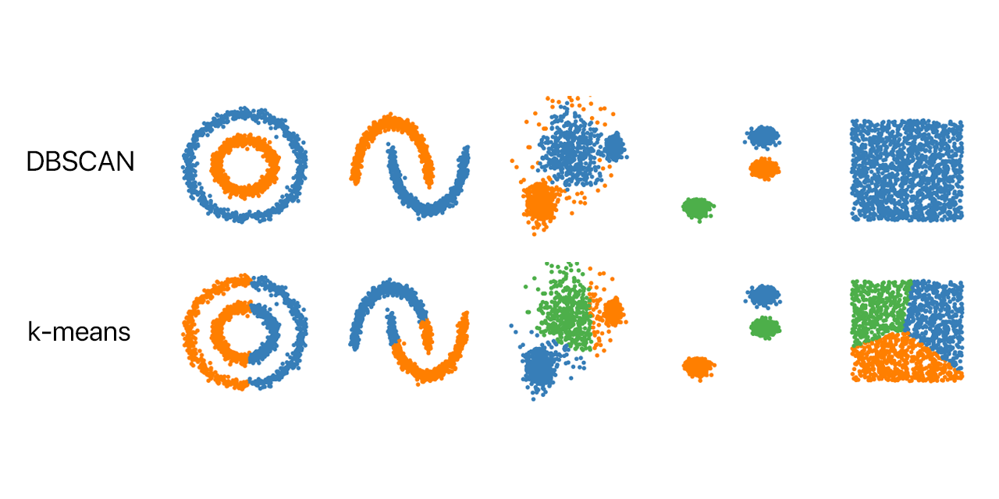
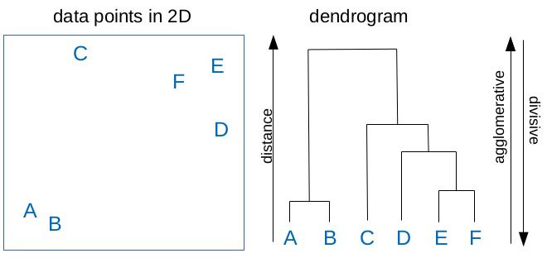
A rough overview of clustering methods
Partitioning
Hierarchical
Agglomerative
Divisive
square-root error criterion
K-Means
HDBSCAN
Single
Ward
Density-Based
e.g. DBSCAN

Slide 21
Understanding K-Means

Slide 22
Understanding DBSCAN

Slide 23
Hierarchical Clustering

Slide 24
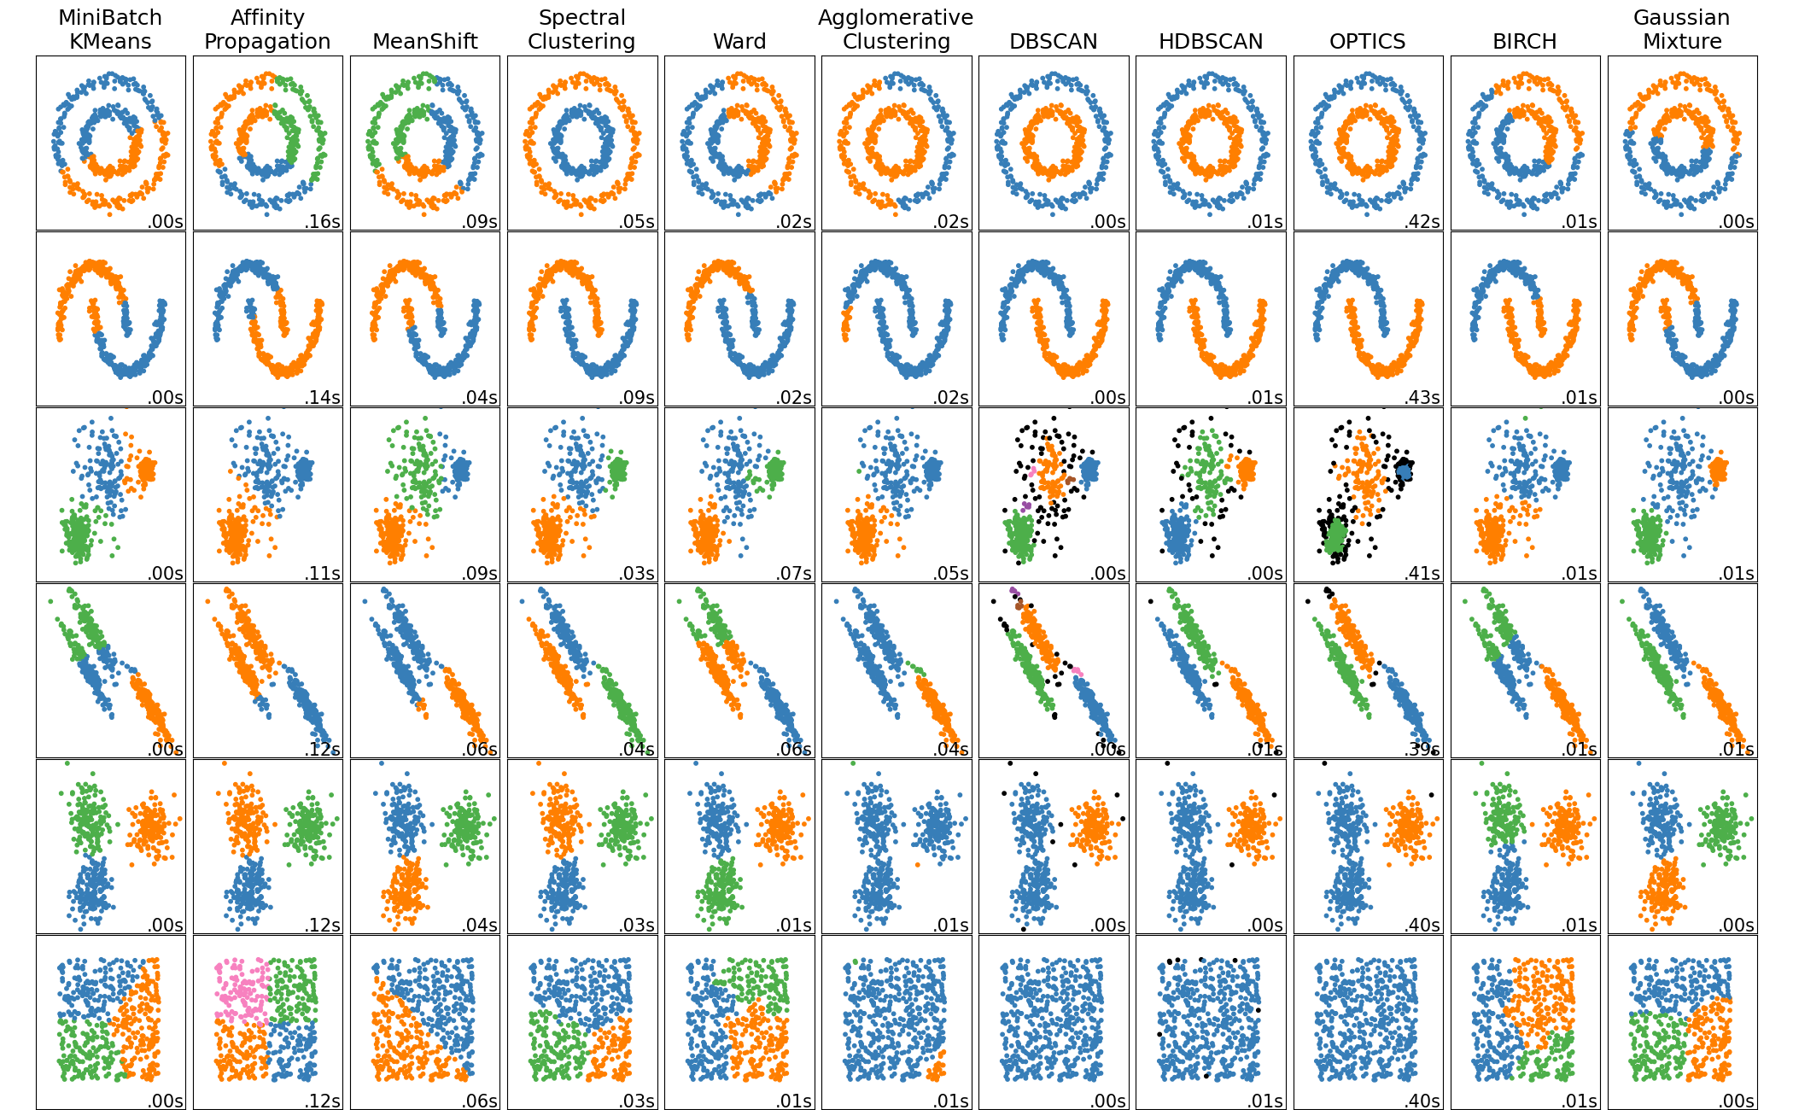
Clustering Overview in Scikit-Learn

Slide 25
What options of data representation do we have?
Hand-design features from time or frequency domain (e.g., peak amplitude, energy, max frequency, mean frequency)
  Easy to interpret but usually low performance
Use time-frequency representations (e.g. wavelet coefficients, spectral coefficients, scattering coefficients, mel-frequency ceptral coefficients)
Learn a representation with unsupervised/self-supervised learning (e.g. auto-encoders, contrastive learning models)
interpretation
Performance (with enough data)

Slide 26
Outline
What is unsupervised learning and why is it interesting?
How do we do unsupervised learning?
Applications
Challenges & Solutions

Slide 27
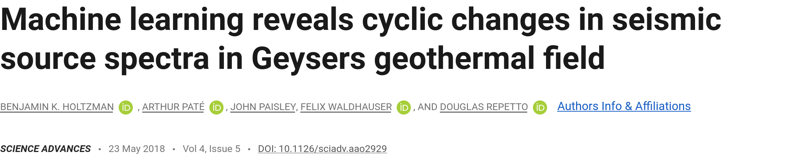
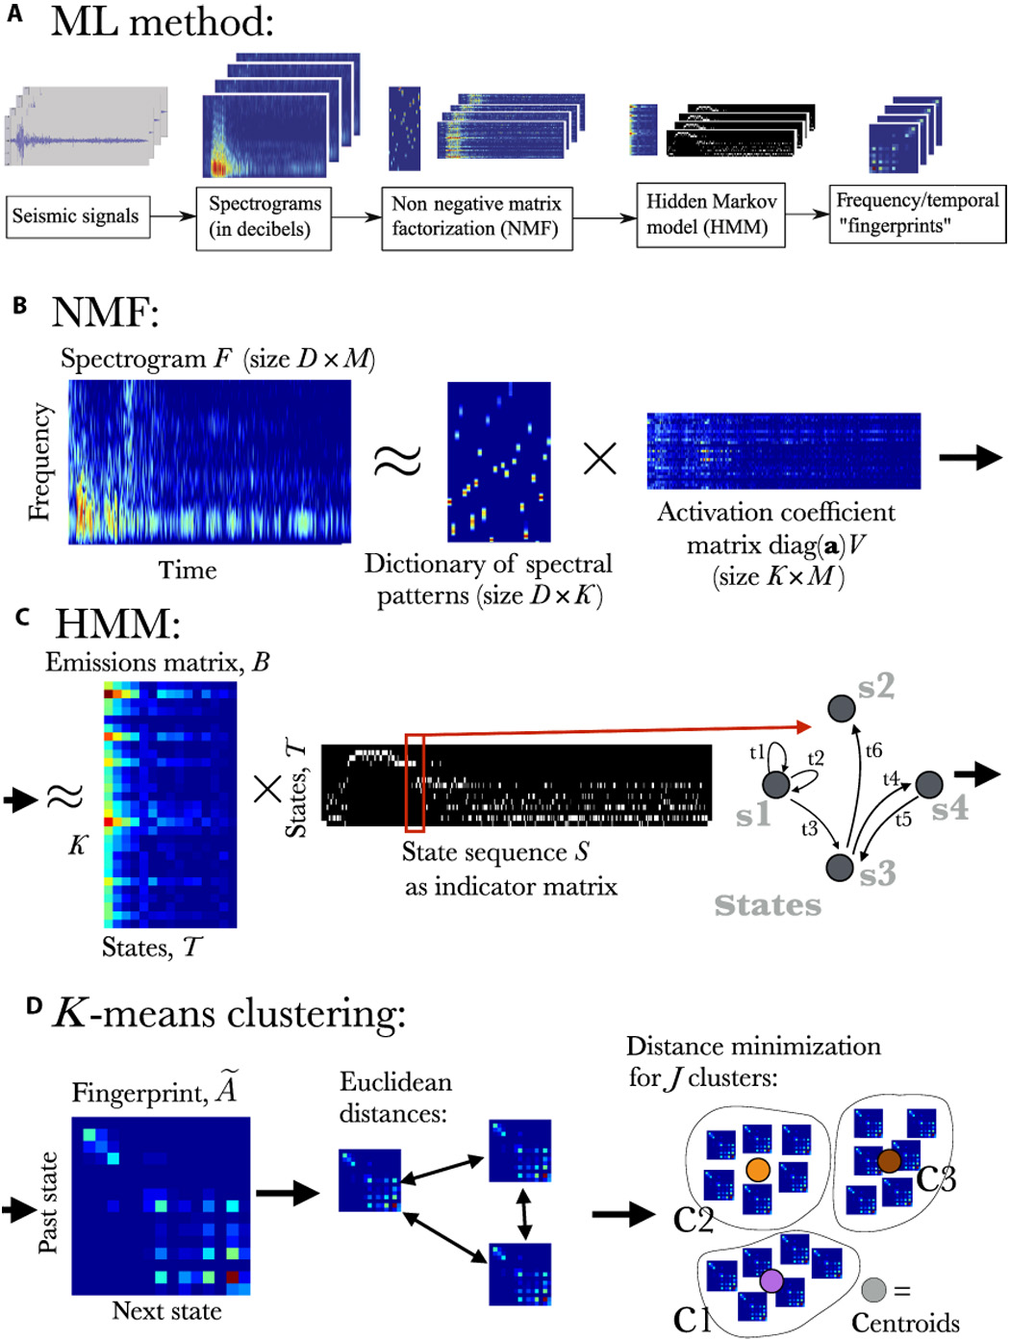
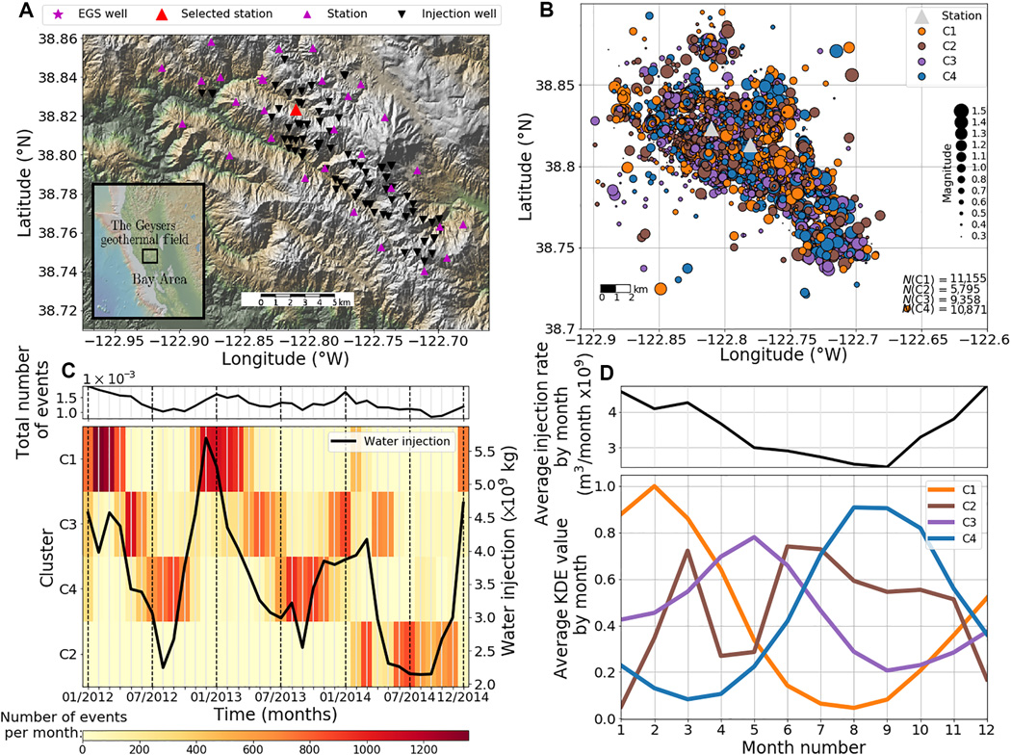
Input: seismic waveforms from catalog
Analysis/Interpretation of clustering output

Slide 28
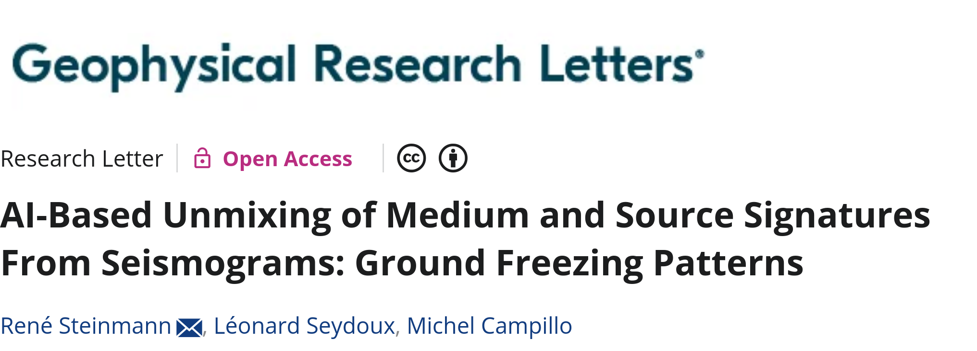
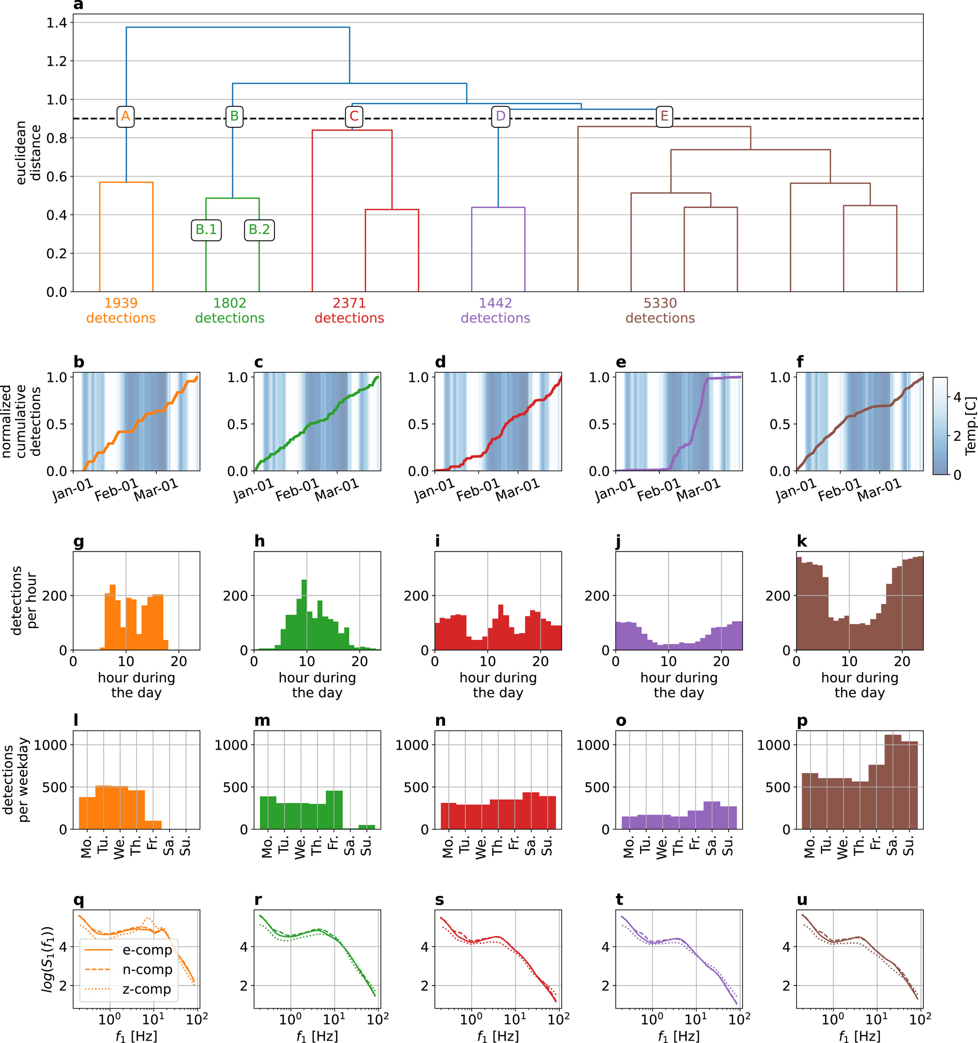
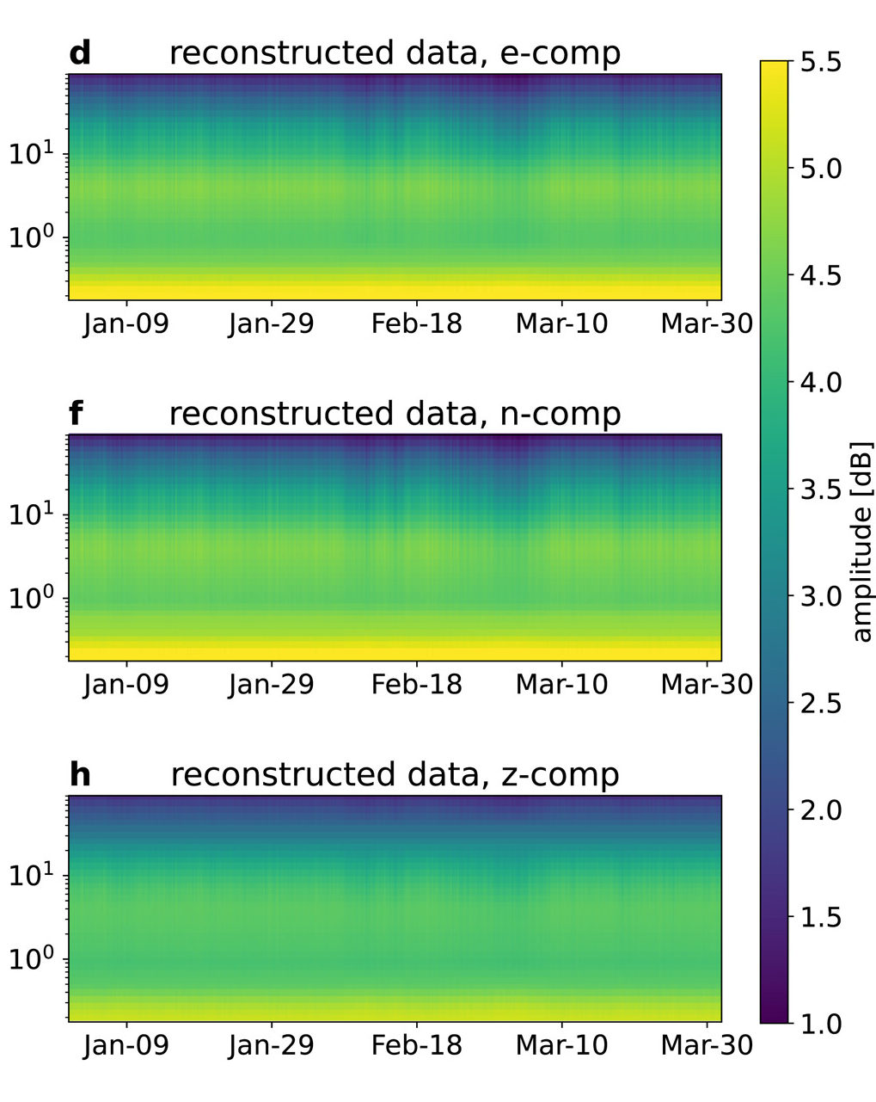
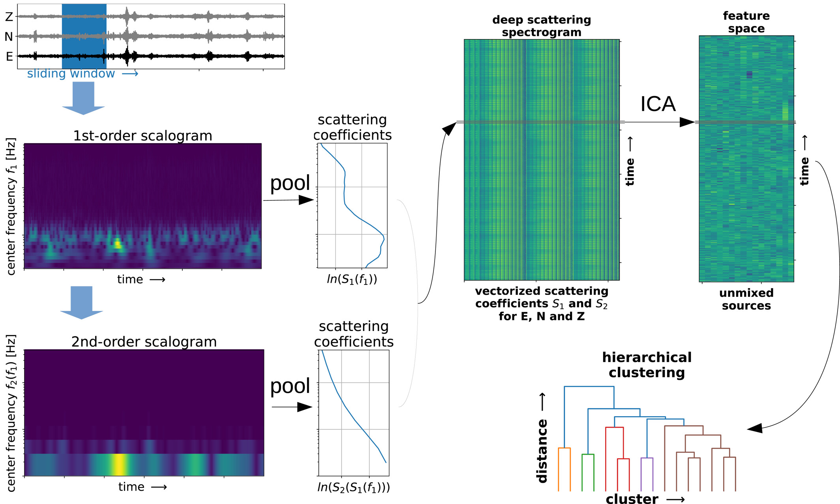
Interpretation of clusters together with „Eigenfaces“
Input: continuous 3-comp seismograms

Slide 29
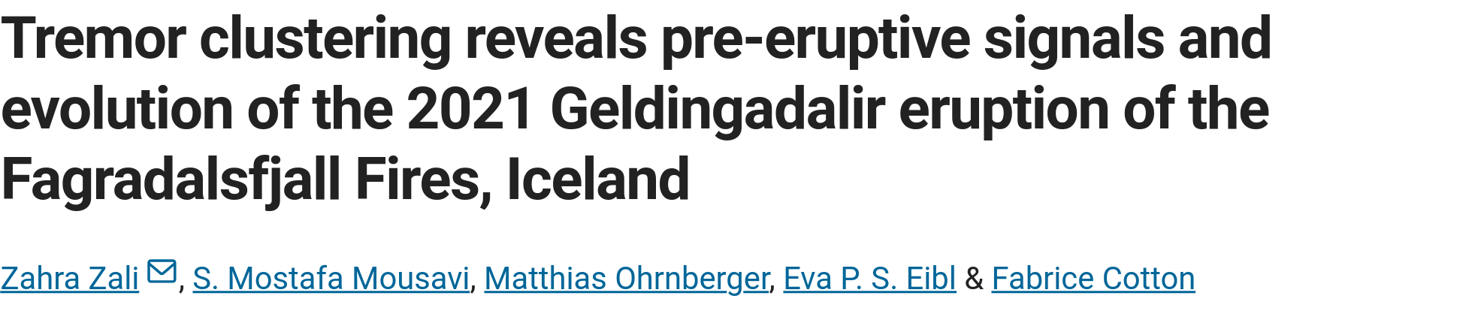
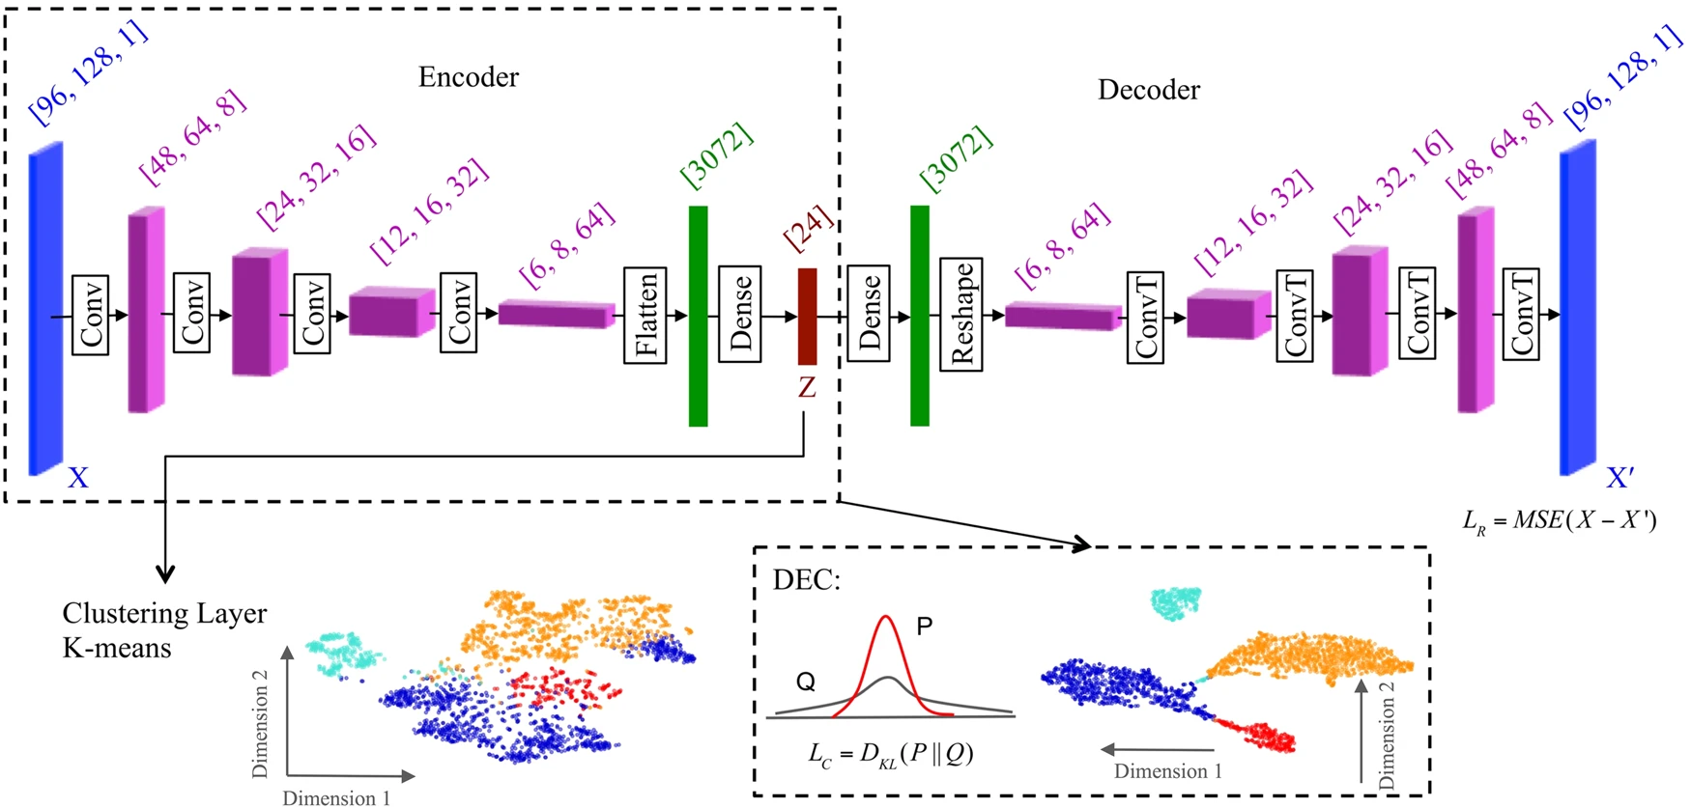
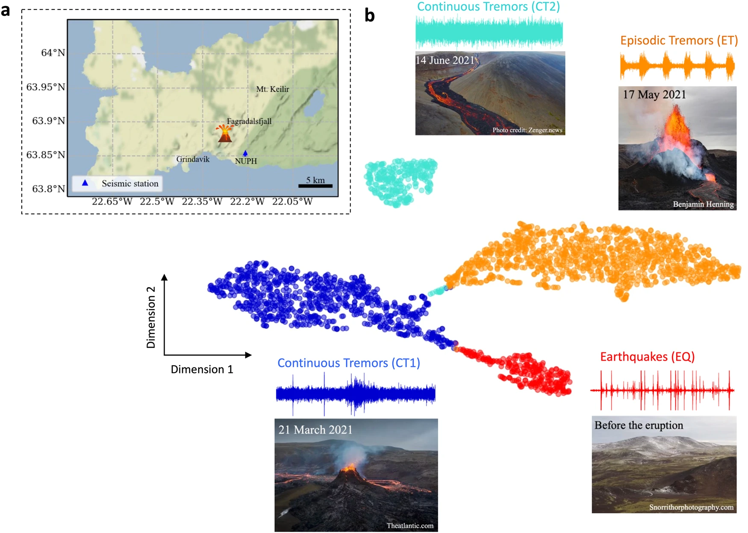

Slide 30
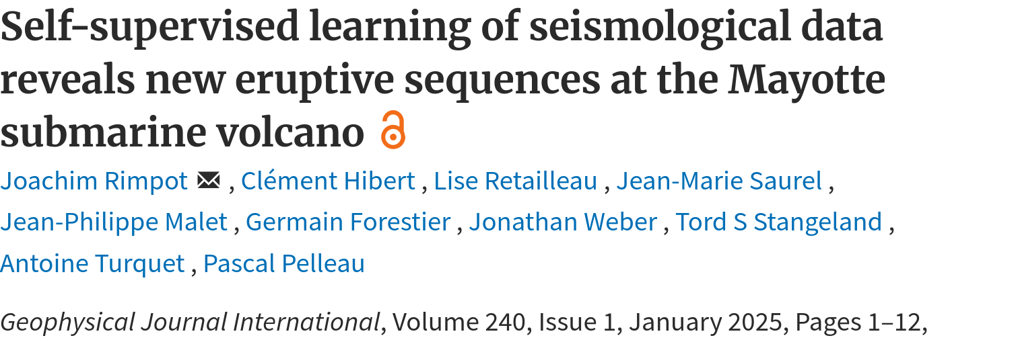
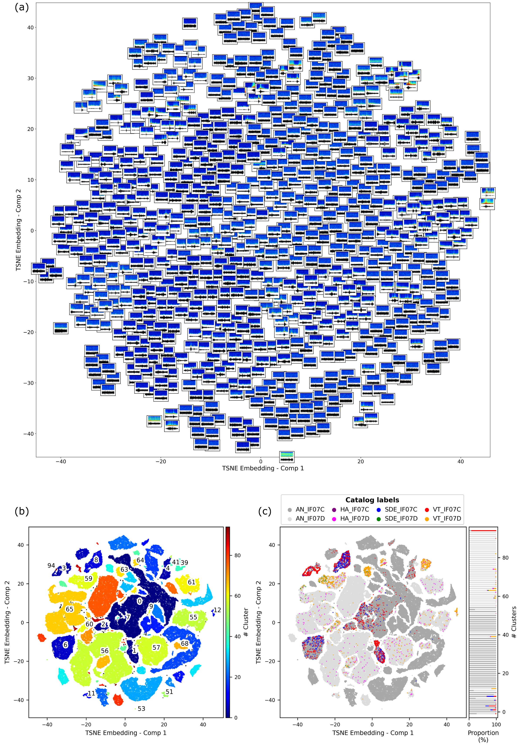
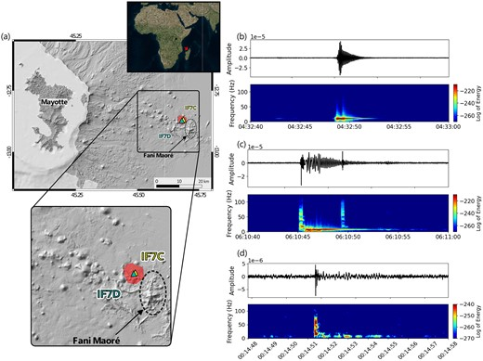
Input: continuous seismograms
Feature Extraction with Contrastive Learning
Dimension Reduction with T-SNE
Clustering with DBSCAN

Slide 31
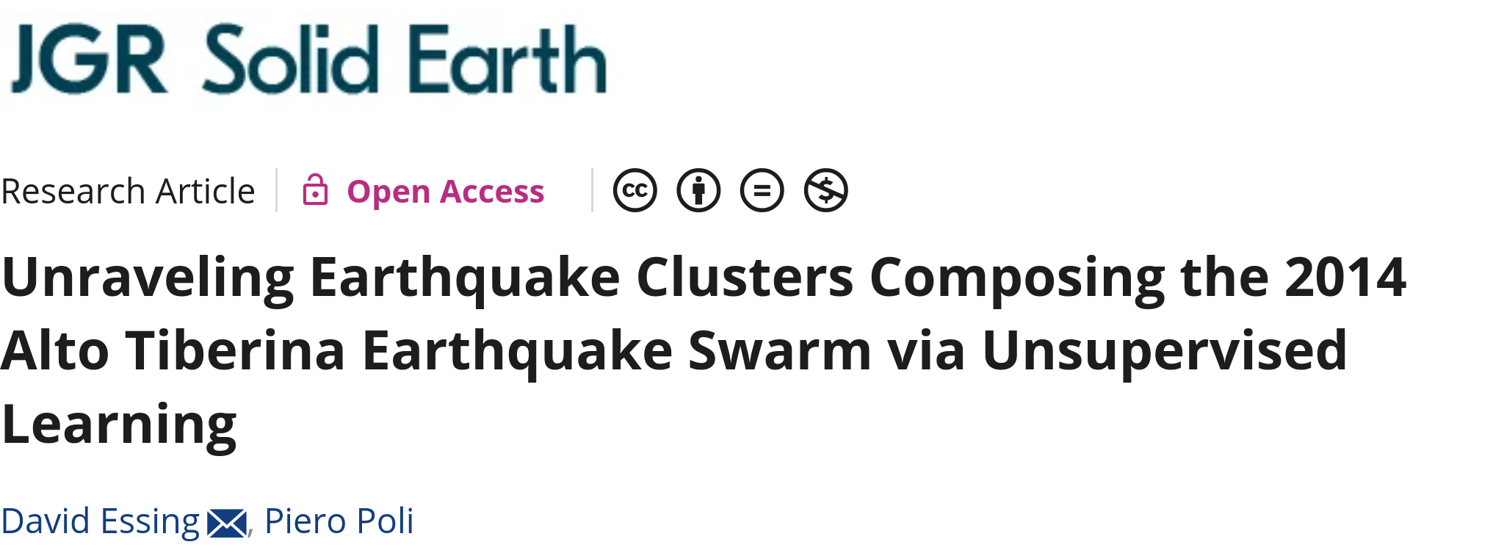
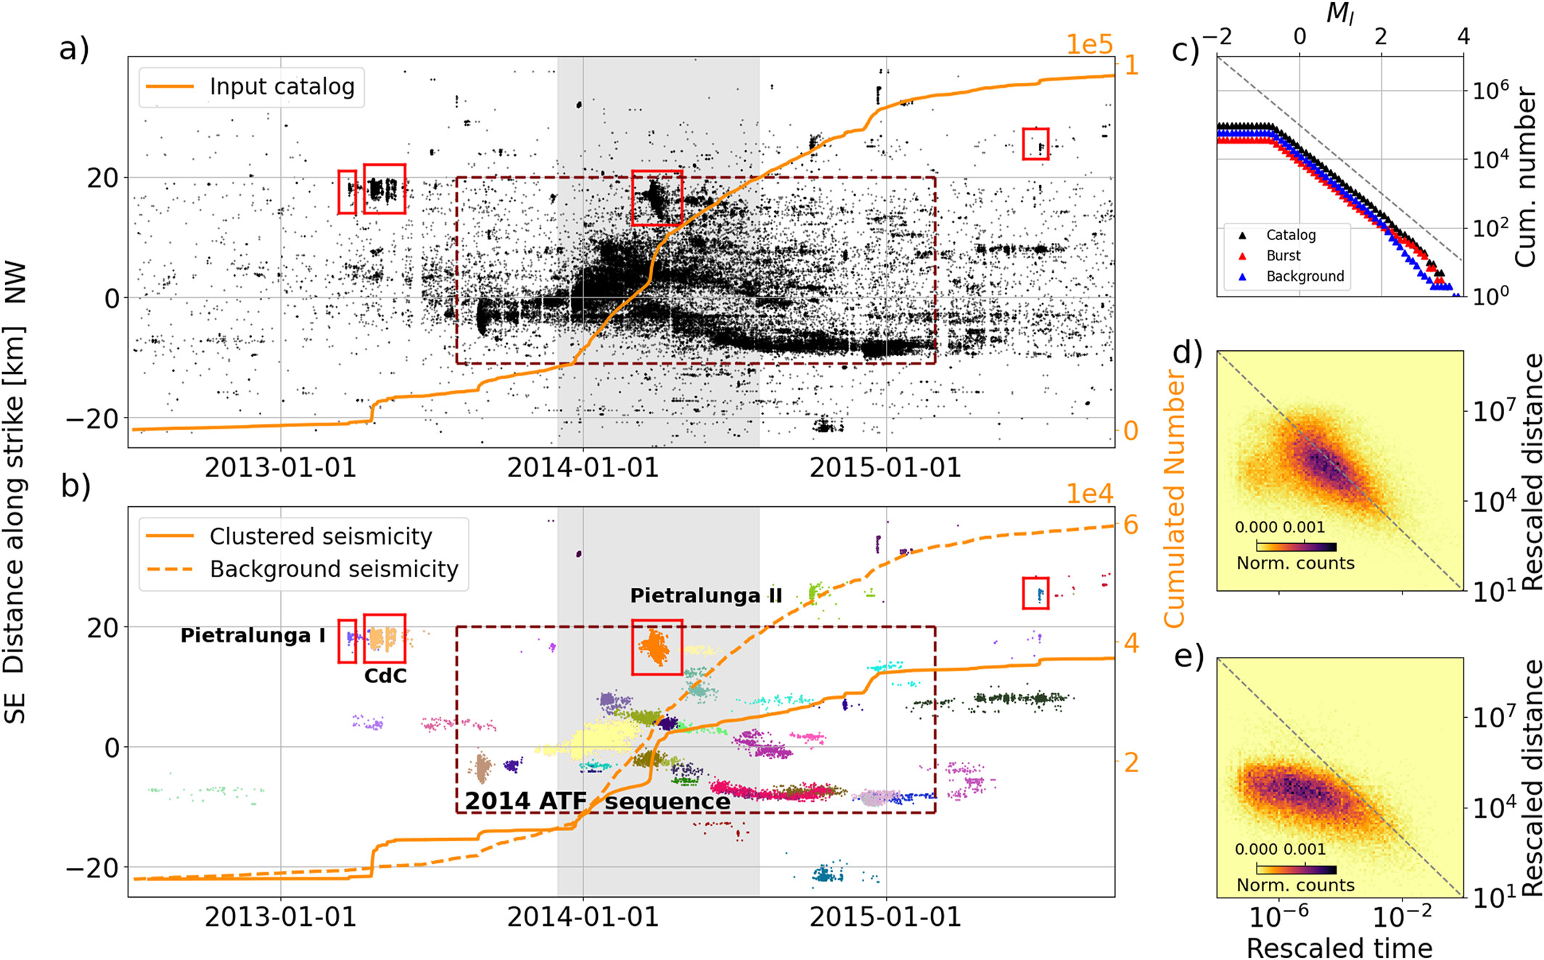
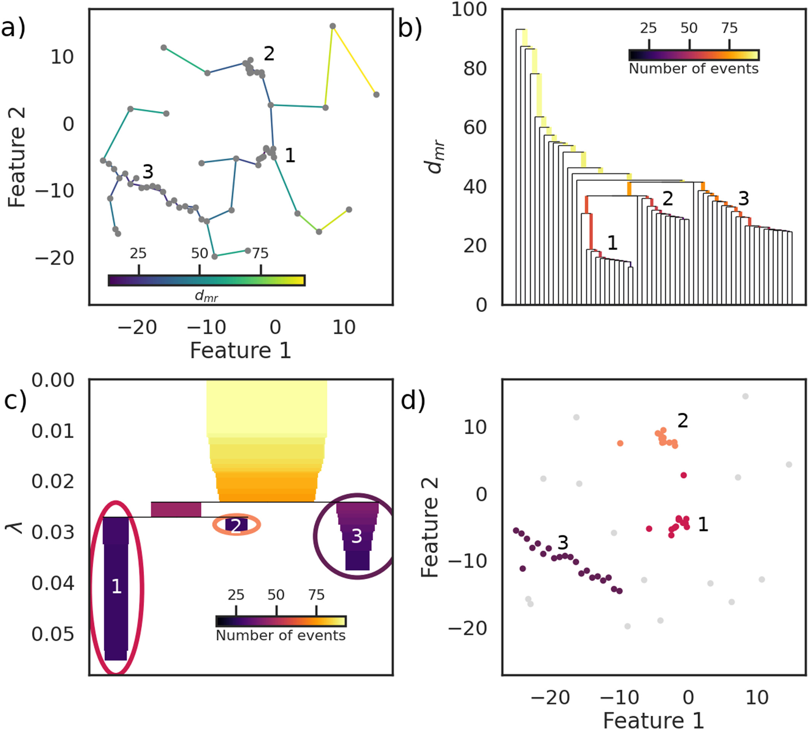
Input: spatial and temporal features of earthquake catalog
Hierachical-DBSCAN

Slide 32
Outline
What is unsupervised learning and why is it interesting?
How do we do unsupervised learning?
Applications
Challenges & Solutions

Slide 33
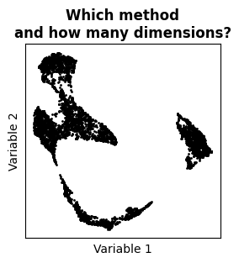
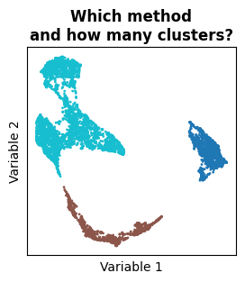
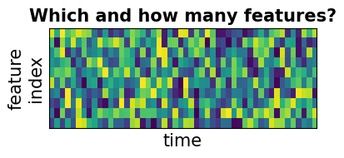
Making a choice
Solution:
adapt method to goal and data
If possibe, use diagnostic methods like Silhouette Analysis or Explain Variance Ratio
If possible ,visualize along the way

Slide 34
Link the results to the real world
Look at data characteristic
of clusters!
Try to visualize your data in different ways.
Any other data available? Water injection rate, temperature, GNSS time series?

Slide 35
Recap
When to use unsupervised learning?
  To find patterns in data without labels — great for exploratory analysis, anomaly detection, and new discoveries.
What sort of data?
  Anything, including continuous seismograms, seismogram snippets, catalogs
Most common pipeline
  Raw Data → Features → Dimensionality Reduction → Clustering
Challenges
  Choosing the right approach, setting parameters, and interpretation

Slide 36
Last slide
→ Example for content
Contact
jane.public@gfz.de
www.gfz.de
+49 (0)3316264-0
Key Messages
Point 1
Point 2
… to be shown at the end for the discussion

Slide 37




Last slide
→ Example 2 for content
Contact
jane.public@gfz.de
www.gfz.de
+49 (0)3316264-0
Follow us on
https://bsky.app/profile/gfz.bsky.social
https://www.instagram.com/gfz_potsdam/
https://www.youtube.com/
user/GFZvideos
https://www.linkedin.com/company/gfz-helmholtz-zentrum-fuer-geoforschung
Instagram

