Slide 1
Сервиз за битова техника
Проект по Системи за управление на бази от данни – практикум
Изготвил: Стелиана Димитрова, ФН: 4MI0700044

Slide 2
Съдържание
01
E/R диаграма на модела
02
Релационни схеми
03
Схема на базата от данни
04
Изгледи
05
Приложение за достъп до базата

Slide 3
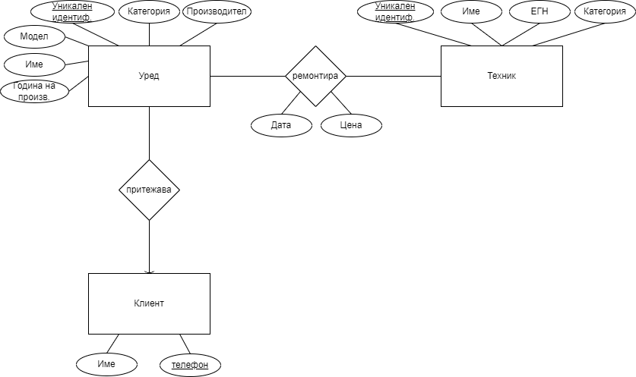
E/R диаграма на модела

Slide 4
Релационни схеми
Релационен модел:
Appliance (name, model, applianceId, applianceCategory, manufacturer, yearOfManufacture)
Technician (name, EGN, texnicianId, texnicianCategory)
Customer (name, phoneNumber)
Repair (applianceId, texnicianId, date, price)
Owns ( applianceId, phoneNumber)
Релационен модел след оптимизация:
Appliance (name, model, applianceId, applianceCategory, manufacturer, yearOfManufacture, customerPhoneNumber)
Technician (name, EGN, texnicianId, texnicianCategory)
Customer (name, phoneNumber)
Repair (applianceId, texnicianId, date, price)

Slide 5
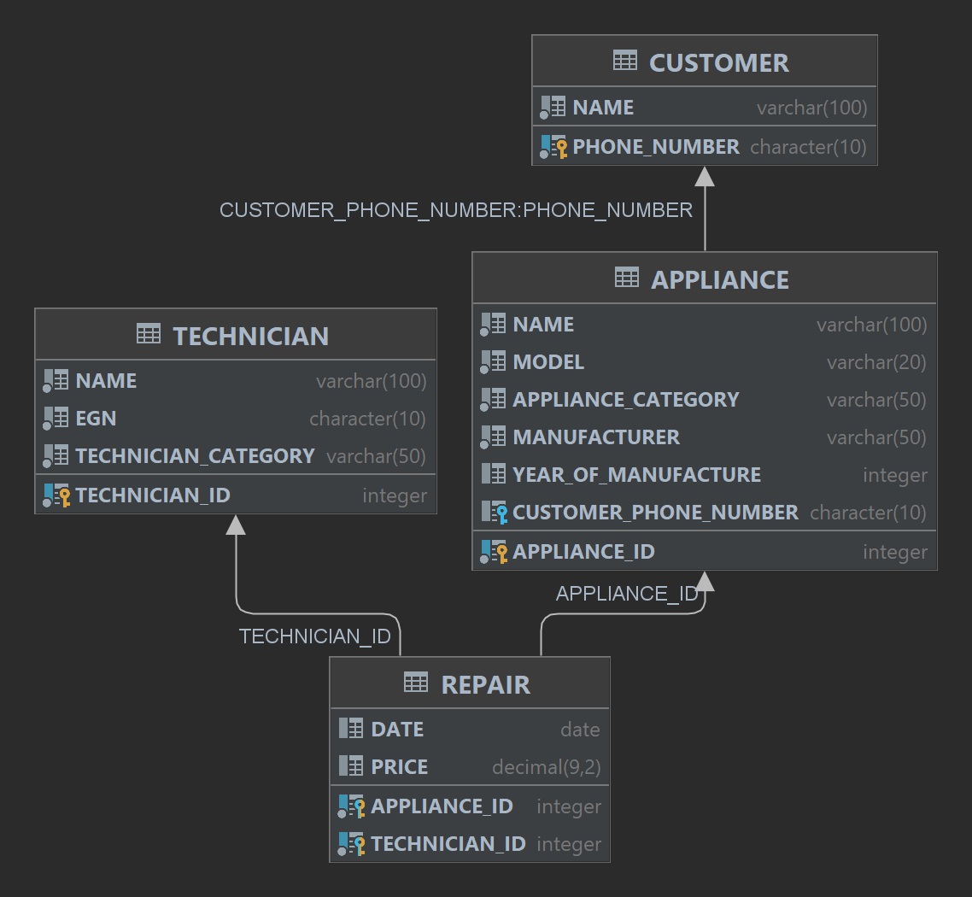
Схема на базата от данни

Slide 6
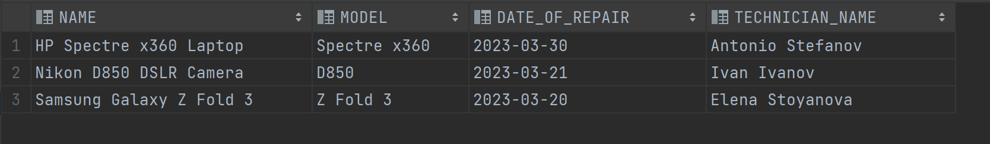
Функции
CREATE FUNCTION F_GET_ALL_APPLIANCES(P_PHONE_NUMBER CHAR(10)) RETURNS TABLE(NAME VARCHAR(100), MODEL VARCHAR(20), DATE_OF_REPAIR DATE, TECHNICIAN_NAME VARCHAR(100)) RETURN SELECT A.NAME, A.MODEL, R.DATE, T.NAME FROM APPLIANCE A, REPAIR R, TECHNICIAN T WHERE A.CUSTOMER_PHONE_NUMBER = P_PHONE_NUMBER AND A.APPLIANCE_ID = R.APPLIANCE_ID AND R.TECHNICIAN_ID = T.TECHNICIAN_ID; SELECT * FROM TABLE(FN4MI0700044.F_GET_ALL_APPLIANCES('0899000112')) T;

Slide 7
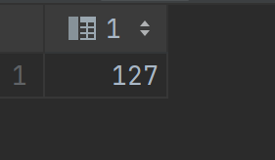
Функции
CREATE OR REPLACE FUNCTION F_AVG_PRICE_FOR_CATEGORY (P_CATEGORY VARCHAR(50)) RETURNS INT BEGIN DECLARE P_AVG_PRICE DECIMAL(9, 2); SELECT AVG(PRICE) INTO P_AVG_PRICE FROM REPAIR WHERE APPLIANCE_ID IN ( SELECT APPLIANCE_ID FROM APPLIANCE WHERE APPLIANCE_CATEGORY = P_CATEGORY); RETURN P_AVG_PRICE; END; VALUES FN4MI0700044.F_AVG_PRICE_FOR_CATEGORY('TV');

Slide 8
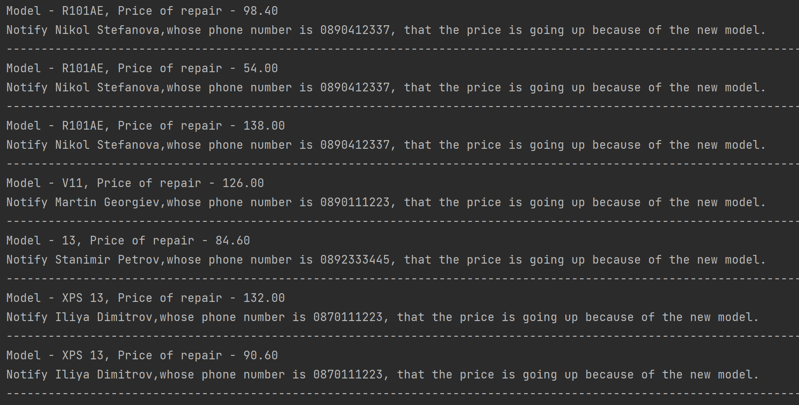
Процедури
CREATE OR REPLACE PROCEDURE P_NEW_PRICE_AFTER_2020() BEGIN DECLARE V_MODEL VARCHAR(30); DECLARE V_YEAR INT; DECLARE V_PRICE DECIMAL(9,2); DECLARE V_NAME VARCHAR(50); DECLARE V_PHONE_NUMBER CHAR(10); DECLARE SQLCODE INT; DECLARE C1 CURSOR WITH RETURN FOR
SELECT A.MODEL, A.YEAR_OF_MANUFACTURE, R.PRICE, C.NAME, A.CUSTOMER_PHONE_NUMBER
FROM APPLIANCE A, REPAIR R, CUSTOMER C
WHERE A.CUSTOMER_PHONE_NUMBER = C.PHONE_NUMBER AND R.APPLIANCE_ID = A.APPLIANCE_ID; OPEN C1; FETCH C1 INTO V_MODEL, V_YEAR, V_PRICE, V_NAME, V_PHONE_NUMBER; WHILE SQLCODE = 0 DO IF V_YEAR > 2020 THEN SET V_PRICE = V_PRICE * 1.2; CALL DBMS_OUTPUT.PUT_LINE('Model - ' || V_MODEL || ', Price of repair - ' || V_PRICE); CALL DBMS_OUTPUT.PUT_LINE('Notify ' || V_NAME || ',whose phone number is ' || V_PHONE_NUMBER || ', that the price is going up because of the new model.'); CALL DBMS_OUTPUT.PUT_LINE('-------------------------'); END IF; FETCH C1 INTO V_MODEL, V_YEAR, V_PRICE, V_NAME, V_PHONE_NUMBER; END WHILE; CLOSE C1; END; CALL FN4MI0700044.P_NEW_PRICE_AFTER_2020();

Slide 9
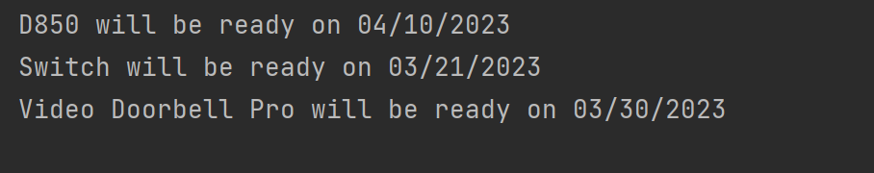
Процедури
CREATE OR REPLACE PROCEDURE P_DAYS_OFF(IN P_NUMBER_OF_DAYS INT, IN P_FROM_DATE DATE, IN P_TECHNICIAN_ID INT, OUT P_NEW_DATE DATE) BEGIN DECLARE V_MODEL VARCHAR(30); DECLARE V_DATE DATE; DECLARE SQLCODE INT; DECLARE C1 CURSOR WITH RETURN FOR
SELECT A.MODEL, R.DATE FROM APPLIANCE A, REPAIR R WHERE R.TECHNICIAN_ID = P_TECHNICIAN_ID AND R.DATE >= P_FROM_DATE AND A.APPLIANCE_ID = R.APPLIANCE_ID; OPEN C1; FETCH C1 INTO V_MODEL, V_DATE; WHILE SQLCODE = 0 DO SET P_NEW_DATE = DATE(V_DATE) + P_NUMBER_OF_DAYS DAYS; CALL DBMS_OUTPUT.PUT_LINE(V_MODEL || ' will be ready on ' || P_NEW_DATE); FETCH C1 INTO V_MODEL, V_DATE; END WHILE; CLOSE C1; END; BEGIN DECLARE NEW_DATE DATE; CALL FN4MI0700044.P_DAYS_OFF(20, '2023-03-01' , 141, NEW_DATE);

Slide 10
Процедури
CREATE OR REPLACE PROCEDURE P_TECHNICIAN_INFO(IN P_TECHNICIAN_ID INT) BEGIN DECLARE V_NAME VARCHAR(100); DECLARE V_EGN CHAR(10); DECLARE V_CATEGORY VARCHAR(50); DECLARE V_ID_COLLECTION INT; DECLARE V_APP_COUNT INT; DECLARE r_error INT DEFAULT 0; DECLARE SQLCODE INT DEFAULT 0; DECLARE NOT_FOUND CONDITION FOR SQLSTATE '21000'; DECLARE EXIT HANDLER FOR NOT_FOUND BEGIN SET r_error = SQLCODE; CALL DBMS_OUTPUT.PUT_LINE('ERROR OCCURS - TECHNICIAN IS NOT FOUND: ' || r_error); END; SELECT COUNT(*) INTO V_APP_COUNT FROM REPAIR R WHERE R.TECHNICIAN_ID = P_TECHNICIAN_ID; SELECT COUNT(*) INTO V_ID_COLLECTION FROM TECHNICIAN WHERE TECHNICIAN_ID = P_TECHNICIAN_ID; IF(V_ID_COLLECTION = 0) THEN SIGNAL NOT_FOUND; ELSE SELECT NAME, EGN, TECHNICIAN_CATEGORY INTO V_NAME, V_EGN, V_CATEGORY FROM TECHNICIAN WHERE TECHNICIAN_ID = P_TECHNICIAN_ID; CALL DBMS_OUTPUT.PUT_LINE('TECHNICIAN NAME: ' || V_NAME); CALL DBMS_OUTPUT.PUT_LINE('TECHNICIAN EGN: ' || V_EGN); CALL DBMS_OUTPUT.PUT_LINE('TECHNICIAN ID: ' || P_TECHNICIAN_ID); CALL DBMS_OUTPUT.PUT_LINE('TECHNICIAN CATEGORY: ' || V_CATEGORY); CALL DBMS_OUTPUT.PUT_LINE('TECHNICAL REPAIRS: ' || V_APP_COUNT); END IF; END; CALL FN4MI0700044.P_TECHNICIAN_INFO( 141); CALL FN4MI0700044.P_TECHNICIAN_INFO( 133);

Slide 11
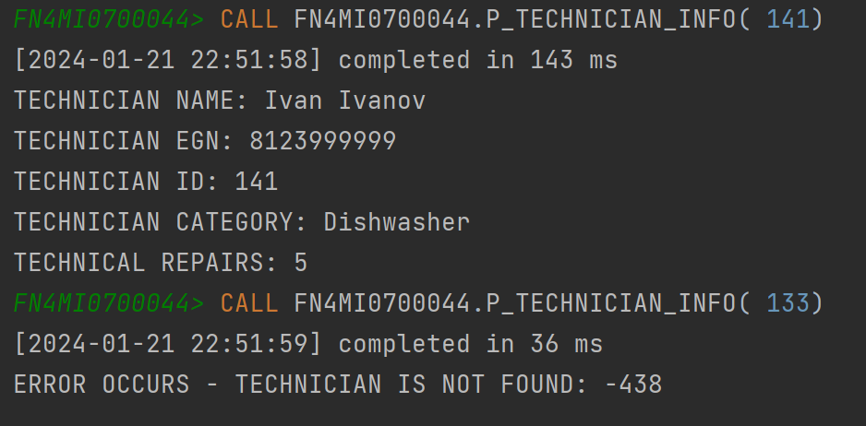
Резултат от последната процедура

Slide 12
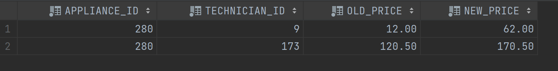
Тригери
CREATE TABLE REPAIR_PRICE_INCREASE_LOG ( APPLIANCE_ID INT NOT NULL, TECHNICIAN_ID INT NOT NULL, OLD_PRICE DECIMAL(9, 2) NOT NULL, NEW_PRICE DECIMAL(9, 2) NOT NULL ); CREATE OR REPLACE TRIGGER TRIG_AFTER_UPDATE_REPAIR_PRICE AFTER UPDATE OF PRICE ON REPAIR REFERENCING NEW AS N OLD AS O FOR EACH ROW WHEN (N.PRICE > O.PRICE) INSERT INTO REPAIR_PRICE_INCREASE_LOG(APPLIANCE_ID, TECHNICIAN_ID, OLD_PRICE, NEW_PRICE) VALUES (N.APPLIANCE_ID, N.TECHNICIAN_ID, O.PRICE, N.PRICE); UPDATE REPAIR SET PRICE = PRICE + 50 WHERE APPLIANCE_ID = 280; UPDATE REPAIR SET PRICE = PRICE - 50 WHERE APPLIANCE_ID = 290; SELECT * FROM REPAIR_PRICE_INCREASE_LOG;

Slide 13
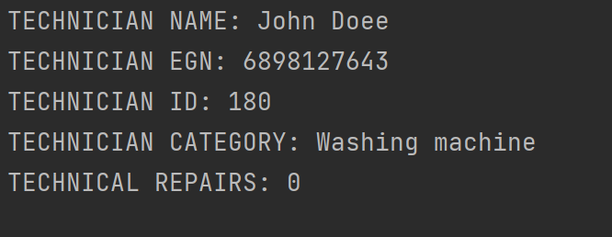
Тригери
CREATE OR REPLACE TRIGGER TRIG_AFTER_INSERT_TECHNICIAN AFTER INSERT ON TECHNICIAN REFERENCING NEW AS N FOR EACH ROW BEGIN DECLARE V_TECHNICIAN_ID INT; SET V_TECHNICIAN_ID = N.TECHNICIAN_ID; CALL FN4MI0700044.P_TECHNICIAN_INFO(V_TECHNICIAN_ID); END; INSERT INTO TECHNICIAN(NAME, EGN, TECHNICIAN_CATEGORY) VALUES ('John Doеe', 6898127643, 'Washing machine');

Slide 14
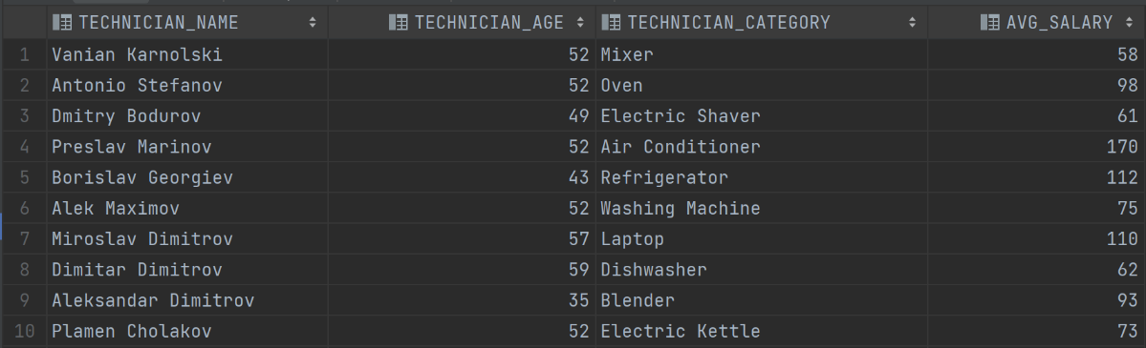
Изгледи
CREATE VIEW TECHNICIAN_INFO (TECHNICIAN_NAME, TECHNICIAN_AGE, CATEGORY, AVG_SALARY) AS SELECT T.NAME, EXTRACT(YEAR FROM CURRENT_DATE) - CAST(CONCAT('19', SUBSTR(T.EGN, 1, 2)) AS INT) AS , T.TECHNICIAN_CATEGORY, FN4MI0700044.F_AVG_PRICE_FOR_CATEGORY(T.TECHNICIAN_CATEGORY) FROM TECHNICIAN T; SELECT * FROM TECHNICIAN_INFO;

Slide 15
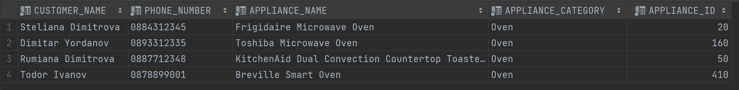
Изгледи
CREATE VIEW V_CUSTOMER_APPLIANCE_INFO (CUSTOMER_NAME, PHONE_NUMBER, APPLIANCE_NAME, APPLIANCE_CATEGORY, APPLIANCE_ID) AS SELECT C.NAME as CUSTOMER_NAME, C.PHONE_NUMBER, A.NAME as APPLIANCE_NAME, A.APPLIANCE_CATEGORY, A.APPLIANCE_ID FROM CUSTOMER C, APPLIANCE A WHERE C.PHONE_NUMBER = A.CUSTOMER_PHONE_NUMBER; SELECT * FROM V_CUSTOMER_APPLIANCE_INFO WHERE APPLIANCE_CATEGORY = 'Oven';

Slide 16
Благодаря за вниманието!

