Slide 1
Сервиз за битова техника
Проект по Бази от данни – практикум
Изготвил: Стелиана Димитрова, ФН: 4MI0700044

Slide 2
Съдържание
01
E/R диаграма на модела
02
Релационни схеми
03
Схема на базата от данни
04
Изгледи
05
Приложение за достъп до базата

Slide 3
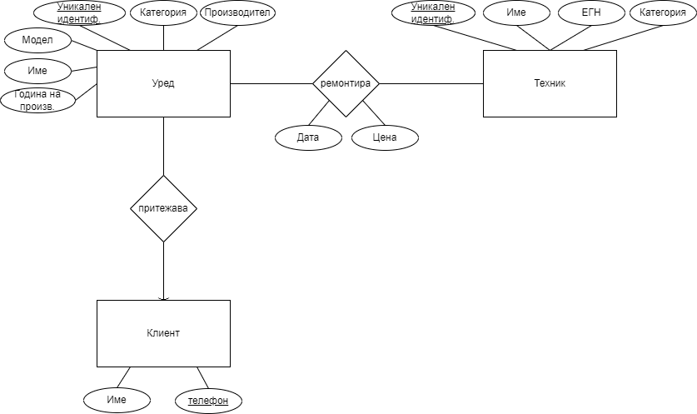
E/R диаграма на модела

Slide 4
Релационни схеми
Релационен модел:
Appliance (name, model, applianceId, applianceCategory, manufacturer, yearOfManufacture)
Technician (name, EGN, texnicianId, texnicianCategory)
Customer (name, phoneNumber)
Repair (applianceId, texnicianId, date, price)
Owns ( applianceId, phoneNumber)
Релационен модел след оптимизация:
Appliance (name, model, applianceId, applianceCategory, manufacturer, yearOfManufacture, customerPhoneNumber)
Technician (name, EGN, texnicianId, texnicianCategory)
Customer (name, phoneNumber)
Repair (applianceId, texnicianId, date, price)

Slide 5
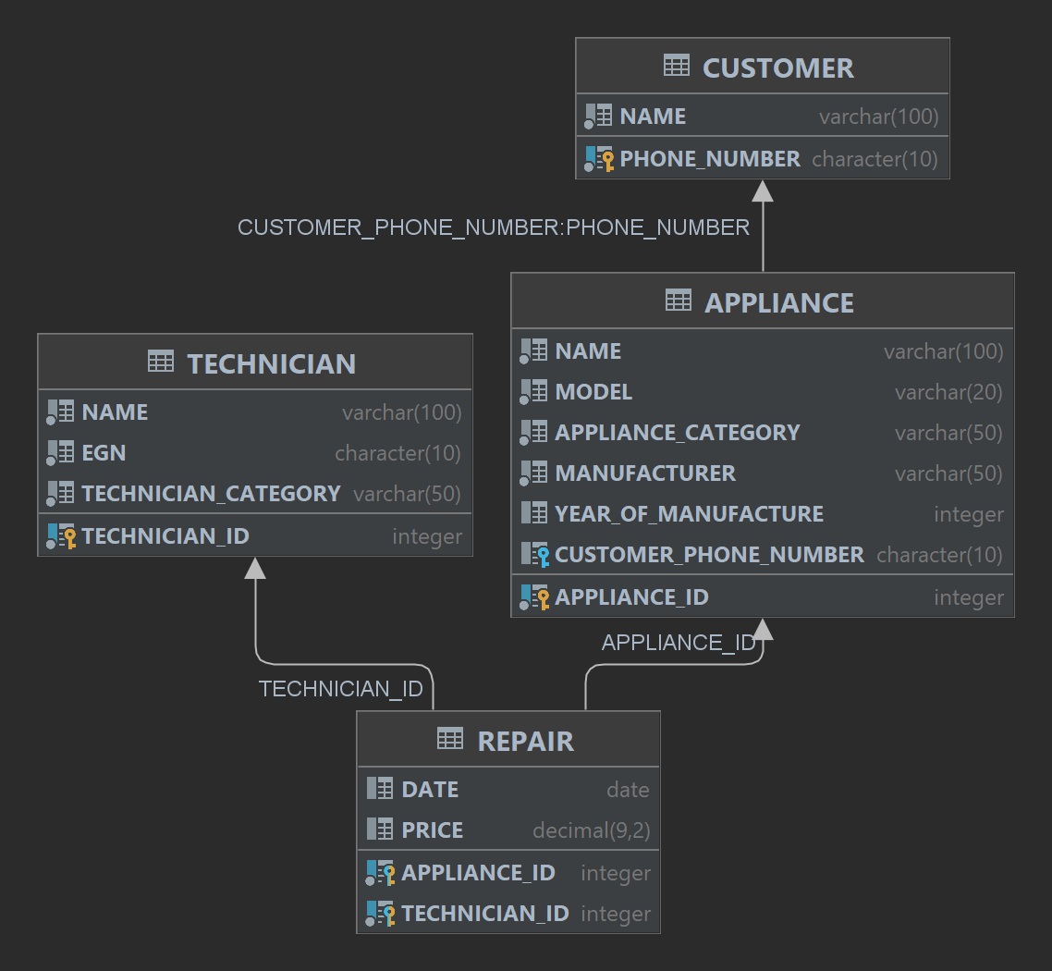
Схема на базата от данни

Slide 6
Изгледи
READONLY
CREATE VIEW V_CUSTOMER_APPLIANCE_INFO (CUSTOMER_NAME, PHONE_NUMBER, APPLIANCE_NAME, APPLIANCE_CATEGORY, APPLIANCE_ID) AS SELECT C.NAME as CUSTOMER_NAME, C.PHONE_NUMBER, A.NAME as APPLIANCE_NAME, A.APPLIANCE_CATEGORY, A.APPLIANCE_ID FROM CUSTOMER C, APPLIANCE A WHERE C.PHONE_NUMBER = A.CUSTOMER_PHONE_NUMBER; SELECT * FROM V_CUSTOMER_APPLIANCE_INFO WHERE APPLIANCE_CATEGORY = 'Oven’;
UPDATABLE
CREATE VIEW V_CUSTOMER_ALL AS SELECT NAME, PHONE_NUMBER FROM CUSTOMER WHERE NAME LIKE '%Dimitrova'; DROP VIEW V_CUSTOMER_ALL; SELECT * FROM V_CUSTOMER_ALL; INSERT INTO V_CUSTOMER_ALL VALUES ('Elina Dimitrova', '0898901234');

Slide 7
Изгледи
WITH CHECK OPTION
CREATE VIEW V_TECHNICIAN_WITH_CK AS SELECT NAME, EGN, TECHNICIAN_CATEGORY FROM TECHNICIAN WHERE TECHNICIAN_CATEGORY = 'Dishwasher' WITH CHECK OPTION; SELECT * FROM V_TECHNICIAN_WITH_CK; INSERT INTO V_TECHNICIAN_WITH_CK (NAME, EGN, TECHNICIAN_CATEGORY) VALUES ('Ivan Ivanov', '0123456789', 'Dishwasher'); SELECT * FROM V_TECHNICIAN_WITH_CK; INSERT INTO V_TECHNICIAN_WITH_CK (NAME, EGN, TECHNICIAN_CATEGORY) VALUES ('Petar Petrov', '0987654321', 'Oven');

Slide 8
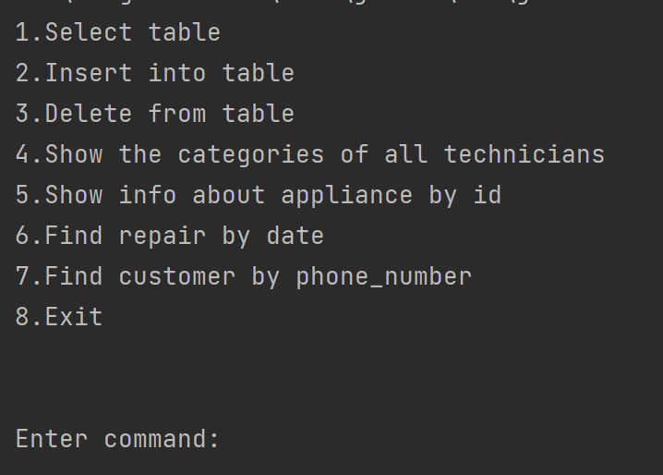
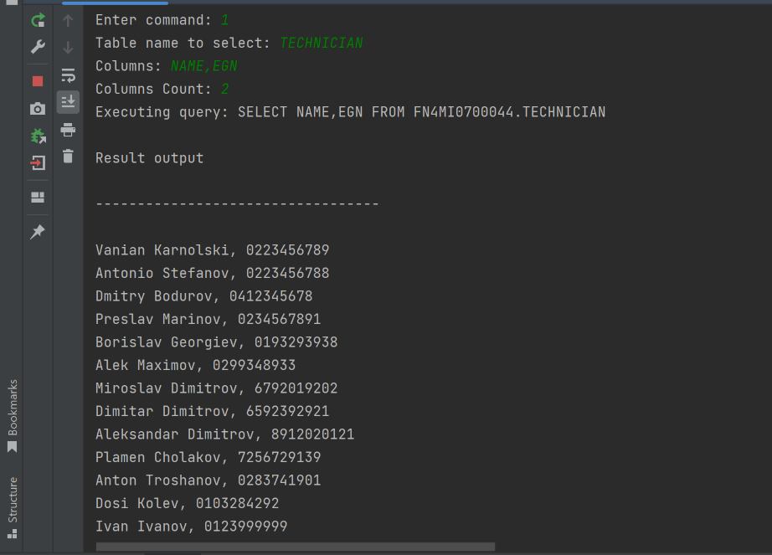
Приложение за достъп до базата

Slide 9
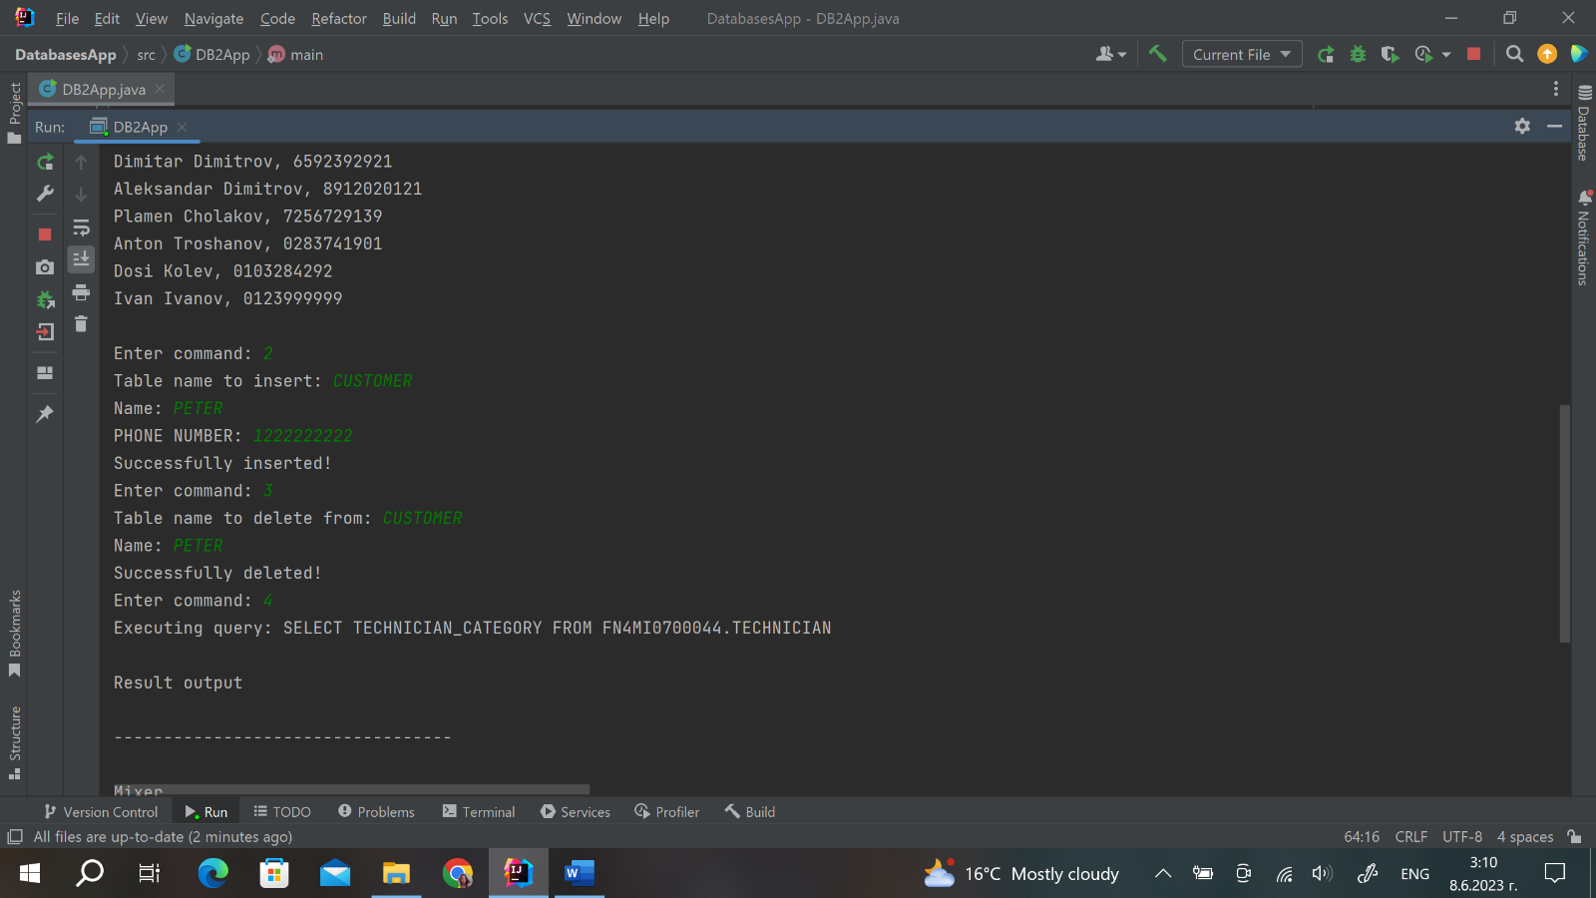
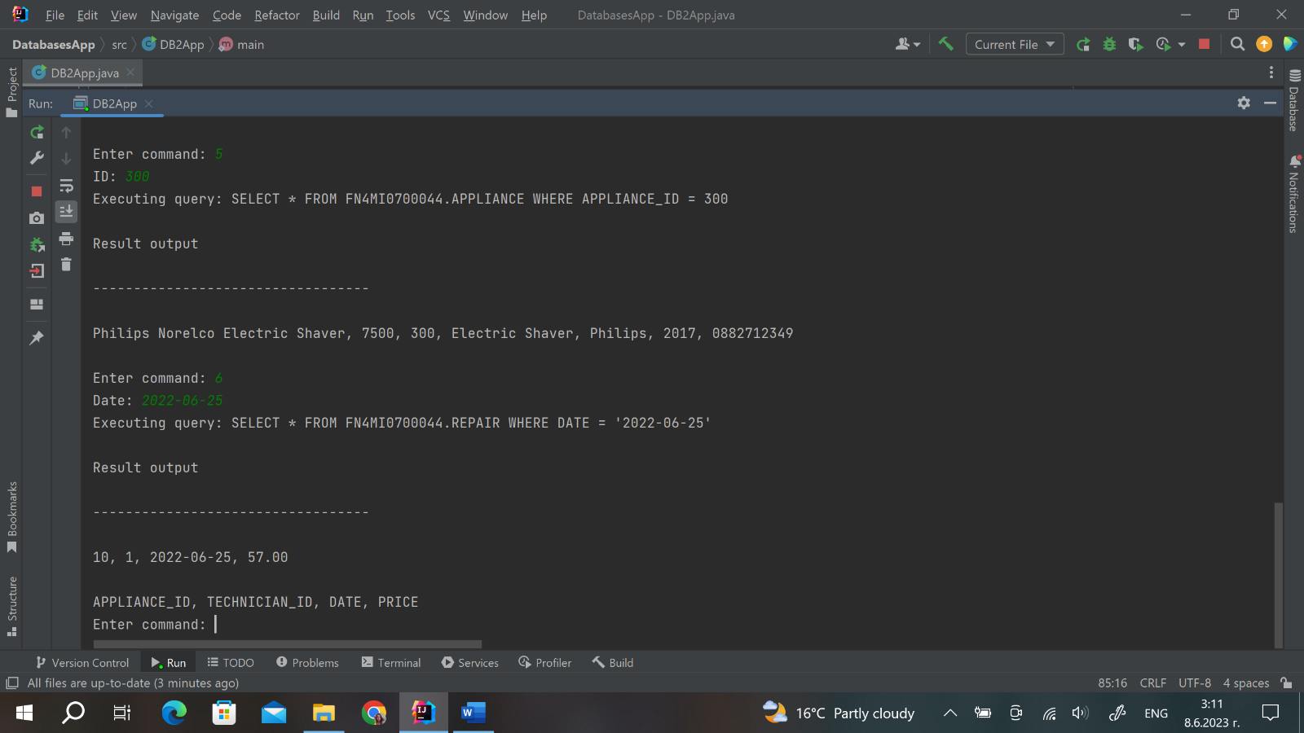
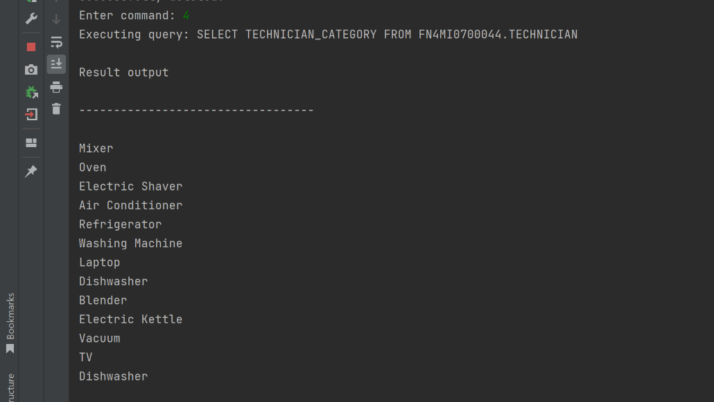
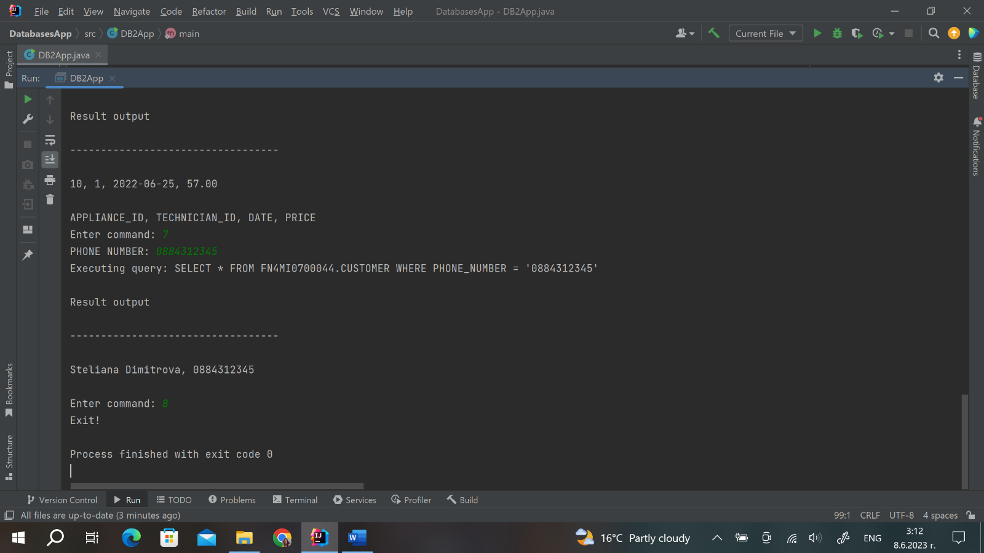
Приложение за достъп до базата

Slide 10
Благодаря за вниманието!

