Slide 1
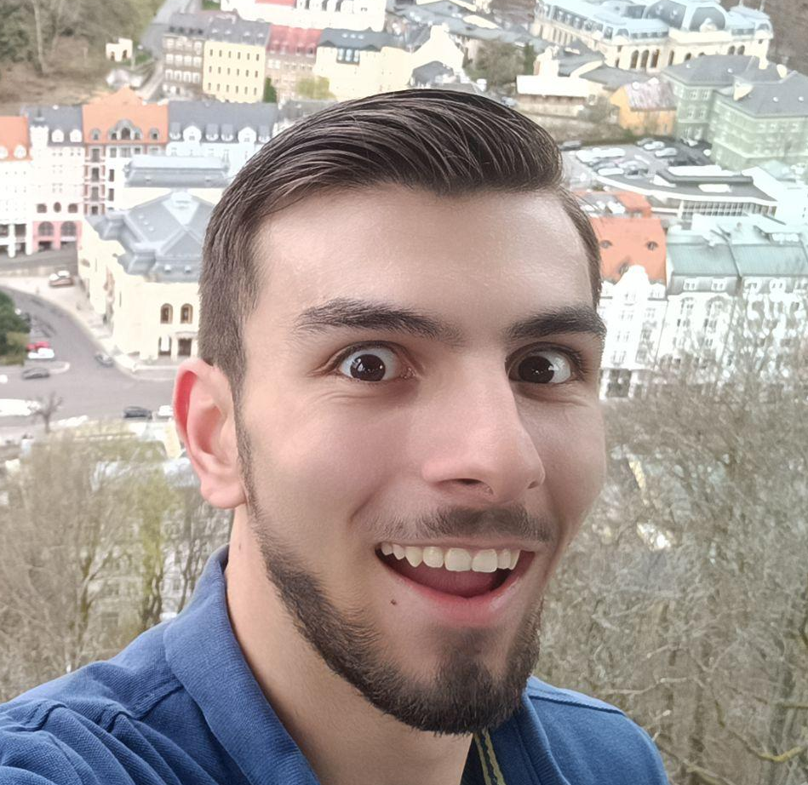
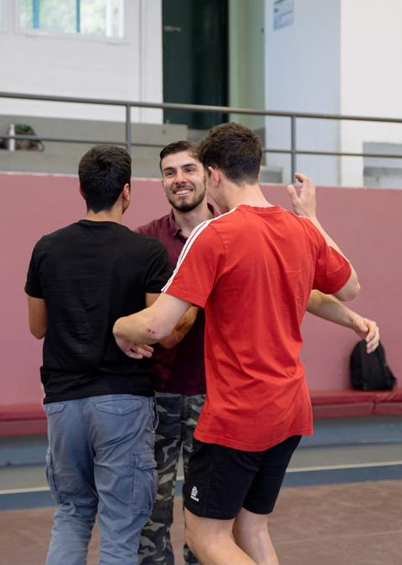
Stelianos Fiotakis, mentor
School:
Model Lyceum
of Anavryta
Special interests:
Calisthenics
Philosophy
History
Skills:
A.I. programming
Robotics engineering
Awards:
PlaisioBots: The Race
Personal goals:
Create some MultiNational Corporations
offering high quality employment opportunities

