Slide 1
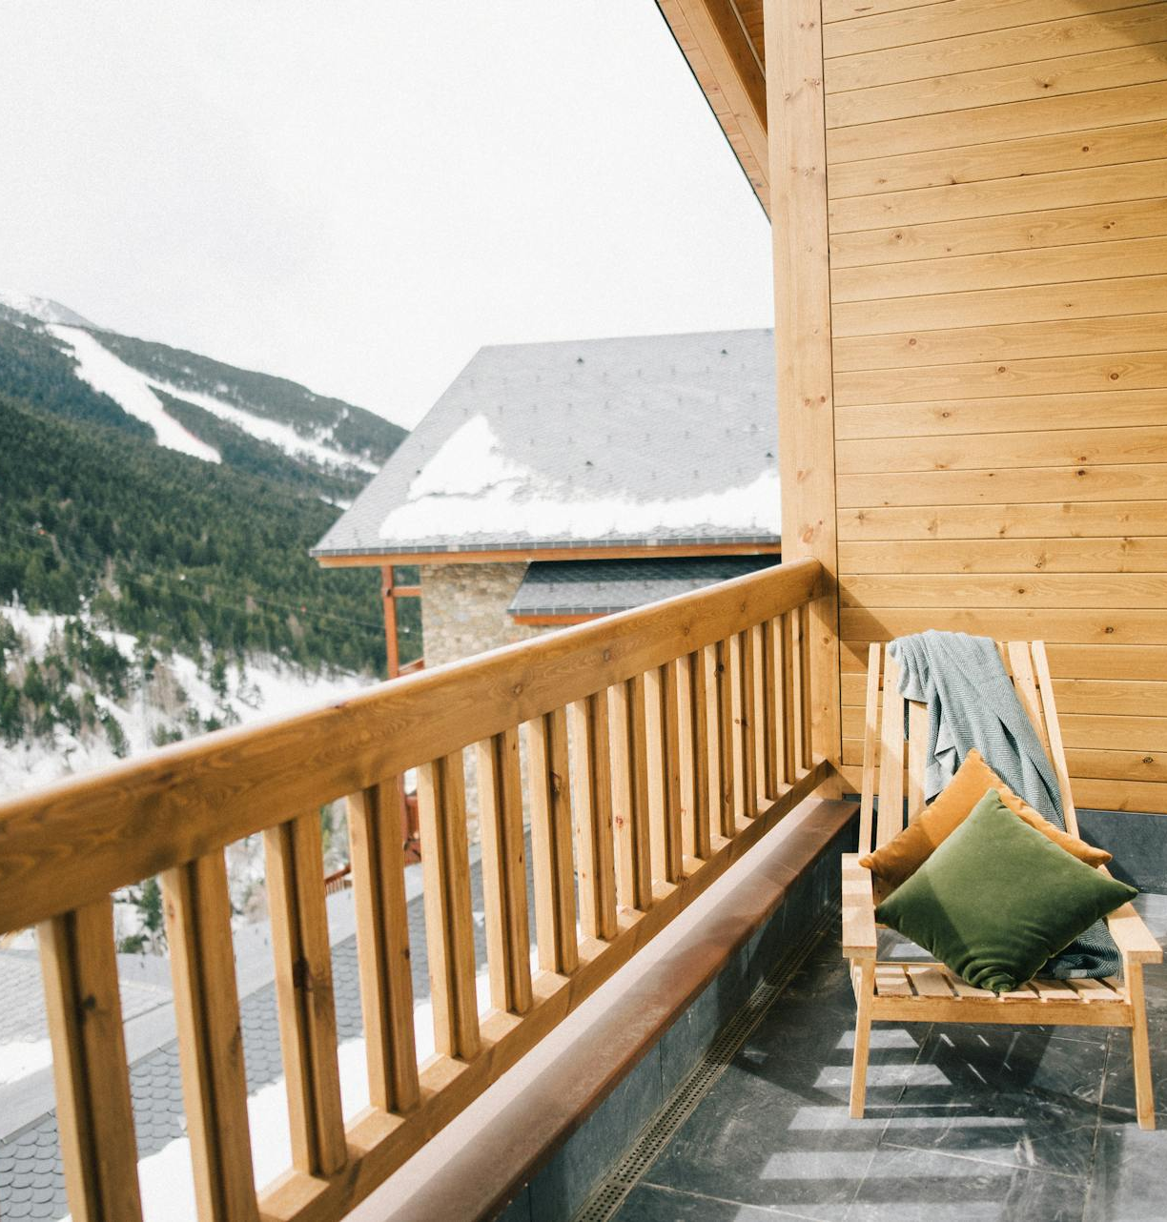
Moffat Bay capstone project
CSD460-O307 Capstone in Software Development (2261-DD)
Module 11 Assignment: Presentation for QA
December 9, 2025
Stella Kemp, Kypton Lantz, & Julio Pochet Edmead

Slide 2
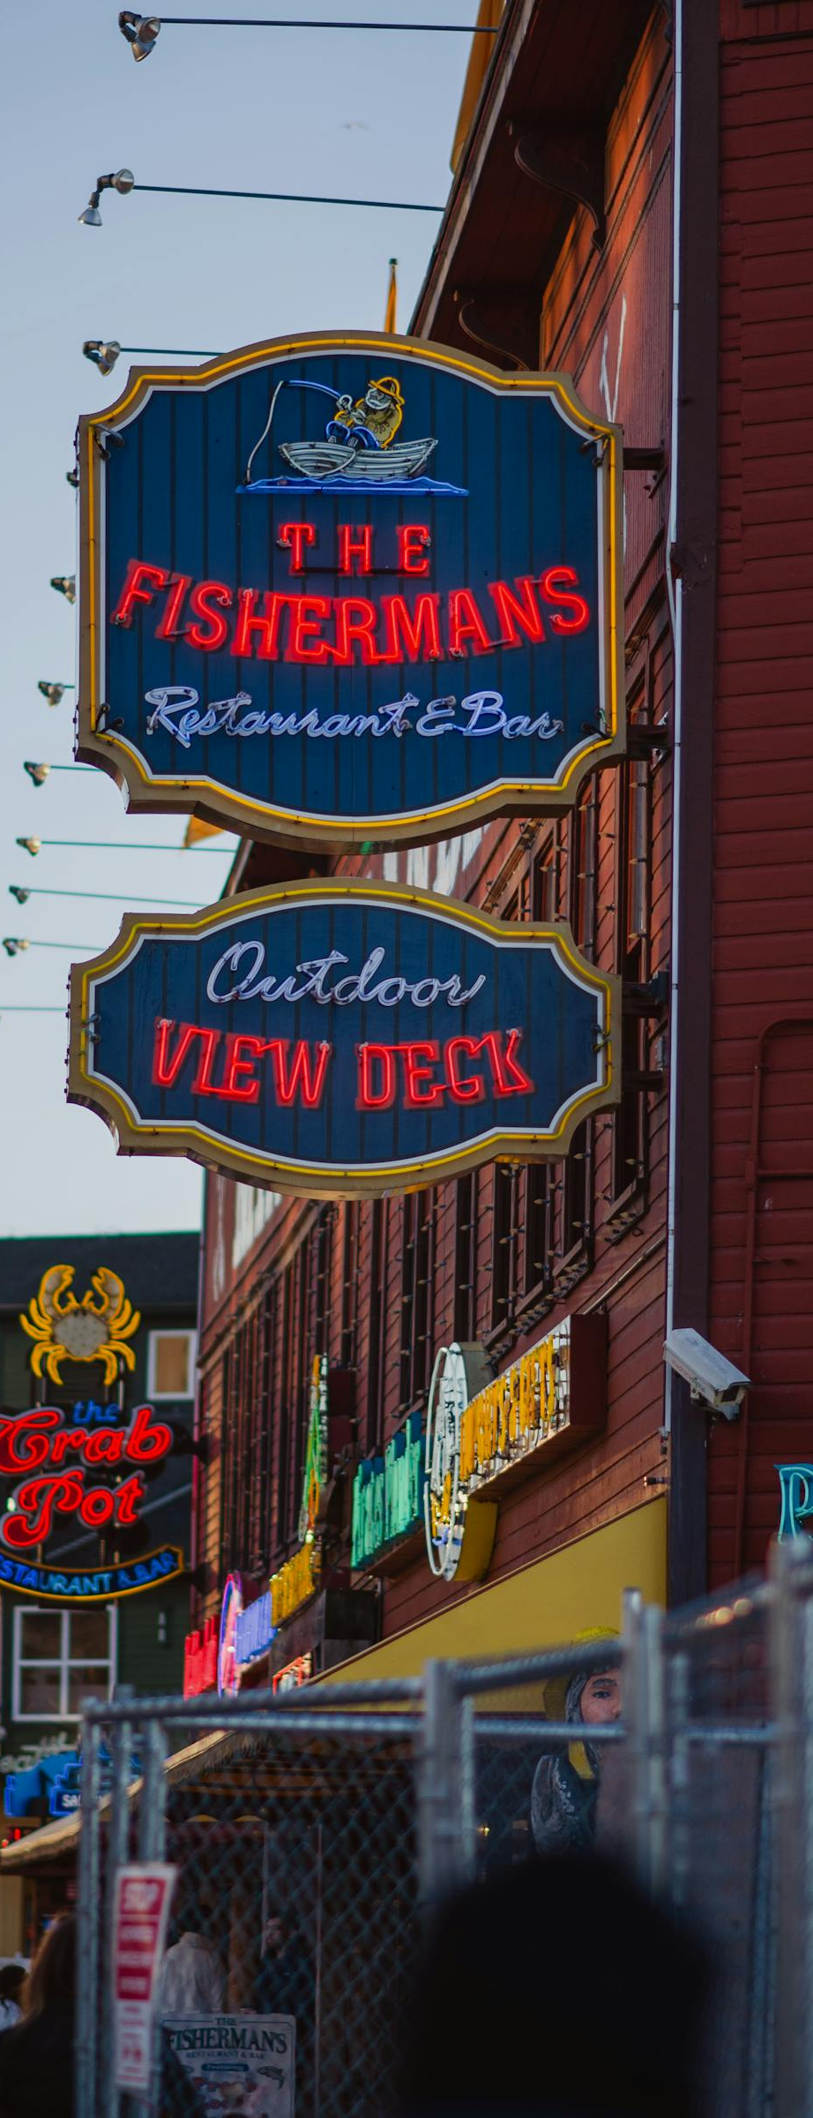
AGENDA
Introduction of Team
Sample Prototypes
ERD
Description of tests created and their results
Lessons Learned as a team.
AGENDA

Slide 3

Meet THE TEAM
STELLA KEMP – TEAM LEAD, BACKEND FUNCTIONALITY
KYPTON LANTZ – BACKEND FUNCTIONALITY
JULIO POCHET EDMEAD – FRONT END DESIGN

Slide 4
SAMPLE PROTOTYPES
THE SIMPLE BEGINNINGS

Slide 5
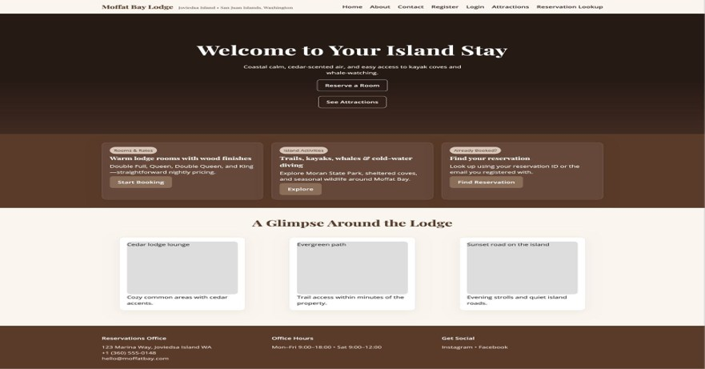
The Landing Page for Moffat Bay Lodge

Slide 6
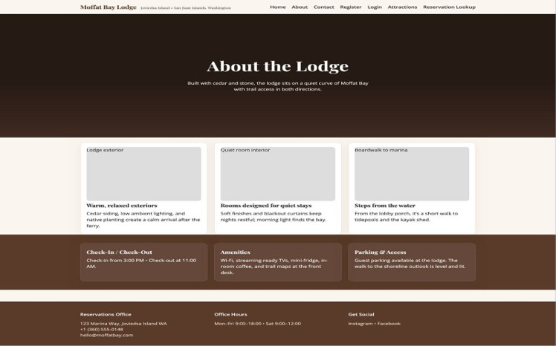
The About Page for Moffat Bay Lodge

Slide 7
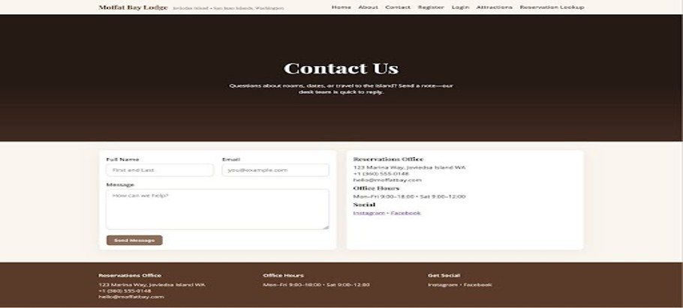
The Contact* Page for Moffat Bay Lodge
*This page was later combined with the About page

Slide 8
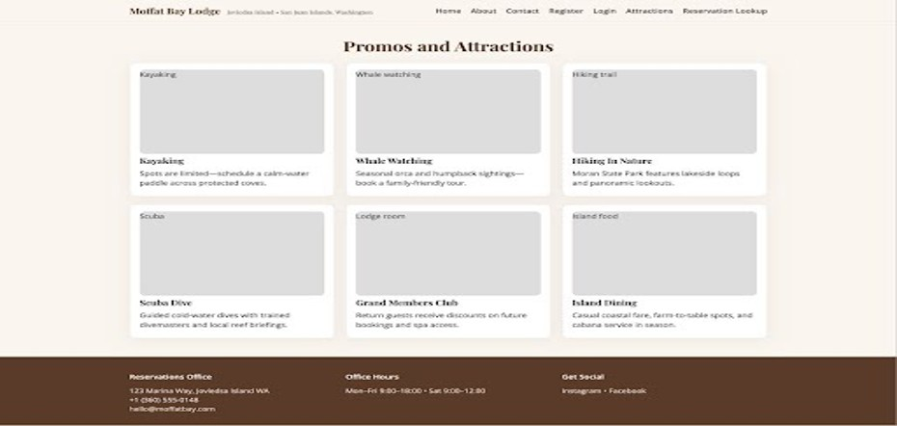
The Attractions Page for Moffat Bay Lodge

Slide 9
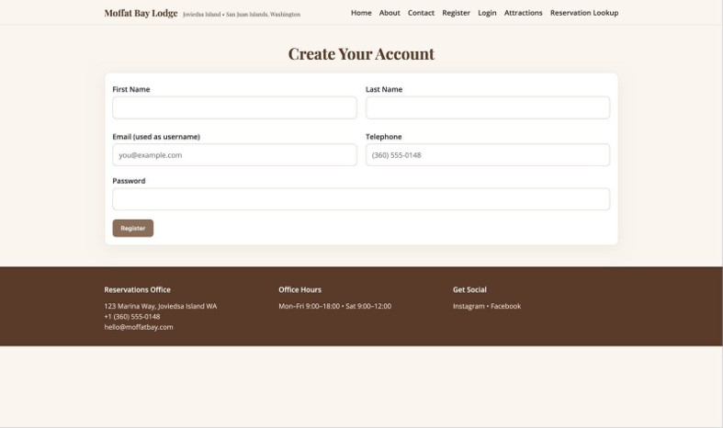
The Registration Page for Moffat Bay Lodge

Slide 10
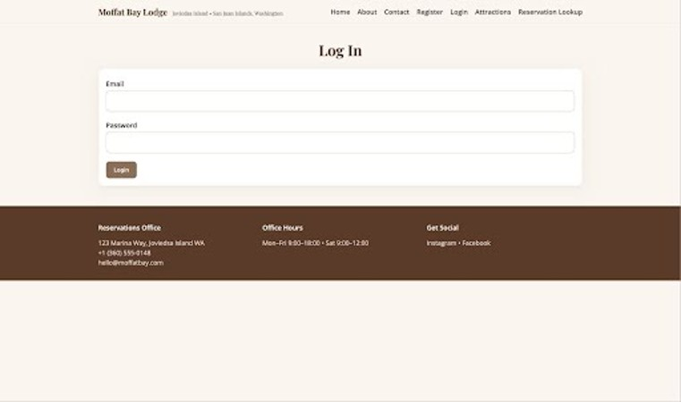
The Login Page for Moffat Bay Lodge

Slide 11
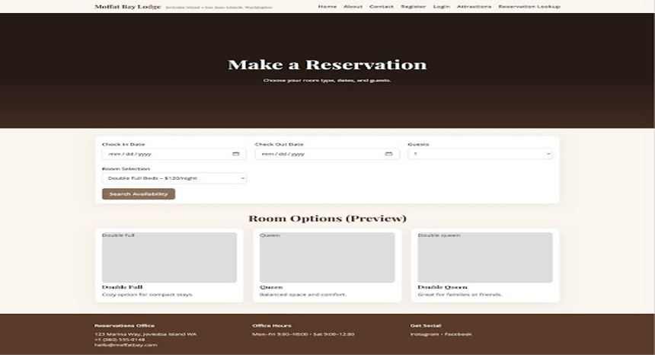
The Reservation Page for Moffat Bay Lodge

Slide 12
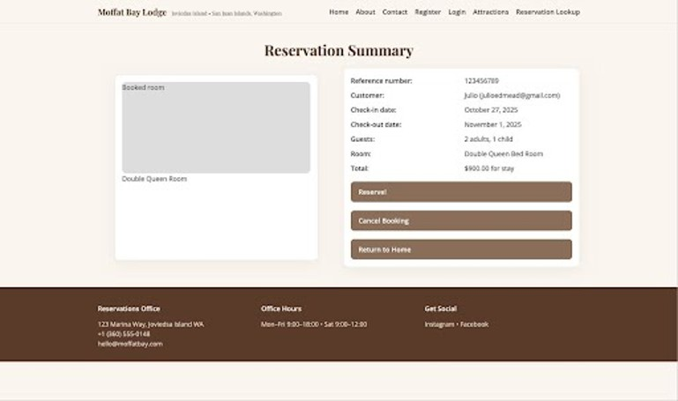
The Reservation Summary Page for Moffat Bay Lodge

Slide 13
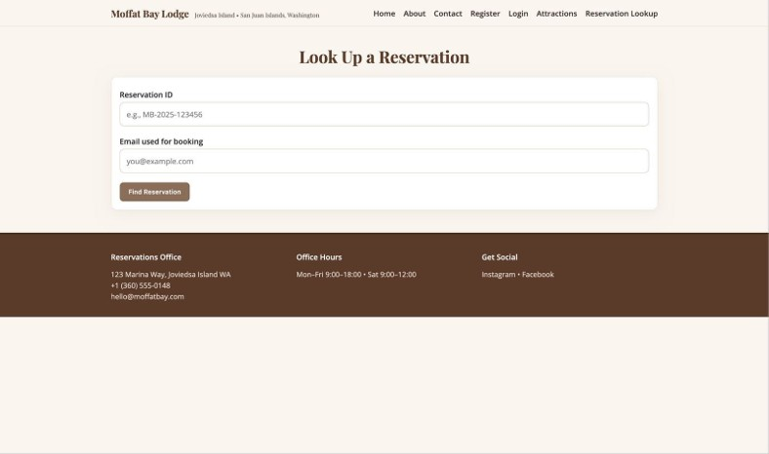
The Reservation Lookup Page for Moffat Bay Lodge

Slide 14
The erd
How the information is structured behind the scenes

Slide 15

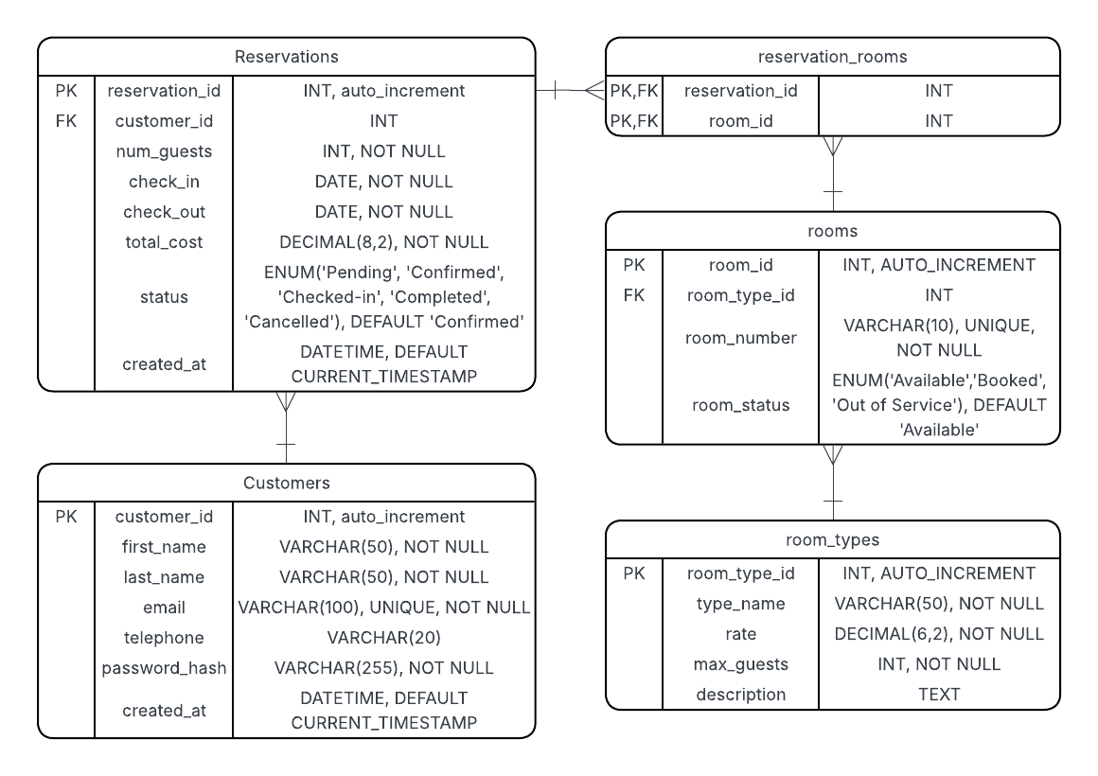
Connecting customers to rooms

Slide 16
Tests and results
5 of our functional tests explained

Slide 17
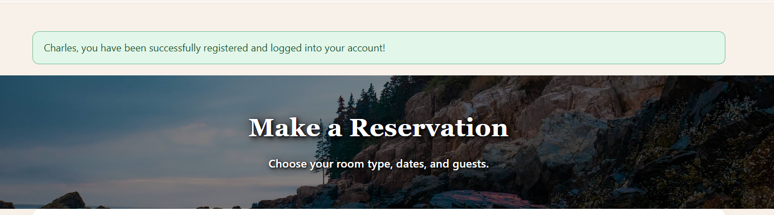
Test 1: Registration Success message
In this test a user registers their account, the information is saved to the database and a session is started.
The user is then rerouted to the reservation page, and a success message is displayed.
*Note: This image is from the updated UI, so it will appear different from the wireframes earlier in the presentation

Slide 18
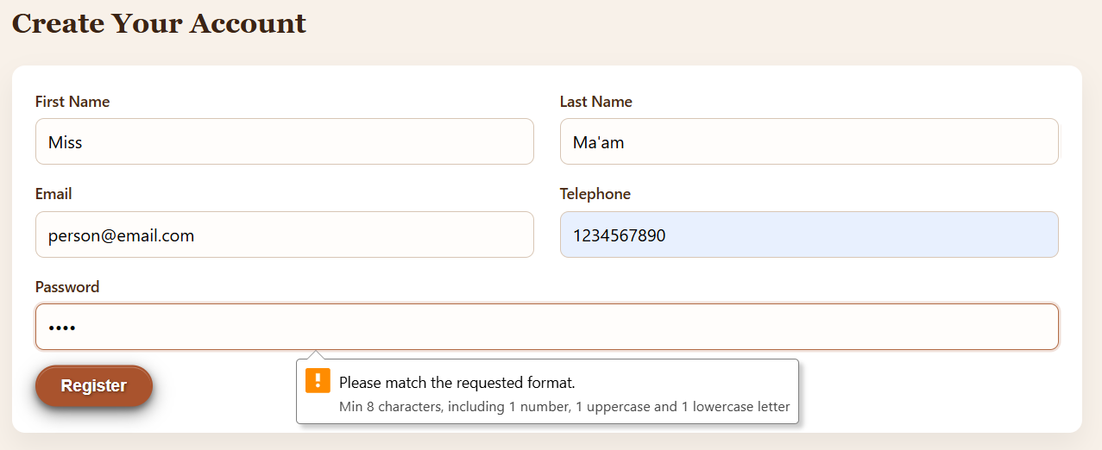
Test 2: Registration password requirements enforced
In this test the user attempts to register their account with a password that does not fulfill the requirements.
An error message pops up and the user is not registered until the password is corrected.

Slide 19
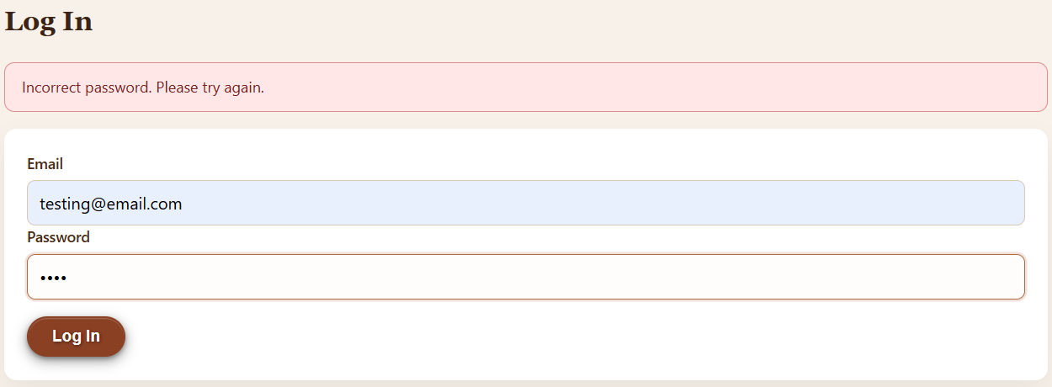
Test 3: login failure messaging
In this test, a registered user attempts to access their account with the wrong password.
A message is displayed, telling them why they have not successfully logged in yet.

Slide 20
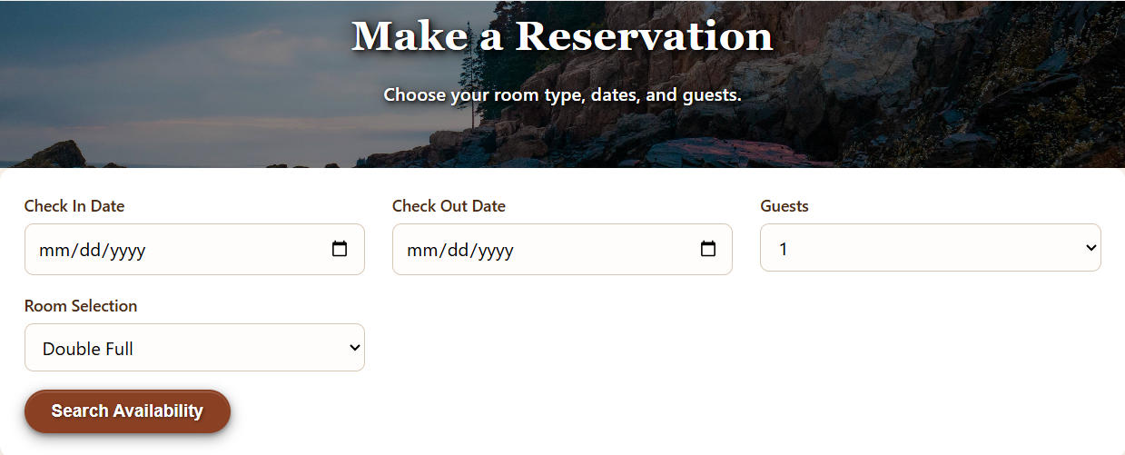
Test 4: reservation availability search
In this test, a user fills out their search preferences and clicks the “Search Availability” button below.
All available rooms that fit their preferences will populate below. (See next slide for the results)

Slide 21
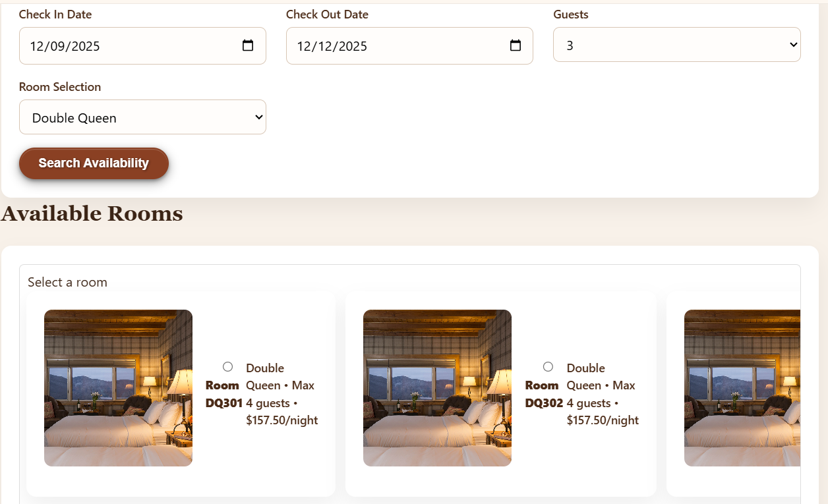

Slide 22
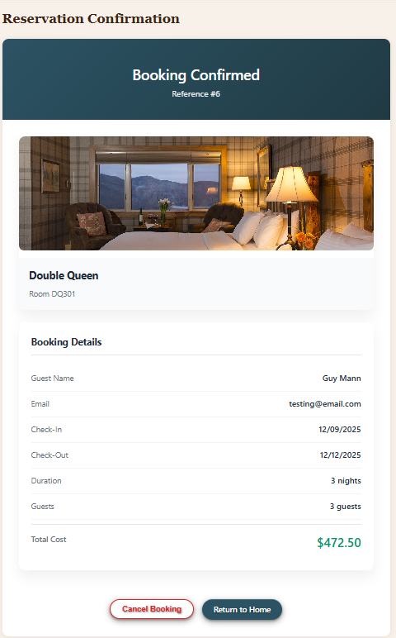
Test 5: reservation confirmation (reroute to summary page)
In this test, a room selection is made and upon clicking the “Reserve Selected Room” button, then information is saved to the database.
The user is rerouted to the Summary page and their reservation information is displayed back to them.

Slide 23
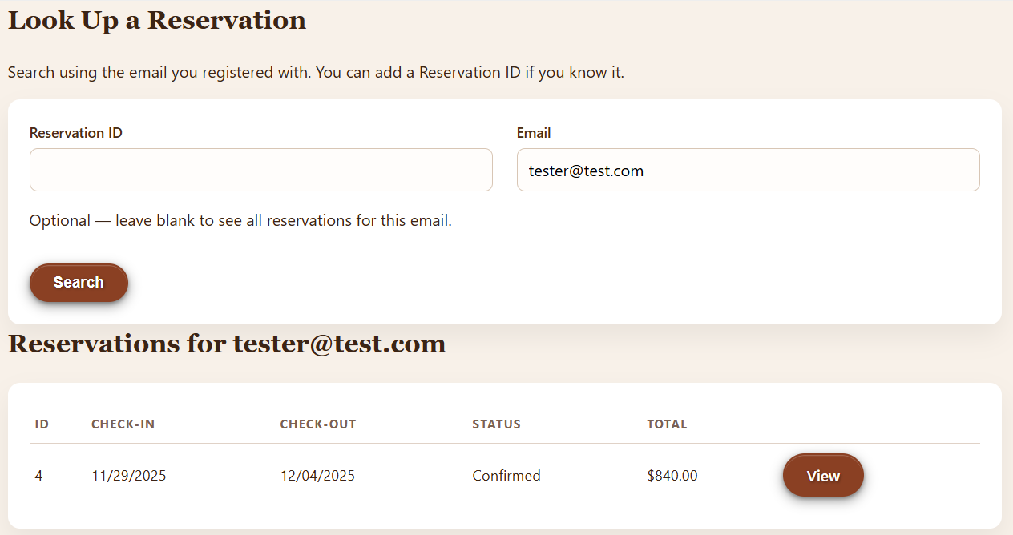
Test 6: reservation lookup via email
In this test, the user fills in their email address and clicks search.
The page then displays all reservations linked to that email address to be viewed in more detail (select “View”).

Slide 24
Lessons learned
Ultimately there is no such thing as failure

Slide 25
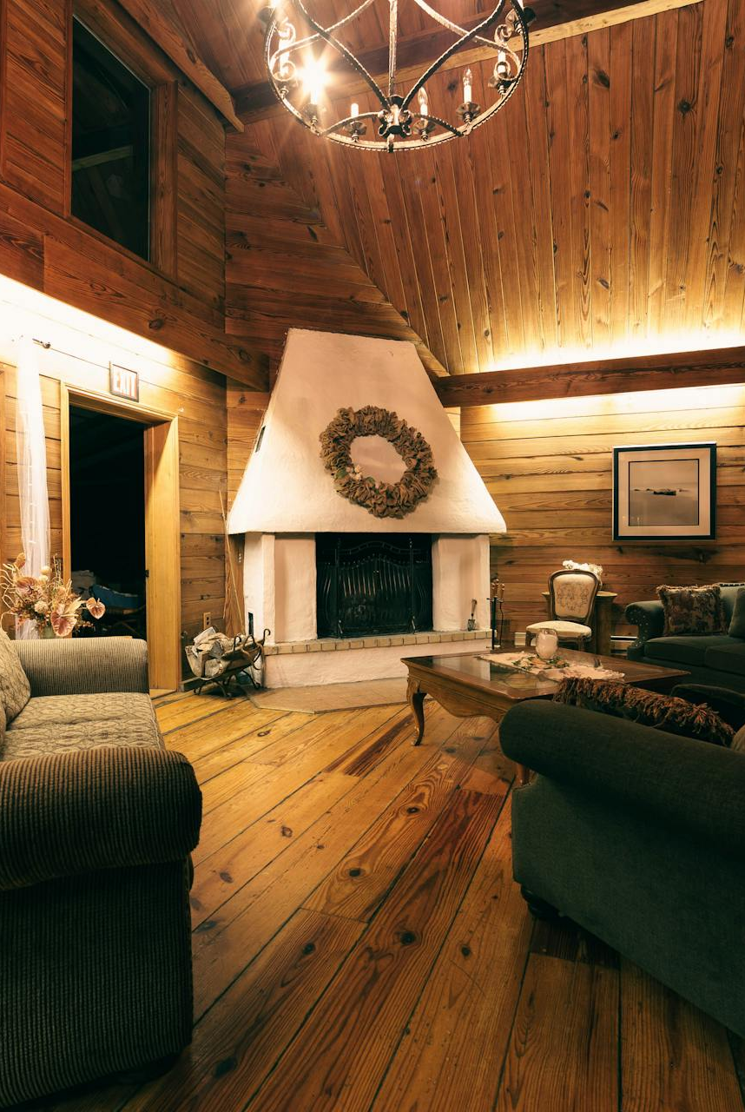
Final takeaways
(Insert at least 1 lesson per teammate here)

Slide 26

THANK YOU
Stella Kemp
Kypton Lantz
Julio Pochet Edmead

