Slide 1
DevOps: Just Learning Culture
Exploring the principles of a just culture to foster continual learning and experimentation in DevOps.
Stella Kemp
Bellevue University
Module 9.2
C380 DevOps

Slide 2
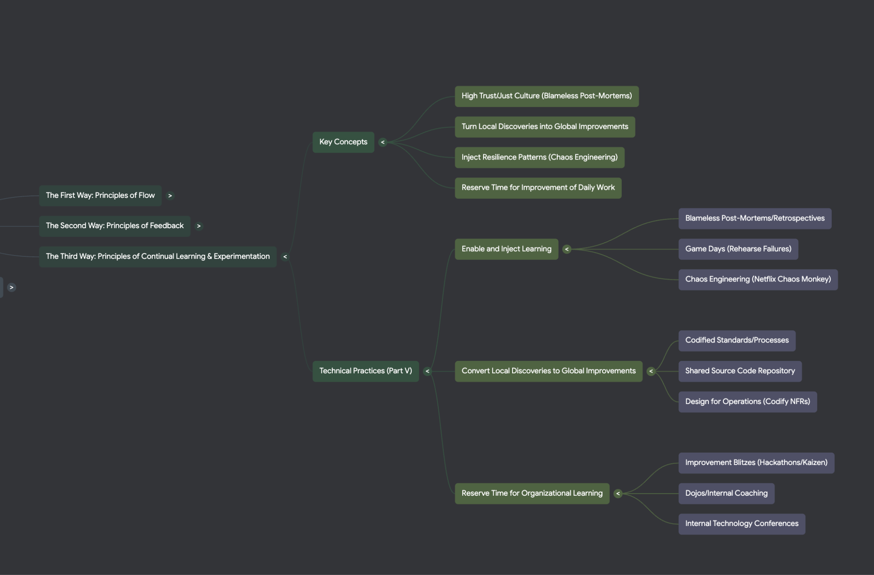

Slide 3

The Necessity for a Just, Learning Culture
A just culture is essential as a foundation for a learning culture in organizations.
It ensures that responses to accidents are fair and constructive, promoting safety and openness rather than fear and secrecy.

Slide 4
Manifestations of Fear:
Responses to incidents seen as unjust impede safety investigations.
Fear promotes professional secrecy, evasion, and self-protection.
Impact of Unjust Responses to Accidents
Organizations with high amounts of fear and threat (Pathological organizations) hide failure and information
When a culture of fear exists, failure signals are likely to remain hidden until a catastrophe occurs
Barrier 1: The Cultural Default of Fear and Blame
The most significant barrier to adopting a just culture is the pervasive existence of pathological and low-trust organizational cultures

Slide 5
Manifestations of Fear:
When accidents happen, the common management reaction is to "name, blame, and shame" the person responsible.
Impact of Unjust Responses to Accidents:
Management may create more processes and approvals, and hint that the guilty person will be punished.
This approach is not helpful because human error is generally a consequence of poor system design (tools, processes, and architecture), not the cause
Barrier 2: Blaming Individuals (The "Bad Apple" Theory)
A deeply ingrained management response to failure is to seek out human error rather than systemic design flaws.
This is often rooted in the "bad apple theory," which asserts that errors are caused by flawed individuals who must be eliminated.

Slide 6
Manifestations of Fear:
Increasing Friction: Controls often add more steps and approvals, which lengthen lead times and reduce the immediacy of feedback, decreasing the ability to learn from successes and failures
Centralized Decision-Making: Relying on approvals from busy people who are distant from the work lowers the quality of decisions and increases cycle time
Decisions are pushed further away from those closest to the problem, who typically know the most about it.
Adding Inspections: In complex systems, adding more inspection steps and approval processes actually increases the likelihood of future failures.
Barrier 3: Ineffective and Overly Controlling Processes
Implementing bureaucratic controls often leads to worse outcomes, undermining the goals of a just culture.

Slide 7

Manifestations of Fear:
Groups may avoid documenting changes and displaying telemetry publicly to avoid being blamed for outages.
This results in a highly charged political atmosphere where people deflect accusations rather than focus on solving the root problem.
Without psychological safety, engineers are dis-incentivized to provide the necessary details about failures, guaranteeing that the failure will recur
Barrier 4: Lack of Transparency and Feedback Suppression
In cultures prone to blame, transparency is actively avoided, suppressing the very information needed for organizational learning.

Slide 8
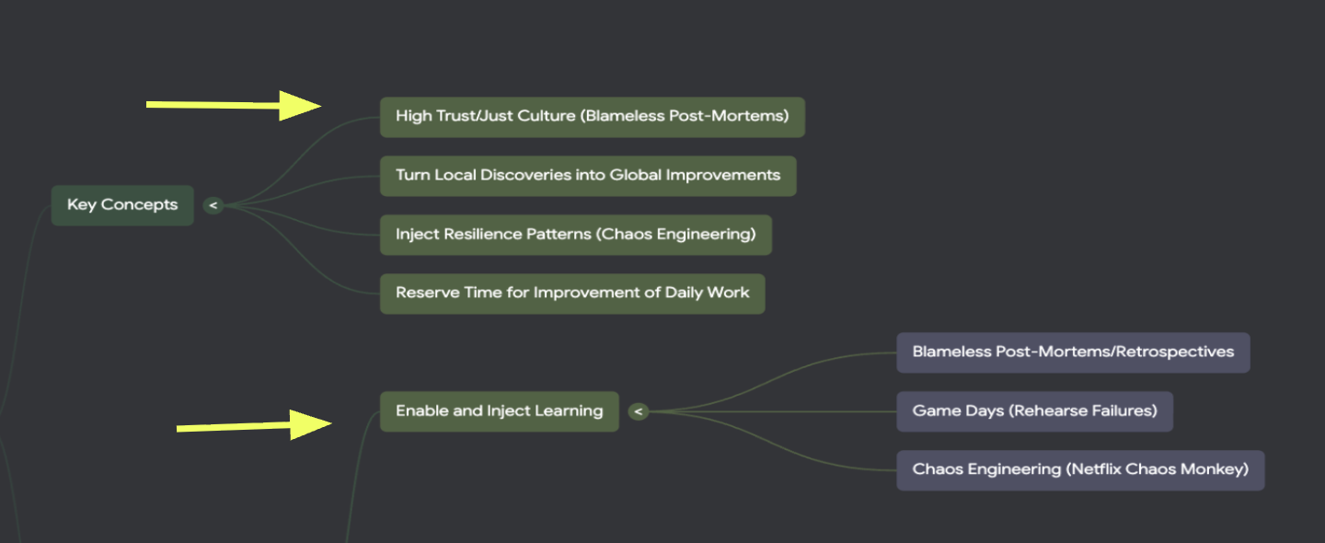
Fostering Organizational Learning and Honesty
Avoid naming, blaming, and shaming individuals involved in failures.
Encourage open sharing of problems to maximize learning opportunities.
Removing blame reduces fear, enabling honesty and prevention.
Focus shifts from punishment to understanding complex system failures.
Errors are not caused by individuals to blame but by system design problems.

Slide 9


Practices Supporting a Just, Learning Culture
Conduct blameless post-mortems after accidents to learn and improve.
Introduce controlled failures in production (e.g., Chaos Monkey) to prepare for real issues.

Slide 10
Conclusion: Overcoming the Barriers
Implementing a just culture requires leaders to recognize that failure is inevitable in complex systems and that the root cause is rarely human error.
Key actions to break barriers:
Replace blame with learning: Conduct blameless post-mortems to analyze system mechanics, not individual actions
Increase transparency: Make work, changes, and telemetry visible to everyone to reinforce shared responsibility.
Build confidence: When blame is removed, fear is removed, enabling honesty, which in turn enables prevention.
The Third Way: Enabling a High-Trust Culture
The Third Way promotes a generative, high-trust culture that supports disciplined experimentation and risk-taking.
Organizations adopting these practices see higher employee recommendation rates and lower burnout.

Slide 11
References : Kim, G., Humble, M. J., Debois, P., Willis, J., & Forsgren, N. (2021). The DevOps Handbook, Second Edition. IT Revolution Press, LLC.

