Slide 1
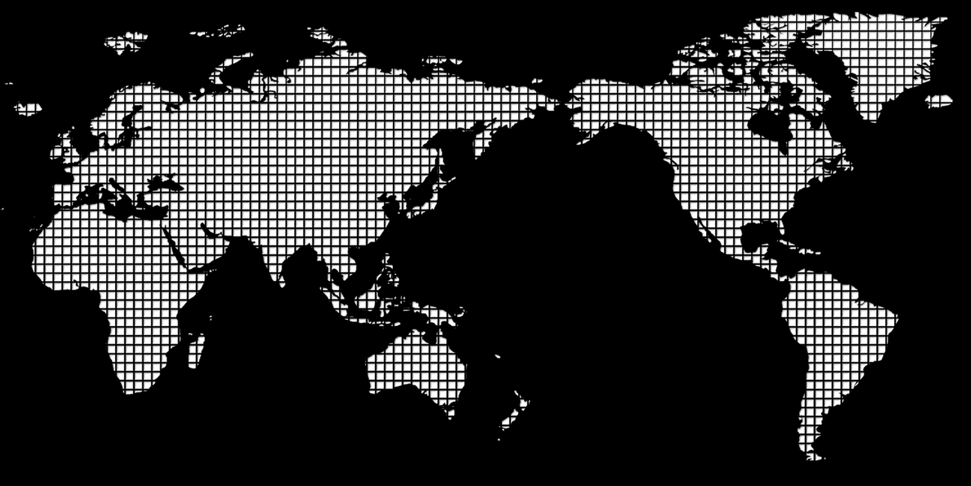

Google Flu Trend
Jingwen Zhang
December 23, 2020

Slide 2

Contents
1
Introduction
2
Methodology
3
Results
4
Conclusion
5
Feature directions

Slide 3

Introduction
Background
As we know, Google flu trend is a representative data analysis algorithm developed by Google engineers. The tower uses keywords searched by people to predict the flu situation in various regions. Its accuracy and timeliness far exceeds that of traditional methods, and it was once regarded as a classic application case in the field of big data. For a variety of reasons, though, the app is no longer available. But the data he left behind could be used for secondary analysis. This article will analyze data from 2003 to 2009 on influenza infections in different regions of the United States.

Slide 4
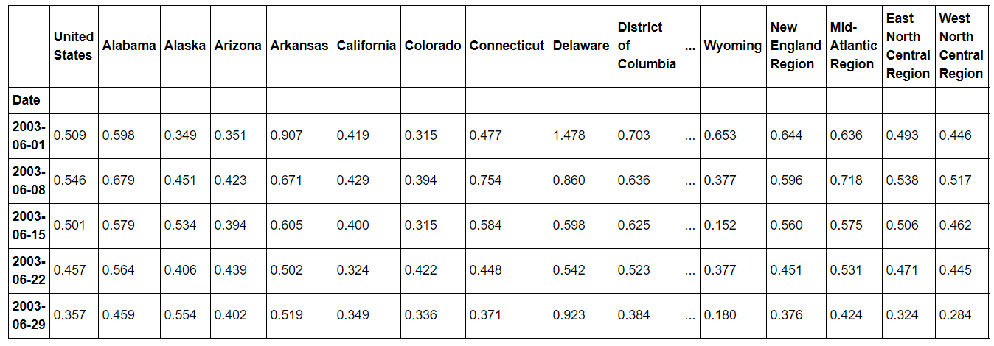
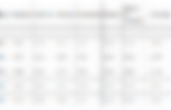
Introduction
Problem and Data
Part of the data was used to analyse the flu situation in Illinois and compare it with Idaho.The states with the initial letter ‘M’ were selected and their flu trends were plotted. Finally, draw a heat-map to see which states had the worst flu in which period.
The data mainly includes the time of the flu, as well as the names of U.S. states. Some data are shown in the figure:

Slide 5
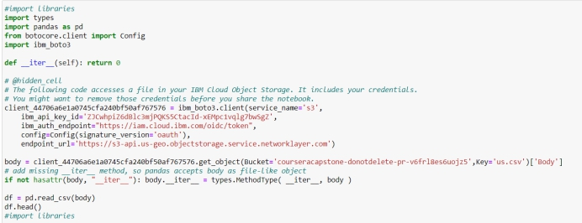
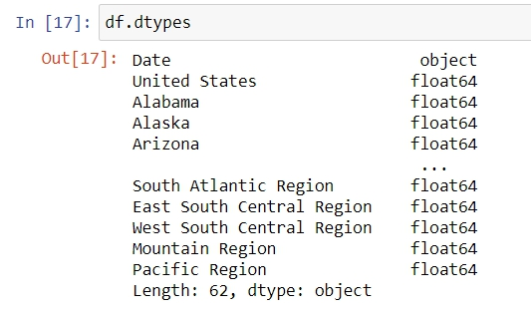
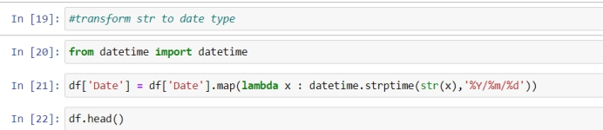
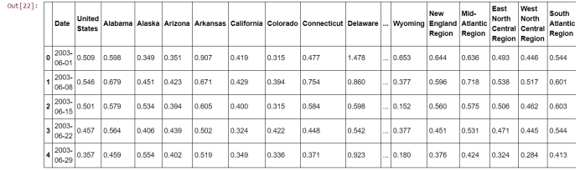
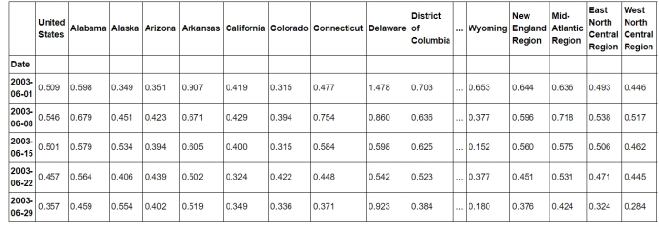
Methodology and results
1.1 Data pre-processing
After downloading the data, delete the description section of the data for ease of use, and the rest data will be separated by commas. Therefore, for convenience of processing, we save the deleted data as CSV file.
l First load the data file (the file is already under the same path as the Python script)
l We can use df.dtypes（） to look at the types of data
l We can see from the output that the type of date is object, which is equivalent to a string. If we want to use some of the features in date types, we need to cast the type of the first column to a date type.
l The transformed data set is shown below
l Then use df.set_index（）：

Slide 6
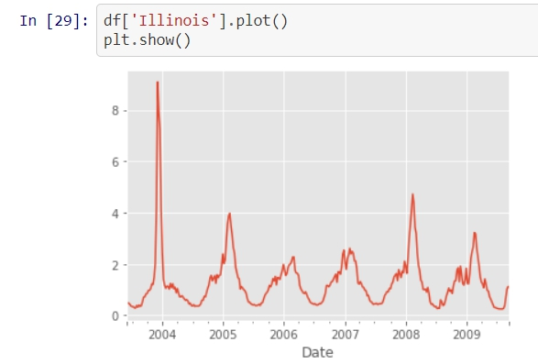
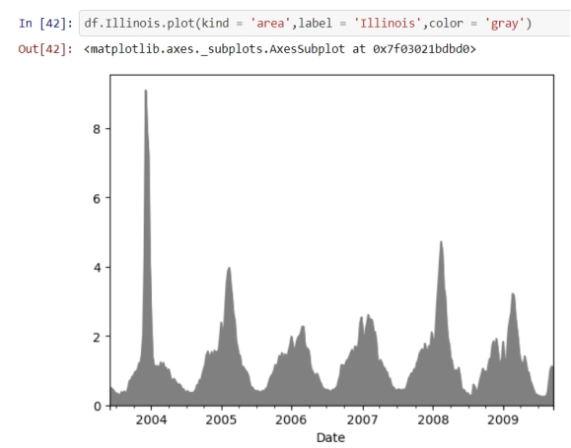
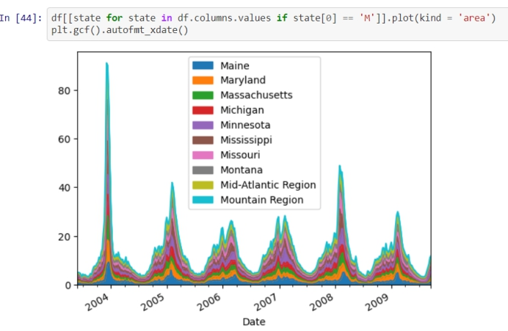
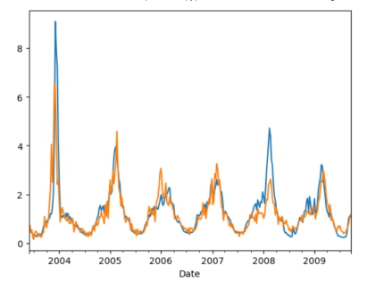
Methodology and results
1.1 Data analysis
Because there are so many states in the United States, if you put all the data into one graph, the graph notes will be incomplete. Therefore, this article will select one state for analysis and then use more sub-graphs to show the data of different states.
l Analysis of the “Illinois”.
l Because the data density is so high, if all the state data is shown in the same graph, the curves will be highly overlapping, resulting in a small degree of differentiation.Therefore, according to the characteristics of the analysis data, to draw an area map.
l There are many states in the United States. Suppose we only consider plotting the flu trend of the states with the initial letter M, using lambda and filter() methods, and using list to type the objects returned by filter. Next, draw the states that begin with the letter ‘M’ on the uniform canvas.
As you can see from the time series, the flu was at its worst in 2003. It has since been repeated, but not to a greater extent than in 2003.
l Compare the two states: Illinois and Idaho:

Slide 7
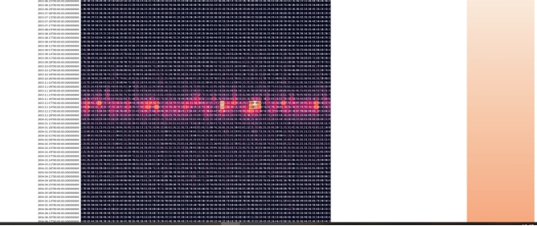

Methodology and results
l The heat map was then chosen to show which states had the most severe flu at which time.The thermal diagram depicts the degree of correlation between data.In the figure below, the names of the states are shown horizontally, the dates on the vertical axis, and the colors indicate severity.Because only part of the heat map is captured, the darker the color, the better the flu, and the brighter the color, the more serious it is.

Slide 8

Conclusion and feature directions
This article focuses on data on Google flu trends.Select partial characteristic data for analysis, and draw area map and hot spot map according to the data characteristic. The method can also be used to analyze the current epidemic of COVID-19 infection heat-map. The color of the heat-map map can be used to identify the worst-hit areas and provide evidence for epidemic prevention and control measures.

