Slide 1
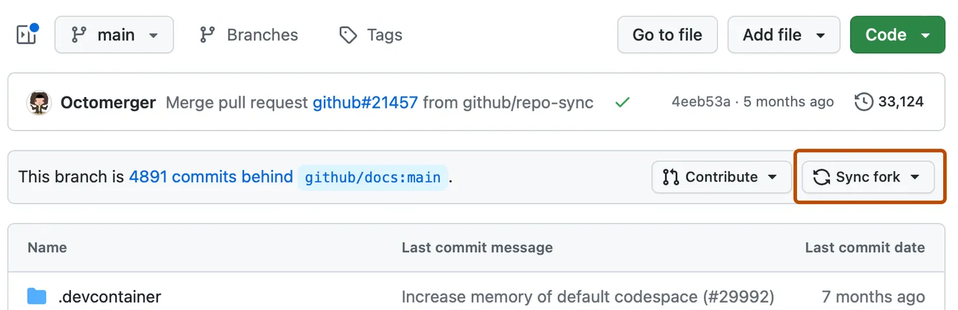
Origin
Fork
The remote repository the project was originally cloned from.
MAIN
MAIN
HEAD
FEATURE
sync
git merge main

