Slide 1
PharmaSUG 2018 - Paper SS-05
Challenges for Implementing Legacy Data Conversion Plan (LDCP) in
Electronic Data Submission
Shengfeng (Philip) Ho, Xiaojia (Jessie) Wang, Rundo International Pharmaceutical Research &
Development Co.,LTD
ABSTRACT
The development of a Legacy Data Conversion Plan (LDCP) is identified as a need in recent released
Study Data Technical Conformance Guide in August 2017 which associated with FDA Guidance on
Providing Regulatory Submissions in Electronic Format – Standardized Study Data (Final FDA Guidance
December 2014). Unlike Study Data Standardization Plan, LDCP serves for legacy study and assists
regulatory reviewers in understanding your data conversion process and possible traceability issue. This
paper presents the challenges for implementing LDCP in legacy study for ISS/ISE submission. The case
study and examples shown in this paper are our working experiences while leading a group of
programmers in the effort to convert data for 9 sub-studies from legacy format to industry-standard.
INTRODUCTION
As FDA announces the deadline, December 17, 2016 and series of binding guidance, that require clinical
and non-clinical study submission to use standards supported in the FDA Data Standards Catalog [1].
There is also a need for legacy study data1 to convert per the standards in the catalog. In study data
technical conformance guide (SDTCG) v4.0, the document clarifies related guidance on converting legacy
data to standard format and provides possible limitations of keeping traceability. Also, Legacy Data
Conversion Plan (LDCP) firstly introduced in the document to serves as an in-front plan for regulatory
reviewers to easily understand your conversion details and how you maintain the traceability, which is
going to be combined with clinical Study Data Reviewer’s Guide as a whole document. Legacy study data
conversion should have following characteristics:
a. Map every data element as originally collected
b. May not be possible to represent a collected data element as a standardized data element
c. Omitted data should be apparent on the annotated CRF and described in the reviewer’s guide
As we may know, most legacy studies may not have well-documented or conducted before CDISC
standards released. Once the legacy data structure doesn’t follow CDASH standard to design or
compatible with other standards, it will increase difficulties to perform data conversion to CDISC standard
format.
Moreover, in the recent survey about the use of CDISC standards in Pharmaceutical industry [3], it shows
that over half (52%) of the respondents2 viewed the difficulty in building governance processes on
implementing standards as the primary organizational challenge, 33% respondents still used
spreadsheets to manage standards and study specifications, and 44 % respondents cited lack of internal
CDISC knowledge and experience as a barrier to standards adoption. So, a professional team and robust
processes/tools are the keys to drive how fast you can prepare study submission package.
Therefore, the challenges you can foresee for legacy study data conversion are from its naive deficiency
of data acquisition design and limitation of utilizing automated metadata tool to complete the data
conversion. In following sections, we describe the LDCP implementation by using a case study and
1 Legacy study data are study data in a non-standardized format, not supported by FDA and not ever
listed in the Catalog.
2 Respondents were high level executives with extensive experience from a range of sub-sectors
including pharmaceutical, biotech, med device manufacturers, academic research centers, contract
research organizations.
1

Slide 2
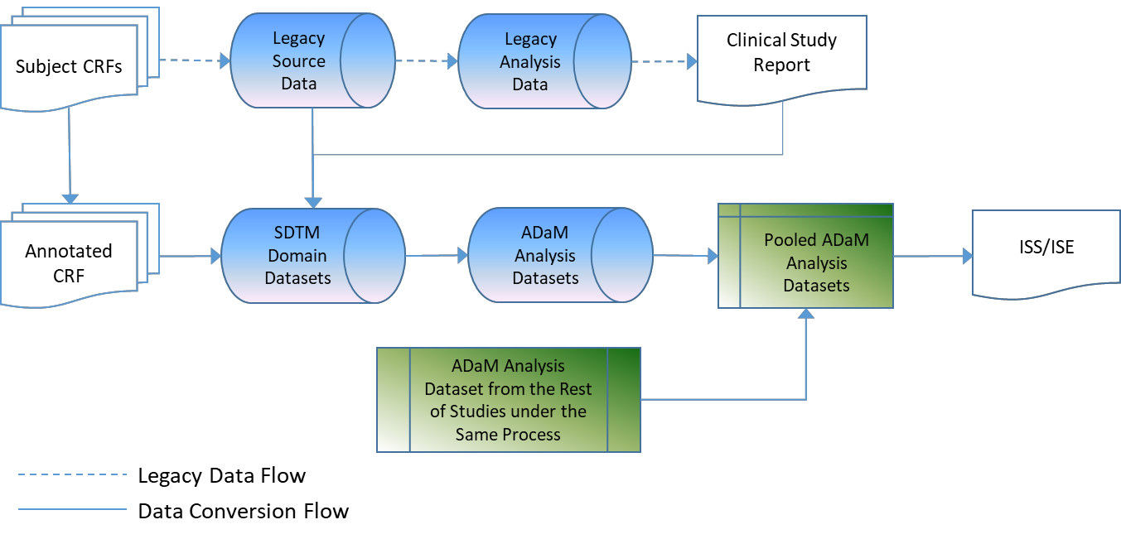
Challenges for Implementing Legacy Data Conversion Plan (LDCP) in Electronic Data Submission, continued
discuss some outstanding issues with regards to traceability and legacy data deficiency. Finally, we wrap
up with suggestions to perform legacy data conversion in a more efficient way.
THE CASE STUDY & LEGACY DATA CONVERSION APPROACH
The case study consisted of 9 independent sub-studies which conducted from 1996 to 2012 and belong
to CNS/Psychiatry therapeutic area. The locked data were used to convert to SDTM and ADaM compliant
datasets in sequence. The conversion was led by 9 programming teams with one programmer lead’s
coordination.
During development of the mapping specification from legacy data to SDTM, CDISC Controlled
Terminology managed in spreadsheet was applied where applicable. Firstly, SDTM annotated CRF was
created to summarize how many SDTM domains were required. After authoring of a mapping
specification and programming of the SDTM SAS datasets, the Pinnacle21 validator was run to check
compliance to SDTM v1.4/ SDTMIG v3.2.
The QC step was performed where the datasets were double-programmed by an independent QC
programmer using the same mapping specification as the reference. Any fall outs were recorded in the
unique tracking sheet and returned to the SDTM programmer for updates. After confirmation that updates
were applied properly, the SDTM data was considered complete then SDTM define.xml created by SAS
with specification-driven approach. The ADaM datasets were derived from the SDTM datasets by ADaM
v2.1/ADaMIG v1.0 under the similar process.
CSR needs to take as input to decide missing data imputation or data mapping issues throughout the
conversion. Finally, all ADaM datasets were pooled together for ISS/ISE analysis. Figure 1 presents the
legacy data conversion flow in the case study.
Figure 1. The Legacy Data Conversion Flow of Case Study
The conversion approach for the case study can also be briefly summarized by Clinical Data Standards
Capability Maturity Model [3] as below three dimensions:
1. CDISC Standard – Use of CDISC Standards for Compliance in Regulatory Submissions
2. Standards Metadata Management and Use – Siloed, Manual Management of Spreadsheet
based Metadata; Limited Metadata-driven Processing
3. Standards governance – Siloed Standards Governance with Limited Dedicated Staff
2

Slide 3
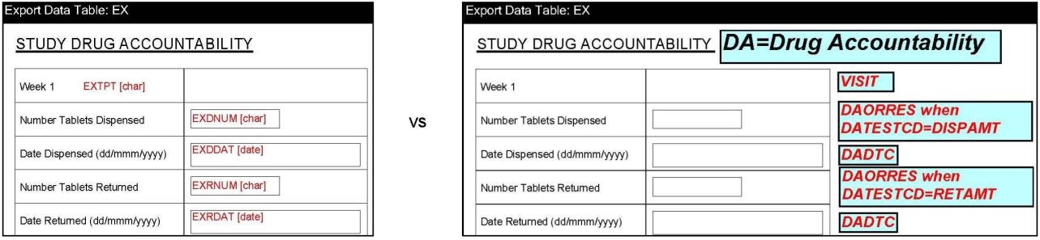
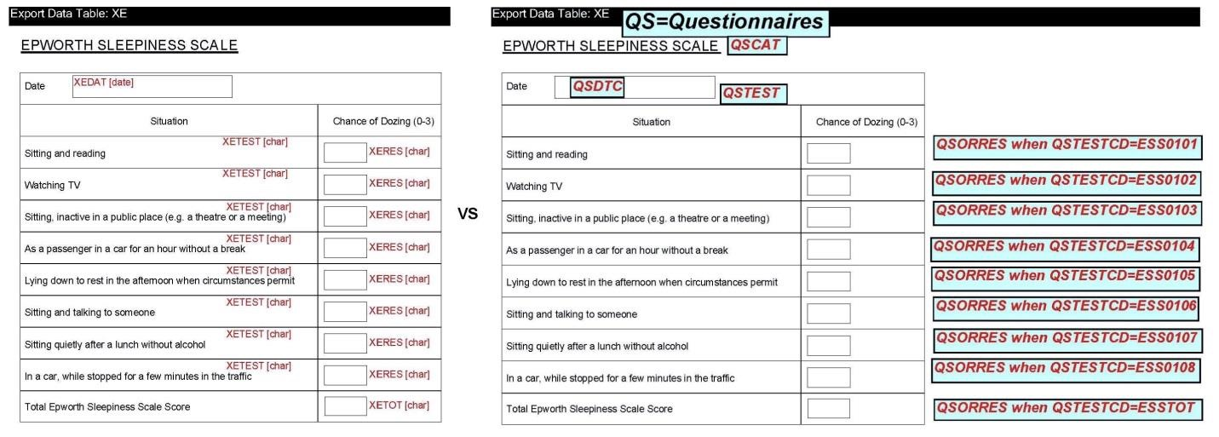
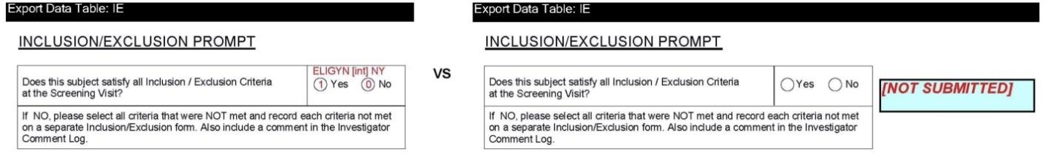
Challenges for Implementing Legacy Data Conversion Plan (LDCP) in Electronic Data Submission, continued
OUTSTANDING ISSUE SUMMARY & WORKAROUND
From annotating CRF through creating ADaM analysis dataset, some challenging issues obstacle us to
rebuild the traceability. In the section, we focus on traceability limitations listed in table 5 of SDTCG and
give some examples to demonstrate our workaround. In addition, other examples are put together in last
limitation, called naïve data deficiency from legacy study.
1. LIMITED ABILITY TO DETERMINE LOCATION OF COLLECTED CRF VARIABLES IN
THE CONVERTED SDTM DATA UNLESS THE LEGACY ACRF IS RE-ANNOTATED
1) Legacy Annotation Misled to SDTM Annotation
Legacy annotation in some forms was not compliant with SDTM. After discussed with sponsor, CRF
should re-annotate per SDTM/SDTMIG and metadata submission guide. Display 1 compares the
annotations between legacy and SDTM.
Display 1. Comparison between Legacy and SDTM Annotation
2) Too Simple CRF Design to Annotate
In a sub-study, laboratory test assessed by central laboratory vendor and the CRF just listed all
categories of laboratory tests. For SDTM aCRF, we re-annotated all LBTESTCDs in the laboratory test
form by using the test name in vendor dataset. Display 2 takes Urine Analysis and external dataset as
example to illustrate the re-annotations.
3

Slide 4
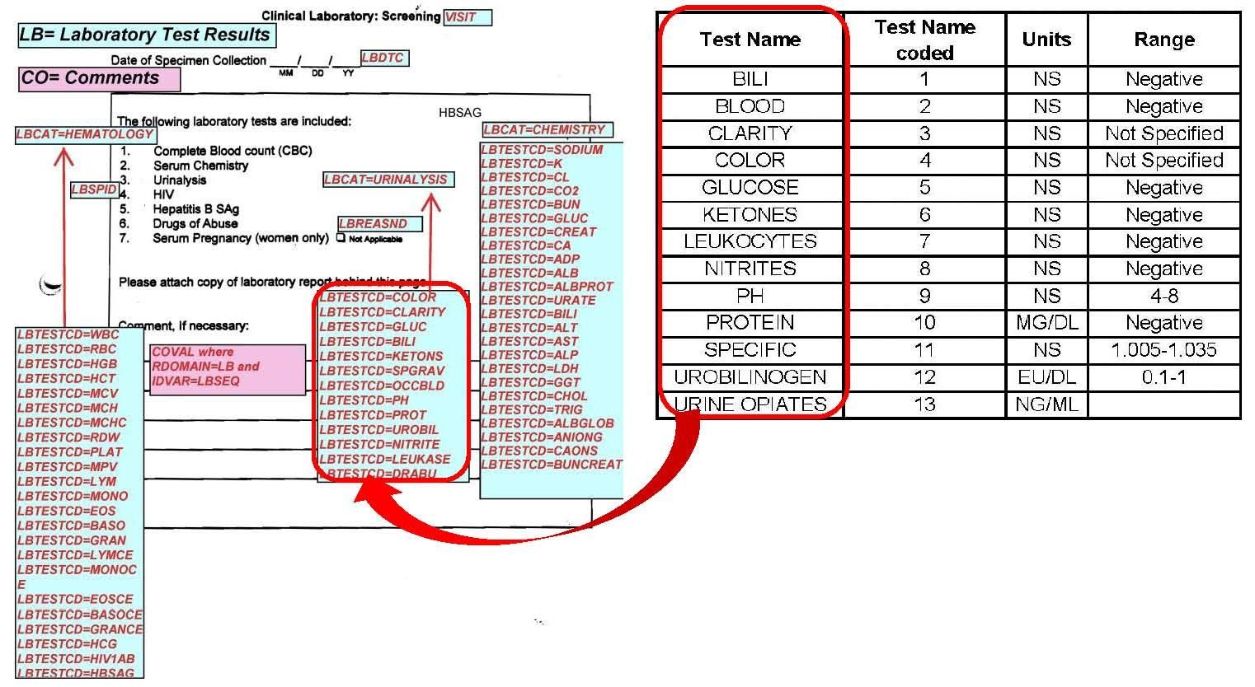
Challenges for Implementing Legacy Data Conversion Plan (LDCP) in Electronic Data Submission, continued
.
Display 2. The Clinical Laboratory Case Report Form and External Urine Analysis Data
2. LIMITED TRACEABLE PATH FROM SDTM TO THE LEGACY ANALYSIS DATA
Not applicable to the case study since legacy analysis datasets were not used to ISS/ISE.
3. LIMITED ABILITY TO REPLICATE/CONFIRM LEGACY ANALYSIS DATASETS (I.E.,
ANALYSIS VARIABLE IMPUTATION OR DERIVED VARIABLES) USING SDTM DATASETS
Not applicable to the case study since legacy analysis datasets were not used to ISS/ISE.
4. LIMITED ABILITY TO CONFIRM DERIVATION OF INTERMEDIATE ANALYSIS
DATASETS OR CUSTOM DOMAINS
Not applicable to the case study since intermediate analysis datasets were not used to ISS/ISE.
5. LIMITED TRACEABLE PATH FROM ADAM TO THE TABLES, FIGURES AND THE CSR
1) Laboratory Clinically Significant Reference Range Referred to CSR
The “Possibly Clinically Significant Limits” in CSR was determined as source data to map into SUPPLB
domain. This is because the source document of the reference range had been lost. The Display 3 takes
Albumin test as example to show the traceability of clinical significant limits from CSR to SUPPLB domain.
4

Slide 5
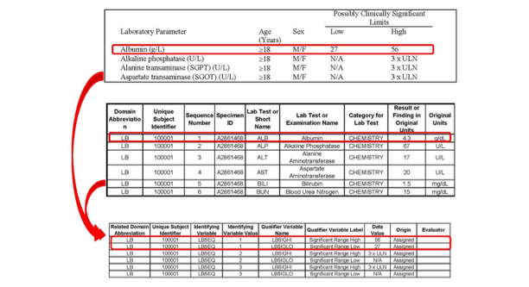
Challenges for Implementing Legacy Data Conversion Plan (LDCP) in Electronic Data Submission, continued
Display 3. The Traceability of Clinical Significant Limits for Laboratory Tests from CSR to SUPPLB
2) EXDOSTXT Mapping Design Due to The Derivation Requirement in ADEX
In one sub-study design, two arms would be administered in escalating doses up to the specified target
dose, active reference compound and placebo would be given at constant dose. During each treatment
day, subjects were supposed to take 4 capsules every day (two capsules in the morning and two
capsules in the evening no matter of study medication or placebo or active reference compound, but the
capsules were designed to have different strength (0 or 100mg).
For example, if a subject was randomly assigned to the 400 mg group, then from the first day to the next
day, the first capsule he took every morning was a capsule containing an effective dose of 100 mg. He
took capsules on the first and second days. The effective dose content was 100 mg in total. From the
third day to the fourth day, he took the first capsule every morning and afternoon was a capsule
containing an effective dose of 100 mg. The effective dose of his capsules on the third and fourth days
was 200 mg in total. From the fifth day to the seventh day, the two capsules he took every morning and
the first capsule took in the afternoon contained an effective dose of 100 mg capsules. The effective dose
of capsules he took on the fifth to the seventh days was 300 mg in total. From the eighth day to the
fourteenth day, two capsules he took every morning and two capsules took in the afternoon contained
effective doses of 100 mg capsules. He had 400 mg total effective dose of capsules on the eighth and
fourteenth days. After the fifteenth day, if the subject did not show symptoms of discomfort, the capsules
were always taken from the eighth day to the fourteenth day until the end of the study. The scheduled
active dosage for study drug administration and the administration of study medication CRF is shown in
Table 1 and Display 4, respectively, for illustration.
5

Slide 6
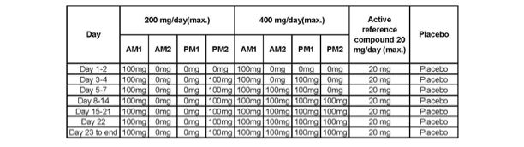
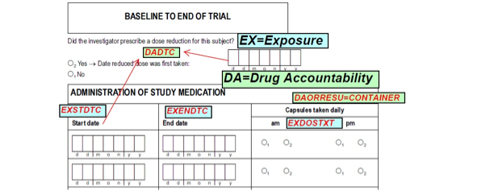
Challenges for Implementing Legacy Data Conversion Plan (LDCP) in Electronic Data Submission, continued
Table 1. The Scheduled Active Dosage for Study Drug Administration
Display 4. Administration of Study Medication
Because capsule numbers and dosage information would be used to derive compliance in ADEX dataset
(shown in Table 2), after discussed with study statistician, we decided to concatenate all required
information, including AM/PM, the order of administration, number of capsule taken, and dosage in
EXDOSTXT variable in EX domain. Table 3 shows one subject’s completed exposure records in final EX
domain.
6

Slide 7
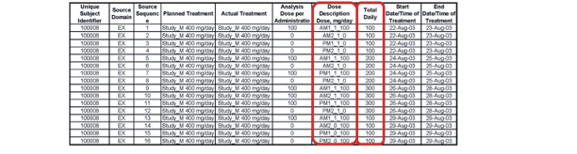
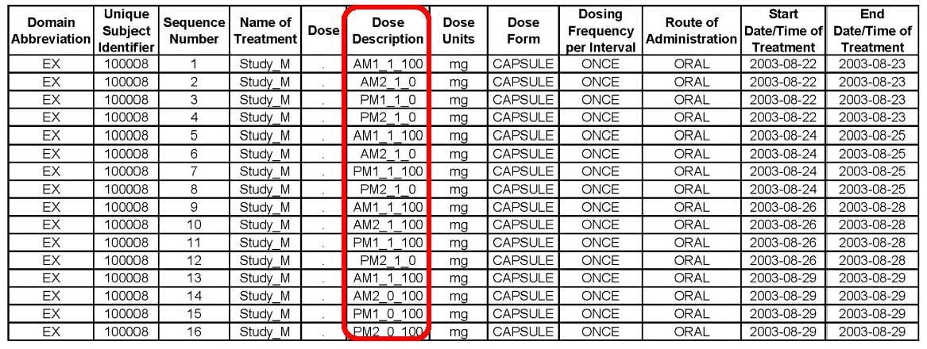
Challenges for Implementing Legacy Data Conversion Plan (LDCP) in Electronic Data Submission, continued
Table 2. ADEX Dataset
Table 3. EXDOSTXT Mapping Design in EX Domain
6. DIFFICULTY IN UNDERSTANDING THE SOURCE OR DERIVATION METHODS FOR
IMPUTED OR DERIVED VARIABLES IN INTEGRATED/POOLED DATA, SUPPLEMENTAL
QUALIFIERS, AND RELATED RECORDS
No such the issue happened to the case study.
7. LIMITED TRACEABILITY KEPT FROM NAÏVE DATA DEFICIENCY IN LEGACY STUDY
1) Non-supported Terminology
In one sub-study, all questionnaires in CDS-R Questionnaire form were not supported by QSTEST non-
extensible code list in SDTM Controlled Terminology. After discussed with sponsor, we still kept them as
user-defined code list value in QSTEST variable and explained the issue in reviewer’s guide. Table 4
presents part of QSTEST code lists in Define.xml.
7

Slide 8
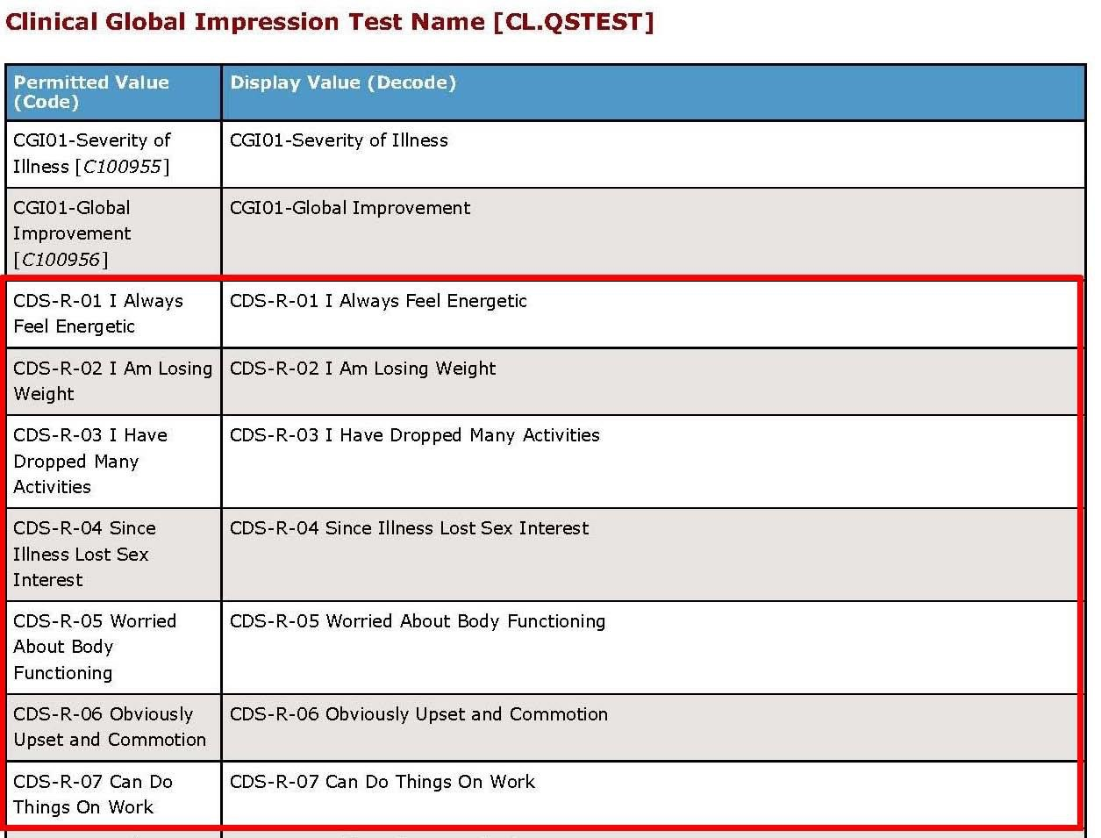
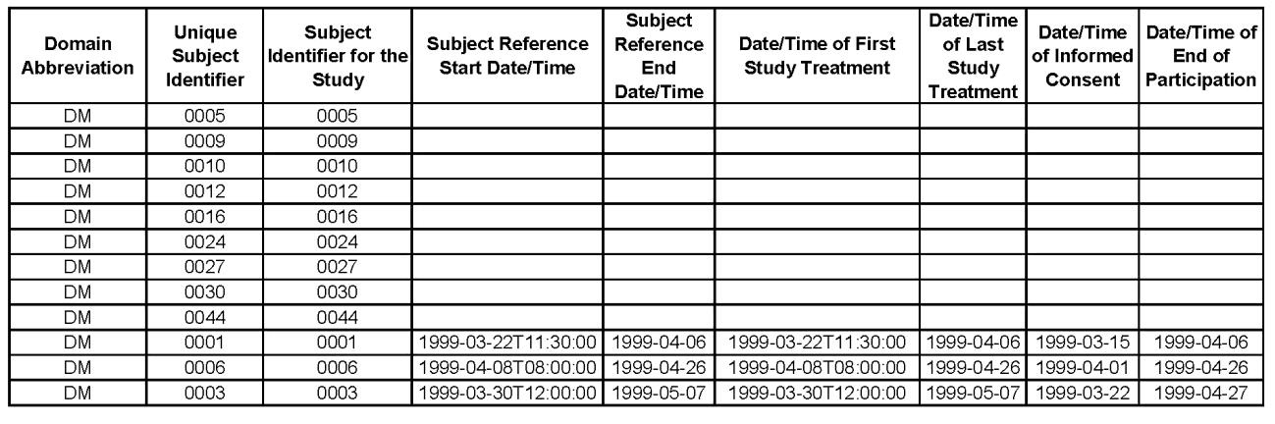
Challenges for Implementing Legacy Data Conversion Plan (LDCP) in Electronic Data Submission, continued
Table 4. Part of User-defined Codelists in Non-extensible Codelist QSTEST
2) Subjects Only Existed in External Data
In one sub-study, there were 9 subjects only existed in external laboratory test result files, but not existed
in all other domains, including IE domain. After discussed with study statistician and sponsor, the 9
subject records still added in DM domain and reported the issue in reviewer’s guide. See Table 7 for the
special tabulation.
Table 7. The 9 Empty Subjects in DM Domain
CONCLUSION
Based on the LDCP implementation in the case study, we successfully delivered SDTM and ADaM
submission packages to the client for their ISS/ISE analysis. As those examples shown, the limitations of
keeping traceability are from many aspects. Other than that, we realized another challenge might come
from primitive data deficiency that needs the study team to take more time to address.
To perform legacy data conversion in a more efficient way should depend on the capability of the study
team and tool. The highly experienced study team is able to make difficult decision on outstanding issues,
and the comprehensive issue tracking system is helpful to keep what issue happened and what decision
8

Slide 9
Challenges for Implementing Legacy Data Conversion Plan (LDCP) in Electronic Data Submission, continued
is made to resolve the issue; then share with other study teams as lesson learned. That will make legacy
study conversion more complete and also keep traceability of every data element as originally collected.
REFERENCES
[1] U.S. Food & Drug Administration. “FDA Data Standards Catalog”. Version 4.10 (10-24-2017).
Available at
https://www.fda.gov/downloads/ForIndustry/DataStandards/StudyDataStandards/UCM340684.xlsx
[2] U.S. Department of Health and Human Services, Food and Drug Administration. “Study Data
Technical Conformance Guide: Technical Specifications Document”. Version 4.0, October, 2017.
Available at
http://www.fda.gov/downloads/ForIndustry/DataStandards/StudyDataStandards/UCM384744.pdf
[3] Dave Evans, Stephen Castellano. “CDISC Standards: A Catalyst for Industry Transformation”.
November, 2016. Available at https://www.accenture.com/t20161125T001213Z__w__/us-
en/_acnmedia/PDF-12/Accenture-CDISC-Standards-Catalyst-Industry-Transformation-Report.pdf
ACKNOWLEDGMENTS
The authors would like to thank Xiaojun (Maggie) Ma of for her review comments that improved the
completeness of this paper.
CONTACT INFORMATION
Your comments and questions are valued and encouraged. Contact the author at:
Shengfeng (Philip) Ho
Rundo International Pharmaceutical Research & Development Co.,LTD
+86-0513-85288638 ext: 2032
shengfeng.he@rundo-cro.com / shengfeng.ho1016@gmail.com (personal)
https://www.linkedin.com/in/shengfeng-h-2b101b41/
Xiaojia (Jessie) Wang
Rundo International Pharmaceutical Research & Development Co.,LTD
+86-0513-85288638 ext: 2038
xiaojia.wang@rundo-cro.com
SAS and all other SAS Institute Inc. product or service names are registered trademarks or trademarks of
SAS Institute Inc. in the USA and other countries. ® indicates USA registration.
Other brand and product names are trademarks of their respective companies.
9

