Slide 1
Retail Banking Analytics:
From Fragmented Data to
Actionable Insights
Stella Babayemi | June 2025
SQL | Excel | Notion | Draw.io

Slide 2



Problem Statement
Retail banks sit on enormous amounts of data, but fragmentation across systems creates blind spots that cost money and increase risk.
Limited Visibility
No unified view of customer behavior across products and segments
Hidden loan risk
Exposure to default risk is scattered and not consolidated for review
Poor product insight
No clear view of which products drive value across customer segments

Slide 3
Objective & Analytical Approach
Objectives
Analyze customer demographics and account behavior
Evaluate loan portfolio performance
Monitor transaction activity
Assess card usage trends
Generate actionable business insights
Analytical Approach
Raw Data
Data Preparation
(Cleaning | Validation | Transformation)
Data Enrichment
(Standardization | Generated Fields)
Data Analysis
(SQL Queries | KPI Development)
Dashboard Development
(Excel)
Business Insights
& Recommendations

Slide 4
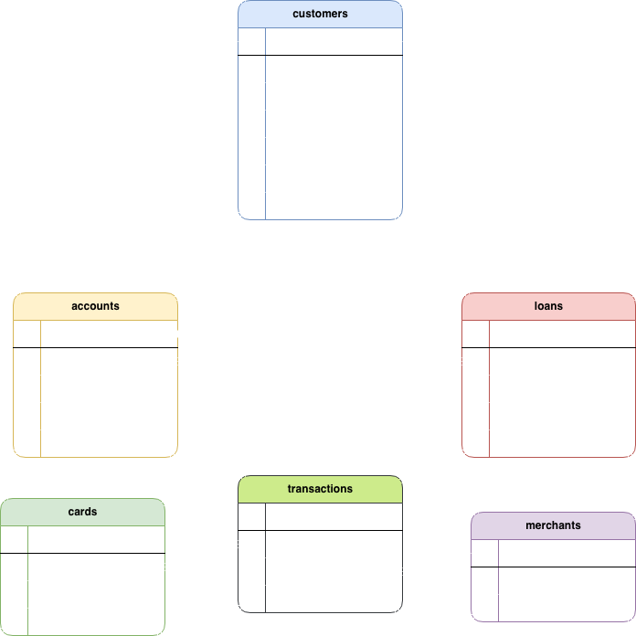
Dataset Overview
This project uses a synthetic retail banking dataset (2019-2025) sourced from Kaggle, comprising six tables used for analysis: customers, accounts, cards, loans, transactions, and merchants plus a standalone branches table which was excluded as it contained no foreign key relationship to the rest of the data.
Tables | Rows | Description
Customers | 50,000 | Customer details
Accounts | 75,000 | Account information
Cards | 100,000 | Card details
Loans | 30,000 | Loan records
Merchants | 5,000 | Merchant details
Transactions | 1,000,000 | Transaction history

Slide 5
Data Cleaning Summary
Table | Issues found | Action taken | Staging table
Customers | None | None | customers_staging
Accounts | None | None | accounts_staging
Cards | None | None | cards_staging
Loans | 15,069 pre-creation records (50.24%) | Excluded invalid records | loans_staging
Merchants | None | None | merchants_staging
Transactions | 406,259 pre-account records (40.63%) | Excluded invalid records | transactions_staging

Slide 6
Data Quality Assessment
TRANSACTIONS - before account creation
WITH totals AS (
SELECT COUNT(*) AS total_transactions
FROM transactions
), invalids AS (
SELECT COUNT(*) AS invalid_transactions
FROM transactions t
JOIN accounts a ON t.account_id = a.account_id
WHERE t.transaction_date < a.open_date
)
SELECT invalid_transactions,
invalid_transactions * 100.0 / total_transactions
AS invalid_percentage
FROM invalids CROSS JOIN totals;
1,000,000
Total transactions
406,259
Invalid - 40.63%
30,000
Total loans
15,069
Invalid - 50.24%
AFTER CLEANING
Valid Transactions - 593,741
Valid Loans - 14,931
LOANS - before customer creation
WITH totals AS (
SELECT COUNT(*) AS total_loans
FROM loans
), invalids AS (
SELECT COUNT(*) AS invalid_loans
FROM loans l
JOIN customers c ON l.customer_id = c.customer_id
WHERE l.start_date < c.created_at
)
SELECT invalid_loans,
invalid_loans * 100.0 / total_loans
AS invalid_percentage
FROM invalids CROSS JOIN totals;
Business rule violation: transactions and loans predating account/customer creation. Raw tables retained for audit. All analysis uses cleaned datasets only.

Slide 7
Feature Engineering & Business Rules
Derived Fields
Field | Based on
Risk Category | Credit Score
Customer Type | Customer Tenure
Balance Category | Account Balance
Card status | Expiration Date

Slide 8
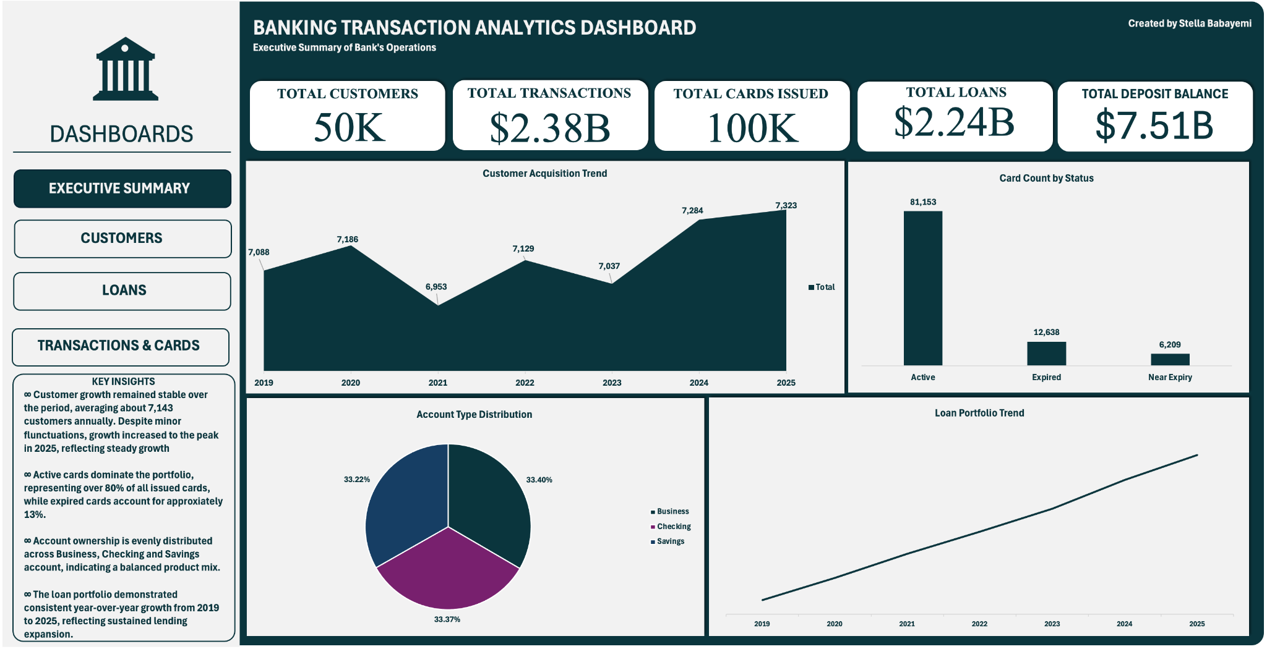
Executive Summary

Slide 9
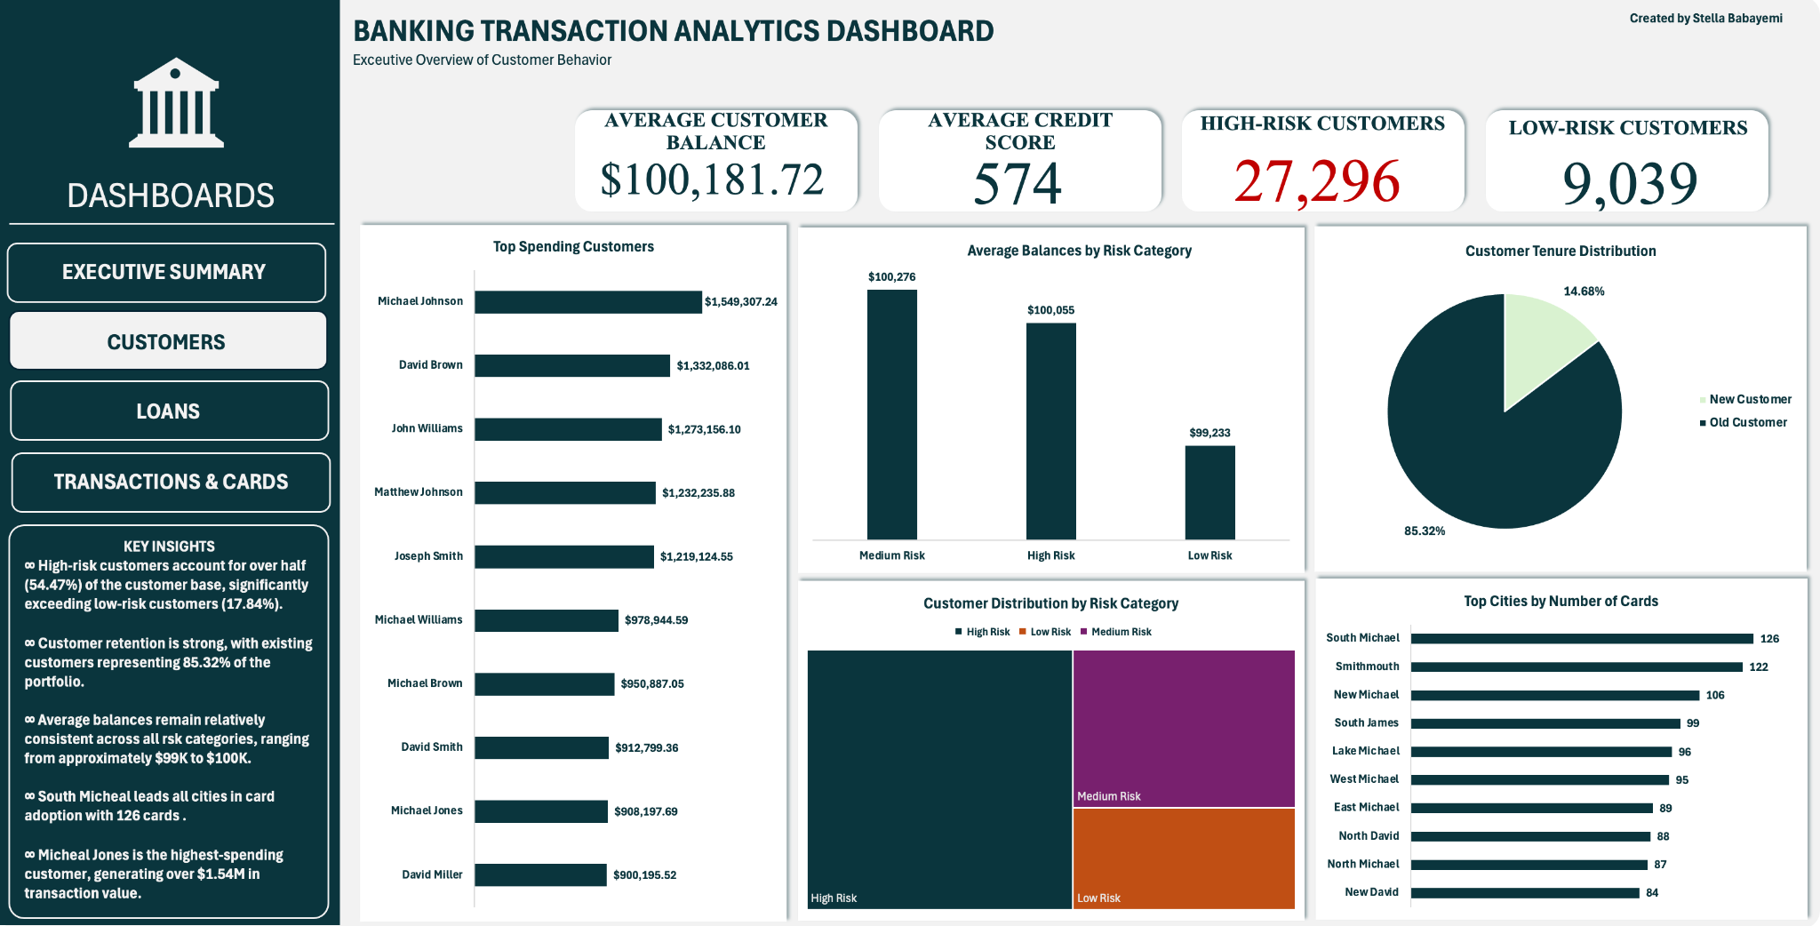
Customers

Slide 10
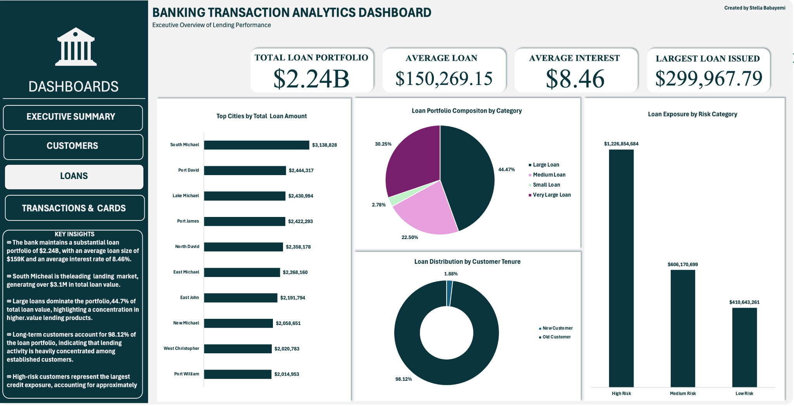
Loans

Slide 11
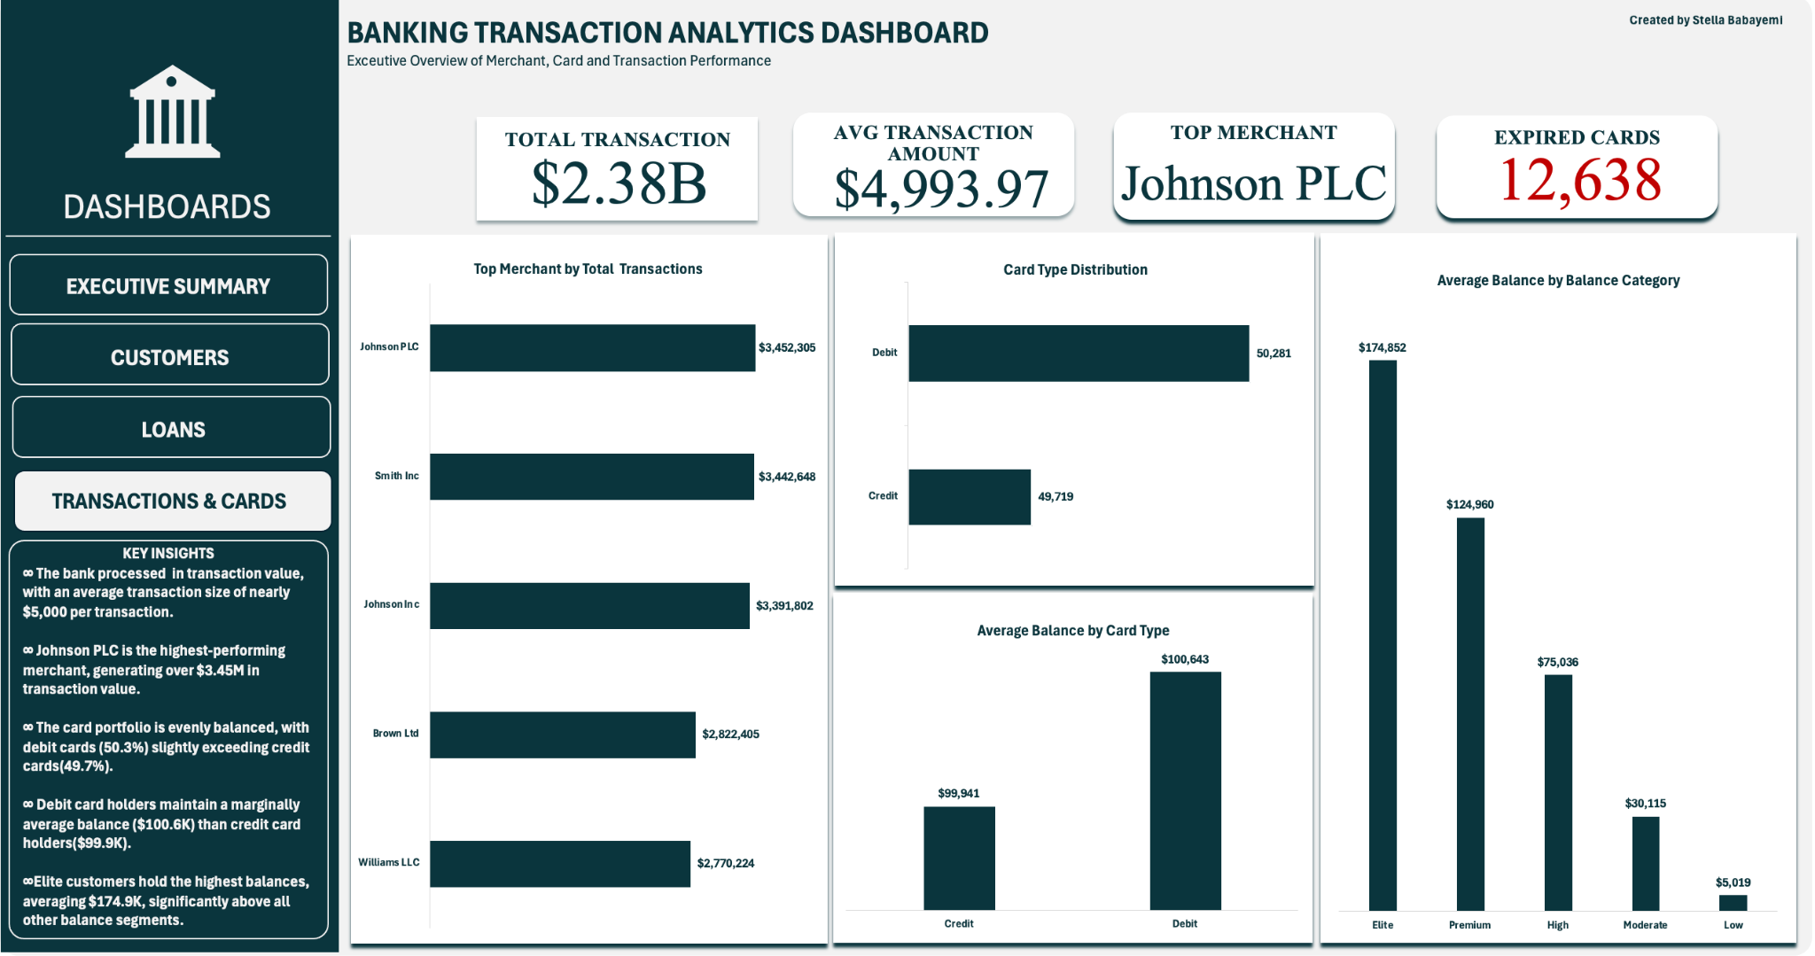
Transactions and Cards

Slide 12
Overall Business Insights
CUSTOMER HEALTH
50K Customers
Strong customer retention
Stable acquisition trend
Mature customer base
CREDIT RISK
54.6% High-Risk Customers
Largest customer segment
$2.24B loan portfolio
Elevated lending exposure
KEY TAKEAWAY
The bank demonstrates strong customer engagement, deposit growth, and lending expansion. However, elevated credit risk exposure and expired card volume require proactive management
DEPOSITS & ACTIVITY
$7.1B Total Balances
Strong deposit base
$2.3B transaction value
Active customer engagement
CARD PORTFOLIO
100K Cards Issued
Balanced debit / credit mix
12.6K expired cards
Renewal opportunity identified

Slide 13
Recommendations
Priority | Recommendation | Business Impact
High | Reduce High-Risk Exposure | Lower Credit Losses
High | Renew 12.6k Expired Cards | Increase Card Revenue
High | Increase Product Adoption Among Existing Customers | Increase Customer Lifetime
Medium | Grow Premium Customer Relationship | Increase Deposits & Lending
Medium | Expand in Top Cities | Improve Acquisition Efficiency
Medium | Strengthen Merchant Partnerships | Increase Transaction Volume
Prioritize three immediate actions: reduce high-risk loan exposure, renew expired cards and expand product adoption among existing customers. These initiatives address the bank’s largest risk area while leveraging its strongest assets

Slide 14
THANK
YOU

