Slide 1
Preventative Health Screening Inventory Database (PHS Database) Stella Anyokwu & Candice Lee

Slide 2
What is the PHS Database
The PHS database is a centralized inventory of patient preventive health screening data.
It will track key interventions across major categories:
Colorectal: Colonoscopy, FIT, Cologuard
Women's health: Mammograms, Pap smears
Cardiovascular: Blood pressure, comprehensive lab panels
Diabetes: A1C labs, retinal exams
Preventive screening data is often fragmented across systems, medical offices, and lab reports.
Care teams lack one clear view of which patients are due, overdue, or completed.
This missing data affects outcomes and plan ratings, including HEDIS and CMS Star Ratings

Slide 3
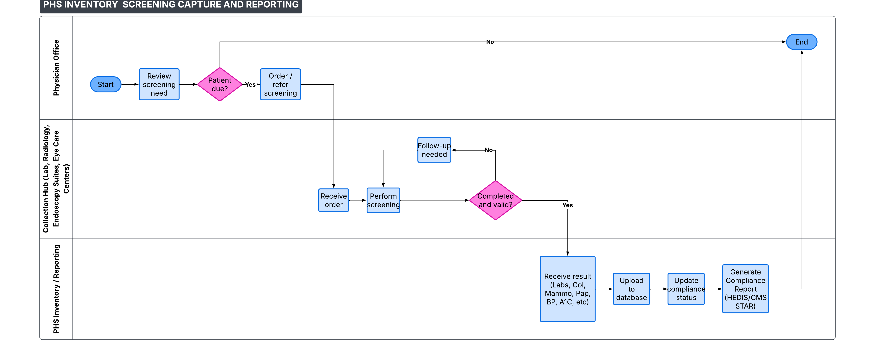
System Architecture

Slide 4
Key Benefits & Organizational Value
Stores completed screening data from multiple healthcare collection hubs in one system.
Generates CSV reports for easy data sharing and analysis.
Helps identify patients who are compliant with required screenings.
Supports HEDIS and CMS Star Ratings reporting requirements.
Contributes to improved healthcare quality outcomes.
Provides a basic but practical framework for preventive health screening management.

Slide 5
DEMO https://github.com/Stella4life/PHS-Inventory

Slide 6
Future Enhancements & System Expansion
Develop a user interface for easier navigation and usability.
Adapt the code to help prevent duplicate patient records/ screening records.
Integrate with electronic health record (EHR) systems.

Slide 7
References
Centers for Medicare & Medicaid Services. (2026). Home. https://www.cms.gov
Google. (2026). NotebookLM [Large language model]. https://notebooklm.google.com/
National Committee for Quality Assurance. (2026). Home. https://www.ncqa.org
OpenAI. (2026). ChatGPT (May 13 version) [Large language model]. https://chat.openai.com/chat

Slide 8


