Slide 2

ORACLE SQL

Slide 3
AGENDA
Introdution
Basic’s of oracle
Sub categories
Constraints
Joins
Functions
Operators

Slide 4
AGENDA
Sub queries
Indexes
Synonyms
Sequence
Views

Slide 5
INTRODUCTION
DATA BASE?
A Data Base is an Organized Collection of Data which can be easily accessed, managed and updated.
WHAT IS DBMS?
DBMS is a software tool that is used to store and manage data in the Database.

Slide 6

TRADITIONAL FILE SYSTEM
Before Database and DBMS were introduced, traditional approach was to store data in flat files (physical files in system) but there were some disadvantages with it.

Slide 7
Ways of Storing data in files customer data
4176 Aniruddha Sarkar SBU1
4181 Manoj Saha SBU1
4183 Moushumi Dharchoudhury SBU1
4203 Suryanarayana D.V.S.S. SBU1
4204 Vivek Rai SBU1
Predefined length
Notes:
Ways of Storing data in files customer data:
Data was stored in the form of records in the files.
Records consists of various fields which are delimited by a space , comma , tab etc.
Special characters used to mark the end of records and end of files.

Slide 8

Problems: Traditional Approach
Data Redundancy
Data Inconsistency
Difficulty in Accessing data
Data Isolation
Data Integrity
Atomicity Problem
Security Problems
Notes:
First Problem is Data Redundancy
Data Redundancy means same information is duplicated in several files. This makes data redundancy.
Second Problem is Data Inconsistency
Data Inconsistency means different copies of the same data are not matching. That means different versions of same basic data are existing. This occurs as the result of update operations that are not updating the same data stored at different places.
Example: Address Information of a customer is recorded differently in different files.
Third Problem is Difficulty in Accessing Data
It is not easy to retrieve information using a conventional file processing system. Convenient and efficient information retrieval is almost impossible using conventional file processing system.
Fourth Problem is Data Isolation
Data are scattered in various files, and the files may be in different format, writing new application program to retrieve data is difficult.
Fifth Problem is Integrity Problems
The data values may need to satisfy some integrity constraints. For example the balance field Value must be grater than 5000. We have to handle this through program code in file processing systems. But in database we can declare the integrity constraints along with definition itself.
Sixth Problem is Atomicity Problem
It is difficult to ensure atomicity in file processing system.For example transferring $100 from Account A to account B.If a failure occurs during execution there could be situation like $100 is deducted from Account A and not credited in Account B.
Seventh Problem is Concurrent Access anomalies
If multiple users are updating the same data simultaneously it will result in inconsistent data state. In file processing system it is very difficult to handle this using program code. This results in concurrent access anomalies.
Eighth Problem is Security Problems
Enforcing Security Constraints in file processing system is very difficult as the application programs are added to the system in an ad-hoc manner.

Slide 9

Database Management Systems
Working of DBMS
User system to extract information from the database
Request for data
Retrieved data returned as a result
DBMS
Database
Notes:
The working of a DBMS is as follows:
First User system places a request with DBMS to extract information from the database.
The DBMS talks and extracts information from the database and passes on the information to the client.
There are three technologies involved to make a DBMS work:
Networking
Client Server Architecture
Relational Algebra forms the mathematical foundation for the data model

Slide 10







Advantages of a DBMS
Data independence
Reduction in data redundancy
Better security
Better flexibility
Effective data sharing
Enforces integrity constraints
Enables backup and recovery
Notes:
Advantages of a DBMS are :
Users and application programs need not know exactly where or how the data is stored in order to access it.
Proper database design can reduce or eliminate data redundancy and confusion.
Support for unforeseen (ad hoc) information requests are better supported - better flexibility.
Data can be more effectively shared between users and/or application programs.
Data can be stored for long term analysis (data warehousing).
Some more advantages are
Data independence
Reduction in data redundancy
Better security
Better flexibility
Effective data sharing
Enforces integrity constraints
Enables backup and recovery

Slide 11
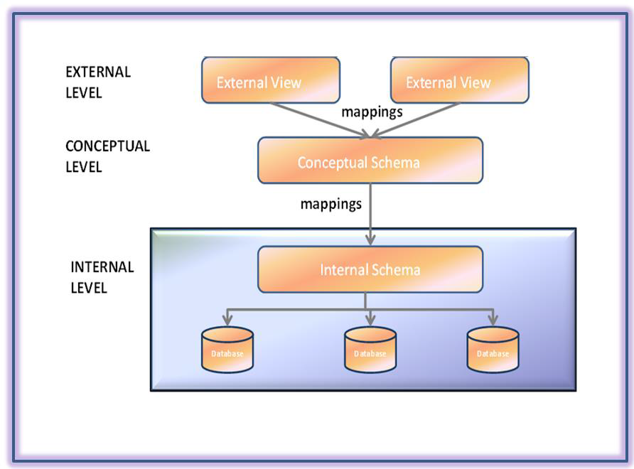
ARCHITECTURE OF THE DBMS
The architecture of the DBMS can be viewed as a 3-level system comprising the following:

Slide 12


WHAT IS SQL ?
SQL is a standard language designed for accessing and managing data in Relational Database Management Systems (RDBMS).
What is rdbms?
a relational data base management system is data base management system(dbms),it is introduced by e.f.codd.

Slide 13
USER
a user is someone who can connect to a database and create different database objects. However the user should have necessary privileges to connect and create.
SCHEMA
All the objects that user owns are collectively called as
schema.

Slide 14
CREATE USER:
CREATE USER user1 IDENTIFIED BY user1;
In the above syntax ‘user1’ is the user name and ‘user1’ is the password.
GRANT ALL TO user1;
Here we have given all the privileges to user ‘user1’.

Slide 15
DATA TYPES:
CHAR(7)
VARCHAR2(10)
NUMBER
NUMBER(10)
NUMBER(8,2)
DATE

Slide 16
SQL SUB CATEGORIES
Data retrieval language (DRL)
Data defination language (DDL)
Data manipulation language (DML)
Transaction control language (TCL)
Data control language (DCL)

Slide 17
.
DRL - Select
DDL - Create,Alter,Rename,Truncate,Drop
DML - Insert,Update,Delete,Merge
TCL - Commit , Save point , Rollback
DCL - Grant , Revoke

Slide 18
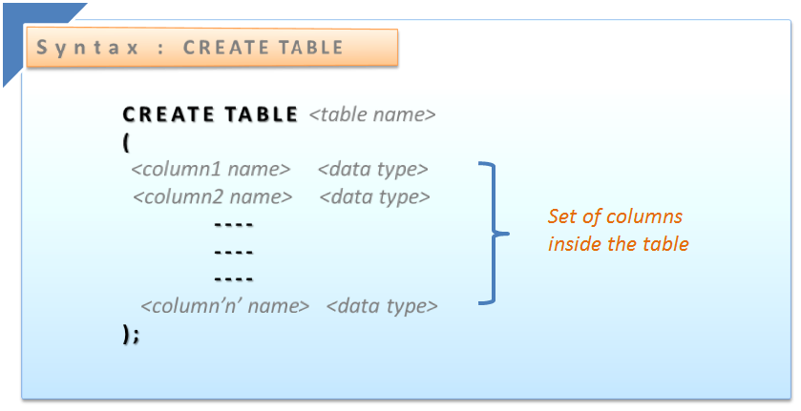
DDL CREATE:

Slide 19
ALTER:
Add, drop and modify table columns
Add and drop constraints
Enable and Disable constraints
ALTER TABLE emp ADD na_column DATE;
ALTER TABLE emp DROP column DATE;
ALTER TABLE emp RENAME COLUMN sal TO salary;
ALTER TABLE emp MODIFY ename VARCHAR(25);

Slide 20
TRUNCATE:
Truncate table <table name>;
DROP:
Drop table <table name>;
RENAME:
RENAME emp TO na_emp;

Slide 21
DML
INSERT:
INSERT INTO <TABLE NAME> (COLUMN LIST) VALUES (VALUES LIST);
UPDATE:
UPADTE EMP SET SAL=SAL+100 WHERE <CONDITION>;
DELETE:
DELETE FROM EMP WHERE <CONDITION>;

Slide 22
MERGE:
MERGE INTO emp1 e1
USING emp2 e2
ON (e1.empno=e2.empno)
WHEN MATCHED
THEN
UPDATE SET sal = e2.sal

Slide 23
WHEN NOT MATCHED
THEN
INSERT (e1.empno, e1.ename, e1.sal)
VALUES (e2.empno, e2.ename, e2.sal);

Slide 24
CONSTRAINTS
Constraint is a rule or restriction which is imposed on the table data.
DOMAIN INTEGRITY CONTRAINTS:
Not null
check
ENTITY INTEGRITYCONSTRAINTS:
Primary
Unique

Slide 25
REFERENTIAL INTEGRITY CONSTRAINTS :
Foreign key
There are three different ways to add constraints:
Column level – along with the column definition
Table level – after the table definition
Alter level – using alter command

Slide 26
CONSTRINTS WITH NAMES:
Constraint names must be unique to the owner.
The constraint name appears in messages when the constraint is violated.
If a constraint name is not specified, the Oracle Server assigns a unique name with the format SYS_C00n.

Slide 27

CHECK CONSTRAINT
Check constraint is used to insert the values based on specified condition. The Check constraint explicitly defines a condition that each row must satisfy.
Syntax: check(condition):

Slide 28
TABLE LEVEL
Constraint with name:
CREATE TABLE emp (
empno NUMBER(10),
enameVARCHAR2 (100),
sal NUMBER (5),
CONSTRAINT emp_ck check(sal<20000));

Slide 29
Constraint with out name:
CREATE TABLE emp (
empno NUMBER,
ename VARCHAR2 (100),
sal NUMBER (5), CHECK(sal<20000));

Slide 30
COLUMN LEVEL:
CREATE TABLE emp (
empno NUMBER Constraint emp_ck check(sal<20000),
enameVARCHAR2 (100),
sal NUMBER (5));

Slide 31
ALTER LEVEL:
ALTER table emp ADD constraint emp_ck check(sal<20000));
ALTER table emp DROP constraint emp_ck;
Select * from user_constraints where table_name=‘emp’;

Slide 32
NOT NULL:
‘NOT NULL’ constraints are used to avoid null values for a specific column.
We can add ‘NOT NULL’ constraint at column level only.
Constraint with out name:
CREATE TABLE emp (empno NUMBER NOT NULL,ename VARCHAR2 (100), sal NUMBER (5));

Slide 33


UNIQUE CONSTRAINT
Unique constraint is used to avoid duplicates values in the column data but it allows null values.
COLUMN LEVEL:
CREATE TABLE emp (
empno NUMBER Constraint emp_un unique,
enameVARCHAR2 (100),
sal NUMBER (5));

Slide 34
TABLE LEVEL
Constraint with name:
CREATE TABLE emp (
empno NUMBER(10),
enameVARCHAR2 (100),
sal NUMBER (5),
CONSTRAINT emp_un unique(empno));

Slide 35
Constraint with out name:
CREATE TABLE emp (
empno NUMBER,
ename VARCHAR2 (100),
sal NUMBER (5),unique(empno));

Slide 36
ALTER LEVEL:
ALTER table emp ADD constraint emp_un unique(empno));
ALTER table emp DROP constraint emp_un;
Select * from user_constraints where table_name=‘emp’;

Slide 37
PRIMARY KEY CONSTRAINT
Primary Key is used to avoid duplicates and nulls. This constraint will work as a combination of both unique and not null.
Only one primary key is allowed to a table.
For parent child relationships across tables, Primary key is always attached to the parent table.

Slide 38
If we want more than one column to work as Primary Key columns then those are called composite primary key.
EXAMPLE:
ALTER TABLE emp2 ADD CONSTRAINT emp_pk PRIMARY KEY (empno);

Slide 39
COMPOSITE PRIMARY KEY
Add a primary key to more then one attribute is known as composite primary key.
we can add composite primary key only in table level and alter level.C

Slide 40
CREATE TABLE employee (
empno NUMBER(5),
name varchar2(20),
address varchar2(20),
PRIMARY KEY(empno,name);

Slide 41

FOREIGN KEY CONSTRAINT
Foreign keys are used to refer the parent table primary key column which does not allow duplicates.
The Foreign key constraint provides referential integrity rules

Slide 42
ALTER LEVEL:
ALTER TABLE emp ADD CONSTRAINT emp_dept_fk FOREIGN KEY (deptno) REFERENCES dept (deptno);
ALTER TABLE emp DROP CONSTRAINT emp_dept_fk;

Slide 43

ON DELETE CASCADE
‘ON DELETE CASCADE’ is an extension to ‘Foreign key’ constraint. If a parent-child relationship exists between the tables then we will not be able delete the parent record when child exists for it.
By using ‘ON DELETE CASCADE’ clause we can remove the parent record even it Childs exists.
Notes:
If we delete any record from parent table irrespectively child table records to be deleted which are matched.

Slide 44
We can define these at all three levels
Column Level
Table Level
Alter Level
ALTER TABLE emp ADD CONSTRAINT emp_dept_fk FOREIGN KEY (deptno) REFERENCES dept (deptno) ON DELETE CASCADE;

Slide 45
COLUMN LEVEL:
CREATE TABLE employee (
empno NUMBER(5),
name varchar2(20),
deptno number(10), CONSTRAINT emp_dept_fk FOREIGN KEY (deptno) REFERENCES dept (deptno) ON DELETE CASCADE;

Slide 46
TABLE LEVEL:
CREATE TABLE employee (
empno NUMBER(5),
name varchar2(20),
deptno number(10), CONSTRAINT emp_dept_fk FOREIGN KEY (deptno) REFERENCES dept (deptno) ON DELETE CASCADE;

Slide 47


Slide 48

Questions:
How many levels we can apply NOTNULL constraint?
Table level
Column level
Alter level
In which levels we can add composite primary key?
Column level
Table level

Slide 49
One table can have two primary keys?(yes/no)
Two attributes can has one unique key?(true/false)
In referential integrity constraints parent table has primary key?(yes/no)

Slide 50

JOINS
A Join is a temporary relation between the common columns of the table (or) the column sharing the common data.
Join is a mechanism to retrieve data from more than one data base tables.

Slide 51
TYPES OF JOINS
CROSS JOIN
EQUI JOIN
NON EQUI JOIN

Slide 52
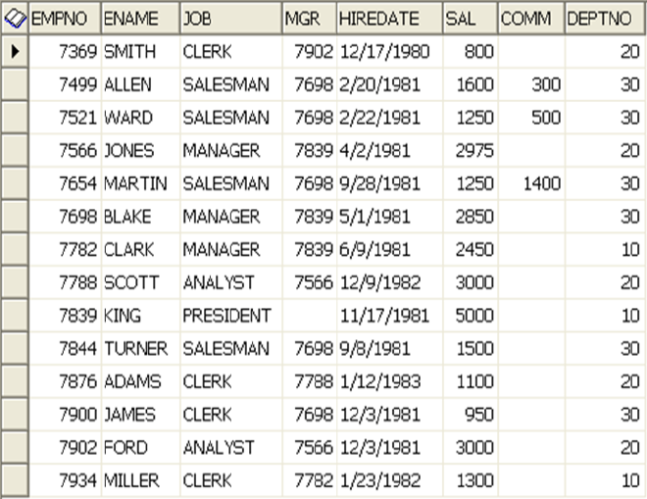
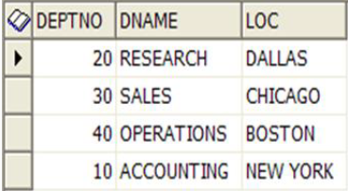
CROSS JOIN
Cross join will fetch all possible combinations between the tables.

Slide 53
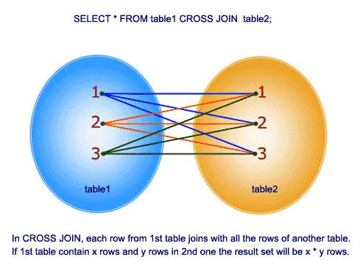
Select e.*,d.* from emp e,dept d;
These queries will fetch 56 rows in total as EMP table has 14 rows and DEPT table has 5 rows .i.e. 14*4=56 rows will be displayed
By using cross join we can retrieve all possible combinations

Slide 54
EQUI JOIN
INNER JOIN
OUTER JOIN
OUTER JOIN
SELF JOIN
LEFT OUTER JOIN
RIGHT OUTER JOIN
FULL OUTER JOIN

Slide 55

EQUI JOIN
Inner join is to retrieve the matching rows of joining tables (or) to retrieve the rows of different tables those are having matching values.
INNER-JOIN:
Inner Join is to retrieve the rows of different tables that having matching values.

Slide 56
INNER JOIN
EMP
DEPT

Slide 57
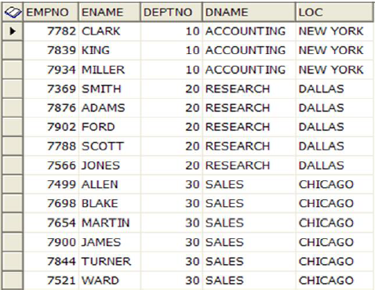
EXAMPLE:
SELECT emp. empno, emp. ename, emp. deptno, dept. dname, dept.loc FROM EMP, DEPT WHERE emp.deptno=dept.deptno;

Slide 58
LEFT OUTER JOIN
Left Outer join will fetch all records from left hand side table in a join, irrespective of the matching.
select emp.ename,dept.dname from emp left outer join dept on emp.deptno=dept.deptno;
OR
select emp.ename,dept.dname from emp ,dept where emp.deptno=dept.deptno(+)

Slide 59
EXAMPLE:
EMP
DEPT

Slide 60
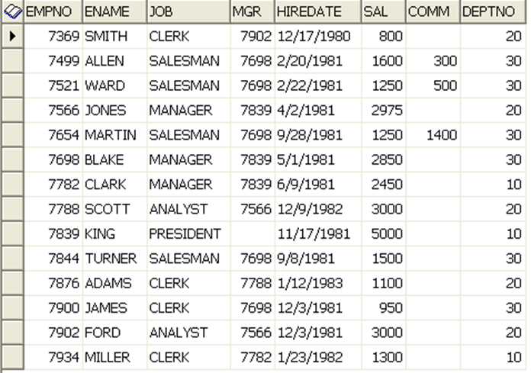
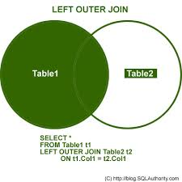

Slide 61
RIGHT OUTER JOIN
Right Outer join will fetch all records from Right hand side table in a join, irrespective of the matching.
select emp.ename,dept.dname from emp right outer join dept on emp.deptno=dept.deptno;
OR
select emp.ename,dept.dname from emp, dept where emp.deptno(+)=dept.deptno

Slide 62
EXAMPLE:
EMP
DEPT

Slide 63
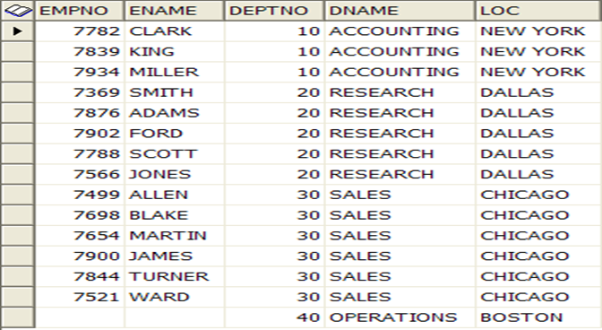
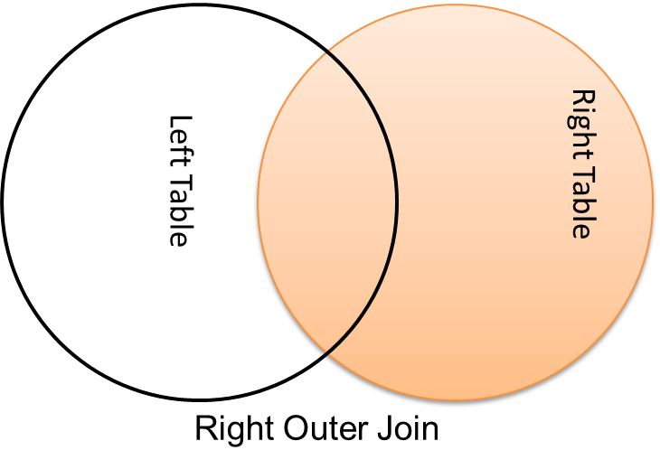

Slide 64
FULL OUTER JOIN
full outer join is to retrieve all the matching data and all additional non-matching data from both left and right side of the tables.
select emp.ename,dept.dname from emp full outer join dept on emp.deptno=dept.deptno;

Slide 65
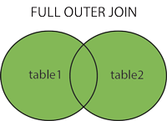

Slide 66
EXAMPLE:
EMP
DEPT

Slide 68
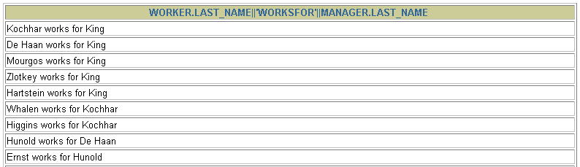
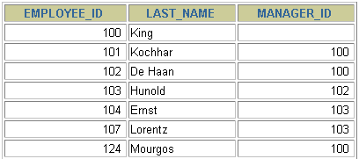
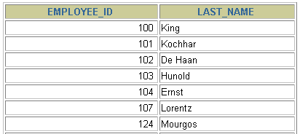
Joining a Table to It-self
SELECT worker.last_name || ' works for ‘ || manager.last_name
FROM employees worker, employees manager
WHERE worker.manager_id = manager.employee_id ;
Self Joins
EMPLOYEES (WORKER)
EMPLOYEES (MANAGER)
…
…
MANAGER_ID in the WORKER table is equal to EMPLOYEE_ID in the MANAGER table
Notes:
Joining a Table to Itself:
The slide example joins the EMPLOYEES table to itself.
To simulate two tables in the FROM clause, there are two aliases, namely w and m, for the same table, EMPLOYEES.
In this example, the WHERE clause contains the join that means where a worker’s manager number matches the employee number for the manager.

Slide 69
select e.empno,m.ename,e.ename as manager from emp e ,emp m where e.empno=m.mgr;

Slide 70
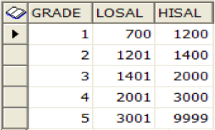
NON-EQUI JOIN
Here we are using two tables EMP and SALGRADE and these tables having no primary key and foreign key relationship
EMP SALGRADE

Slide 71
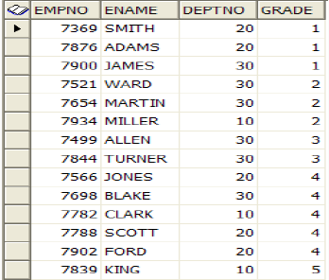
SELECT e.empno, e.ename, e.deptno, s.grade FROM emp e, salgrade s WHERE e.sal BETWEEN s.losal AND s.hisal;

Slide 72

Questions:
In left outer join we are using ‘+’ symbol on right side in the condition?(true/false)
Self join performs on two tables?(yes/no)
If table1 has 12 rows and table2 has 8 rows so how many records cross will fetch?
4
96
20

Slide 73
4) Non – equi join also should have at least one common column?
Yes
No
Right outer join will fetch only matching records from right side of the table?
True
false

Slide 74

FUNCTIONS
STRING FUNCTIONS
NUMERIC FUNCTIONS
DATE FUNCTIONS
CONVERSION FUNCTIONS
GROUP FUNCTIONS

Slide 75
STRING FUNCTIONS
UPPER
LOWER
INITCAP
LENGTH
SUBSTR
REPLACE

Slide 76
UPPER
The function will convert the given string into upper case
Syntax: upper(string);
Example: Select upper(‘proven’) from dual;
--PROVEN

Slide 77
LOWER
The function will convert the given string into lower case
Syntax: lower(string);
Example: Select lower(‘Todaydate’) from dual;
--todaydate

Slide 78
INITCAP
The function will capitalize the first letter of string
Syntax: INITCAP(string);
Example: select ‘enter’ from dual;
--Enter

Slide 79
LENGTH
The function will give length of string
Syntax: length(string);
Example: select length(‘hello’) from dual;
--5

Slide 80

. SUBSTR
The function will extract the perticular portion of the string
Syntax: substr(string , positions)
Example: select substr(‘deptno10’,5,8) from dual;
--no10

Slide 81

REPLACE
The function will replace the set of character string by string
Syntax: Replace(string , oldchar , newchar);
example: select replace(‘ram’,’r’,’s’) from dual;
--sam

Slide 82
NUMERIC FUNCTIONS
ABS
SIGN
SQRT
CEIL
FLOOR

Slide 83
ABS
Absolute value is always a positive number.
Syntax Abs(value);
Example : Select Abs(5),Abs(-5),abs(0),Abs(null) From Dual;
--5,5,0, .

Slide 84
SIGN
Sign gives the sign of a value
Syntax : sign(value);
Example: Select sign(5),sign(5),sign(0),sign(null),sign(0.5) from dual;
--1,-1,0, ,1.

Slide 85
SQRT
The function will give square root of the given value
The input value must be positive
Syntax: sqrt(value);
Example: select sqrt(4),sqrt(2),sqrt(0),sqrt(null) form dual;
--2,1.414,0, .

Slide 86

CEIL
This function will produce a whole number that is greater than or equal to the specified value.
Syntax : ceil(value);
Example: select ceil(5.1),ceil(5),ceil(0), ceil(-4.3),ceil(null) from dual;
--6,5,0,-4, .

Slide 87

FLOOR
This function will produce a whole number that is less than or equal to the specified value.
Syntax : floor(value);
Example: select floor(3.2),floor(3),floor(0),floor(null) from dual;
--3,3,0, .

Slide 88
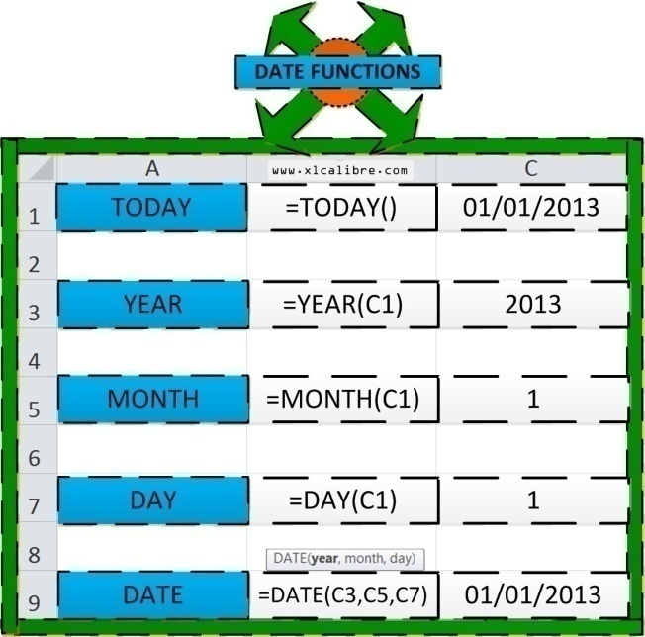
DATE FUNCTIONS
SYSDATE
CURRENT_TIMESTAMP
MONTHS_BETWEEN
SESSIONTIMEZONE

Slide 89
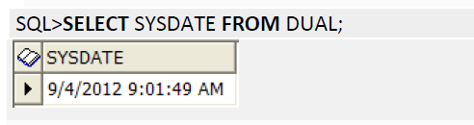
SYSDATE
The function will give system date
Example: Select sysdate from Dual;

Slide 90
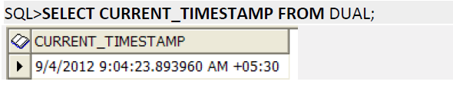
CURRENT_TIMESTAMP
This will returns current timestamp with the active time zone information.
Example : Select current_timestamp from Dual;

Slide 91
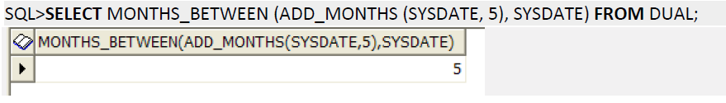
MONTHS_BETWEEN
This will give difference of months between two dates
Example: select months_between(sysdate , hiredate) from emp;

Slide 92
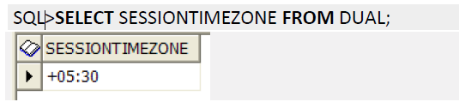
SESSIONTIMEZONE
This will returns the value of current session time zone
Example: Select sessiontimezone from dual;

Slide 93

CONVERSION FUNCTIONS
TYPES:
TO_NUMBER
TO_CHAR
TO_DATE

Slide 94
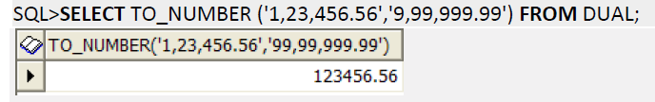
TO_NUMBER
To_Number will convert a char or varchar into number
SQL>TO_NUMBER (CHAR, [format]);

Slide 95
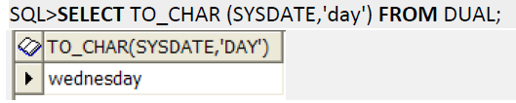
TO_CHAR
TO Char function will convert a number or date to character string.

Slide 96
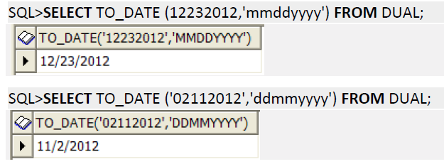
TO_DATE
To date function will convert a char or varchar value into date value.
Syntax: – TO_DATE (char, [format])

Slide 97
GROUP FUNCTIONS
SUM
AVG
MIN
MAX
COUNT

Slide 98
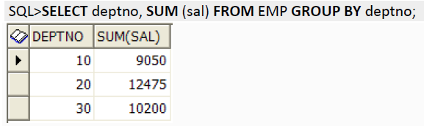
SUM
This will give sum of the values to the specified column
Example:
Select deptno,sum(sal) from emp Group by deptno;

Slide 99
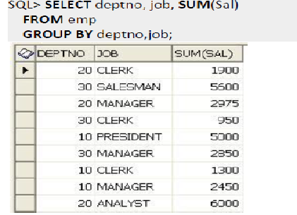
Group By

Slide 100
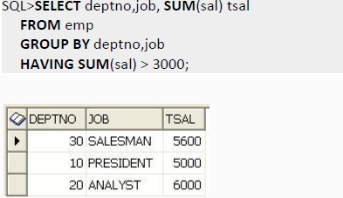
Group By With Having

Slide 101
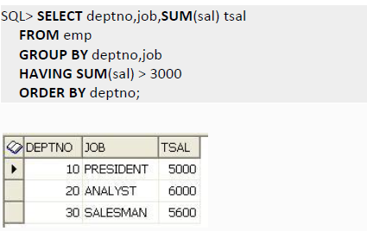
Group By With Having and Order By

Slide 102
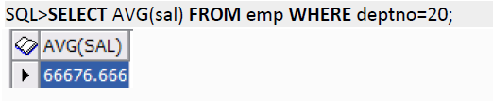
AVG
This will give average value
Example: select avg(sal) from deptno=20;

Slide 103
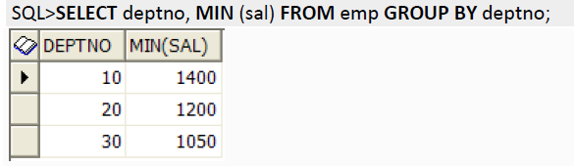
MIN
This will give min values of specified column
Example: select deptno,min(sal) from emp group by deptno;

Slide 104
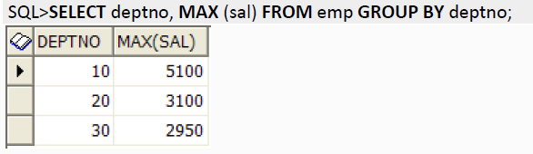
MAX
This will give maximum values of specified column
Example: select deptno,max(sal) from emp group by deptno;

Slide 105
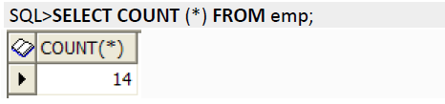
COUNT
This will give count of the values of the specified column
Example: select deptno,count(*) from emp group by deptno;

Slide 106
Questions :
Replace ‘indian’ into ‘xadxaa’ in the following which function I have to choose?
Replace
Translate
Retrieve unique values in one specific column so which function I have to select of the following?
Count
Distinct

Slide 107
3) We use TO_DATE to Convert char into date ?(True/false)
4) Which of the following is used to Get highest value ?
Sum
Max
5) In the following which function will give greater value?
Ceil
Floor

Slide 108
OPERATORS
RELATIONAL
(=,<,>,!=,^=,<>,in,between,like)
LOGICAL
(AND,OR,NOT)
ARITHMATIC
(*,/,+,-)

Slide 109
SUB QUERIES
A sub query is a SELECT statement which is embedded in another SELECT statement .
Sub queries are very useful to achieve complex requirements.
We can write a sub query in any part of the select statement.

Slide 110
TYPES OF SUB QUERIES
SINGLE ROW
MULTI ROW
CORELATED SUBQUERIES
NESTED SUB QUERIES

Slide 111
SINGLE ROW:
Single row sub query is a sub query which will return only one value.
SELECT * FROM emp
WHERE sal > (SELECT sal FROM emp WHERE empno = 7566);

Slide 112
MULTI ROW:
Multi row sub query is a sub query which will return more than one value. In such cases we should include operators like ‘ANY, ALL, IN or NOT IN’ along with the sub query
ANY:
SELECT * FROM emp
WHERE sal > ANY (SELECT sal FROM emp WHERE sal BETWEEN 2500 AND 4000);

Slide 113
ANY:
SELECT * FROM emp
WHERE sal > ANY (SELECT sal FROM emp WHERE sal BETWEEN 2500 AND 4000);
Empno | Ename | Deptno | Sal
1 | Sam | 10 | 2800
2 | Jack | 10 | 1500
3 | Clark | 20 | 3000
4 | King | 30 | 3500
5 | Smith | 40 | 4500
6 | Jones | 20 | 5000
7 | James | 30 | 4000
OUTPUT
Sal
2800
3000
3500
4000
3000
3500
4500
5000
4000

Slide 114
ALL:
SELECT * FROM emp
WHERE sal > ALL (SELECT sal FROM emp WHERE sal BETWEEN 2500 AND 4000);
Empno | Ename | Deptno | Sal
1 | Sam | 10 | 2800
2 | Jack | 10 | 1500
3 | Clark | 20 | 3000
4 | King | 30 | 3500
5 | Smith | 40 | 4500
6 | Jones | 20 | 5000
7 | James | 30 | 4000
OUTPUT
Sal
2800
3000
3500
4000
4500
5000

Slide 115
IN:
SELECT * FROM emp
WHERE sal IN ( SELECT sal FROM emp WHERE sal BETWEEN 2500 AND 4000)
Empno | Ename | Deptno | Sal
1 | Sam | 10 | 2800
2 | Jack | 10 | 1500
3 | Clark | 20 | 3000
4 | King | 30 | 3500
5 | Smith | 40 | 4500
6 | Jones | 20 | 5000
7 | James | 30 | 4000
OUTPUT
Sal
2800
3000
3500
4000
2800
3000
3500
4000

Slide 116
CORELATED SUB QUERIES:
A sub query is called correlated sub query if the sub query has a relation with the parent query.
SELECT * FROM IBM WHERE SAL>(SELECT SAL FROM WIPRO WHERE IBM.SAL>=WIPRO.SAL;
SELECT D.* FROM DEPT D WHERE EXISTS(SELECT E.EMPNO FROM EMP E WHERE E.DEPTNO=D.DEPTNO);

Slide 117
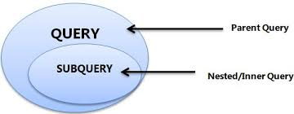
NESTED SUB QUERIES:
A query with in a Sub-Query is nothing but Nested Sub Query.
To achieve complex requirements we will keep adding sub queries, resulting in nested structure.
Notes:
In sub queries the inner query will execute first later outer query
SELECT * FROM emp WHERE sal = ( SELECT MAX (sal) FROM emp WHERE sal < ( SELECT MAX (sal) FROM EMP));
In this query
SELECT MAX (sal) FROM EMP -------- it prints max sal from the emp table
SELECT MAX (sal) FROM emp WHERE sal < ------this query compare with max sal and print all less salaries then the max sal and it takes max sal from remaining salaries so we will get second highest salary
SELECT * FROM emp WHERE sal =----- it prints all the details of the second highest salary employee

Slide 118
EXAMPLE:
Display the second highest salary in emp table
SELECT * FROM emp WHERE sal =
( SELECT MAX (sal) FROM emp WHERE sal <
( SELECT MAX (sal) FROM EMP));

Slide 119
SUB QUERY IN SELECT CLAUSE
Sub-Query in SELECT clause is nothing but providing SELECT statement in the place of column name.
Sub query in SELECT should always return one value.
SELECT empno, ename, sal, (SELECT MAX (sal) FROM emp) maxsal FROM emp;

Slide 120
SUB QUERY IN FROM CLAUSE
In the FROM clause of the SELECT statement we specify tables or views as data sources.
SELECT ename, sal, rownum rank
FROM (SELECT * FROM emp ORDER BY sal);

Slide 121
SUB QUERY IN WHERE CLAUSE
Sub-Query in WHERE clause is basically used for conditions. i.e. if a condition has to be driven based on a value retrieved by query then we use sub query in where clause.
SELECT empno, ename, sal, deptno FROM emp WHERE deptno IN(SELECT deptno FROM dept WHERE loc=’CHICAGO’);

Slide 122
Questions :
In Single row sub query inner query will returns single value? (True/False)
Which of the following sub query has a relation between inner query and outer query?
Nested sub query
Co-related sub query

Slide 123
3) Multi row sub query output returns always multiple values?
True
False
How many SELECT clauses we can use in Nested sub query?
2
3
More than 3

Slide 124


INDEXES
INDEX is a pointer locates the physical address of data.
We will be creating indexes explicitly to speed up SQL statement execution on a table.
Indexes can be created on a single column or a group of columns.
Notes:
Index gives speed up to select statement execution in table
Index is like content of book
When there are thousands of records in a table, retrieving information will have performance issue. Therefore indexes are created on columns which are accessed frequently, so that the information can be retrieved quickly.

Slide 125
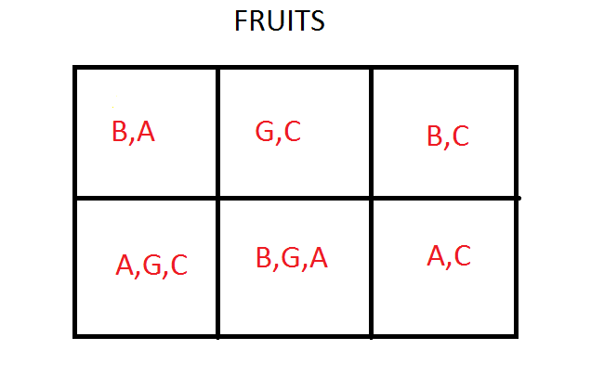
EXAMPLE: FRUITS TABLE

Slide 126

EXAMPLE: FRUITS TABLE
INDEX CREATED

Slide 127
TYPES OF INDEXES
Unique index
Non-unique index
Composite index
Function based index

Slide 128
Unique index
Unique index is also a part of indexes which guarantee that no two rows of a table have duplicate values in the columns that define the index.
It will not allow duplicate values.
Whenever we create unique index, internally unique constraint will get created and similarly when unique constraint is created unique index is created.

Slide 129
CREATE UNIQUE INDEX loc_uniq_deptno ON dept (loc);
INSERT INTO dept VALUES (50,'TESTING','CHICAGO');
* ERROR at line 1:
ORA-00001: UNIQUE CONSTRAINT (APPS.NA_IDX) violated

Slide 130
For dropping index
Syntax:Drop index <index_name>;
Example:
DROP INDEX idx7;
--index dropped

Slide 131
Non-unique index
Non unique index does not impose any restrictions on column values.
NON Unique index- indexes duplicate values.
CREATE INDEX na_non_job ON emp (job);
--index created
Notes:
So when ever we use this index column (JOB) in “where” clause, index (na_non_job) will automatically activated.

Slide 132
Composite index
Composite index is an index created on multiple columns (It allows maximum 32 columns).
Columns in a composite index can appear in any order and need not be adjacent columns of the table.
CREATE INDEX na_comp_idx ON emp(hiredate, sal)
--index created

Slide 133
Function based index
Function based index is a index which is based on function instead of a column.
We use Function based index to improve performance whenever we have functions used in the SELECT and WHERE clause.
CREATE INDEX na_fbi_job ON emp (UPPER (job));
--index created

Slide 134
Example:
SELECT *FROM emp WHERE UPPER (job) =’MANAGER’;
We can not create index by using more than one function.
DROP INDEX idx4;
--index dropped

Slide 135
Questions:
Which constraint will automatically created when we use Unique index?
Primary key
Unique key
How many functions we can use in function based index?
1
2
More than 2

Slide 136
3) How many columns can have same index?
128
32
64
None of these
Non – unique index allows duplicate values?
True
False

Slide 137
SYNONYMS
A synonym is a database object, which is used as an alias for a table, view or sequence.
Synonym basically allows us to create a pointer to an object that exists in different schema.
Notes:
• A Synonym acts as an alternative name for an existing schema object.
By using a Synonym, we can avoid the entry of the schema name, when referencing objects that belong together schema.

Slide 138
TYPES OF SYNONYMS
Public
Private
Syntax :
create [public]synonym syn_name for scott.emp;

Slide 139
PUBLIC SYNONYMS
Private synonym is available to the particular user who creates.
Public synonym is created by DBA which is available to all the users.
Advantages:-
Hide the name and owner of the object.
Provides location transparency for remote objects of a distributed database.

Slide 140
Example:
CREATE PUBLIC SYNONYM na_pub_emp FOR scott.emp;
--synonym created
GRANT ALL ON na_pub_emp TO user1;
conn user1/user1
SELECT * FROM na_pub_emp;
DROP PUBLIC SYNONYM emp_syn;

Slide 141
PRIVATE SYNONYM
Private synonym is a synonym that is available to the particular user who creates it.
To create a private synonym in our own schema, we must have the CREATE SYNONYM system privilege.
Private synonym is specific to the user.

Slide 142
GRANT CREATE SYNONYM TO username; //as as admin
conn user1/user1@vis;
--connected
SELECT * FROM scott.emp;
--Table will display
CREATE SYNONYM na_emp FOR scott.emp;
--synonym created

Slide 143
CREATE SYNONYM na_emp FOR scott.emp;
--synonym created
SELECT * FROM na_emp;
--Table will display’s
Drop synonym:
DROP SYNONYM na_emp;
--synonym dropped

Slide 144

SEQUENCE
Sequence is a Schema or Database Object that can generate UNIQUE Sequential Values.
Can be used to generate PRIMARY KEY values automatically.
SEQUENCE can be either incremented or decremented Sequence.

Slide 145
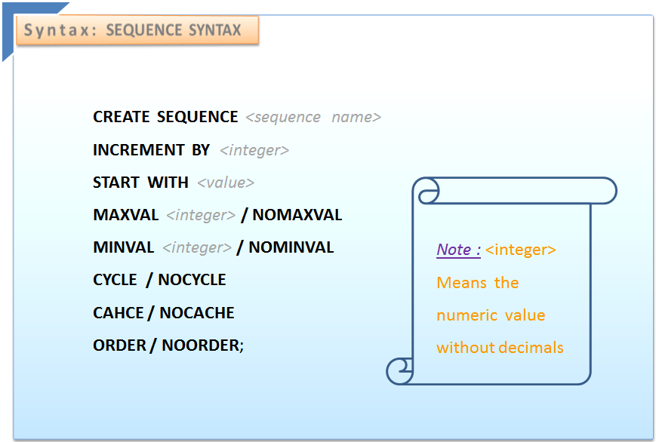
CREATING SEQUENCE

Slide 146
By default the sequence starts with 1, increments by 1 with minvalue of 1 and with nocycle, nocache.
MINVAL clause:-
Specifies the sequences minimum value.
MAXVAL clause:-
Specifies the maximum value that can be generated.

Slide 147
CYCLE clause:-
Specifies the sequence, will continue to generate values after reaching either maximum value.
NOCYCLE clause:-
Specifies the sequence cannot generate more values after the targeted limit.

Slide 148
CACHE clause:-
Specifies the pre-allocation of sequence numbers, the minimum is 2.
NOCACHE clause:-
Specifies the values of sequence are not pre-allocated.

Slide 149
ORDER clause:-
Guarantees the sequence number to be generated in the order of request.
NOORDER clause:-
Does not guarantee the sequence number with order.

Slide 150
CREATE SEQUENCE sampleseq
INCREMENT BY 1
START WITH 0
MINVALUE 0
MAXVALUE 10
NOCACHE
NOCYCLE;
--sequence created

Slide 151
After the creation of sequence, it generates sequential numbers for use in our tables. Reference the sequence values by using the NEXTVAL and CURRVAL Pseudo columns.

Slide 152
NEXTVAL-
When we call ’sequencename.NEXTVAL’ , a new sequence number is generated and displayed.
If we run it again then next value will be generated.
CURRVAL-
It is used to refer to a sequence number that the current session has just generated Or the current value that sequence holds.

Slide 153

CREATE TABLE seq_tab (empno NUMBER(10),ename varchar2(10));
-- Table created
INSERT INTO seq_tab
VALUES (sampleseq.NEXTVAL,'CAMERON');
-- 1 row inserted
SELECT *FROM seq_tab;
--

Slide 154


INSERT INTO seq_tab VALUES (sampleseq.NEXTVAL,'JOHN');
--1 row inserted
SELECT *FROM seq_tab;
SELECT sampleseq.CURRVAL FROM dual;

Slide 155
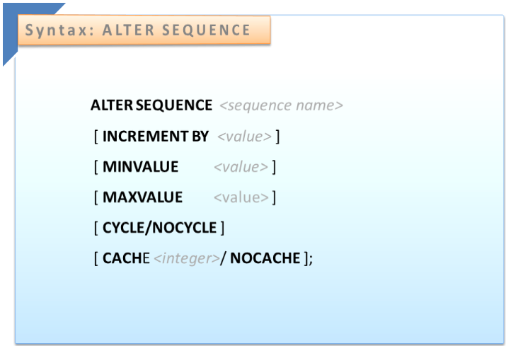
ALTERING SEQUENCE
Set or eliminate minvalue or maxvalue.
Change the increment value.
Change the number of cached sequence numbers

Slide 156
ALTER SEQUENCE sampleseq</code>
MAXVAL 10
CACHE
NOCYCLE;
Drop sequence:
DROP SEQUENCE sampleseq ;

Slide 157
VIEWING THE SEQUENCES CREATED
The following tables lists all the Sequences which are created by the users.
DBA_SEQUENCES
ALL_SEQUENCES
USER_SEQUENCES
Example:
SELECT * FROM USER_SEQUENCES;

Slide 158
Questions :
1. DBA cannot create private synonym?
True
False
2. Can we retrieve database object from different schema?
Yes
No

Slide 159
3. How we can get the current value that sequence hold?
PRESENTVAL
CURRVAL
NEXTVAL
4. By default sequence starts with ?
0
1

Slide 160

VIEW
A view is a logical representation of the data.
View does not have storage of its own.
View can be used just like a table in SELECT statement.
A view can be considered as a virtual table.

Slide 161
WHY VIEWS?
Provides additional level of security by restricting access to a predetermined set of rows and/or columns of a table.
Hide the data complexity.

Slide 162
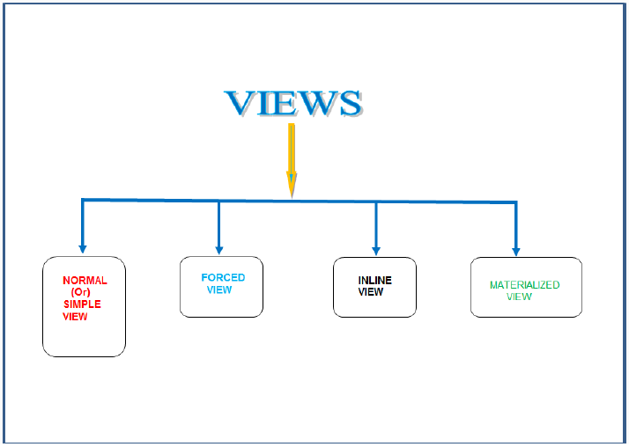
TYPES OF VIEWS
We have two types of views:
1) Normal / Simple View
2) Forced View
3) complex View

Slide 163
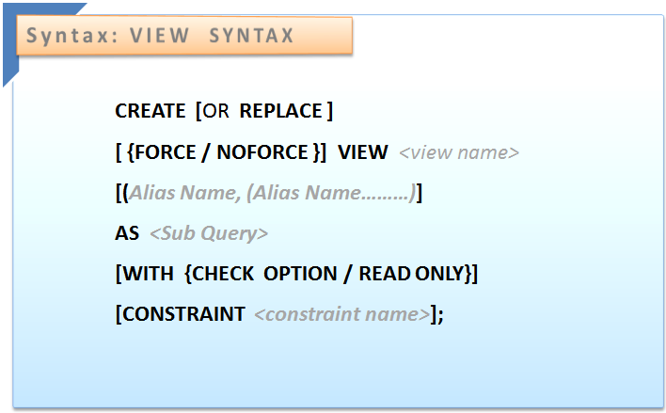
SYNTAX FOR CREATING VIEW

Slide 164
SIMPLE VIEW
Simple view is the view that is created based on a single table.
A Simple View is the one that:
Derives data from only one table.
Contains no functions or groups of data.
Can perform DML operations through the view.

Slide 165
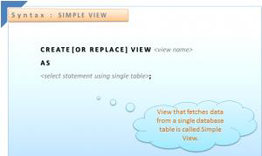
CREATE OR REPLACE VIEW na_emp_v AS SELECT * FROM emp;
--view is created

Slide 166
COMPLEX VIEW
Derives data from many tables.
Contains functions or groups of data.
Does not allow DML operations directly.

Slide 167
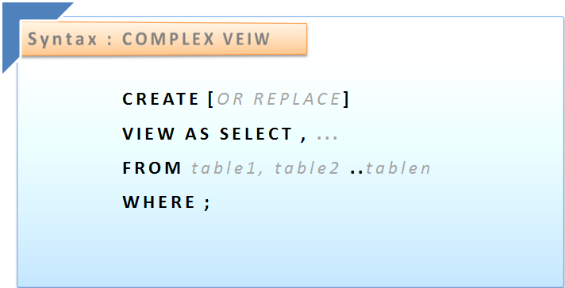
SYNTAX FOR COMPLEX VIEW

Slide 168
CREATING COMPLEX VIEW
CREATE OR REPALCE VIEW na_emp_v AS
SELECT e.empno, e.ename, e.sal, e.deptno, d.dname, d.loc
FROM emp e,dept d
WHERE e.deptno = d.deptno;

Slide 169
FORCE VIEW
A view can be created even if the defining query of the view cannot be executed. We call such a view as view with errors.
if a view refers to a non-existent table or an invalid column of an existing table
We can create such views by using the FORCE option in the CREATE VIEW command:

Slide 170
CREATING FORCE VIEW
CREATE OR REPLACE FORCE VIEW na_view
AS SELECT * FROM dummy_table;
-- Warning: View created with compilation errors.
The advantage of force view is that in future if view script becomes valid, we can start using the view.
DROP VIEW view_name;
--index dropped

Slide 171
Questions :
1. View is stored like database object in database?
Yes
No
2. View can be create only on one table ?
True
False

Slide 172
3. Which of the following we can perform?
Drop view
Alter view
Both a and b
4. Which type of View can created with compilation errors?
Inline view
Force view

Slide 173
THANKS & REGARDS

