Slide 1
How to start your NLP journey…
Maciej Kowalski

Slide 2
Resources
Google account (every google account has access to Colab environment),
spinaker-nlp-notebook.ipynb
Additional resources on github: https://github.com/dotjabber/spinaker-nlp

Slide 3
What is NLP?
NLP stands for Natural Language Processing and it is related to processing information written in natural language. It joins the topics of artificial inteligence, text analysis, translation and generation.

Slide 4
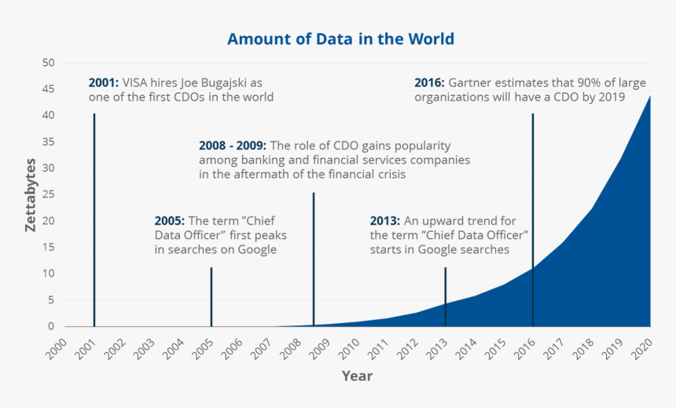
But why?
Lots of textual data and the need
to process it,
We can count a lot faster than in
XX century. Can we read faster?

Slide 5
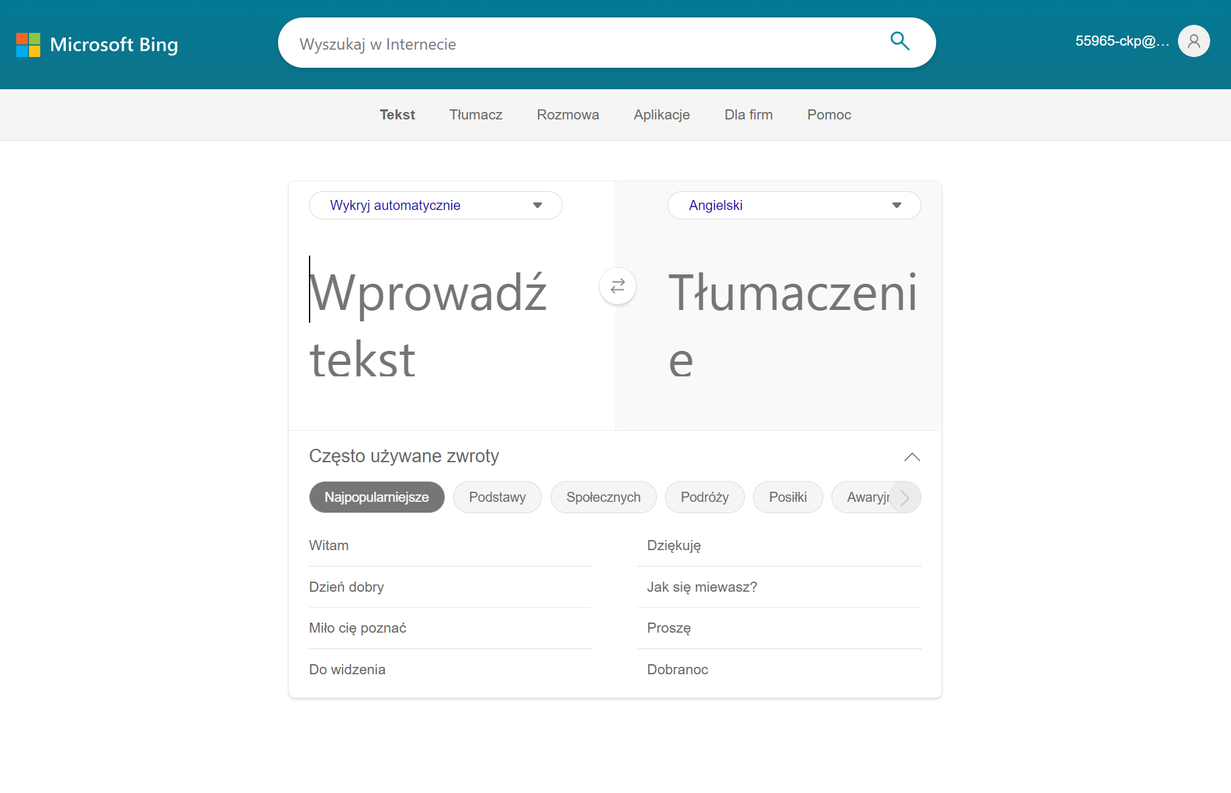
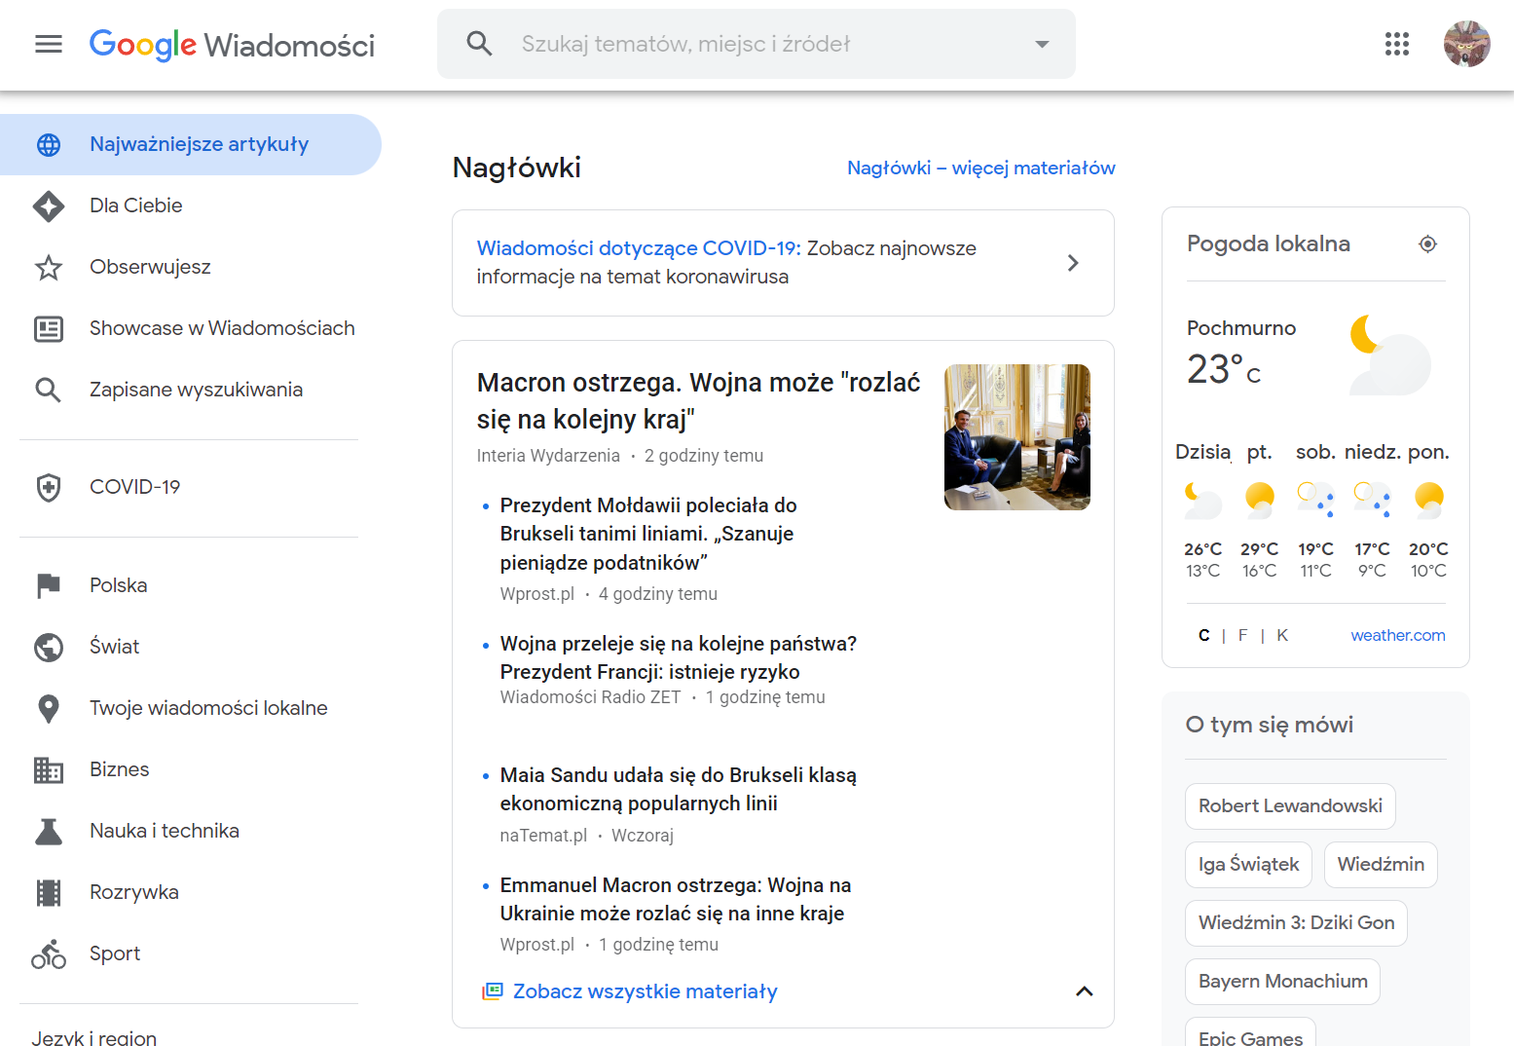

Examples?
Sure ☺

Slide 6
Component: Stemming/Lemmatization
Lexem / Lemma - designation of all inflectional forms of a given word / basic form of the lexeme.
Stemming - automatic finding of word roots. Most stemmers do not ensure that the strings they create are roots - but this is not essential, as long as we get the same root for all the words belonging to a given lexeme.

Slide 7
Component: PoS tagging
Linguistics groups words into sets according to their similar behavior in sentences (syntax) and similar morphological features Names - parts of speech (PoS), syntactic categories, grammatical-lexical categories, etc.
noun - description of things (objects, concepts, etc.)
verb - description of action
adjective - description of the features of nouns

Slide 8
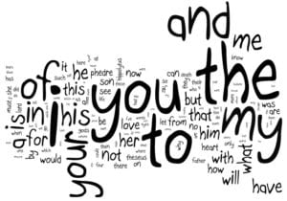
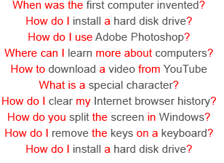
Component: Stop-words
Are there words with little or no information?
https://en.wikipedia.org/wiki/Stop_word
https://webstrategies.com/stop-words-everything-you-should-know/

Slide 9
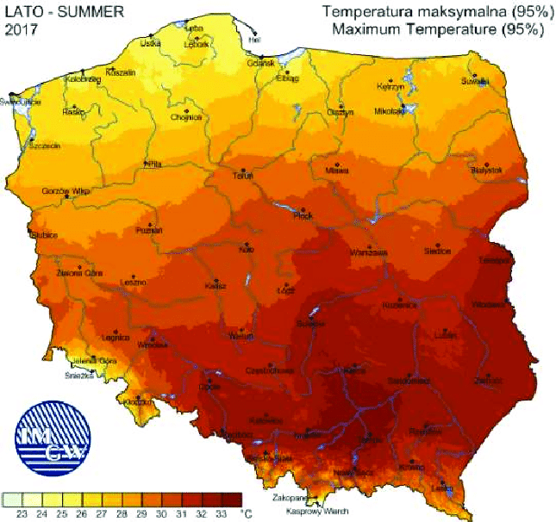
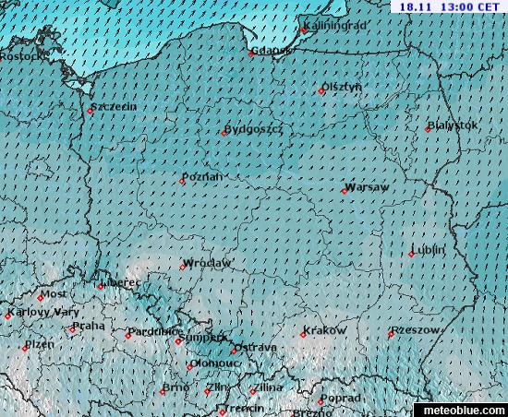
Component: Vectors

Slide 10
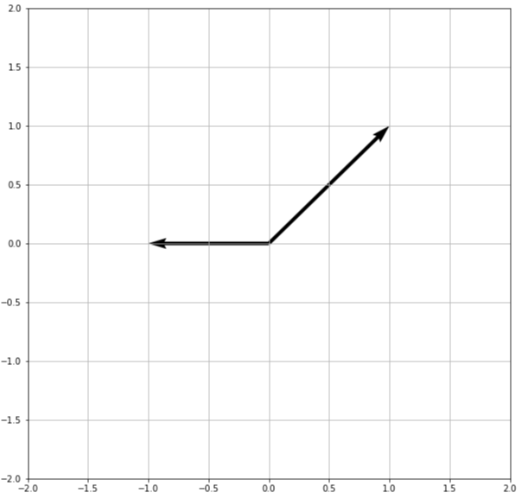
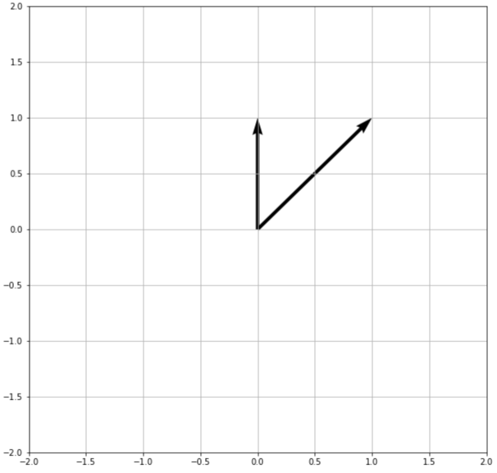
How does a computer calculate simmilarity?

Slide 11
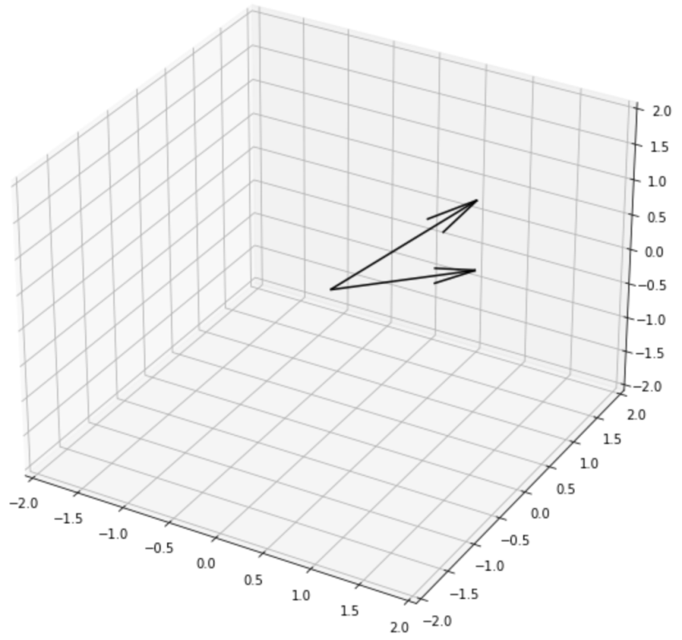
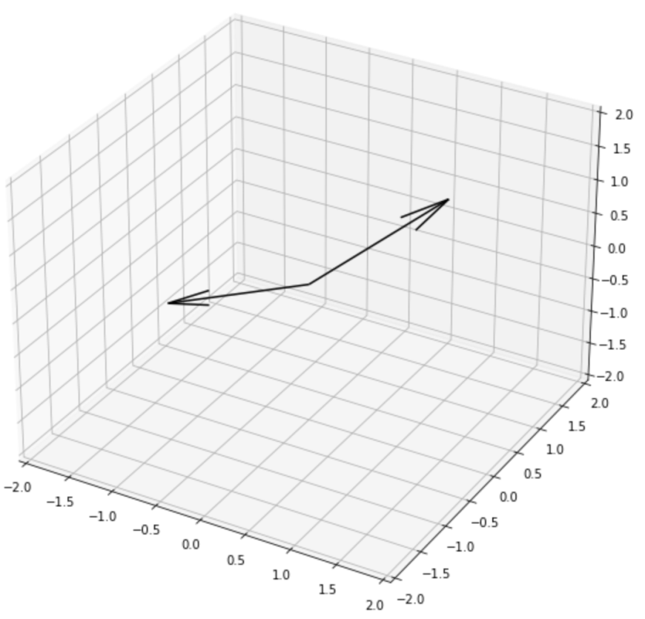
How does a computer calculate simmilarity?

Slide 12
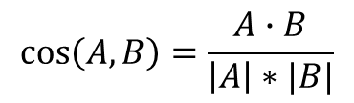
Distances…
Manhattan, Euclidean
Cosine
B
B
A
A
^A
^B
$$cos\left(A, B\right)=\frac{A∙B}{\left|A\right|∗|B|}$$

Slide 13
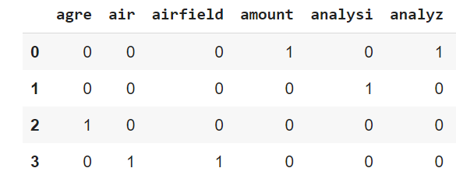
OK, but why do we need that?
Natural language processing (NLP) is a subfield of linguistics, computer science, and artificial intelligence concerned with the interactions between computers and human language, in particular how to program computers to process and analyze large amounts of natural language data. The goal is a computer capable of "understanding" the contents of documents, including the contextual nuances of the language within them.
Natural-language understanding (NLU) or natural-language interpretation (NLI) is a subtopic of natural-language processing in artificial intelligence that deals with machine reading comprehension. Natural-language understanding is considered an AI-hard problem. There is considerable commercial interest in the field because of its application to automated reasoning, machine translation, question answering, news-gathering, text categorization, voice-activation, archiving, and large-scale content analysis.
Natural language generation (NLG) is a software process that produces natural language output. While it is widely agreed that the output of any NLG process is text, there is some disagreement on whether the inputs of an NLG system need to be non-linguistic. Common applications of NLG methods include the production of various reports, for example weather and patient reports image captions and chatbots.
The Battle of Heraklion was fought during World War II on the island of Crete between 20 and 29 May 1941. British, Australian and Greek forces defended the port and the airfield of Heraklion against a German paratrooper attack. The German assault was launched without direct air support and drops occurred over several hours rather than simultaneously.
Term Document Matrix (TDM)

Slide 14
… I’m listening…
world
[goodbye, world]
[helo, world]
goodbye
helo
simmilarity = cos([helo, world], [goodbye, world])

Slide 15
Let’s compare
D1 = "Natural language processing (NLP) is a subfield of linguistics, computer science, and artificial intelligence concerned with the interactions between computers and human language…”
D2 = "Natural-language understanding (NLU) or natural-language interpretation (NLI) is a subtopic of natural-language processing in artificial intelligence that deals with machine reading comprehension…."
D3 = "Natural language generation (NLG) is a software process that produces natural language output. While it is widely agreed that the output of any NLG process is text, there is some disagreement on whether the inputs…
D4 = "The Battle of Heraklion was fought during World War II on the island of Crete between 20 and 29 May 1941. British, Australian and Greek forces defended the port and the airfield of Heraklion ...."
cos(D1, D2) = 0.1479
cos(D1, D3) = 0.2767
cos(D1, D4) = 0.0

Slide 16
And that is NLP in action ☺
Having a dictionary (list of words used among documents, preferably stemmed/lemmatized), one can encode a document in vector form,
Such vectors can be compared.

Slide 17
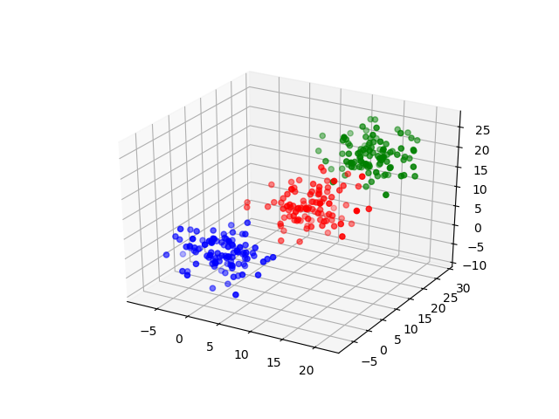
Grouping
Having been able to measure distance between vectors, we can group tchem -> K-Means ☺

Slide 18
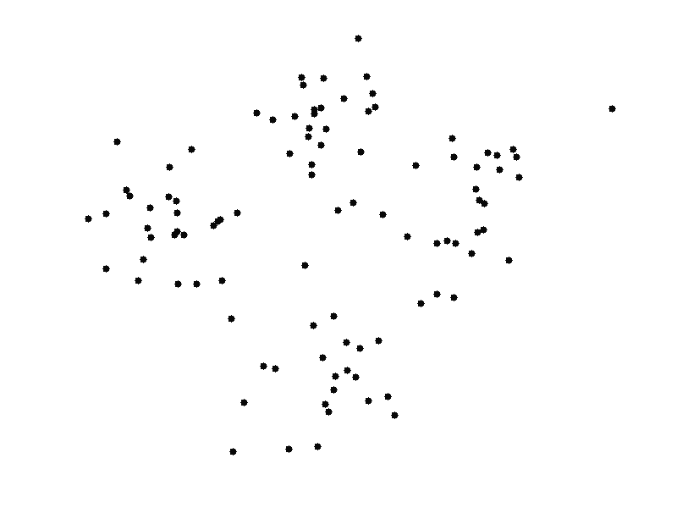
K-Means
http://shabal.in/visuals/kmeans/3.html

Slide 19
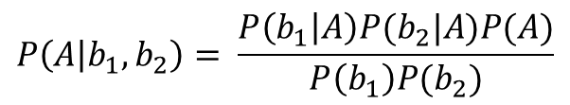
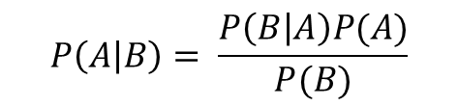
Anything more, that is simple?
Sure ☺
$$P\left(A | B\right)= \frac{P\left(B | A\right)P(A)}{P(B)}$$
$$P\left(A | b_{1},b_{2}\right)= \frac{P\left(b_{1} | A\right)P(b_{2}|A)P(A)}{P\left(b_{1}\right)P(b_{2})}$$
Outlook | Temperature | Humidity | Windy | Play Golf
Rainy | Hot | High | False | N
Rainy | Hot | High | True | N
Overcast | Hot | High | False | Y
Sunny | Mild | High | False | Y
Sunny | Cool | Normal | False | Y
Sunny | Cool | Normal | True | N
Overcast | Cool | Normal | True | Y
Rainy | Mild | High | False | N
Rainy | Cool | Normal | False | Y
Sunny | Mild | Normal | False | Y
Rainy | Mild | Normal | True | ???
Overcast | Mild | High | True | Y
Overcast | Hot | Normal | False | Y
Sunny | Mild | High | True | N

Slide 20
I know, math… but simple!
Outlook | Y | N | P(Y) | P(N)
Sunny | 3 | 2 | 3/8 | 2/5
Overcast | 4 | 0 | 4/8 | 0/5
Rainy | 1 | 3 | 1/8 | 3/5
Suma | 8 | 5 | 1 | 1
Temperature | Y | N | P(Y) | P(N)
Hot | 2 | 2 | 2/8 | 2/5
Mild | 3 | 2 | 3/8 | 2/5
Cold | 3 | 1 | 3/8 | 1/5
Suma | 8 | 5 | 1 | 1
Humidity | Y | N | P(Y) | P(N)
High | 3 | 4 | 3/8 | 4/5
Normal | 5 | 1 | 5/8 | 1/5
Suma | 8 | 5 | 1 | 1
Windy | Y | N | P(Y) | P(N)
True | 2 | 3 | 2/8 | 3/5
False | 6 | 2 | 6/8 | 2/5
Suma | 8 | 5 | 1 | 1
Golf? | # | P
Y | 8 | 8/13
N | 5 | 5/13
Suma | 13 | 1

Slide 21
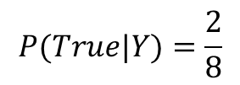
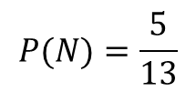
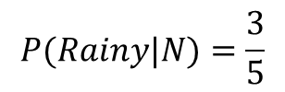
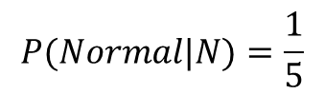
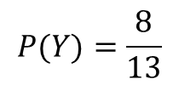
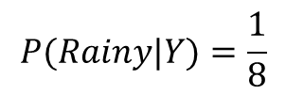
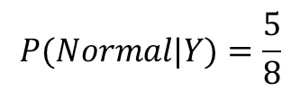
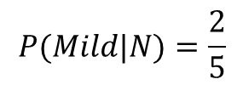
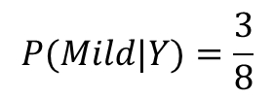
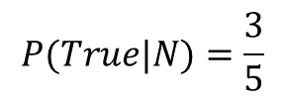
You will hate me for that ☺
Outlook | Temperature | Humidity | Windy | Play Golf
Rainy | Mild | Normal | True | ???
$$P(Rainy|Y)=\frac{1}{8}$$
$$P(Mild|Y)=\frac{3}{8}$$
$$P(Normal|Y)=\frac{5}{8}$$
$$P(True|Y)=\frac{2}{8}$$
$$P(Rainy|N)=\frac{3}{5}$$
$$P(Mild|N)=\frac{2}{5}$$
$$P(Normal|N)=\frac{1}{5}$$
$$P(True|N)=\frac{3}{5}$$
$$P(Y)=\frac{8}{13}$$
$$P(N)=\frac{5}{13}$$
$$P\left(Y | Rainy,Mild,Normal,True \right)\tilde{=}P\left(Rainy | Y\right)P\left(Mild | Y\right)P\left(Normal | Y\right)P\left(True | Y\right)P(Y)$$
$$P\left(N | Rainy,Mild,Normal,True \right)\tilde{=}P\left(Rainy | N\right)P\left(Mild | N\right)P\left(Normal | N\right)P\left(True | N\right)P(N)$$
$$P\left(Y | Rainy,Mild,Normal,True \right)\tilde{=}\frac{1}{8}∗\frac{3}{8}∗\frac{5}{8}∗\frac{2}{8}∗\frac{8}{13}=0,00451$$
$$P\left(N | Rainy,Mild,Normal,True \right)\tilde{=}\frac{3}{5}∗\frac{2}{5}∗\frac{1}{5}∗\frac{3}{5}∗\frac{5}{13}=0,01108$$

Slide 22
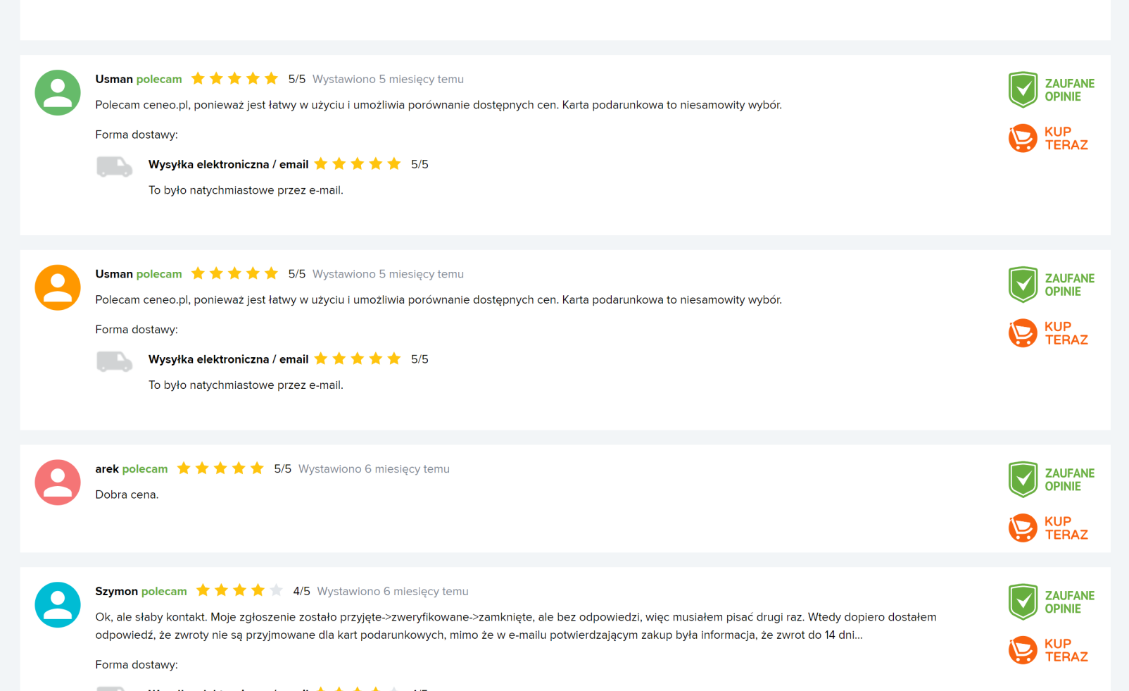
What does it have to do with NLP?

Slide 23

NLP

