Slide 1
Programming Lab0
2017-09-12

Slide 2
Notice in laboratory How to use FTP in SS How to use elearning How to send and receive e-mail

Slide 3
Notice
1. No eating.
2. No strangers.
3. Do not move your computer.
4. Do not set password on your computer.

Slide 4
How to use FTP
Used for…
Release labs and projects
Submit all your uploads
How to link to FTP
client FileZilla
File folder in Windows
FTP address for us
ftp://10.132.141.33 for all major classes
ftp://10.132.141.33/classes/17/171 程序设计A(戴开宇)
Username/password: student number
The File Transfer Protocol (FTP) is a standard network protocol used to transfer computer files from one host to another host over a TCP-based network, such as the Internet.

Slide 5
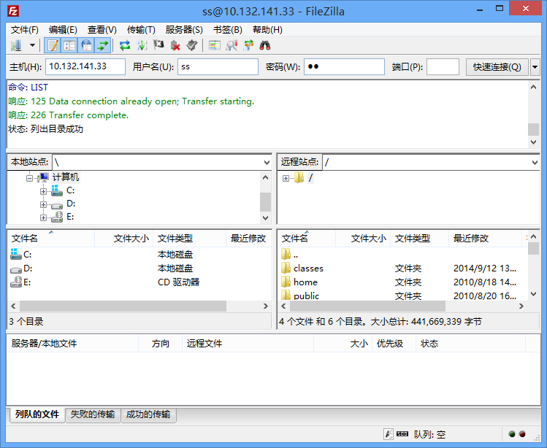
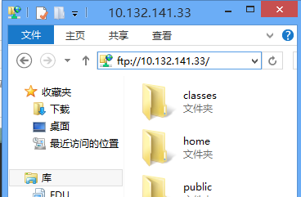
Two ways to link to FTP
FileZilla
File folder in Windows

Slide 6
How to use elearning
Used for…
Release lectures
Elearning address
http://elearning.fudan.edu.cn/

Slide 7
How to send and receive e-mail
http://mail.fudan.edu.cn/

Slide 8
Homework
Send an e-mail to two teaching assistants.
14302010005@fudan.edu.cn
14302010040@fudan.edu.cn
Contents include but not limit to
Your expectation on TAs.
Your preferred projects.
…

