Slide 1


Introduction to
Robotic Process Automation
Online Food Ordering System
Roll No: 220701020
Name: Akash Narayan P
Mentor: Jinu Sophia J, M.E., (Ph.D)
Designation and Department: Assistant Professor, Computer Science and Engineering

Slide 2
Abstract
The "Online Food Ordering System" utilizes Robotic Process Automation (RPA) to streamline and automate the entire food ordering process, significantly reducing the need for manual intervention. The system offers flexibility by allowing users to order based on either food or restaurant preferences. Once the user selects their choice, the bot automatically navigates the Swiggy website, adds the selected items to the cart, and processes the payment using UPI. Following the successful payment, a confirmation email is sent to the user, and the order details are logged into a CSV file for future reference. This system enhances operational efficiency, ensures greater accuracy, and provides an improved user experience by automating repetitive tasks, ultimately saving time and minimizing human error.

Slide 3
Need for the Proposed System
Manual food ordering processes often involve multiple steps that are repetitive, time-consuming, and prone to human errors. These inefficiencies can lead to delays, incorrect orders, and inconsistent customer experiences. This project aims to overcome these challenges by automating the entire workflow, from order placement to payment processing and confirmation. By automating these processes, the system ensures faster and more accurate order fulfillment, reduces the chances of mistakes, and guarantees secure record-keeping. Ultimately, automation enhances the overall user experience, making it a vital tool for modern food delivery systems, increasing both efficiency and customer satisfaction.

Slide 4
Advantages of the Proposed System
Efficiency: Faster and error-free order processing.
Convenience: Simplifies food ordering with minimal user effort.
Accuracy: Ensures accurate payment processing and record storage.
Scalability: Handles multiple orders efficiently without delays.
User Satisfaction: Improves the customer experience through streamlined operations.

Slide 5
Literature Survey
Efficiency and Time Reduction in online food ordering systems
Advantages
Automation of food ordering reduces the time spent on placing orders by up to 60%, ensuring faster user experiences.
Automated systems minimize human errors, leading to more consistent and accurate order placements.
Disadvantages
Over-reliance on automation might result in service disruptions during system failures.
Implementing RPA requires upfront investment and technical expertise, which can be challenging for smaller businesses.

Slide 6
Literature Survey
2) Automation tools for online food ordering
Advantages
UiPath offers robust features for automating repetitive tasks and handling complex workflows, making it a preferred tool among automation platforms.
UiPath’s RE Framework provides a modular design and strong exception handling, making it suitable for large-scale automation projects.
Disadvantages
Mastering UiPath’s advanced features and frameworks may require significant training and experience.
Implementing UiPath for large projects can be resource-intensive in terms of system requirements and costs.

Slide 7
Main Objective
The primary objective of the "Online Food Ordering System" project is to fully automate the food ordering process, providing a seamless, efficient, and error-free experience for users. By harnessing the capabilities of UiPath, this system enables customers to place orders based on either food or restaurant preferences, securely processes payments, and automatically sends confirmation emails. Furthermore, the system keeps a structured record of all orders in an Excel file, ensuring accuracy, minimizing human involvement, and maintaining consistency across all online food delivery transactions. This results in faster order fulfillment, reduced chances of errors, and improved customer satisfaction, making it a reliable solution for both users and food delivery services.

Slide 8
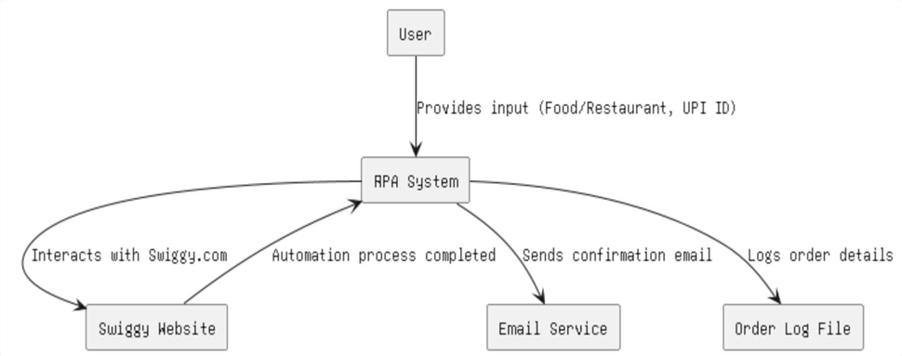
Architecture
The Architecture Diagram provides a high-level view of system’s structure and its components.

Slide 9
System Requirements
Hardware
Processor: Dual-core or above
RAM: Minimum 4 GB
Storage: 10 GB free space
Network: Reliable internet connection
Software
UiPath Studio
Browser (Google Chrome/Edge)
Swiggy website access
Email client (e.g., Gmail)
Microsoft Excel

Slide 10
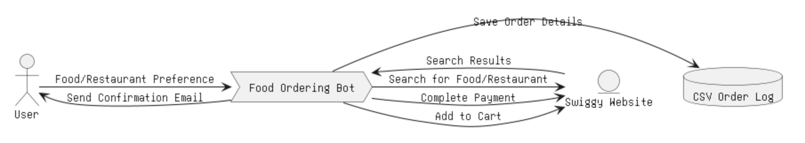
Functional Description
User Preference and Search Handling
This module illustrates the flow of data from the user input to the completion of the food order process. It includes steps like user preference input, searching on Swiggy, adding to the cart, and processing payments.

Slide 11
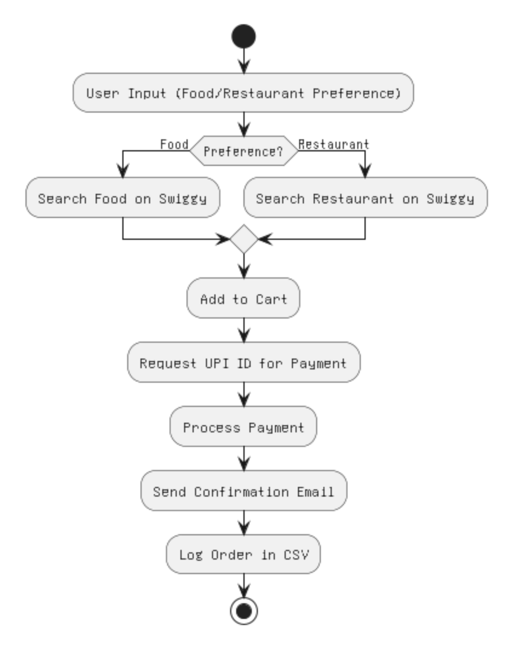
Functional Description
Automated Ordering Workflow
The activity diagram represents the sequence of operations, from user input to email confirmation and order logging.

Slide 12
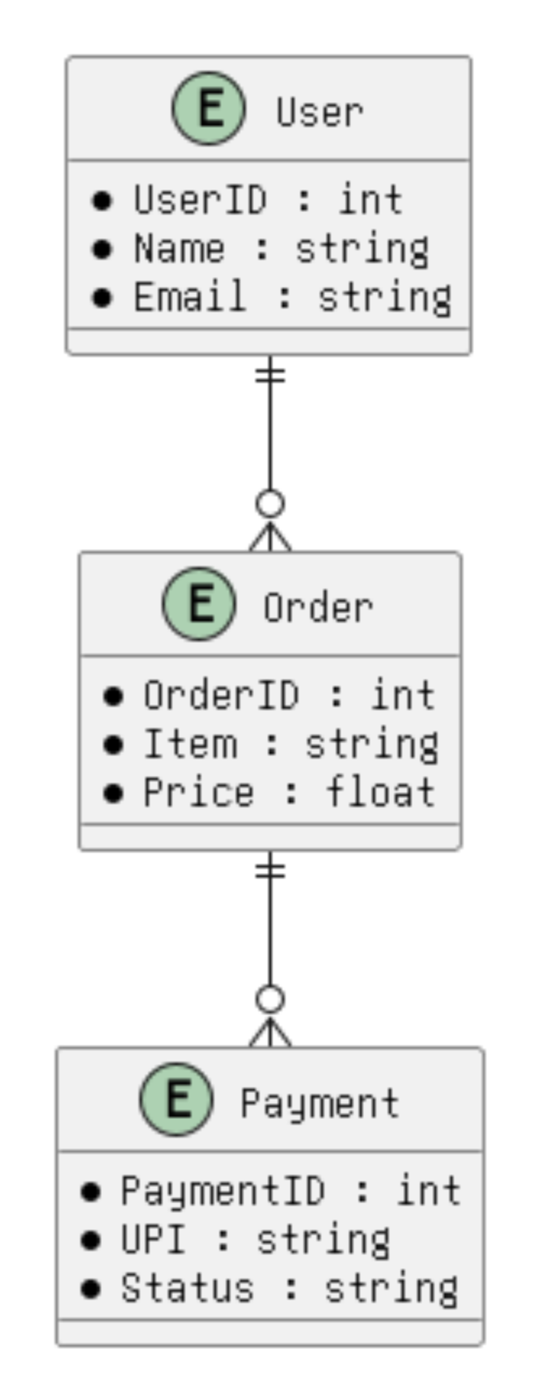
Entity Relationship Diagram
Represents the relationships between entities like Users, Orders, and Payment Details.

Slide 13
Process Design
Main Process
Input user preferences (food or restaurant).
Navigate Swiggy to locate items.
Add to cart and complete payment.
Sub Process
Save order details to a CSV file.
Send confirmation email.

Slide 14
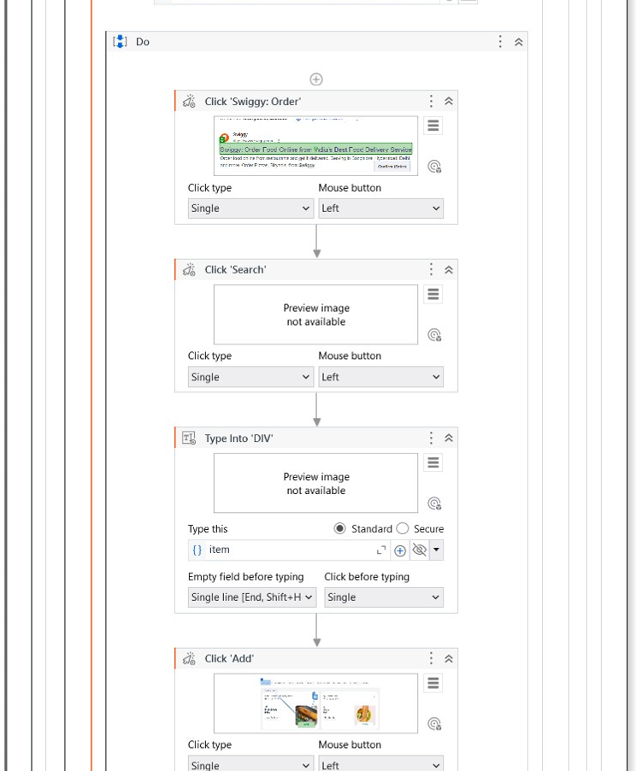
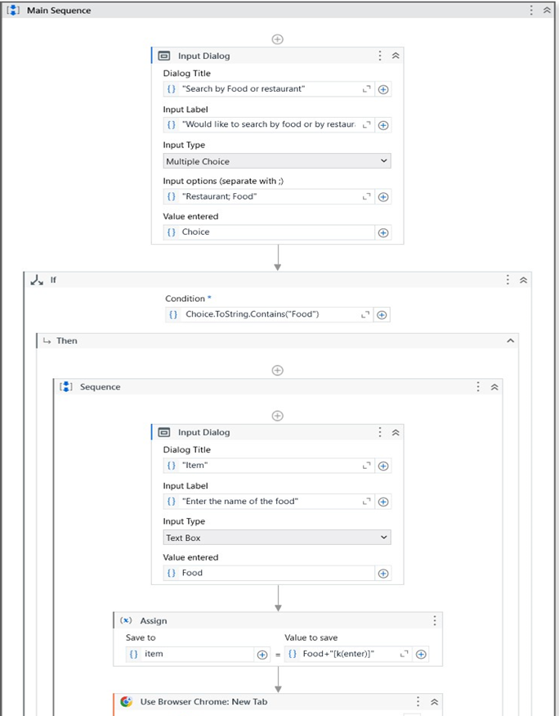
Implementation
Implementation of Module 1 (Search and Add to Cart)
Automates the browsing and searching of food/restaurants on Swiggy based on user input and adds selected items to the cart.

Slide 15
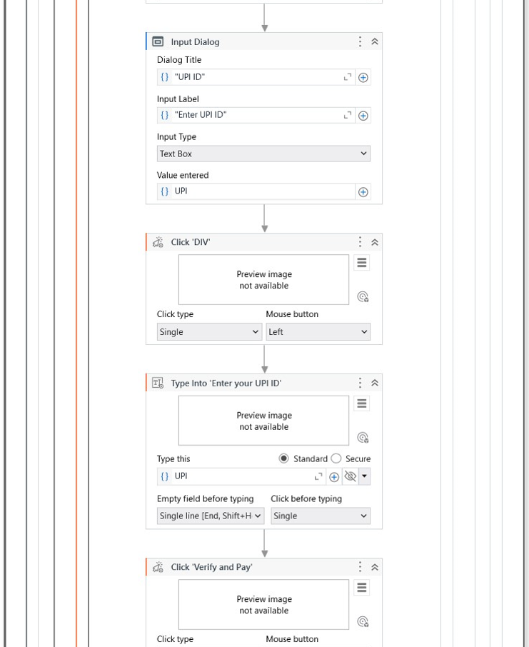
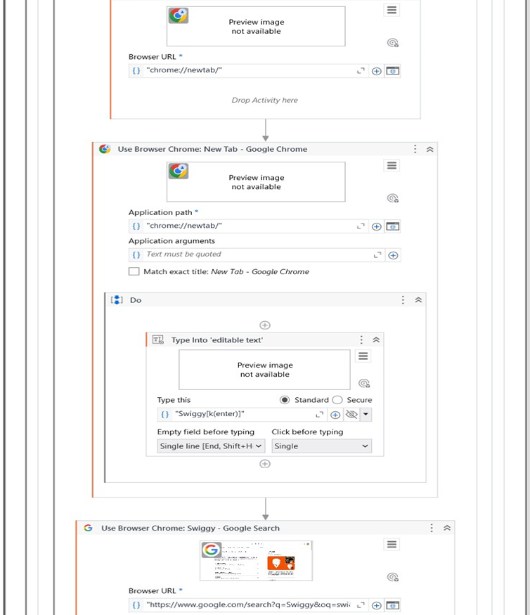
Implementation
Implementation of Module 2 (Payment and Confirmation)
Handles UPI payment, sends an email confirmation, and saves order details to a CSV file.

Slide 16
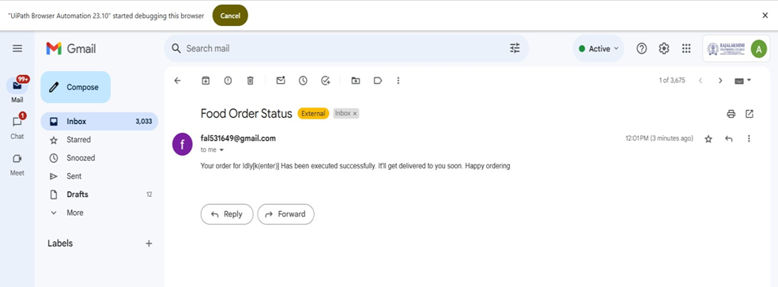
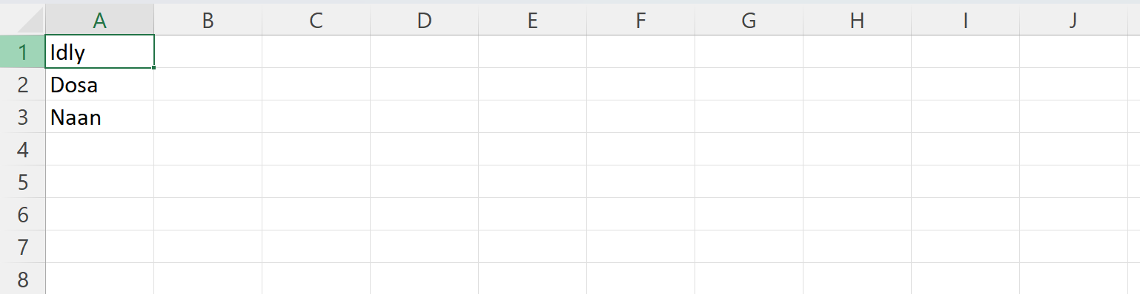
Testing
Testing involves verifying the accuracy of searches, payment processing, email notifications, and data logging. Functional and exception testing ensures the system works seamlessly, even with invalid inputs or network issues.

Slide 17
Conclusions
The automation of the Online Food Ordering System highlights the transformative potential of Robotic Process Automation (RPA) in streamlining routine tasks. By automating key steps like order placement, payment processing, and confirmation, the system significantly enhances operational efficiency while minimizing errors. The result is an improved customer experience, offering faster, more accurate service. Additionally, the solution's scalability ensures it can handle increased order volumes without compromising performance. This system serves as a reliable, cost-effective tool for modern food delivery services, ultimately improving both user satisfaction and operational effectiveness.

Slide 18
Future Enhancement
Multi-Platform Support
Expanding the system to support multiple food delivery platforms like Zomato or Uber Eats would enhance its utility. This feature would allow users to select their preferred platform and ensure the best deals or availability, improving customer satisfaction and flexibility.
Description 2
Incorporating voice recognition technology would enable hands-free operation. Users could provide their preferences via voice commands, making the system more accessible and user-friendly, especially for individuals with physical limitations or during multitasking.

Slide 19
IEEE Paper
Title: "Foody - Smart Restaurant Management and Ordering System"
Authors: IEEE Xplore
Link: https://ieeexplore.ieee.org/document/8629835

Slide 20
References
Journals
IEEE Xplore: "RPA in Food Ordering Systems“
Springer: "Automation in Modern Food Delivery"

Slide 21
Demonstration
https://drive.google.com/file/d/1XqPPLzx4PKq1nfkWaMIFINExv45gtjhR/view

Slide 22
Thank You

