Slide 1
Private Non-Profit Support for U.S. Fusion Research
A Critical Component of Global Energy Strategy and U.S. Technology Leadership

Slide 2
Stellar Energy Foundation, Inc. 501(c)(3) Public Charity
Founders
Jesse I. Treu, Ph.D.
Partner and co-founder, Domain Associates, L.L.C.
34 years of professional venture capital experience
Matthew D. Miller, Ph.D.
Seasoned C-level technology executive
Serial technology entrepreneur

Slide 3
Climate Change Is a Critical Problem
Climate Change Could Disrupt Food ‘Chokepoints’ (Umberto Bacchi, Thomson Reuters Foundation)
Severe Weather events will increase (Climate Central report)
As CO₂ Goes Up, Ocean Health Goes Down (Climate Central report)
Global Sea Level Rise Accelerates Since 1990 (Alister Doyle, Reuters)
CO₂ Levels In Our Atmosphere
Must Be Lowered or, at least,
Held Constant

Slide 4
Current Green Energy Ideas
Are a Start…
But
All Fall Short of the Total Solution!

Slide 5
“Green Energy” Ideas Fall Short
Fossil fuel plus CO₂ sequestration
Needs technology to store CO₂ for centuries
Geological sites for store not uniformly available

Slide 6
“Green Energy” Ideas Fall Short
Generating sites not uniformly available
Need to develop inexpensive energy storage technology
Solar and Wind plus storage

Slide 7
“Green Energy” Ideas Fall Short
Long term radioactive waste concerns
Catastrophic failure of nuclear facility is a risk
Weapons potential of fuel
Nuclear power (fission)

Slide 8
Nuclear Fusion Energy
Nuclear Fusion Energy is fundamentally different from Nuclear Fission Energy (“conventional” nuclear energy)!
Nuclear Fusion Energy has genuine potential as a clean, inexpensive source of power on the scale needed to support a global economy.

Slide 9
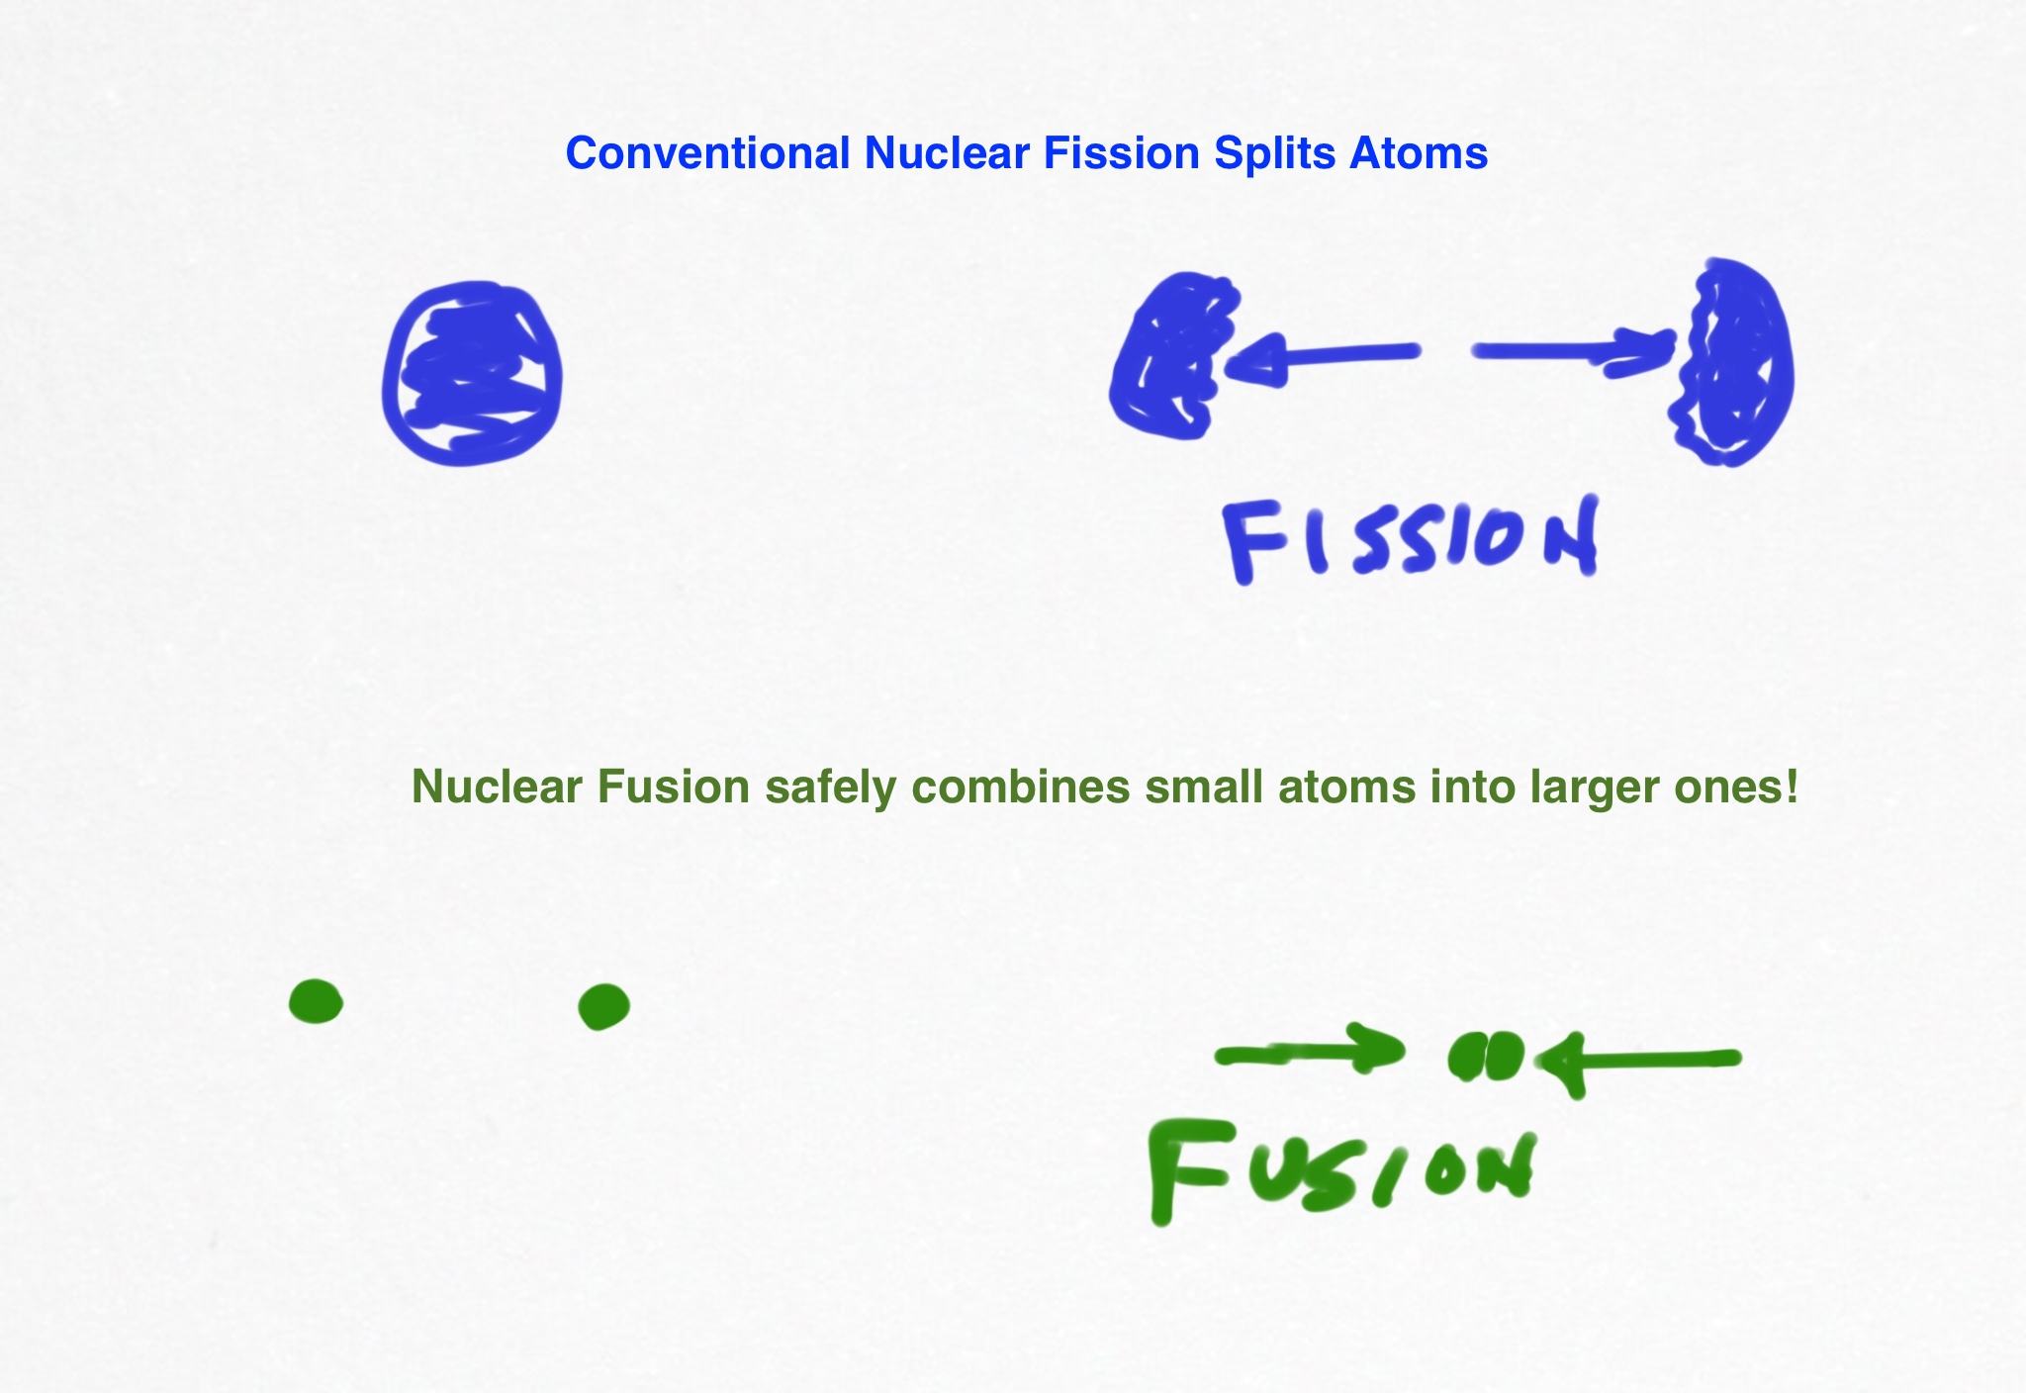

Slide 10
Confined Nuclear Fusion
Safe
Fuel is available
No long term environmental affects
Can be sited anywhere
Generates no CO₂ or other greenhouse gases

Slide 11
So, what is the problem with fusion?
Big technical challenges remain

Slide 12
What are Scientists Working on?
Holding the reacting fuel… at
- High temperature (~170 million ºC)
High pressure
For long enough to generate power (avoid unstable turbulence)
With acceptable amounts of damage to the reaction vessel walls
How to transfer the heat out ?

Slide 13
How to Hold the Reacting Material
Gravity – this is how stars manage it
Magnetic confinement
- Use magnetic fields to contain the reaction
Need to get the details right for stability
Need to develop solutions for the surrounding materials

Slide 14
What’s Different Today?
Analogous to the semiconductor “revolution”, fusion can benefit from …
Modern supercomputer power enables the design work needed to build Stellarator
Breakthroughs in material science enables Liquid Metal Walls and High Field Superconducting Magnets
Liquid Metal Walls will solve the wall damage problem
High Field Superconducting Magnets will lower the capital cost of a power plant

Slide 15
What’s happening in Fusion now?
ITER – world consortium working on fusion
US is a very small participant
US expertise in fusion is eroding seriously
Progressing very slowly, behind schedule
Does not go “on line” until 20xx
Does not address reaction stability, wall damage, heat transfer
Very low levels of government funding in US now
Three breakthrough technologies ought to be funded now to dovetail with knowledge gained at ITER
Stellarator
Liquid Metal Walls
High field superconducting magnet architecture

Slide 16
Magnetic Designs
Tokomak
Torus shape
Inherent instabilities – can damage the vessel
Need injection of power to sustain the burn
ITER (International project in France) under construction
Stellarator
Twisted torus
Inherently stable plasma
Does not require “injections” of power
Requires modern computer power to design
PPPL Stellarator canceled in 2008 due to cost over-runs

Slide 17
Wall Design
ITER – not designed to solve the wall or heat transfer issues, but will add important knowledge.
“Liquid Metal” technology
- Promising idea for a survivable wall
- Needs to be tried out
- Paves the way for heat transfer

Slide 18
Fusion R&D Status
U.S. government funding has been far too little.
Arguably the most promising pathway to commercial power generating fusion (Stellarator) mostly cut off in the U.S. due to over-runs in 2008.
International project (ITER) employs an earlier tokamak design which is a good vehicle for studying burning plasmas, but not the best ultimate reactor.
German W-7X Stellarator began operational testing in 2016 and will produce important results on one specific design concept.

Slide 19
What’s Needed
Next-Generation Stellarator is possible
Incorporate modern computer capabilities to fine-tune the shape
Test more compact stellarator design using high field strength magnet technology
- Solve residual turbulence issues
Needs to be designed and built
R&D: Liquid Metal Wall technologies

Slide 20
Princeton Plasma Physics Lab “PPPL”
Department of Energy National Laboratory.
A pioneer in magnetically confined controlled fusion research.
Pioneered a Stellarator design in the 2000’s.
Stellarator was canceled by DOE at the beginning of the financial crisis, due to cost-over-runs.
Team still in place, anxious to work on Next-Gen Stellarator and Liquid Metal Walls.

Slide 21
MIT Plasma Science and Fusion Center
Leadership center of excellence in High Transition Temperature Superconducting Magnet technology
This technology offers potential for compact and thus cheaper designs for fusion energy reactors
Offers a clear path to commercially practical electricity generators

Slide 22
Specifically….
$ [ ] MM scopes out concepts for a Next-Generation Stellarator design, leveraging high field magnet technology
$ [ ] MM funds testing of Liquid Metal Wall prototypes.
In position to accelerate the learning from ITER and W7-X, decreasing the time needed to build a proto-type electrical reactor.

Slide 23
What’s at Stake
Climate modeling suggests global warming will be severe in 50 years.
We need to get serious NOW to avoid catastrophic climate affects.
We need to accelerate solutions to the energy problem now, while there is still (barely) enough time!
Now is the time to fund the Next Gen Stellarator.

Slide 24
Stellar Energy Foundation
Philanthropic Support
For
Next Generation Stellarator

