Slide 1

Phase II: Technology Introduction and Lab
Learning Objectives:
Technologies overview. Why? What? How do they work?
Basic know-how-to-do it through lab.
Brain-storm: how can we utilize in our project or project like ours
4 lectures. Nov 2019

Slide 2
Phase II: Technology Introduction and Lab
Review Week 1 of Phase II:
Anaconda
NLTK

Slide 3
Phase II: Technology Introduction and Lab
Learning Objectives:
Technologies overview. Why? What? How do they work?
Basic know-how-to-do it through lab.
Brain-storm: how can we utilize in our project or project like ours
Week 1
AI: 1). What is AI and areas of AI
2). How we are going to use AI
3). Illustrations of Algorithm
4). NLTK and Lab
Week 2
Git and Github, and Open Source:
1). How does a software project work
2). What is Git
3). Final checkup for dev environment
(except py env)
4). Lab
Week 3
Open Source, Web Crawling and Python
1). What are “libraries“
2). Web Crawling
3). Python: what is and what can be done
4). Python environment fine tune
5). Lab
Week 4
Web/UI
1). Technologies Overview
2). Lab: build a simple site

Slide 4
Phase II: Technology Introduction and Lab
Week 2: Software PM, Git, GitHub and Open Source
Software Project Management
What is VCS?
Git and GitHub
Lab
Homework

Slide 5
Phase II: Technology Introduction and Lab
Week 2: Software PM, Git, GitHub and Open Source
Software Project Management: MORE
Components
Goal: What are you trying to achieve?
Timeline: When are you trying to achieve it by?
Budget: How much will it cost to achieve / How much time to commit?
Stakeholders: Who are the major players who have an interest in this project?
Resources Pool: Extra help available
Project manager: Who is going to make sure everything that needs to be completed gets completed?

Slide 6
Phase II: Technology Introduction and Lab
Week 2: Software PM, Git, GitHub and Open Source
Software Project Management:
The Top Project Management Methodologies
A. The Traditional, Sequential Methodologies
Waterfall Project Management Methodology
Critical Path Method (CPM)
Critical Chain Project Management (CCPM)
B. The Agile Family
Agile Project Management Methodology
Scrum
Kanban
Extreme Programming (XP)
Adaptive Project Framework (APF)
C. The Change Management Methodologies
Event Chain Methodology (ECM)
Extreme Project Management (XPM)

Slide 7
Phase II: Technology Introduction and Lab
Week 2: Software PM, Git, GitHub and Open Source
Software Project Management:
The Top Project Management Methodologies
D. The Process-Based Methodologies
Lean
Six Sigma
Lean Six-Sigma
Process-Based Project Management
E. Other Methodologies
PRINCE2
PRiSM
Benefits Realization
F. The PMBOK “Method”
Management Body of Knowledge (PMBOK). The five stages include:
Initiating / Planning /Executing/Controlling/Closing

Slide 8
Phase II: Technology Introduction and Lab
Week 2: Software PM, Git, GitHub and Open Source
2. What is VCS
Version Control System: tracking changes in computer file
Changes mean: who, when (did) what
Distributed version control (also means different network)
Coordinates work between us all
Revert back at any time
Local and remote repos

Slide 9
Phase II: Technology Introduction and Lab
Week 2: Software PM, Git, GitHub and Open Source
2. What is VCS
In more detail:
Keeps track of code history
Takes “snapshots” of your files
You decide when to take a snapshot by making a “commit”
Visit any snapshot at any time
Staging files before committing

Slide 10
Phase II: Technology Introduction and Lab
Week 2: Software PM, Git, GitHub and Open Source
2. Git and GitHub
Installation (revisit)
Linux (Debian)
$sudo apt-get install git
Linux (Fedora)
$sudo yum install git
Mac
http://git-scm.com/download/mac
Windows
http://git-scm.com/download/win
Git –version (2.23.0windows.1) -- e.g.

Slide 11
Phase II: Technology Introduction and Lab
Week 2: Software PM, Git, GitHub and Open Source
2. Git and GitHub
It is all about
local
remote
branch

Slide 12
Phase II: Technology Introduction and Lab
Week 2: Software PM, Git, GitHub and Open Source
2. Git and GitHub
Git Basic Commands
On local side
$git init // initialize local git repository
$git add <file> // add file(s) or working tree
$git status // check status of working tree
$git commit // from staging to local

Slide 13
Phase II: Technology Introduction and Lab
Week 2: Software PM, Git, GitHub and Open Source
2. Git and GitHub
Git Basic Commands
On remote Side:
$git push // Push to remote repository. To github, with credentials
$git pull // pull latest from remote repository
$git clone // clone repository into a new directory(folder)

Slide 14
Phase II: Technology Introduction and Lab
Week 2: Software PM, Git, GitHub and Open Source
2. Git and GitHub
Git Basic Commands
What about branch?
$git branch -v (-a –r or blank)
$git checkout -b hotfix
$git --single-branch …….
$git branch merge hotfix
$git merge !!!!!!!master ?

Slide 15
Phase II: Technology Introduction and Lab
Week 2: Software PM, Git, GitHub and Open Source
2. Git and GitHub
Let’s go

Slide 16
Phase II: Technology Introduction and Lab
Week 2: Software PM, Git, GitHub and Open Source
2. Git and GitHub
Use gitbash. Try to get used to command as much as you can
Tricks:
bash from the folder: right click
show hidden files

Slide 17
Phase II: Technology Introduction and Lab
Week 2: Software PM, Git, GitHub and Open Source
3. Lab
Step by step.
1). Create a folder
2). Cd to the folder or “bash here”
3). $git init
4). (optional) show hidden files.
5). Open Code
6). Add user name and email to git

Slide 18
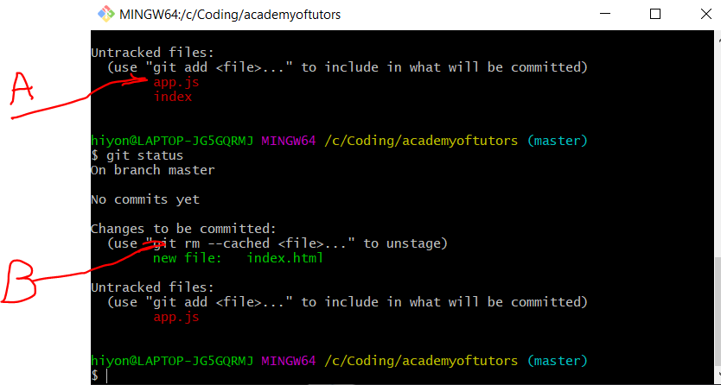
Phase II: Technology Introduction and Lab
Week 2: Software PM, Git, GitHub and Open Source
3. Lab
Step by step.

Slide 19
Phase II: Technology Introduction and Lab
Week 2: Software PM, Git, GitHub and Open Source
3. Lab
Step by step.
Notes: to remove from staging. Many options.
https://git-scm.com/docs/git-rm
$git rm –cached index.html
$git rm --cached -r directory-name

Slide 20
Phase II: Technology Introduction and Lab
Week 2: Software PM, Git, GitHub and Open Source
3. Lab
Step by step.
Notes: to add. Many options.
https://git-scm.com/docs/git-add
$git add subpath/\*.txt
$git add .

Slide 21
Phase II: Technology Introduction and Lab
Week 2: Software PM, Git, GitHub and Open Source
3. Lab
Step by step.
Notes: to commit. Many options.
https://git-scm.com/docs/git-commit
$git commit (if not core.editor added, it will show in place,
otherwise, will show the editor. To set editor
git config - -global core.editor notepad
$git commit –m “this is committee”
One hyphen and two hyphens:
Single letter parameter with one –
Multi-letters parameter with - -

Slide 22
Phase II: Technology Introduction and Lab
Week 2: Software PM, Git, GitHub and Open Source
3. Lab
clear
……………. What if we want to ignore some files?

Slide 23
Phase II: Technology Introduction and Lab
Week 2: Software PM, Git, GitHub and Open Source
3. Lab
clear
Branch
Git branch fixgrammer
Git checkout fixgrammer
…
Git checkout master
Git merge fixgrammer
(to list bran:
Git branch –a : both remote and local
Git branch –r : remote only
Git branch : local only
Remove branch: git branch -d fixgrammer
Delete remote branch: git push origin :the_remote_branch

Slide 24
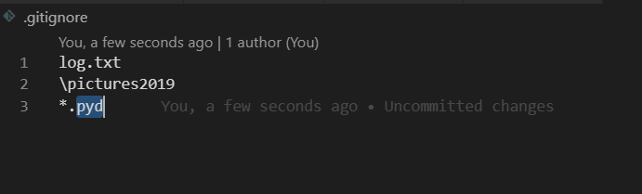
Phase II: Technology Introduction and Lab
Week 2: Software PM, Git, GitHub and Open Source
3. Lab
clear
……………. What if we want to ignore some files?

Slide 25
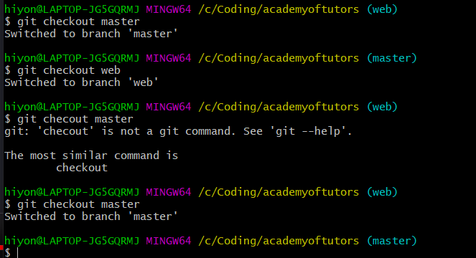
Phase II: Technology Introduction and Lab
Week 2: Software PM, Git, GitHub and Open Source
3. Lab
clear
Work on your own branch
Where are the files?
Merge it
Git merge web

Slide 26
Phase II: Technology Introduction and Lab
Week 2: Software PM, Git, GitHub and Open Source
3. Lab
clear
now remote
(To delete a repo: go to repo setting/danger zone)

Slide 27
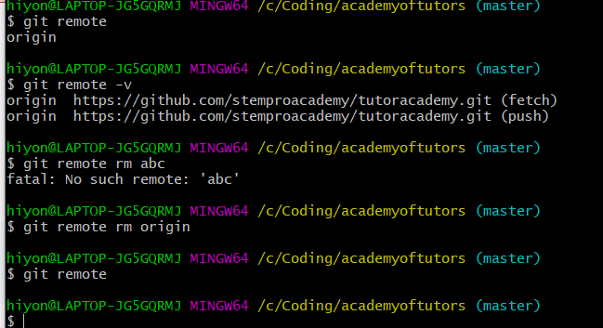
Phase II: Technology Introduction and Lab
Week 2: Software PM, Git, GitHub and Open Source
3. Lab
clear
now remote
To view existing remote:
Git remote –v
Will see pairs
To remove:
Git remote rm [nameofremote]

Slide 28
Phase II: Technology Introduction and Lab
Week 2: Software PM, Git, GitHub and Open Source
3. Lab
clear
now remote
Add remote
$git remote add origin https://github.com/stempro-ai-pro/nltk.git
Permission error: a git username and password so if you shift to another account the error 403 will appear. Below is the solution For Windows you can find the keys here:
control panel > user accounts > credential manager > Windows credentials > Generic credentials
Next remove the Github keys.

Slide 29
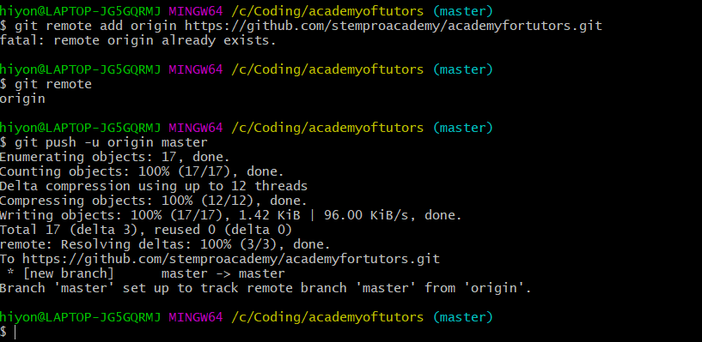
Phase II: Technology Introduction and Lab
Week 2: Software PM, Git, GitHub and Open Source
3. Lab
clear
now remote
Add remote

Slide 30
Phase II: Technology Introduction and Lab
Week 2: Software PM, Git, GitHub and Open Source
3. Lab
clear
Push to a new remote branch:
Git checkout –b remotebranchname
git push -u origin collegeai (this is the new branch in github)
View branch:
Git branch –a, -r or blank
To delete local:
git branch -d branch_name
$ git push <remote name> --delete <branch_name> or
git push origin :serverfix

Slide 31
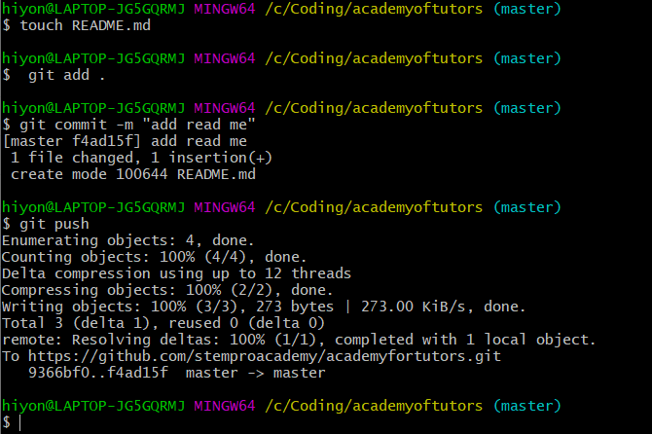
Phase II: Technology Introduction and Lab
Week 2: Software PM, Git, GitHub and Open Source
3. Lab
clear
now remote
Now we can push

Slide 32
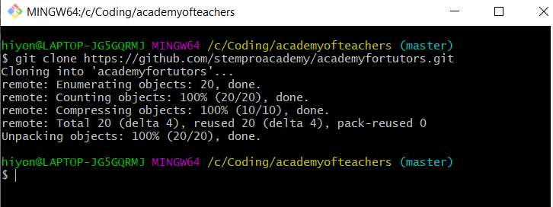
Phase II: Technology Introduction and Lab
Week 2: Software PM, Git, GitHub and Open Source
3. Lab
clear
now remote
What about clone?
Create a new folder and bash here
Git pull
How about a specific branch?
git checkout -b hotfix (create and check out new branch at the same time)
git clone --single-branch --branch collegeai https://github.com/stempro-ai-pro/collegeai.git

Slide 33
Phase II: Technology Introduction and Lab
Week 2: Software PM, Git, GitHub and Open Source
5. Homework – 800 scale
1). Explain why we need version control system -100 points
2). Explain how vcs work – 200 points
3). Manipulate local repository – 200 points
bonus: branch manipulation – 100 points
4). Manipulate remote – 200 points
bonus: NLTK_Basics.ipynb in git
5). What’s your Proposal on how to manage repositories for this project – 100 Points

Slide 34
Phase II: Technology Introduction and Lab
Week 2: Software PM, Git, GitHub and Open Source
5. Homework – Grading System
1). Who To Grade: Mutual agreement between students and teachers. Preferrabley come up with an action plan when full score is not achieved
2). What are grades used for:
a. TA qualifications for future projects
b. Criteria for awards based on stempro.org funding

