Slide 1

Phase II: Technology Introduction and Lab
Learning Objectives:
Technologies overview. Why? What? How do they work?
Basic know-how-to-do it through lab.
Brain-storm: how can we utilize in our project or project like ours
4 lectures. Nov 2019

Slide 2
Phase II: Technology Introduction and Lab
Review Week 3 of Phase II:
Python
Web Crawling : setup Scrapy
Lab

Slide 3
Phase II: Technology Introduction and Lab
Learning Objectives:
Technologies overview. Why? What? How do they work?
Basic know-how-to-do it through lab.
Brain-storm: how can we utilize in our project or project like ours
Week 1
AI: 1). What is AI and areas of AI
2). How we are going to use AI
3). Illustrations of Algorithm
4). NLTK and Lab
Week 2
Git and Github, PM and Open Source:
1). How does a software project work
2). What is Git
3). Final checkup for dev environment
(except py env)
4). Lab
Week 3
Web Crawling and Python
1). Python
2). Web Crawling
3). Lab
Week 4
Web/UI
1). Technologies Overview
2). Setup and mini-labs
3). Lab: Tic-Tac-Toe
4). Deployment and Docker

Slide 4
Phase II: Technology Introduction and Lab
Week 4: Web/UI
1). Technologies Overview
2). Setup VS Code, Django/react/channels, redis
3). Lab: Tic-Tac-Toe
4). Deployment and Docker

Slide 5
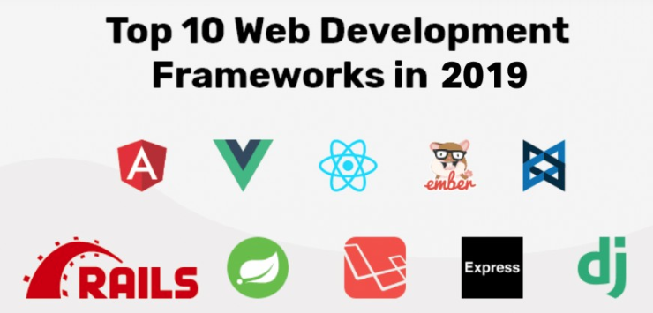
Phase II: Technology Introduction and Lab
Week 4: Web/UI
1). Technologies Overview: Here

Slide 6

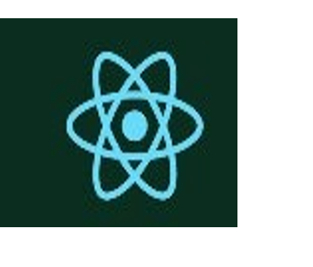


Phase II: Technology Introduction and Lab
Week 4: Web/UI
1). Technologies Overview: Here
Backend
frontend

Slide 7

Phase II: Technology Introduction and Lab
Week 4: Web/UI
2). Setup VS Code, Django/react/channels, redis
VS Code and html5
(homework)Html5: https://www.w3schools.com/html/html5_intro.asp
How much to learn? Be able to explain and tell the structure. E.g.:
<!DOCTYPE html>
<html>
<head>
<meta http-equiv="X-UA-Compatible" content="IE=edge">
<meta charset="utf-8">
<title></title>
<meta name="description" content="">
<meta name="author" content="">
<meta name="viewport" content="width=device-width, initial-scale=1">
<link rel="stylesheet" href="">
<!--[if lt IE 9]>
<script src="//cdnjs.cloudflare.com/ajax/libs/html5shiv/3.7.2/html5shiv.min.js"></script>
<script src="//cdnjs.cloudflare.com/ajax/libs/respond.js/1.4.2/respond.min.js"></script>
<![endif]-->
<link rel="shortcut icon" href="">
</head>
<body>
<!-- Place your content here -->
<!-- SCRIPTS -->
<!-- Example: <script src="//cdnjs.cloudflare.com/ajax/libs/jquery/2.1.1/jquery.min.js"></script> -->
</body>
</html>

Slide 8
Phase II: Technology Introduction and Lab
Week 4: Web/UI
2). Setup VS Code, Django/react/channels, redis
VS Code and html5
Handy Libraries
Auto Close Tag
Auto Rename Tag
html tag wrapper
Live Server
Open in Browser
vs code settings:
file --> preference --> settings.

Slide 9

Phase II: Technology Introduction and Lab
Week 4: Web/UI
2). Setup VS Code, Django/react/channels, redis
django
Django (/ˈdʒæŋɡoʊ/ JANG-goh; stylised as django)^{[4]} is a Python-based free and open-source web framework, which follows the model-template-view (MTV) architectural pattern.
Mini-lab: There are many ways to install and verify installation
Closest way to our project development I would recommend is here
$Pip install pipenv
$Mkdir webnotes
$Cd webnotes
$pipenv install Django
Verification after installation:
$django-admin startproject web_project
$django-admin startapp webdialogs
$python manage.py runserver
(before runserver, need to add “webdialogs” to Installed_apps

Slide 10
Phase II: Technology Introduction and Lab
Week 4: Web/UI
2). Setup VS Code, Django/react/channels, redis
django
Mini-lab (optional):
Install Django rest framework (DRF)
Cors headers (cors stands for Cross-Origin Resource Sharing)
Model serializers
Why we need these?
Feed/gather → communicate with frontend
Who need to set up?
If you choose Python and/or Web Dev

Slide 11
Phase II: Technology Introduction and Lab
Week 4: Web/UI
2). Setup VS Code, Django/react/channels, redis
Django: Continued
Mini-lab (optional)
migrate db
super user set up
Add models

Slide 12

Phase II: Technology Introduction and Lab
Week 4: Web/UI
2). Setup VS Code, Django/react/channels, redis
ReactJS
For frontend.
Very clear steps that fit our dev environment setup:
https://nodejs.org/en/
for windows, follow these steps: https://makandracards.com/reactjs-quick/52419-install-reactjs-windows
for macOS: https://nodejs.org/en/download/
make sure path is export to PATH: export PATH=$PATH:~/opt/bin
Install reactjs: https://www.zeolearn.com/magazine/setup-react-mac
(may need to use sudo npm install -g create-react-app)
to validate: create-react-app –version
cd to the folder and npm start should bring up the page

Slide 13
Phase II: Technology Introduction and Lab
Week 4: Web/UI
2). Setup VS Code, Django/react/channels, redis
Django channels / redis:
For communications
Mini-lab (not covered today: windows docker for redis is not fully functioning without custom setup. Working on detailed steps.
First setup redis: pull docker image
Then install channels and channels_redis to the environment

Slide 14
Phase II: Technology Introduction and Lab
Week 4: Web/UI
3). Lab: Tic-Tac-Toe UI: Jack Yuan
Home work: Pull the repo and replicate

Slide 15
Phase II: Technology Introduction and Lab
Week 4: Web/UI
3). Deployment and Docker: Benjamin Yin

Slide 16
Phase II: Technology Introduction and Lab
Week 4: Web/UI
Homework:
?

Slide 17
Phase II: Technology Introduction and Lab
Sum up
What’s next?
Week 1
AI: 1). What is AI and areas of AI
2). How we are going to use AI
3). Illustrations of Algorithm
4). NLTK and Lab
Week 2
Git and Github, PM and Open Source:
1). How does a software project work
2). What is Git
3). Final checkup for dev environment
(except py env)
4). Lab
Week 3
Web Crawling and Python
1). Python
2). Web Crawling
3). Lab
Week 4
Web/UI
1). Technologies Overview
2). Setup and mini-labs
3). Lab: Tic-Tac-Toe
4). Deployment and Docker

Slide 18
Phase II: Technology Introduction and Lab
Sum up
What’s next?
What’ve been doing well?
Motivated
Strength of each students
What haven’t?
git setup
Homework enforcement
What to make-up and how?
git setup: mandatory for every one
Each technology areas for those who will be signing for
How? After thanksgiving, make-up and tutoring.

Slide 19
Phase II: Technology Introduction and Lab
Sum up
What’s next?
What’s Next?
Primary Task: Choose
Outside of Course Initiatives:
data collection for college admissions. Nice-to-have features for our ai models will be individual admission data. I am thinking of paying each students certain amount for them to give us their [school admitted | essays | report cards | vital information]. OF COURSE, all these data must be redacted for privacy.
(this is not a must-have, although it will biased toward projections for local students’ profiles)
make connections with college counselors, either school ones or paid professionals.

Slide 20
Phase II: Technology Introduction and Lab
Logistics and serious next steps:
Phase
iiI Resumes On the 8th.
Lesson Time depends on students’ tasks and teachers’ preference
Make-up and tutoring can be optionally on site. Call it Tutoring Sunday (or Sat?)

Slide 21
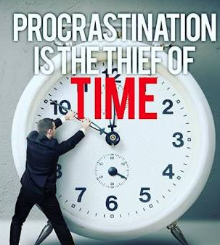
Phase II: Technology Introduction and Lab
Week 4: Web/UI
Homework: Revisit

Slide 22
Phase II: Technology Introduction and Lab
Week 4: Web/UI
Homework: Revisit
Home repo setup – mandatory
Project repo setup – not mandatory for phase IV for certain tasks
Dev environment for NLTK, Scrapy, Django, Redis and ReactJS -- Mandatory for certain tasks
Docker for Win/Linux – Mandatory for some (we will have Zoom class BEFORE Phase IV starts)
Sign-up Today for Zoom Meetings for Phase IV Readiness
 |  |  | Allen | Angus | Jason | Jingyi | Wilson | Zilin
25-Nov-19 | Monday | 7:15 - 8:45
26-Nov-19 | Tuesday | 7:15 - 8:45
27-Nov-19 | Wednesday | 7:15 - 8:45
29-Nov-19 | Friday | 4:00-6:00
3-Dec-19 | Tuesday | 7:15 - 8:45
4-Dec-19 | Wednesday | 7:15 - 8:45

Slide 23
Phase II: Technology Introduction and Lab
Week 4: Web/UI
2). Setup VS Code, Django/react/channels, redis
django
Django (/ˈdʒæŋɡoʊ/ JANG-goh; stylised as django)^{[4]} is a Python-based free and open-source web framework, which follows the model-template-view (MTV) architectural pattern.
Mini-lab:
$Mkdir webnotes
$Cd webnotes
$pipenv install Django
$pipenv shell (this is for virtual env. In Code. $code . Need to choose interpreter
$django-admin startproject web_project
$django-admin startapp webdialogs
$python manage.py runserver
(before runserver, need to add “webdialogs” to Installed_apps

