Slide 1

Phase III: Coordinated Learning
Learning Objectives:
Do it
Learn it
Do it better
Learning with purpose
~ 12 lessons till early March

Slide 2
Phase III: Coordinated Learning
Data Structure
Feature Engineering and Modeling
College Admission Insights
Docker and Deployment
Content Acquisition: Python
UI and Web Dev
AI Project: College Admission and Gap Analysis

Slide 3
Phase III: Coordinated Learning
Expectations:
Basic: be able to explain convention ai models
Enhanced: Clear statement on project problems
Practical: Be able to implement basic models and understand most of conventional models

Slide 4
Phase III: Coordinated Learning
AI: Feature Engineering and Modeling
Homework:
a). Re-Run jupyter Notebook
b). Review, yes, again, the next 7 slides
c). Read up to page 33 of Book
https://courses.edx.org/asset-v1:ColumbiaX+CSMM.101x+1T2017+type@asset+block@AI_edx_ml_5.1intro.pdf
Book A: Book on NLTK: https://www.nltk.org/book/
Book B: Book on AI (tentative): BeginnersML.pdf (in the folder)

Slide 5
Read and Review NLTK in Phase II
Syntax
Parsing
Determine the parse tree (grammatical analysis) of a given sentence. The grammar for natural languages is ambiguous and typical sentences have multiple possible analysesThere are two primary types of parsing, Dependency Parsing and Constituency Parsing. Dependency Parsing focuses on the relationships between words in a sentence (marking things like Primary Objects and predicates), whereas Constituency Parsing focuses on building out the Parse Tree using a Probabilistic Context-Free Grammar (PCFG). See also: Stochastic grammar.
Sentence breaking (also known as sentence boundary disambiguation)
Given a chunk of text, find the sentence boundaries. Sentence boundaries are often marked by periods or other punctuation marks, but these same characters can serve other purposes (e.g. marking abbreviations).
Stemming
The process of reducing inflected (or sometimes derived) words to their root form. (e.g. "close" will be the root for "closed", "closing", "close", "closer" etc.).
Word segmentation
Separate a chunk of continuous text into separate words
Terminology extraction
The goal of terminology extraction is to automatically extract relevant terms from a given corpus.
Read and Review NLTK in Phase II

Slide 6
Read and Review NLTK in Phase II
Semantics
Lexical semantics
What is the computational meaning of individual words in context?
Distributional semantics
How can we learn semantic representations from data?
Machine translation
Automatically translate text from one human language to another. This is one of the most difficult problems, and is a member of a class of problems colloquially termed "AI-complete", i.e. requiring all of the different types of knowledge that humans possess (grammar, semantics, facts about the real world, etc.) in order to solve properly.
Read and Review NLTK in Phase II

Slide 7
Read and Review NLTK in Phase II
Semantics
Named entity recognition (NER)
Given a stream of text, determine which items in the text map to proper names, such as people or places, and what the type of each such name is (e.g. person, location, organization). Although capitalization can aid in recognizing named entities in languages such as English, this information cannot aid in determining the type of named entity, and in any case is often inaccurate or insufficient. For example, the first letter of a sentence is also capitalized, and named entities often span several words, only some of which are capitalized.
Natural language generation
Convert information from computer databases or semantic intents into readable human language.
Natural language understanding
Read and Review NLTK in Phase II

Slide 8
Read and Review NLTK in Phase II
Semantics
Optical character recognition (OCR)
Given an image representing printed text, determine the corresponding text.
Question answering
Given a human-language question, determine its answer. Typical questions have a specific right answer (such as "What is the capital of Canada?"), but sometimes open-ended questions are also considered (such as "What is the meaning of life?"). Recent works have looked at even more complex questions.^{[16]}
Recognizing Textual entailment
Given two text fragments, determine if one being true entails the other, entails the other's negation, or allows the other to be either true or false.
Relationship extraction
Given a chunk of text, identify the relationships among named entities (e.g. who is married to whom).
Sentiment analysis (see also multimodal sentiment analysis)
Extract subjective information usually from a set of documents, often using online reviews to determine "polarity" about specific objects. It is especially useful for identifying trends of public opinion in the social media, for the purpose of marketing.
Topic segmentation and recognition
Given a chunk of text, separate it into segments each of which is devoted to a topic, and identify the topic of the segment.
Word sense disambiguation
Many words have more than one meaning
Read and Review NLTK in Phase II

Slide 9
Read and Review NLTK in Phase II
Discourse
Automatic summarization
Produce a readable summary of a chunk of text. Often used to provide summaries of text of a known type, such as research papers, articles in the financial section of a newspaper.
Coreference resolution
Given a sentence or larger chunk of text, determine which words ("mentions") refer to the same objects ("entities"). Anaphora resolution is a specific example of this task, and is specifically concerned with matching up pronouns with the nouns or names to which they refer. The more general task of coreference resolution also includes identifying so-called "bridging relationships" involving referring expressions. For example, in a sentence such as "He entered John's house through the front door", "the front door" is a referring expression and the bridging relationship to be identified is the fact that the door being referred to is the front door of John's house (rather than of some other structure that might also be referred to).
Discourse analysis
This rubric includes a number of related tasks. One task is identifying the discourse structure of connected text, i.e. the nature of the discourse relationships between sentences (e.g. elaboration, explanation, contrast). Another possible task is recognizing and classifying the speech acts in a chunk of text (e.g. yes-no question, content question, statement, assertion, etc.).
Read and Review NLTK in Phase II

Slide 10
Read and Review NLTK in Phase II
Speech
Speech recognition
Given a sound clip of a person or people speaking, determine the textual representation of the speech. This is the opposite of text to speech and is one of the extremely difficult problems colloquially termed "AI-complete" (see above). In natural speech there are hardly any pauses between successive words, and thus speech segmentation is a necessary subtask of speech recognition (see below). In most spoken languages, the sounds representing successive letters blend into each other in a process termed coarticulation, so the conversion of the analog signal to discrete characters can be a very difficult process. Also, given that words in the same language are spoken by people with different accents, the speech recognition software must be able to recognize the wide variety of input as being identical to each other in terms of its textual equivalent.
Speech segmentation
Given a sound clip of a person or people speaking, separate it into words. A subtask of speech recognition and typically grouped with it.
Text-to-speech
Given a text, transform those units and produce a spoken representation. Text-to-speech can be used to aid the visually impaired.^{[18]}
Read and Review NLTK in Phase II

Slide 11
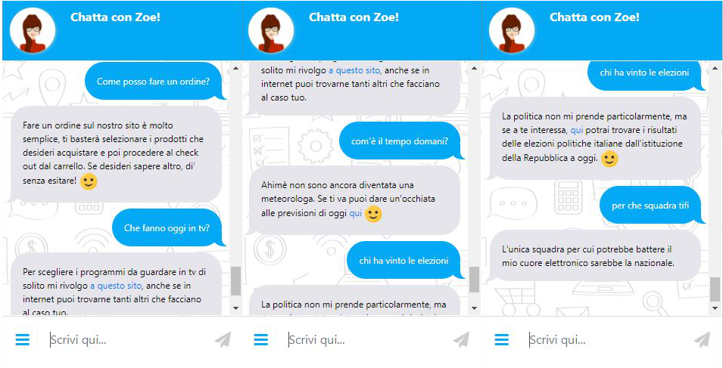
Read and Review NLTK in Phase II
Conversation and Q/A
ChatBot （Apple’s Siri, Amazon’s Alexa, Microsoft’s Tay/Zo)
Read and Review NLTK in Phase II

