Slide 1

AI Modeling Language Features and Introduction to Scikit-learn Lecture 2 Dec 22, 2019

Slide 2
The Goal of This Course
You will learn:
1. What can be considered as language features?
2. What is scikit-learn package, how can we use it.
You will do:
Listen to lecture and answer questions
Do exercise and build your first model.

Slide 3
Features, Features, Features.
What are the features in machine learning?
Features are the variables found in the given problem set that can strongly/sufficiently help us build an accurate predictive model.
Example: If you want to predict the price of the house, what will be the features you consider?
Think: If you want to predict which college/university is the best for you, what are the features?
Domain
Knowledge
Statistics

Slide 4
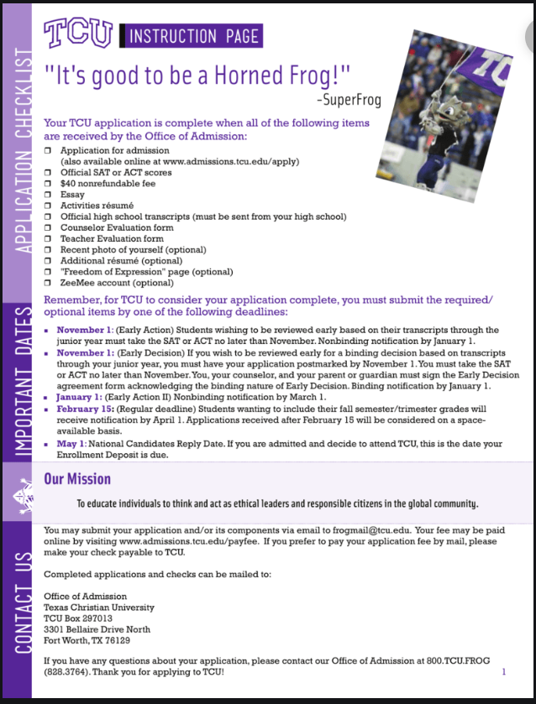
Features of the Text
Documents
Name of University
We need to extract useful information to understand the content and take actions.
The texture of the document matters!
URL
Date
Content
Address
Phone Nr.

Slide 5
Features of the Text Documents
Given a document, what are the useful features in order to distinguish this one from the others?
1. Tokenization Tokenization is the task of splitting a text into meaningful segments, called tokens.
New York University was accepting 10000 candidates around the world in 2018 semester. We are planning to accept 7000 students in New York campus this year.

Slide 6
Features : Unigrams
Individual words give us information, but….
We forget the data sequence
Some words are repeating many times.
Stop words:
The, a, it, he, him, I, you, what,...
In most of the cases, Stop words don’t contain any information.

Slide 7
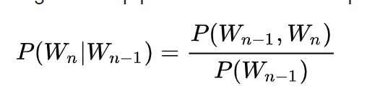
Features : Bigrams
Combine words give us more information:
It keeps more about the sequence of the words
It contains phrase, not just words.
New York University was accepting 10000 candidates around the world in 2018 semester. We are planning to accept 7000 students in New York campus this year.
Higher order of grams ?

Slide 8
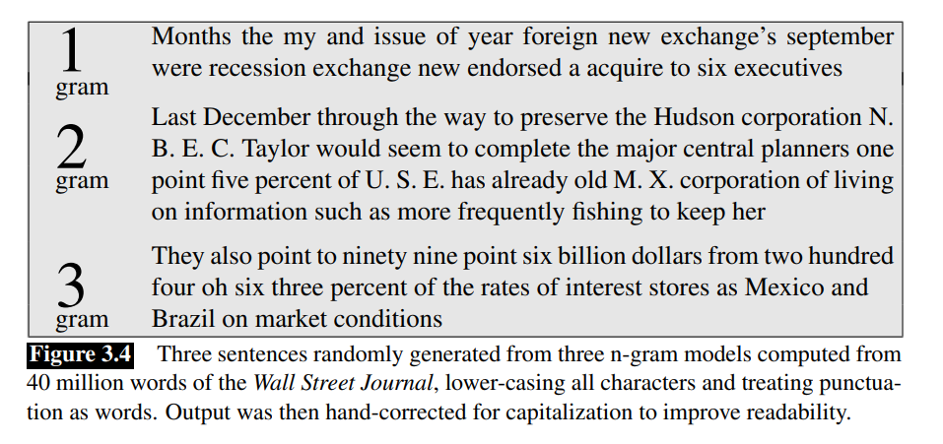
Examples of document generated by n-grams

Slide 9
Features of the Text Documents
3. Sentence segmentation
Knowing the boundary of the sentence.
this is a sentence...hello...and another sentence.
Cautious while using dot (.) as a sentence separator.
=> The procedures of the processing the text matter!

Slide 10
Features of the Text Documents
2. Part of Speech Tagging (POS) : Grammatical tagging or word-category disambiguation.
The University is located at beautiful city center and
N V Adj N N
it is one of the hottest traffic hubs in the nation.
Pron Adj N N N

Slide 11
Features of the Text Documents
3. Dependent Parsing:
Syntactic Parsing or Dependency Parsing is the task of recognizing a sentence and assigning a syntactic structure to it. The most widely used syntactic structure is the parse tree which can be generated using some parsing algorithms. Study the correlations among the POS tags.
The University is located at beautiful city center and
N V Adj N N
it is one of the hottest traffic hubs in the nation.
Pron Adj N N N

Slide 12
Features of the Text Documents
3. Name Entity Recognition
A named entity is a “real-world object” that’s assigned a name – for example, a person, a country, a product or a book title.
Usually two methods:
Hand writing rules (regex)
AI modeling, Sequence modeling.

Slide 13
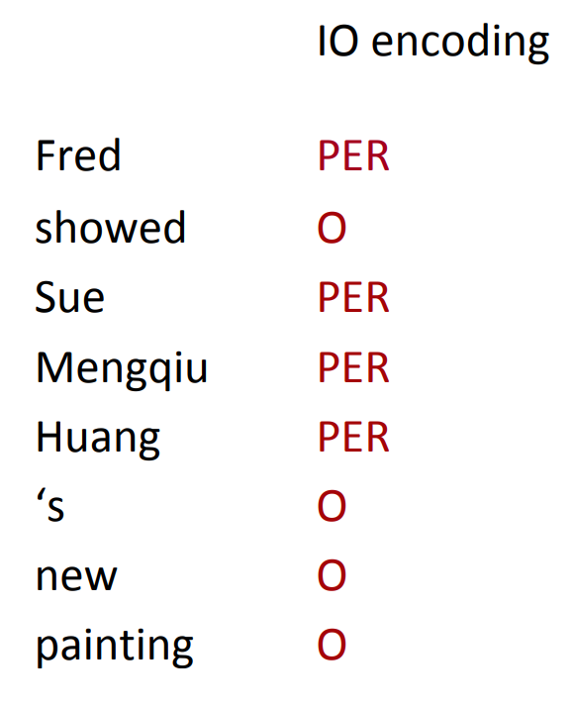
NER : Sequence Modeling
Words:
• Current word (essentially like a learned dictionary)
• Previous/next word (context)
Labels: Previous (and perhaps next) label
Another useful features:
• Word Shapes
• Map words to simplified representation that encodes attributes such as length, capitalization, numerals, Greek letters, internal punctuation, etc.
TCU XXX
John Xxxx
425-449-1947 ddd-ddd-dddd

Slide 14
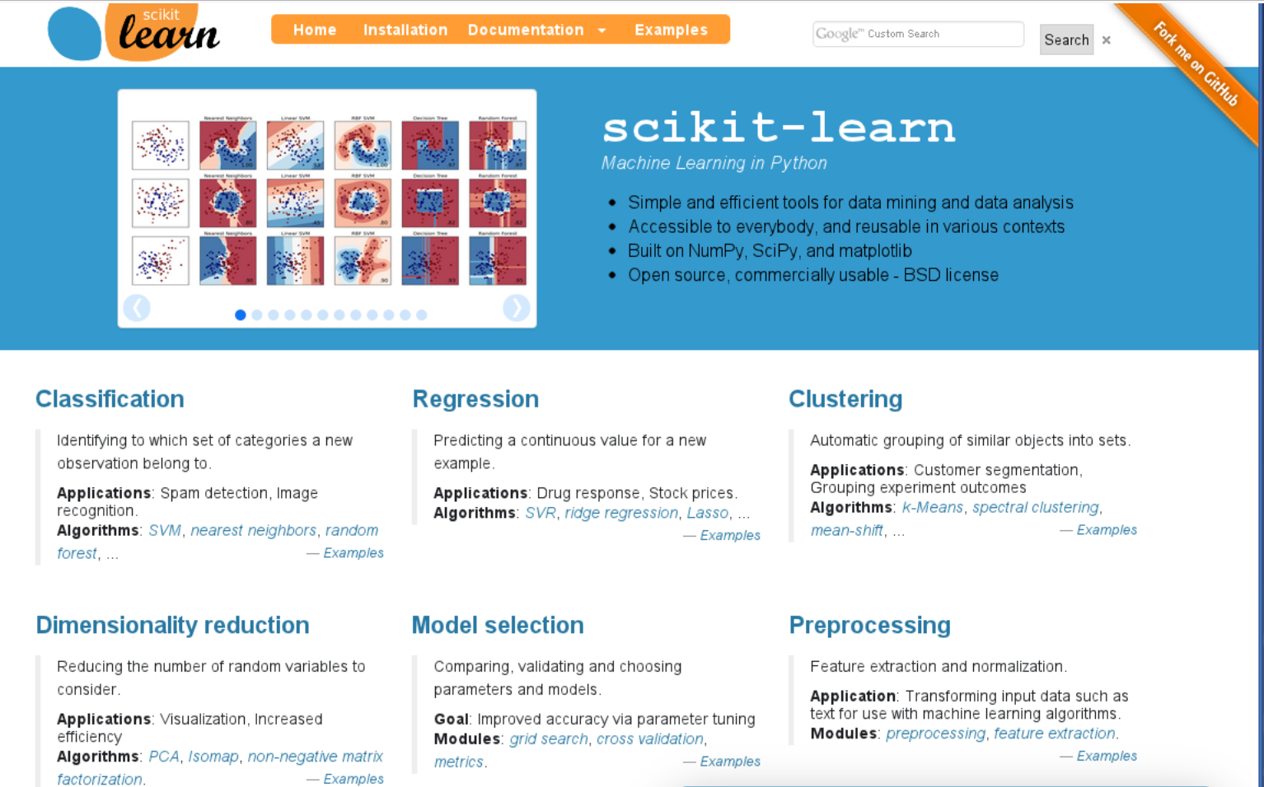
Introduction to Scikit-Learn
Scikit-learn was initially developed by David Cournapeau as a Google summer of code project in 2007.
NumPy: Base n-dimensional array package
SciPy: Fundamental library for scientific computing
Matplotlib: Comprehensive 2D/3D plotting
IPython: Enhanced interactive console
Sympy: Symbolic mathematics
Pandas: Data structures and analysis

Slide 15
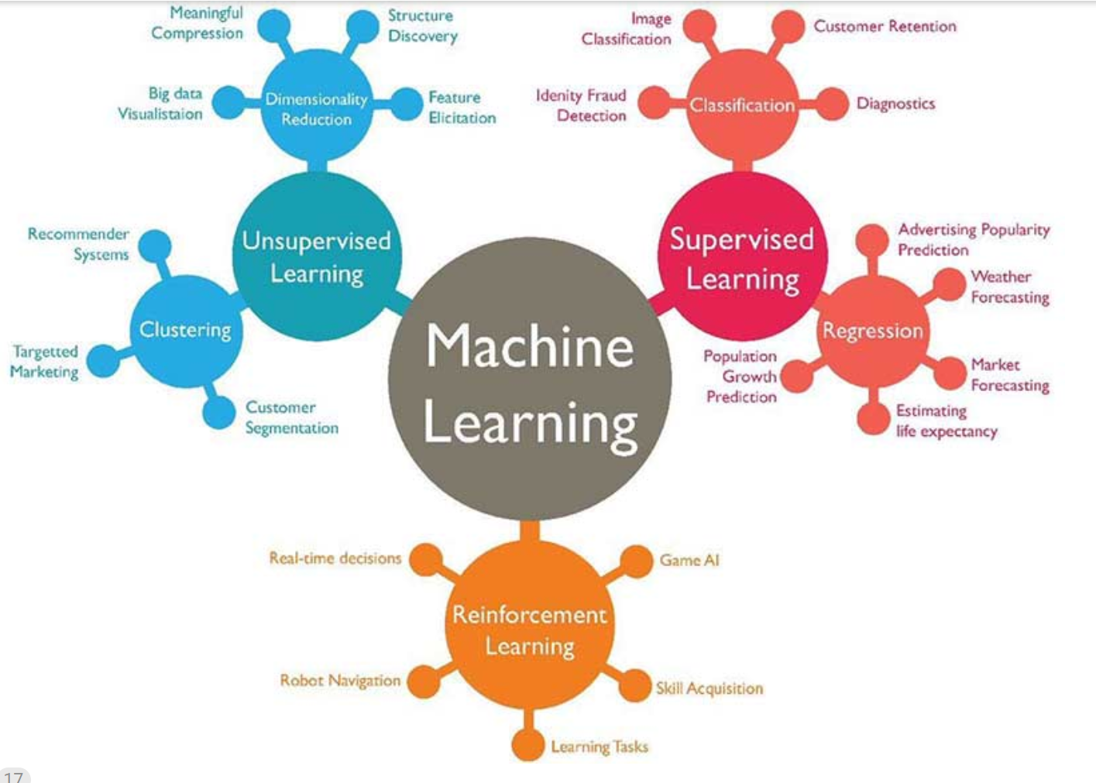
Three kinds of Machine learning Problems

Slide 16
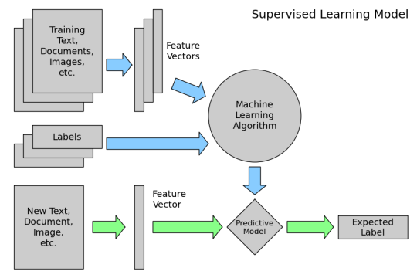
The procedures of the supervised learning

Slide 17
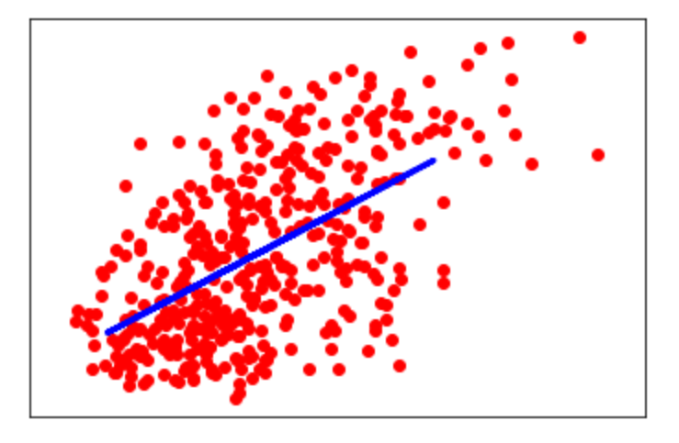
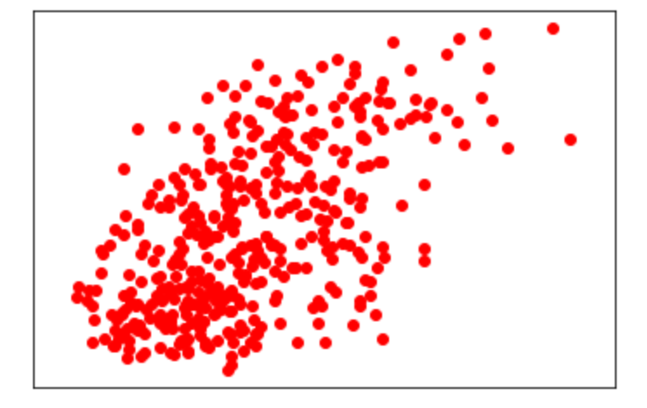
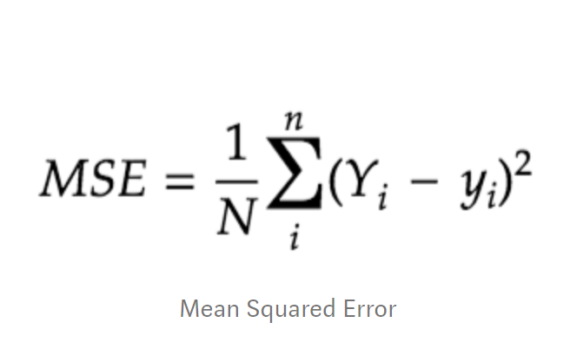
First Scikit-Learn Model: Liner Regression
Given a data set (X,Y), build a model which can predict y value with a given x.
Linear model:
y = mx +b

