Slide 1

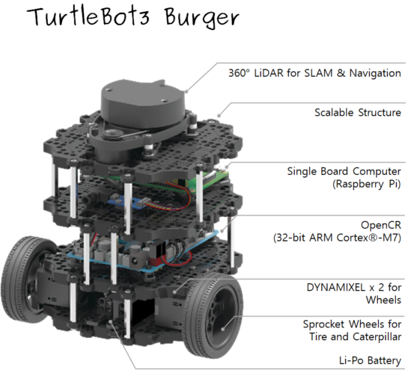
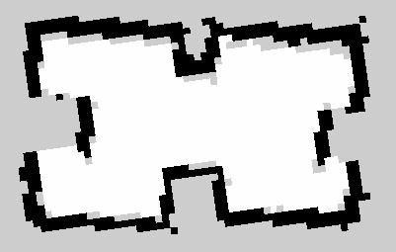
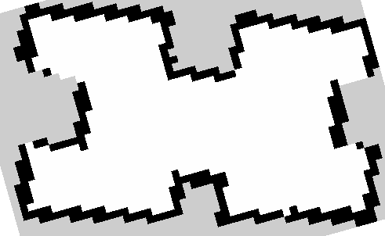
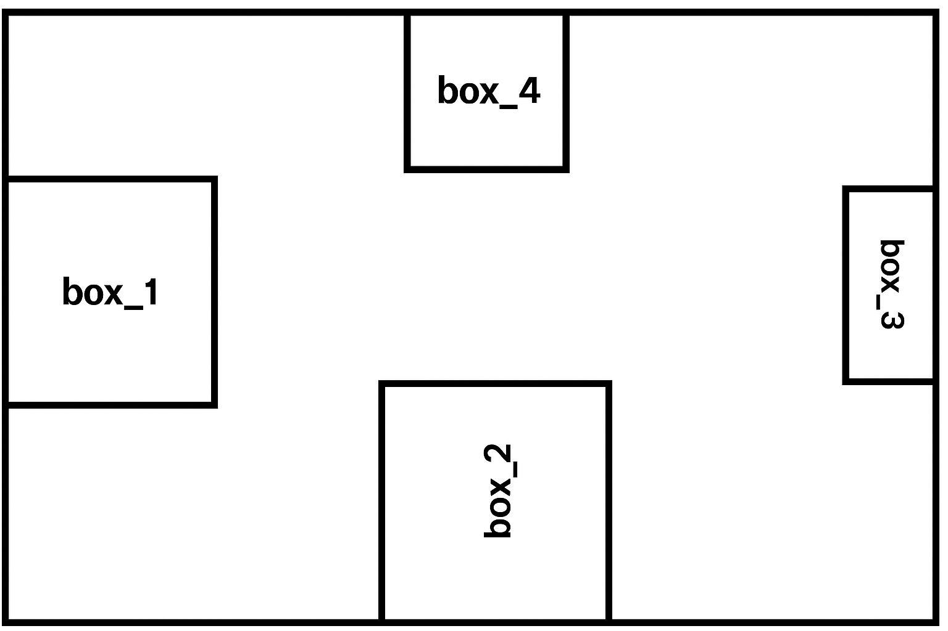
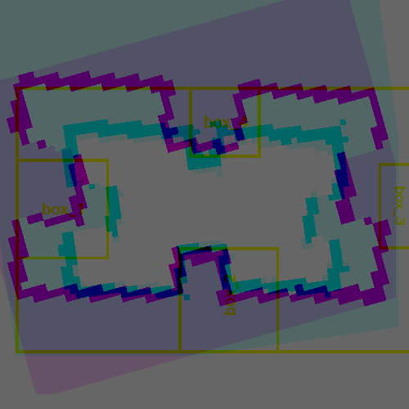

A Comparative Study of SLAM Algorithms
for Robot Operating System
Stenneth Swaby
Department of Computer Science, The College of New Jersey
Mentor: Dr. Sejong Yoon
MOTIVATION
TurtleBot3 with ROS2 provides an ideal testbed for evaluating SLAM algorithm accuracy and reliability in real-world robotics.
SLAM Toolbox and Cartographer often produce maps of different geometric quality under identical conditions, affecting localization and navigation.
Improving SLAM precision supports advanced applications such as autonomous exploration and loop-closure correction in dynamic environments.
Model of the Turtlebot 3 test Environment
METHODOLOGY
Objective: Evaluate the mapping accuracy of Cartographer and SLAM Toolbox by generating and comparing maps under identical conditions.
Both algorithms were launched using the default packages and nodes from the ROBOTIS e-Manual (cartographer_bringup, slam_toolbox_bringup).
Tests were performed in the same maze environment to ensure repeatability and eliminate environmental bias.
nav2_map_server package to ensure uniform output quality.
Cartographer Map:
SLAM Toolbox Map:
All saved maps were resized to a fixed pixel dimension to maintain consistent scaling.
A Python script was developed to overlay maps and visually align them for direct comparison.
+----
The same script computed the map error by quantifying pixel-level deviations between the generated SLAM maps.
The mapping error (eₘ) quantifies how closely the estimated map matches the ground-truth map.
It is computed as the mean absolute error (MAE) between estimated and true positions.
Each point (xᵢ, yᵢ) represents a feature location (e.g., wall or trunk) in the generated map.
Each (xᵢᴳᵀ, yᵢᴳᵀ) represents the corresponding feature position in the ground-truth map.
The term inside the square root measures the Euclidean distance between estimated and true positions.
Dividing by N, the total number of points, gives the average positional deviation across the entire map.
Smaller eₘ values indicate a more accurate and consistent SLAM-generated map.
RESULTS
SLAM Toolbox(the image on the right) produced sharper walls and more accurate alignment with ground-truth maze dimensions.
Cartographer (the image on the left) generated smoother global maps but exhibited higher boundary deviation.
Quantitative analysis showed SLAM Toolbox achieved lower average map error, confirming higher geometric precision.
Results indicate that algorithm design trade-offs affect local vs. global consistency in mapping.
Algorithm | Mean Map Error (px) | Mean Map Error (cm)* | Correlation Coefficient
SLAM Toolbox | 18.19 | 94.56 | 0.068
Cartographer | 32.46 | 162.29 | -0.020
BACKGROUND/PRIOR WORKS
Li & Zhu (2024) evaluated three 2D LiDAR SLAM algorithms Hector, GMapping, and Cartographer n simulated orchard environments using Gazebo.
Cartographer achieved the best localization and mapping accuracy (≈ 8 cm error at 4 cm resolution) but required more CPU and memory.
The paper’s findings established a controlled simulation framework and performance metrics (localization error RMSE, mapping error MAE, CPU/memory usage) that serve as a standard benchmark for later SLAM comparisons.
This project builds directly on Li & Zhu’s work, applying their evaluation approach to real-world TurtleBot 3 experiments in ROS 2, comparing SLAM Toolbox and Cartographer under identical maze conditions.
Over the summer, I expanded the research by experimenting with an additional framework, TinySLAM, to observe how lightweight, scan-matching-based algorithms handle real-time mapping. Using Python Matplotlib, I visualized raw LiDAR data to better understand how different SLAM algorithms interpret spatial information and generate occupancy grids in real time.
DISCUSSION
The quantitative analysis further reinforces the visual findings: SLAM Toolbox achieved a lower mean map error of 18.19 px (≈ 94.56 cm) compared to Cartographer’s 32.46 px (≈ 162.29 cm), indicating substantially higher geometric precision relative to the ground-truth maze. This difference highlights SLAM Toolbox’s stronger local accuracy and its ability to preserve wall geometry during mapping, even when operating in confined environments with close-range LiDAR reflections.
The correlation coefficients (0.068 for SLAM Toolbox vs –0.020 for Cartographer) suggest that the Toolbox’s output maintains slightly better spatial agreement with the ground truth, whereas Cartographer’s results diverge more in localized regions. These findings align with the qualitative observation that SLAM Toolbox produces sharper, better-defined boundaries, while Cartographer favors globally smooth but less detailed reconstructions.
Overall, the results confirm that algorithmic design trade-offs directly affect mapping fidelity. Cartographer’s smoothing heuristics promote global continuity but can blur finer structures, whereas SLAM Toolbox’s pose-graph optimization preserves local accuracy. The improved error computation and fine-alignment overlay introduced in this study provide a more objective framework for comparing SLAM performance, offering a reproducible method for future evaluations of mapping accuracy in ROS-based robotic systems.
PROBLEM FORMULATION
The study compares Cartographer and SLAM Toolbox to determine which SLAM algorithm generates more accurate and consistent maps under identical conditions.
Although both are widely used for autonomous navigation, performance differences arise from sensor noise, environment geometry, and algorithm design.
These variations directly influence a robot’s ability to localize and navigate effectively.
A controlled maze environment with fixed ground-truth dimensions was used to ensure fair testing and repeatable conditions.
The experiment quantifies mapping accuracy, reliability, and structural fidelity, identifying which algorithm provides superior geometric precision for the TurtleBot 3 platform.
REFERENCES
ROBOTIS. (n.d.). TurtleBot3 quick start guide. ROBOTIS e-Manual. Retrieved November 2, 2025, from https://emanual.robotis.com/docs/en/platform/turtlebot3/quick-start/
Articulated Robotics. (n.d.). Getting ready to build a ROS robot. Retrieved November 2, 2025, from https://articulatedrobotics.xyz/category/getting-ready-to-build-a-ros-robot
Li, Q., & Zhu, H. (2024). Performance evaluation of 2D LiDAR SLAM algorithms in simulated orchard environments. Computers and Electronics in Agriculture, 221, 108994. https://doi.org/10.1016/j.compag.2024.108994

